Slide 1
LIPNET: END-TO-END SENTENCE-LEVEL LIPREADING
Harshith Deshalli Ravi – A-20552830
Sachin Shivanna – A-20552795

Slide 2
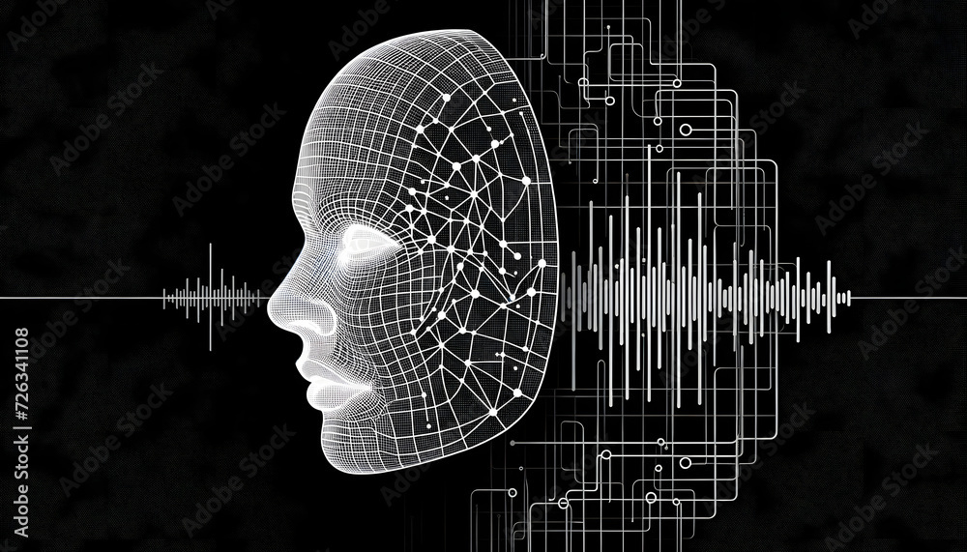
PROBLEM STATEMENT
The ﬁne distinction is the major obstacle for humans to read from lips and as reported previously only around 20% reading accuracy can be achieved.
Digital editing tools enable audio manipulation in videos, leading to misinformation. Automated systems are needed to verify if lip movements match audio to detect such manipulations. Current methods often assess words individually, missing context and making it difficult to check alignment across entire sentences.
2

Slide 3
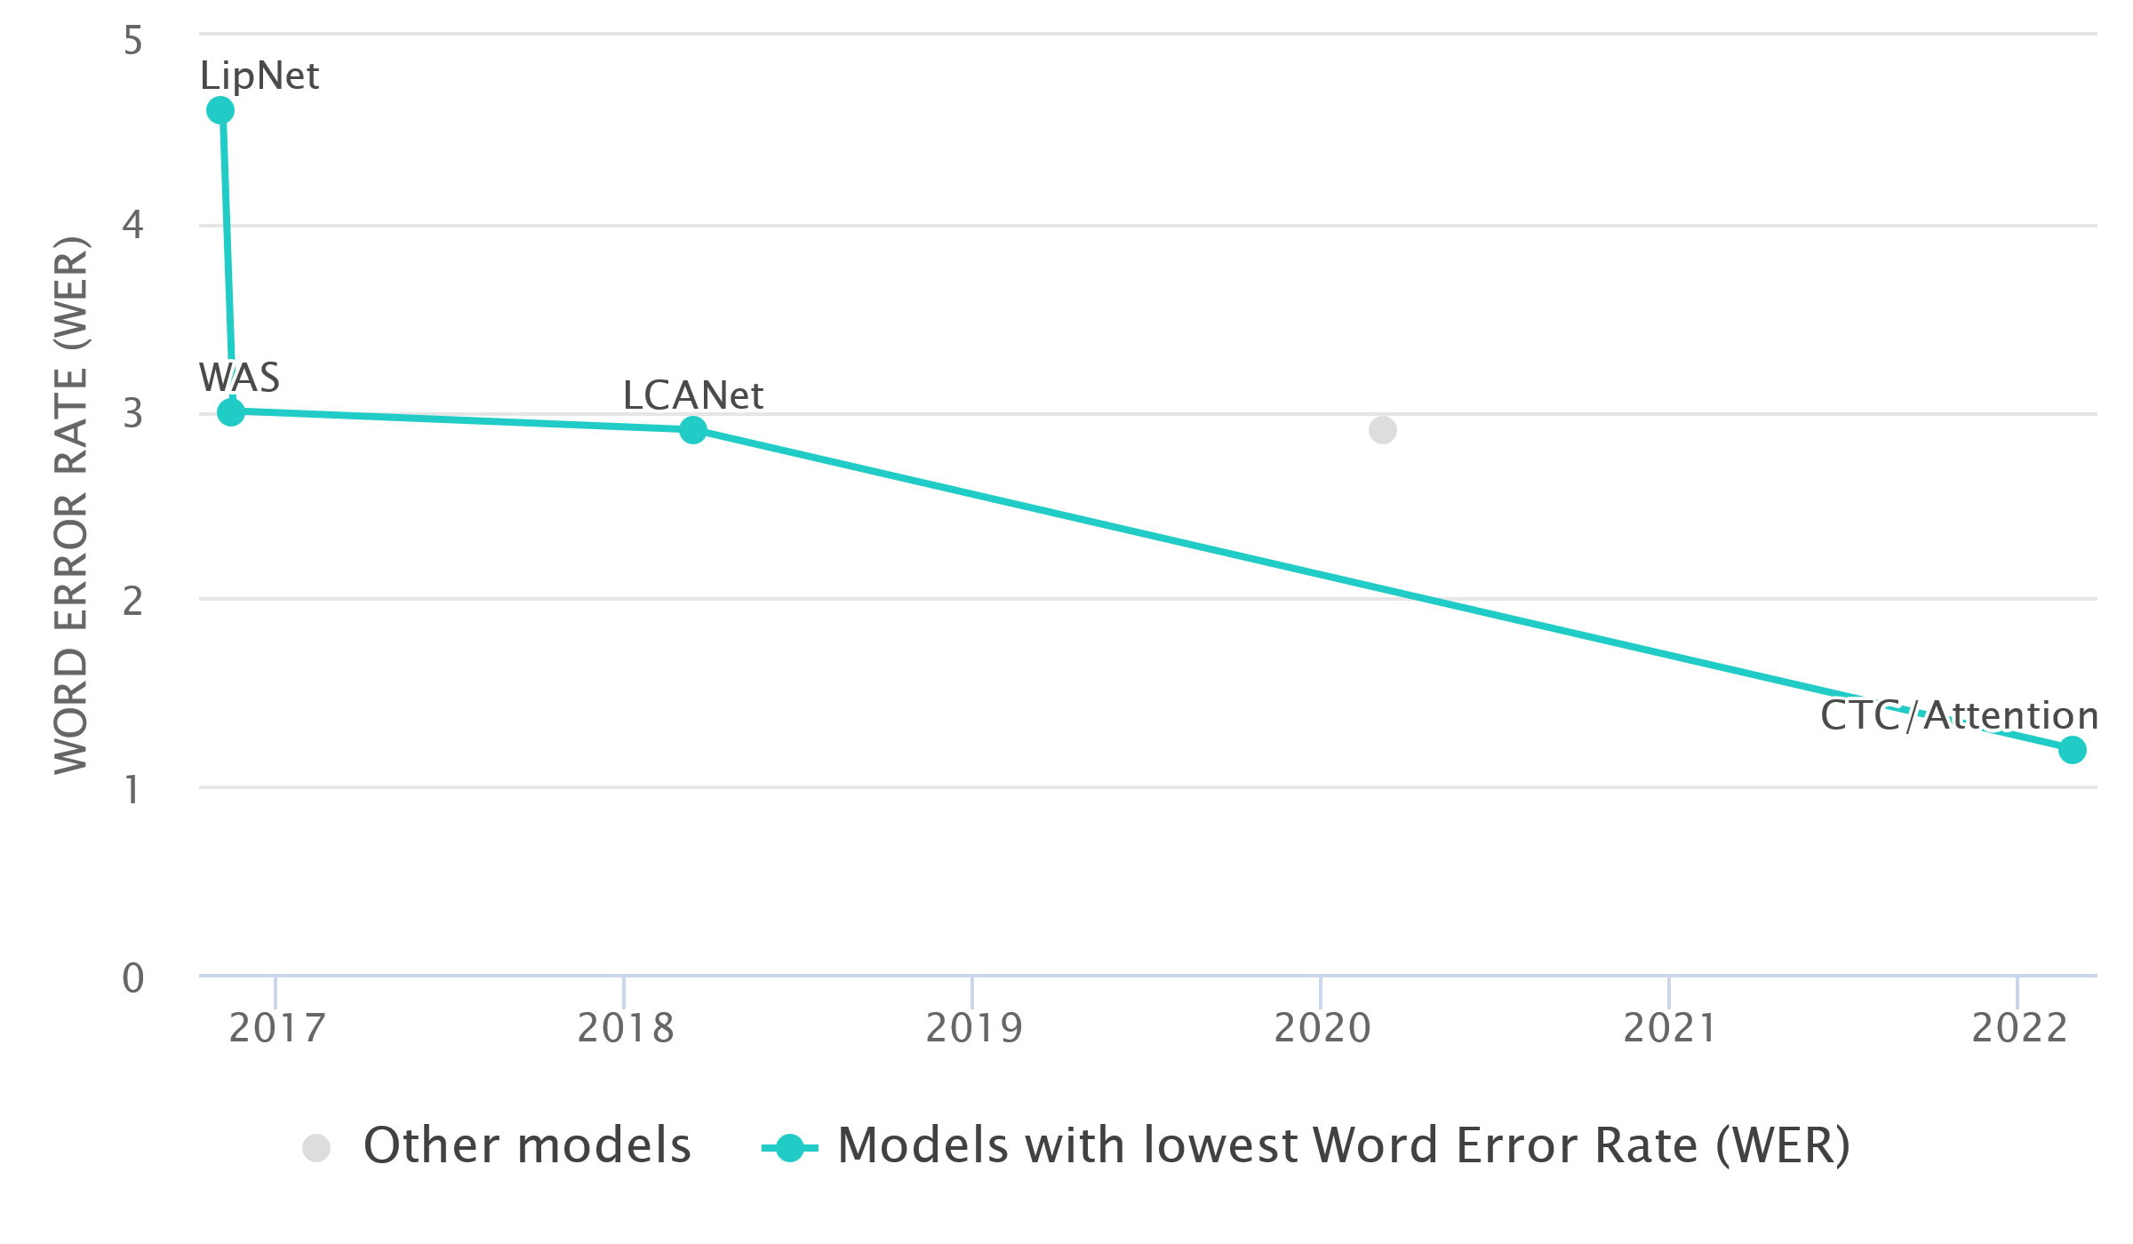

Source: GRID Corpus Benchmark (LipReading)
HISTORY
2022
CTC/Attention
Attention model
2018
LCANet
Cascaded Attention
introduced
2016
WAS
CNN-RNN hybrid model
Older approaches used word classification rather than classifying, rather than full sentence-level sequence prediction.
2016
LipNet
Deep Neural Network

Slide 4
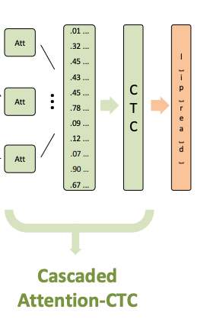
PROPOSAL
To enhance the LipNet model, we propose integrating techniques from the LCANet paper, where we are focusing on cascaded attention on Connectionist Temporal Classification (CTC) optimization. Using this architecture will significantly improve the decoder decision and more robust for continuous speech recognition.
The design has replaced GRU layer in the original LipNet and LCANet with Bi-Directional LSTM layer due to its accuracy in long-sequence understanding.
Source: LCANet paper

Slide 5
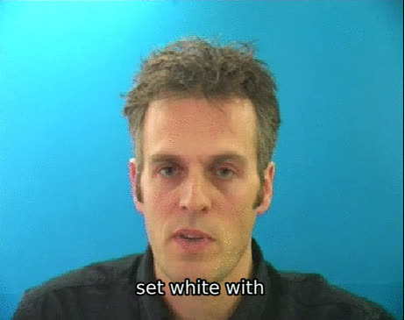
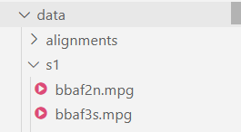
DATASET
Dataset Source: https://spandh.dcs.shef.ac.uk/gridcorpus/
Train size: 450 video clips
Test size: 50 video clips
Sample
File structure
rizkiarm/LipNet git repo

Slide 6
FLOW DIAGRAM
1
2
3
4
5
Data pipeline
Convert frames to tensor
Tensorflow pipeline
Data preparation
Crop video frame
Train model
Callback functions
Data Collection
Model Evaluation
Notes:
Data preparation
- DLib face detector is used in the paper
Callback functions
- scheduler( to check for epoch and learning rate)
- model checkpoints
- example prediction after each epoch

Slide 7
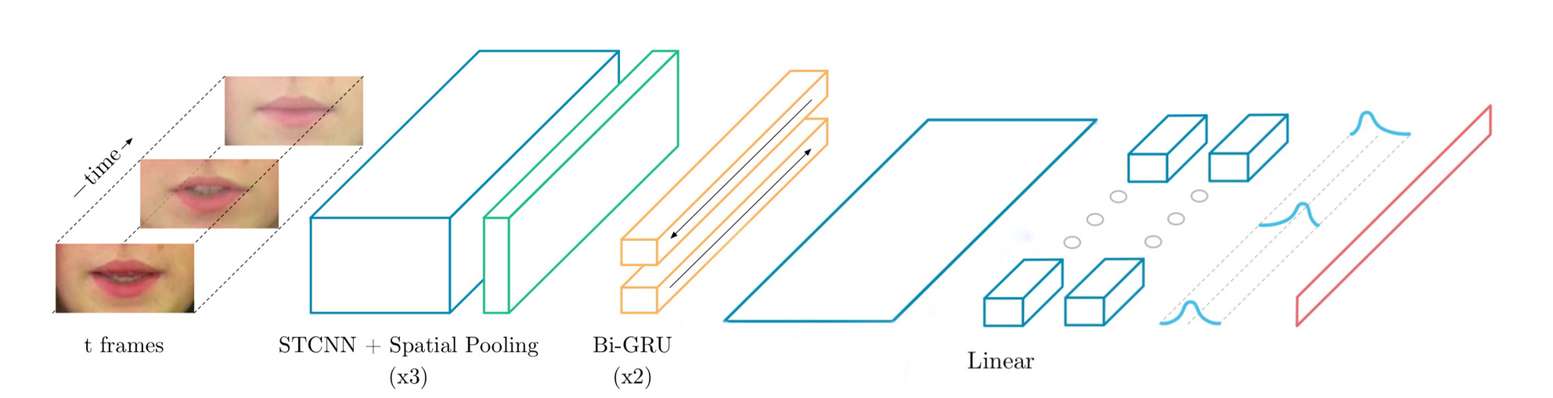

ARCHITECTURE
K
Q
V
STCNN + Spatial Pooling
(x3)
STCNN + Spatial Pooling
(x3)
LSTM
(x2)
t frames
LSTM
(x2)
t frames
Multihead Attention
Linear
(x2)
CTC

Slide 8
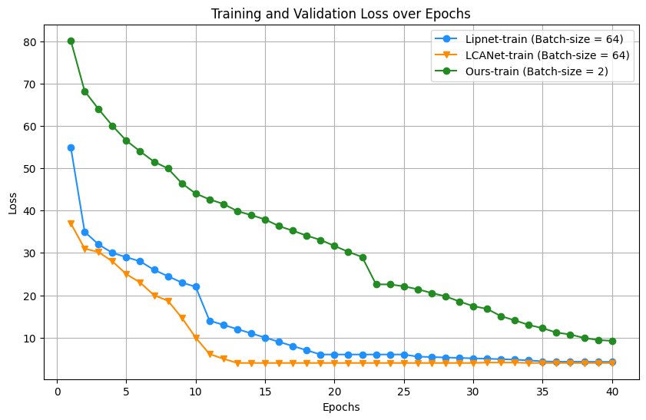

RESULTS OVERVIEW
Observations:
By doubling the number of epochs with batch size 2 and dataset with 450 video clips, we were able to achieve better loss.
Model | Loss | Batch-size | Dataset size | Epochs
LipNet | 4.27 | 64 | 25,330 | 50
LCANet | 4.16 | 64 | 25,330 | 50
Our Model | 3.90 | 2 | 450 | 100
Note : Batch size and dataset size is reduced due to memory constrains

Slide 9
PERFORMANCE METRICS
# | Method | CER % | WER %
1 | LipNet | 1.9 | 4.8
2 | LCANet | 1.3 | 2.9
3 | Our Model | 0.29 | 1.38
4 | CTC/Attention | 0.05 | 1.2
Observations:
With this architecture both CER and WER have been drastically improved on Overlapping data.

Slide 10
DEMO

Slide 11
APPLICATIONS
Speech understanding for people with hearing impairments
Federal agencies to authenticate video evidence.
Used for video forensics to track down lip-syncing deepfakes.
Can be employed for security and surveillance to interpret conversations in situations where audio is not available or is of poor quality.
The model can contribute to research in speech perception, language acquisition, and the relationship between visual and auditory processing in the brain.

Slide 12
REFERENCES
Research Paper-1 :
LipNet: End-To-End Sentence-Level Lip Reading
Research Paper-2 :
LCANet: End-to-End Lipreading with Cascaded Attention-CTC
Repository :
https://github.com/rizkiarm/LipNet
Dataset :
https://spandh.dcs.shef.ac.uk/gridcorpus/
Other Resources :
https://paperswithcode.com/sota/lipreading-on-grid-corpus-mixed-speech

Slide 13
QUESTIONS?

Slide 14
THANK YOU!

