Slide 1
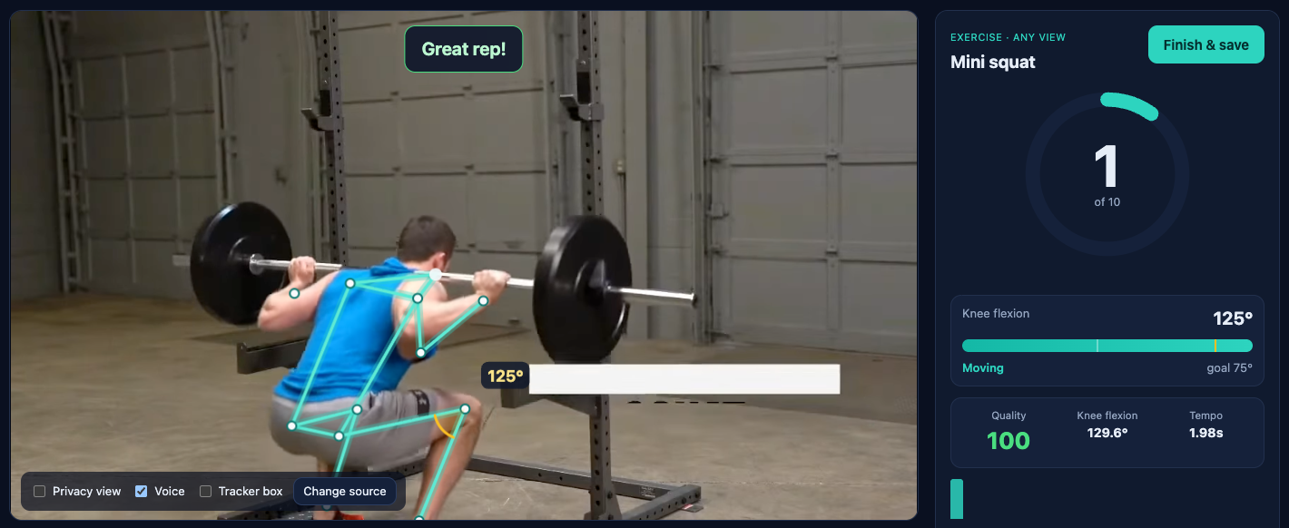
SNAPDRAGON AI LAB · BUILD & PRESENT CHALLENGE 2026
PunarGati
पुनर्गति · movement, restored
A physiotherapist's eyes at home, running on the Snapdragon NPU.
Live squat coaching: skeleton, knee angles, rep counter and form cues.
On-device pose tracking, clinical screening tests and coaching in 7 Indian languages. Offline, private, and with no subscription.
Qualcomm AI Hub MoveNet
Hexagon NPU · QNN EP
Local LLM
7 languages
Offline
Sachin · github.com/Sachin0496/punargati

Slide 2
THE PROBLEM
Recovery happens at home: unsupervised, uncounted, unmeasured
28.7%
101 M
1 in 3
pooled prevalence of knee osteoarthritis in Indian studies
Indians with diabetes. About 13% of them develop frozen shoulder
adults over 65 fall every year, and fall-risk screening needs a trained assessor
Pal et al., Indian J Orthop 2016
ICMR-INDIAB 2023 · Zreik et al. 2016
WHO Falls Prevention Report 2007
Patient gets an exercise sheet and a weekly visit
Nobody counts reps, checks form or measures range at home
The physio finds out a week later, or never
PunarGati · Snapdragon AI Lab Build & Present 2026
2

Slide 3
WHY ON-DEVICE
A camera in someone's bedroom must never stream to a server
Cloud AI coach
PunarGati on a Snapdragon PC
Privacy
Home video of patients goes to a server: a DPDP-Act risk
Frames live in RAM for ~1 ms on the NPU. Only numbers are saved; there's a skeleton-only privacy view
Connectivity
30 fps upload fails in tier-2/3 towns
Fully offline. Models ship inside the repo
Cost
Per-minute inference makes free home rehab impossible
One-time laptop, unlimited sessions
Latency
A network round trip breaks rep timing and live cues
~1 ms pose inference and instant spoken feedback
PunarGati · Snapdragon AI Lab Build & Present 2026
3

Slide 4
THE SOLUTION
PunarGati turns a Snapdragon laptop into a physiotherapist's eyes
1
2
3
4
Coach
Test
Track
Plan & ask
9 prescribed exercises. Reps per side, range of motion, tempo and a quality score for every rep. Spoken form corrections.
30-s chair stand (CDC fall-risk norms), single-leg balance, and shoulder / knee range of motion against AAOS reference values.
Recovery curves per joint, day streaks, and a printable report the patient hands to the physio.
Paste the physio's note to get a one-tap plan. The local LLM answers questions from your own data and escalates red flags.
Coaching languages: English, Hindi, Tamil, Telugu, Kannada, Marathi and Bengali, with offline Windows voices
PunarGati · Snapdragon AI Lab Build & Present 2026
4

Slide 5
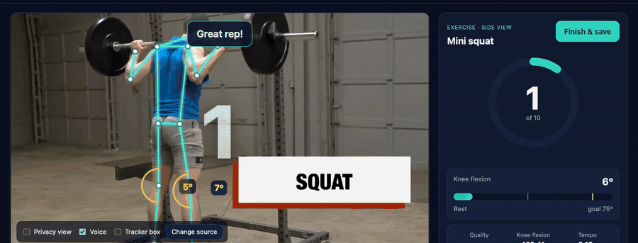
LIVE COACHING
Every rep measured: angle, tempo and quality, plus a spoken correction
Goniometer-style joint angles
Knee, hip, shoulder, elbow and trunk, computed in isotropic pixel space
Per-rep quality score
Range reached × tempo × form, so a partial rep gets "go a little further"
View-aware form rules
Knees caving in (front view), chest dropping (side view), elbow bending, shrugging
Privacy view
Hide the room and show only the skeleton
Validated on real footage: 3/3 stands on the CDC's own chair-stand video (front view) and 2/2 squats on the demo clip. Both are regression tests.
PunarGati · Snapdragon AI Lab Build & Present 2026
5

Slide 6
CLINICAL SCREENING
Standard fall-risk and mobility tests, scored against published norms
30-second chair stand
30-s chair stand: stands that indicate fall risk (CDC STEADI)
Counts full stands in 30 s and flags fall risk using CDC STEADI thresholds by age and sex
Age | Men | Women
60–64 | < 14 | < 12
65–69 | < 12 | < 11
70–74 | < 12 | < 10
75–79 | < 11 | < 10
80–84 | < 10 | < 9
85–89 | < 8 | < 8
90–94 | < 7 | < 4
Single-leg balance
Times the stance until the foot touches down. Under 5 s flags fall risk (Vellas 1997); age means from Springer 2007
Range of motion
Shoulder flexion and abduction, knee flexion. Median-of-5 frames, compared with AAOS 180° / 180° / 135°
Automatic countdown, timing and counting. The result card compares the score with the patient's age band.
PunarGati · Snapdragon AI Lab Build & Present 2026
6

Slide 7
ARCHITECTURE
The browser sees, the NPU understands, and nothing leaves the PC
BROWSER UI (OFFLINE)
PYTHON ENGINE · 127.0.0.1 · numpy + onnxruntime
LOCAL INTELLIGENCE
Webcam / video
getUserMedia, 30 fps
MoveNet · Qualcomm AI Hub
w8a16 on Hexagon NPU (QNN EP, HTP), ~1 ms
Crop tracker + One-Euro
stable keypoints, next crop
Summaries · plan · Q&A
templates if no LLM; red-flag safety
Crop to person
192×192 RGBA, tracked
Local LLM (optional)
Qwen3-4B Q4_0 · llama.cpp on Oryon CPU, or GenieX / Foundry Local
Clinical tests
CDC · Springer · AAOS norms
Goniometry
knee · hip · shoulder · elbow · trunk
Overlay + voice
skeleton, angle arcs, cues in 7 languages
Reps + form rules
per-side hysteresis, quality score
./data (JSON)
angles, reps, scores. Never frames
Only 3 native dependencies (numpy, onnxruntime, onnxruntime-qnn), all with Windows-on-ARM64 wheels. No OpenCV, PyTorch or npm build.
PunarGati · Snapdragon AI Lab Build & Present 2026
7

Slide 8
SNAPDRAGON COMPUTE
Two AI Hub pose models run on the Hexagon NPU in under 3 ms per frame
Pose cascade
Hexagon NPU
MoveNet tracks and RTMPose-WholeBody refines (133 keypoints, feet). onnxruntime-qnn, strict 100% offload, context cache
Benchmark / fallback
Adreno GPU · CPU
Same model through the QNN GPU backend or the ORT CPU EP, with the fallback reason shown in the UI
LLM, after a session
Oryon CPU
llama.cpp Q4_0 with i8mm repack. It decoded faster than the NPU/GPU backends in our earlier X Elite tests
Source: Qualcomm AI Hub device profiles, v0.63.0 (ONNX). The cascade uses <10% of the 33 ms frame budget at 30 fps.
Built-in benchmark (NPU vs GPU vs CPU): latency, CPU load at 30 fps, and battery watts on the user's own device.
PunarGati · Snapdragon AI Lab Build & Present 2026
8

Slide 9
TECHNICAL IMPLEMENTATION
Engineered to be accurate, provable, and impossible to break in a demo
Provable NPU offload
Two-model NPU cascade
Accuracy from small models
Sessions are built with session.disable_cpu_ep_fallback=1. Success means every operator is on the Hexagon NPU.
MoveNet tracks the person. RTMPose-WholeBody re-estimates 133 keypoints on its box. Exact uint16 I/O from AI Hub metadata.
MoveNet crop tracking keeps the person large; One-Euro filtering in body-scale units.
Honest rep counting
View-independent tests
Never dead in a demo
Per-side hysteresis state machines, duration/timeout guards, form rules that must persist 4 frames.
Self-calibrating shoulder-height signal for sit/stand. 3/3 stands on the CDC's own front-view video.
NPU → GPU → CPU ladder, a QNN 1.x fallback route, LLM-free fallbacks, 31 tests incl. real video.
PunarGati · Snapdragon AI Lab Build & Present 2026
9

Slide 10
DEPLOYMENT & ACCESSIBILITY
One script to install, one click to run, and no internet after that
1
scripts\setup.ps1
Accessible by default
Finds or installs native ARM64 Python, installs 3 packages, verifies AI Hub models by SHA-256, and self-tests the NPU
7 Indian languages, offline voices
PunarGati.bat
Privacy view: skeleton only
2
Double-click. The browser opens on 127.0.0.1 and the NPU badge shows the live latency
Runs on any laptop (CPU fallback)
Bundled demo clip, no webcam needed
3
scripts\setup-llm.ps1 (optional)
No account, no subscription
llama.cpp win-arm64 + Qwen3-4B Q4_0. Auto-detected, or use GenieX, Foundry Local or LM Studio
Data stays in ./data on the PC
PunarGati · Snapdragon AI Lab Build & Present 2026
10

Slide 11
IMPACT & ROADMAP
Next: hands, feet and voice, all on the same NPU
Now
Next
Then
Pilot
Two-model NPU pose cascade, 9 exercises, 5 tests, reports, local LLM, 7 languages
Hand-focused RTMPose crop for wrist and finger ROM (stroke and hand therapy)
Whisper on the NPU for hands-free "next / stop / pain" commands
Validate against a goniometer with a physio clinic; FHIR/ABDM export; Arduino UNO Q haptic rep band
Patients
Physiotherapists
Tier-2/3 India
supervised-quality home exercise, visible progress, early fall-risk flags
measured adherence and ROM trends between visits
works with no connectivity and no cloud bill
PunarGati · Snapdragon AI Lab Build & Present 2026
11

Slide 12
Private. Offline. Multilingual. Measured.
PunarGati puts a physiotherapist's eyes in every home that has a Snapdragon PC.
github.com/Sachin0496/punargati
MoveNet via Qualcomm AI Hub · ONNX Runtime QNN EP · llama.cpp · Qwen3 · MIT licensed

