Slide 1


CMR TECHNICAL CAMPUS
UGC AUTONOMOUS
Accredited by NBA & NAAC with ‘A’ Grade
Approved by AICTE, New Delhi and JNTU, Hyderabad
Kandlakoya(V), Medchal Road, Hyderabad-501401, Telangana
Department of Computer Science and Engineering
PLANT DISEASE IDENTIFICATION AND PESTICIDES RECOMMENDATION
USING CNN
BATCH NO : 03
  G. Manisha 217R1A0525
  M. Sachin 217R1A0535
  B. Govardhan 217R1A0514
Under the Guidance of
DR.K.Maheswari
(Associate Professor)

Slide 2
Introduction
Abstract
Existing system
Disadvantages of existing system
Proposed system
Advantages of proposed system
Hardware and software requirements
Novelty
Architecture
Modules
UML Diagrams
Sample Code
Results
Conclusion
Future Scope
References
Github Link
CONTENTS

Slide 3
INTRODUCTION
Agriculture is vital for human survival, especially in developing countries like India, where increasing agricultural output is crucial for public health and food security.
Diseases can drastically reduce crop yields and are difficult to manage, as farmers lack direct access to plant pathologists, making human-assisted diagnosis inefficient.
Automating crop disease diagnosis using technology is critical to overcoming the limitations of human diagnosis, making it affordable and accessible for farmers.

Slide 4
OVERVIEW
The project titled "Plant Disease Identification and Pesticide Recommendation Using CNN" aims to address the significant challenges faced by farmers due to plant diseases, which severely impact crop yields. Traditional methods of disease diagnosis, reliant on agricultural experts, are inefficient, especially in large, scattered farming areas. The project proposes an automated solution using Convolutional Neural Networks (CNNs) to classify plant diseases based on images uploaded by farmers via a smartphone app. The system offers pesticide recommendations and generates disease density maps using cloud-based infrastructure. Continuous learning improves the CNN model's accuracy over time. This solution leverages advancements in AI, cloud computing, and mobile technology, providing a scalable, low-cost, and accessible tool for farmers to manage plant diseases effectively

Slide 5
EXISTING SYSTEM
Farmers in India lose nearly one-third of their harvest due to pests and diseases, leading to significant economic losses.
Farmers often struggle to access agricultural experts, making it difficult to get timely diagnosis and disease management advice.
There is widespread misuse of toxic and biomagnified pesticides, posing serious health risks to humans and the environment.
Current methods fail to detect plant diseases early, leading to more widespread damage and crop loss..
Traditional methods rely on human expertise, which is inefficient and unable to meet the broad needs of large, dispersed farming communities​

Slide 6
DisadvantageS of Existing System
Time-Consuming and Labor-Intensive
Prone to Human Error
Difficulty in Early Diagnosis
Lack of Robustness and Accuracy

Slide 7
Proposed system
The proposed system uses Convolutional Neural Networks (CNNs) to automatically identify plant diseases from images uploaded by farmers.
Along with disease identification, the system provides specific pesticide recommendations to help manage the detected disease.
The system allows farmers to upload plant images through a smartphone app, enabling real-time disease diagnosis and feedback.
The system stores data in the cloud, enabling continuous learning and retraining of the CNN model to improve accuracy over time.
The system generates geo-tagged disease density maps, helping farmers monitor disease spread and take preventive actions​

Slide 8
Advantages of proposed system
Higher accuracy in disease prediction
  .Faster and more efficient than manual methods
  Scalable to large-scale agricultural fields.
  .User-friendly interfaces and mobile applications for easy deployment and usage.

Slide 9

Requirements specification
Hardware requirements :
System : Windows
Processor : Intel Core i3 or higher
Hard disk : 512GB
RAM : Atleast 4GB
Software requirements :
Operating System : Windows 10 or 11
Coding Language : Python 3.7.0
Libraries : Pandas,Matplotlib,
Tensorflow
Image processing Libraries : OpenCV

Slide 10
Novelty
The use of Convolutional Neural Networks (CNNs) for automated and accurate plant disease identification is a novel approach, reducing the reliance on human experts.
The integration of cloud computing allows for real-time image analysis and disease prediction, making it accessible to farmers through a simple smartphone app.
The system continuously improves its accuracy by retraining the CNN model with new user-uploaded images and expert feedback, ensuring it stays up-to-date with new diseases.
The project offers the unique feature of generating disease density maps using geo-tagged images, enabling proactive monitoring of disease spread.
The system provides a user-friendly interface, making it easy for farmers to diagnose diseases and get treatment recommendations without needing specialized

Slide 11
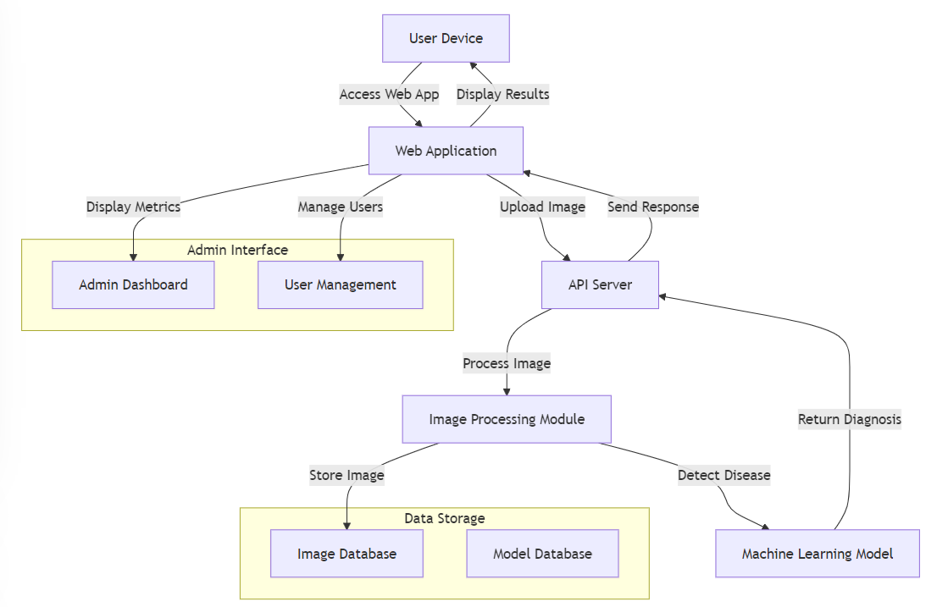
ARCHITECTURE

Slide 12
MODULES
Register Module
Login Module
Upload Plant Image Module
Disease Classification Module
Pesticide Recommendation Module
Logout Module:

Slide 13
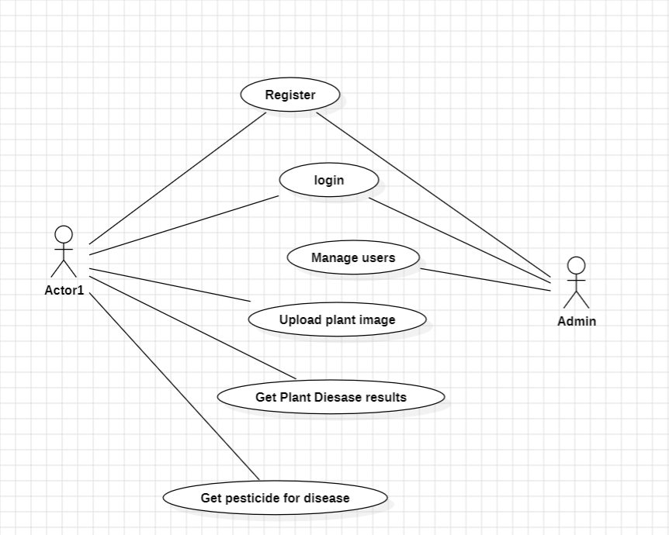
UML DIAGRAMS
USE CASE DIAGRAM:

Slide 14
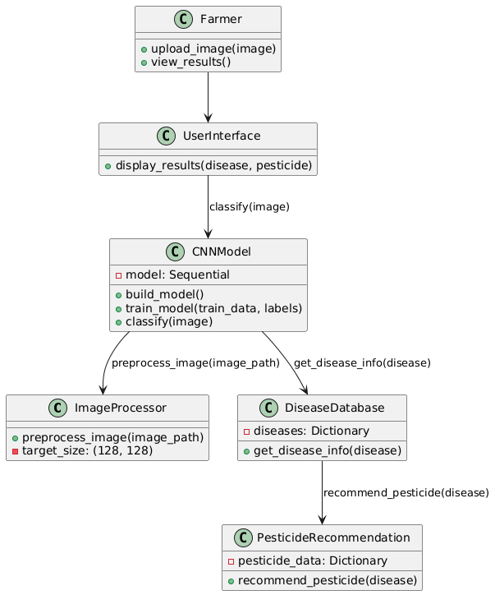
UML DIAGRAMS
CLASS DIAGRAM:

Slide 15
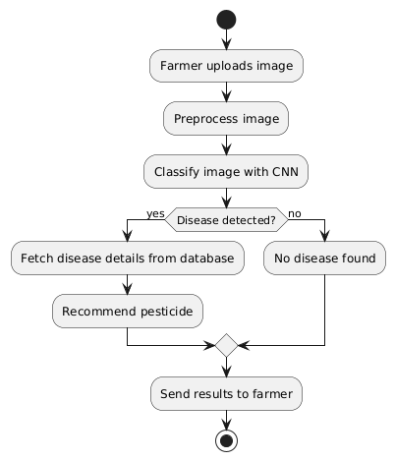
UML DIAGRAMS
ACTIVITY DIAGRAM:

Slide 16
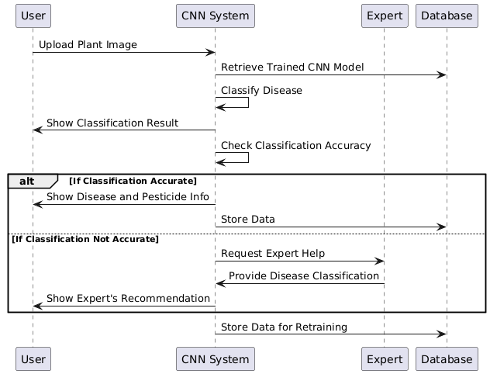
UML DIAGRAMS
SEQUENCE DIAGRAM:

Slide 17
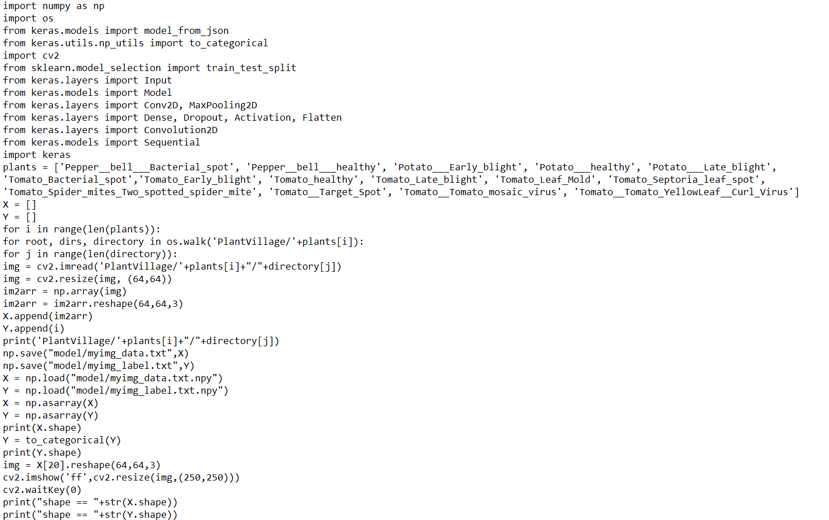
SAMPLE CODE

Slide 18
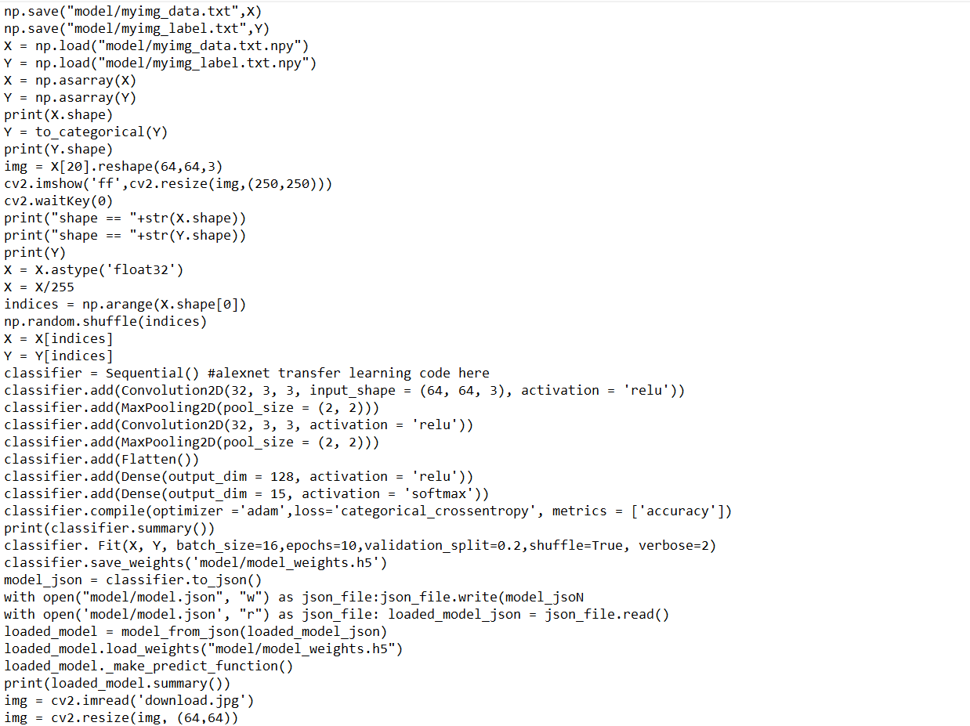
SAMPLE CODE

Slide 19
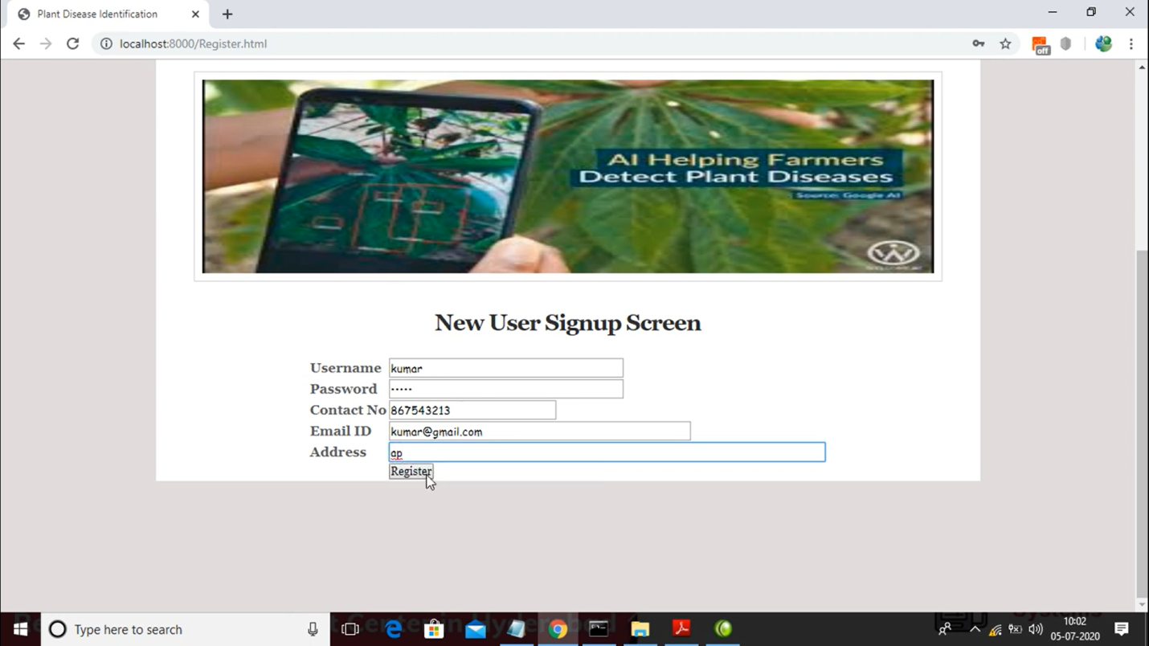
RESULTS

Slide 20
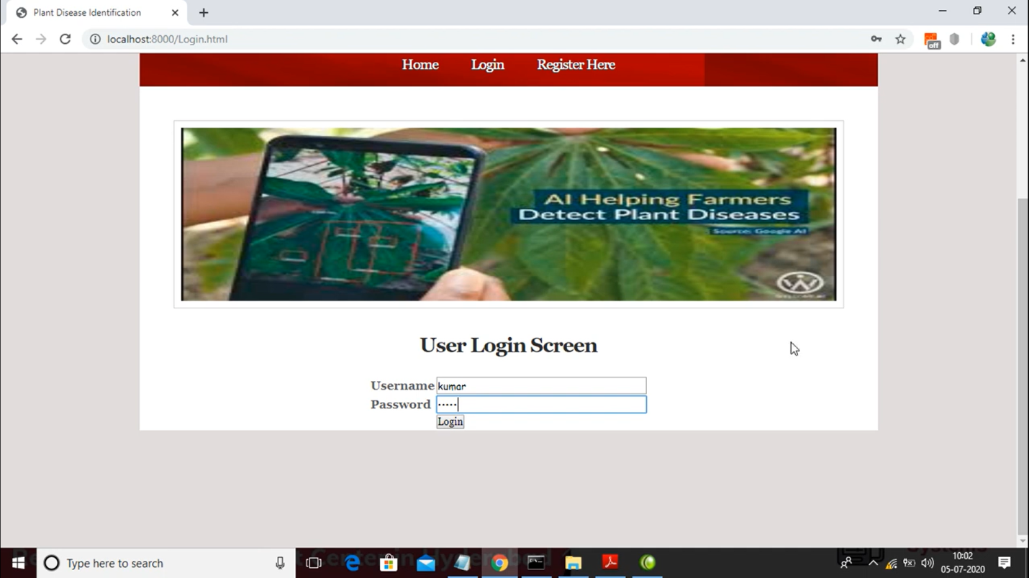
RESULTS

Slide 21
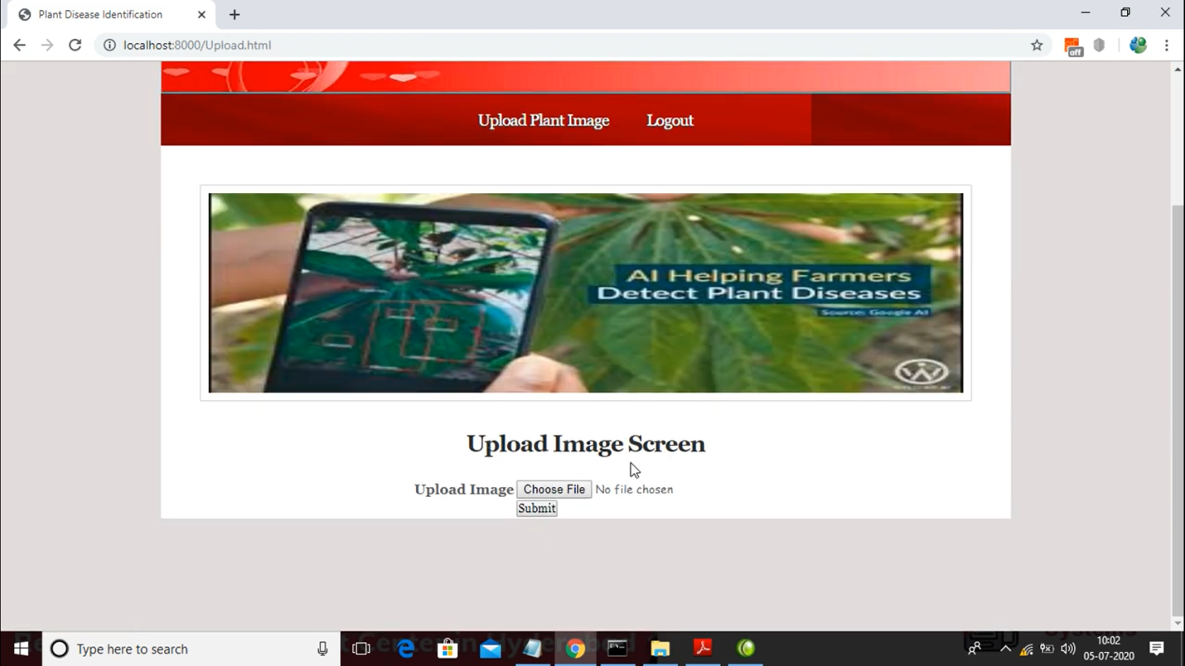
RESULTS

Slide 22
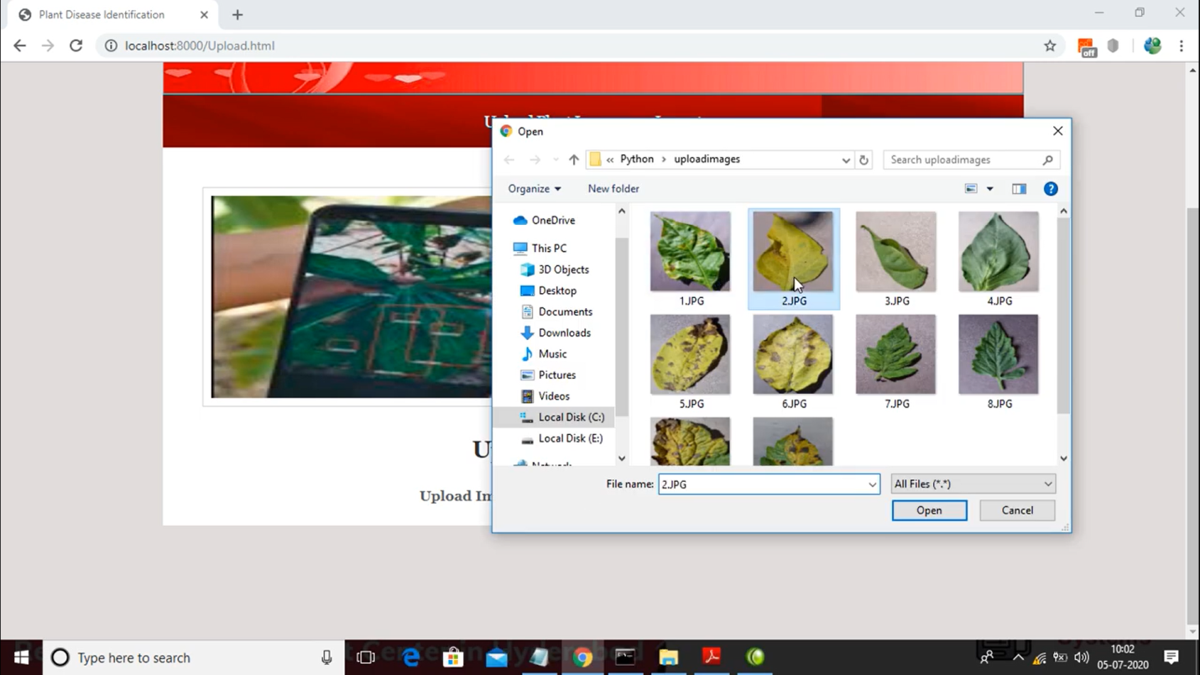
RESULTS

Slide 23
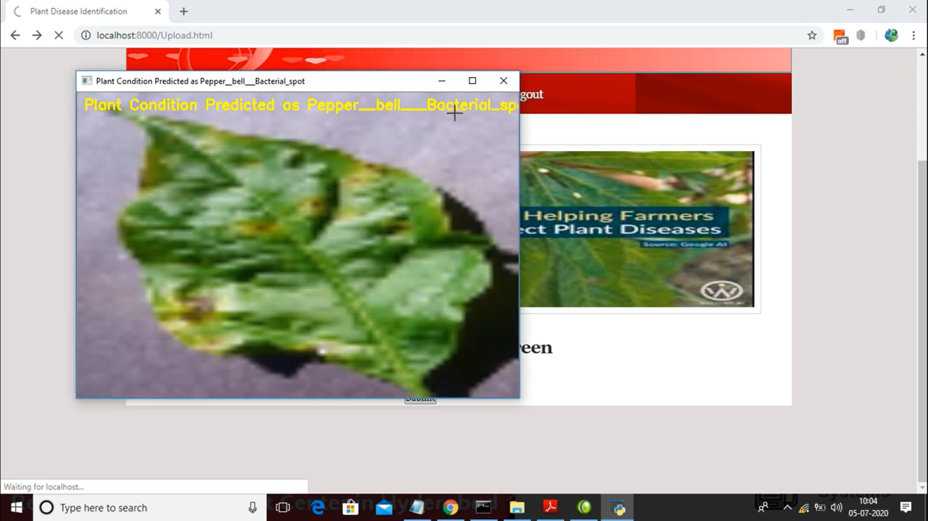
RESULTS

Slide 24
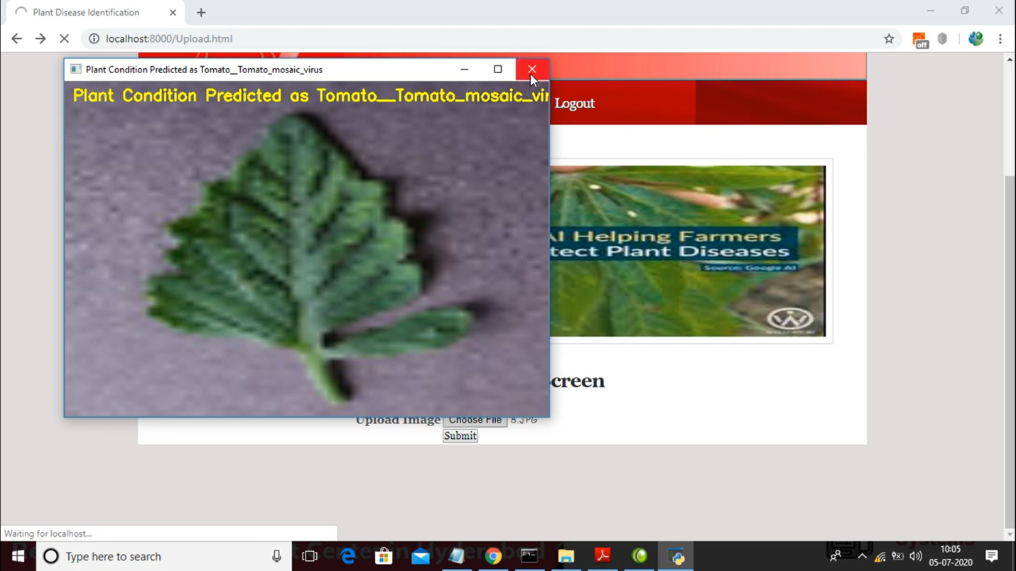
RESULTS

Slide 25
CONCLUSION
The project provides an automated, low-cost, and user-friendly solution for early plant disease diagnosis using Convolutional Neural Networks (CNNs) and a cloud-based platform. It enables real-time disease identification and offers pesticide recommendations, making it accessible for farmers.
The system improves accuracy through user-submitted images and expert feedback, and it generates disease density maps for effective outbreak monitoring. This approach addresses the urgent need for timely disease management, aiming to enhance crop yields and reduce pesticide misuse, making it a valuable resource for sustainable farming.

Slide 26
FUTURE SCOPE
Incorporating Environmental Factors
Improve accuracy by including soil conditions, temperature, humidity, and rainfall.
User Input Feature
Allow farmers to input soil conditions and past pesticide applications for better diagnosis.
Predictive Analytics Module
Alert users about potential outbreaks using environmental and geolocation data.
Self-Learning AI Model
Minimize expert intervention by continuously updating the AI model for self-learning.
Handling New Plant Diseases
Continuously update the training dataset to manage newly discovered diseases.
Automated Monitoring Systems
Use time-based infection density maps to facilitate real-time disease management.​

Slide 27
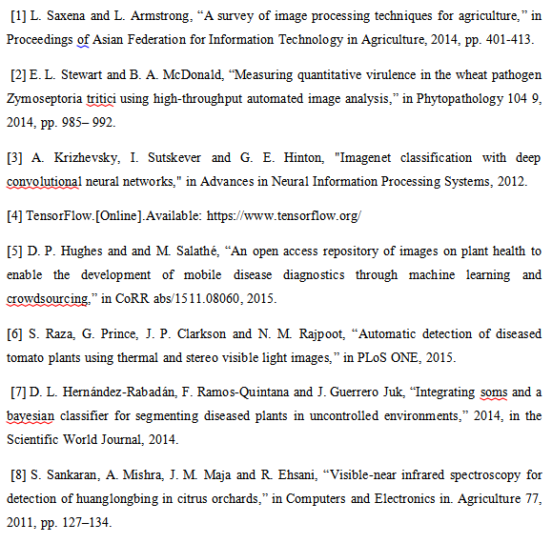
REFERENCES

Slide 28
Github Link
https://github.com/Sachin0535m/PLANT-DISEASE-IDENTIFICATION

Slide 29

THANK YOU
Name
BATCH NO : 3
CSE - A

