Slide 1
Circular Queue
Lect 8
Shilpa Ingoley

Slide 2
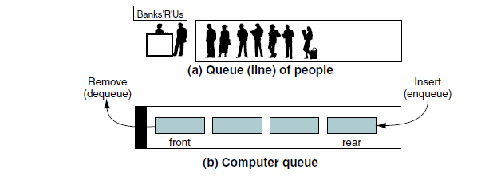
Queue
The queue insert operation is known as enqueue.
The queue delete operation is known as dequeue.

Slide 3
Circular Queues: Circular Array Implementation 3
Drawbacks of the Queue (Two methods)
Array implementation queue Method 1(Brute force )
n elements have to move after one dequeue
This is O(n) time per deletion!
And we know, conceptually, a dequeue should be O(1)
Array implementation queue Method 2(Without moving the element)
The problem: we end up with wasted cells
As the front moves towards the rear (when dequeues occur), we have empty, useless cells in the array

Slide 4
Circular Queues: Circular Array Implementation 3
Circular arrays are a very common way of implementing an array-based queue
What is a circular array?
It is a regular array
We simply “view” it as being circular
In a circular implementation, the queue is considered to be full whenever the front of the queue immediately precedes the rear of the queue in the counterclockwise direction.
The examples on the following slide should help you to visualize a “circular” array.

Slide 5
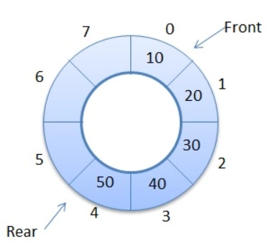
Contd…
Circular Queue Representation

Slide 6
Contd…
rear
front
4
2
15
11
10
6
8
8
4
front
rear
normal array implementation: queue is full
2
6
10
15
11
10
6
8
4
2
15
11
rear
front
visualization of a queue
implemented as a circular array
circular array implementation: queue is full

Slide 7
Queues: Array Implementation (3)
Circular Array Implementation
This implementation allows us to keep the elements in their respective “cells” of the array
We don’t need to move n elements during dequeues
AND we also don’t have wasted space!
The circular “view” of the array allows us to “wrap” around the array
Assume the length of the array is SIZE/MAX
It is NOT the case that the rear most stop at index[MAX-1]
meaning, the last element
Rather, since the array wraps around, the front could be at a greater index than the index of the rear!

Slide 8
Queues: Circular Array Implementation
Circular Array Implementation
The next several slides illustrate the operation of a circular array based implementation of a queue.
However, remember that the brute force method is extremely inefficient due to the amount of data movement required by dequeue operations.

Slide 9
Queues: Circular Array Implementation
Queues:
Circular Array Implementation
The scenario begins at some point in time before which other enqueue and dequeue operations have occurred on the queue.
Our scenario begins with some elements already in the queue.
these elements were enqueued in the order of: 2, 4, and 8.
The scenario continues by enqueuing 6, enqueuing 10, dequeue, enqueuing 18, dequeue, dequeue, dequeue, enqueuing 9, dequeue, dequeue, and finally one last dequeue which empties the queue at this point.

Slide 10
Queues: Circular Array Implementation
front
2
4
dequeue()
dequeue()
dequeue()
Enqueue(2)
Enqueue(4)
Enqueue(8)
Enqueue(6)
8
6
2
4
8
before
rear
front
rear
visualization of a queue
implemented as a circular array
after insertion of element 6
2
4
8
6
after
front
rear
circular array implementation
Enqueue element 6

Slide 11
Queues: Circular Array Implementation
front
2
dequeue()
dequeue()
dequeue()
Enqueue(2)
Enqueue(4)
Enqueue(8)
Enqueue(6)
Enqueue(10)
4
10
8
rear
6
2
4
8
6
before
front
rear
visualization of a queue
implemented as a circular array
after insertion of element 10
10
2
4
8
6
after
rear
front
circular array implementation
Enqueue element 10

Slide 12
Queues: Circular Array Implementation
front
dequeue()
dequeue()
dequeue()
Enqueue(2)
Enqueue(4)
Enqueue(8)
Enqueue(6)
Enqueue(10)
dequeue()
4
10
8
rear
6
10
2
4
8
6
before
rear
front
visualization of a queue
implemented as a circular array
after dequeue operation
10
4
8
6
after
rear
front
circular array implementation
dequeue

Slide 13
Queues: Circular Array Implementation
dequeue()
dequeue()
dequeue()
Enqueue(2)
Enqueue(4)
Enqueue(8)
Enqueue(6)
Enqueue(10)
dequeue()
Enqueue(18)
front
18
4
rear
10
8
6
10
4
8
6
before
rear
front
visualization of a queue
implemented as a circular array
after insertion of element 18
10
18
4
8
6
after
rear
front
circular array implementation
Enqueue element 18

Slide 14
Queues: Circular Array Implementation
dequeue()
dequeue()
dequeue()
Enqueue(2)
Enqueue(4)
Enqueue(8)
Enqueue(6)
Enqueue(10)
dequeue()
Enqueue(18)
dequeue()
18
rear
10
8
front
6
10
18
4
8
6
before
rear
front
visualization of a queue
implemented as a circular array
after dequeue operation
10
18
8
6
after
rear
front
circular array implementation
dequeue

Slide 15
Queues: Circular Array Implementation
dequeue()
dequeue()
dequeue()
Enqueue(2)
Enqueue(4)
Enqueue(8)
Enqueue(6)
Enqueue(10)
dequeue()
Enqueue(18)
dequeue()
dequeue()
18
rear
10
6
10
18
8
6
before
front
rear
front
visualization of a queue
implemented as a circular array
after dequeue operation
10
18
6
after
rear
front
circular array implementation
dequeue

Slide 16
Queues: Circular Array Implementation
dequeue()
dequeue()
dequeue()
Enqueue(2)
Enqueue(4)
Enqueue(8)
Enqueue(6)
Enqueue(10)
dequeue()
Enqueue(18)
dequeue()
dequeue()
dequeue()
18
rear
10
front
10
18
6
before
rear
front
visualization of a queue
implemented as a circular array
after dequeue operation
10
18
after
front
rear
circular array implementation
dequeue

Slide 17
Queues: Circular Array Implementation
dequeue()
dequeue()
dequeue()
Enqueue(2)
Enqueue(4)
Enqueue(8)
Enqueue(6)
Enqueue(10)
dequeue()
Enqueue(18)
dequeue()
dequeue()
dequeue()
Enqueue(9)
rear
9
18
10
front
10
18
before
front
rear
visualization of a queue
implemented as a circular array
after insertion of element 9
10
18
9
after
front
rear
circular array implementation
Enqueue element 9

Slide 18
Queues: Circular Array Implementation
dequeue()
dequeue()
dequeue()
Enqueue(2)
Enqueue(4)
Enqueue(8)
Enqueue(6)
Enqueue(10)
dequeue()
Enqueue(18)
dequeue()
dequeue()
dequeue()
Enqueue(9)
dequeue()
rear
9
18
front
10
18
9
before
front
rear
visualization of a queue
implemented as a circular array
after dequeue operation
18
9
after
front
rear
circular array implementation
dequeue

Slide 19
Queues: Circular Array Implementation
dequeue()
dequeue()
dequeue()
Enqueue(2)
Enqueue(4)
Enqueue(8)
Enqueue(6)
Enqueue(10)
dequeue()
Enqueue(18)
dequeue()
dequeue()
dequeue()
Enqueue(9)
dequeue()
Dequeue()
rear
front
9
18
9
before
front
rear
visualization of a queue
implemented as a circular array
after dequeue operation
9
after
front/rear
circular array implementation
dequeue

Slide 20
Queues: Circular Array Implementation
dequeue()
dequeue()
dequeue()
Enqueue(2)
Enqueue(4)
Enqueue(8)
Enqueue(6)
Enqueue(10)
dequeue()
Enqueue(18)
dequeue()
dequeue()
dequeue()
Enqueue(9)
dequeue()
Dequeue()
Dequeue()
rear
front
9
before
front/rear
visualization of a queue
implemented as a circular array
after dequeue operation
after
Rear/front
circular array implementation
dequeue – queue empties!

Slide 21
Queues: Circular Array Implementation
Queues:
Circular Array Implementation
So this works great in pictures
But think about something…
How did we modify the position (index) of front and rear?
Did we just increment the front/rear indices as needed?
Meaning, did we simply increment the index of rear every time an enqueue occurs?
And did we simply increment the index of front every time a dequeue occurs?
In a normal array, this is fine.
However, this is a circular array, and we must pay attention!
Simply incrementing using previous methods may not benot Sufficient!

Slide 22
Queues: Circular Array Implementation
Queues:
Circular Array Implementation
How did we modify the position (index) of front and rear?
We find (and then modify) the index of front and rear using modulo arithmetic.
This implements the circular nature of this array
Ex: suppose we have the situation below
If we dequeue, the front will need to refer to the ‘10’ in index 0!
So how do we make this happen?
Can we simply increment front?
10
18
6
before
rear
front

Slide 23
Queues: Circular Array Implementation
Queues:
Circular Array Implementation
But think about something…
Ex: suppose we have the situation below
If we dequeue, we usually simply increment the front
But if we did so, this would make front refer to index 7
BUT this is out of bounds!!!
However, (front + 1) mod 7 = 0
This is PRECISELY the index we want!
10
18
6
before
rear
front
The ‘7’ here refers to the size of the array

Slide 24
Queues: Circular Array Implementation
Queues:
Circular Array Implementation
But think about something…
Ex: suppose we have the situation below
So how do we get front to “point” to index 0?
We need to use mod!
We increment front and then mod it by the queue size
front = (front + 1) mod 7
So now the new front refers to index 0.
This is PRECISELY the index we wanted!
10
18
6
before
rear
front

Slide 25
Understanding modulo arithmetic.
Assume we want to increment front i.e. front=front +1
Lets see how we can do it using modulus (%) →mod gives you remainder
If front = 0 , front = (front + 1) mod 5 now value of front is 1
If front = 1 , front = (front + 1) mod 5 now value of front is 2
If front = 2 , front = (front + 1) mod 5 now value of front is 3
If front = 3 , front = (front + 1) mod 5 now value of front is 4
If front = 4 , front = (front + 1) mod 5 now value of front is 0
Can we have formula for increment of front/rear i.e. front++ and rear++
If front = i , front = (front + 1) mod MAX now value of front is front + 1

Slide 26
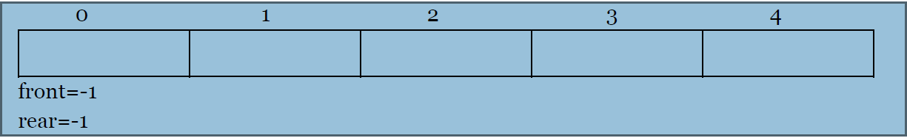
Implementation of Circular queue
Queue empty/ Underflow:
➢ When queue is empty, both rear and front will be equal to -1.
If we are trying to delete/display/peek an element(s) in empty queue then this condition is known as queue underflow.

Slide 27
Contd…
Queue Full/ Overflow:
1) front ==0 and rear == MAX-1
2) front == rear+1
10
20
30
40
50
Front=0
Rear = 4
60
70
80
40
50
Rear = 2
Front=3

Slide 28
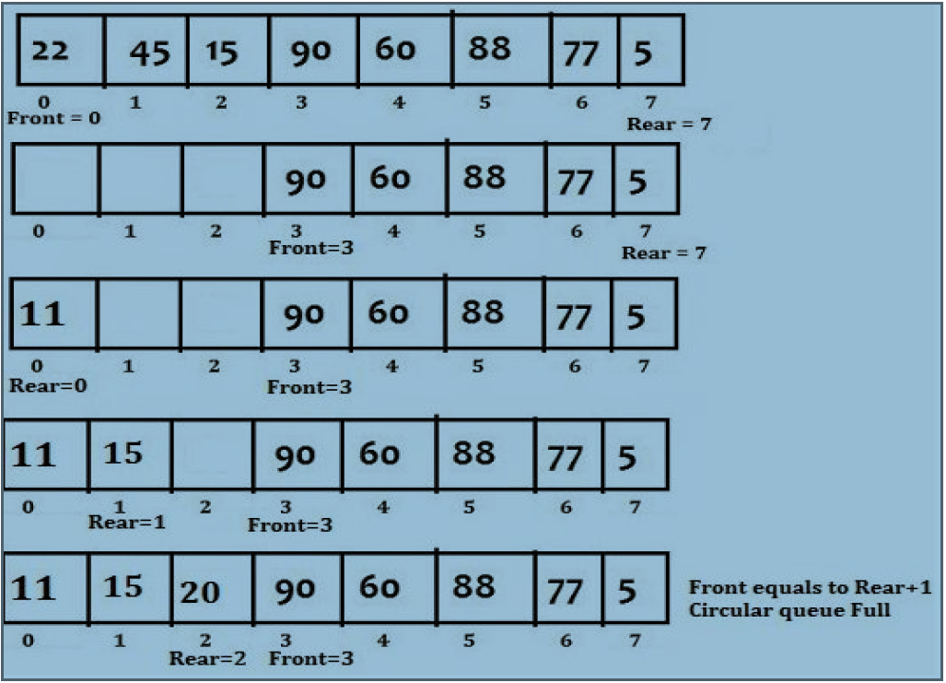
Way to check → C-Queue is Full
Queue Full/ overflow condition:
➢When the queue is full and if we try to insert new element then that condition is known as overflow condition.
If (front==0 && rear==max-1 || front==rear+1)
printf(“\n circular queue is full.”);

Slide 29
Contd…
No need to use two conditions just one is sufficient
Rear=6
front=0
rear
front
if ((rear+1)% MAX== front )
printf(“Circular Queue is full--> Overflow !!! ");
8
4
6
2
10
15
11
If rear =6 then front =0
visualization of a queue
implemented as a circular array
rear
front
Rear=2
Front=3
8
4
6
2
If rear = 2 then front =3
10
15
11
visualization of a queue
implemented as a circular array

Slide 30
Inserting/Enqueue Contd…
void enqueue(int ele)
{
if(front ==-1 && rear==-1) // Checking for if queue is empty
{
front=rear=0;
cqueue[rear]=ele;
}
// Checking for Overflow condition
else if ((rear+1)% MAX== front )
printf("\n **c-Queue is full--> Overflow !!! **\n ");
else
{
rear=(rear+1)%MAX;
cqueue[rear]=ele;
}
}
Front=-1
Rear =-1
10
Rear =0
Front=0
10
20
30
40
50
Front=0
Rear = 4
60
70
80
40
50
10
20
30
Rear = 2
Front=3
Front=0
Rear =2

Slide 31
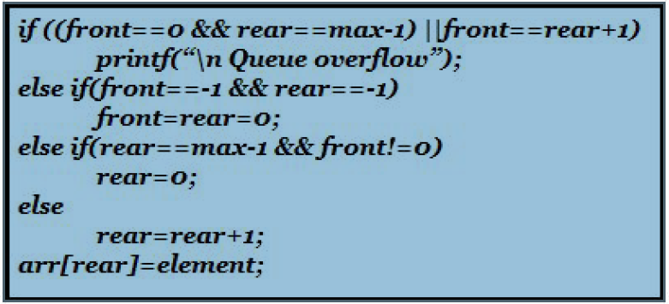
Contd…
Alternative Insert operation in circular queue:
➢Before inserting an element in the queue, we must check for overflow condition.
➢ Then check if the queue is empty, in case the queue is initially empty then value of front is set to zero so that new value can be stored at 0 th location.
➢ Then check if rear end has already reach to max while there are certain free locations before the front end so bring the rear pointer at 0 th location.
➢ Otherwise simply increment the value of rear pointer by 1.
➢ Finally value is stored in array at location pointed by rear.

Slide 32
Contd…
Delete operation in circular queue:
void dequeue()
{
if(front ==-1 && rear==-1) // C-Queue is Empty
{
printf("\n ** Queue is EMPTY: Underflow condition !!! **\n ");
}
else if(front==rear) //only one element left
{
printf(" Deleted item is %d",cqueue[front]);
front=rear=-1;
}
else
{
printf(" Deleted item is %d",cqueue[front]);
front=(front+1)%MAX; //front++;
}
}
Front=-1
Rear =-1
30
Rear =2
Front=2
10
30
40
50
Rear =0
Front=2

Slide 33
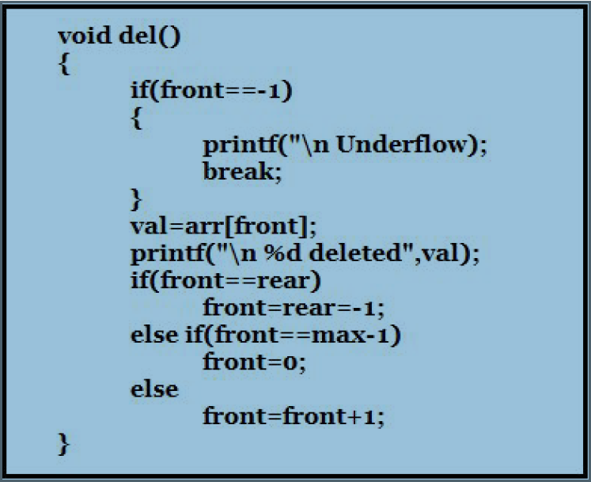
Contd…
Alternative Delete operation in circular queue:
For deleting an element we will check following conditions:
First we check for underflow condition
Then we need to see if queue has become empty after deletion then front & rear will be set to -1.
If front has reached to maximum capacity of queue then set front = 0
Otherwise simply increment the value of front.

Slide 34
Contd…
Displaying Contents of C-Queue
void traverse()
{
int i;
if(front== -1 && rear== -1)
printf("\n ** Queue is EMPTY -- Underflow!!! ** \n");
else
{
printf("\n Queue contains following elements : \n");
for(i=front; i!=rear; i=(i+1)%MAX)
printf(" %d ->",cqueue[i]);
printf(" %d ->",cqueue[i]);
}
}
Front=-1
Rear =-1
10
30
40
50
Rear =0
Front=2
10
20
30
40
50
Front=0
Rear = 4

Slide 35
Alternative way of displaying Contents of C-Queue
Can use multiple loops

Slide 36
Contd…
Displaying the value at front/Peek
void peek()
{
if(front== -1 && rear== -1)
printf("\n ** C-Queue is EMPTY -- Underflow!!! ** \n");
else
printf("\n C-Queue contains elements at front : %d \n",cqueue[front]);
}

Slide 37
Limitation of Circular Queue
The number of memory locations are fixed, so size can not be changed

