Slide 1
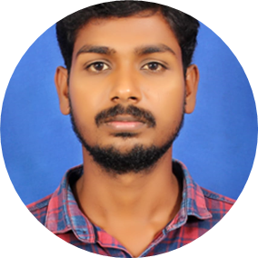

Sachin V Bajantri
Analyst/Software Engineer
BACHELOR OF TECHNOLOGY
Computer Science and technology Engineering:2017-2021
Skills
C#
Dot net core
ASP. Net
Manual Testing
DatabaseL
MS SQL Server 2019
SQL core
Web Technologies
HTML5
CSS3
AddOns
Github
Postman
Additional skills
Leadership Qualities
Quick Learner
Team Management
Good communication
BANGALORE
Sachin-v.bajantri@capgemini.com
+91 9108057468
A4
Well versed with the functional knowledge of SDLC stages ranging from Requirement Gathering to Analysis, Design, Development, Testing, and Deployment.
A team player with good communication skill always ready to work for the enrichment of knowledge. Able to adopt the process changes effectively.
Ability and flexibility to multi-task, prioritize, and organize multiple projects/ tasks concurrently while meeting project deadlines.
Have better understanding on process agility and can come to up to speed on new technologies/ methodologies in best possible way.
Ready to learn new technologies and implement them to further improve my knowledge
Laundry Management System :
Completed end to end case study of Laundry management System along with postman, html, CSS.
Microsoft Azure Fundementals Certificate :
Completed this course AZ-900 Certification
Experience
worked in PCT project(March 29th to May 31st)
used ASP.NET for viewing employee salary & student details.
Role: Developer role
Working in Carnival migration project(Jun 24th to nov 30th)
Working on converting dot net(.Net) version 4.0 to Version( 6.0 and testing the micro services with help of Postman
Role: QA

