Slide 1
Capstone project Hotel Booking Analysis Project Type: EDA Contribution : Sachin Kumar

Slide 2
Content
Problem Statements
Data Summary
Exploratory Data Analysis
EDA For Hotel Booking Analysis
Charts
Correlation Matrix
Challenges
Conclusion

Slide 3
Problem Statement
Analysis Based on Yearly Bookings Of Hotel.
Analysis Based on Monthly Bookings Of Hotel.
Analysis Based on Country of Guests Visiting Hotel.
Analysis Based on Bookings By Market Segment.
Analysis Based on Hotel Prices.
Analysis Based on Length Of In The Hotel.

Slide 4
Data summary
In the Hotel booking analysis project there is a Dataset which contains Booking information for city and resort hotels.
The dataset has total of 32 columns and 119390 rows.
The Dataset spans over 3 years that is 2015, 2016 & 2017.
The Dataset contains information on Length of stays, Numbers of guests, Bookings of hotel among other things.

Slide 5
Exploratory Data Analysis
Exploratory Data Analysis is also known as EDA, is the process of interpreting datasets by summarizing their key properties and frequently visualizing them.
EDA refers to the critical process of performing initial investigation on dataset so as discover the patterns, to spot anomalies, to test hypothesis, and to check assumptions with the help of summary statistics and graphical representation.
In EDA, plotting options include Box plots, Line plots, Scatter plots and many more.
EDA always comes first when conducting a data analysis.

Slide 6
EDA For Hotel Booking Analysis
In order to identify the length of stay, prices of hotel, bookings made and comparing of hotel types, we conducted Exploratory Data Analysis on the Hotel Booking Dataset.
EDA, means analysing the provided dataset and to look for patterns and assumptions.
There are attributes in the dataset, including years, months, days, countries, guests and many more.

Slide 7
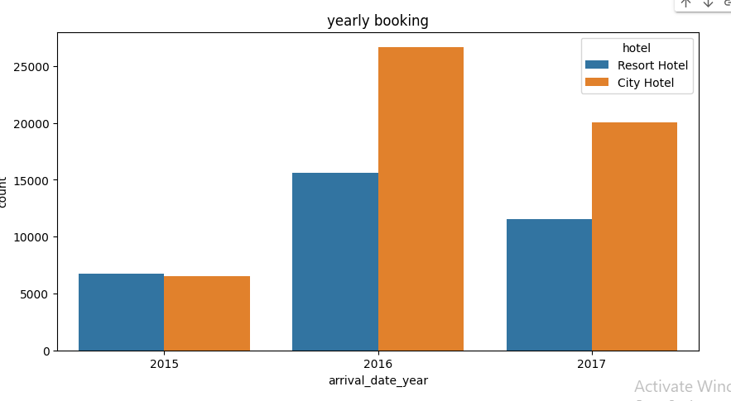
Hotel Wise Yearly Booking
The above graphs shows the Booking across years is higher for city hotel than resort hotel and most booking are in 2016 compared to 2015 and 2017.

Slide 8
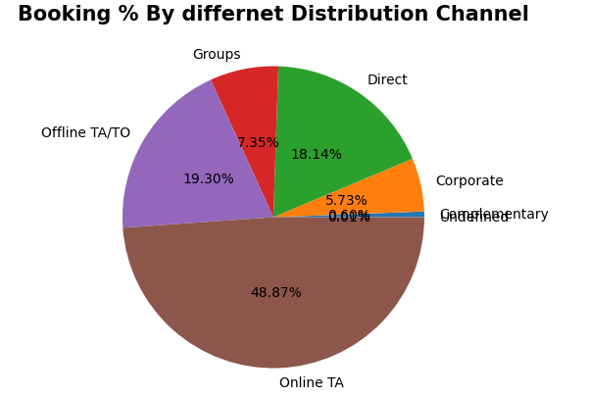
Distribution Channels of Booking
From the pie chart I can conclude that approx 49% people book the hotel by the Online TA.
From the pie chart I can conclude that approx 49% people book the hotel by the Online TA.
.

Slide 9
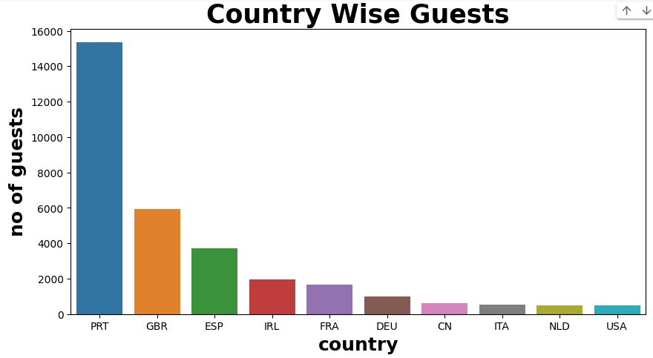
Country Wise Guests
The above Bar chart shows most of the guests from Portugal and other European Countries

Slide 10
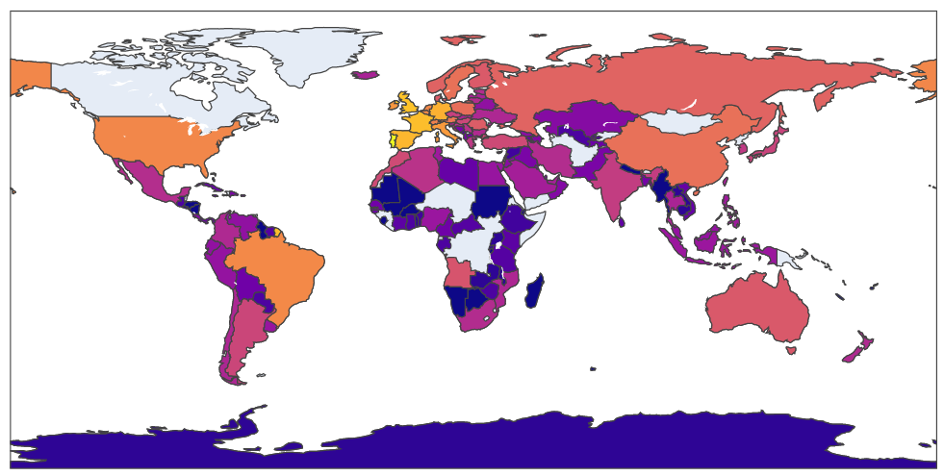


Slide 11
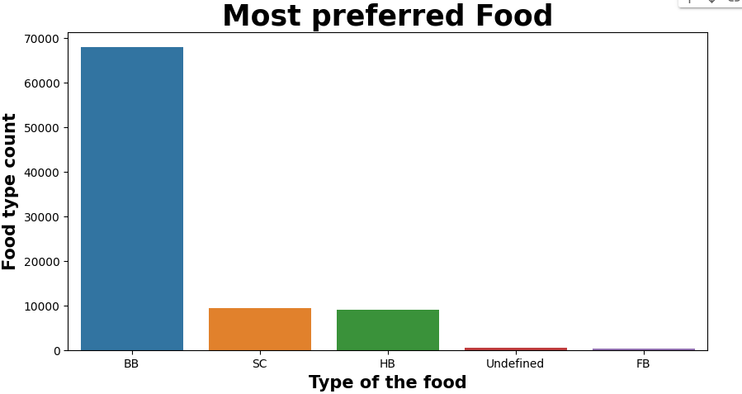
Most Preferred Food
Guest Like BB types of Food while least food like by Guests is FB.

Slide 12
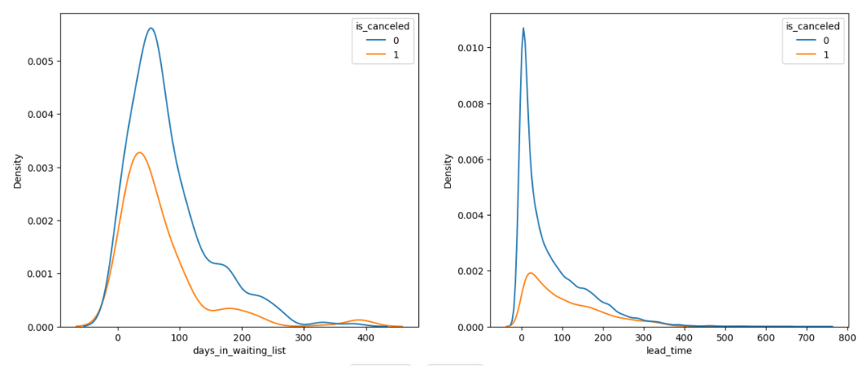
Booking cancellation Analysis

Slide 13
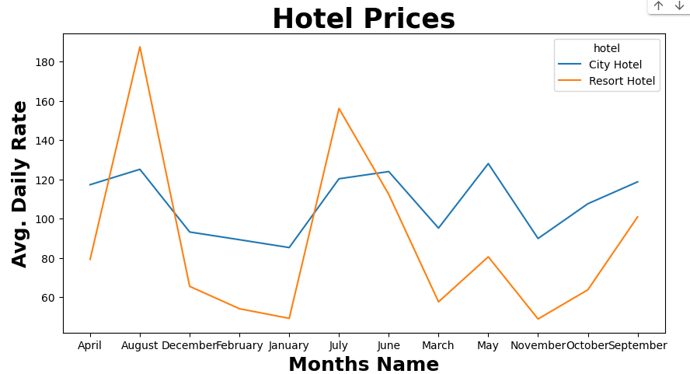
Month Wise ADR
ADR of City Hotel & Resort Hotel are Highest in the month of Jan & November.

Slide 14
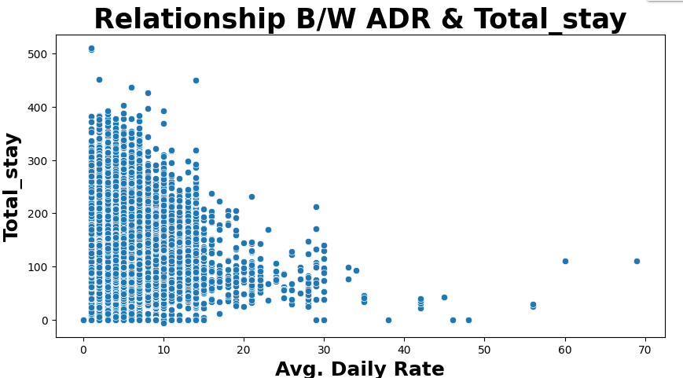
Relationship B/W ADR & Total_stay
The above scatter plot shows that the relationship b/w ADR & Number of Days stay is Inverse.

Slide 15
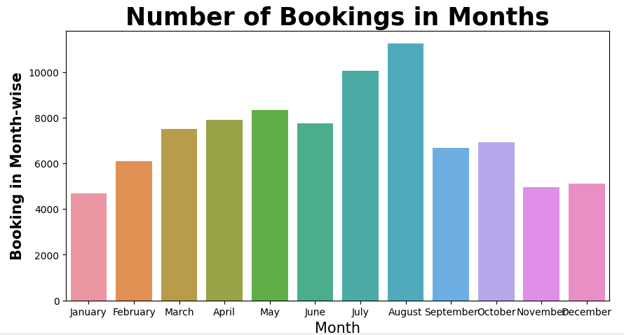
Number of Booking in Each Month
Most of the guests prefer July & August.

Slide 16
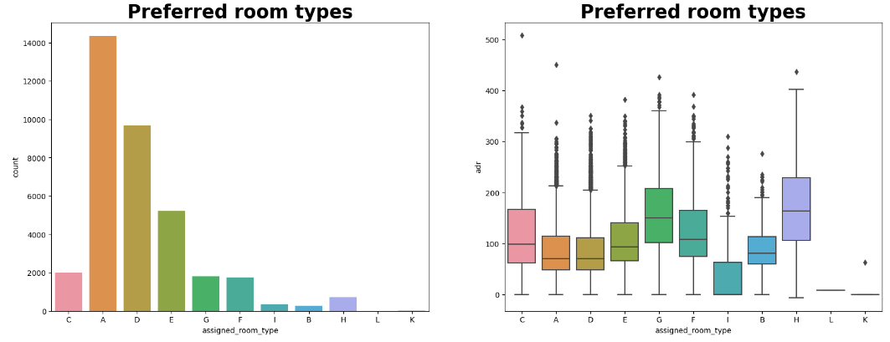
Most preferred Room type
Guests like to book A & C type of rooms. Even A & D have the highest number of booking.
However room type H, G & C have better ADR (Avg, Daily Rate).

Slide 17
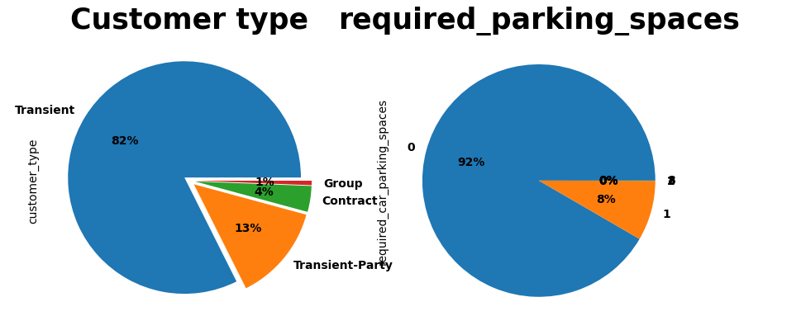
Customer Type & Parking required
82% Customers are Transient. Which is highest number among all.
Only 8% requried Parking.

Slide 18
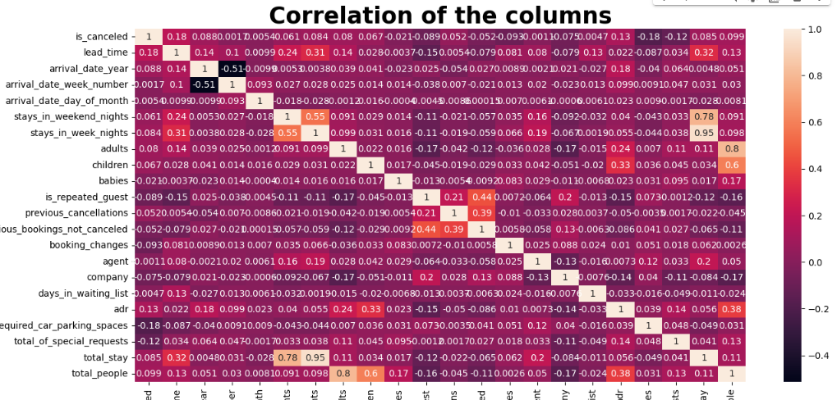
Correlation Between The Numerical Data
ADR & Adult columns has Negative correlation (-0.58) . Stay_weeken_night and total Stay has positive coorelation (0.95.

Slide 19
Challenges
Understanding the columns of the dataset
There were many missing values in the dataset and removing the missing value columns.
Adding up the guests and stay columns which required for analysis
Finding the right graph for analysis of the dataset

Slide 20
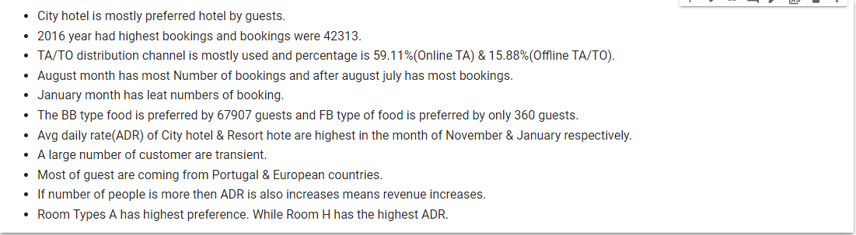
CONCLUSION

Slide 21
Q&A

