Slide 1


BMS INSTITUTE OF TECHNOLOGY AND MANAGEMENT YELAHANKA BANGALORE
Department of Computer Science & Engineering
Major Project Phase 2 Review 2 Presentation
FORGEWEB
AI-Assisted Full-Stack Web Application Generator
Pratyush Manas (1BY23CS163)
Rajeev Kumar (1BY23CS171)
Sachin Yash Raj (1BY23CS192)
Sanaa Kumari (1BY23CS202)
B.E. • Computer Science and Engineering
Guide name and designation: to be confirmed
Academic Year 2026–27

Slide 2
CONTENTS
01 Overview: abstract, introduction and motivation
02 Problem statement and objectives
03 Methodology and system diagrams
04 Algorithms and experimental setup
05 Demonstration and result analysis
06 SDG alignment and complex engineering problem
07 Project management, finance and future work
08 References and publication status

Slide 3
ABSTRACT
ForgeWeb helps users turn a plain-language idea into a full-stack web application. It prepares requirements and an architecture file for approval before generating code.
A schema-first pipeline connects React interfaces, FastAPI models and SQLite storage. Saved checkpoints protect completed work when generation stops.
Local checks compile the frontend and test API behavior and persistence. The aim is to make generation more dependable while clearly reporting what has and has not been verified.

Slide 4
INTRODUCTION
• Full-stack development connects the interface, server logic and database.
• AI can produce code quickly, but separate files may disagree about routes, fields or validation.
• ForgeWeb provides an approval-led workflow for planning, generation, preview and inspection.
• The current reliability target is React, Python FastAPI and SQLite.
• The platform keeps project history and supports bounded, checkpoint-based recovery.

Slide 5
MOTIVATION
• Students and small teams often spend substantial effort setting up repeated application foundations.
• A generated page is useful only when its actions connect to working server behavior.
• Failures should preserve progress rather than force users to restart.
• Users need clear evidence of real saves, valid responses and durable data.
• ForgeWeb combines faster prototyping with visible engineering checks.

Slide 6
PROBLEM STATEMENT
Users need a practical way to build web applications from natural-language requirements without manually coordinating every interface, API and database detail. However, generated components can use inconsistent field names, incompatible category values or missing storage dependencies. A page may compile and still fail when a user submits a form.
The problem is therefore to create an approval-led generation workflow that preserves the user’s requirements, maintains a consistent full-stack contract, saves partial progress and verifies observable behavior before presenting the application as working.

Slide 7
OBJECTIVES OF THE WORK
• Create a clear architecture file from the user’s requirements.
• Generate source only after the proposed plan is approved.
• Derive shared types and server models from one schema.
• Connect React actions to FastAPI routes and persistent SQLite data.
• Preserve checkpoints and support controlled recovery.
• Test compilation, API workflows, validation and persistence.
• Report failures and unverified behavior honestly.

Slide 8
METHODOLOGY
1. Understand the prompt and prepare requirements and architecture.
2. Ask the user to approve or revise the proposed plan.
3. Freeze a machine-readable schema for routes and data models.
4. Generate shared bindings, frontend pages and backend services.
5. Save accepted files as durable checkpoints.
6. Run isolated compilation, API and persistence checks.
7. Show source, preview, version history and verification evidence.

Slide 9
SYSTEM ARCHITECTURE
USER LAYER
Prompt • approval • preview
FORGEWEB CONTROL PLANE
Workflow • versions • budget
DESIGN & MODEL SERVICES
Stitch reference • code model
SHARED CONTRACT
Schema • types • HTTP helpers
GENERATED APPLICATION
React → FastAPI → SQLite
ISOLATED VERIFICATION
Compile • API tests • restart
Model services generate source; the isolated application runs with its own persistent data.

Slide 10
DATA FLOW DIAGRAM — LEVEL 0
ForgeWeb
Plan → generate → verify
User
Requirements / approval
Project store
Source / checkpoints
Preview + test evidence
Inputs become project artifacts; results return as inspectable source, preview and verification evidence.

Slide 11
DATA FLOW DIAGRAM — LEVEL 1
1. Plan and
approve
2. Freeze schema
and generate
3. Execute
checks
4. Preview /
report failure
Project SQLite store
History • source • checkpoints
Generated-app SQLite
User records • transactions
ForgeWeb project data and generated application records remain separate.

Slide 12
SEQUENCE DIAGRAM — GENERATION
User
ForgeWeb
Model service
Verifier
Submit prompt
Proposed plan
Approve plan
Request source
Save checkpoints
Run verification tests
A failed stage keeps accepted files; continuation is bounded and preserves the approved plan.

Slide 13
TRANSACTION DIAGRAM — SAVING DATA
Validate request
Begin transaction
Write related records
Return confirmation
Commit on success
Rollback on failure
Related writes share one connection. Success is returned only after commit; failures must not leave partial data.

Slide 14
ALGORITHMS USED
• Schema validation checks types, references and routes before generation.
• Deterministic bindings create matching TypeScript and Python models.
• Checkpoint recovery reuses accepted files after an interruption.
• Workflow verification checks responses and persistent data.
• Graph retrieval selects relevant code for scoped reviews and edits.
• Budget checks stop requests that cannot fit the approved allowance.

Slide 15
EXPERIMENTAL SETUP
Software
React and TypeScript; Python FastAPI; SQLite; Docker; Playwright; local Graphify.
Hardware
Intel Core i7-11800H, 16 GB RAM and NVIDIA RTX 3050 Ti laptop GPU.
Test environment
Isolated containers, disposable test databases and synthetic records. External generation uses server-side credentials; secrets are excluded from source and exports.

Slide 16
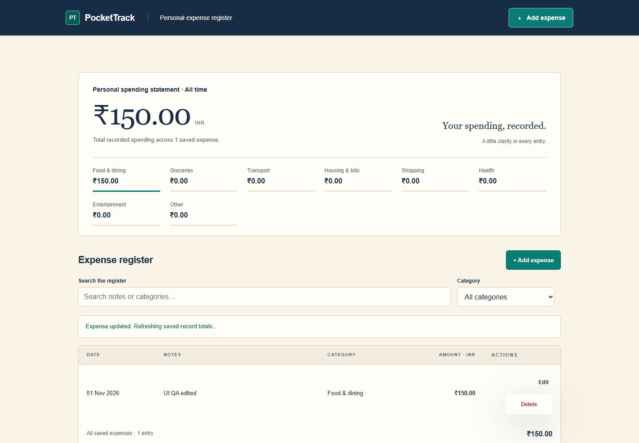
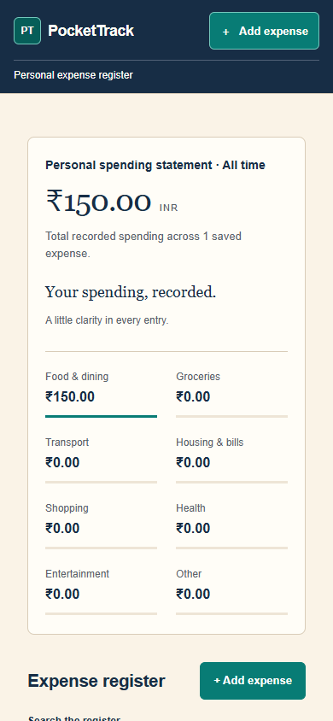
DEMONSTRATION — GENERATED APPLICATION
PocketTrack: real API-connected expense forms, calculated totals and mobile layout. Demonstration from a repaired project—not a fresh autonomous build.

Slide 17
RESULT ANALYSIS — TEST CASES
• Contract tests reject mismatched enums, routes and request models.
• CRUD tests check real create, read, update and delete behavior.
• Input tests reject invalid values and undeclared fields.
• Transaction tests check rollback and concurrent writes.
• Restart tests distinguish SQLite persistence from in-memory state.
• Recovery and export tests protect accepted work and reject invalid versions.
Evidence: local suites and isolated fixtures passed; fresh paid model generation remains unverified.

Slide 18
RESULT ANALYSIS — OBSERVATIONS
What improved
Shared bindings reduce inconsistent data definitions. Checkpoints retain progress. Business-route tests catch failures hidden by a healthy startup.
What the evidence does not prove
Passing local fixtures does not guarantee every future prompt will succeed. API workflow checks do not replace browser tests for every interface.
Current boundary
The supported schema subset and direct Sol path are implemented; further live acceptance requires a controlled, approved run.

Slide 19
SDG ALIGNMENT
SDG 4 — Quality Education
Supports learning by making architecture, code and test evidence visible to students.
SDG 9 — Industry, Innovation and Infrastructure
Explores reusable application foundations and more dependable software prototyping.
Assessment boundary
These are qualitative project links, not measured social-impact claims. Department-specific SDG scoring metrics were not supplied and must be confirmed before submission.

Slide 20
COMPLEX ENGINEERING PROBLEM
• Reconcile an open-ended prompt with a precise, executable contract.
• Coordinate independently generated UI, API and persistence code.
• Balance output limits, response time, test coverage and API cost.
• Preserve state when models, storage or runtimes fail.
• Isolate generated code while still providing a usable live preview.
• Distinguish convincing output from evidence of correct behavior.

Slide 21
PROJECT MANAGEMENT AND FINANCE
Completed phases
Requirement-led planning; generation and project history; SQLite persistence; checkpoint recovery; schema bindings; local verification gates.
Current focus
Controlled acceptance testing of fresh generation and broader UI scenarios.
Resources and cost control
Team development effort and existing laptop hardware. Hosted model use follows an explicit test allowance; local guards stop requests that cannot fit. No commercial deployment budget is claimed.

Slide 22
CONCLUSION AND FUTURE WORK
ForgeWeb connects planning, code generation and observable verification in one workflow. The key lesson is that a good-looking interface and valid source are not enough: the complete data flow must work.
Next steps
Run bounded fresh-generation acceptance tests; broaden independent browser scenarios; improve supported schema coverage and performance measurements. Additional stacks remain future work.
A universal or 100% generation-success claim is not supported by current evidence.

Slide 23
REFERENCES — IEEE STYLE
[1] M. Chen et al., “Evaluating Large Language Models Trained on Code,” arXiv:2107.03374, 2021.
[2] Y. Li et al., “Competition-level code generation with AlphaCode,” Science, vol. 378, no. 6624, pp. 1092–1097, 2022.
[3] B. Rozière et al., “Code Llama: Open Foundation Models for Code,” arXiv:2308.12950, 2023.
[4] J. Liu et al., “Is Your Code Generated by ChatGPT Really Correct? Rigorous Evaluation of Large Language Models for Code Generation,” NeurIPS, 2023.

Slide 24
PUBLICATIONS AND REPORT STATUS
• A project research-paper draft and LaTeX source have been prepared in earlier project work.
• No journal acceptance, conference acceptance or indexing status has been verified.
• Publication venue and submission details must be confirmed by the team.
• Replace all pending academic details before final submission.
• Presentation wording is original and project-specific; no plagiarism-detector score is claimed.

