Slide 1



7th Semester, Major Project Phase-2 (BCS705)
Review – 1 Presentation on
FORGEWEB
Architecture-First Full-Stack Web Application Generator
[Student Name 1] ([USN 1])
[Student Name 2] ([USN 2])
[Student Name 3] ([USN 3])
[Student Name 4] ([USN 4])
VII SEMESTER DEGREE OF BACHELOR OF ENGINEERING IN
COMPUTER SCIENCE AND ENGINEERING
UNDER THE GUIDANCE OF
[Guide Name]
[Designation] • DEPT. OF CSE • BMSIT&M

Slide 2
CONTENT
• Abstract
• Introduction
• Problem Statement
• Objectives of the Work
• Methodology
• System Architecture Diagram
• Data Flow Diagram
• Demonstration of Project Execution
• Experimental Setup, Results and Analysis
• Project Status and Conclusion
• Publication Status and References

Slide 3
ABSTRACT
Context: AI website builders can create pages quickly, but they may repeat layouts, miss requirements or generate code before the user approves the plan.
Problem: A polished screen is not enough when buttons, backend routes, files or security rules are incomplete.
Objective: ForgeWeb turns a product idea into a reviewed full-stack project. It creates requirements and an architecture file, asks for confirmation, and then generates the frontend and backend.
Method: The platform uses React and TypeScript, Gemini for planning and frontend generation, and Groq with OpenRouter fallback for backend generation. It also maintains versions, validation checks and requirement-to-file traceability.
Result: The prototype creates visibly different interfaces for portals, stores, restaurants, inventory tools, schedulers and general websites. Files are inspectable, previews are responsive and project versions can be restored or deleted.
Keywords: Full-stack generation, architecture-first workflow, React, TypeScript, FastAPI, LLM routing, code traceability, responsive UI.

Slide 4
INTRODUCTION
• AI can generate code quickly, but fast output is not always complete or dependable.
• ForgeWeb converts a plain-language idea into requirements, architecture, code, tests and a live preview.
• The user stays in control through a mandatory architecture approval step.
• The platform is designed for students, founders and developers who need a working starting point, not only a mock-up.
• Its main difference is prompt-specific generation: a restaurant, store or client portal receives its own structure and visual style.

Slide 5
PROBLEM STATEMENT
People can describe a software idea in simple words, but converting that idea into a complete full-stack application is still difficult. Many AI development tools move directly from the prompt to code without first confirming the real requirements. They may reuse the same design, create disconnected frontend and backend files, or leave important buttons and workflows incomplete. The result can look ready during a demonstration even though the application does not fully match the user’s need.
The main problem is the absence of a guided and trustworthy generation process. A user needs a system that understands the product, prepares a clear architecture for review, generates a prompt-specific frontend and backend only after approval, and then checks whether the complete application works as one connected system. The user should also be able to inspect every file, view the application, track versions and continue the work safely when an AI provider is unavailable.

Slide 6
OBJECTIVES OF THE WORK
01
Architecture First
02
Approval Gate
Create ARCHITECTURE.md before code generation.
Generate source only after the user confirms the plan.
03
Full-Stack Output
04
Prompt-Led Design
Build a responsive frontend and contract-matched Python backend.
Respect the product name, colors, content, domain and layout.
05
Project Workspace
06
Reliable AI Routing
Provide files, preview, history, versions, restore and export.
Use Gemini, Groq and OpenRouter through controlled fallback.
07
Quality & Traceability
Validate behavior and map requirements to files and tests.
The goal is a controlled journey from product idea to a working, reviewable application.

Slide 7
METHODOLOGY
PLANNING & APPROVAL
01
02
03
04
Understand Prompt
Plan Architecture
User Approval
Generate Full Stack
Identify users, features and visual rules.
Prepare scope, data, APIs and the test plan.
Edit the prompt or confirm the architecture.
Create the React frontend and Python backend.
BUILD & VERIFY
✓
07
06
05
Ready Project
Version & Trace
Validate Result
Engineering Discipline
Deliver a reviewable full-stack workspace.
Save files, versions and the review graph.
Check build, APIs, controls and accessibility.
Use scoped work, review and bounded repair.
Code generation begins only after architecture approval.

Slide 8
SYSTEM ARCHITECTURE
USER LAYER
User Prompt
Product idea and visual needs
ForgeWeb React UI
Prompt, approval, files and preview
CONTROL PLANE
Workflow API
State and confirmation gate
Requirement & Architecture Planner
Product intent and ARCHITECTURE.md
Provider Router
Gemini, Groq and OpenRouter
Project Workspace API
Files, history and export
GENERATION & REVIEW
Frontend Generator
React and TypeScript
Backend Generator
Python API and contracts
Review & Validation
Build and interaction checks
Code Review Graph
Requirement-to-file traceability
PROJECT DATA
Atomic Project Store
Build and project state
Generated Source & Preview
Frontend, backend and tests
Versions & ZIP Export
Restore and delivery
API keys remain in the server layer; generated projects receive only approved source and configuration examples.
Dept. of CSE,BMSIT&M
7th Semester, MAJOR PROJECT PHASE-2 (BCS705) REVIEW ‘1
AY : 2026-27

Slide 9
DATA FLOW DIAGRAM
User Prompt
Product features, users, content and visual direction
Requirement & Product-Intent Extraction
Creates structured scope and assumptions
ARCHITECTURE.md Proposal
Frontend, backend, data, security and test plan
Edit returns to the prompt before any source is generated
User Review
Edit the prompt or confirm the architecture
Frontend Generation
React and responsive UI
Backend Generation
Python API and shared contract
Review, Tests and Code Graph
Checks behavior and maps requirements to files
Project Workspace
Files, preview, versions, restore and ZIP export
Dept. of CSE,BMSIT&M
7th Semester, MAJOR PROJECT PHASE-2 (BCS705) REVIEW ‘1
AY : 2026-27

Slide 10
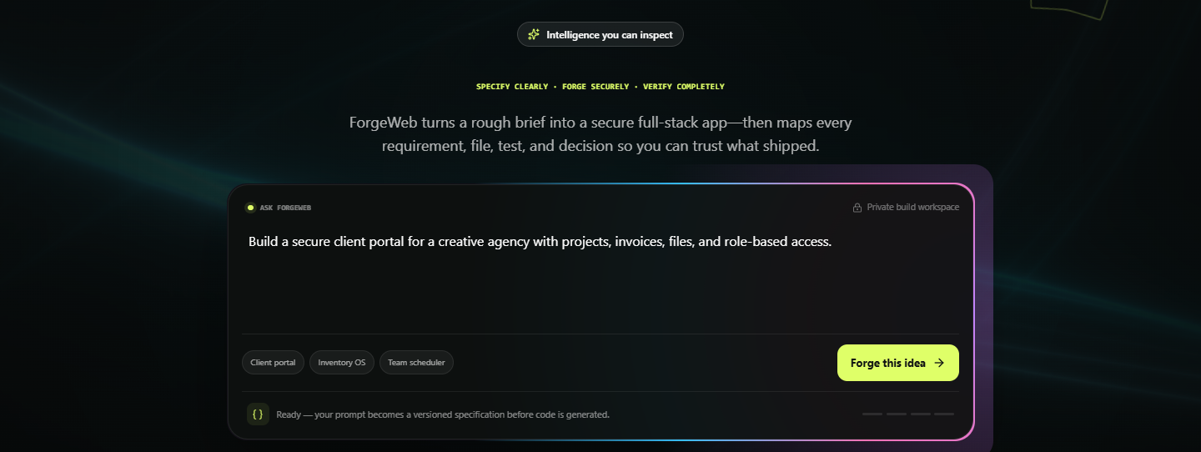
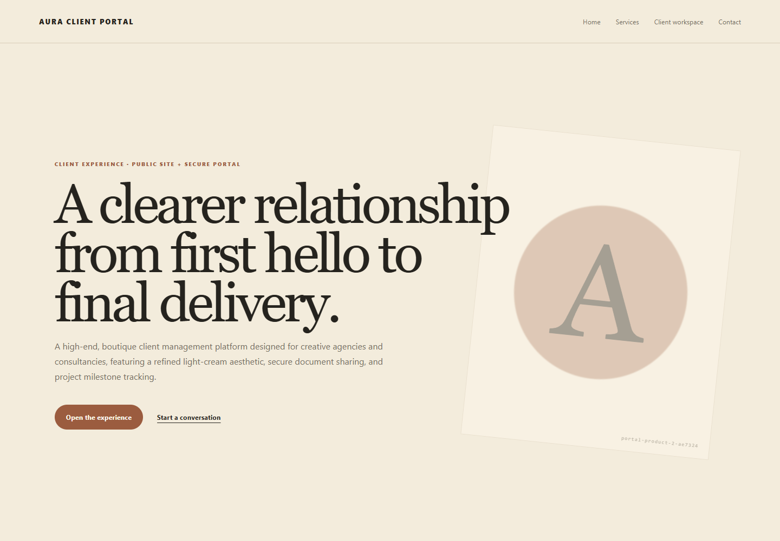
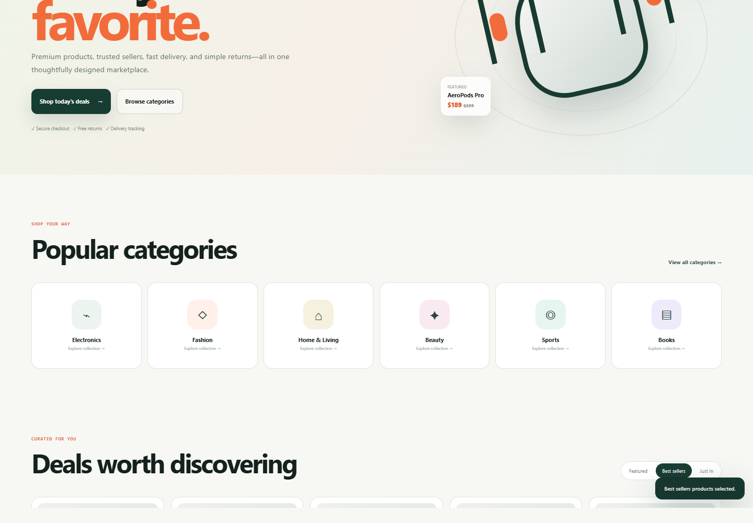
DEMONSTRATION OF PROJECT EXECUTION
Working flow
• Enter a product idea in the prompt box.
• Review requirements and ARCHITECTURE.md.
• Edit the prompt or confirm generation.
• Open frontend, backend, contract, and test files.
• Run the responsive preview and save a version.
Implemented stack
React 19 • TypeScript • Vite • Node.js • FastAPI output • Playwright • GSAP • Anime.js • Three.js
ForgeWeb prompt and architecture-first entry point
Prompt-specific client portal
Prompt-specific e-commerce site

Slide 11
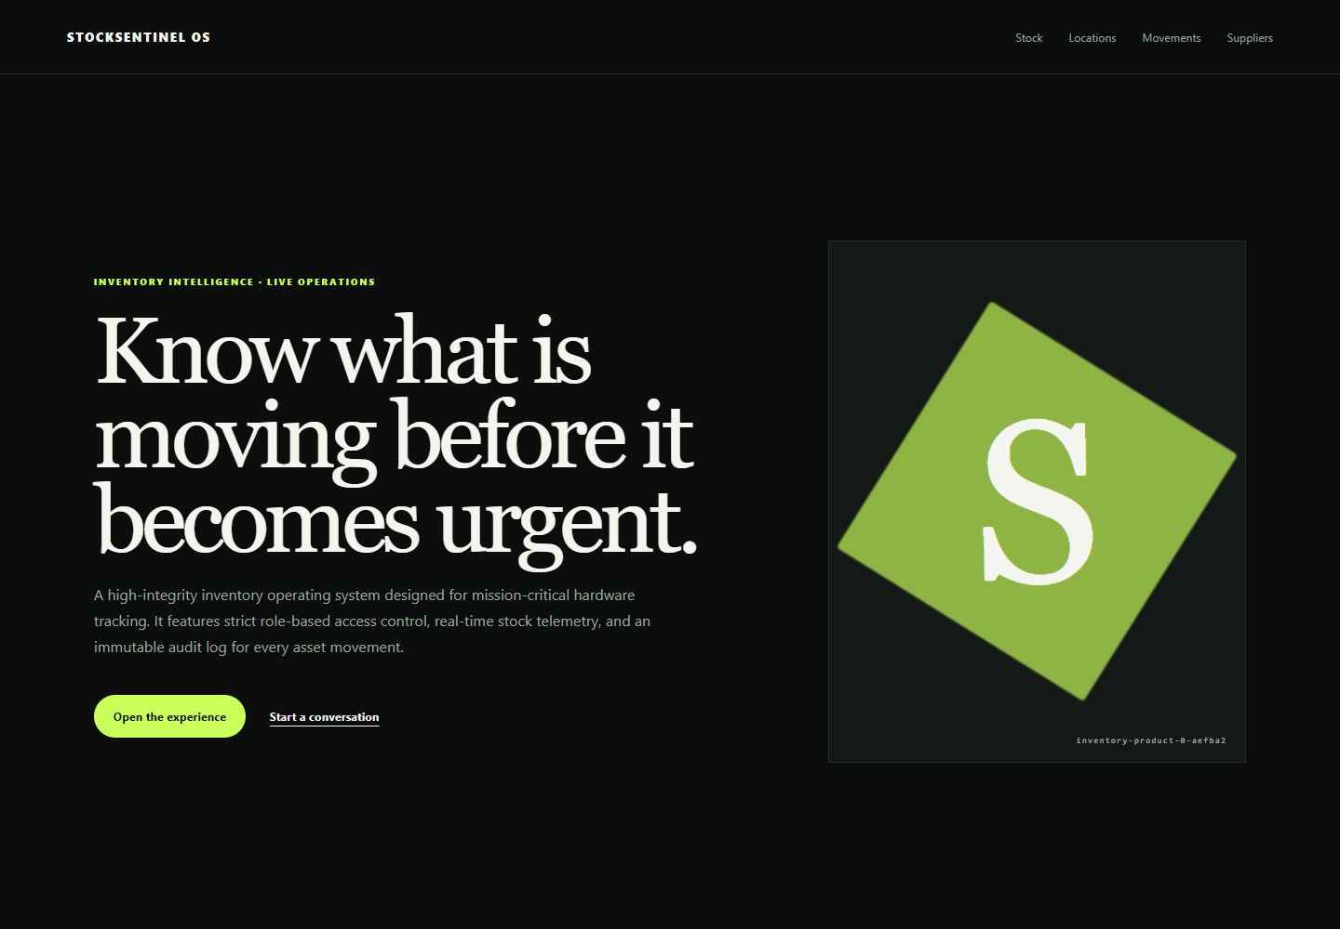
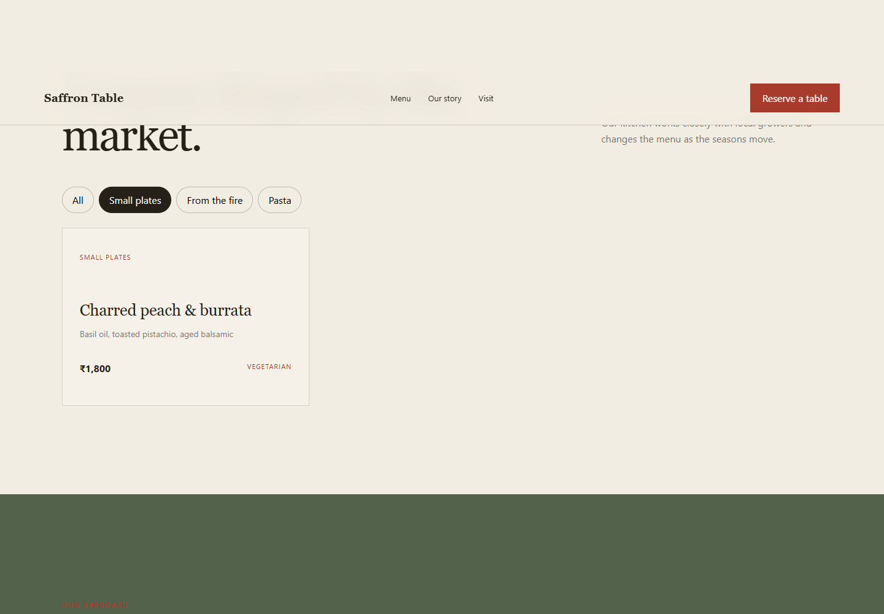
EXPERIMENTAL SETUP, RESULTS & ANALYSIS
Experimental setup
The platform was tested with prompts for portals, online stores, restaurants, inventory systems and schedulers. Each generated site was checked in the browser for layout, responsiveness and working controls.
Results
The websites followed the requested product type, content and visual direction. Navigation, forms, search, file viewing, preview and project actions worked as intended.
Analysis
Different prompts created visibly different applications instead of one repeated interface. Provider fallback also kept generation available when a model could not respond.
Inventory system
Client portal
E-commerce platform
Restaurant booking

Slide 12
PROJECT STATUS, CONCLUSION
Completed
• Architecture-first workflow with a mandatory approval gate.
• Prompt-specific frontend, backend and controlled AI fallback.
• Files, preview, history, versions, restore, delete and export.
• Browser, API and workflow checks for reliable generation.
In Progress
• Integrating an OpenAI API key and a stronger code-generation model for more complex projects.
Next Phase
• Hosted deployment, external Git synchronization and production database adapters.
ForgeWeb turns a product idea into a working, reviewable full-stack project.

Slide 13
PUBLICATIONS & REFERENCES
Publication status
• Paper draft in preparation: ‘ForgeWeb: Architecture-First Prompt-to-Full-Stack Generation with Traceability.’
• Target venue will be selected after the complete Phase-2 evaluation; the paper has not yet been submitted.
References (IEEE format)
[1] T. Thuy and contributors, ‘Code Review Graph,’ GitHub repository, 2025. [Online]. Available: https://github.com/tirth8205/code-review-graph
[2] G. Tan, ‘gstack,’ GitHub repository, 2026. [Online]. Available: https://github.com/garrytan/gstack
[3] multica-ai, ‘andrej-karpathy-skills,’ GitHub repository, 2026. [Online]. Available: https://github.com/multica-ai/andrej-karpathy-skills
[4] Meta Platforms, Inc., ‘React Documentation,’ 2026. [Online]. Available: https://react.dev
[5] S. Ramírez, ‘FastAPI Documentation,’ 2026. [Online]. Available: https://fastapi.tiangolo.com
[6] Google, ‘Gemini API Documentation,’ 2026. [Online]. Available: https://ai.google.dev

