Slide 1


BMS INSTITUTE OF TECHNOLOGY AND MANAGEMENT YELAHANKA BANGALORE
Department of Computer Science & Engineering
Major Project Phase 2 Review 2 Presentation
FORGEWEB
Schema-First AI Web Application Generator
Pratyush Manas • 1BY23CS163
Rajeev Kumar • 1BY23CS171
Sachin Yash Raj • 1BY23CS192
Sanaa Kumari • 1BY23CS202
B.E. — Computer Science and Engineering
Guide name / designation: to be confirmed
2026–27

Slide 2
CONTENTS
01
Overview & objectives
02
Methodology & diagrams
03
Algorithms & setup
04
Demonstration & results
05
Engineering & management
06
Conclusion & references

Slide 3
ABSTRACT
ForgeWeb helps users turn a plain-language idea into a full-stack web application. It prepares requirements and an architecture file for approval before generating code.
A schema-first pipeline connects React interfaces, FastAPI models and SQLite storage. Saved checkpoints protect completed work when generation stops.
Local checks compile the frontend and test API behavior and persistence. The aim is to make generation more dependable while clearly reporting what has and has not been verified.

Slide 4
INTRODUCTION
• Full-stack development connects the interface, server logic and database.
• AI can produce code quickly, but separate files may disagree about routes, fields or validation.
• ForgeWeb provides an approval-led workflow for planning, generation, preview and inspection.
• The current reliability target is React, Python FastAPI and SQLite.
• The platform keeps project history and supports bounded, checkpoint-based recovery.

Slide 5
MOTIVATION
01
Students and small teams often spend substantial effort setting up repeated application foundations.
02
A generated page is useful only when its actions connect to working server behavior.
03
Failures should preserve progress rather than force users to restart.
04
Users need clear evidence of real saves, valid responses and durable data.
05
ForgeWeb combines faster prototyping with visible engineering checks.

Slide 6
PROBLEM STATEMENT
Users need a practical way to build web applications from natural-language requirements without manually coordinating every interface, API and database detail. However, generated components can use inconsistent field names, incompatible category values or missing storage dependencies. A page may compile and still fail when a user submits a form.
The problem is therefore to create an approval-led generation workflow that preserves the user’s requirements, maintains a consistent full-stack contract, saves partial progress and verifies observable behavior before presenting the application as working.

Slide 7
OBJECTIVES OF THE WORK
01
Create a clear architecture file from the user’s requirements.
02
Generate source only after the proposed plan is approved.
03
Derive shared types and server models from one schema.
04
Connect React actions to FastAPI routes and persistent SQLite data.
05
Preserve checkpoints and support controlled recovery.
06
Test compilation, API workflows, validation and persistence.
07
Report failures and unverified behavior honestly.

Slide 8
METHODOLOGY
1. Understand the prompt and prepare requirements and architecture.
2. Ask the user to approve or revise the proposed plan.
3. Freeze a machine-readable schema for routes and data models.
4. Generate shared bindings, frontend pages and backend services.
5. Save accepted files as durable checkpoints.
6. Run isolated compilation, API and persistence checks.
7. Show source, preview, version history and verification evidence.

Slide 9
SYSTEM ARCHITECTURE
USER LAYER
Prompt + approval
Files • preview • history
Budget / status
FORGEWEB CONTROL PLANE
ISOLATED GENERATED APP
Schema stage
Models + routes
Typed bindings
TS client + Pydantic
React → FastAPI
Code generation
Bounded file tasks
Verification gate
Compile + API checks
SQLite
Application records
Provider/design services supply reference and source. Checkpoints and graphs stay project-scoped.

Slide 10
DFD — CONTEXT LEVEL
Requirements
Bounded tasks
USER
Prompt / approval
0. FORGEWEB
Plan • build • verify
MODEL / DESIGN
Source / reference
Artifacts / status
Generated files
Save
Recover
D1: PROJECT STORE
Files • versions • evidence

Slide 11
DFD — LEVEL 1
1. Plan & approve
2. Freeze contract
3. Generate source
Frozen state
Accepted files
5. Present results
Preview / failure
Evidence / errors
4. Verify
API + persistence
D1: Checkpoints
D2: App data
Restore

Slide 12
SEQUENCE DIAGRAM
User
Workflow
Model
Verifier
SQLite
1 Prompt
2 Proposed plan
3 Approve
4 Schema / source
5 Complete files
6 Save checkpoints
7 Run workflows
8 Evidence
9 Preview / failure

Slide 13
TRANSACTION FLOW
Validate payload
BEGIN IMMEDIATE
Write + audit
Same connection
Yes
All writes
successful?
No
Return success
After commit
COMMIT
Confirm save
ROLLBACK
Safe error
Invariant: related records are saved together, or none of the changes are retained.

Slide 14
ALGORITHMS USED
• Schema validation checks types, references and routes before generation.
• Deterministic bindings create matching TypeScript and Python models.
• Checkpoint recovery reuses accepted files after an interruption.
• Workflow verification checks responses and persistent data.
• Graph retrieval selects relevant code for scoped reviews and edits.
• Budget checks stop requests that cannot fit the approved allowance.

Slide 15
EXPERIMENTAL SETUP
Software
React and TypeScript; Python FastAPI; SQLite; Docker; Playwright; local Graphify.
Hardware
Intel Core i7-11800H, 16 GB RAM and NVIDIA RTX 3050 Ti laptop GPU.
Test environment
Isolated containers, disposable test databases and synthetic records. External generation uses server-side credentials; secrets are excluded from source and exports.

Slide 16
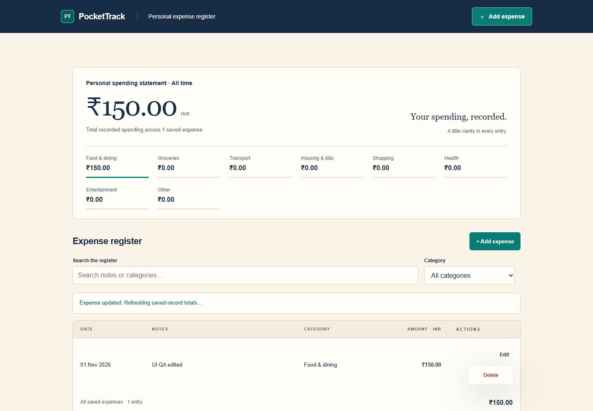
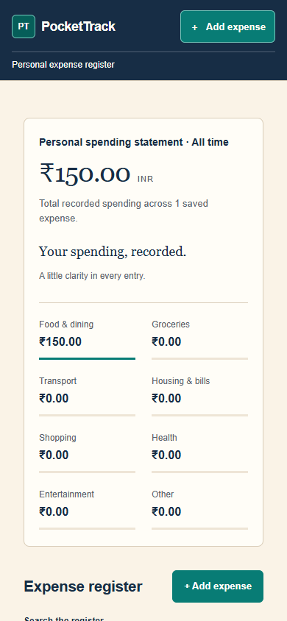
PROJECT DEMONSTRATION
PocketTrack: desktop and mobile views from the tested, repaired demonstration project.

Slide 17
TEST CASES
• Contract tests reject mismatched enums, routes and request models.
• CRUD tests check real create, read, update and delete behavior.
• Input tests reject invalid values and undeclared fields.
• Transaction tests check rollback and concurrent writes.
• Restart tests distinguish SQLite persistence from in-memory state.
• Recovery and export tests protect accepted work and reject invalid versions.
Evidence: local suites and isolated fixtures passed; fresh paid model generation remains unverified.

Slide 18
RESULT ANALYSIS
What improved
Shared bindings reduce inconsistent data definitions. Checkpoints retain progress. Business-route tests catch failures hidden by a healthy startup.
What the evidence does not prove
Passing local fixtures does not guarantee every future prompt will succeed. API workflow checks do not replace browser tests for every interface.
Current boundary
The supported schema subset and direct Sol path are implemented; further live acceptance requires a controlled, approved run.

Slide 19
SDG ALIGNMENT
SDG 4 — Quality Education
Supports learning by making architecture, code and test evidence visible to students.
SDG 9 — Industry, Innovation and Infrastructure
Explores reusable application foundations and more dependable software prototyping.
Assessment boundary
These are qualitative project links, not measured social-impact claims. Department-specific SDG scoring metrics were not supplied and must be confirmed before submission.

Slide 20
ENGINEERING CHALLENGES
01
Reconcile an open-ended prompt with a precise, executable contract.
02
Coordinate independently generated UI, API and persistence code.
03
Balance output limits, response time, test coverage and API cost.
04
Preserve state when models, storage or runtimes fail.
05
Isolate generated code while still providing a usable live preview.
06
Distinguish convincing output from evidence of correct behavior.

Slide 21
MANAGEMENT & FINANCE
Completed work
Planning, source generation, SQLite storage, checkpoint recovery and verification gates.
Current work
Fresh-generation acceptance and wider browser scenarios.
Resources and controls
Existing team hardware and open-source tools. Model calls follow an approved allowance; the local budget guard stops requests that cannot fit.

Slide 22
CONCLUSION & FUTURE WORK
ForgeWeb connects planning, code generation and observable verification in one workflow. The key lesson is that a good-looking interface and valid source are not enough: the complete data flow must work.
Next steps
Run bounded fresh-generation acceptance tests; broaden independent browser scenarios; improve supported schema coverage and performance measurements. Additional stacks remain future work.
A universal or 100% generation-success claim is not supported by current evidence.

Slide 23
REFERENCES — IEEE STYLE
[1] M. Chen et al., “Evaluating Large Language Models Trained on Code,” arXiv:2107.03374, 2021.
[2] Y. Li et al., “Competition-level code generation with AlphaCode,” Science, vol. 378, no. 6624, pp. 1092–1097, 2022.
[3] B. Rozière et al., “Code Llama: Open Foundation Models for Code,” arXiv:2308.12950, 2023.
[4] J. Liu et al., “Is Your Code Generated by ChatGPT Really Correct? Rigorous Evaluation of Large Language Models for Code Generation,” NeurIPS, 2023.

Slide 24
PUBLICATION STATUS
• A project research-paper draft and LaTeX source have been prepared in earlier project work.
• No journal acceptance, conference acceptance or indexing status has been verified.
• Publication venue and submission details must be confirmed by the team.
• Replace all pending academic details before final submission.
• Presentation wording is original and project-specific; no plagiarism-detector score is claimed.

