Slide 1
Rao Birender Singh State Institute of Engineering & Technology, Zainabad (Rewari)
Project Name: Attendance Management System (attend2.web.app)
Name: Sachin Thakur
Branch : CSE
Year: 1st
Roll no:191251015012
Project Incharge: Kamal Sluja

Slide 2
Introduction
It is a Students Attendance Management System. In which College admin, Teachers and Students have their account. Teachers are allowed to take attendance through Mobile app. Teachers have only permission to take attendance and edit it. And Students can see their attendance.

Slide 3



Working Diagram
Connected
to
Students Account
Connected
to
Teachers Account
Admin
Admin/College Account
FirebaseDB
Mobile App for Teachers to take attendance
Teachers / Students / Admin Dashboard

Slide 4
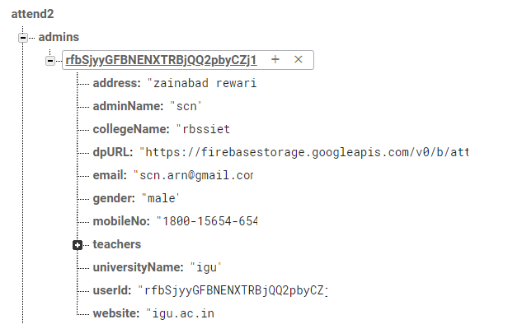
Data Structure
Unique Id

Slide 5
Working Principle
Real Time Database
Cloud Storage
No SQL Data Structure
No server
Free of cost
Single Database for All Device (IOS/Android/Web/Unity)
Easily can get Analytics as well as Crashlytics.

Slide 6
Usefulness And Future Scope
Teachers, Students/Parents and Admin all can see their Record.
Less Paper work
Management of Files and Register become Easy (No Register – No Management cost)
Easy to Search.

