Slide 1


Full Stack-Web Development – React JS
-by Sachin Barpanda

Slide 2

React Intro
React is a library
React has React-Dom for browser app , React-Native for Mobile app.
We have npm(node package manager) to get the stater files for React.
We can use npx create-react-app –filename– (but this is slower and bulky)
We can run this file using start script ( npm run start).
When we build the project, it serves us the html ,css , js files (npm run build).
Delete reportVitals, logo, app.test and css files.
So we will use npm create vite@latest (lighter package and faster)
Here it asks name , framework and language to choose
Get react and javascript , we can get the project done now.
To get node modules , we then have to go into the project and run (npm i)
To run this we use run script (npm run dev) .
Delete logo and css files .

Slide 3
React Intro
Remember we cannot render any files without Html , Css , JS.
React only does that under the hood.
In Create-React-App the id=‘root’ is mentioned in html .
This id is used in the main index file to render the react app.
App renders HTML through JS , thus we get to programme HTML directly.
Here react-script scripts are responsible for injecting elements inside webpage.
1. In vite the script tag is injected from the beginning.
2. We can create our own jsx file at this point and render it in main.jsx in vite.
3. Make sure to keep files name capital.
4. React converts the elements to DOM tree using React Dom Object.

Slide 4
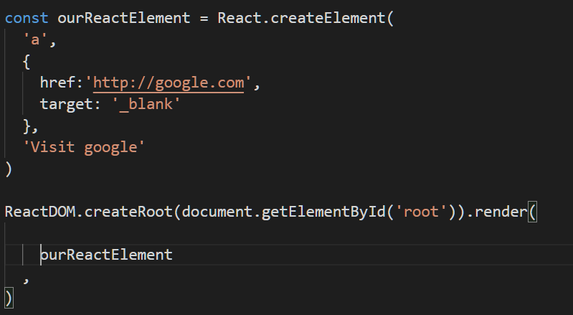
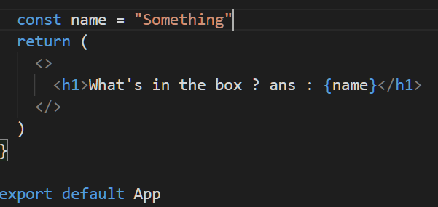
Create React Element
Under the hood react elements are nothing but JS objects.
So whatever tags we write they are converted to Objects and then rendered.
React provide a method createElement we can use to make our own element.
To declare variable we have to use { } inside the tag , this is called ‘evaluated expression’ and the elements which contains it are called ‘expression’.

Slide 5

useState() hook
We will observe it using a counter app.
We have to call the counterFunction when onClick().
But this will not show up in the UI.
Because react reacts to changes and it tries to control what to show up in the UI.
Thus we need react’s hooks to make changes in the UI.
UseState change state of our UI,
15 is the default value.
counter is the variable we are using.
setCounter changes counter on demand.
It also gives us a callback which returns the previous value which we can update on the go . (interview ques)

Slide 6
Understanding Fiber (Link to source)
Now a days Virtual Dom is not being used in react , instead fiber is being used which helps in incremental rendering. i.e to split render into chunks and spread it over multiple frames.
Also the ability to pause , abort , or reuse new updates and to assign priority to updates during hydration (coming up of JS) .
Reconciliation : algorithm to diff one tree with another to determine which part need to be changed.( tree from CreateRoot)
Update : A change in data used to re-render a react app ( like setState).
Reconciliation is behind the scene known as Virtual DOM.
Fiber takes different approach :
i . Different Component generate different keys , due to this a complete new tree is generated.
Ii . Keys are used so that the performance is uplifted.
(Read Docs from the link for more understanding of Fiber).

Slide 7
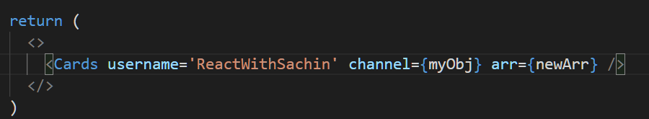
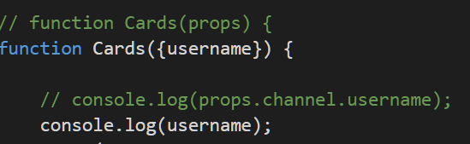

Learning Props with Tailwind CSS
React tells us not to segregate on the basis of technology rather functionality. Thus we use component based on the type of work they do.
Props are the values that can be passed from where we are calling to another called component.
We can pass variable, object,
and arrays in it.
4 . Now use it inside the component
5. If someone didn’t pass any value then use default value like in function argument in JS.
You can pass other values and play with it yourself.

Slide 8

Background Color changer
UseState firstly
Use style to change the background color using
In it’s child class make a color pallet to keep all colors
And in the color pallets define all the colors
onClick accepts a function only , so we can’t use setColor directly , so we use a callback function to call setColor this will not break the code.
Make the rest of the colors like pink , yellow , olive , cyan and your choices.
Do CSS to your hearts content

Slide 9
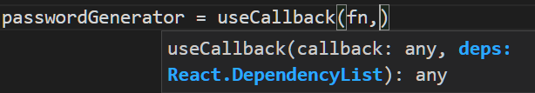
Password Generator using useCallback, useEffect & useRef
First make 3 hooks for slider , character and numbers. And 1 for password
useCallback : helps us to only render what we have changed and not everything, like here we have character and number checkbox.
Give ‘Dependency List’ to govern in which values the caching and re-render will happen. It will include the 3 hooks and setPassword.
Inputs will be taken and in range and checkboxes onChange will be given a callback where the desired results will be given to the input fields.
Now we have to generate Password , if we call it directly we are violating react, how ? Because in react we never control what to render it is done by react .
So to achieve this we will use useEffect().
To use copy we can use useRef() which takes reference from any item.

Slide 10
Building our own hook with currency converter
Hooks are nothing but function. So we will be making a hook of our own which will fetch data when a currency is passed into it.
Simply , just use useEffect() and make a dependency on currency call , use fetch to get data , use useState() to setData and return data from the function and at the end return the entire function .
Note : Use (‘use’ keyword to make your own hook too )
Use the UI given in the github to make the first component CSS , then get methods and the variables from the props.
Set label , use amountDisable for input to disable any layout , value to input amount and apply onChange on onAmountChange to take ‘Number’ values.
Set value of the select option field to selectCurrency and onChange to onCurrencyChange to pass the selected string (e.g “inr”, “usd” , etc.)
Make a index.js for component folder.
UseId( ) makes things even more optimize. Just bind it with the label and inputs in the component.

Slide 11
Building our own hook with currency converter
Now in App.jsx use the hooks for amount , from ,to , convertedAmount and our custom made hook for currency Info.
Then we will get all the keys using Object.keys(currency Info).
Try making swap yourself…
Make a convert function to convert amount from one currency to other.
Put setAmount value when onAmountChange.
Pass the 2 input with relevant values and swap button in middle. And when onSubmit is called then convert triggers.

Slide 12
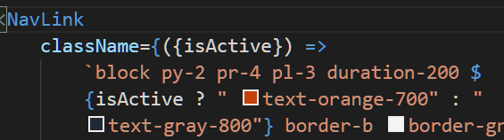
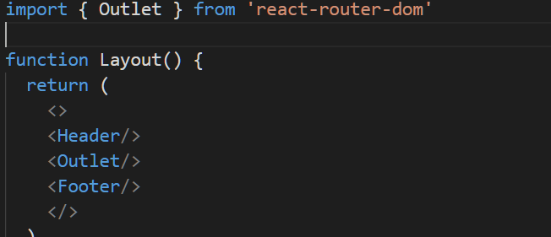
React Router DOM
It is a third party tool that will be integrated in React.
First install RRD, then get the header and footer UI from Github.
Import Link and NavLink from ‘react-router-dom’.
Link is used instead of ‘a’ tag in React. (since page doesn’t refresh in react.)
And ‘href’ replaced with ‘to’
NavLink will enable us to highlight the page we are currently in .
Now we don’t need App.jsx we need to make router in main.jsx
Let’s make a Layout.jsx where we
will insert router components inside
static components, using Outlet
which helps us in specifying location
of varying files .

Slide 13
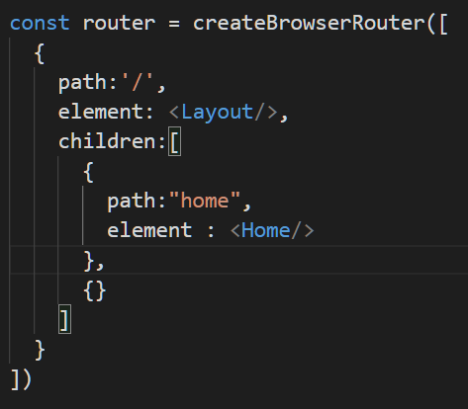
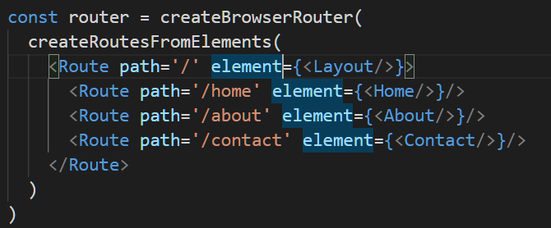
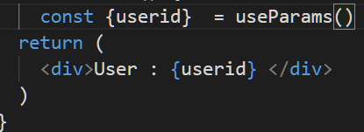
React Router DOM
Now we can make the routers using
createBrowswerRouter.
10. Now create about section and do the same.
11. Another way of doing this is :
Then we experiment how to get params
First get the route for userid and put ‘:’
13. Then we can use a hook useParams()
which gives us userId

Slide 14
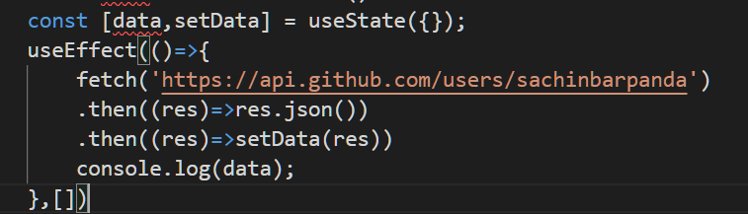
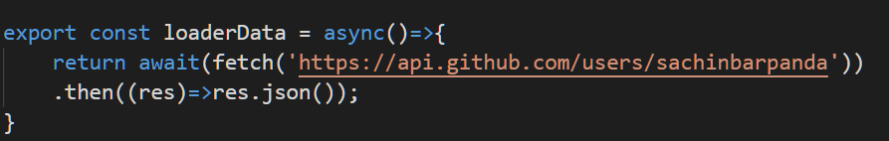
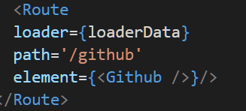
React Router DOM
Now let’s see how to fetch data from Github api and use it in our webpage.
10. One way is using useEffect and fetch
the data the set data using UseState.
11 . Another optimized way of doing it
Is by using a hook useLoaderData().
First make a loaderData function in Github , then use it in the loader in main.jsx .
Then use useLoaderData() to get data and set it in your UI.

Slide 15
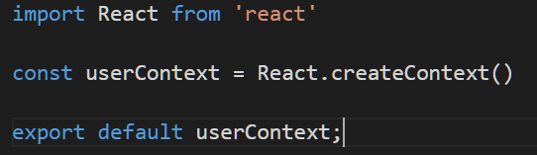
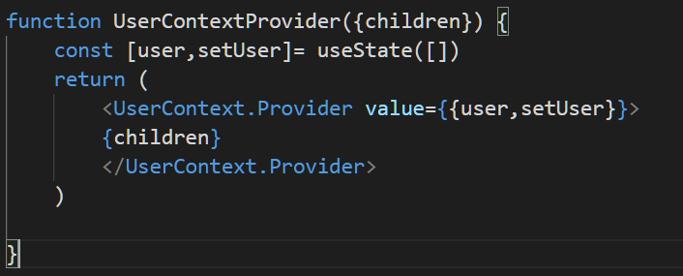
Context API
There is a big problem in earlier version of react is that when we have to pass a prop through multiple component that are inside one another then we have to go into each one , one after the other. This is known as Prop Drilling.
To Prevent this Context API has been introduced. We are gonna built a project to under this.
After creating a base project , make a folder context and make a userContext.js
Inside it create Context .
Context gives us a provider which can wrap and gives us access to data to all components.
Now we have to make a provider which
will get the access of the children and wrap
it inside the provider.

Slide 16

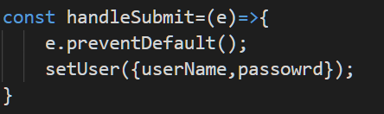
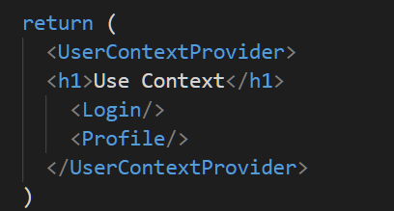
Context API Continued…
Now lets make a login , by first make two input fields and a button which triggers on onClick event .
Then make 2 setState for username and password and set them on onChange .
Now use useContext in which userContext you made earlier.
When the onClick triggers then first preventDefault();
then setUser with username and password.
Now our data can be passed directly from this component to another without passing the props to one another using useContext();
Just useContext to get the user and use it in the profile app.
In App.jsx wrap login and profile inside the
UserContextProvider.

Slide 17
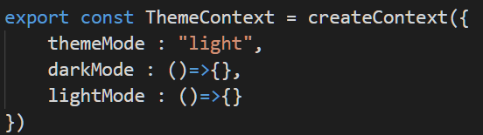
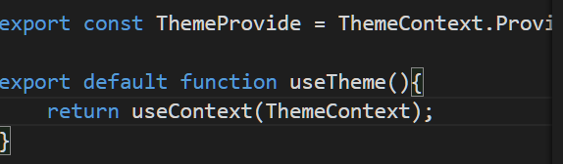



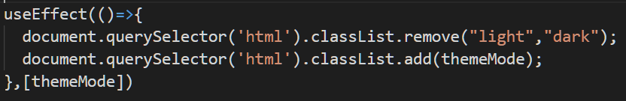
Context API 2nd way (Theme Switcher)
Make a context for theme.js
First Create a themeContext with default
themeMode and 2 methods light and dark mode.
Then make a ThemeContext.provider ,
also make a function useTheme() which return
useContext with themeContext in it .
Wrap the objects in App.jsx and get the values, use functions of darkMode and lightMode to enable the values that are being passed.
Write useEffect to run it once the app starts and change the themes in HTML
Now make 2 component of button and card and get the component from online themes.

Slide 18
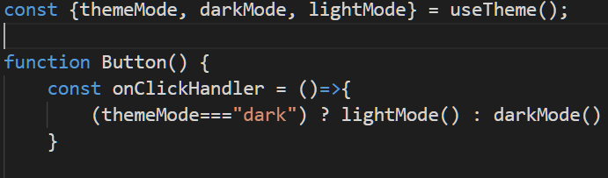
Context API 2nd way (Theme Switcher)
Now make a onClick in the button which uses context to get the value and now you can make changes in the UI, using this .
And make sure to config the tailwind config because we have to enable dark mode class there.

Slide 19
Context API Complex (To Do List)
First make the basic TodoContext and return useTodo and a provider for it.

