Slide 1


Full Stack-Web Development - CSS

Slide 2

CSS Intro
3 Ways of Declaration
Inline -> As style attribute
Internal -> As style tag
External -> As separate file
Inline css : property
key : value pair is used.
e.g color:violet, border:2px solid red

Slide 3
CSS Intro
Internal css
made with tag inside head tag
p{
key:value;
}
eg. backgroud-color: aquamarine;
text-decoration:underline;

Slide 4
CSS Intro
External css
New file made with link inside head tag
Tag : link
Attribute: rel-> relation
p{
key:value;
}
eg. backgroud-color: cornflower;
text-decoration:line-through;

Slide 5
CSS Intro
I
Specificity
Inline>Internal>External
Selectors
Basic Selectors
Advance Selectors

Slide 6
I
Basic Selectors (categorize to 5 types)
Element selectors (eg. p,div,h1)
Id Selectors (eg. Id=“name” ->
#name{
background-color:purple;
}
Note: Do not repeat id name

Slide 7
I
Basic Selectors (categorize to 5 types)
iii. Class Selectors(eg. Class=“className”->
.className{
border:2px solid orange;
}
Note: We can repeat class names

Slide 8
I
iv. Attribute Selectors
eg.href=“www.google.com”->
a[href=“www.google.com”]{
font-size:200px;
}
eg. <input type=“text”>->
input[type=“text”]{
border:2px dashed red;
}

Slide 9
I
Universal Selector
*{
border:2px solid yellow;
}
Note: It selects everything
Specificity:
Inline>id>class>element

Slide 10
I
Advance Selectors (categorize to 4 types)
Combinators
Pseudo Classes
Structural Pseudo classes
String Matching

Slide 11
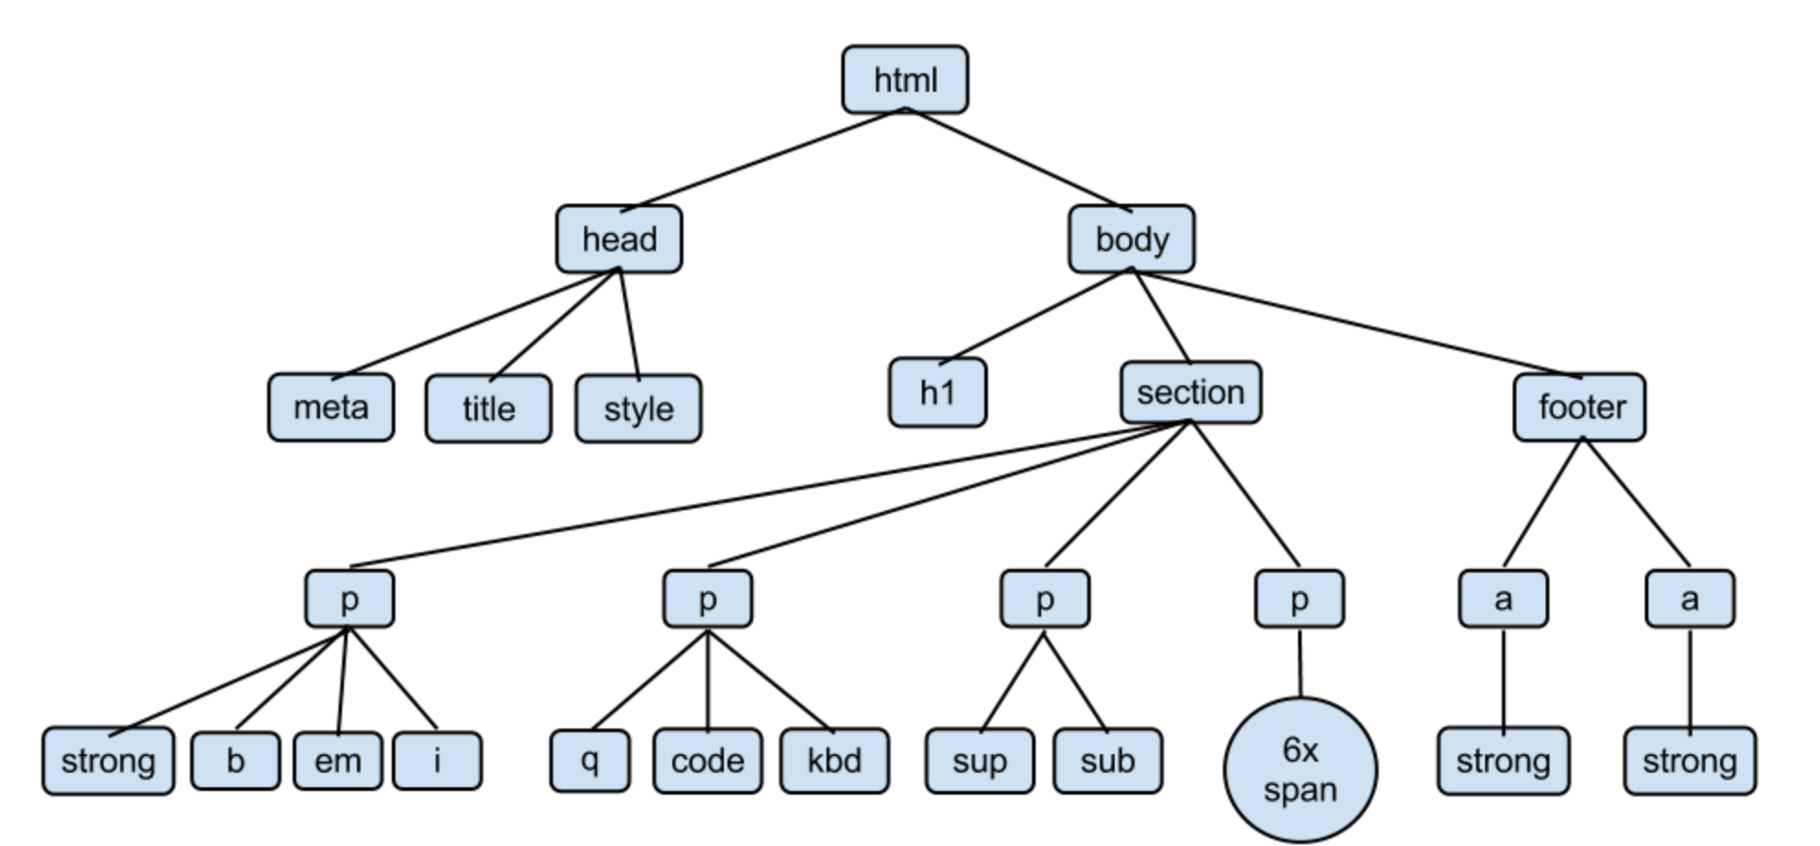
I
HTML is the root element
Here,
->p tags are the descendent of
Body.
->And sibling among themselves.
->strong,b,em are also descendants
of body.
->strong,code,sup,sub are general
siblings.

Slide 12
I
Advance Selectors
Combinators : Combination of 2 things
i. Descendants
-> a ‘space’ in between them means a descendent.
-> it works on any level.
ii. Child
-> we have to use ‘>’ to denote child selector.
-> it do not work on all level.

Slide 13
I
Combinators
iii. Adjacent Sibling
-> it is denoted via ‘+’
-> only one tag is selected that comes after element.
iv. General Sibling
-> it is denoted via ‘~’(Tilde)
-> all the tag is selected that comes after element.

Slide 14
I
Advance Selectors
Pseudo Classes
:hover
:active
:visited
:nth of the type(odd,even)
:first-child,:last-child
:focus

Slide 15
I
nth of the type
:nth-of-type(an+b)
an+b->cycle formula
an-> intervals
b-> offset

Slide 16
Pseudo Elements
A CSS pseudo-element is used to style specified parts of an element.
-> It doesn’t work on inline elements.
p::first-letter
p::first-line
::after (don’t affect inline elements)
::before
Css-property : content: ‘\1F4F1’ (CSS Unicode)

Slide 17
String Matching
1.Starts with : ^=
Eg. a[href ^= “https”]
2.Ends with : $=
Eg. a[href $= “com”]
3.Present anywhere : *=
Eg. a[href *= “google”]

Slide 18
Inheritance
Child adapt properties of parents.
Works on : color, font-size, background-color
Doesn’t works on : border
Colors
Primary Colors : R G B
How many colors are there?
R G B takes -> 1byte ->8bits
Thus we have => 2⁸ * 2⁸ * 2⁸ = 16Million Colors

Slide 19
Colors
Ways of Declaration of colors
Hexadecimal: R G B #(0-f, 0-f) ,(0-f ,0-f) ,(0-f ,0-f)
RGB : rgb(0-255, 0-255, 0-255)
RGBA : rgba(0-255, 0-255, 0-255 , 0-1)
Explore more colors scheme for your projects.

Slide 20
Box Model
It treats every element as a rectangular box.
Properties of box model:
1.Dimension (height & width in 2d)
2.Border (dashed, dotted and solid)
3.Margin
4.Padding

Slide 21
Margin
Space between 2 elements.
Margin-top
Margin-right
Margin-left
Margin-bottom
Shorthand: Top right bottom left (in clockwise direction)
Top-bottom right-left
Top right-left bottom

Slide 22
Padding
Space inside the selected element.
Padding-top
Padding-right
Padding-left
Padding-bottom
Shorthand: Top right bottom left (in clockwise direction)
Top-bottom right-left
Top right-left bottom
Note : These works properly only on block element.

Slide 23
CSS Units
It is ways of measurement
2 types are present
1.Absolute : These are fixed and don’t show responsiveness.
2.Relative : %, em, rem, vh , vw
Absolute way
1. px : most commonly used.
2. cm , mm and inch : these are only used in big screens and posters.

Slide 24
CSS Units
Relative way
% : relative to its parent.
2. em : it is also relative to its lexical parent and inherit their properties.
Due to this it shows ‘Snowball effect’.
3. rem : it is relative to it’s root and inherit their properties.
Due to this it avoids ‘Snowball effect’.
4.vh : view-height and vw : view-width (here view stands for viewport.

Slide 25
Box Model (Display)
Display : Block -> It works on Box Model.
Display : Inline -> Doesn’t works on Box Model.
Display : Inline-block -> to make box model work on element showing inline elements we use .
Display : none-> Items become invisible and it won’t take any space.
Visibility: hidden -> Items become invisible and it won’t take any space.

Slide 26
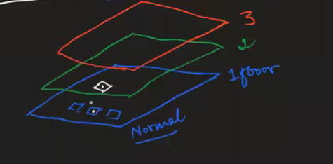
Positions
We have 4 offsets top bottom left right.
There are 5 properties positions present:
1.static: It doesn’t leave it’s normal flow.
2.relative: It changes it’s position with respect to its previous position.
3.absolute: It comes out of its normal flow
and it changes position with
respect to most recent positioned
parent.

Slide 27
Positions
There are 5 properties positions present:
4.Fixed: i. Aligned itself to respect of the body.
ii. It will take the offset and not move from their.
iii.It is not dependent on parent element.
iv. Can use any position except static.
5.Sticky : i. Mixture of 2 positions -> relative and fixed
ii. It depend on parent’s height.
iii. It will offset acc. to your viewport.

Slide 28
Task : Make a navbar
Do it yourself
Solution:
Make a list of elements and make it horizontal.
Put it inside nav tag and put nav tag inside section tag
Now section tag is the parent so we can use sticky in nav tag and give offsets to make it work.
Style for better results.

Slide 29
Font
Properties:
1.font-family-> serif, san-serif, cursive, monospace, fantasy
2. font-size-> any size (css units)
3. font-weight -> (range -> 100 – 900)
4. font-style -> italic
5. line-height -> any size (css units)
6. letter-spacing -> any size (css units)

Slide 30
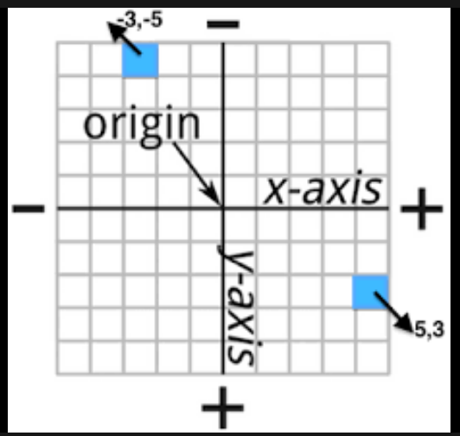
Text Shadow
text-shadow: x y sharpness color
->We can use multiple shadows to make a chain.
Box Shadow
box-shadow: x y sharpness color
Same properties of text shadow can be applied here.

Slide 31
List Properties
list-style-type: circle, square,(also css-unicode)
list-style-position: inside/outside
Shorthand
list-style: list-style-type list-style-position

Slide 32
Overflow properties
1.white-space: wrap/nowrap
2.overflow: hidden/scroll
3.text-overflow: clip/ellipsis;
To make it look better, use
‘overflow : scroll and text-overflow: ellipsis;’
only in hover.
max-width: If viewport crosses that limit it shrinks the element.
min-width: After this limit the element can overflow.

Slide 33
Clear And Float
Also used to get out of normal flow.
Float : Gets out of the normal flow and places itself w.r.t it’s given direction. (left /right).
Clear : It clears the direction set by the float (left/right).
Task: Make a newspaper article (try it yourself).

Slide 34
Background Images
1.background-image: url(‘--any-image--’);
2.background-repeat: no-repeat
3.background-size: cover/contain
4.background-position: center/right/left
5.opacity: (0-1 range)
6.filter: grayscale (0%-100%)

Slide 35
Flexbox
Property for parent visible on child
When ‘display:flex;’ is applied, 2 axis are created:
1.Main axis (default row)
2.Cross axis (default col)
Properties (Main axis)
1.flex-direction : row(by default)/column/row-reverse
2.justify-content : flex-start/center/flex-end/space-(around/between/evenly)
3.flex-wrap: wrap/nowrap/wrap-reverse

Slide 36
Flexbox
Properties (Cross axis)
1.align-items: flex-start/flex-end/center/stretch(default)
2.align-content: center/flex-start/flex-end/space-(around/between)
Child Properties
1.flex-basis: gives selected child different dimensions.
2.flex-grow : 1 (accepts ratio from remaining space).
3.flex-shrink: 2 (shrinks at specified rate)
4.align-self: center/flex-end

Slide 37
Media Query
@media [target-> (screen , print and all)] and (situations)
Situations e.g.:
1.max-width:800px; (Note: Bigger values will come first)
2.min-width:200px; (Note: Smaller values will come first)
3.Orientation : landscape/portrait
Most Used Breakpoints: 1200px , 991px, 767px, 576px
4. Or : using ‘ , ’ for condition A or condition B
(eg. @media screen and (condition A) , (condition B) )

Slide 38
Transition
Using hover we get abrupt transition. To avoid it we use:
1.transition:2s (shorthand)
2.transition-duration: 2s (duration of animation)
3.transition-delay: 2s (duration before animation)
Specifying transition in only one property
4.transition-property: border-radius
5.transition-timing-function: ease-in, ease-out, ease-in-out, linear
(tip: try using width instead of margin)

Slide 39
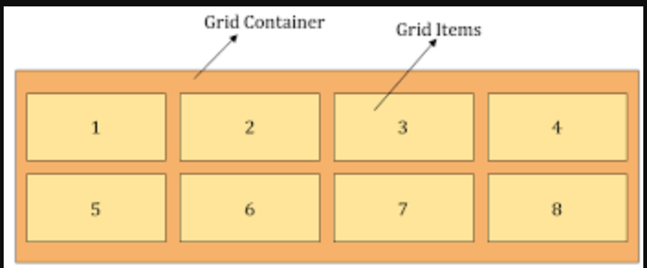
Grid
Grid is the very first CSS module created specifically to solve the layout problems.
Grid Container : Parent’s Properties
Grid Items : Children’s Properties
(grid can be overided with ease)
display: grid;
grid-template-columns: 100px 200px;(set size by columns)
grid-template-rows: 50px 100px 150px; (set size by rows)
grid-auto-rows: 50px ; (unspecified items will take only this size)
grid-auto-flow : column;

Slide 40
Grid Properties
1.display: grid;
2.grid-template-columns: 100px 200px;(set size by columns)
3.grid-template-rows: 50px 100px 150px; (set size by rows)
4.grid-auto-rows: 50px ; (unspecified items will take only this size)
5.grid-auto-flow : column; (where to put unset items (default: row))
6.grid-auto-columns: 50px ; (unspecified items will take only this size in columns)
Span Properties
grid-column: span 2; grid-row: span 2;
grid-column-start:2; grid-column-end:3;
grid-row-start:2; grid-row-end:3; (explore more ways mdn/w3 se)

Slide 41
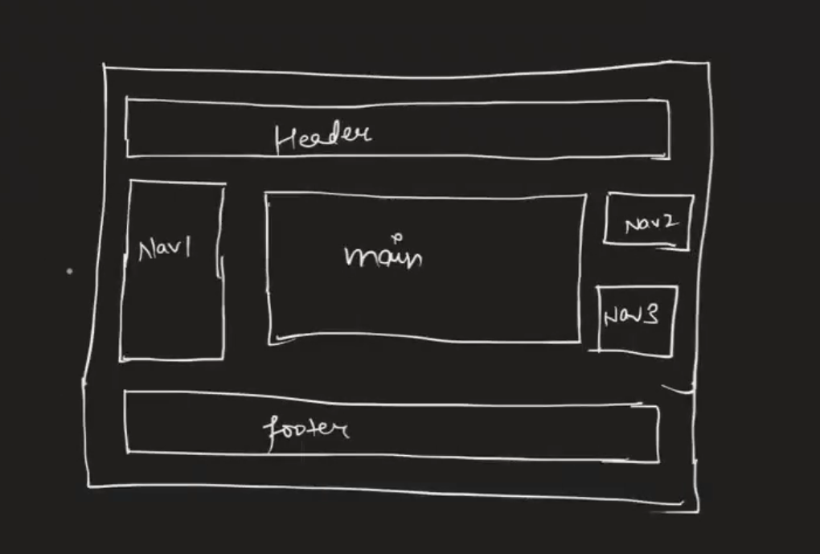
Grid Template Areas link
Simpler way of Grid
1.grid-template-columns: 1fr 5fr 1fr;(fraction of space)
2. grid-template-rows : 1fr 5fr 5fr 1fr;
3.grid-template-areas: “header header header”
"nav1 main nav2"
"nav1 main nav3"
"footer footer footer“;
Give childs individual names in ‘grid-area’ property.

Slide 42
Transform
Changes to an Object
Properties:
1.transform : translateX(400px), translateY(400px), translateZ(400px)
2.transform : rotateX(180deg), rotateY(180deg), rotateZ(360deg)
3.transform : scaleX(1.5), scaleY(1.5), (scale(1.5,1.5)(shorthand))
4.transform : skewX(1.5), skewY(1.5), (scale(1.5,1.5)(shorthand))

Slide 43
Transform
Project : Rotating Card
1.We make 2 faces : Face A and Face B make them absolute
2.Make their parent relative.
3.In FaceA use z-index:1; and backface-visibility : hidden;
4.In FaceB use transform: rotateY(180deg);
5.In parent use transition , transform-style : preserve-3d;
6.in parent’s parent i.e., body use perspective:900px;
7.use hover effect where it is necessary

Slide 44
Animation
@keyframes : key points in animation (e.g. @keyframes -name-)
Now include that -name- and give duration in
1. animation-name: -name-
2. animation-duration:2s
Now for 2 states we can use ‘from’ then ‘to’
But for more we will need 0% to 100% then 20% etc.
3. animation-timing-function: ease-in, ease-out, ease-in-out, linear
4. animation-iteration-count: infinite;(any number)
5. animation-direction: normal, reverse, alternate-reverse, alternate
6. animation-fill-mode: forwards,backwards;
7.animation-play-state: running,paused;(refer mdn for more)

Slide 45
CSS Variables
We make 1 property as varibales and use it anywhere.
Then we make a scope :
:root{ (→root is scope)
--bg-color: red ; (→this is variable)
}
Usage:
.className{
color: var(--bg-color);
}
Why to use ? → DRY - Do not repeat yourself (more preferred)
WET - Write Everything Twice (less preferred)

Slide 46
Bootstrap
It’s a framework.
Other frameworks : 1.Bulma 2.Semantic UI 3. Material UI 4.Tailwind
How to use it?
Via Copying and Pasting CDN-> Content Delivery Network
Container
It is default grid system.
.container-{breakpoint}, which is width: 100% until the specified breakpoint

Slide 47
Grid
Working:
Bootstrap divides the viewport into 12 parts that we can dynamically allocate the contents in our hand.
To use the default way we specify the container class , inside it give a class row and inside it make all the cols you want to set.
To use separate property of space use col-{num}.
Similarly we can use col-(lg,md,sm)-{num} for specifying grids while specifying screen size.

Slide 48
Making a website using Bootstrap.
Take the main parts of a website.
1.Header Main and Footer
2.Take a navbar from documentation.
3.Make Carousel and cards inside the main.(img-fluid)
4.Gutters : To provide spacing between the cards or elements layout.
(e.g. gx-(0-5) , gy-(0-5))
5.We can also include ‘FORM’ ( from documentation )
6.Buttons : primary, secondary etc
7.Spinners
8.Margin : mx and my / Padding: px and py

