Slide 1


Full Stack-Web Development - JS
-by Sachin Barpanda

Slide 2

JS Intro
-made by Brenden Eich
→Adds Interactivity to website
→P.Lang are of 2 types : Interpreted and Compiled
→JS is a Interpreted Programming Language,
i.e. JS is executed line by line
→Browser has 2 engines : Layout and JS Engine
Layout Engine : HTML and CSS , JS Engine : JS for interaction

Slide 3
JS Datatypes
Primitive Datatypes (7 types)
String (we don’t have char ‘-’ and “-” is same for now…)
Number (here we don’t have int, float , long)
Boolean (true and false)
Undefined
null
BigInt
Symbol
REPL -> Read Evaluate Print Loop

Slide 4
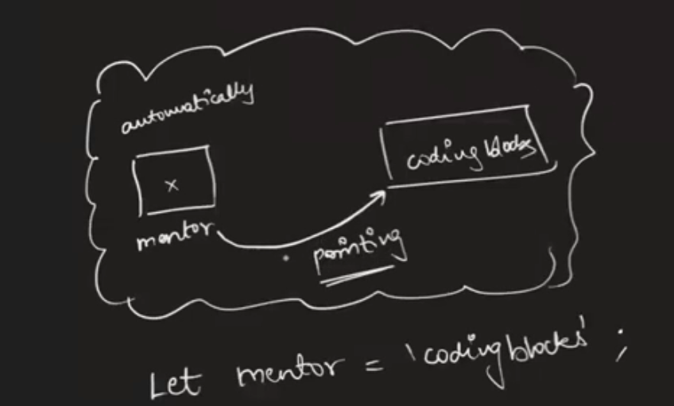
Variables in JS
It is declared using : Let (for now)
Rules :
Cannot start with a number
Can use any alphabet
No spaces in between
No Keywords can be used
only ‘_’ and ‘$’ is allowed in symbols.

Slide 5
Ways of Declaring Variables
1.Normal Case : e.g let firstname = ‘-’
2.Camel Case : e.g let firstName = ‘-’
3.Snake Case : e.g let first_name = ‘-’
4.Kebab Case : e.g let first-name = ‘-’ (only supported by CSS)
Use of ‘\’ : 1.Used to write ‘s inside String
2.\n for new line -> inside file of js

Slide 6
Backticks ( ` ) String Template
Useful in writing string .
e.g let s = `hi there ${firstName} this side`
Number :
We can use add (+), multiply (*),
divide(/) (can also give floating point num),
modulus (%) , pow (**).
Max Num : Number.MAX_SAFE_INTEGER
Min Num : Number.MIN_SAFE_INTEGER

Slide 7
Strings
Q: let str = ‘Hi this is JS’ , str[5] = ?;
H i t h is is JS
idx ->0 1 2 3 4…
dynamically typed -> variable type is understood in run-time.
statically typed -> variable type is understood in compiled-time.
So , JS is a interpreted , weakly typed , dynamically typed PL.
Now if console.log(str[100])-> undefined.//something it can’t define
When no value is given to ‘let‘ it returns undefined.
e.g. let name; console.log(name);//undefined

Slide 8
String Methods
1.substr : str.substr(2)-> removes portion from first
str.substr(2,5) -> 5 is size
str.substr(-5,5) -> starts from last
2.substring : str.substring(2)-> removes portion from first
str.substring(2,5)-> 5 is the ending index.(not included)
str.substring(5,2)-> it swaps to (2,5).
str.substring(-5,2)-> it makes -ve to 0.
3.indexOf : str.indexOf(‘a’). -> returns number
str.indexOf(‘a’,2). -> starts from index 2 then returns
(DIY Ques: try getting the 3rd a).
4.replace : str.replace(‘a’,’m’) -> only replace first
str.replaceAll(‘a’,’m’) -> replaces all

Slide 9
String Methods
5. repeat : str.repeat(3)
6. str.toUpperCase() , str.toLowerCase()
7. trim: str.trim(); //removes starting and ending whitespace
Boolean
== -> general equality
=== -> strict equality
Ques: 1==1 , 1===1, 1==‘1’, 1==true, 1===true, ‘1’==true , ‘true’==true, “ ”==0,

Slide 10
More Number Game
typeof : console.log(typeof 2) ;
Ques : 1. 10/0=>Infinity -10/0=>?
2. 0/0 => ?
3. typeof(NaN) => ?
Math Functions : PI , E , .sqrt(25) , .min(3,4,1) , .max(4,6,1) ,
.round(10.5), .floor(10.2) , .ceil(10.2)
Math.random() => range from (0,1)
Ques(DIY): Use this function to generate number between 22 - 26.

Slide 11
Conditionals
if(conditions) { { } -> Block
//true condition
}else if(2nd conditions ){
//true 2nd condition
}else{
//all conditions false
}
Logical Operators : and(&&), or(||) , not(!)
Relational Operators : != , !== , == , === , > , < , =< , >=

Slide 12
User Input
We use prompt to take user input.
let a = prompt(“Entera a number”);
→Prompt returns all values in String
We have to parse it into our desired datatypes using parse
(e.g parseInt(a) ,parseFloat…)

Slide 13
Array
Array is a Data Structure.
Ordered data structure.
Heterogenous types of data ( in JS)
e.g. let arr = [] ; print(arr); // it returns object of Array, why?
ans - Everything inside JS is an Object.
1.Access content in 1d arr : arr[i];
2.Access content in 2d arr : arr[i][j];
3.Access content in 3d arr : arr[i][j][k];

Slide 14
Array Methods
1. Destructive : Changes in the original array.
2. Non Destructive : No changes in the original array.
Methods:
push(x) -> destructive method (adds at the end), returns len
pop() -> destructive method (remove from the end), returns ele
unshift(x) -> destructive method (adds at the start), returns len
shift() -> destructive method (remove from the start), returns ele
5. slice(x,y) -> returns array = [x,y) , (like substring for arr , Non-dest)
6. splice(x,y) -> return array = [x],y is size (dest method)
e.g. splice(2,3,’a’,’b’) -> will add ‘a’ and ‘b’ after 2nd index.

Slide 15
Array Methods
7. split(‘/’) : String’s method splits at ‘/’ , returns array. (Non - dest)
join(‘/’) : joins the array to a String.
8. concat: Joins 2 arrays and strings both.
e.g. arr1.concat(arr2); (Non - dest)
9. includes(‘x’) : returns Boolean value.
10. indexOf(‘x’): retuns -1(if not present) or integer.
11. reverse() : reverse the array . (dest method)
Note: Arrays are reference type , i.e. change in one array is reflected in another array.

