Slide 1


Full Stack-Web Development - JS

Slide 2

JS Intro
-made by Brenden Eich
→Adds Interactivity to website
→P.Lang are of 2 types : Interpreted and Compiled
→JS is a Interpreted Programming Language,
i.e. JS is executed line by line
→Browser has 2 engines : Layout and JS Engine
Layout Engine : HTML and CSS , JS Engine : JS for interaction

Slide 3
JS Datatypes
Primitive Datatypes (7 types)
String (we don’t have char ‘-’ and “-” is same for now…)
Number (here we don’t have int, float , long)
Boolean (true and false)
Undefined
null
BigInt
Symbol
REPL -> Read Evaluate Print Loop

Slide 4
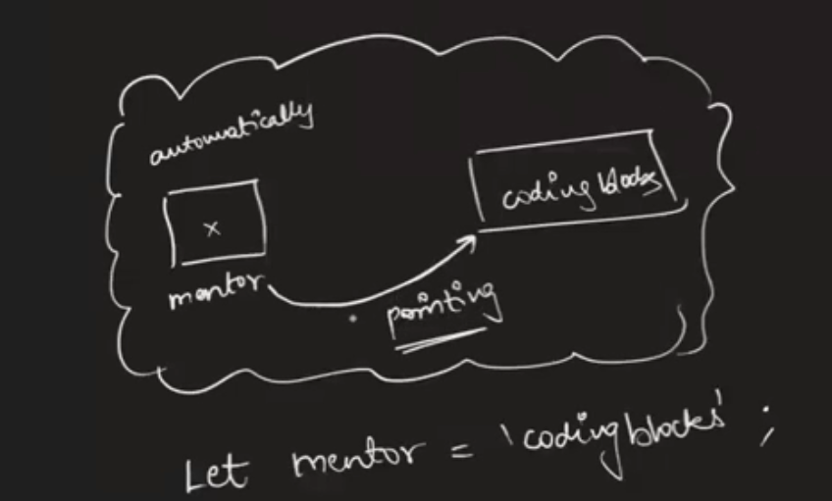
Variables in JS
It is declared using : Let (for now)
Rules :
Cannot start with a number
Can use any alphabet
No spaces in between
No Keywords can be used
only ‘_’ and ‘$’ is allowed in symbols.

Slide 5
Ways of Declaring Variables
1.Normal Case : e.g let firstname = ‘-’
2.Camel Case : e.g let firstName = ‘-’
3.Snake Case : e.g let first_name = ‘-’
4.Kebab Case : e.g let first-name = ‘-’ (only supported by CSS)
Use of ‘\’ : 1.Used to write ‘s inside String
2.\n for new line -> inside file of js

Slide 6
Backticks ( ` ) String Template
Useful in writing string .
e.g let s = `hi there ${firstName} this side`
Number :
We can use add (+), multiply (*),
divide(/) (can also give floating point num),
modulus (%) , pow (**).
Max Num : Number.MAX_SAFE_INTEGER
Min Num : Number.MIN_SAFE_INTEGER

Slide 7
Strings
Q: let str = ‘Hi this is JS’ , str[5] = ?;
H i t h is is JS
idx ->0 1 2 3 4…
dynamically typed -> variable type is understood in run-time.
statically typed -> variable type is understood in compiled-time.
So , JS is a interpreted , weakly typed , dynamically typed PL.
Now if console.log(str[100])-> undefined.//something it can’t define
When no value is given to ‘let‘ it returns undefined.
e.g. let name; console.log(name);//undefined

