Slide 1


Full Stack-Web Development - JS
-by Sachin Barpanda

Slide 2

JS Intro
-made by Brenden Eich
→Adds Interactivity to website
→P.Lang are of 2 types : Interpreted and Compiled
→JS is a Interpreted Programming Language,
i.e. JS is executed line by line
→Browser has 2 engines : Layout and JS Engine
Layout Engine : HTML and CSS , JS Engine : JS for interaction

Slide 3
JS Datatypes
Primitive Datatypes (7 types)
String (we don’t have char ‘-’ and “-” is same for now…)
Number (here we don’t have int, float , long)
Boolean (true and false)
Undefined
null
BigInt
Symbol
REPL -> Read Evaluate Print Loop

Slide 4
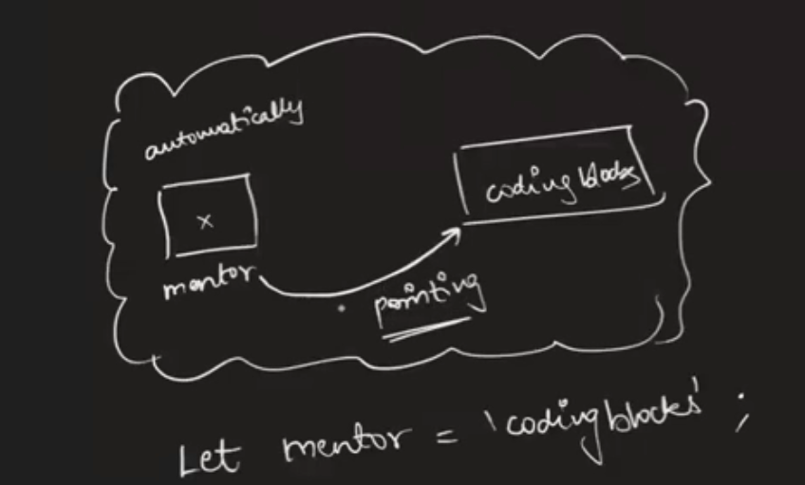
Variables in JS
It is declared using : Let (for now)
Rules :
Cannot start with a number
Can use any alphabet
No spaces in between
No Keywords can be used
only ‘_’ and ‘$’ is allowed in symbols.

Slide 5
Ways of Declaring Variables
1.Normal Case : e.g let firstname = ‘-’
2.Camel Case : e.g let firstName = ‘-’
3.Snake Case : e.g let first_name = ‘-’
4.Kebab Case : e.g let first-name = ‘-’ (only supported by CSS)
Use of ‘\’ : 1.Used to write ‘s inside String
2.\n for new line -> inside file of js

Slide 6
Backticks ( ` ) String Template
Useful in writing string .
e.g let s = `hi there ${firstName} this side`
Number :
We can use add (+), multiply (*),
divide(/) (can also give floating point num),
modulus (%) , pow (**).
Max Num : Number.MAX_SAFE_INTEGER
Min Num : Number.MIN_SAFE_INTEGER

Slide 7
Strings
Q: let str = ‘Hi this is JS’ , str[5] = ?;
H i t h is is JS
idx ->0 1 2 3 4…
dynamically typed -> variable type is understood in run-time.
statically typed -> variable type is understood in compiled-time.
So , JS is a interpreted , weakly typed , dynamically typed PL.
Now if console.log(str[100])-> undefined.//something it can’t define
When no value is given to ‘let‘ it returns undefined.
e.g. let name; console.log(name);//undefined

Slide 8
String Methods
1.substr : str.substr(2)-> removes portion from first
str.substr(2,5) -> 5 is size
str.substr(-5,5) -> starts from last
2.substring : str.substring(2)-> removes portion from first
str.substring(2,5)-> 5 is the ending index.(not included)
str.substring(5,2)-> it swaps to (2,5).
str.substring(-5,2)-> it makes -ve to 0.
3.indexOf : str.indexOf(‘a’). -> returns number
str.indexOf(‘a’,2). -> starts from index 2 then returns
(DIY Ques: try getting the 3rd a).
4.replace : str.replace(‘a’,’m’) -> only replace first
str.replaceAll(‘a’,’m’) -> replaces all

Slide 9
String Methods
5. repeat : str.repeat(3)
6. str.toUpperCase() , str.toLowerCase()
7. trim: str.trim(); //removes starting and ending whitespace
Boolean
== -> general equality
=== -> strict equality
Ques: 1==1 , 1===1, 1==‘1’, 1==true, 1===true, ‘1’==true , ‘true’==true, “ ”==0,

Slide 10
More Number Game
typeof : console.log(typeof 2) ;
Ques : 1. 10/0=>Infinity -10/0=>?
2. 0/0 => ?
3. typeof(NaN) => ?
Math Functions : PI , E , .sqrt(25) , .min(3,4,1) , .max(4,6,1) ,
.round(10.5), .floor(10.2) , .ceil(10.2)
Math.random() => range from (0,1)
Ques(DIY): Use this function to generate number between 22 - 26.

Slide 11
Conditionals
if(conditions) { { } -> Block
//true condition
}else if(2nd conditions ){
//true 2nd condition
}else{
//all conditions false
}
Logical Operators : and(&&), or(||) , not(!)
Relational Operators : != , !== , == , === , > , < , =< , >=

Slide 12
User Input
We use prompt to take user input.
let a = prompt(“Entera a number”);
→Prompt returns all values in String
We have to parse it into our desired datatypes using parse
(e.g parseInt(a) ,parseFloat…)

Slide 13
Array
Array is a Data Structure.
Ordered data structure.
Heterogenous types of data ( in JS)
e.g. let arr = [] ; print(arr); // it returns object of Array, why?
ans - Everything inside JS is an Object.
1.Access content in 1d arr : arr[i];
2.Access content in 2d arr : arr[i][j];
3.Access content in 3d arr : arr[i][j][k];

Slide 14
Array Methods
1. Destructive : Changes in the original array.
2. Non Destructive : No changes in the original array.
Methods:
push(x) -> destructive method (adds at the end), returns len
pop() -> destructive method (remove from the end), returns ele
unshift(x) -> destructive method (adds at the start), returns len
shift() -> destructive method (remove from the start), returns ele
5. slice(x,y) -> returns array = [x,y) , (like substring for arr , Non-dest)
6. splice(x,y) -> return array = [x],y is size (dest method)
e.g. splice(2,3,’a’,’b’) -> will add ‘a’ and ‘b’ after 2nd index.

Slide 15
Array Methods
7. split(‘/’) : String’s method splits at ‘/’ , returns array. (Non - dest)
join(‘/’) : joins the array to a String.
8. concat: Joins 2 arrays and strings both.
e.g. arr1.concat(arr2); (Non - dest)
9. includes(‘x’) : returns Boolean value.
10. indexOf(‘x’): retuns -1(if not present) or integer.
11. reverse() : reverse the array . (dest method)
Note: Arrays are reference type , i.e. change in one array is reflected in another array.

Slide 16
Objects
Unordered Data Structure ( Collection of properties)
It is Non-primitive
Properties → Pair of key and value. e.g let obj = { k:v }
Multiple properties -- let obj2 = {prop1 , prop2 }
(Everything in JS is an Object)
Accessing data in Objects
→Print(obj2.prop1’s key ); // output = prop1’s value
obj2[‘prop1’s key’] ; // output = prop1’s value
because objects are stored as string in memory.
They are pass by reference.

Slide 17
Objects
Methods : Functions inside the Object is called Methods.
let obj = {
p1: 100,
p2 : 200,
a : function(){
print(this.p1+this.p2); // to access this use obj.a();
return this.p1+this.p2; // it returns undefined if not specified anything
}
}

Slide 18
Loops
Loops: for , while , do-while
Task: WAP where num is div by 3 then print ‘kit’ , if num is div by 5 then print ‘kat’. And if num is div by both 3 and 5 then print ‘kitkat’.
**new loops :
for-in : inside object e.g. let obj = { k1 : v1 , k2 : v2 }
for(let item in obj){ print(`${obj[item]}`) }
for-of : inside array , vector , list
arr -> let arr = [‘a’,’b’]
for(let item of arr){ print(item);}

Slide 19
Functions
Program that does something when told to do something.
Parts of function :
Function declaration
Function calling
Parameters of a function
e.g. function sum(){
//some kaam
}
sum (); // function call here
sum(30); // function with parameters.

Slide 20
Functions
e.g. function sum(num){
//some kaam
}
sum(30); // function with parameters.
→Functions always returns something
e.g. print(sum()) ; returns undefined.
→We can return something inside the function to avoid ‘undefined’.
→Q : What if we pass only 1 argument.
(o/p NaN because NaN come from -> 30 + undefined

Slide 21
Functions
Default Parameters
e.g. function sum(num=40){
//some kaam
}
sum(20,50); // here 50 will have more weightage.
Task: Make a grade calculator using parameterized functn.
{Note : 1+true→2 , ‘1’+true→1true and 1+‘a’→1a}
→We can also store an entire function in a variable and It’s called:
1. functional expression 2. first-class function 3.first-class citizen
e.g. let a = function sum(num=40){
//some kaam
}

Slide 22
Functions running behind the scenes
→When JS code runs Global Execution Context is created .
GEC has 2 parts :-
MCP (Memory creation Phase) and CEP(Code Execution Phase
→In MCP entire function is given memory before it has run.
→In CEP the code will be ran line by line.
When a new function is seen in CEP another Execution Context is created and a new MCP and CEP is created inside it.

Slide 23
IIFE-Immediately Invoked Function Expression
Functions are invoked immediately after being declared .
e.g (func(){})()→this last part is where the function is called.
→to pass params : ( sum(a,b) {a+b} )(x,y);
Scope:
let & const →Block Scope
var → Functional Scope
 | Redeclare | Reassign
Const | No | No
Let | No | Yes
Var | Yes | Yes

Slide 24
Hoisting
Consider this example :
print(a);
a();
var a = 10;
function a(){ };
This will give undefined.
So, Hoisting is when you can use var or function before declaration.
All let, const , var can perform hoisting.
→But if we replace ‘var’ with ‘let’ then error will occur. Because the hoisting of let and const happens in Dead Temporal Zone (DTZ).
It’s between MCP and CEP.

Slide 25
Scope
It is Local Memory + Lexical Environment of Parents.
Lexical Environment of Parent is : Local + Parent’s memory
and it goes on…
So In GEC {let and const → Script Scope}
{var → Global Scope}
In EC {let and const → Block Scope}
{var →Functional Scope}
Let’s check using following :
let x = 20;{ var x = 20;{
let y = 30; var y = 30;
function b(){ function b(){
console.log(x); console.log(x);
console.log(y); console.log(y);
} }
b(); b();
} }

Slide 26
Higher Order Function
Function that operate on other function either by :
i. taking them as an argument.
ii. returning them from inside.
e.g. function a(arg){
return arg;
}
function b(){
print(“something”)
}
a(b);
Task : Try to return a function that is declared inside the first function and print it.

Slide 27
Callback Function
Function passed into another function where it is invoked inside that fun
e.g. function a(arg){
return arg();
}
function b(){
print(“something”)
}
a(b);
here b is callback function if invoked inside the function.
Task: Make a calculate function in which the all mathematical calculations (+,-,/,%,*) is done inside the callback function.

Slide 28
Practical JS Methods
forEach() : it accepts a callback function and iterate through a list of arrays.
map() : it accepts a callback function and can return a array with different value as specified by us.
filter() : it also accepts a callback function and returns a truthy or falsy values.
sort() : Lexicographically sorted by default , then we can pass a callback function and change it’s properties like in compareTo.

Slide 29
Closure
Function bundled along with the reference to its lexical env.
function anything(){
let name = ‘x’;
function printName(){
log(name);
}
return printName();
}
let a = anything();//here ‘a’ will have everything including name variable ‘name’ inside it.

Slide 30
Prototype
It is an Object which is used as an fallback Source.
let obj = {
title : “buy something”
fun : function(){
return `buy this ${this.title}`;
}
};
here fun.toString() is an object found inside prototype.
To Check Prototype of any object we can use dender proto (.__proto__)
arr → Array ’s Prototype → Object’s Prototype → null
String → String’s Prototype → Object’s Prototype → null
Function → Function’s Prototype → Object’s Prototype → null

Slide 31
Constructor Functions
“new” keyword before function call creates a constructor function.
It creates an Object
function a(){ this.user = “first” ;}
let a = new a();
print(a);
We can pass the values in a(val1,val2) too.
To make Prototype use:
a.prototype.getName = function(){log(//name)};

Slide 32
Class Syntax
Syntactical Sugar for Constructor Function.
class Person {
constructor(a,b,c){
this.a = a;
…;
}
getName(){log(`print name`)}//method
}
let prs1 = new Person(2,4,5);
log(prs1.a);log(prs1.b);
Inheritance : Getting existing properties from previous classes.
class Student extends Person{//default super()}
class Student extends Person{constructor(a,b,c,d){super(a,b,c);this.d = d}}
let std1 = new Student(2,3,5,6);
log(std1.a);

Slide 33
This
Regular invocation
function fn(){
log(this);
}//→ this points to windows obj
2. Method invocation
let obj = {
num : 2;
fn:function(){log(this)}
};
obj.fn(); → this points to obj Object
let x = obj.fn; x(); → this points to windows Object
3.Constructor function calling
function CreateObj(){
this.x = 20;
}; let obj = new CreateObj();

Slide 34
This
Call : Used to call functions from other objects.
let obj = {
a:20,
fn:function(a,b,c){
log(this,a,b,c);
}
}
let obj2 = { a:50 }
obj.fn.call(obj2,11,12,31);//50
2. Apply : It works same as call except we have to use [] for multiple arguments.
obj.fn.call(obj2,[21,31,43]);//50
3. Bind : It makes the obj to get fixated on one obj and not change.
let newObj = obj.fn.bind(obj); newObj(); //will not point to window object

Slide 35
Arrow Function (=>)
ES6 feature to write function precisely
e.g let fun = ()=>{//do something}; fun();
In case of arrow function it points to this of previous object .
let obj = { num : 3, fn()=>{log(this);}}
obj.fn();// window ko point karega because of this
let obj = { obj2 : {fn1:function { fn()=> {log(this); } fn();}}
obj.obj2.fn1(); here this will point to obj2

Slide 36
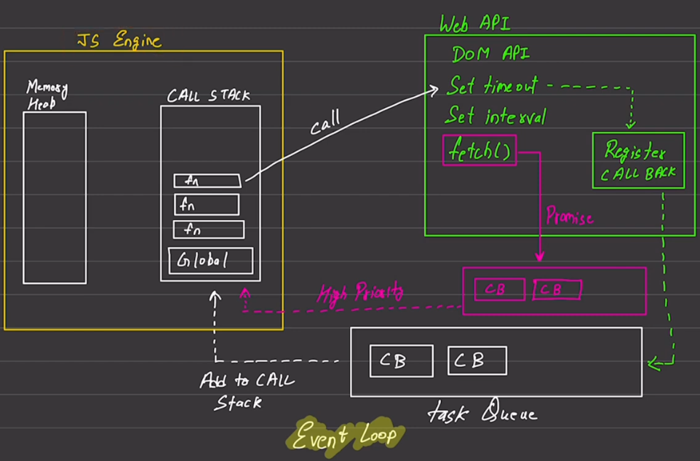
Async JavaScript Fundamentals
There are 2 types of codes :
Blocking Code : Block the flow of Program → Read File in Sync
Non Blocking Code : Don’t Block the execution → Read File in Async
→ JS standalone is not used anywhere.
→ settimeout and setinterval is called .
→ Register callback keeps the record of
these calls.
→ taskQueue keeps the tasks and adds it
to the call stack.
‘promise’ is a new async function
which has high priority queue in it.

Slide 37
Async JavaScript Fundamentals
Examples:
setTimeout(function(){
log(“do something”);
},2000);
clear
setInterval(function(){
log(“do something”,Date.now());
},1000);
//by providing reference
const newFun = function(){ log(“doing it in ref”); }
setTimeout(newFun);//don’t call the function, only provide its ref.

Slide 38
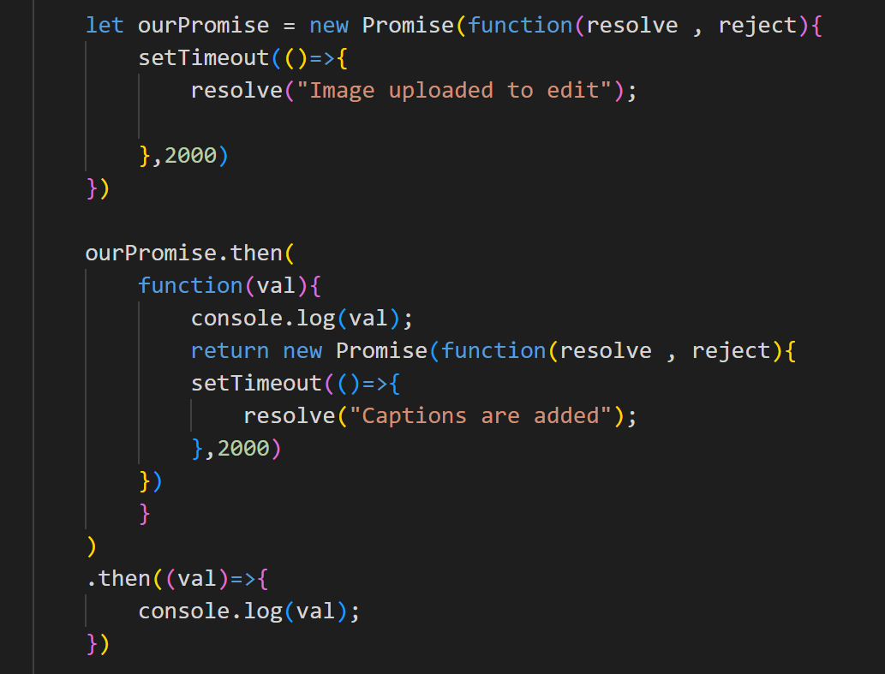
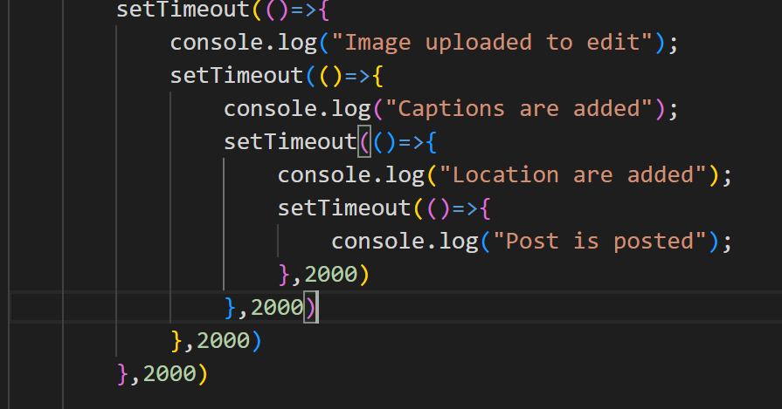
Async JavaScript Fundamentals
Continuous use of callback one inside other results in ‘callback hell’. To resolve this we have promise.
Promise is either resolve or reject
if resolve it return values in .then()
if rejected it returns values in .catch()

Slide 39
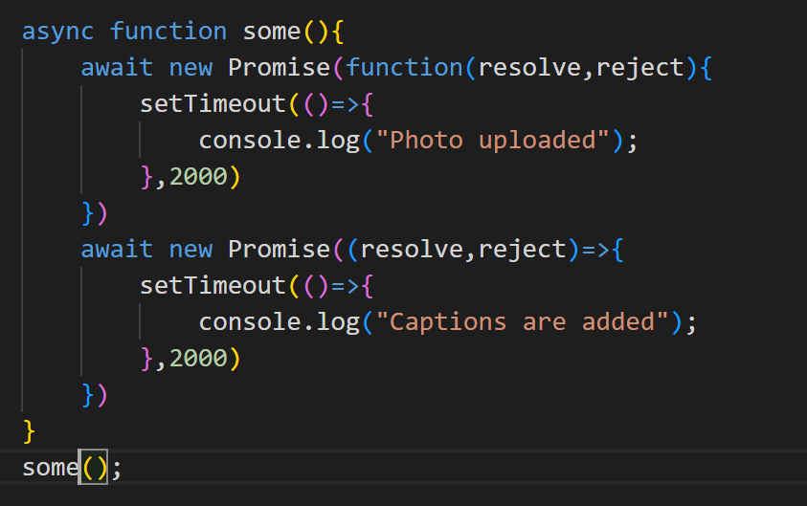
Async JavaScript Fundamentals
1. async - await function returns a promise .
2. async always works with await.

Slide 40
DOM(Document Object Model)
Document -> HTML
Object -> JS Object
Model -> to manipulate
5 types of Selectors
1.getElementsByTagName(‘h1’)-> returns HTMLCollection i.e. array
we can loop through them and apply style to them
for(let item of arr){
item.style.color = ‘red’;
}
2. getElementByID(‘h1’)-> returns single element
3. getElementsByClassName(‘h1’)-> returns HTMLCollection

Slide 41
DOM(Document Object Model)
2. querySelector(‘h1’)-> returns single element
It takes class(.x) , id(#x) and tag(x) as argument
3. querySelectorAll(‘h1’)-> returns Nodelist
Propeties of HTML (Like Setter and Getter)
1. innerText -> gives text inside that tag, can apply css in it.
2. textContent -> gives text inside that tag, cannot apply css in it.
3. innerHTML -> returns text + tags

Slide 42
Attribute Manipulator
Helps in manipulating attribute inside HTML
getAttribute(‘href’) -> to fetch attribute data from tag
setAttribute(‘href’ , ‘www.something.com’);
setAttribute(‘class’ , ‘one two three’);//multiple classes possible
Task: Make a slider using ‘setInterval’ and attribute manipulator, which changes image in 2 seconds.
ClassList
add : doc.classList.add(‘cl1’,’cl2’); // class can be added
remove : doc.classList.remove(‘cl1’,’cl2’); // remove these classes
toggle : doc.classList.toggle(‘tc1’);// make true->false and vice-versa
contains : doc.classList.contains(‘present’); //returns true or false

Slide 43
Dom Tree Traversing
To access the child elements of parent tag we have to use
.children
let parent = doc.querySelector(‘.parent’);
parent.children; // gives HTML collection array
parent.children[1];//gives specific element
Similarly, we can access parent from child elements
let child = doc.querySelector(‘.day’);
child.parentElement; // gives parent element
child.nextElementSibling;// gives second sibling element of selected element

Slide 44
Adding Element in DOM
1.//make element
let ele = doc.createElement(‘div’);
2.//get the parent or children previously present
let presentEle = doc.getElementById(‘parent’);
3.//insert content in the element
ele.innerText = “some content”;
4.//append it to the parent(previous element present)
presentEle.appendChild(ele);
To input multiple childs we can use .append
To remove elements we can use removeChild();
To directly remove use remove();

Slide 45
DOM Events
Actions that happen in HTML document.
Inline: onclick as attribute
onclick directly
const btn = doc.querySelector(‘.btn’);
btn.onclick = ()=>{ log(‘clicked’); }
3. using eventListener
btn.addEventListener(‘click’,()=>{ log(‘clicked’); } ); btn.addEventListener(‘dblclick’,()=>{ log(‘clicked twice’); } );
Input Events
btn.addEventListener(‘input’,()=>{ log(‘clicked’); } );
→To access the elements in input tag we use arg e and e.target.value for its value
btn.addEventListener(‘input’,(e)=>{ log(e.target.value); } );

Slide 46
DOM Events
Submit Events : Used in form tag
0.const form = doc.querySelector(‘form’);
1.form.addEventListener(‘submit’,()=>{ log(‘form submitted’); } );
//the submit will reload the page,
//to stop it we have to use event.preventDefault()
2.form.addEventListener(‘submit’,(e)=>{e.preventDefault();log(‘form submitted’);});
Access Elements of form
For 2 input fields in form
1.log(form.elements[0].value);
2.log(form.elements[1].value);

Slide 47
Project ( Note Taking App)
We will need html tags such as ul , input , button
Get elements in JS for all tags
when click event in button then create li.
Insert input element value to it.
next clear the value .
appendChild the created element into the ul
Add click to the created element to remove() it , when click over it.
Add CSS to your heart’s content.

Slide 48
Event Life Cycle
The 3rd parameter of addEventListener denotes propagation of events.
When child is clicked, first the child is registered then parent because of bubbling mode.
parent.addEventListener('click',(e)=>{
console.log("Parent is selected”);},false)
3. But if we make the 3rd para true then it will capture parent first then child because of capturing mode.
parent.addEventListener('click',(e)=>{
console.log("Parent is selected");
e.stopPropagation();},true)
we can also use event’s stop propagation for stopping the propagation of event.

Slide 49
JQuery
JQuery is a JS library.
Use jQuery by downloading the codes and including it in jQuery.js
1. $ → selector .(same as querySelectorAll)
2. to use style use $(‘h1’).css(‘background-color’, ‘red’);
3. to use multiple styles we will use object and for properties we use CamelCase. ex-backgroundColor : ‘plum’
4. to use innerText = $(‘h1’).text()//output, $(‘h1’).text(‘new Text’)//input
5. to use innerHTML= $(‘h1’).html(‘<h2>new Text</h2>’)//input
6. to use attribute= $(‘a’).attr(‘href’)//get
$(‘a’).attr(‘href’, ‘www.google.com’ )//set
7. to use input value = $(‘input’).val()//get
$(‘input’).val(‘some value’)//set

Slide 50
JQuery
8. Events : 1. General click
$('button').click(function(){console.log("normal Function");})
2. To select a particular element when multiple buttons are there
$('button').click(function(){$(this).css(“color“,“red”);})
//for addEventListerner → we have “$(‘button’).on”
$('button’).on(‘click’,function(){$(this).css(“color“,“red”);})
3. Input event
$(‘input’).keyup(function(){log(“Key released”)};
$(‘input’).keyup(function(e){log(“Key released”,e.val())};

Slide 51
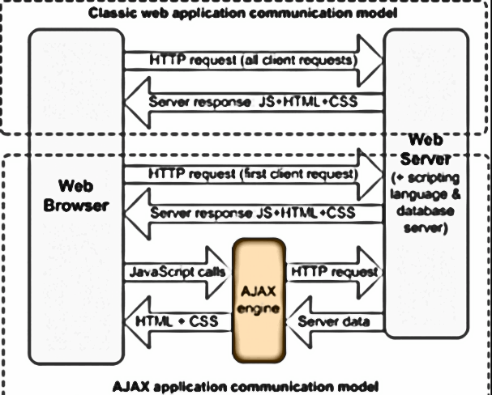
AJAX (Asynchronous Javascript and XML)
1. This is a web Technique to create SPA(Single Page Application).
Model of sending request
Ajax has a JS layer that only controls
the response part without including
html or css. This is the AJAX engine.
→We get 2 types of data
1.XML - Xtensible Markup Lang.
2.JSON- Javascript object notation.
(“key”:“value”) pair with double
inverted comma.
3.API - Application Programming Interface.

Slide 52
AJAX (Asynchronous Javascript and XML)
→ We cannot work with json data directly.
Json.parse(Json String)→We have to convert it into usable JS object or array.
→ Json.stringify(Json object)→ Converts Json object into usable JS String.
let jsonData = { "employee":{"name":"John", "age":30, "city":"New York"} };
let obj = JSON.stringify(jsonData);
let obj1 = JSON.parse(obj);
console.log(obj1);
console.log(obj1['employee']['name’]);
Now we have to send request using JS.
1. HTTP Request(e.g. https://isro.vercel.app/api/spacecrafts)
let req = new XMLHTTpRequest();
req.open(‘GET’, ‘api_url’);
req.send();//to send data
req.onload = function(){log(JSON.parse(this.reponse),onLoad)};
req.onerror = function(){log(this,onError)};

Slide 53
AJAX (Asynchronous Javascript and XML)
2. Fetch: (Part of browser and returns a promise)
fetch(‘api_url’)
.then(function(response)){
return response.json(); // this also returns a promise thus we can use .then
})
.then(function(data){//to resolve
log(data)
})
.catch(function(err)){
log(err);
})
→It returns small chunks of data

Slide 54
AJAX (Asynchronous Javascript and XML)
3.Axios : (3rd party , It also returns a promise)
→ include the cdn:
<script src="https://cdn.jsdelivr.net/npm/axios/dist/axios.min.js"></script>
<script>
axios.get('https://isro.vercel.app/api/spacecrafts')
.then(function(res){
console.log(res.data);
})
.catch(function(err){
console.log(err);
})
</script>
→Axios put pressure on servers so using fetch is better when data is limited.

Slide 55
Task Project ( Movie Search WebApp)
First make input , button , section to store cards.
Select them all in JS using the right queries.
On event click fetch the data with api
API = {https://api.tvmaze.com/search/shows?q=${input.value}}
implement then to return response.json
then implement then to get data
use section.firstChild to remove the first child so as to clear prev data.
use for of loop to parse through all objects , make card and add innerHTML values of image and name of the data got.
appedChild the card to the section
Add CSS to your heart’s content

Slide 56
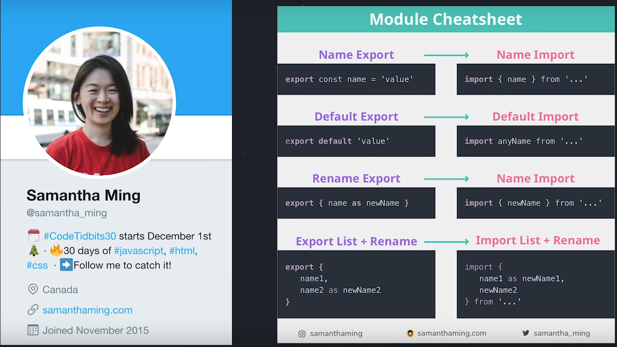
JS Modules
We can declare variables in one file and use it elsewhere.
start with : <script type="module" src="import.js"></script>

