Slide 1


Full Stack-Web Development - NodeJS
-by Sachin Barpanda

Slide 2

Prerequisite
1 . Spread Operator: (…) we can attach2 arrays directly.
e.g arr1=[…arr2,50,60,70];
It can be used for objects also.
2 . Rest Parameter : We can add more parameter in funct
e.g function sum (a,b,c,…d){//sum them};
3. Destructure: Shaking up the internal structure of Arrays , Objects etc .
e.g let fruits = [‘apple’,‘banana’]; let[a,b] = fruits;
here, ‘apple’ → a & ‘banana’ → b
e.g let car = { name : ‘nano’ , price: 10000};
let {name, price} = car;
let {name:n, price:p} = car;
//now name is in n and price in p
//values are not in name anymore

Slide 3
NodeJS Intro
CSR : Client Side Rendering
SSR : Server Side Rendering
Ryan Delh made nodejs by putting js engine from browser to machine.
Browser has document for DOM but Node JS do not .
Node JS has file system access which browser lacks.
Browser has window object and node has global object.

Slide 4
Node JS Commands
process: stores all ongoing info of node JS.
process.argv : current directory of node JS.
Now if we use cmd like : node ind.js 10 20 30 , we can use String operation
e.g process.argv.slice(2); or loop through them
4.process.cwd() : current working directory.
5.__dirname : current directory files are in.

Slide 5
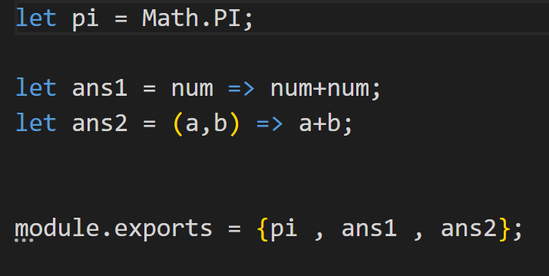
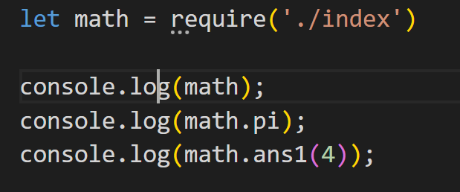
Requiring a File
When we don’t have a html file then we can use require and use module.exports .
By default it is an empty object.
In ES 6 we don’t need to include both key and value pair when they have same name.

Slide 6
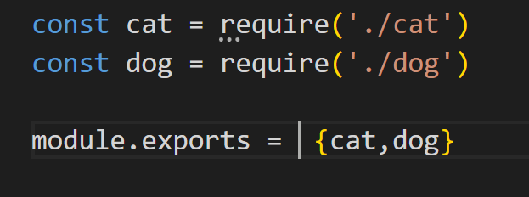
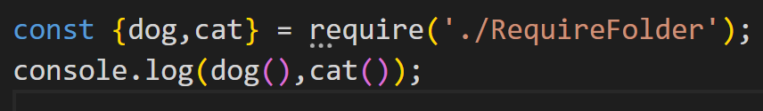
Requiring a Folder
In this a special file with the name index.js keeps all the imports and exports .

Slide 7
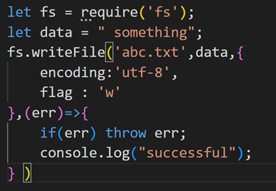
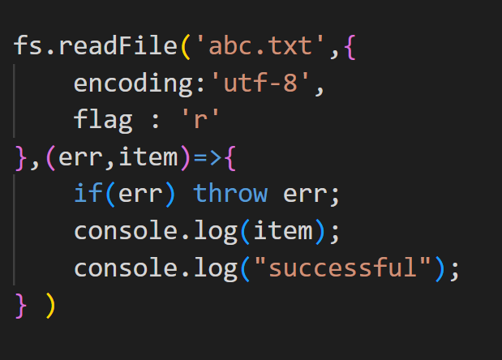
File System
Database is the replacement of file systems to perform CRUD operation i.e.
Create 2. Read 3. Update 4 . Delete
Create : we use writeFile
2nd way
fs.writeFileSync(‘file-name’,data);
Read : Same here:
1st way: readFile
2nd way : readFileSync(data.toString());

Slide 8
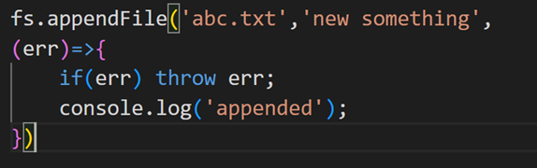
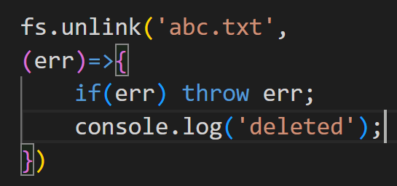
File System
3. update : We use appendFile
4 . Delete : We use unlink
Path
1 . Joins : →Joins them with a slash
→automatically removed extra slashes too.
e.g. path.join(‘a’, ‘b’, ‘c’);→ a/b/c

Slide 9
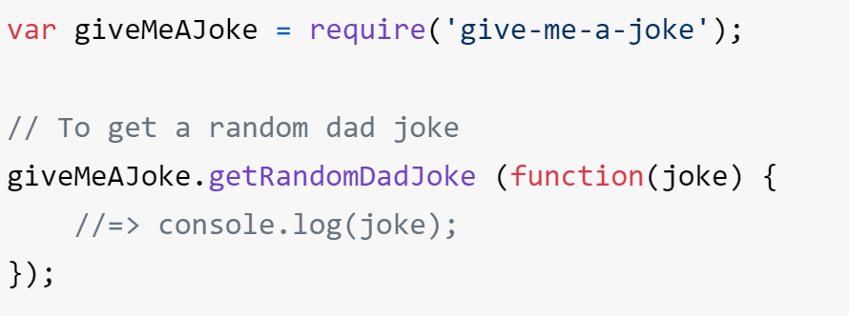
NPM
Node Package Manager
Node is also like a command line tool.
To initialize a project we use npm init and it gives package.json
We can now install npm packages.(e.g give-me-a-joke).
Now we will get package-lock.json and node_modules.
Then we make index.js where everything will be made .
Then we read docs and make our
app :)
Similarly try doing the same steps
with ‘figlet’ package from npm.

Slide 10
MERN
MongoDB, Express JS , React , Node JS
ExpressJS - It is a framework. Used in making web server .
Making a server
make folder and type npm init
then install express by npm i express
create an express server
const express = require('express’)
const app = express();
→ Then listen to the port that server is running in. app.listen(8080,function(){
console.log("server connected at port 8080");
})

Slide 11
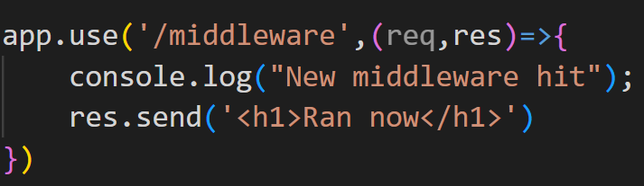
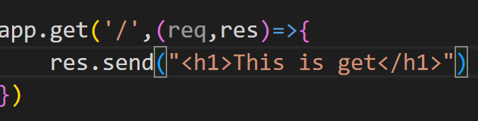
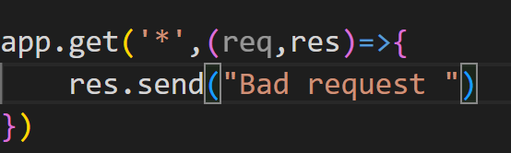
Express Methods
app.use([path]callback [,callback]) : it runs middleware (callbacks) when path hits the routes .
Middleware : just a function that will run on hitting routes.
Routing : HTTP methods are:- i.get ii.post iii.patch iv.put v.delete
app.get(path,callback) :-
HTTP get will run
Handle bad request :
Put this at the last

Slide 12
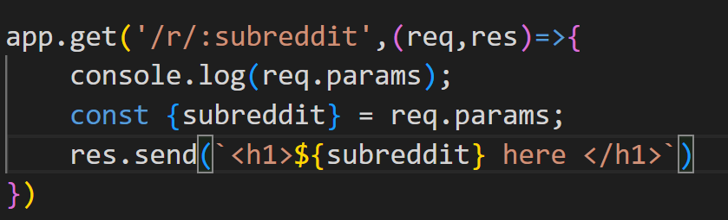


Express Methods
Note : to restart server when change happens we will use ‘Nodemon’.
create start in scripts , and use “nodemon index.js”
Then we can use npm start
Now to get Subpaths for (e.g. subreddit ) we have to get help from URL
We have path and query
present in our request this can be
used to render in our browser too.
2. Params (after ‘ : ’)can be fetched from URL with the help of req.params.
URL:
O/P:

Slide 13
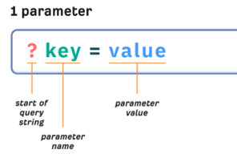
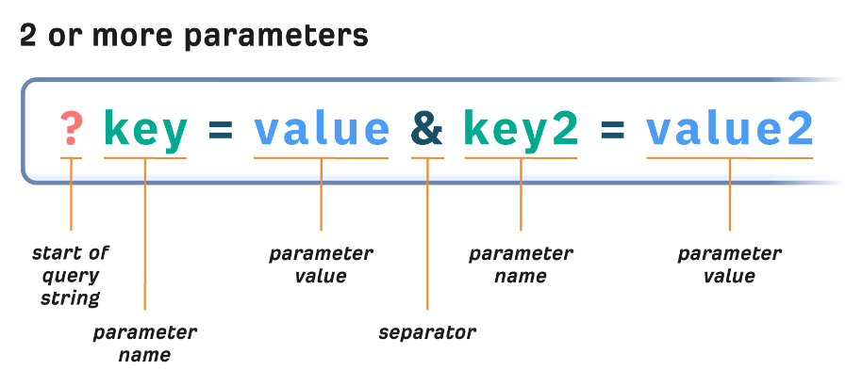
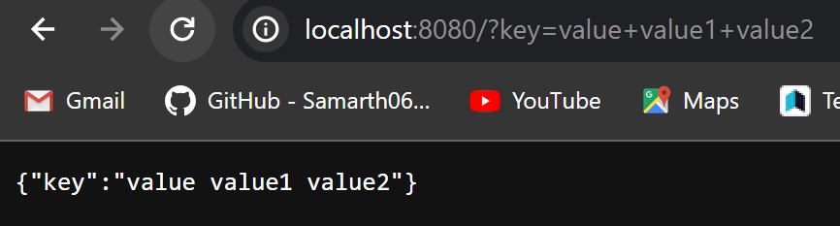
Express Methods
Query: We get query as object from url. (e.g when req.query in res.send)

Slide 14


Templating
We have res.render(view,[local],[callback]): Here view is the templating engine, that is going to be used.
Templating : Rendering the pages with our changes in it.
We’re going to use EJS , Tags that will be used to write the HTML
<% :- 'Scriptlet' tag, for control-flow, no output
<%= :- Outputs the value into the template (HTML escaped)
Mention the view engine
Views folder will be made to keep templates and extension of ‘.ejs’
This will be called using response .render and we will not need to mention views because it will automatically go there to call it.(default path )
We can also write JS inside EJS also.
Now set the path using the app.set so our template works anywhere .

Slide 15
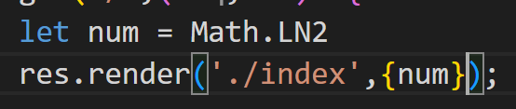
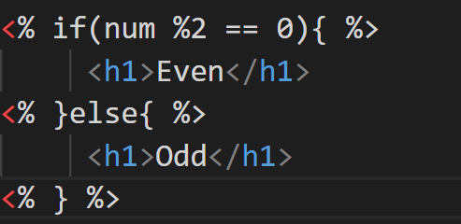
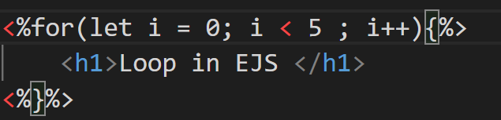
Templating
We can also pass values from routes to ejs files
“inside ejs file”
To make loops or conditionals we use <% %>

Slide 16
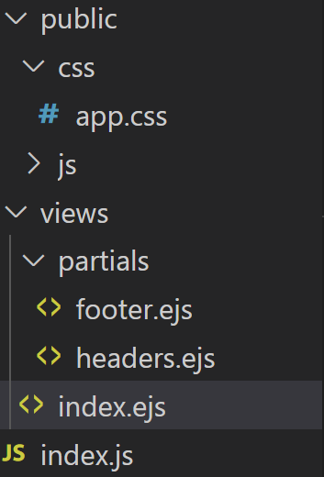
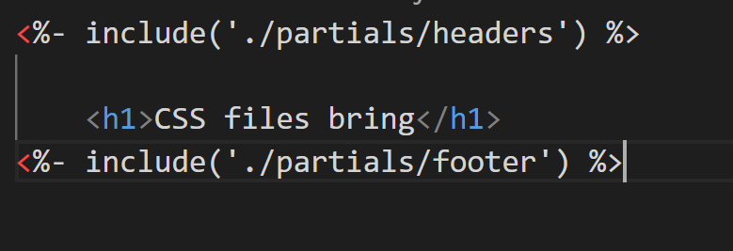
Serving Static Files
Public : we put static files in our public folder.
Make a public folder in the project and make css and js folders .
Now make a ejs file and connect the css and JS files we made .
Here since the path till the public is set so we don’t need to think about till that.
Now app.use() to start using static files
We can also separate the files into header.ejs and footer.ejs . This will be made inside a folder called partials.
Now include header.ejs and footer.ejs using <%- %>

Slide 17
GET VS POST
GET | POST
1. Should be used to retrieve data. | 1. Should be used to make changes in server. i.e. in DB
2. data available inside query parameter | 2. Data is available as reqest.body.
3 . Less Secure | 3. More secure
4 . data will be plain string and only in query parameter | 4. Data of diff types can be sent text , JSON , XML etc
5 . Limited data can be send | 5. Huge data can be send .

Slide 18
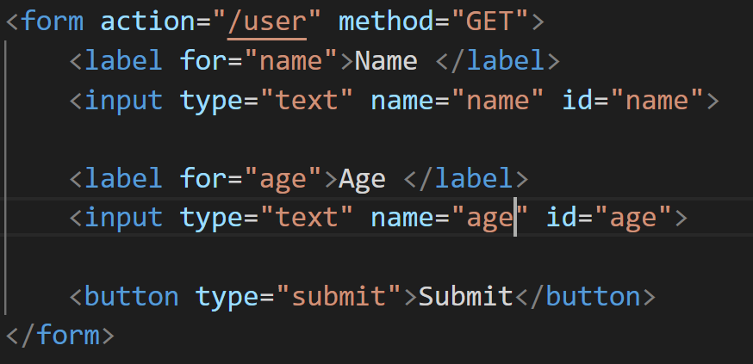
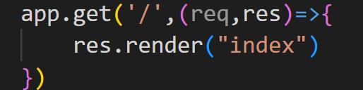
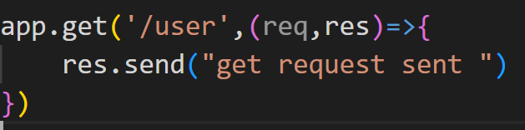
Getter and Setter Methods
In form the name tells us the attribute that is binding with which key .
We don’t have to write our entire path everywhere in node and express this is called ‘Strongly coupled application’.
By default we have GET request in form.
Make changes in index.js (entry file)
Our page gets render in root(‘/’) path.
After that because of action data gets send
to ‘/user’.

Slide 19
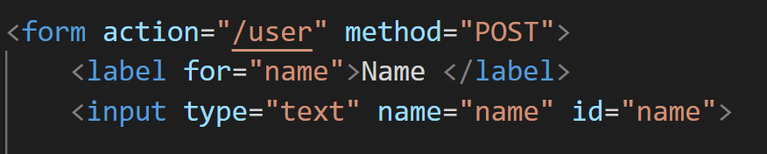
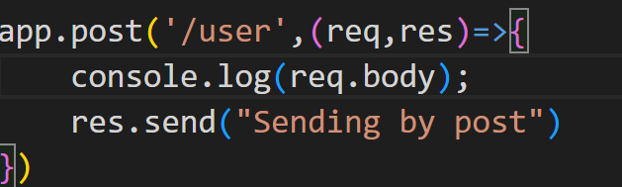
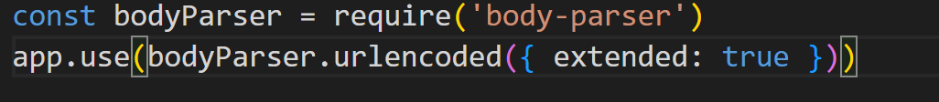

Getter and Poster Methods
Our page gets render in root(‘/’) path.
Make the method POST
After that because of action data
gets send to ‘/user’ via post method
and in index.js use app.post to get data
from there.
5. By default req.body gives undefined so we
have to use a middleware i.e
and for json() data use :

Slide 20
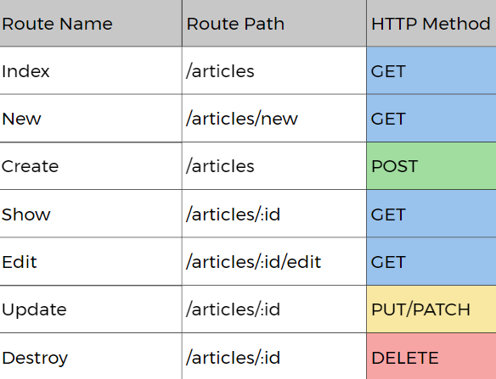
RESTful Routing
Representational State Transfer.
Resful Routing : HTML, CSS , JS show kar rahe thee.
Resful API : Data from URL hit .
source : medium
Path used as a convention to make routes with their methods and operations

Slide 21
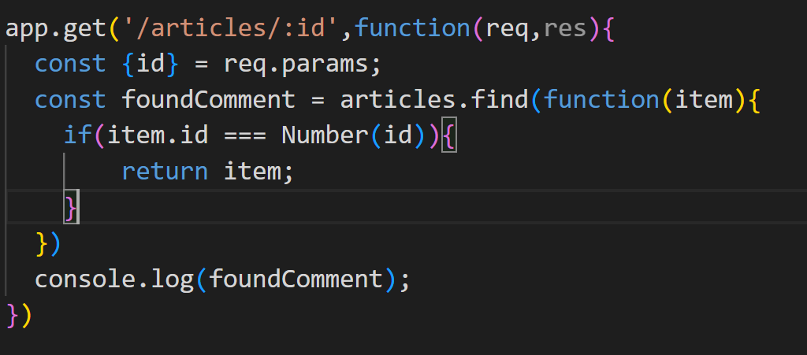
RESTful Routing
First make an array to replicate DB.
Then make the get data and send it to the index.ejs to render the cards .
Next create a ejs file in form to add new task in path /article/new
Next Post the form to add it to the array .
Next we have to show a particular id of article. So make a get request with the id as params and make a new ejs to show article.
In the list of all articles make a button to
enable click functionality and take it’s input to
a particular id ;
Use find to get the details of the article and
return the item .
8. Now we have to edit the form , to do that we have to first make a form and add some existing data.

Slide 22
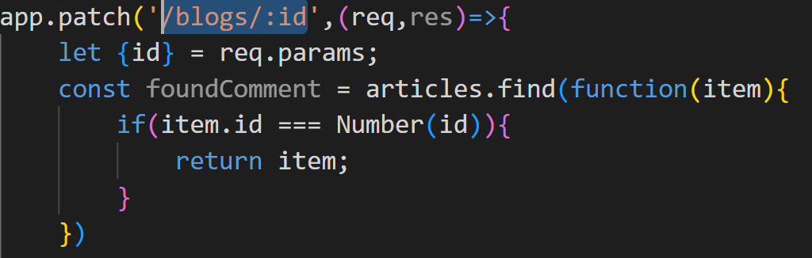
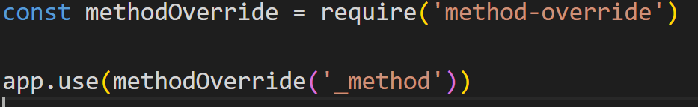
RESTful Routing
Post will create a new data so we will be using PUT or PATCH.
PUT : It will modify the entire resource like if we send 2 out of 4 fields in an update operation then it will remove the existing resources.
PATCH : It will modify the part of resource required to achieve editing.It do not replaces the existing data entirely.
So we will use ‘patch’
And to use patch in the form we have to
override method POST to PATCH , so we will
use an npm package. ‘method-override’
and use the middleware for it.
6. And use it to override the url in form.
7. Now we will get our data in req.body because method was POST.

Slide 23
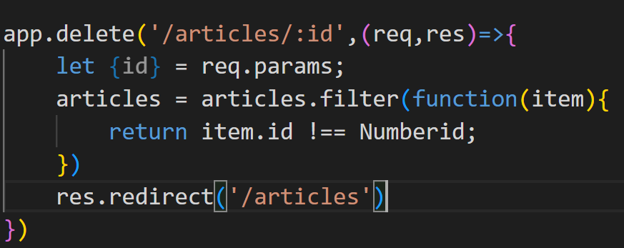
RESTful Routing
Now to delete we have to just search the id of the post and override the method delete. But without form we cannot send a method.

Slide 24
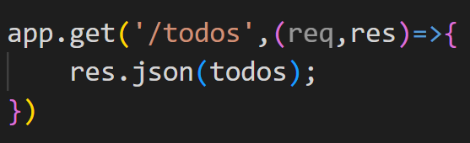
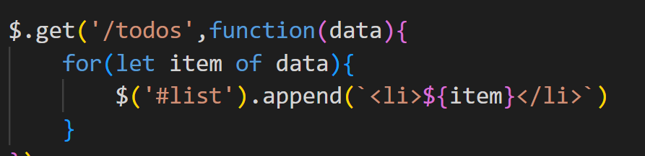
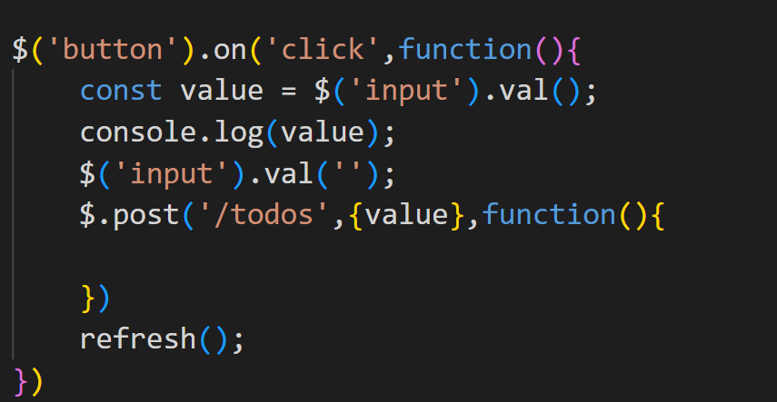
CSR vs SSR
Everything will be done in the client side so , we will be using AJAX request to send our data through api.
For this we will be using public folder which will include js and html files.
Here we have to make an array and when
client request the data we have to give it to
client. So we want data to be in json format.
We have to go to ‘/todos’ by using AJAX that will be written in JS .
loop through the data in js file and show it in the page. Put it in a function
Now use post request to send the data
to the server , where the server will add the
data to the array or database accordingly.

Slide 25
Databases
Databases are used to prevent duplicacy, data inefficiency , better security , scalability.
Most important is to prevent Data Redundancy : different datas in 2 different places.
Types of DB languages : SQL and NoSQL
Types of DBMS :
Relational: Those dbs with tables .
Non relational : Those dbs without tables .
5. Databases are choosen based on CAP theorem ( consistency avaibility and partition tolerance)

Slide 26
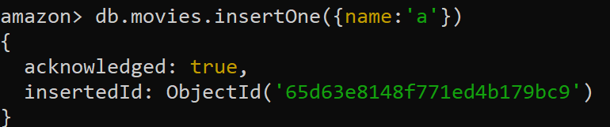

MongoDB
Install mongodb, then go to cmd and open mongosh.
show databases : shows all the list of databases.
use --db_name-- : makes a db if not exist.
note: empty data do not show up
Document : A single atomic entity is called a document.
BSON : Binary JSON
So we will make a collection and inside it we will make document.
Let’s make a db with collections of user product etc…
8. We can check using show collections

Slide 27
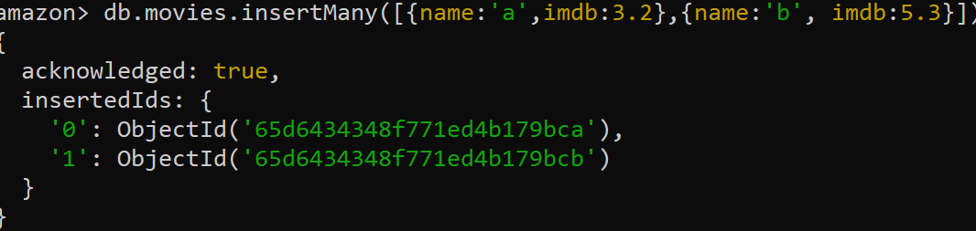
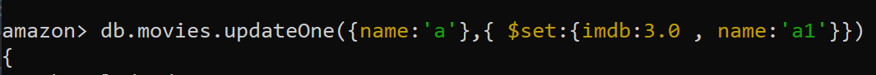
MongoDB
We can check the movies using find
insertMany : use array to enclose all objects.
Edit : updateOne
We can also use updateMany too.
Delete : DeleteOne : will delete the first occurance
DeleteMany : will delete all occurance

Slide 28
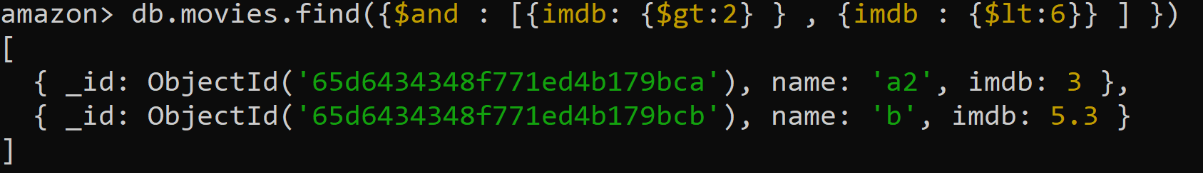
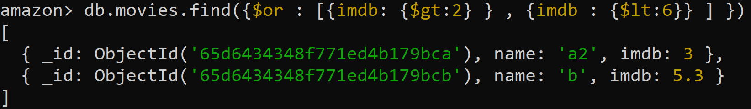
MongoDB Operations
Equals :
Greater and Greater Than Equals :
Lesser and Lesser Than Equals :
$inside : value in this range:
And ($and)
OR ( $ or)

Slide 29
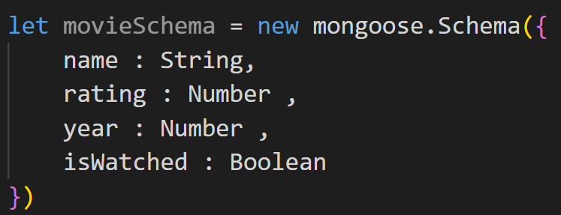
Mongoose
The layer which connects database to the server we have ODM in NoSQL and ORM in SQL server languages.
Mongoose is an ODM layer which converts the Json to usable JS object.
Official docs : https://mongoosejs.com/
To use mongoose just include npm i mongoose while making server.
Models : The collections that are made inside JS project
Schema : The blueprint which will be used for data storing.
Models Convention :
Models returns a JS class
Its always singular
1st letter always capital.

Slide 30
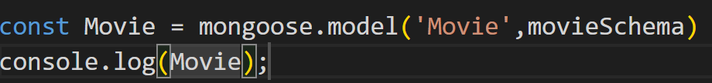
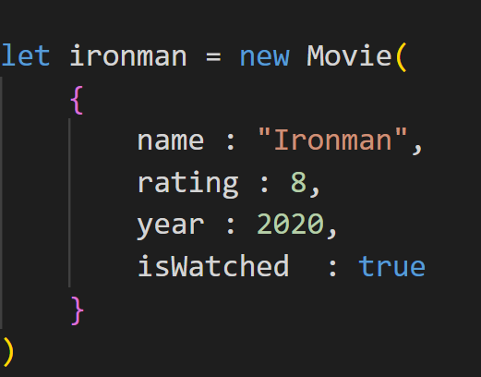

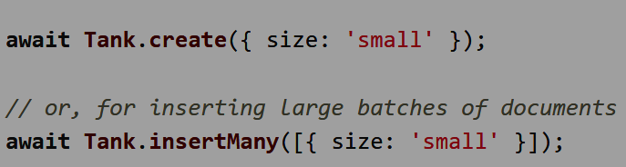
Mongoose
Model : Collection for db
We can make new JS objects using Models class.
Now we have to save it in our DB
OR we can use mongoose methods directly ,
Source : https://mongoosejs.com/docs/models.html

