Slide 1


Full Stack-Web Development - NodeJS
-by Sachin Barpanda

Slide 2

Prerequisite
1 . Spread Operator: (…) we can attach2 arrays directly.
e.g arr1=[…arr2,50,60,70];
It can be used for objects also.
2 . Rest Parameter : We can add more parameter in funct
e.g function sum (a,b,c,…d){//sum them};
3. Destructure: Shaking up the internal structure of Arrays , Objects etc .
e.g let fruits = [‘apple’,‘banana’]; let[a,b] = fruits;
here, ‘apple’ → a & ‘banana’ → b
e.g let car = { name : ‘nano’ , price: 10000};
let {name, price} = car;
let {name:n, price:p} = car;
//now name is in n and price in p
//values are not in name anymore

Slide 3
NodeJS Intro
CSR : Client Side Rendering
SSR : Server Side Rendering
Ryan Delh made nodejs by putting js engine from browser to machine.
Browser has document for DOM but Node JS do not .
Node JS has file system access which browser lacks.
Browser has window object and node has global object.

Slide 4
Node JS Commands
process: stores all ongoing info of node JS.
process.argv : current directory of node JS.
Now if we use cmd like : node ind.js 10 20 30 , we can use String operation
e.g process.argv.slice(2); or loop through them
4.process.cwd() : current working directory.
5.__dirname : current directory files are in.

Slide 5
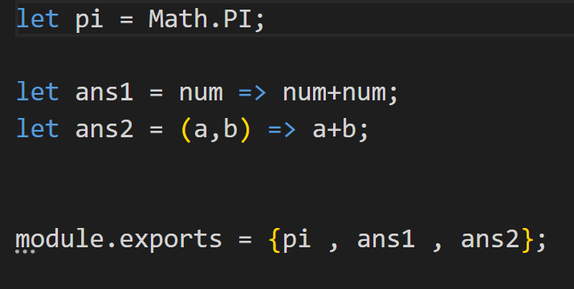
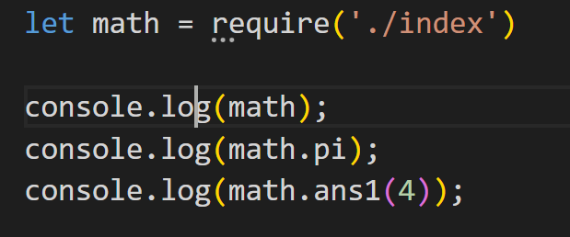
Requiring a File
When we don’t have a html file then we can use require and use module.exports .
By default it is an empty object.
In ES 6 we don’t need to include both key and value pair when they have same name.

Slide 6
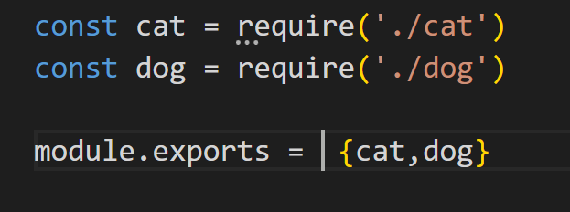
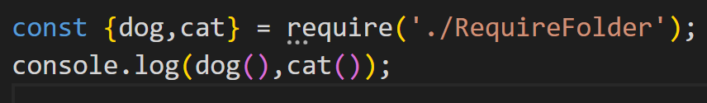
Requiring a Folder
In this a special file with the name index.js keeps all the imports and exports .

Slide 7
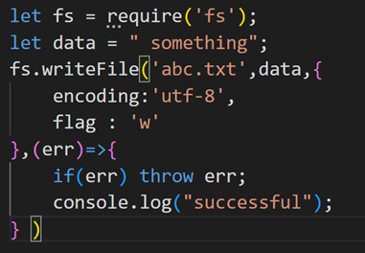
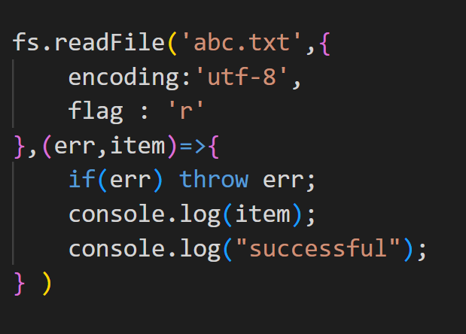
File System
Database is the replacement of file systems to perform CRUD operation i.e.
Create 2. Read 3. Update 4 . Delete
Create : we use writeFile
2nd way
fs.writeFileSync(‘file-name’,data);
Read : Same here:
1st way: readFile
2nd way : readFileSync(data.toString());

Slide 8
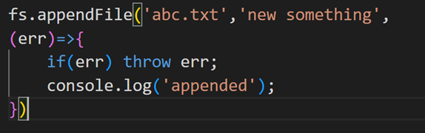
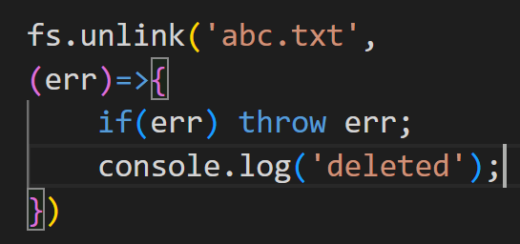
File System
3. update : We use appendFile
4 . Delete : We use unlink
Path
1 . Joins : →Joins them with a slash
→automatically removed extra slashes too.
e.g. path.join(‘a’, ‘b’, ‘c’);→ a/b/c

Slide 9
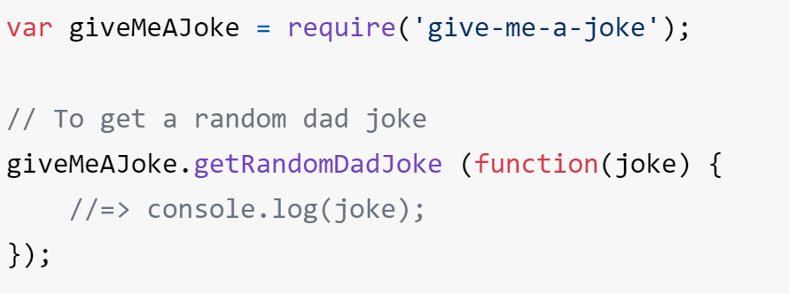
NPM
Node Package Manager
Node is also like a command line tool.
To initialize a project we use npm init and it gives package.json
We can now install npm packages.(e.g give-me-a-joke).
Now we will get package-lock.json and node_modules.
Then we make index.js where everything will be made .
Then we read docs and make our
app :)
Similarly try doing the same steps
with ‘figlet’ package from npm.

Slide 10
MERN
MongoDB, Express JS , React , Node JS
ExpressJS - It is a framework. Used in making web server .
Making a server
make folder and type npm init
then install express by npm i express
create an express server
const express = require('express’)
const app = express();
→ Then listen to the port that server is running in. app.listen(8080,function(){
console.log("server connected at port 8080");
})

Slide 11
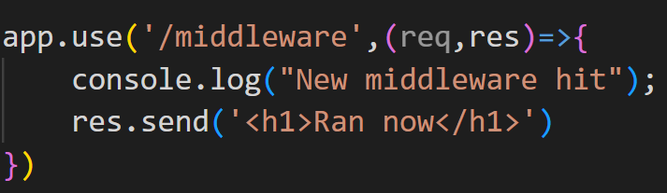
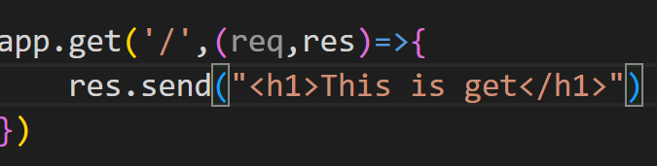
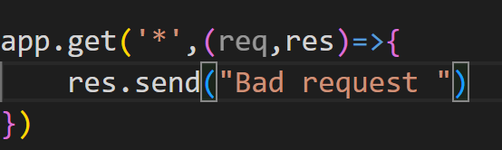
Express Methods
app.use([path]callback [,callback]) : it runs middleware (callbacks) when path hits the routes .
Middleware : just a function that will run on hitting routes.
Routing : HTTP methods are:- i.get ii.post iii.patch iv.put v.delete
app.get(path,callback) :-
HTTP get will run
Handle bad request :
Put this at the last

Slide 12
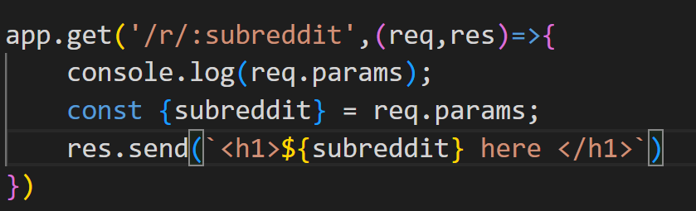


Express Methods
Note : to restart server when change happens we will use ‘Nodemon’.
create start in scripts , and use “nodemon index.js”
Then we can use npm start
Now to get Subpaths for (e.g. subreddit ) we have to get help from URL
We have path and query
present in our request this can be
used to render in our browser too.
2. Params (after ‘ : ’)can be fetched from URL with the help of req.params.
URL:
O/P:

Slide 13
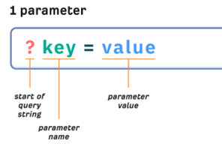
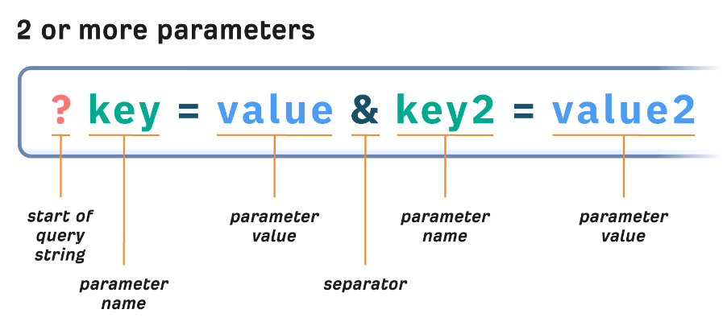
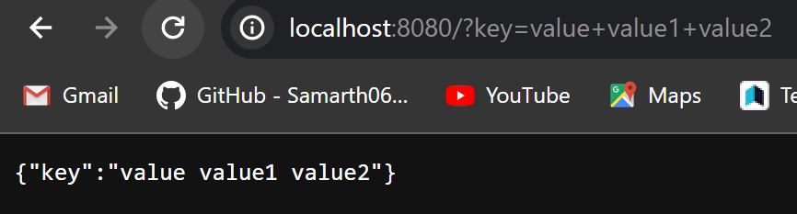
Express Methods
Query: We get query as object from url. (e.g when req.query in res.send)

Slide 14
Templating
We have res.render(view,[local],[callback]): Here view is the templating engine, that is going to be used.
Templating : Rendering the pages with our changes in it.

