Slide 1
Student Attendence System
Students Name:
Sachin chaudhary(20scse1280021)
Section: 1
Program: B.Tech in Computer Science
Specialization: AI-DS
Supervised By:
Mr. Mohd. Anas
Reviewed By:
Ms . Sudhriti Sen

Slide 2
1) INTRODUCTION 2) ABOUT STUDENT ATTENDENCE SYSTEM 3) WHY STUDENT ATTENDENCE SYSTEM IS IMPORTANT 4) PROBLEM IDENTIFICATION 5) SOLUTION 6) CONCLUSION
CONTENTS

Slide 3
Attendance Management System is a software developed for daily student attendance in schools, colleges, and institutes. It facilitates to access the attendance information of a particular student in a particular class. The information is sorted by the operator, which will be provided by the lecturer or teacher for the particular class. This will also help in evaluating the attendance eligibility criteria of the student for exams. As for system development and implementation is concerned, it should help teachers or lecturers in managing their student attendance systematically. The system must have a database that contains a student or student information and it must help the lecturer or teacher to manipulate data, update the database, alert the manager as and when needed. The developed system considers as an alternative to the traditional one, it is easy, fast and reliable than the traditional one, especially after the development of information technology and its usage by educational institutions. Therefore, the design of student attendance system has a significant reality meaning.
INTRODUCTION

Slide 4
Attendance is one of those administrative tasks that must be done at the start of each class. It can take up valuable time at the beginning of class and sometimes be difficult to manage. Attendance books traditionally are big grids with tiny squares that are hard to read and can be easy to make errors in. With QuickSchools' Online Student Information System (also known as Online School Management System), taking and managing attendance is no longer a hassle with our easy to use and robust school attendance system. The easy to use online student attendance system designed by QuickSchools make taking attendance quick and less prone to errors. Record a student’s attendance on the colored chart with a click of the mouse. The information pertaining to the student attendance can then be immediately shared with parents via cloud (i.e., online) to help them keep track of their students via our online school management system. With our online school management system, working with an attendance chart has never been so easy. Colorful headers; wide, shaded rows; and a clean, large font make reading your class attendance rooster easier than ever. Online attendance is more efficient for teachers, too. Simply click a button to indicate a student’s presence or absence. No more trying to make a small mark in an even smaller square. The bright and clean pages make managing and maintaining your attendance records a breeze.
ABOUT STUDENT ATTENDENCE SYSTEM

Slide 5
1.Reduce paperwork and save time and money with mobile and cloud-based attendance management system. 2.Eliminate duplicate data entry and errors in time and attendance entries. 3.Improve visibility to track and manage student attendance & absenteeism across multiple campuses.
WHY STUDENT ATTENDENCE SYSTEM IS IMPORTANT

Slide 6
Attendance Management System is software developed for daily student attendance in schools, colleges and institutes. It facilitates to access the attendance information of a particular student in a particular class. This system will also help in evaluating attendance eligibility criteria of a student. By just a click on the mouse, the system will be able to produce the students' attendance report thus reducing the need for manual labour which is prone to human errors and time consuming. This application is built for automating the processing of attendance. It also enhances the speed of performing attendance task easily. The student can only view the attendance record on weekly, monthly, and whole semester basis. The staff can view as well as modify the attendance record. Printing facility for attendance record is available for both students and staff.
PROBLEM IDENTIFICATION

Slide 7
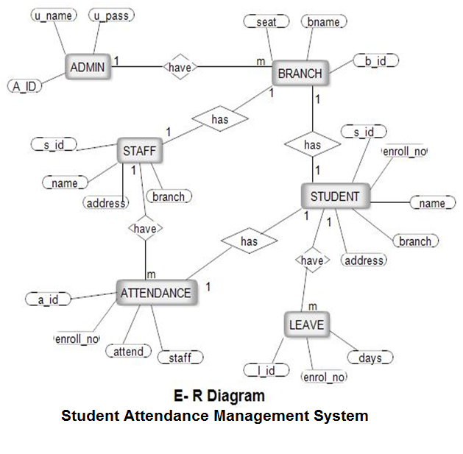
SOLUTION

Slide 8
1. HTML The HyperText Markup Language, or HTML is the standard markup language for documents designed to be displayed in a web browser. It can be assisted by technologies such as Cascading Style Sheets and scripting languages such as JavaScript 2. CSS Cascading Style Sheets is a style sheet language used for describing the presentation of a document written in a markup language such as HTML. CSS is a cornerstone technology of the World Wide Web, alongside HTML and JavaScript. CSS is designed to enable the separation of presentation and content, including layout, colors, and fonts.
What We Use

Slide 9
3.PHP PHP is a programming language used to script websites that are dynamic and interactive. You'll find it in various types of web applications, from e-commerce websites to CRM systems like HubSpot and Salesforce. The term PHP stands for PHP Hypertext Preprocessor. Originally, the "PHP" within the acronym stood for Personal Home Page. But, as the language evolved and caught on, it ended up being used for more than just personal home pages. So, that acronym, in turn, became just the "P" within PHP.

Slide 10
Finally, in the student attendance management system, the outcome of all the hard work done for the attendance management system is here. It is software that helps the user to work with the attendance, fees update, course update, and messages, etc. This software reduces the amount of manual data entry and gives greater efficiency. The User Interface of it is very friendly and can be easily used by anyone. It also decreases the amount of time taken to write details and other modules. All the details about students, teachers, and their other tasks can only be seen by the verified users. This Attendance Management System is a solution to all the problems related to the attendance, message, fee status, courses taken by the teachers and the students, etc. In the end, we can say that this software is performing all the tasks accurately and is doing the work for which it is made and this system can be implemented in N number of colleges and schools.
CONCLUSION

Slide 11
THANK YOU

