Slide 1




Course : GenAI
Lecture On : Scaling and Deploying Generative AI Systems
Instructor : Aditya Bhattacharya
EEdiditt MMaaststeerr tteexxtt ststyleyless
16-05-2021
2

Slide 2



Today’s Agenda
Streamlit and LangChain Application
AWS EC2 Remote Virtual Machines
Docker Containers
LLM App Deployment
16-05-2021
3

Slide 3
StreamLit Application
Streamlit is an open-source Python library that makes it easy to create and share beautiful, custom web apps for machine learning and data science. In just a few minutes you can build and deploy powerful data apps.
Example Streamlit Apps:
https://bgremoval.streamlit.app/
https://whitphx-streamlit-stt-app-app-deepspeech-m6tt1k.streamlit.app/
https://streamlit.io/

Slide 4
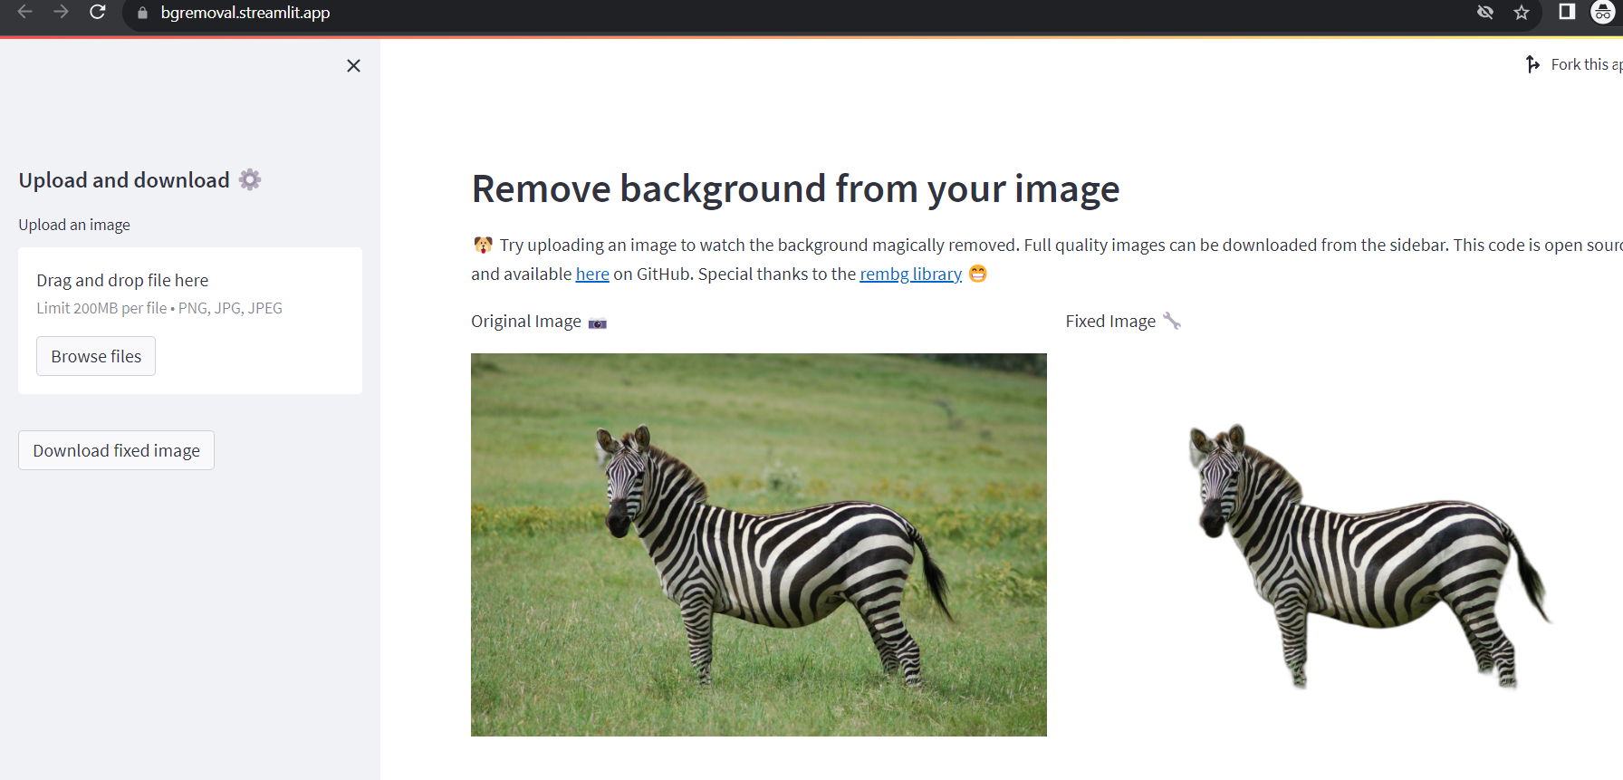
StreamLit Application
https://bgremoval.streamlit.app/

Slide 5
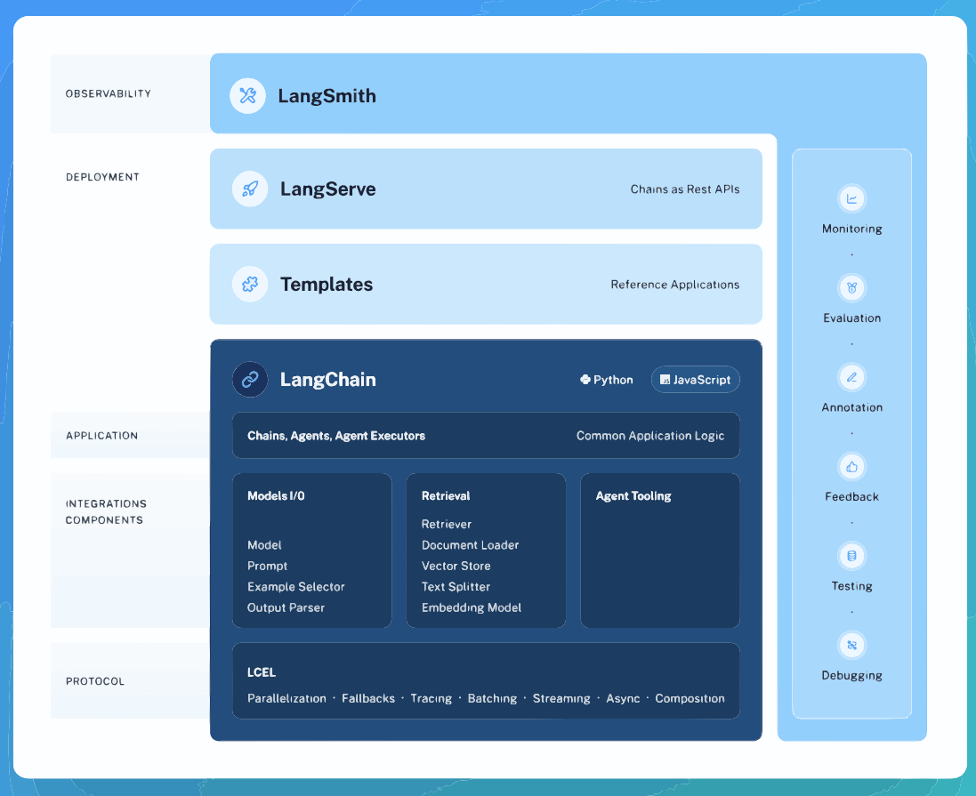
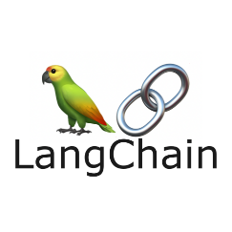
LangChain
LangChain is a framework for developing applications powered by language models.
https://python.langchain.com/docs/get_started/introduction

Slide 6
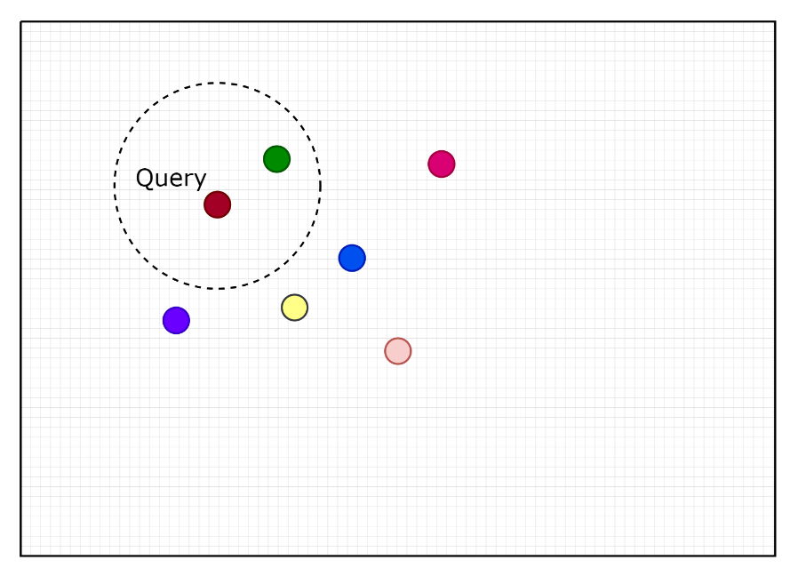
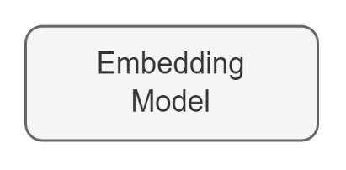
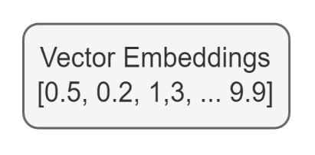

Vector Databases
Vector stores specializes in storing and retrieving high-dimensional vector embeddings
They are designed to efficiently manage and index high-dimensional vectors allowing for fast similarity searches

Slide 7

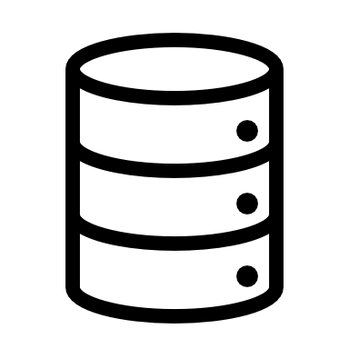


Difference between RDBMS and VDBMS
Features | Relational Database | Vector Store
Architecture | Traditional relational databases are designed for storing and querying structured data | Vector stores are specifically designed for storing unstructured data, such as text or images in the form of vector embeddings
Data Storage | Traditional relational databases store data in tables with rows and columns | Vector embeddings are stored as vectors or arrays
Querying | Querying traditional databases involves comparing specific values in specific columns. | Vector stores are optimized for similarity search, clustering, and classification tasks
Information Retrieval | Information retrieval of vector embeddings from a traditional RDBMS is sub-optimal | Information retrieval of vector embeddings is efficient due to vector-specific indexing methods like HNSW or IVF that can retrieve similar vectors quickly

Slide 8


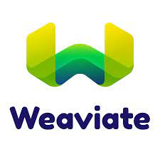
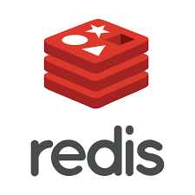
Vector Databases
Features | FAISS | Chroma | Pinecone | Weaviate
Open Source | Yes | Yes | No | No
Cloud-native/Self-hosted | Self-hosted | Self-hosted | Cloud-native | Both
Free Tier | Yes | Yes | Yes | Yes
Multiple Distance Metrics Supported | Yes | Yes | Yes | Yes
Multiple indexing | Yes | Not yet | Yes | Not yet

Slide 9
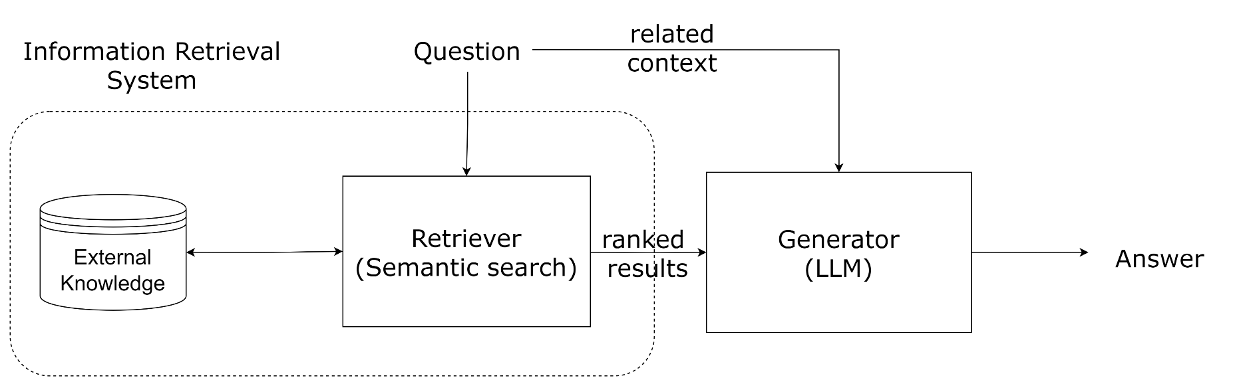
Retrieval Augmented Generation (RAG)

Slide 10
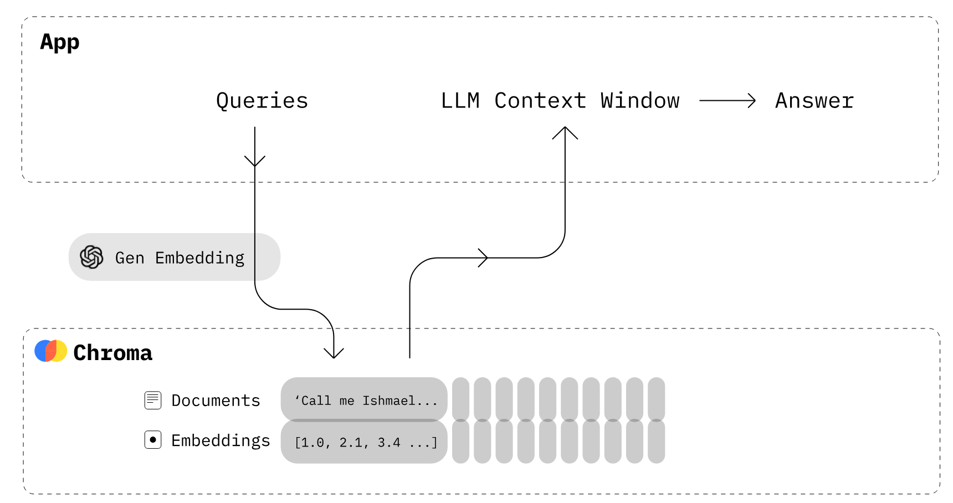

Slide 11


RAG Pipeline
Embedding Layer
Search & Rank Layer
Generation Layer

Slide 12

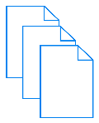

Step 1: Build the Vector Store
Embedding Model
Step 2: Embed the Query and Perform Semantic Search
Query
Embedding
Index search Vector DBs
Indexes of top-k closest documents/chunks for the query
+
Step 3: Pass Prompt with Query and Relevant Document to LLM
Query
Prompt
Retrieved Relevant Documents
+
+
LLM
Model Response

Slide 13
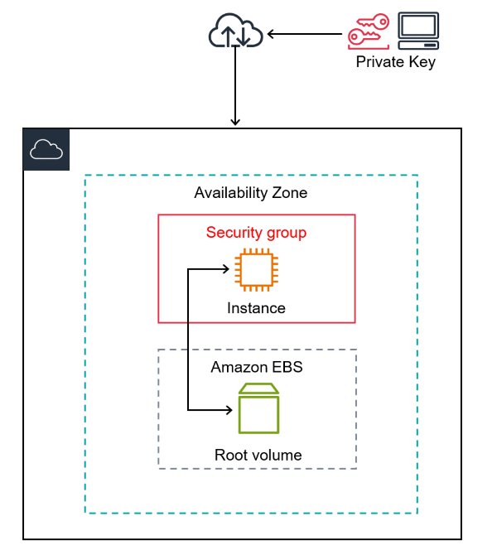
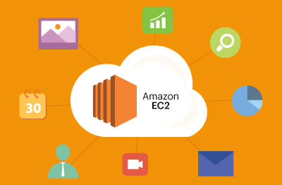
AWS EC2 Cloud VM
https://docs.aws.amazon.com/AWSEC2/latest/UserGuide/EC2_GetStarted.html

Slide 14
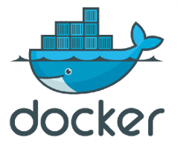


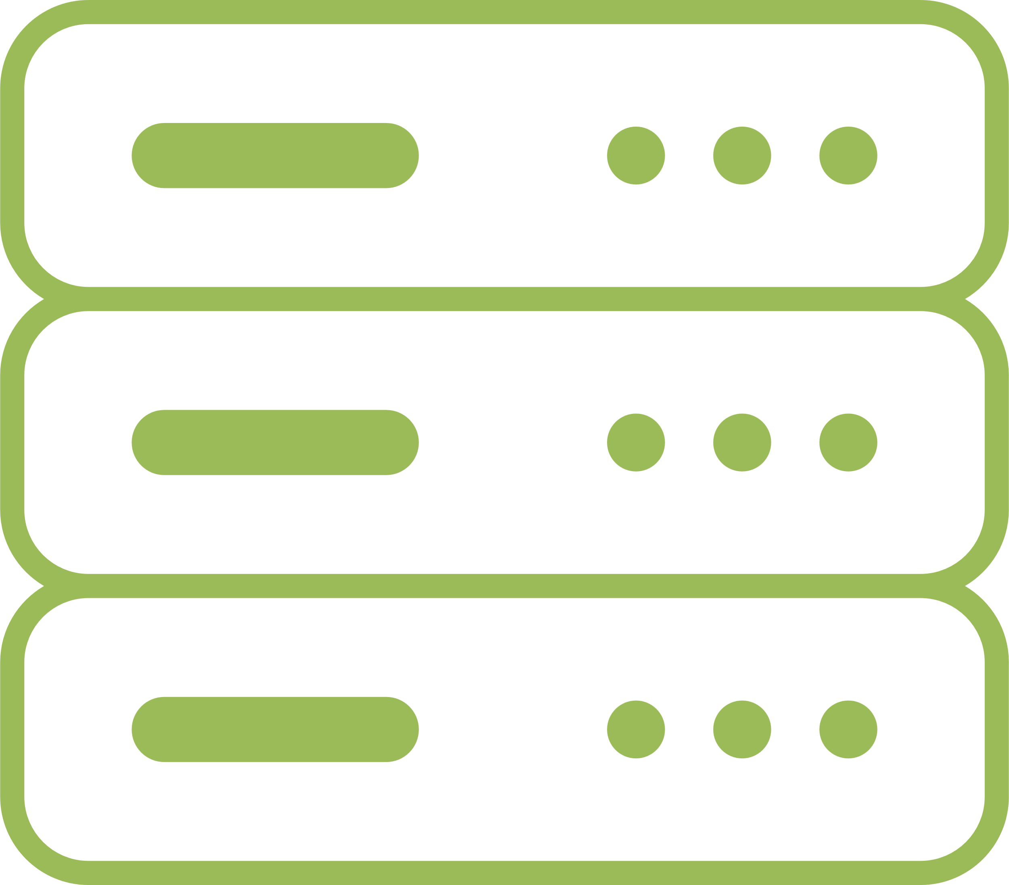
INTRODUCTION TO DOCKER
Whenever you pass on your model to the testing/deploying stage which is totally on different environment, your model may not work as the entire model working depends on libraries, frameworks, configuration etc.
Docker solves this problem by providing a complete environment where you can develop, ship and run your models anywhere. Therefore it is called as container management service as it provides an environment through which lets you run the model easily without any problem of dependencies.
Build
Ship
Run
Develop an app using Docker containers with any language and any toolchain
Ship the “Dockerised” app and dependencies anywhere – to QA, teammates, or the could – without breaking anything
Scale to 1000s of nodes, move between data centers and clouds, update with zero downtime and more

Slide 15
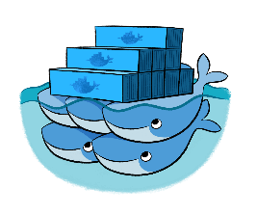
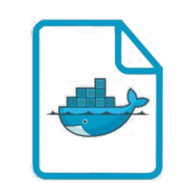
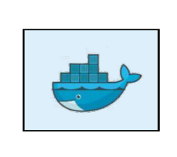

Docker Workflow
Docker hub
A cloud service for sharing applications and automating workflows
Pull
Push
Build
Run
Docker file
Docker image
Docker container
It contains everything you need to run in a container
Notes:
It is a simple text file with a set of command or instruction. These commands/instructions are executed successively to perform actions on the base image to create a new docker image.
comments and commands + arguments are two kinds of main line blocks in Dockerfile syntax

Slide 16

UNDERSTANDING ML PIPELINES
Model Training
(.h5/,pkl/.joblib)
AI Applications
Production
Create a docker image to containerize our AI application

Slide 17

Let’s see an example

Slide 18

Thank You !

