Slide 1
ROUGE (Recall-Oriented Understudy for Gisting Evaluation).

Slide 2
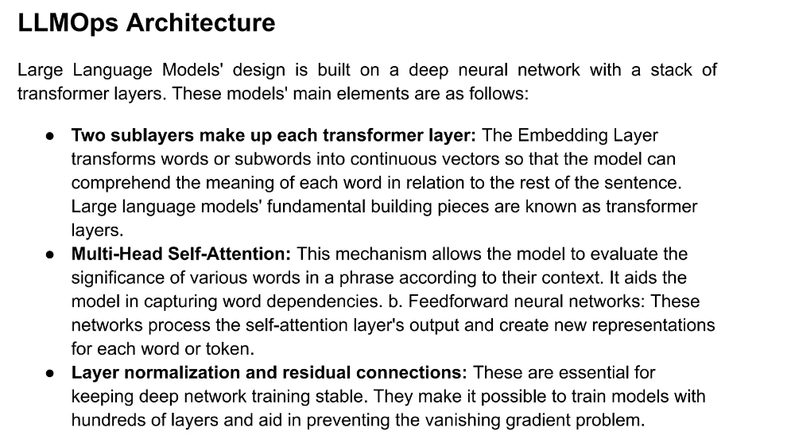

Slide 3
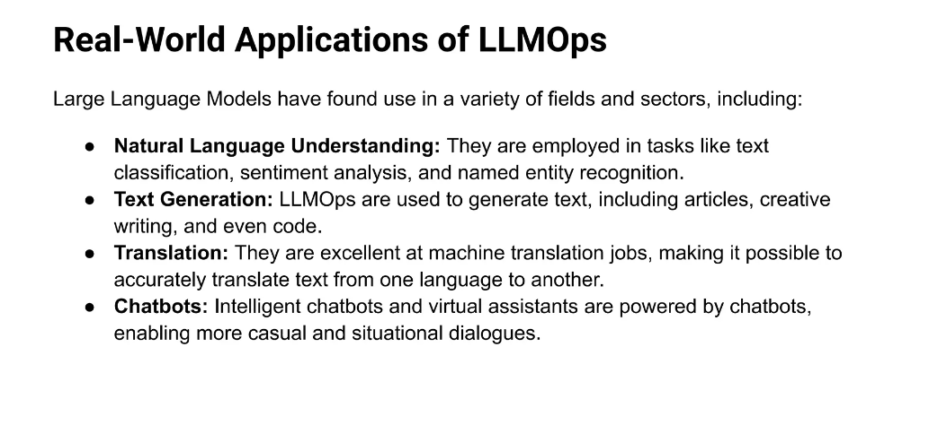

Slide 4
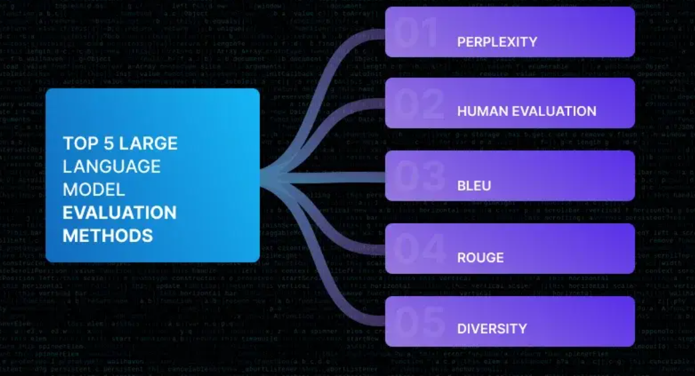

Slide 5
ROUGE, which stands for Recall-Oriented Understudy for Gisting Evaluation, is a metric used to assess the quality of machine-generated text, especially when compared to human-generated reference texts. It plays a pivotal role in the evaluation of content generated by Large Language Models, making it a crucial tool in natural language processing and text generation.

Slide 6
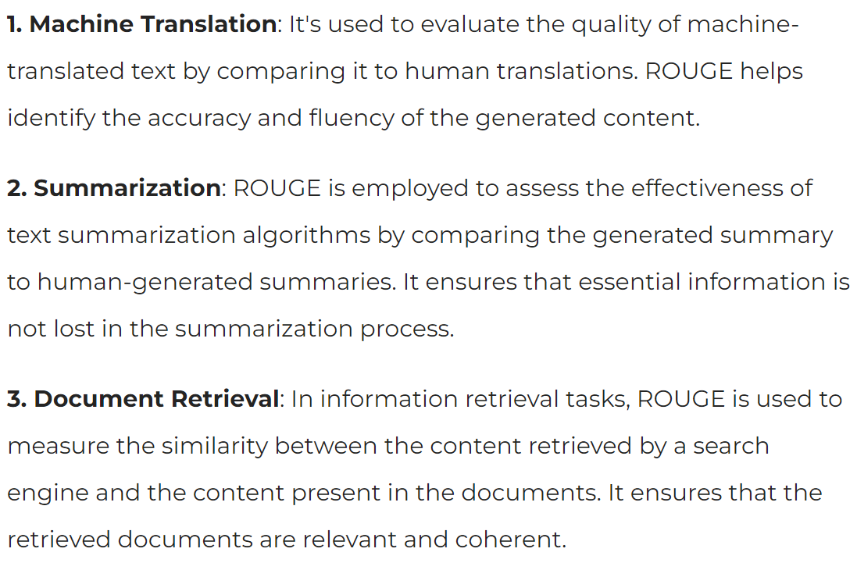
Use Cases and Importance of ROUGE SCORE

Slide 7
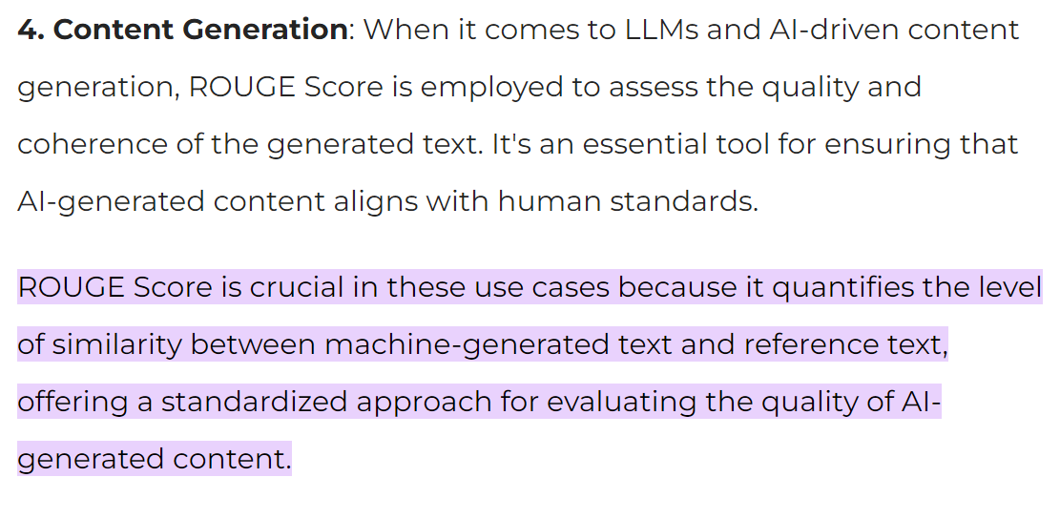

Slide 8
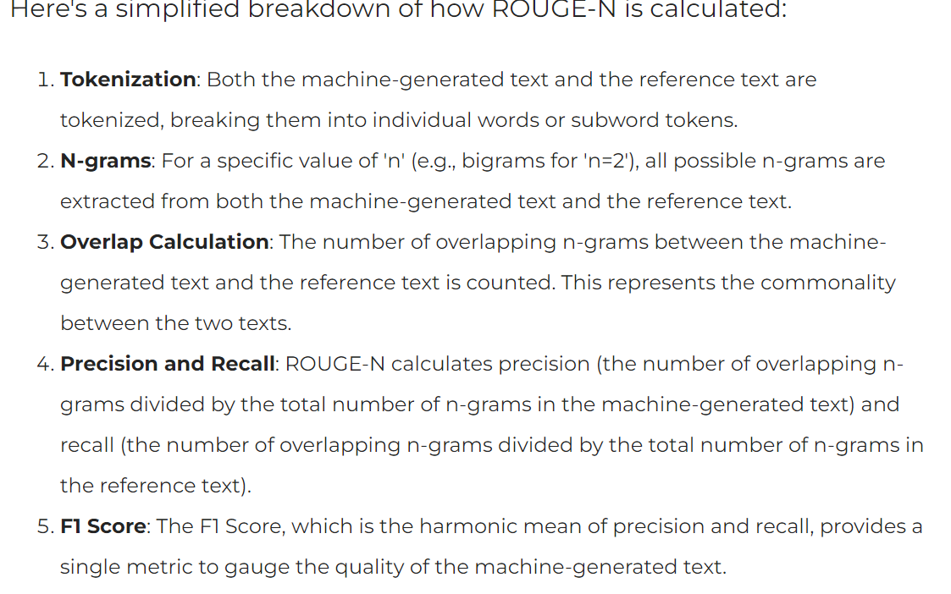
ROUGE Score is calculated by comparing the machine-generated text to one or more reference texts created by humans. The most common ROUGE metric is ROUGE-N, which assesses the overlap of n-grams (contiguous sequences of n words) between the machine-generated text and the reference text.

Slide 9
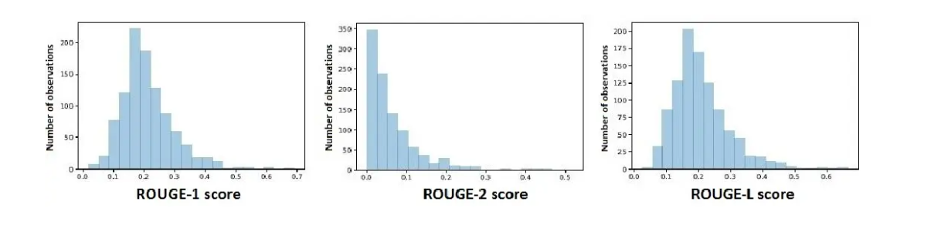
ROUGE-N can be extended to ROUGE-L (measuring longest common subsequence), ROUGE-W (measuring weighted longest common subsequence), and more, depending on the specific evaluation requirements. Each of these metrics offers a distinct perspective on the quality of the generated content

Slide 10
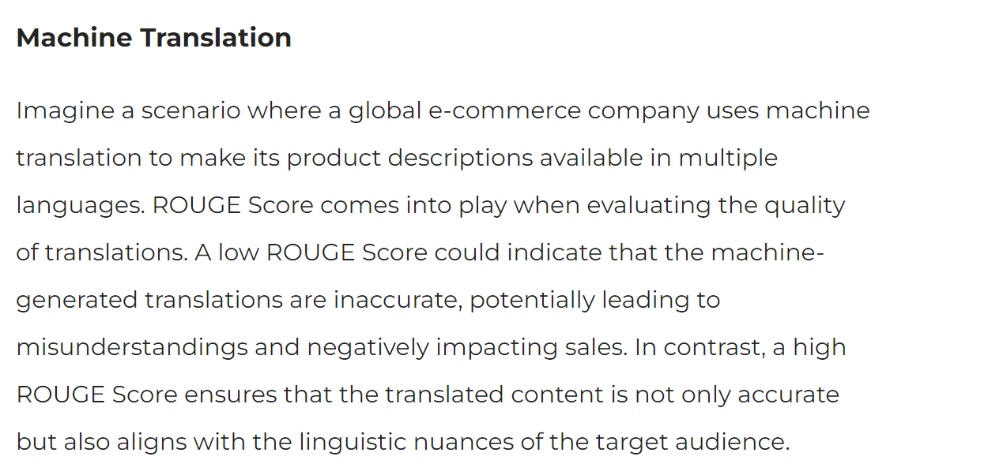
ROUGE Score in Real-Life Scenarios

Slide 11
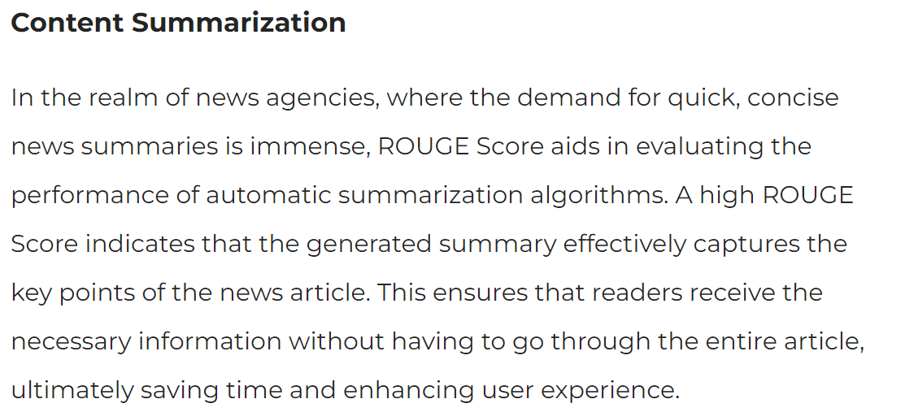

Slide 12
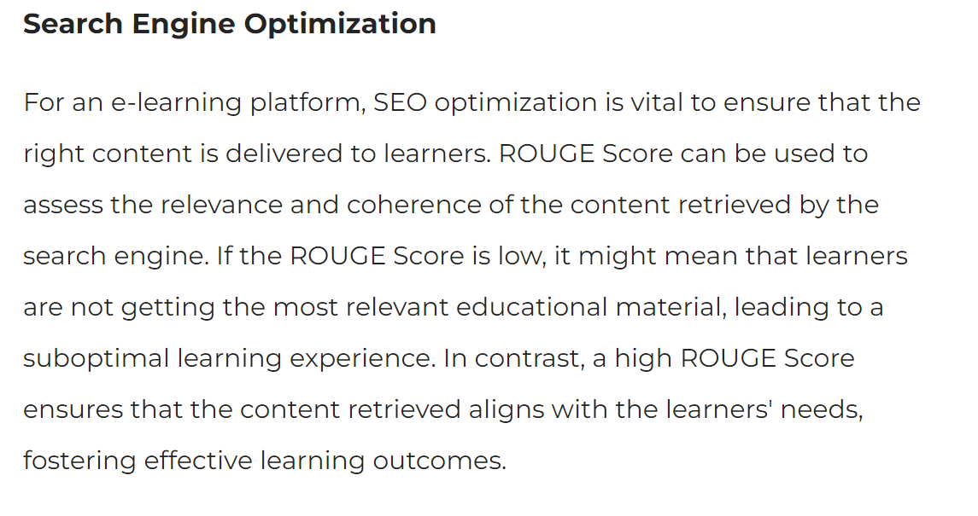

Slide 13
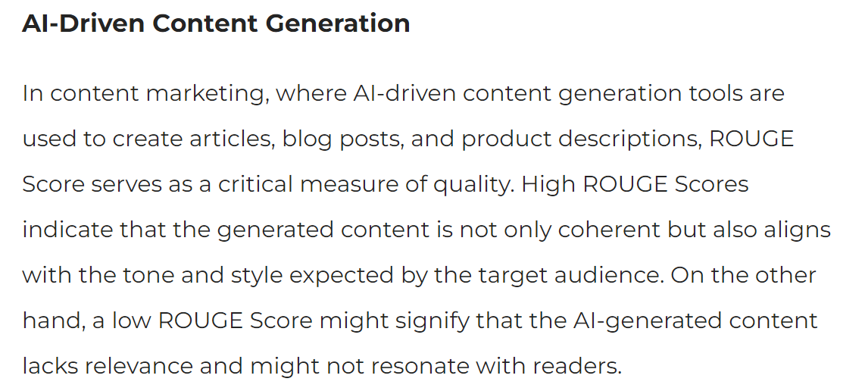

Slide 14
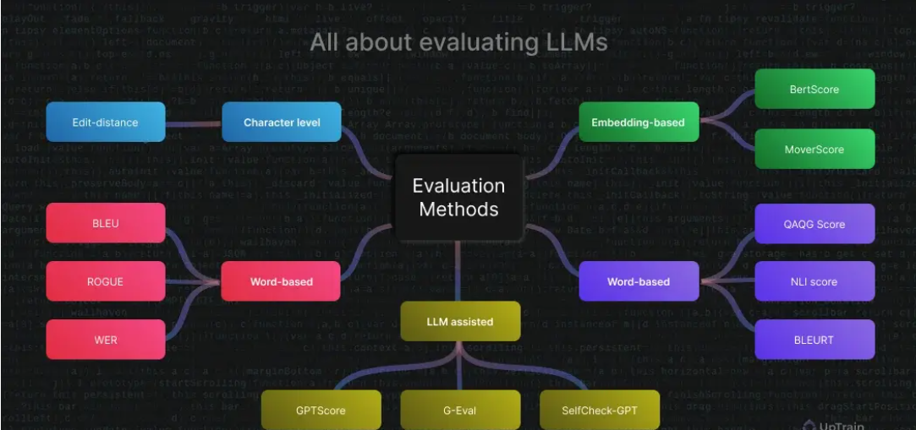

Slide 15
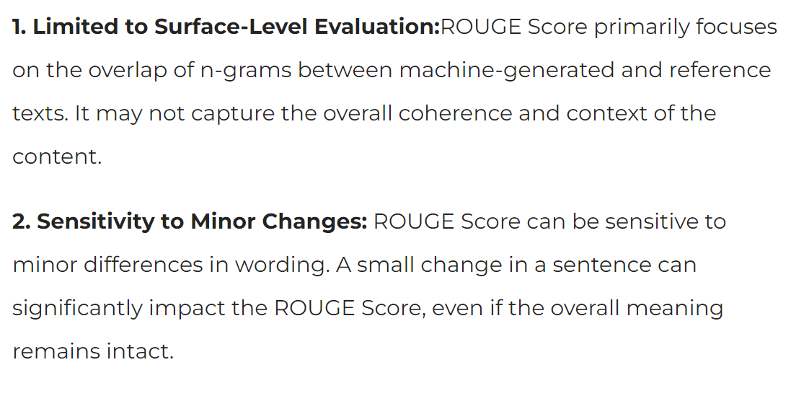
Issues with ROUGE Score?

Slide 16
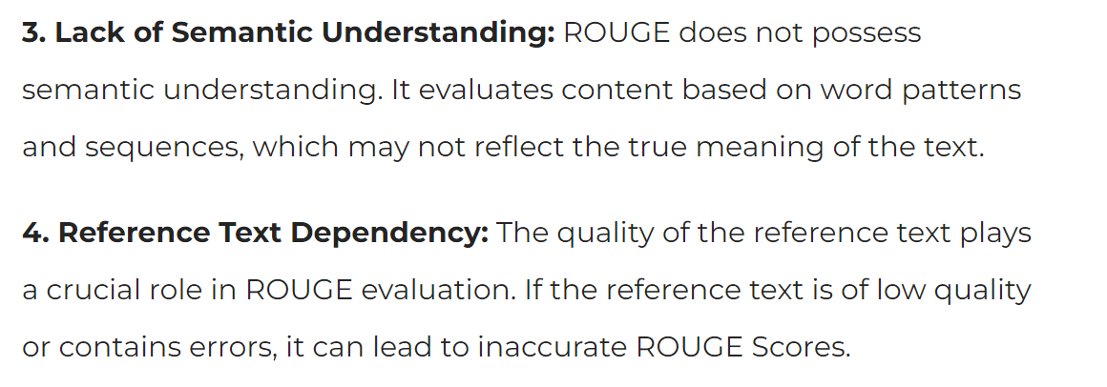

Slide 17
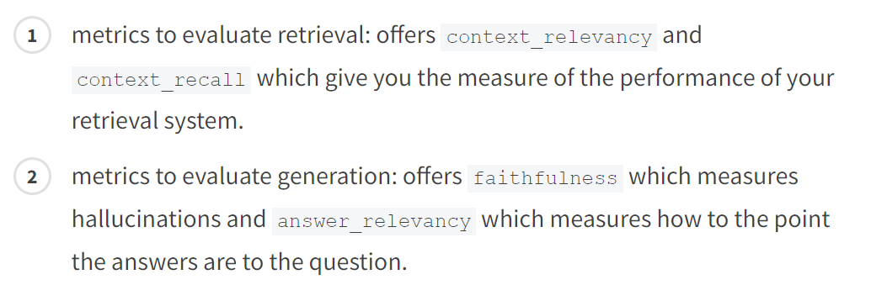
Ragas is a framework that helps you evaluate your QA pipelines across these different aspects. It provides you with a few metrics to evaluate the different aspects of your QA systems namely

Slide 18
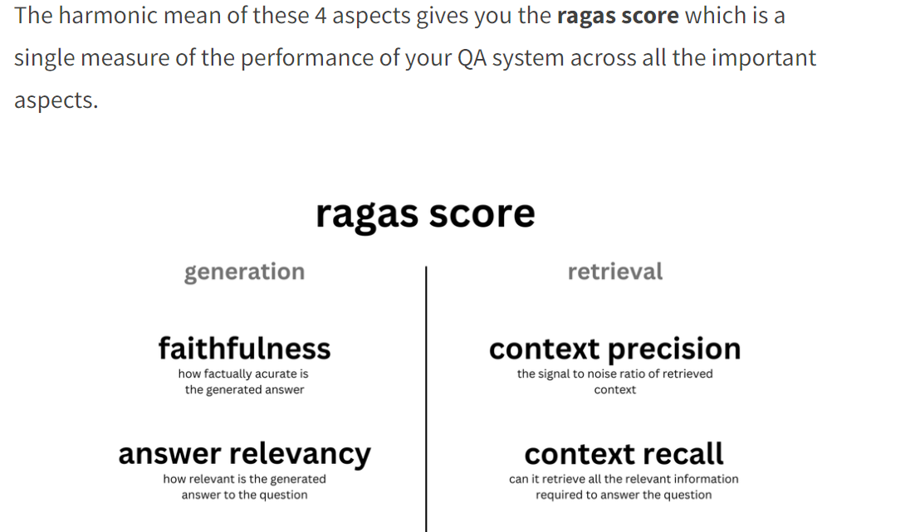

Slide 19
BLEU, or the Bilingual Evaluation Understudy

Slide 20
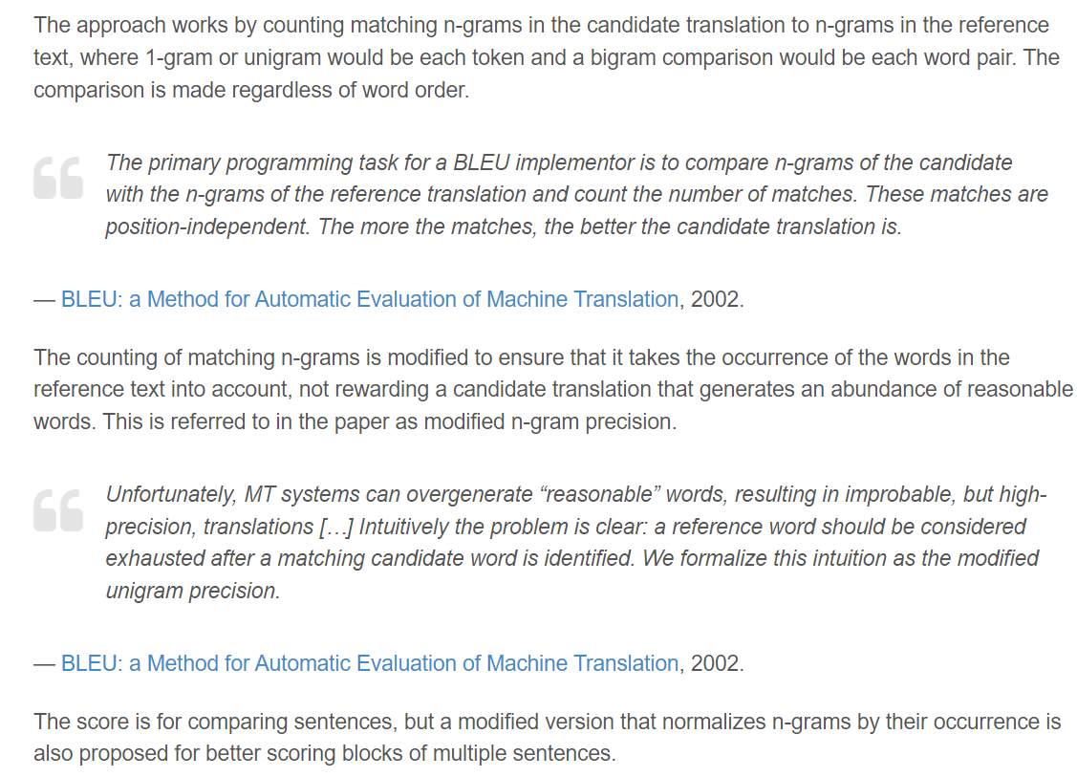

Slide 21
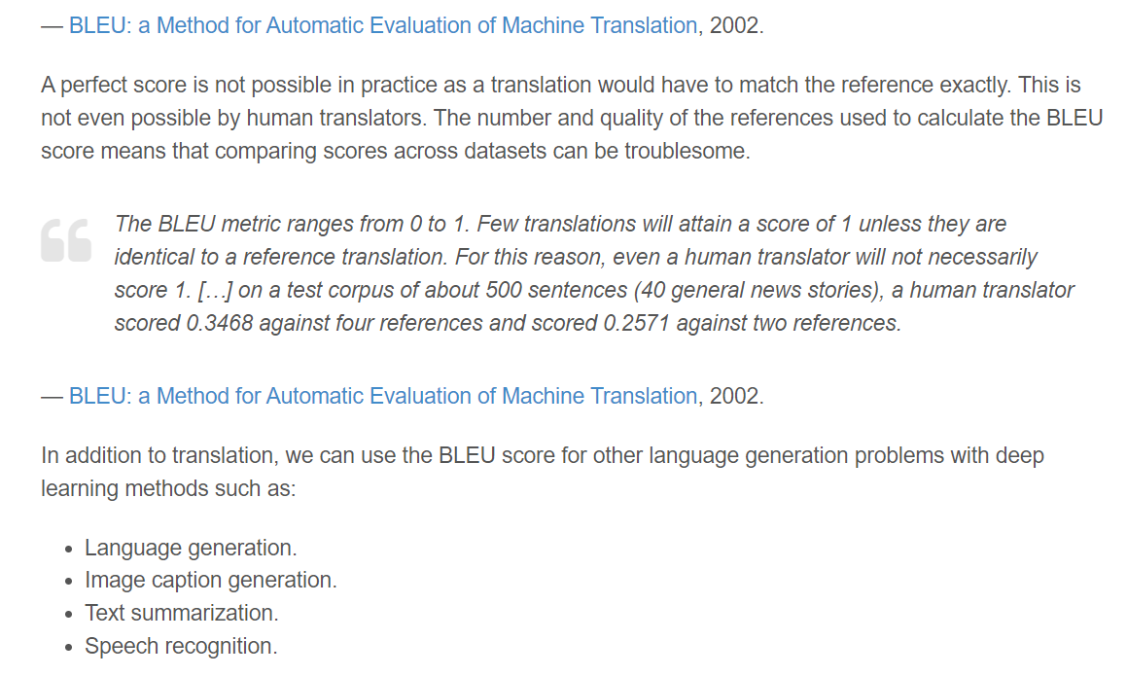

Slide 22
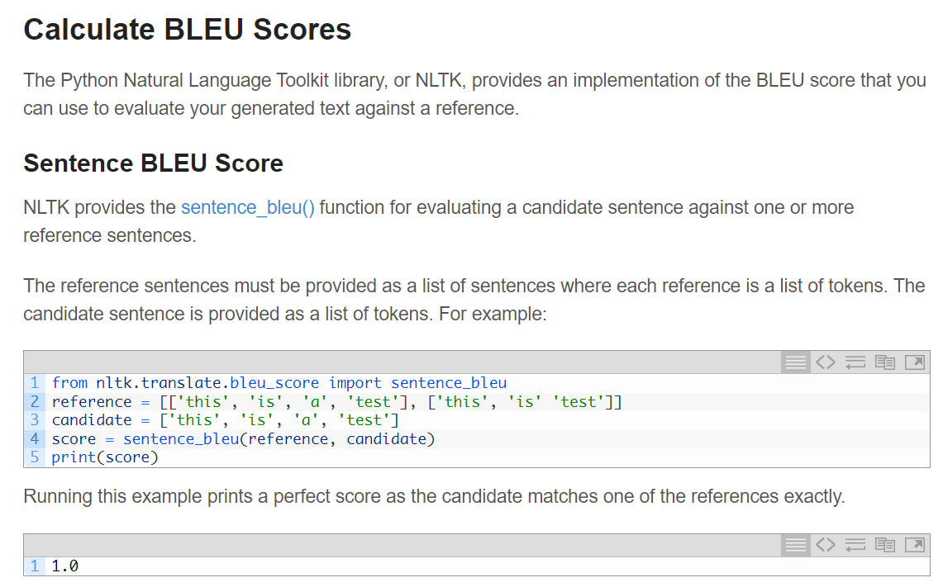

Slide 23
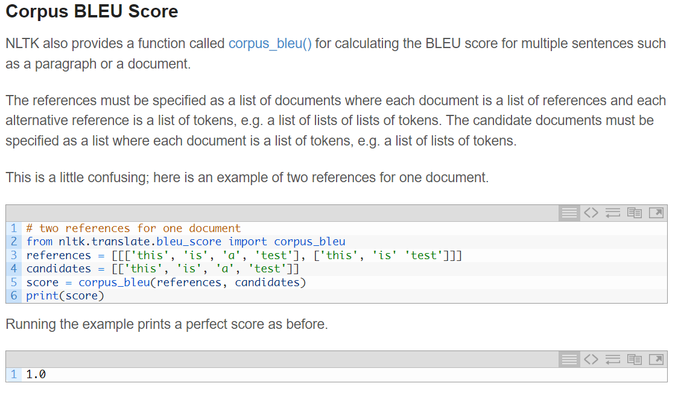

Slide 24
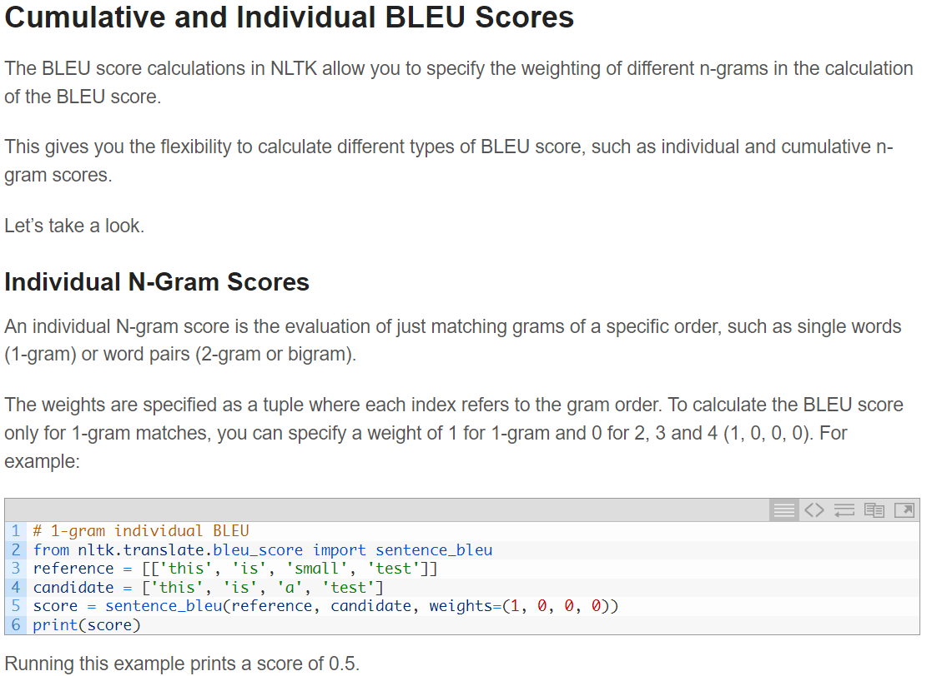

Slide 25
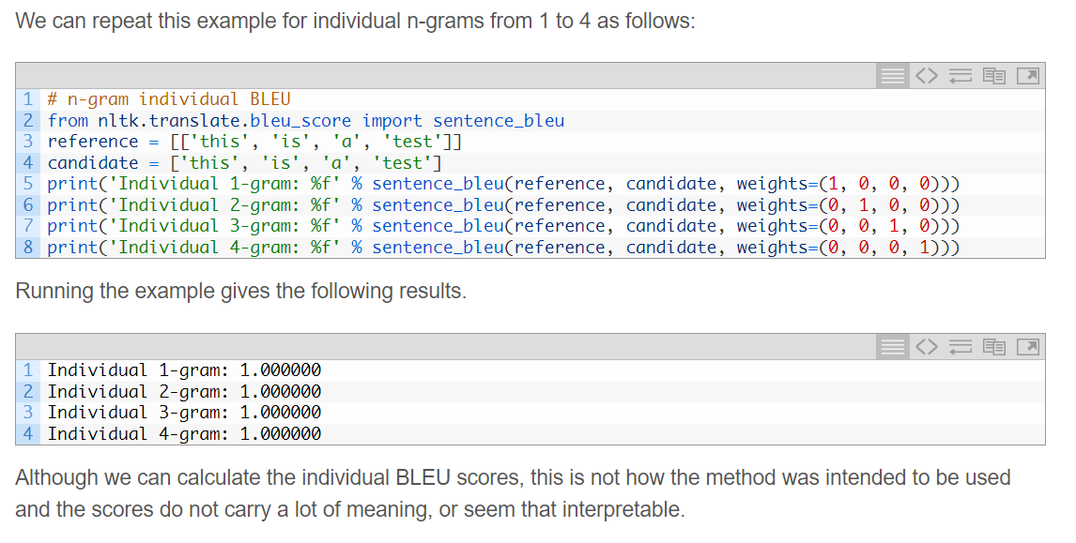

Slide 26
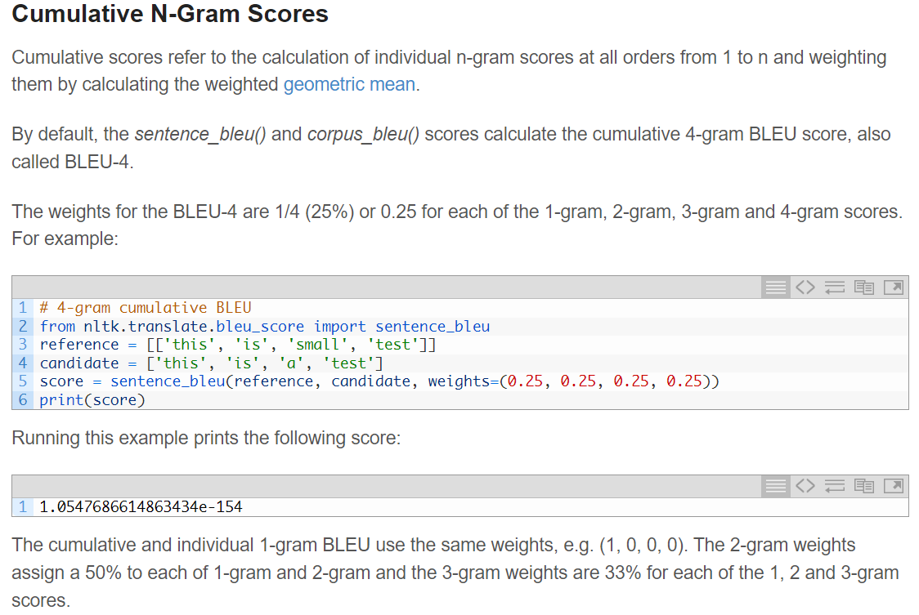

Slide 27
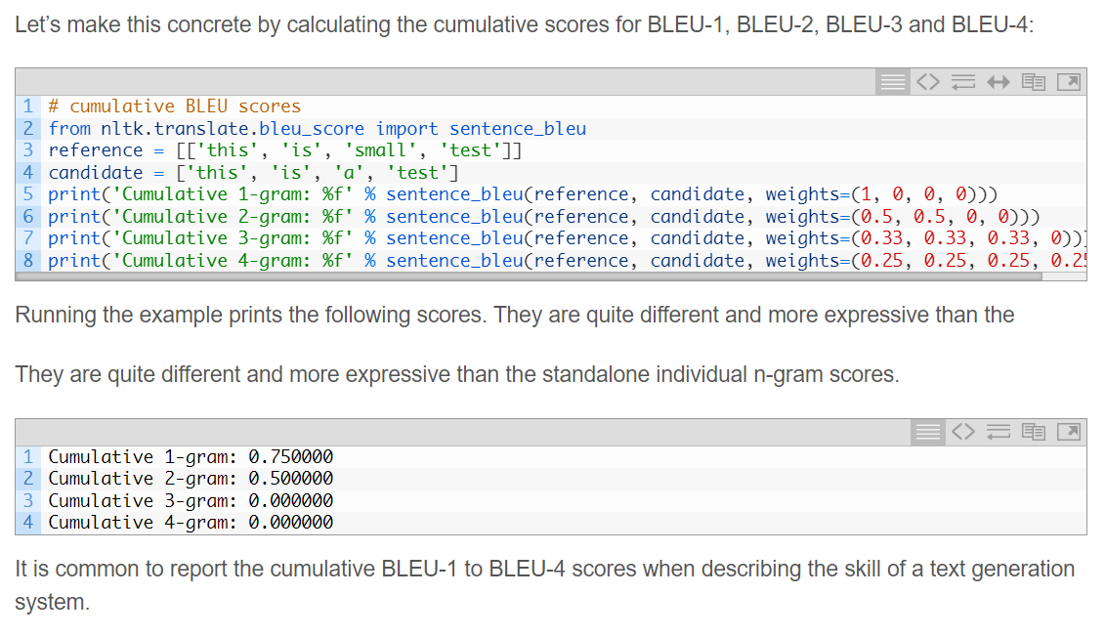

Slide 28
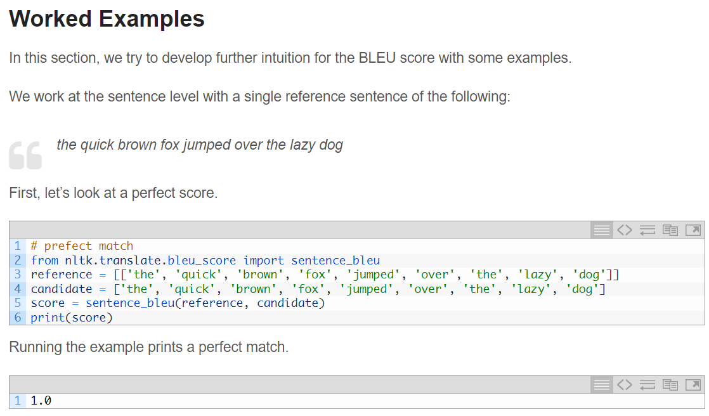

Slide 29
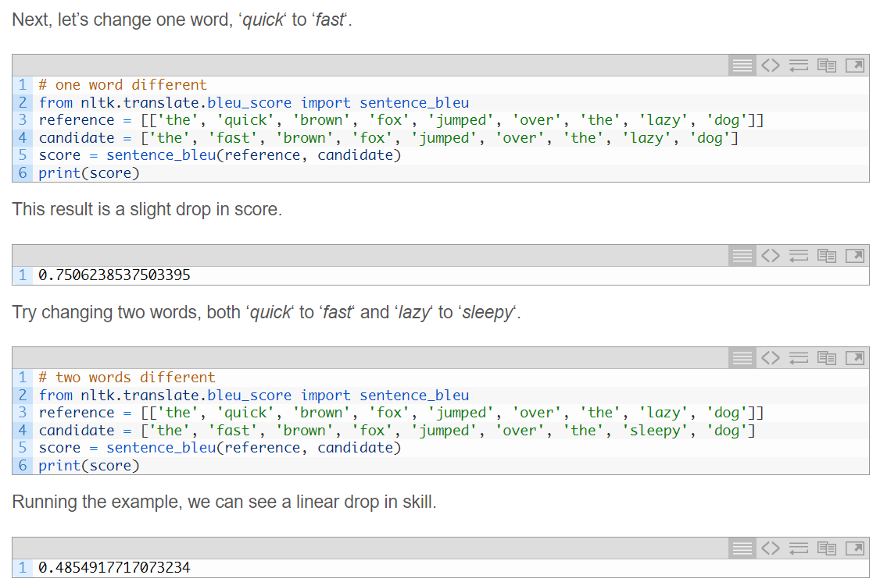

Slide 30
