Slide 1
WORD Embeddings
Word embeddings are a way of representing words as vectors in a high-dimensional space, where each dimension corresponds to a feature/set of features representing the word.
These features can be anything from the frequency of the word in a corpus to its semantic meaning. The key idea underlying the principle of word embeddings is that words with similar meanings and contexts tend to be grouped close together in a high-dimensional space.
They are created using algorithms such as Word2vec and GloVe and have many applications in information retrieval, language modelling and other areas of NLP.

Slide 2
WORD Embeddings
We do not have to specify this encoding by hand. An embedding is a dense vector of floating point values (the length of the vector is a parameter you specify).
Instead of specifying the values for the embedding manually, they are trainable parameters (weights learned by the model during training, in the same way a model learns weights for a dense layer).
It is common to see word embeddings that are 8-dimensional (for small datasets), up to 1024-dimensions when working with large datasets. A higher dimensional embedding can capture fine-grained relationships between words, but takes more data to learn.

Slide 3
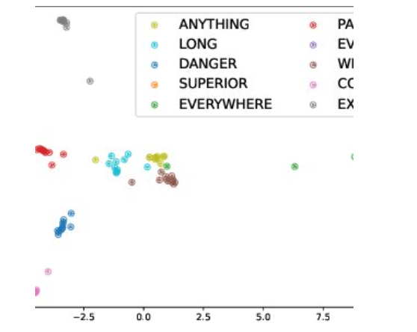
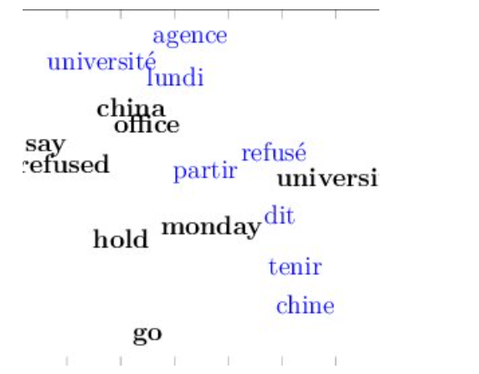
WORD EMBEDDINGS

Slide 4
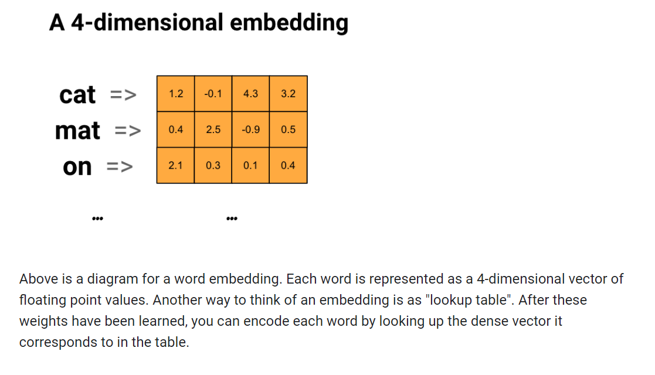
WORD Embeddings

Slide 5
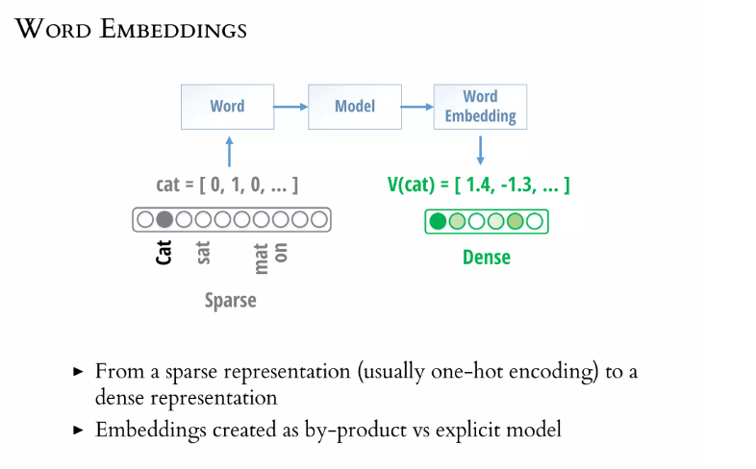

Slide 6
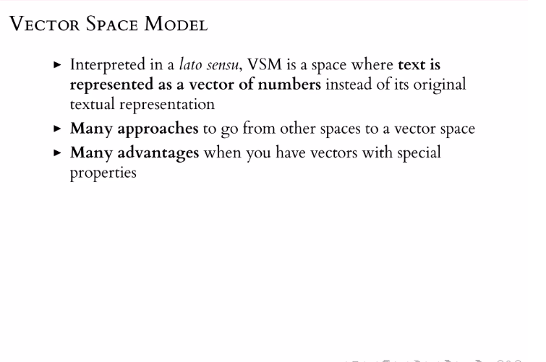
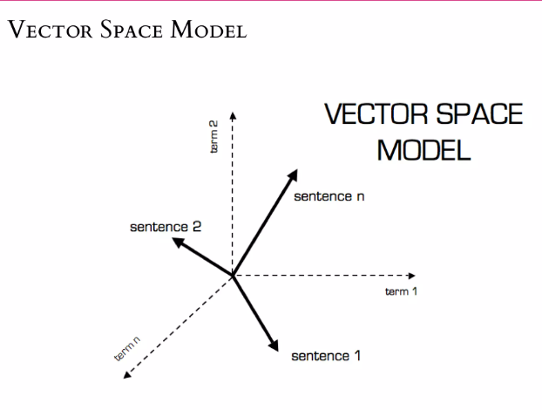

Slide 7
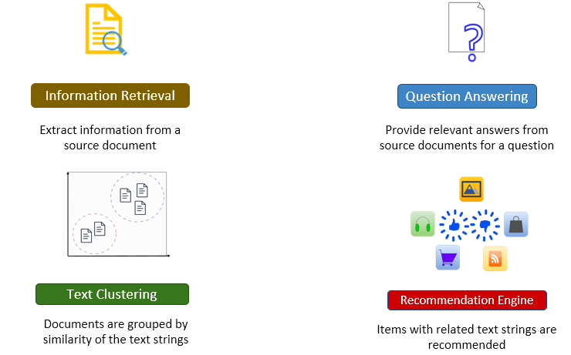
Applications of Word Embedding

Slide 8
Applications in NLP
Embeddings and distance metrics find applications in a wide range of NLP tasks. A few examples are listed below:
Information retrieval: In search engines, embeddings help match user queries with relevant documents. By calculating the similarity between query embeddings and document embeddings, search engines can rank results effectively.
Sentiment analysis: Embeddings can be used to analyse the sentiment of text. Similarity between the embedding of a word in a sentence and a sentiment lexicon can indicate the sentiment of the sentence.
Machine translation: In machine translation models, embeddings help align words or phrases in the source and target languages. Similar embeddings indicate translation equivalents.
Clustering and classification: Text clustering and classification tasks benefit from embeddings and distance metrics. Similarity-based clustering and classification are common approaches.

Slide 9
Goal of Word Embeddings
To reduce dimensionality
To use a word to predict the words around it
Interword semantics must be captured
How are Word Embeddings used?
They are used as input to machine learning models. Take the words —-> Give their numeric representation —-> Use in training or inference
To represent or visualize any underlying patterns of usage in the corpus that was used to train them.

Slide 10
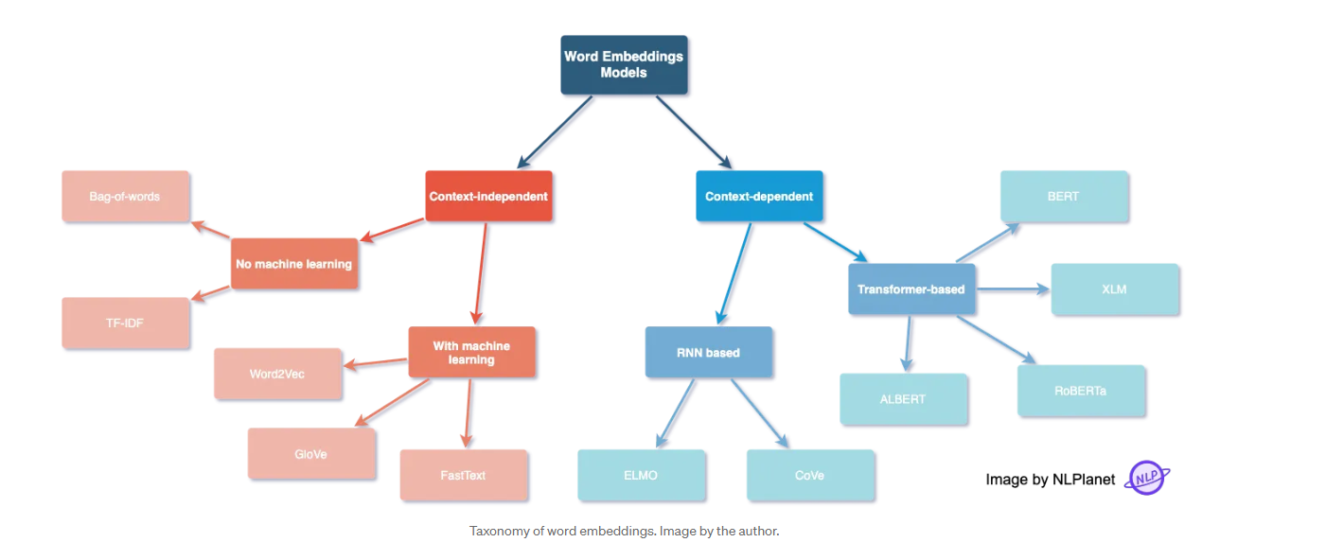

Slide 11
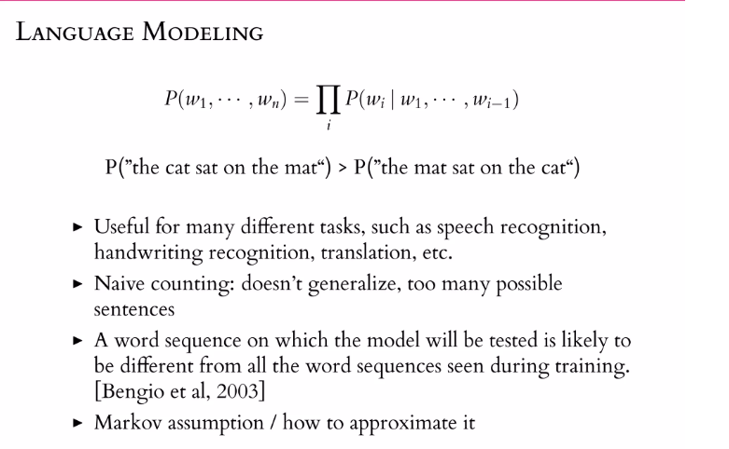

Slide 12
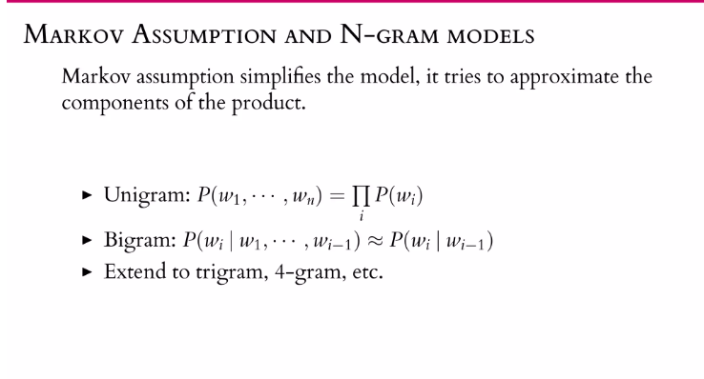

Slide 13
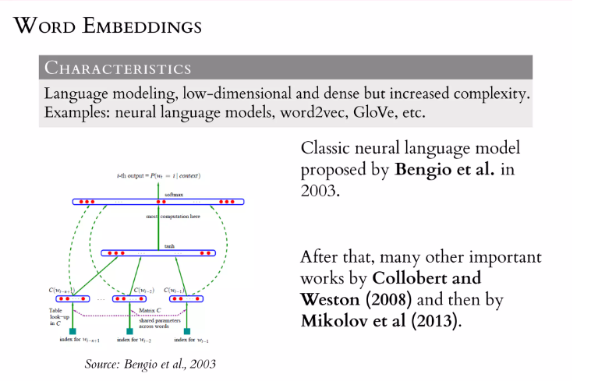

Slide 14
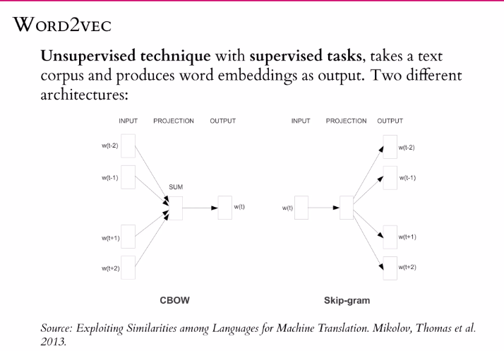

Slide 15
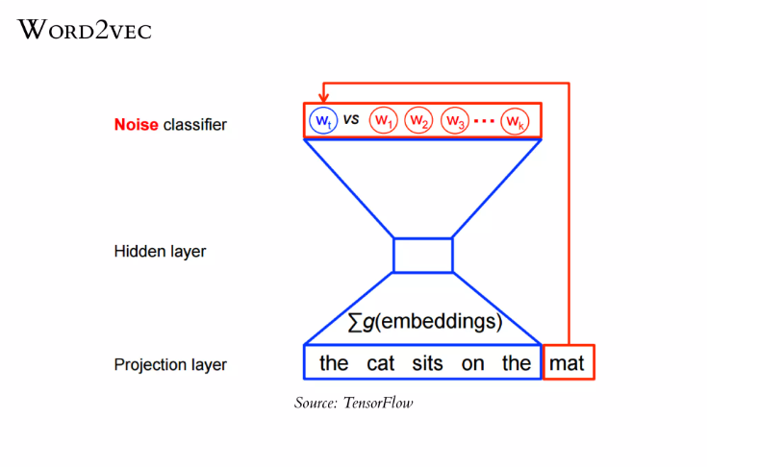

Slide 16
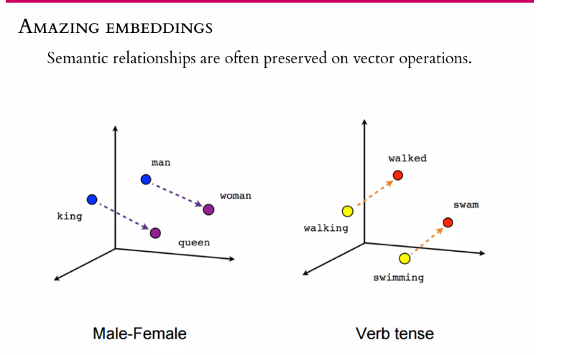

Slide 17
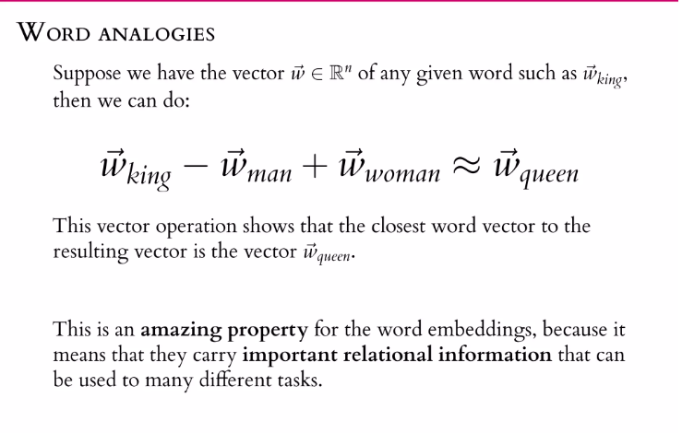

Slide 18
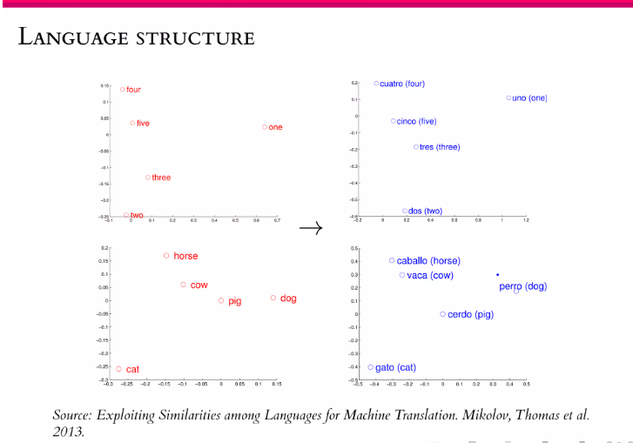

Slide 19
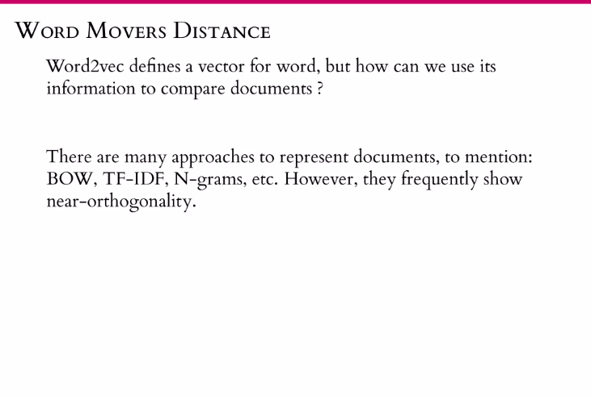
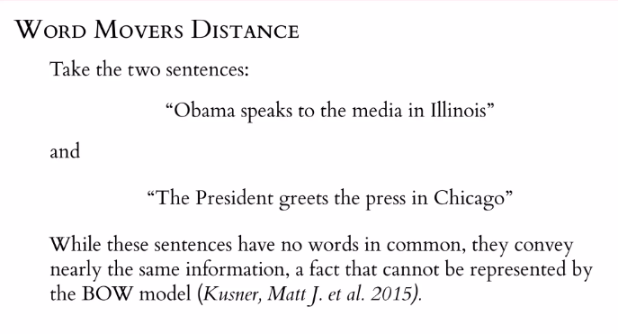

Slide 20
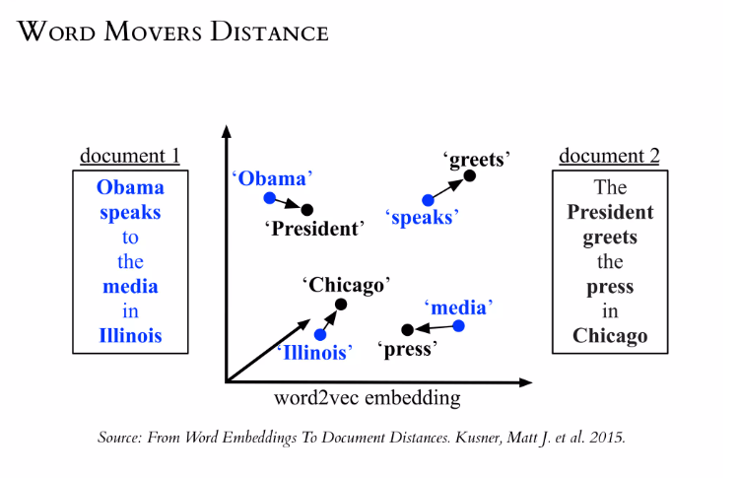
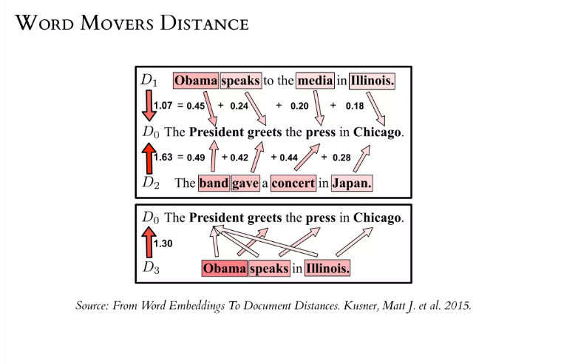

Slide 21
Benefits of using Word Embeddings:
It is much faster to train than hand build models like WordNet(which uses graph embeddings)
Almost all modern NLP applications start with an embedding layer
It Stores an approximation of meaning
Drawbacks of Word Embeddings:
It can be memory intensive
It is corpus dependent. Any underlying bias will have an effect on your model
It cannot distinguish between homophones. Eg: brake/break, cell/sell, weather/whether etc.

Slide 22
Search Systems
Since the use of LLMs has become mainstream, augmenting the capabilities of LLMs to provide more relevant and accurate information by providing them with a knowledge base has become an active research area. One such active area is in the field of information retrieval and search systems.
the term ‘search’ primarily refers to the information retrieval process that is usually employed to extract relevant information from source documents based on the user’s query

Slide 23
Semantic Search
Semantic search can be considered to be a subset of information retrieval that seeks to improve search accuracy by understanding the user's intent and the contextual meaning of terms by applying the principles of embedding space.
Semantic search uses vector search and machine learning techniques to return results that aim to match a user’s query even when there are no word matches.

Slide 24
Generative search refers to the use of generative artificial intelligence (AI) algorithms and techniques to explore and generate new content, ideas or solutions based on user's query. It is a next-generation approach to online search that leverages AI to produce contextual answers to complex questions and generate unique outputs. Generative search relies on generative AI models such as ChatGPT and user prompts or inputs to generate new content in response to a user query.
Increased personalisation and outputs: By leveraging the generative capabilities of LLMs to generate content such as text, images, audio, program code and more from a given sample, traditional search systems can be enhanced to produce new outputs that are unique to a particular searcher and their search habits. This can lead to a more personalised and tailored search experience.
Enhanced user experience: Generative search results can deliver a better user experience by compiling an answer faster than having to read through individual search results. Users are more likely to find what they are looking for and have a more efficient search experience.

Slide 25
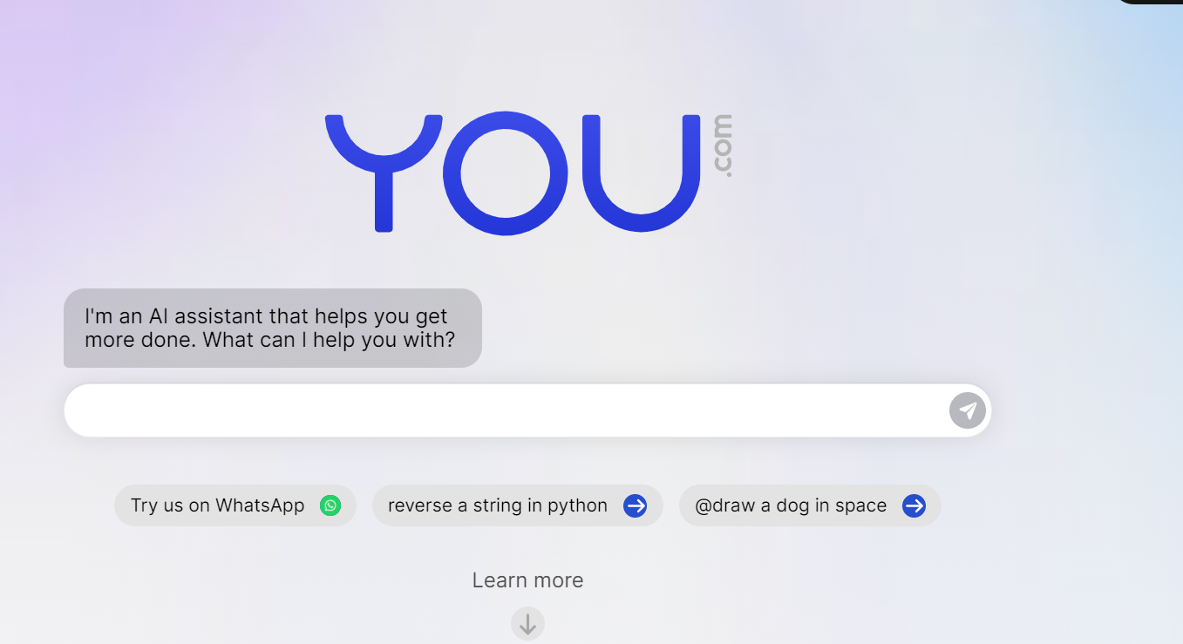
Generative search is an exciting development in the field of AI and has the potential to revolutionise the way we search for information online. Companies such as You.com and Google are exploring generative search capabilities and integrating them into their search engines. By leveraging generative AI algorithms, generative search can provide more personalised and accurate search results, enhancing the overall search experience for users. This new search paradigm is also being increasingly used by organisations for various purposes such as creating question-answering systems, chatbots and semantic search applications.

Slide 26
How Is Generative AI Search Different From Regular Online Search
The regular world wide web search is a manual online research process. Here, you need to type your question or keyword into a search box of the search engine. Search engine providers like Google, Yahoo, Bing, etc., weigh the resulting websites containing the content you want according to some proprietary logic.
For example, the website’s authority on the relevant niche, readership, website page quality, etc. Then, the search engine assigns ranks to each website against your search and shows all websites according to their rank. For instance, a website with rank one will show up on the top of the search engine result pages.
In a nutshell, regular online search engines do not create content. They just syndicate content from several websites. When you click on a search result, you go to a specific website directly.

Slide 27
How Is Generative AI Search Different From Regular Online Search
with the launch of generative search, you will get limited content. The underlying AI will analyze all the search results, generate custom content, and show that to you using a web browser. There could be links to the sources the generative AI used to craft the content it shows you.
If generative AI search becomes the new normal of online search, then you can expect the following additional differences:
The output content from your search query will depend a lot on the polarization of the company that created the generative AI search model
Some schools of thought will prefer XYZ generative AI search tool over the ABC tool. Thus there will be rising anomaly in online search-based works
Such search tools may sometimes come up with similar content, and the publisher may risk uploading plagiarized content on their website
The search result will become intuitive and filled with related content in different forms like texts, images, video, audio, and so on
You will stop visiting websites and interacting with web ads if you get content in a ChatGPT-like interface where there are no distractions
Your online research effort will decrease drastically. You no longer need to read through several web pages and compose your own content
AI developers will come up with new AI-based online advertising and other revenue models to increase their operational profits
There will be less distraction in web search, so the quality of search may decrease a lot

Slide 28
Impacts of Generative AI Search on Search Engines
The popularity of the search giants like Google, Yahoo, DuckDuckGo, and Brave will go down a lot
The ad revenue collected from search engines will also decrease substantially
The free and fair web search results will be impacted, and a new revenue stream will spring up where website owners will pay the generative AI search providers to show content from their pages
Footfall on websites will decrease a lot because the users will get the content they need on a different web pag

Slide 29
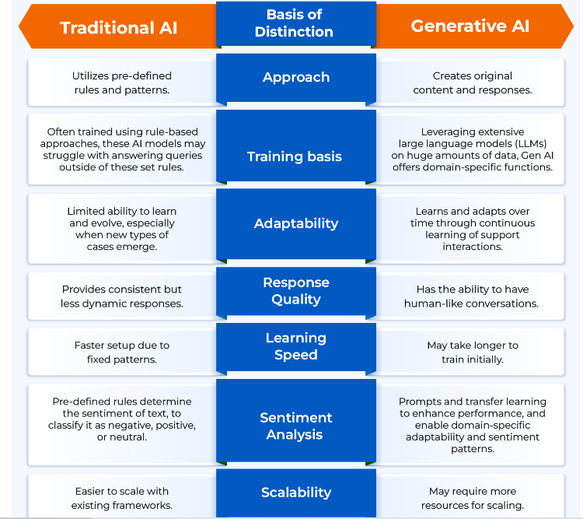

Slide 30

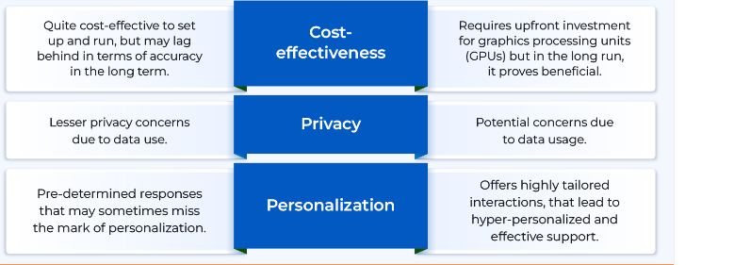

Slide 31
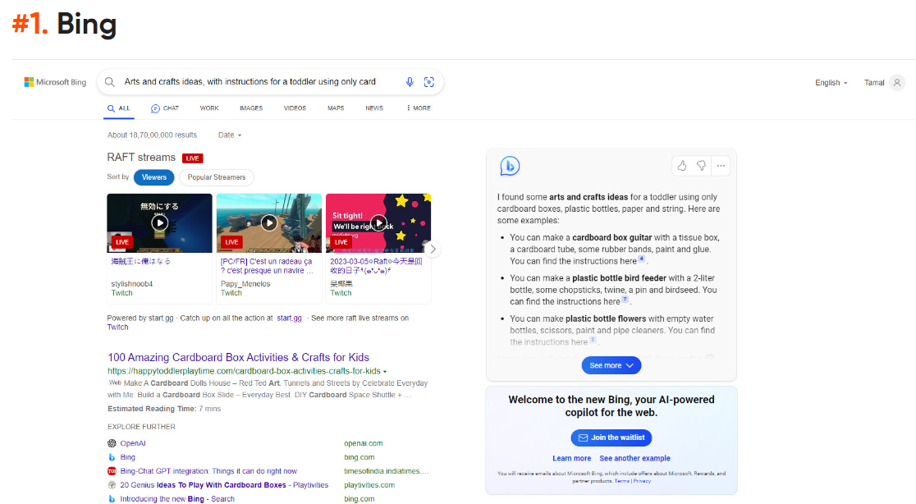
Search Engines That Use Generative AI Search

Slide 32

Search Engines That Use Generative AI Search

Slide 33
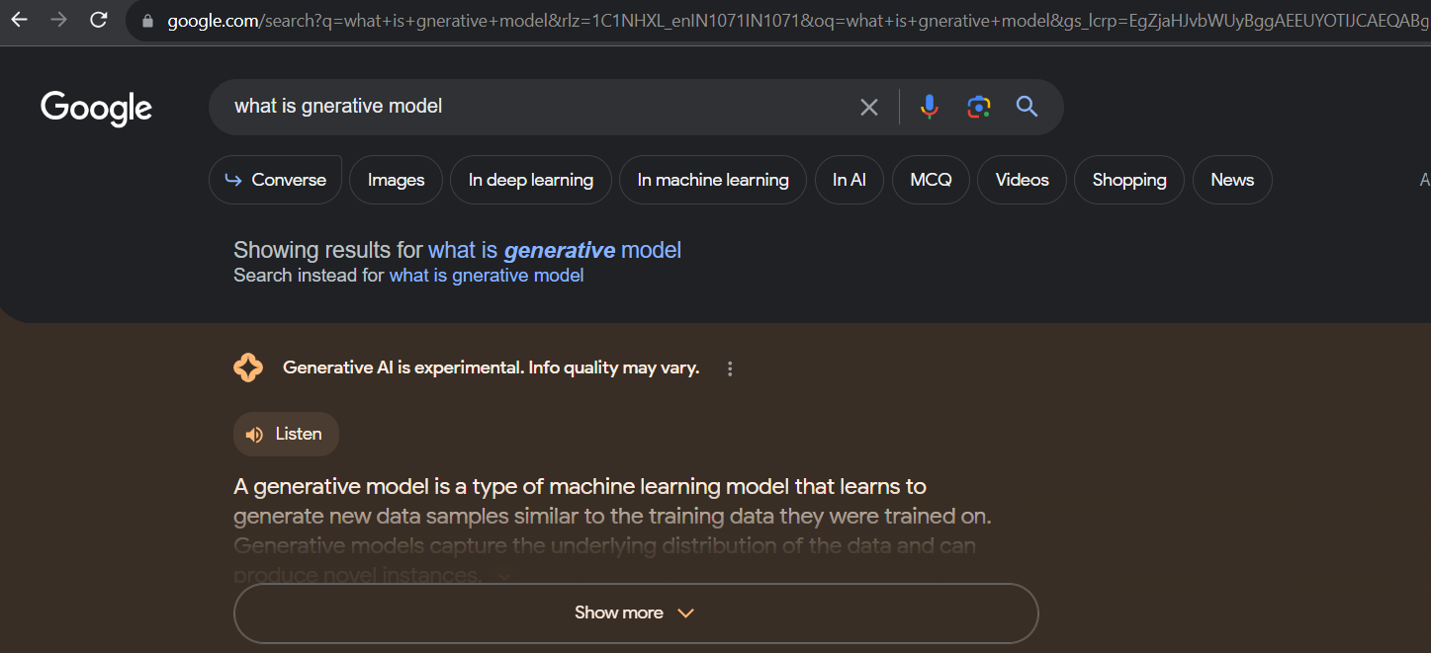
Search Engines That Use Generative AI Search

