Slide 1
Introduction to Web Technologies
  Dr. Susan Gauch

Slide 2
Internet History
1969 – Defense Advanced Research Project Agency (DARPA) creates ARPANET
  Internet project creates protocols (TCP/IP)
    Transmission Control Protocol (TCP)
    Internet Protocol (IP)
    Allows computers to talk over networks
    Creates the “Internet” – 4 nodes
  Links together DARPA supported sites
1979 – USENET started
  Interconnection of Computer Science Departments
    Duke and UNC-Chapel Hill
  First emoticon created
    -) (tongue in cheek)
    1982 :- ) and :- ( get added

Slide 3
Internet History Continued
1985 – first domain name – Symbolics.com
1986 – NSFNET
  government support for major Internet backbone
1988 – Internet Worm affects 6,000 of 60,000 Internet sites
  30 seconds on NBC evening news
  Son of National Security Agency Chief Scientist

Slide 4
Web History
1991 – World Wide Web released by CERN
  First Web Server
    WhatYouSeeIsWhatYouGet (WYSYWIG)
  First Web Site
    (Stanford Linear Accelerator)
1992 – 50 Web servers
1993 – first Internet Worms/Spiders/Wanderers/Robots
  First search engines
  Mosaic – first graphical browser for Web
  341,000% growth rate in WWW

Slide 5
Web History Continued
Yahoo – Yet Another Hierarchical Officious Oracle
  2 Ph.D. Students from Stanford
Peaks about Dec. 2001 at 40 million web servers
Keys to success:
  Client-server architecture
    Users all over world can run programs on my computer
    Don’t need to ship software, just publish the url
    Don’t have to create a GUI – just create a web page
    Browser runs on client, displays web page
      Sends messages to server
      Receives and displays answers

Slide 6
URL- Universal Resource Locator
Unique address for a resource on the Internet
Scheme://hostname[:port]/path/filename
  Scheme:
    http: HyperText Transfer Protocol
    ftp: File Transfer Protocol
    mailto: send email
    News: newsnet news

Slide 7
HTML – HyperText Markup Language
Create textual description of appearance of documents
Document Structure
<HTML>
  <HEAD> <TITLE> My Lecture </TITLE>
  </HEAD>
  <BODY> I have to say something.
  </BODY>
</HTML>

Slide 8
Meta Document Information
“meta” - information about
Meta document - information about the document
Meta data – information about the data
Meta tags
  <META NAME="name"
  HTTP-EQUIV="FieldName" CONTENT="value" >

Slide 9
MetaTags
<META HTTP-EQUIV="Refresh" CONTENT="2;URL=http:nextdoc.html">
  - in 2 sec. redirect browser to nextdoc.html.
<META NAME="keywords" CONTENT="Web, HTML, tags">
  Set keywords for the document, used by search engines to index your document

Slide 10
Basic HTML Tags
<b> </b> - bold
<ul> - unnumbered list
<li> first thing
<li> second thing
</ul>
<ol> </ol> - ordered (numbered) list
<p> </p> - paragraph begin and end
<br> - line break
<pre> </pre> - preformatted text
<h1> </h1> - big heading (also h2 .. h6)
<i> </i> - italics
<center> </center> - center
<!-- comment -->

Slide 11
A Minimal HTML Document
<html>
<head>
<TITLE>A Simple HTML Example</TITLE>
</head>
<body>
<H1>HTML is Easy To Learn</H1>
<P>Welcome to the world of HTML. This is the first
paragraph. While short, it is still a paragraph!
</P>
<P>And this is the second paragraph.
</P>
</body>
</html>

Slide 12
Special Characters and Links
Special Characters
  unlike rest of HTML, case sensitive
  &lt; - less than <
  &gt; - greater than >
  &nbsp; - non-blocking space

Slide 13
Linking to Documents and Images
Links to Documents and Images
  The displayed text is called the “anchor”
<A HREF=“Presentation.ppt"> Document in same
directory</A>
  <A HREF=“http://www.csce.uark.edu/~sgauch">
  Full path to a page</A>
    <img src="images/sgauch.jpg" WIDTH=190 HEIGHT= 200>

Slide 14
Tables - Syntax
<TABLE>
<TR>
<TD> Row 1, Cell 1 </TD>
<TD> Row 1, Cell 2 </TD>
</TR> <!-- end of first row definition -->
<TR> <!-- start of last row definition -->
<TD> Row 2, Cell 1 </TD>
<TD> Row 2, Cell 2 </TD>
</TR> <!-- end of last row definition -->
</TABLE> <!-- end of table definition -->

Slide 15
Tables – Output
Row 1, Cell 1 | Row 1, Cell2
Row 2, Cell 1 | Row 2, Cell 2

Slide 16
Creating HTML Files
Text Editor
  vi, notepad, emacs, pico, …
  Don’t need to learn a new editor
  Have control over output
  Need to know syntax of HTML
HTML Authoring Tools
  Allaire, Netscape, DreamWeaver
  WYSIWYG
General Purpose WSYIWYG
  Word
  Creates enormous, ugly HTML code
  Badly formatted, lots of unnecessary tags

Slide 17
CGI – Common Gateway Interface
An html web page is static (unchanging)
  Text document sent from server to browser
CGI program creates dynamic information
  Program is executed upon demand
  Generates fresh content for each request

Slide 18
CGI Overview
Developer creates an HTML page with a <FORM> on it
  Specifies the name of the program
  Names some variables that can hold data
User enters information into the Web page (fills in the variables in the <FORM> and clicks <SUBMIT>
Browser sends the information to the URL

Slide 19
CGI Overview continued
Server unpacks the HTTP message
  Finds the name of the program to call
  Finds the data
Server calls the program and passes in the data
Program generates output and writes it to “standard out” (the screen, usually)
Server takes the output and passes it along to the browser
Browser displays the output on the user’s screen

Slide 20
Forms
Forms are part of regular HTML documents
There may be more than one form in a document
Forms may not be nested
<FORM ACTION=“url”> … </FORM>

Slide 21
INPUT
Forms receive input from the user
Each input area has its own name and type of input it may receive
Forms may receive input from
  Text
  Radio
  Checkbox
  Submit
  Reset
  Password

Slide 22
Submitting Information via a FORM
When SUBMIT is pushed, the contents of the form get sent to the server in the form:
programname?var1=value1&var2=value2
You may send the data via POST or GET
  You choose this when you write the HTML page with the FORM in it

Slide 23
POST and GET
POST
  cgi program reads from stdin (i.e., the keyboard)
  No limit on the amount of data sent
GET
  CGI program reads from an environment variable (QUERY_STRING)
  Limit on length of data sent (1,000? Characters?)
Recommend that you use POST

Slide 24
A Simple Perl Program tiny.pl
#!/usr/bin/perl
#Prints “Hello Susan”
use strict; # syntax checking
use warnings; # runtime checking
my $username = ‘Susan’; # "declare" variable
print "Hello, $username.\n"; # print out greeting

Slide 25
A Simple CGI Program tinyPL.cgi
#!/usr/bin/perl
#Prints static Web page “Hello Susan”
use strict; # syntax checking
use warnings; # runtime checking
use CGI qw(:standard); # use the CGI library
my $username = ‘Susan’; # "declare" the variable
print header(); # output http, <HTML>
start_html(“First CGI program”); # add a title
print "Hello, $username.\n";
print end_html(); # output </HTML> etc

Slide 26
Program Output
Content-Type: text/html; charset=ISO-8859-1
<!DOCTYPE html
PUBLIC "-//W3C//DTD XHTML 1.0 Transitional//EN"
"http://www.w3.org/TR/xhtml1/DTD/xhtml1-transitional.dtd">
<html xmlns="http://www.w3.org/1999/xhtml" lang="en-US" xml:lang="en-US">
<head>
<title>First CGI program</title>
<meta http-equiv="Content-Type" content="text/html; charset=iso-8859-1" />
</head>
<body>
Hello Susan.
</body>
</html>

Slide 27
Call the program
In browser bar, type
http://www.csce.uark.edu/~sgauch/cgicode/tinyPL.cgi

Slide 28
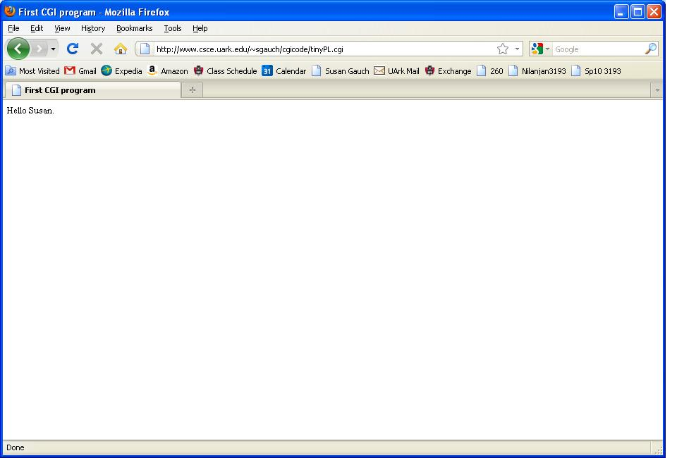
What it looks like

Slide 29
Passing Parameters to a CGI program adduserPL.cgi
#!/usr/bin/perl
use strict;
use warnings;
use CGI qw(:standard); #use the CGI library
my $cgiform = new CGI; #Create a CGI object
#Extract username and password from the form-passed parameters
my $username = $cgiform->param("username");
my $password = $cgiform->param("password");
#Output the username and password
print header();
print start_html("Add a User");
print "<h2>Username: $username</h2>\n";
print "<h2>Password: $password</h2>\n";
print end_html();

Slide 30
Calling it from a Web Page
<html><head><title> Add a New User </title></head>
<body bgcolor=white>
<FORM ACTION="adduserPL.cgi“METHOD="POST">
<center><table width=70% cellpadding=5 border=1 bgcolor=#008080>
<tr>
<td align=center> <font size=+3 style=times color=white>
Become a Registered Customer</font><br>
</td>
</tr>
</table></center><p>
<table border="0">
<tr>
<td>Choose your username: </td>
<td><INPUT TYPE="text" SIZE="20" NAME="username"></td>
</tr>
<tr>
<td>Choose your password: </td>
<td><INPUT TYPE="text" SIZE="20" NAME="password"></td>
</tr>
</table>
<p><input type="submit" value="Add Me">
</form></body></html>

Slide 31
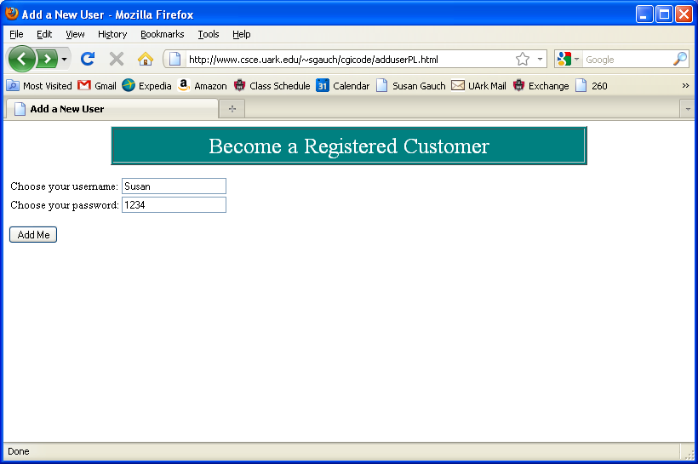
What the Web Page Looks Like

Slide 32
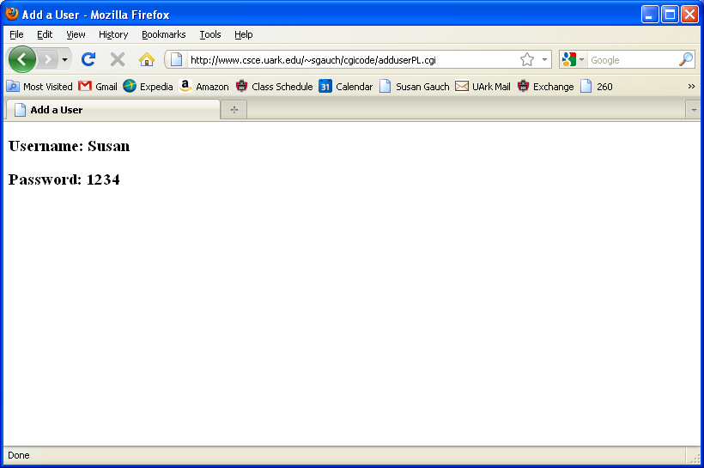
What the results are

Slide 33
Creating CGI Programs
First step – Create and view a static html page
  Create your public_html directory
  Set permissions so the world can read & execute it
  Create a simple html page (index.htm)
  Check that you can view it from
  http://www.csce.uark.edu/~yourusername/
Second step – Test existing cgi program
  Copy tiny.html and tinyPL.cgi to your public_html directory
  Test that they work
  Copy adduserPL.html and adduserPL.cgi to your public_html directory
  Test that they work

Slide 34
Creating CGI Programs
Third step – Check that your program produces valid HTML output
  Create a program that runs from the command line
  Put the program in your public_html/ (cgi-bin directory optional)
  Name the program ending in .cgi
  Set the variables in the program
    e.g., $username = “sgauch”;
  Save the output to a file
    perl myprog.cgi > output.html
  Remove everything before <html> in nano
  View the file in a browser

Slide 35
Creating CGI programs
Fourth step – Check that the permissions are set so others besides you can execute the program
  Have a friend login and run your program from their directory
    e.g., perl /users/myusername/.public_html/cgi-bin/myprogram.cgi > output
Fifth step – Create a web page to call a simple program
  Design a form that calls a dummy cgi
  That cgi should just print out “hello world”
  Put the form in your .public_html directory
  View the form in the browser
  Click submit
  Check that you see “hello world”

Slide 36
Creating CGI programs continued
Sixth step – Create a web page to call a simple version of your final program that confirms parameters are passed
  In your perl program, comment out all parts of the program
  Just print the parameters to confirm you’re getting them
  Call this program from the form
Seventh step – Run the full program
  Remove comments and test the REAL progrram

Slide 37
Debugging CGI programs
- Permissions problems
  inadequate permissions
  Test this by having someone besides yourself execute the code
  Do and ls –l on the directory structure
    It should be drwxr-wr-x on all directories
    Chmod 755 my directory
    Chmod 644 for your perl program
Path problems
  Test this by creating and calling a really simple cgi program
Invalid HTML produced
  Call this and save output to a file
  View file in a browser

Slide 38
Common Problems
#!/usr/bin/perl must be the first line in the file
  Even before any other comments
Remember to call the print header() function
  It must occur before any other print statements
On some systems, the filename must end .cgi not .pl
On some systems, the executables must be in public_html/cgi-bin directory

Slide 39
Useful Links
www.sergey.com/web_course/
  JumpStart to the Web Technologies
http://www.isoc.org/internet/history/
  History of the Internet and Web
http://www.w3schools.com/html/
  A thorough description of HTML tags
http://www.cgi101.com/book/
  A good tutorial on CGI programming

