Slide 1


Introduction to PHP

Slide 2
Welcome
This slideshow presentation is designed to introduce you to PHP. It is the first of two PHP workshops available at www.tinyurl.com/rpi123. In addition to the two PHP workshops, there are also workshops on HMTL and CSS.
These slides are based on source material found at the w3schools.com website.
You are encouraged to visit the site – it is a great resource.

Slide 3
Caveat
PHP and MySQL are tricky to teach without access to a server and a database. We'll do the best we can in the slides that follow.
They are also tricky considering how complex they are. Take a look at the PHP cheat sheet I found online...

Slide 4
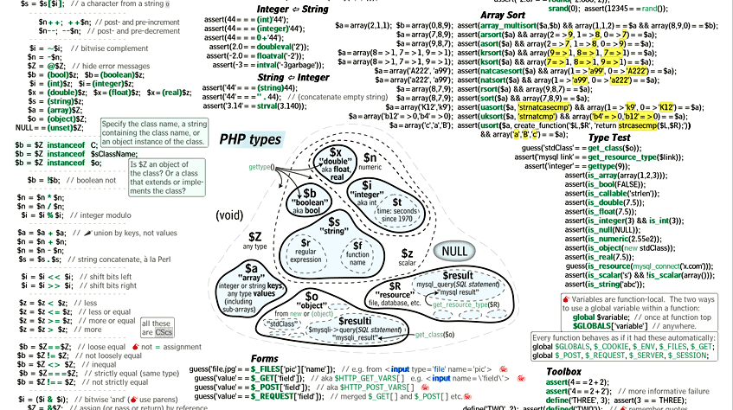
Yikes

Slide 5
PHP Introduction
PHP is a recursive acronym for “PHP: Hypertext Preprocessor” -- It is a widely-used open source general-purpose scripting language that is especially suited for web development and can be embedded into HTML.

Slide 6
PHP Introduction
> PHP is a server-side scripting language
> PHP scripts are executed on the server
> PHP supports many databases (MySQL, Informix, Oracle, Sybase, Solid, PostgreSQL, Generic ODBC, etc.)‏
> PHP is open source software
> PHP is free to download and use

Slide 7
PHP Introduction
> PHP runs on different platforms (Windows, Linux, Unix, etc.)‏
> PHP is compatible with almost all servers used today (Apache, IIS, etc.)‏
> PHP is FREE to download from the official PHP resource: www.php.net
> PHP is easy to learn and runs efficiently on the server side

Slide 8
PHP Introduction
Some info on MySQL which we will cover in the next workshop...
> MySQL is a database server
> MySQL is ideal for both small and large applications
> MySQL supports standard SQL
> MySQL compiles on a number of platforms
> MySQL is free to download and use

Slide 9
PHP Introduction
Instead of lots of commands to output HTML (as seen in C or Perl), PHP pages contain HTML with embedded code that does "something" (like in the next slide, it outputs "Hi, I'm a PHP script!").
The PHP code is enclosed in special start and end processing instructions <?php and ?> that allow you to jump into and out of "PHP mode."

Slide 10
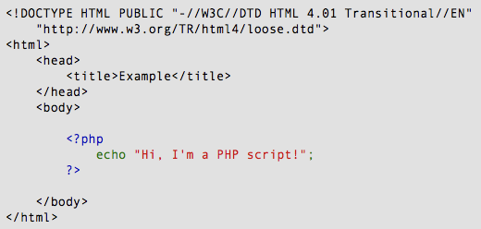
PHP Introduction

Slide 11
PHP Introduction
PHP code is executed on the server, generating HTML which is then sent to the client. The client would receive the results of running that script, but would not know what the underlying code was.
A visual, if you please...

Slide 12
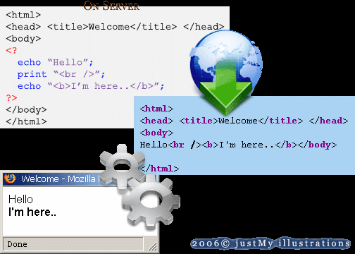
PHP Introduction

Slide 13
PHP Getting Started
On windows, you can download and install WAMP. With one installation and you get an Apache webserver, database server and php.
http://www.wampserver.com
On mac, you can download and install MAMP.
http://www.mamp.info/en/index.html

Slide 14
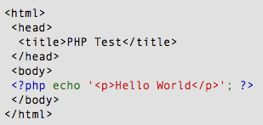
PHP Hello World
Above is the PHP source code.

Slide 15
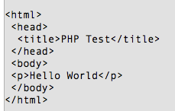
PHP Hello World
It renders as HTML that looks like this:

Slide 16
PHP Hello World
This program is extremely simple and you really did not need to use PHP to create a page like this. All it does is display: Hello World using the PHP echo() statement.
Think of this as a normal HTML file which happens to have a set of special tags available to you that do a lot of interesting things.

Slide 17
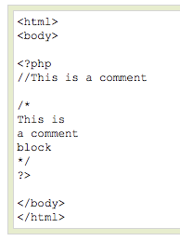
PHP Comments
In PHP, we use // to make a single-line comment or /* and */ to make a large comment block.

Slide 18

PHP Variables
> Variables are used for storing values, like text strings, numbers or arrays.
> When a variable is declared, it can be used over and over again in your script.
> All variables in PHP start with a $ sign symbol.
> The correct way of declaring a variable in PHP:

Slide 19

PHP Variables
> In PHP, a variable does not need to be declared before adding a value to it.
> In the example above, you see that you do not have to tell PHP which data type the variable is.
> PHP automatically converts the variable to the correct data type, depending on its value.

Slide 20
PHP Variables
> A variable name must start with a letter or an underscore "_" -- not a number
> A variable name can only contain alpha-numeric characters, underscores (a-z, A-Z, 0-9, and _ )‏
> A variable name should not contain spaces. If a variable name is more than one word, it should be separated with an underscore ($my_string) or with capitalization ($myString)‏

Slide 21
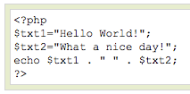
PHP Concatenation
> The concatenation operator (.) is used to put two string values together.
> To concatenate two string variables together, use the concatenation operator:

Slide 22

PHP Concatenation
The output of the code on the last slide will be:
If we look at the code you see that we used the concatenation operator two times. This is because we had to insert a third string (a space character), to separate the two strings.

Slide 23
PHP Operators
Operators are used to operate on values. There are four classifications of operators:
> Arithmetic
> Assignment
> Comparison
> Logical

Slide 24
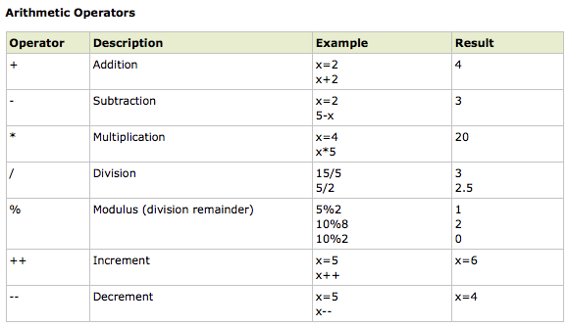
PHP Operators

Slide 25
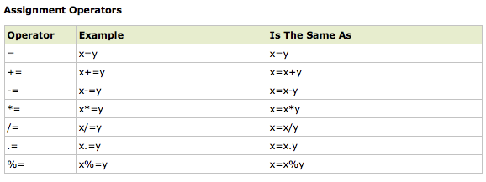
PHP Operators

Slide 26
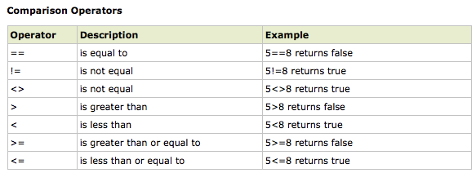
PHP Operators

Slide 27
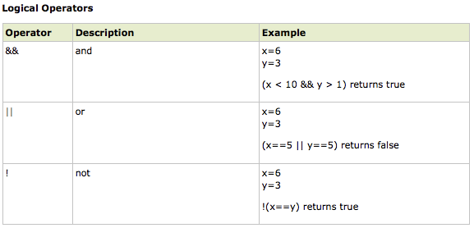
PHP Operators

Slide 28
PHP Conditional Statements
> Very often when you write code, you want to perform different actions for different decisions.
> You can use conditional statements in your code to do this.
> In PHP we have the following conditional statements...

Slide 29
PHP Conditional Statements
> if statement - use this statement to execute some code only if a specified condition is true
> if...else statement - use this statement to execute some code if a condition is true and another code if the condition is false
> if...elseif....else statement - use this statement to select one of several blocks of code to be executed
> switch statement - use this statement to select one of many blocks of code to be executed

Slide 30
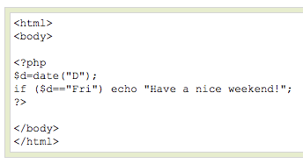
PHP Conditional Statements
The following example will output "Have a nice weekend!" if the current day is Friday:

Slide 31
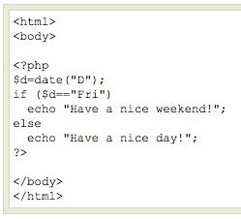
PHP Conditional Statements
Use the if....else statement to execute some code if a condition is true and another code if a condition is false.

Slide 32
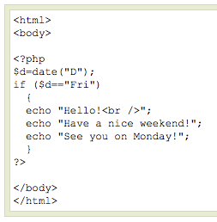
PHP Conditional Statements
If more than one line should be executed if a condition is true/false, the lines should be enclosed within curly braces { }

Slide 33
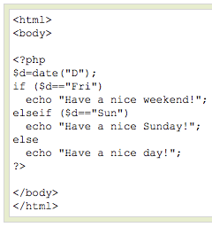
PHP Conditional Statements
The following example will output "Have a nice weekend!" if the current day is Friday, and "Have a nice Sunday!" if the current day is Sunday. Otherwise it will output "Have a nice day!":

Slide 34
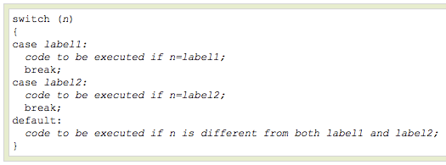
PHP Conditional Statements
Use the switch statement to select one of many blocks of code to be executed.

Slide 35
PHP Conditional Statements
For switches, first we have a single expression n (most often a variable), that is evaluated once.
The value of the expression is then compared with the values for each case in the structure. If there is a match, the block of code associated with that case is executed.
Use break to prevent the code from running into the next case automatically. The default statement is used if no match is found.

Slide 36
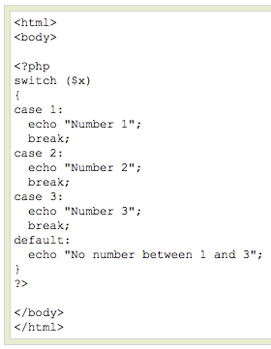
PHP Conditional Statements

Slide 37
PHP Arrays
> An array variable is a storage area holding a number or text. The problem is, a variable will hold only one value.
> An array is a special variable, which can store multiple values in one single variable.

Slide 38

PHP Arrays
If you have a list of items (a list of car names, for example), storing the cars in single variables could look like this:

Slide 39
PHP Arrays
> However, what if you want to loop through the cars and find a specific one? And what if you had not 3 cars, but 300?
> The best solution here is to use an array.
> An array can hold all your variable values under a single name. And you can access the values by referring to the array name.
> Each element in the array has its own index so that it can be easily accessed.

Slide 40
PHP Arrays
In PHP, there are three kind of arrays:
> Numeric array - An array with a numeric index
> Associative array - An array where each ID key is associated with a value
> Multidimensional array - An array containing one or more arrays

Slide 41
PHP Numeric Arrays
> A numeric array stores each array element with a numeric index.
> There are two methods to create a numeric array.

Slide 42


PHP Numeric Arrays
In the following example the index is automatically assigned (the index starts at 0):
In the following example we assign the index manually:

Slide 43
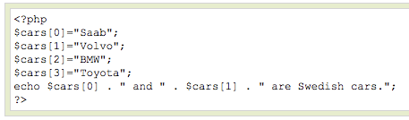

PHP Numeric Arrays
In the following example you access the variable values by referring to the array name and index:
The code above will output:

Slide 44
PHP Associative Arrays
> With an associative array, each ID key is associated with a value.
> When storing data about specific named values, a numerical array is not always the best way to do it.
> With associative arrays we can use the values as keys and assign values to them.

Slide 45

PHP Associative Arrays
In this example we use an array to assign ages to the different persons:
This example is the same as the one above, but shows a different way of creating the array:

Slide 46
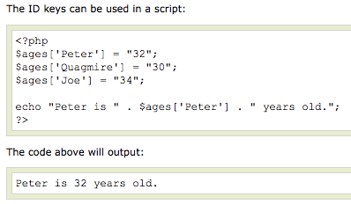
PHP Associative Arrays

Slide 47
PHP Multidimensional Arrays
In a multidimensional array, each element in the main array can also be an array.
And each element in the sub-array can be an array, and so on.

Slide 48
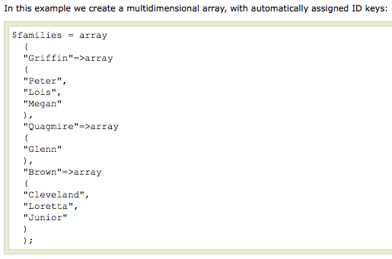
PHP Multidimensional Arrays

Slide 49
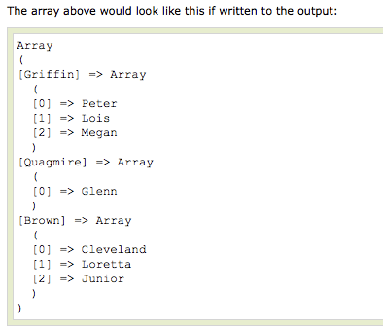
PHP Multidimensional Arrays

Slide 50
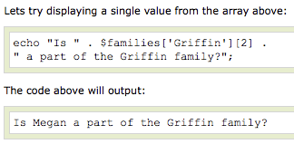
PHP Multidimensional Arrays

Slide 51
PHP Loops
> Often when you write code, you want the same block of code to run over and over again in a row. Instead of adding several almost equal lines in a script we can use loops to perform a task like this.
> In PHP, we have the following looping statements:

Slide 52
PHP Loops
> while - loops through a block of code while a specified condition is true
> do...while - loops through a block of code once, and then repeats the loop as long as a specified condition is true
> for - loops through a block of code a specified number of times
> foreach - loops through a block of code for each element in an array

Slide 53
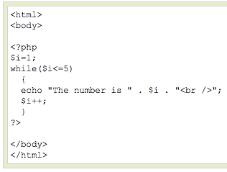
PHP Loops - While
The while loop executes a block of code while a condition is true. The example below defines a loop that starts with
i=1. The loop will
continue to run as
long as i is less
than, or equal to 5.
i will increase by 1
each time the loop
runs:

Slide 54
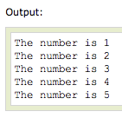
PHP Loops - While

Slide 55
PHP Loops – Do ... While
The do...while statement will always execute the block of code once, it will then check the condition, and repeat the loop while the condition is true.
The next example defines a loop that starts with i=1. It will then increment i with 1, and write some output. Then the condition is checked, and the loop will continue to run as long as i is less than, or equal to 5:

Slide 56
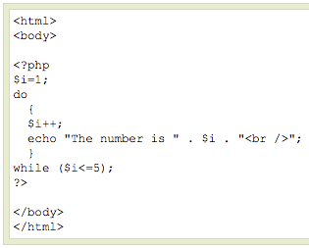
PHP Loops – Do ... While

Slide 57
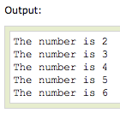
PHP Loops – Do ... While

Slide 58
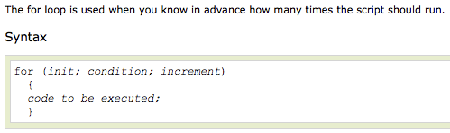
PHP Loops - For

Slide 59
PHP Loops - For
Parameters:
> init: Mostly used to set a counter (but can be any code to be executed once at the beginning of the loop)‏
> condition: Evaluated for each loop iteration. If it evaluates to TRUE, the loop continues. If it evaluates to FALSE, the loop ends.
> increment: Mostly used to increment a counter (but can be any code to be executed at the end of the loop)‏

Slide 60
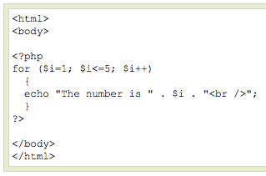
PHP Loops - For
The example below defines a loop that starts with i=1. The loop will continue to run as long as i is less than, or equal to 5. i will increase by 1 each time the loop runs:

Slide 61
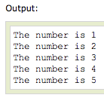
PHP Loops - For

Slide 62

PHP Loops - Foreach
For every loop iteration, the value of the current array element is assigned to $value (and the array pointer is moved by one) - so on the next loop iteration, you'll be looking at the next array value.

Slide 63
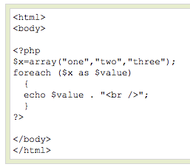
PHP Loops - Foreach
The following example demonstrates a loop that will print the values of the given array:

Slide 64

PHP Loops - Foreach
Winner of the most impressive slide award

Slide 65
PHP Functions
> We will now explore how to create your own functions.
> To keep the script from being executed when the page loads, you can put it into a function.
> A function will be executed by a call to the function.
> You may call a function from anywhere within a page.

Slide 66

PHP Functions
A function will be executed by a call to the function.
> Give the function a name that reflects what the function does
> The function name can start with a letter or underscore (not a number)‏

Slide 67
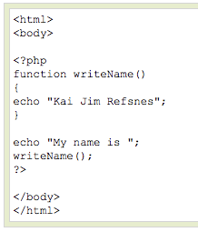
PHP Functions
A simple function that writes a name when it is called:

Slide 68
PHP Functions - Parameters
Adding parameters...
> To add more functionality to a function, we can add parameters. A parameter is just like a variable.
> Parameters are specified after the function name, inside the parentheses.

Slide 69
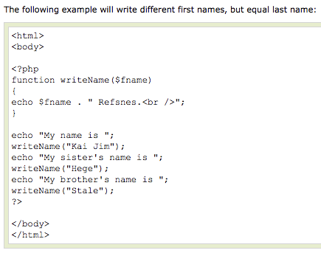
PHP Functions - Parameters

Slide 70

PHP Functions - Parameters

Slide 71
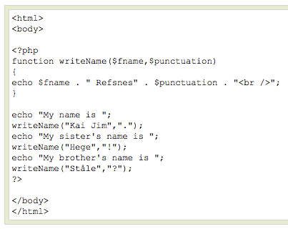
PHP Functions - Parameters
This example adds different punctuation.

Slide 72

PHP Functions - Parameters

Slide 73
PHP Forms - $_GET Function
> The built-in $_GET function is used to collect values from a form sent with method="get".
> Information sent from a form with the GET method is visible to everyone (it will be displayed in the browser's address bar) and has limits on the amount of information to send (max. 100 characters).

Slide 74
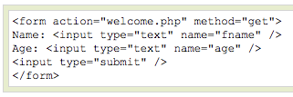


PHP Forms - $_GET Function
Notice how the URL carries the information after the file name.

Slide 75
PHP Forms - $_GET Function
The "welcome.php" file can now use the $_GET function to collect form data (the names of the form fields will automatically be the keys in the $_GET array)‏

Slide 76
PHP Forms - $_GET Function
> When using method="get" in HTML forms, all variable names and values are displayed in the URL.
> This method should not be used when sending passwords or other sensitive information!
> However, because the variables are displayed in the URL, it is possible to bookmark the page. This can be useful in some cases.
> The get method is not suitable for large variable values; the value cannot exceed 100 chars.

Slide 77
PHP Forms - $_POST Function
> The built-in $_POST function is used to collect values from a form sent with method="post".
> Information sent from a form with the POST method is invisible to others and has no limits on the amount of information to send.
> Note: However, there is an 8 Mb max size for the POST method, by default (can be changed by setting the post_max_size in the php.ini file).

Slide 78


PHP Forms - $_POST Function
And here is what the code of action.php might look like:

Slide 79
PHP Forms - $_POST Function
Apart from htmlspecialchars() and (int), it should be obvious what this does. htmlspecialchars() makes sure any characters that are special in html are properly encoded so people can't inject HTML tags or Javascript into your page.
For the age field, since we know it is a number, we can just convert it to an integer which will automatically get rid of any stray characters. The $_POST['name'] and $_POST['age'] variables are automatically set for you by PHP.

Slide 80
PHP Forms - $_POST Function
When to use method="post"?
> Information sent from a form with the POST method is invisible to others and has no limits on the amount of information to send.
> However, because the variables are not displayed in the URL, it is not possible to bookmark the page.

Slide 81

End of Workshop
More web workshops can be found at
www.tinyurl.com/rpi123

