Slide 1

Financial Risk
Intelligence Platform
AI/NLP risk signals from news and social media, driving tactical index rebalancing and regulator-grade portfolio stress testing.

Slide 2
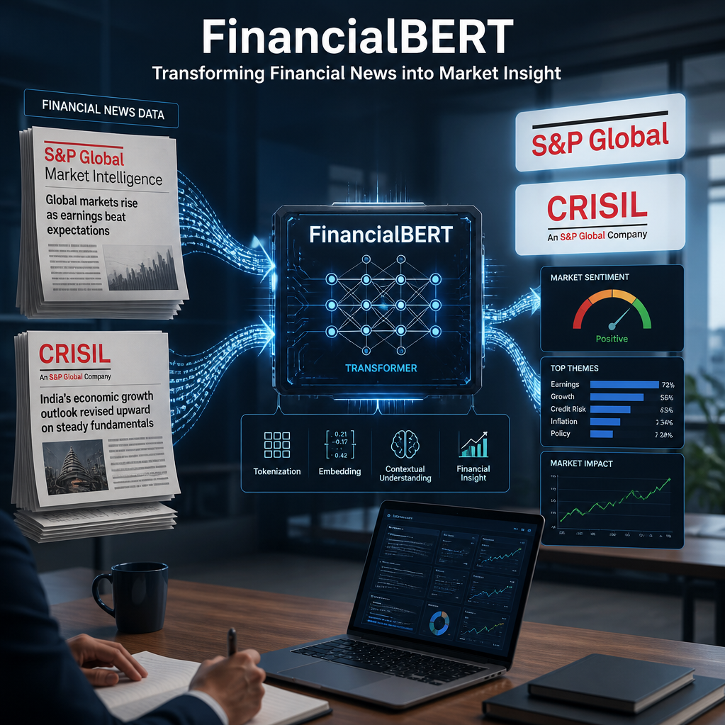
Methodology
Problem & Approach
The Problem
Market-moving information exists in unstructured formats. Human interpretation is:
Slow: lagging behind real-time market movements
Subjective: vulnerable to individual bias
Limited: restricted by human operating hours
Our Approach
Specialist models: FinancialBERT for calibrated sentiment, a small LLM for per-entity understanding
Backtesting: benchmarked against 15 years of real news data and market reactions
Core Outputs
Sentiment: scaled -1 to 1 (96.7% accuracy)
Event class: categorized across 6 primary labels
Impact score: calibrated 1-10 based on 19,872 historical events

Slide 3
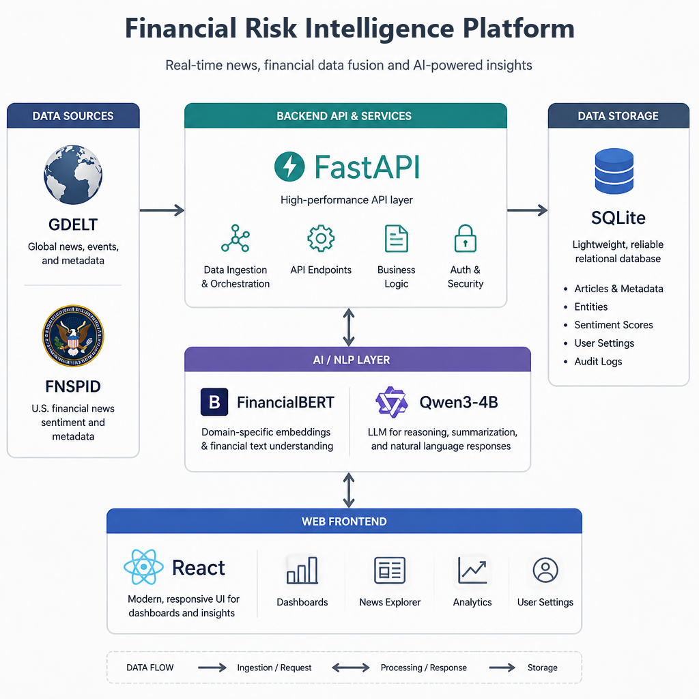
System Design Architecture
One engine, three layers, and two downstream decision-making modules
Ingestion Layer
Aggregates data from GDELT (15m live news), 91k FNSPID headlines, and 10.5k tweets.
AI/NLP Risk Engine
Executes a pipeline involving entity matching, FinancialBERT sentiment analysis, Qwen3-4B LLM processing, event classification, and impact calculation.
Events & Decisions
Performs 24h event clustering to feed into volatility-adjusted index tilting and scenario stress/CET1 flow modules.
Operational Serving
FastAPI backbone supporting 15 endpoints and a React dashboard with 47 verified tests.

Slide 4
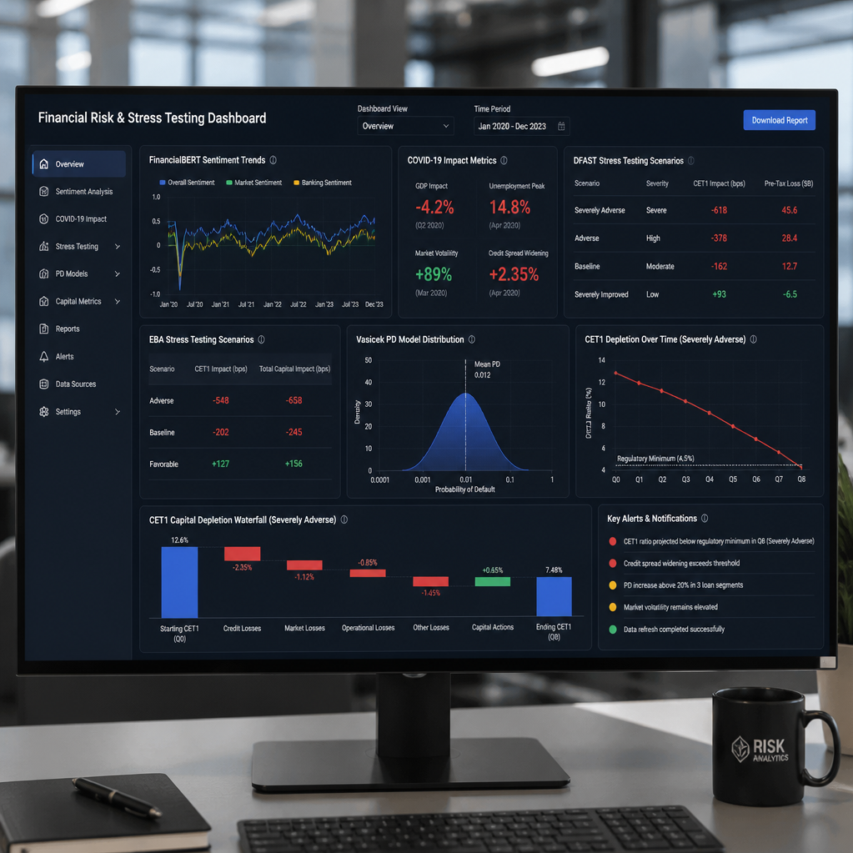
Implementation Highlights
Choices we can defend, and the evidence behind each.
FinancialBERT for bulk sentiment
Achieved 96.7% accuracy on held-out data.
LLM for per-entity reading
Outperformed the shared-score baseline: 72.4% vs 59.8% on SEntFiN human labels.
Impact calibrated on real data
Validated against 19,872 events, showing firm-specific news drives higher alpha.
Regulator-grade stress testing
Compliant with DFAST/EBA standards, featuring 2,287 bps COVID depletion modeling.
Our methodology ensures robust, data-backed performance compliant with industry stress-testing standards.

Slide 5
KEY RESULTS: 15 Years of Empirical Evidence
News Sentiment vs. Market Reality
Sentiment Accuracy
Directional Hit Rate
Credit-Event Reaction
Impact Score (IC)
96.7%
56.2%
+24.9
+0.098
FinancialBERT; bake-off of 6 models
vs. 53-55% benchmark
bps CAR; t = 2.96, significant at 1%
calibrated severity + VIX regime
Portfolio Alpha
Risk Management
Data Integrity
Calibrated Precision
+0.9
-10.4%
Derived from 78k+ articles and 10.5k tweets; no synthetic data used.
Credit parameters stress-tested against 1.35M real Lending Club loan records.
pts vs. cap-weight, net of costs
vol-targeted variant at 20.7% vol
Metrics reflect actual market history, not theoretical marketing projections.

Slide 6
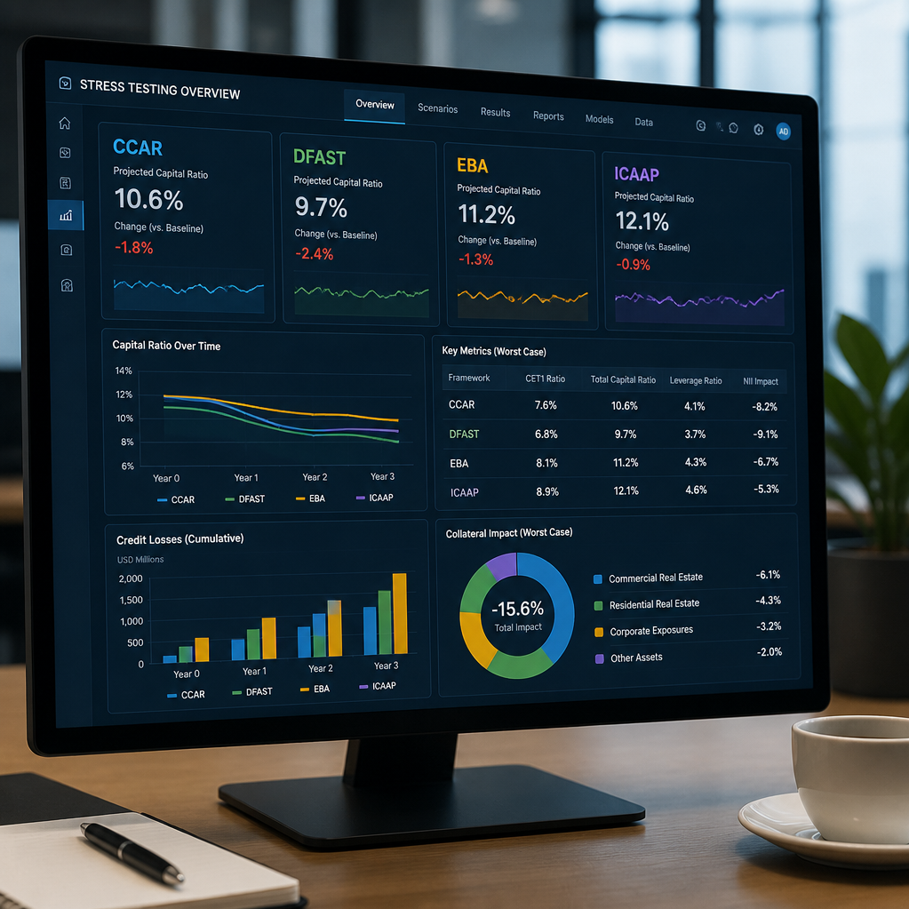
Domain Impact
Transforming Workflow Efficiency and Regulatory Compliance
Workflow Efficiency
Compresses industry-trusted risk patterns from weeks of manual effort into seconds of automated processing.
Intelligence & Signaling
Automates news-to-signal extraction by combining industry-standard intelligence with real-time novelty and corroboration.
Regulatory Alignment
Mirrors supervisory playbooks like CCAR/DFAST and EBA/ICAAP using transition matrices and Vasicek PD modeling.
Strategic Capital Output
Delivers actionable CET1 depletion figures in basis points, purpose-built for wholesale banking and ratings analysis.

Slide 7
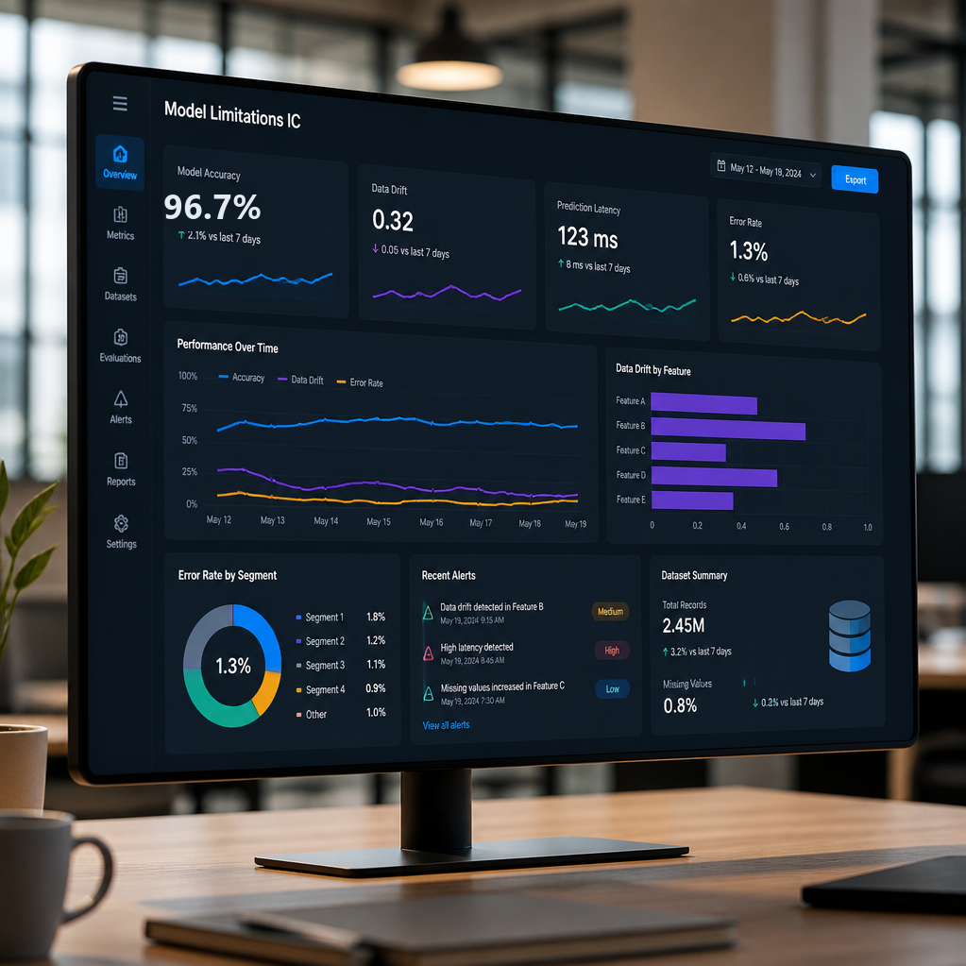
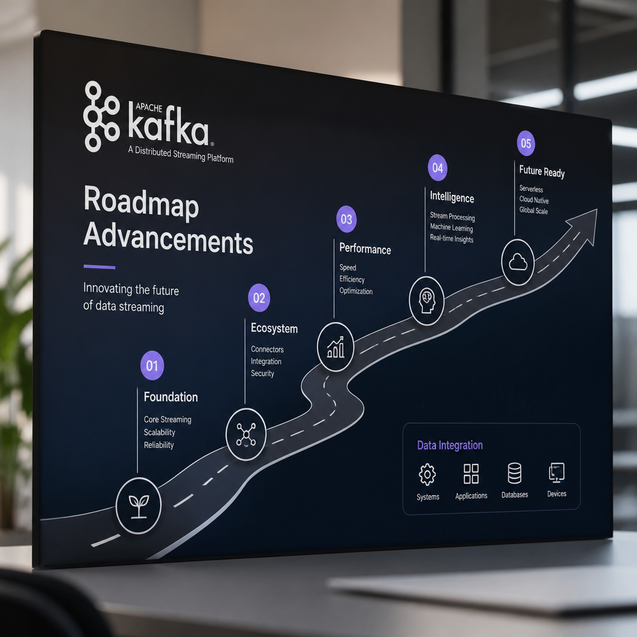
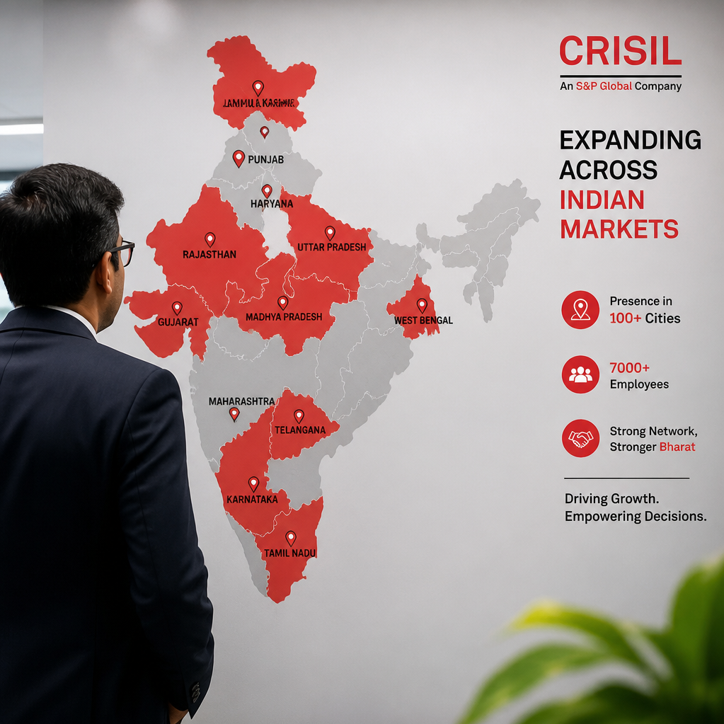
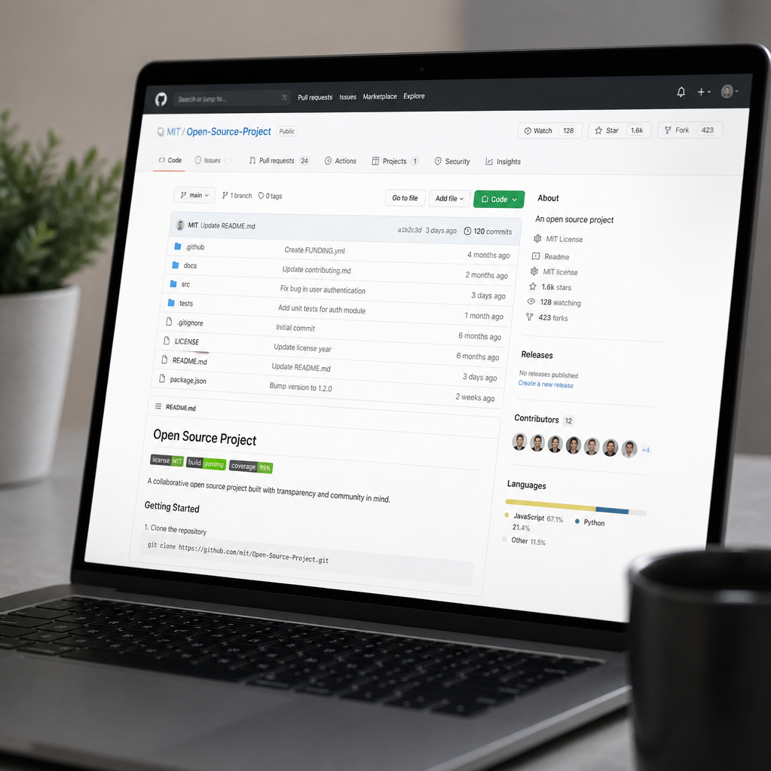
Limitations & Next Steps
Assessing performance gaps and future development path
Model Limitations
Roadmap Advancements
Market Expansion
Resources & Transparency
Current system issues include illustrative shock calibration, rule-based logic limitations, a modest 0.065 impact IC, and trailing performance against equal-weight benchmarks in 2022.
Planned upgrades include intraday event windows, fine-tuned event classifiers, embedding-based deduplication, and a transition to Kafka-based streaming architecture.
Scaling coverage from the current 14 names to broader Indian markets, specifically targeting Crisil indices.
All code, evidence artifacts, and measurement scripts are accessible via our public repository under an MIT license.

