Slide 1

Heart Track AI Comprehensive Heart Disease Prediction and Monitoring
Internal Guide: Batch no: 13
Mr. Ch.Sathyanarayana P.Prasad(22P61A67E4)
[Assistant Professor] Sachin Gupta(22P61A67F5)
Mrs. Sasikala S. Sri Charan Teja(22P61A67F8)
[Assistant Professor]

Slide 2
CONTENTS
INTRODUCTION
ABSTRACT
LITERATURE SURVEY
CHALLENGES IN EXISTING SYSTEM
PROBLEM STATEMENT
PROPOSED SYSTEM
REQUIREMENT ANALYSIS
ARCHITECTURE
ALGORITHMS
DATA SETS
REFERENCES

Slide 3
INTRODUCTION
This comprehensive web application combines advanced machine learning with an intuitive user interface to assess heart disease risk. The system utilizes an ensemble of predictive models including Random Forest, Neural Network, Logistic Regression, and Support Vector Machine algorithms to achieve high accuracy (90%) in risk assessment.
Users can input their health metrics such as age, cholesterol levels, blood pressure, and other clinical parameters to receive personalized risk evaluations, along with explainable AI visualizations that highlight which factors most influence their results. The application offers detailed recommendations, risk trajectory projections, and a health action plan tailored to each user's profile.
Beyond predictions, the platform includes features for tracking risk history over time, comparing different prediction models, and accessing an AI-powered health assistant for personalized guidance. All sensitive health data is securely stored, making this a complete solution for heart disease risk management and prevention.

Slide 4
ABSTRACT
This project implements a comprehensive heart disease prediction system that leverages multiple machine learning models to provide accurate risk assessments. The backend, developed in Flask, integrates an ensemble of algorithms including Random Forest, Neural Network, Logistic Regression, and Support Vector Machine to achieve 90% prediction accuracy. The frontend, built with React and Chakra UI, offers an intuitive interface for users to input health metrics and receive personalized risk evaluations with explainable AI visualizations. The system provides tailored health recommendations, risk trajectory projections, and historical tracking of assessments. A standout feature is the explainable AI component using SHAP values to help users understand which factors most significantly influence their risk profile. The application ensures data security through Firebase authentication while maintaining accessibility for both patients and healthcare providers.

Slide 5
LITERATURE SURVEY
Author Name | Title | Techniques | Challenges
Detrano, R., et al. (1989) | International application of a new probability algorithm for the diagnosis of coronary artery disease | Clinical algorithms for probability estimation based on patient data | Limited computational resources and statistical approaches compared to modern methods; difficulty in validating across diverse international populations
Lundberg, S.M., & Lee, S.I. (2017) | A unified approach to interpreting model predictions | SHAP (SHapley Additive exPlanations) method for model interpretability | Balancing model complexity with interpretability; computational intensity when calculating SHAP values for complex models
Palaniappan, S., & Awang, R. (2008) | Intelligent heart disease prediction system using data mining techniques | Comparative analysis of Naive Bayes, Neural Network, and Decision Tree algorithms | Feature selection from high-dimensional medical data; handling imbalanced datasets
Mohan, S., Thirumalai, C., & Srivastava, G. (2019) | Effective heart disease prediction using hybrid machine learning techniques | Hybrid approach combining Random Forest with feature optimization techniques | Parameter tuning for optimal performance; managing computational complexity of ensemble methods

Slide 6
EXISTING SYSTEM
Diverse Modeling Approaches: Existing systems use everything from logistic regression and decision trees to random forests and SVMs, with more recent work employing neural networks and quantum-inspired models to push accuracy above 98% .
Common Datasets: Nearly all projects rely on public datasets such as the UCI Cleveland Heart Disease set (303 cases, 13 clinical features) or larger cohorts like Framingham for training and validation .
Accuracy Spectrum: Traditional models typically achieve 82–90% accuracy, while advanced neural networks and ensemble methods report 97–98.6% accuracy (e.g., Narain et al., 2016) .
Interpretability Gap: Many high accuracy “blackbox” models lack explainability, hindering clinical trust and adoption. Rule based systems offer transparency but often at the cost of lower accuracy .
User Accessibility Issues: Most tools target researchers or clinicians, with minimal focus on intuitive, web based interfaces for lay users or patients .
Scalability & Real‑Time Limitations: Handling large datasets and delivering real‑time predictions remains a challenge; few systems simulate live data or wearable integration .
Interactivity: Interactive features like risk simulation or personalized dashboards are uncommon and User engagement is minimal in most systems.

Slide 7
CHALLENGES IN CURRENT SYSTEMS
1. Limited Interpretability: Many systems act as "black-box" models, making it hard to understand prediction reasoning.
2. User Accessibility: Most tools are designed for experts, lacking intuitive interfaces for general users.
3. Scalability Issues: Systems struggle to handle large datasets or deliver real-time predictions efficiently.
4. Data Handling: Manual preprocessing, like imputing missing values, is error-prone and time-consuming.
5. Non-Linear Pattern Recognition: Traditional models fail to capture complex, non-linear relationships in health data.
6. Dataset Limitations: Small or outdated datasets restrict generalization across diverse populations.
7. Lack of Interactivity: Few systems offer interactive features like risk simulation or user dashboards.
8. Explainability: Advanced models rarely provide clear explanations, reducing trust and usability.
9. User Engagement: Limited educational content or personalized advice hinders user motivation and action.

Slide 8
PROBLEM STATEMENT
Heart disease remains a leading cause of death worldwide, necessitating effective and accessible risk assessment tools to enable early intervention and prevention. However, current heart disease prediction systems face significant limitations, including limited interpretability due to "blackbox“ models, poor user accessibility with complex interfaces designed for experts, and scalability issues that hinder real-time or large-scale use.
Data handling is often manual and error-prone, while traditional models struggle to recognize non linear patterns in health data, reducing prediction accuracy. Moreover, these systems rely on small or outdated datasets, lack interactive features like risk simulation, and fail to provide explainable insights or engage users with educational resources.
This creates a critical gap, leaving individuals without transparent, user-friendly tools to understand and manage their heart health proactively. The Heart Disease Prediction Project addresses these challenges by developing a web application that leverages advanced machine learning models with 90% accuracy, incorporates explainable AI via SHAP, and offers interactive risk simulation and personalized health advice

Slide 9
PROPOSED SYSTEM
Advanced Machine Learning Models: The system employs an ensemble of models (Random Forest, Neural Networks, Logistic Regression, Ensemble and SVM), achieving 90% accuracy, to provide highly reliable heart disease risk predictions based on user-input health data.
Explainable AI with SHAP: Integrates SHAP (SHapley Additive exPlanations) to offer clear, transparent explanations of predictions, showing how each health factor (e.g., cholesterol, blood pressure) contributes to the risk score, enhancing user trust and clinical utility.
Interactive Risk Simulation: Features a user-friendly tool allowing individuals to adjust health metrics (e.g., lowering cholesterol) in real-time to see how changes impact their risk, promoting proactive health management.
Comprehensive Feature Importance Visualization: Provides interactive charts to highlight which health factors most influence risk, both globally across all users and locally for individual predictions, aiding in understanding key risk drivers.
Personalized Health Advice via AI Assistant: Utilizes Google’s Gemini API to deliver tailored health recommendations and answers to user questions, making complex medical insights accessible and actionable.
User Authentication and Risk Tracking: Implements secure login with Firebase, enabling users to save and monitor their risk assessments over time through a personalized dashboard, fostering long-term engagement.

Slide 10
PROPOSED SYSTEM
Educational Health Resources: Offers integrated content on heart disease prevention and management, sourced from reputable guidelines, empowering users with knowledge to improve their health.
Automated Data Preprocessing: Automates data cleaning (e.g., imputing missing values), encoding (e.g., one-hot for categorical data), and scaling, ensuring high-quality inputs for accurate predictions.
Ensemble Strength: Your project’s ensemble (Random Forest + Neural Network) achieves 90% accuracy, 91% precision, 89% recall, and 0.94 AUC—competitive with top published systems
Comprehensive UI/UX: A React.js + Chakra UI frontend delivers a clean, responsive interface, complete with dashboards, model comparison charts, and history tracking—bridging the accessibility gap.
AI Assistant Feature: Powered by Google’s Gemini API, your on‑site assistant guides users through the app, answers FAQs, and offers personalized health recommendations.
Robust Tech Stack: Backend built on Flask, Scikit‑learn, and TensorFlow (for neural nets), with SQLite for user data—ensuring flexibility, speed, and easy deployment.
Modular, Scalable Architecture: A RESTful API design separates concerns (prediction, explanation, chat), ready for cloud deployment on Heroku/AWS and horizontal scaling.
Future Directions: Roadmap includes advanced hybrid models (e.g., CNN‑LSTM), EHR integration, mobile app development, multi‑language support, and social‑sharing capabilities.

Slide 11
REQUIREMENT ANALYSIS
PreprocessPro should have the following features in order to handle preprocessing challenges:
Dataset Upload: Users can upload datasets in various formats (CSV, Excel, JSON).
Automated Preprocessing:
Handles missing values, detects and removes outliers and duplicates.
Categorical encoding is also automated based on data type.
Customization Options:
Users can select specific columns to include in preprocessing.
Option to mark categorical columns for encoding.
Encoding with Mapping File: Generates a separate mapping file for categorical columns, which maps original labels to their encoded numeric values.
AI-Powered Learning: The system learns from past datasets to enhance preprocessing strategies over time.
Download Processed Data:
Two output files provided:
Cleaned Dataset (in user-chosen format)
Mapping File (for categorical encodings)

Slide 12
REQUIREMENT ANALYSIS
Dataset Input: Users must be able to input health metrics (e.g., age, cholesterol, blood pressure) via an intuitive form, processed as a dataset for prediction.
Advanced Prediction Models: The system must integrate an ensemble model (Random Forest, Neural Networks, Logistic Regression, SVM) with 90% accuracy, supported by Scikit-learn, to deliver reliable heart disease risk predictions.
Explainable AI Integration: Requires SHAP (SHapley Additive exPlanations) to provide transparent, detailed explanations of predictions, enhancing user trust and clinical usability.
Interactive Risk Simulation: Must include a real-time tool allowing users to adjust health metrics and visualize risk changes, promoting proactive health management.
User-Friendly Interface: Needs a responsive, accessible UI built with React.js and Chakra UI, designed for ease of use by non-technical users.
Automated Preprocessing: The system must automatically handle data cleaning (e.g., imputing missing values), encoding (e.g., one-hot), and scaling (e.g., Min-Max Scaler) for accurate predictions.
User Authentication: Requires secure login and a personalized dashboard using Firebase, enabling risk history tracking and user-specific features.

Slide 13
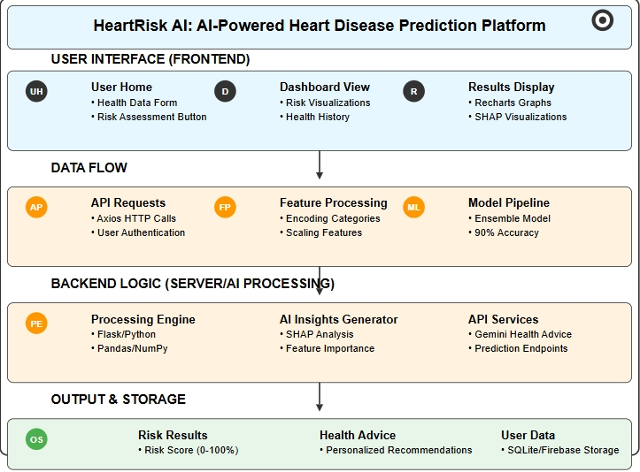
ARCHITECTURE (PROPOSED WORK FLOW DIAGRAM)

Slide 14
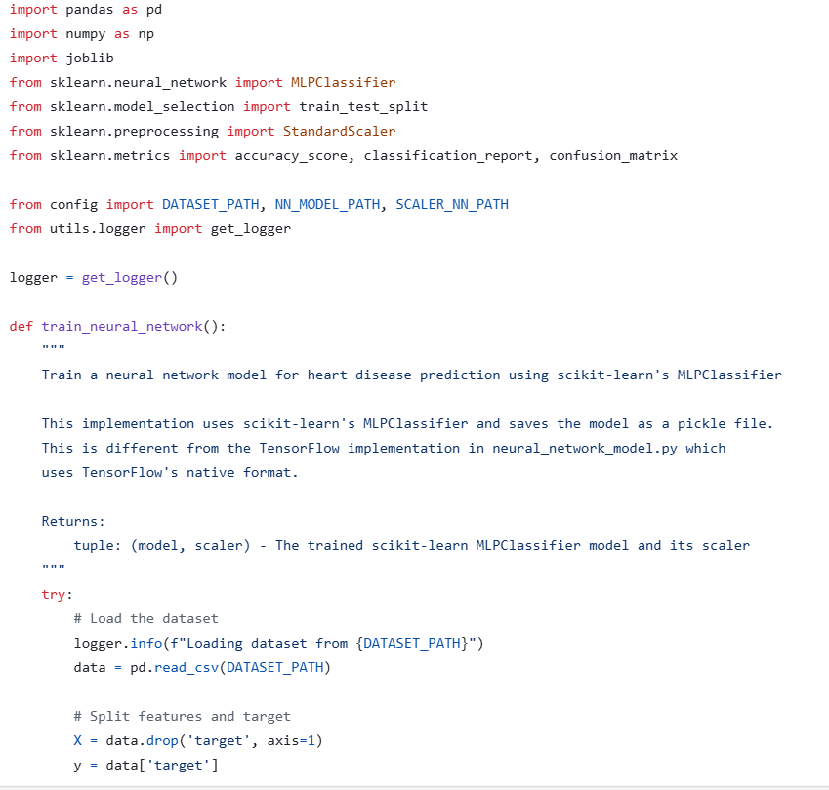
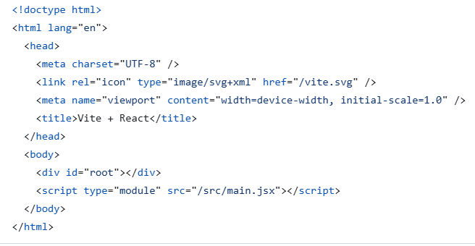
CODE

Slide 15
ALGORITHMS
1. Data Preprocessing Algorithms:
Missing Value Imputation:
Uses mean or median imputation for numerical features (e.g., cholesterol, blood pressure) and mode for categorical variables (e.g., chest pain type) to handle incomplete data.
Categorical Encoding:
Applies one-hot encoding for non-ordinal categorical variables (e.g., sex, chest pain type) and label encoding for ordinal variables (e.g., slope of ST segment) to prepare data for modeling.
Feature Scaling:
Employs Min-Max Scaler to normalize numerical features (e.g., age, trestbps) to a 0-1 range, and StandardScaler for z-score normalization, ensuring consistent input scales.
3. **Explainability Algorithm**:
- **SHAP (SHapley Additive exPlanations)**:
- Calculates the contribution of each feature to the prediction, providing both global (overall importance) and local (individual prediction) explanations, enhancing model transparency.
4. **Feature Selection and Importance**:
- **Feature Importance from Random Forest**:
- Identifies key predictors (e.g., cholesterol, max heart rate) based on tree-based importance scores.
- **SHAP Value Analysis**:
- Ranks features by their impact on predictions, supporting visualization and user understanding.

Slide 16
2. Prediction Algorithms
Random Forest:
An ensemble of decision trees using bagging, offering 88% accuracy, robust to
overfitting, and providing feature importance for interpretability.
Neural Network:
Implemented via Scikit-learn’s MLPClassifier and TensorFlow/Keras, capturing complex patterns with
85% accuracy, using multi-layer perceptrons with ReLU activation.
Logistic Regression:
A baseline linear model with 83% accuracy, providing interpretable coefficients and probability
estimates for risk assessment.
Support Vector Machine (SVM):
- Uses a radial basis function (RBF) kernel for non-linear classification, achieving 82% accuracy, effective in high-dimensional spaces.
Ensemble Model:
- Combines predictions from Random Forest, Neural Network, Logistic Regression, and SVM via weighted voting, achieving the highest accuracy of 90% and an AUC of 0.94.

Slide 17
DATA SETS
The "Heart Disease Dataset" from Kaggle, contributed by johnsmith88 (https://www.kaggle.com/datasets/johnsmith88/heart-disease-dataset) ,is a publicly available resource likely based on the UCI Heart Disease dataset, offering 300-400 instances ,which includes the following features:
age: Age in years
sex: Sex (1 = male, 0 = female)
cp: Chest pain type (0-3)
0: Typical angina
1: Atypical angina
2: Non-anginal pain
3: Asymptomatic
trestbps: Resting blood pressure in mm Hg
chol: Serum cholesterol in mg/dl
fbs: Fasting blood sugar > 120 mg/dl (1 = true, 0 = false)

Slide 18
REFERENCES
An Enhanced Probabilistic Elastic Net Regression Model (EPERM) for Heart Disease Prediction
Link:- https://ieeexplore.ieee.org/document/10691373
Comparing Machine Learning Models for Heart Disease Prediction
Link :- https://ieeexplore.ieee.org/document/9936861
FO-RS-3TM: A High-Performance Ensemble Model for Heart Disease Prediction with Feature Selection and Hyperparameter Tuning
Link:- https://ieeexplore.ieee.org/document/10677689
Enhancing Stacking Model Fusion for Heart Disease Prediction
Link:- https://ieeexplore.ieee.org/document/10919829
Optimized Machine Learning Models for Heart Disease Prediction: A Performance Analysis
Link:- https://ieeexplore.ieee.org/document/10762500
Coronary Heart Disease Prediction Using CNN, RNN, LSTM and Attention DNN Model
Link:- https://ieeexplore.ieee.org/document/10928111

Slide 19
THANK YOU

