Slide 1
Fantasy Quest: Aptitude Adventure
A Gamified Learning Experience
Presented by: Game Development Team

Slide 2
Presentation Overview
1. Game Concept & Vision
2. The Storyline
3. Characters & Lore
4. Core Game Mechanics
5. Features & Power-ups
6. Technical Architecture
7. Design & UI/UX
8. Future Roadmap

Slide 3
Game Concept
What is Fantasy Quest?
Genre: Educational RPG / Trivia
Platform: Web Browser (Responsive)
Objective: Combine learning with engaging gameplay mechanics to make studying fun.
Target Audience: Students preparing for aptitude tests, coding interviews, and general knowledge enthusiasts.

Slide 4
The Story: The Legend of Garuddwar
A Kingdom in Peril
The peaceful village of Garuddwar has been attacked by the ancient dragon Nagshakthi. The beast has kidnapped the Princess and taken her to its lair deep within the Sky Kingdom.

Slide 5
The Weapon of Choice
Knowledge is Power
Swords and arrows cannot pierce the dragon's hide.
Only correct answers to aptitude questions can weaken Nagshakthi.
The Hero must prove their intellect across 7 distinct levels to defeat the beast.

Slide 6
Characters: The Hero
The Player Avatar
Represents the user embarking on a quest for knowledge.
Equipped with the Sword of Intellect and Shield of Wisdom.
Can customize their name at the start of the journey.
Gains power and confidence with every correct answer.

Slide 7
Characters: Nagshakthi
The Dragon Boss
Nagshakthi is a formidable foe that guards each level.
Attacks the player when they answer incorrectly.
Has powerful 'Fire Breath' and 'Special Beam' attacks.
Its health is directly tied to the remaining questions in the level.

Slide 8
Characters: Master Roshi
The Wise Guide
A legendary sage who offers guidance to the hero.
Provides hints when the player is stuck.
Offers motivational quotes during streaks.
Scolds the player gently for careless mistakes, encouraging focus.

Slide 9
Core Gameplay Mechanics
Turn-Based Quiz Combat
Question Phase: Player is presented with an aptitude question.
Action Phase: Answering correctly deals damage to the dragon (progression).
Reaction Phase: Answering incorrectly causes the dragon to attack (lose a life).
Timer Phase: Players have a limited time (base 15s) to answer.

Slide 10
The Timer System
Adding Urgency
Base Time: Starts at 15 seconds per question.
Scaling Difficulty: Time increases slightly with higher levels to account for complexity.
Timeout Penalty: If time runs out, it's an immediate 'Game Over' (high stakes).
Visual Cues: Timer ring turns red when critical (< 5s).

Slide 11
Lives & Health System
Survival Mechanics
The Hero starts with 3 Hearts (Lives).
Wrong answers deduct 1 Heart.
Losing all hearts results in a 'Game Over'.
Players must balance speed with accuracy to preserve health.

Slide 12
Unique Features: Power-ups
Strategic Advantages
Random Drops: Power-ups (Extra Time, Free Hint) drop randomly (30% chance) on correct answers.
Extra Time (+5s): Adds 5 seconds to the current timer.
Free Hint: Reveals a hint without the usual penalty.
Inventory: Power-ups are stored in the HUD for later use.

Slide 13
Unique Features: Streak System
Rewarding Consistency
Consecutive Correct Answers build a streak.
3-Streak Reward: Grants the 'Shield of Knowledge' (blocks one attack).
4-Streak Reward: Grants a 'Magic Key' (Subway Surfers style extra life).
Critical Hits: Answering very quickly deals double damage/points.

Slide 14
Level Progression
Journey Through Realms
The game features 7 distinct levels/rooms.
Environments: Forest -> Cave -> Castle -> Mountain -> Desert -> Ocean -> Sky.
Dynamic Backgrounds: The background changes with each level to reflect the journey.
Princess Gifts: Completing levels awards gifts (Golden Rose, Diamond Tiara) to collect.

Slide 15
Technical Stack
Modern Web Technologies
Frontend Framework: React 19 (Component-based UI)
Build Tool: Vite (Fast HMR and bundling)
Language: JavaScript (ES6+)
Styling: Vanilla CSS3 (Variables, Animations, Flexbox/Grid)
Audio: Web Audio API (Synthesized sound effects in pure JS)

Slide 16
Project Structure
Organized & Scalable
src/components: Reusable UI blocks (GameScreen, HUD, QuestionCard).
src/hooks: Custom logic extraction (useTimer, useSound).
src/data: Static content (questions.js, quotes.js).
src/assets: Images and media resources.

Slide 17
Key Component: GameScreen
The Brain of the Operation
Manages global game state (Score, Level, Lives, Status).
Handles game loop logic (Question Generation -> Answer Check -> Transition).
Coordinates animations and sound effects.
Orchestrates sub-components like HUD and Battle Arena.

Slide 18
Key Component: HUD
Heads-Up Display
Provides real-time feedback to the player.
Visualizes the Timer (SVG Ring Animation).
Displays Score, Level, and Current Room.
Shows Power-up inventory and Control buttons (Pause, Mute).

Slide 19
Key Component: QuestionCard
The Interaction Layer
Renders the current question and options.
Handles user clicks and selection states.
Displays feedback (Correct/Incorrect animations).
Includes the Hint UI bubble.

Slide 20
Custom Hook: useTimer
Time Management Logic
Encapsulates all timer-related logic (Start, Stop, Pause, Reset).
Uses `setInterval` and `useRef` to maintain accurate time tracking.
Handles callback execution on timeout.
Promotes code reusability and separation of concerns.

Slide 21
The Audio System
Web Audio API Synthesis
Instead of loading heavy MP3 files, we synthesize sounds in real-time.
Oscillators generate waves (Sine, Square, Sawtooth) for effects.
Effects include: Correct (Chime), Wrong (Buzz), Victory (Fanfare), and ambient music.
Benefits: Zero load time, tiny bundle size, dynamic pitch control.

Slide 22
Data: Questions & Logic
The Knowledge Base
questions.js: Central repository of categorized questions (Coding, Maths, Logic).
Randomization: Questions are shuffled and served dynamically.
Difficulty Tiers: Questions have difficulty ratings (1-3) to scale challenge.
Scalable: Easy to add new categories or questions without code changes.

Slide 23
UI/UX & Design Philosophy
Immersive & Premium
Glassmorphism: Translucent UI elements for a modern feel.
Animations: CSS keyframes for entrances, attacks, and particle effects.
Responsive Design: Adapts to different screen sizes.
Visual Feedback: Screen shake on damage, confetti on victory.

Slide 24
Conclusion & Future Roadmap
What's Next?
Leaderboards: Global high scores.
Multiplayer Mode: 1v1 Battles.
More Content: New question packs and storylines.
Mobile App: React Native port.

Slide 25
Gameplay Flow Diagram
How the Game Works
Start Game
(Select Name)
Level 1
(Forest Room)
Battle Logic
(Q -> A -> R)
Outcome:
Win / Game Over

Slide 26
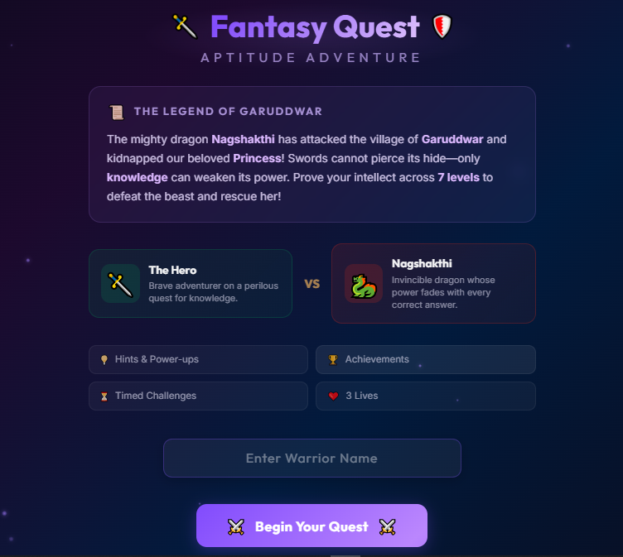
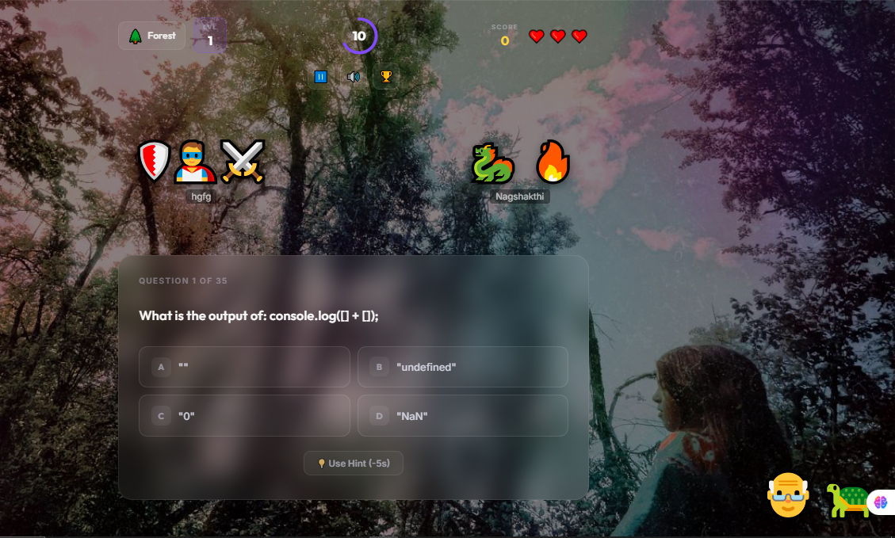
Visual Gallery
Screenshots from Fantasy Quest
[PLACEHOLDER: Intro Screen]
Paste screenshot here
[PLACEHOLDER: Battle Screen]
Paste screenshot here

Slide 27
Thank You!
Any Questions?

