Slide 1
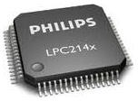
PLL in LPC2148

Slide 2


PLL
There are 2 PLLs in LPC2148 ➔ PLL0, PLL1
PLL0 ➔ System Clock
PLL1 ➔ USB Clock
Input clock to both the PLLs must be between 10MHz to 25MHz strictly.
This input clock is multiplied with a suitable multiplier and scaled accordingly
We have a upper limit of 60MHz which is the maximum frequency of operation for lpc214x MCUs.
FOSCL
(10-25MHz)
CCLK (CPU Clock)
(60MHz)

Slide 3

Current Controlled Oscillators (CCO)
CCOs operate in range of 156Mhz to 320Mhz and there is also a divider to force CCOs to remain in their range.
FOSC (10-25MHz)
PLL CCO
CCLK (CPU Clock)
(60MHz)

Slide 4



PLL Architecture
FOSC | => frequency from the crystal oscillator(XTAL)/external clock
FCCO | => frequency of the PLL Current Controlled Oscillator(CCO)
CCLK | => PLL output frequency (CPU Clock)
M | => PLL Multiplier value from the MSEL bits in the PLLCFG register
P | => PLL Divider value from the PSEL bits in the PLLCFG register
PCLK | => Peripheral Clock which is derived from CCLK
FOSC
PLL
CCO
CCLK (CPU Clock)
xM %P
VPB
Divider
PCLK (Peripheral Clock)

Slide 5


Equations
FOSC
PLL
CCLK (CPU Clock)
VPB
Divider
PCLK (Peripheral Clock)
xM %P
CCLK = M x FOSC
CCLK = FCCO / (2 x P)
FCCO = FOSC x M x 2 x P

Slide 6
Frequency Ranges:
FOSC is in the range of 10 MHz to 25MHz.
CCLK is in the range of 10 MHz to 60MHz
FCCO is in the range of 156 MHz to 320 MHz.

Slide 7
SFRS Used:
PLL0FEED ➔ Feed Sequence SFR
PLL0CON ➔ PLL Control Register
PLL0CFG➔ PLL Configure Register
PLL0STAT ➔ PLL Status Register
VPBDIV ➔ VLSI Peripheral Bus Divider

Slide 8
Setting Up PLL

Slide 9
How to Setup PLL
Setup PLL
Apply Feed Sequence
Wait for PLL to lock and then connect PLL
Apply Feed Sequence.

Slide 10
1. PLL Feed Sequence
Assignment of two particular fixed values to PLLFEED register to configure PLL.
PLL0FEED = 0xAA;
PLL0FEED = 0x55;
Something similar to a Key to open a Safe

Slide 11
2. PLL Control Register (PLL0CON)
Used to Enable and connect the PLL.
First bit is Enable the PLL
Second bit is Connect the PLL from internal RC oscillator to CPU.

Slide 12
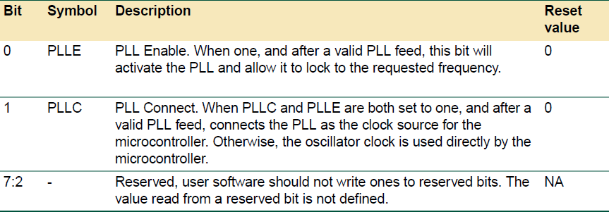
PLL0CON:
PLL0CON = 0x01 ➔ PLL Enable
PLL0CON = 0x03 ➔ PLL Enable & Connect

Slide 13
3.PLL Configure Register (PLL0CFG)
Multiplier and Divider are stored here.
First 5 bits are MSEL (Multiplier)
Bit 5,6 are called PSEL (Divider)

Slide 14
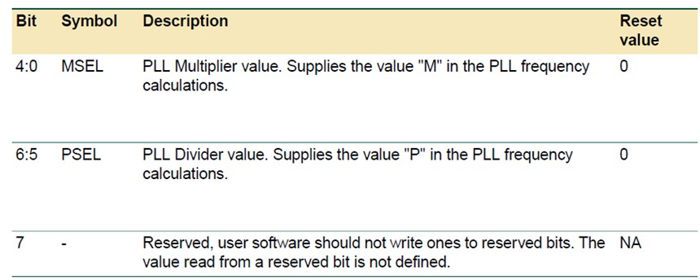
PLL0CFG
PLL0CFG = 0x24 00100100

Slide 15

MSEL
FOSC
PLL
CCLK (CPU Clock)
xM %P
VPB
Divider
PCLK (Peripheral Clock)
M = CCLK / FOSC
M = 60MHz / 12MHz
M = 5
Load 5-1 = 4
The value written to the MSEL bits in PLLCFG is (M − 1)

Slide 16
PSEL
Values of PSEL for P are :
P | Value(binary) in PSEL Bit(5,6)
1 | 00
2 | 01
4 | 10
8 | 11
P = FCCO/(2xCCLK).
We want FCCO in range 156Mhz to 320Mhz
For FCCO = 156 and we get P = 1.3 For FCCO i.e 320Mhz we get P = 2.67
Now , P must be an integer between 1.3 and 2.67.
So we will use P=2.

Slide 17

PLL Status Register (PLL0STAT)
Read Only Register.
10th Bit of PLL0STAT is called LOCK Bit
If LOCK Bit = 1, this means PLL has now latched to the Target Frequency.

Slide 18
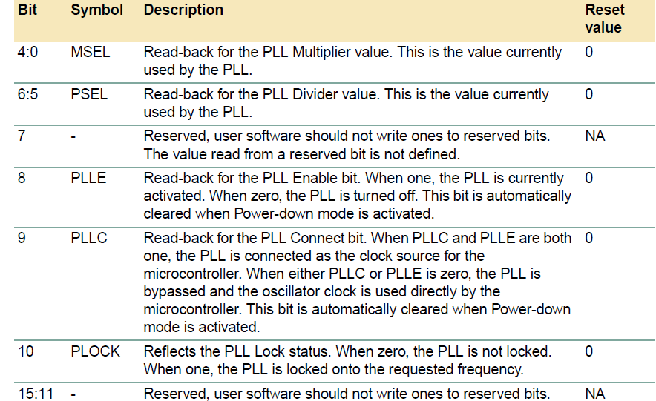
PLL0STAT
while( PLL0STAT & 0x400 ==0 );
100 0000 0000

Slide 19
Void InitPLL()
Void initPLL()
{
PLL0CON = 0x01 ; PLL0CFG = 0x24 ;
// Enable PLL
// Set Up PLL for CClk = 60MHz
PLL0FEED = 0xAA;
PLL0FEED = 0x55; // Apply Feed Sequence
while( PLL0STAT & 0x400 ==0 ); // Check Whether CCO Latched
PLL0CON = 0x03; // Enable & Connect PLL
PLL0FEED = 0xAA;
PLL0FEED = 0x55; // Apply Feed Sequence
}

Slide 20
Deriving Pclk from Cclk
FOSC
PLL
CCLK (CPU Clock)
VPB
Divider
xM %P
PCLK (Peripheral Clock)
VPBDIV=0x00; | (PCLK) is one fourth of the processor clock (CCLK)
VPBDIV=0x01; | (PCLK) is the same as the processor clock (CCLK)
VPBDIV=0x02; | (PCLK) is one half of the processor clock (CCLK)
VPBDIV=0x03; | Reserved. If this value is written to the APBDIV register, it has no effect (the previous setting is retained).

Slide 21
Void InitPLL()
Void initPLL()
{
PLL0CON = 0x01 ;
PLL0CFG = 0x24;
// Enable PLL
// Set Up PLL for CClk = 60MHz
PLL0FEED = 0xAA; PLL0FEED = 0x55; // Apply Feed Sequence
while( PLL0STAT & 0x400 ==0 );// Check Whether CCO Latched
PLL0CON = 0x03; // Enable & Connect PLL
PLL0FEED = 0xAA; PLL0FEED = 0x55; // Apply Feed Sequence VPBDIV=0x01; // Pclk is same as Cclk (60 MHz)
}

Slide 22
End of Session

