Slide 1
ARM:

Slide 2
ARM INTRODUCTION:
ARM Originally Arcon RISC Machine.
Later Advanced RISC Machine.
It is family of Reduced Instruction Set Computer(RISC).
British Company ARM Holding develops the architecture and licences it to companies, who design their own product implement one of those architectures.
ARM do not make IC’s.
ARM grant licences of core to different silicon vendors like NXP,Atmel, Cirrus Logic, etc.
Example : LPC2148 from NXP.
AT91RM9200 form Atmel.

Slide 3
ARM PROCESSORS:
ARM Processors can be divided into 3 parts:
1) ARM Classic Processors.
2) ARM Embedded Processors.
3) ARM Applications Processors.

Slide 4
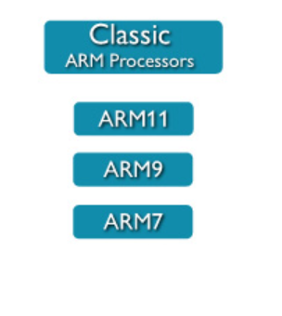
ARM Classic Processors:
ARM Classic Processors include ARM7, ARM9, ARM11 families.
ARM7TDMI is still still highest shipping 32-bit processors.
ARM7 based processors are still used in many small and simple 32-bit devices.

Slide 5
ARM Embedded Processors:
Even though ARM7 and other Classic ARM Processor can be used for small scale embedded systems, never embedded systems are build using the advanced ARM Embedded Processors.
Such as Cortex-M processors and Cortex-R Processors.
ARM Cortex-M have a Microcontroller profile while the ARM Cortex-R have a Real time profile.

Slide 6
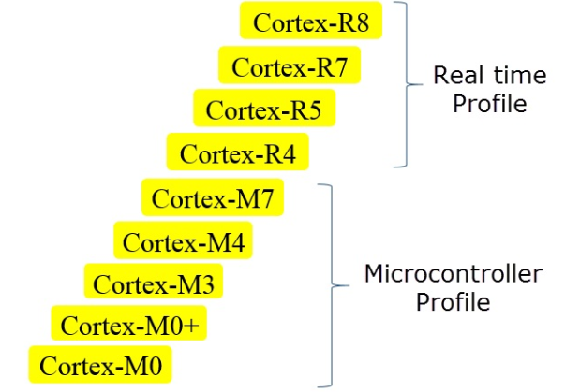
ARM Embedded Processors:

Slide 7
ARM Applications Processors:
ARM Cortex A series of Processors are Applications Processors.
They are Highest Performance processors from ARM.
They are used in powerful mobile, compelling technology products like network devices, consumers applications, automation system, automobile and other embedded system.
The Cortex-A processors are again divided into high performance, high efficiency and ultra-high efficiency type processors.

Slide 8
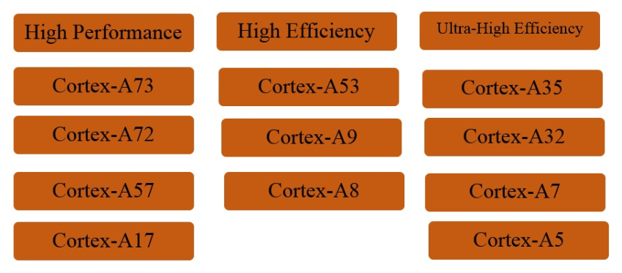
ARM Applications Processors:

Slide 9
LPC2148

Slide 10
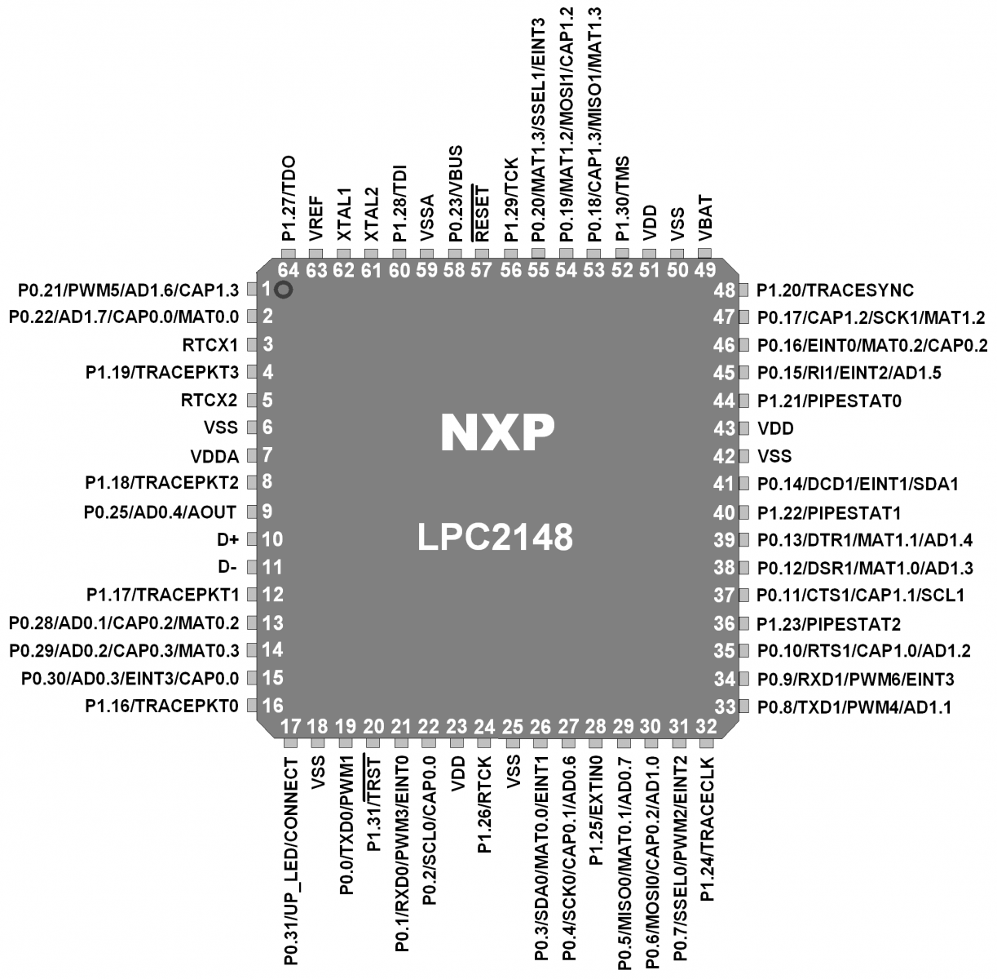
PIN DIAGRAM:

Slide 11
Features of LPC2148:
• CPU = ARM 7 Core
• Word Length = 32 Bit
• ROM = 512 KB
• RAM = 40KB
• 2 Port (P0,P1 29+16 = 45 GPIO)
• 2 Timers (32 Bit) 4 Compare,4 Capture,6 PWM
• Interrupts sources = 22
• 1 WatchDog Timer
• 1 RTC
• 2 ADC (AD0,AD1) 8+6 = 14 Channels (10 Bit)
• 1 DAC (10 Bit)
• 2 - I2C-bus, 2 –UARTs, 2-SPI/ SSP, 1 USB

Slide 12
Types of Buses:
• In LPC2148 three types of busses are used to connect the core with other peripherals on chip.
1. Local Bus to connect the on-chip memory controllers and fast GPIO’s.
2. Advance High Performance Bus (AHB) for interrupt controller
3. VLSI Peripheral Bus (VPB) for other on-chip peripherals.
• AHB acts as a bridge for VPB.
• VPB is mainly meant for connecting slower peripherals with processor.

Slide 13
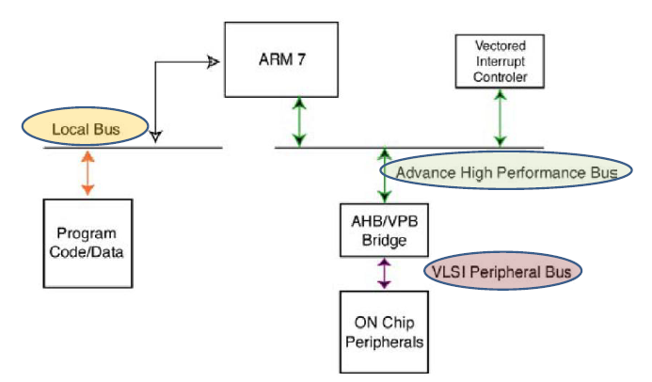
BUS Architecture:

Slide 14
Advanced High performance Bus (AHB)
• The ARM7 core is connected to the Advanced High performance Bus (AHB)
• This is the Fastest Bus in ARM7 core.
• Connected to the AHB is the vector interrupt controller and a bridge to a second bus called the
VLSI peripheral bus (VPB).
• Since the Interrupt vector controller is responsible for managing all the device interrupt sources, it is connected to the ARM7 core by the fastest bus.

Slide 15
VLSI Peripheral Bus [VPB]
• All the user peripherals are connected to the VPB.
• The VBP bridge contains a clock divider, so the VPB bus can be run at a slower speed than the ARM7 core and the AHB.

Slide 16
Why VPB is operated at Slow Speeds
• For two reasons
• First, we can run the user peripherals at a slower clock rate than the main processor to conserve power.
Second, it gives Philips the option of adding a slower peripheral to the LPC2000 family without it becoming a bottleneck on the AHB bus.

Slide 17
What is the Optimum speed of VPB
• Currently all the on-chip peripherals are capable of running at 60 MHz so the VPB bus can be set to the same speed as the AHB bus.
• It is important to note that after reset the VPB
divider is set to divide down the AHB clock by four, so all the on-chip peripherals will be running at 1⁄4 the CPU clock frequency.

Slide 18
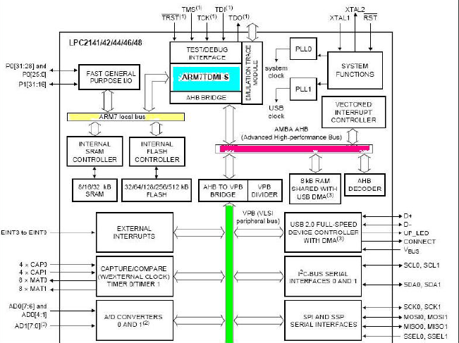

Slide 19
Local Bus:
There is a third local bus which is used to connect the on-chip Flash and RAMto the CPU.
Connection of the program code and data store to the ARM7 CPU via the AHB bus is possible, but this introduces some execution stalls because of contention on the bus.
Using a separate local bus removes the possibility of these stalls to give the best processor performance.

Slide 20
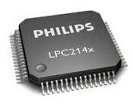
Activating LPC2148
Microcontroller:

Slide 21
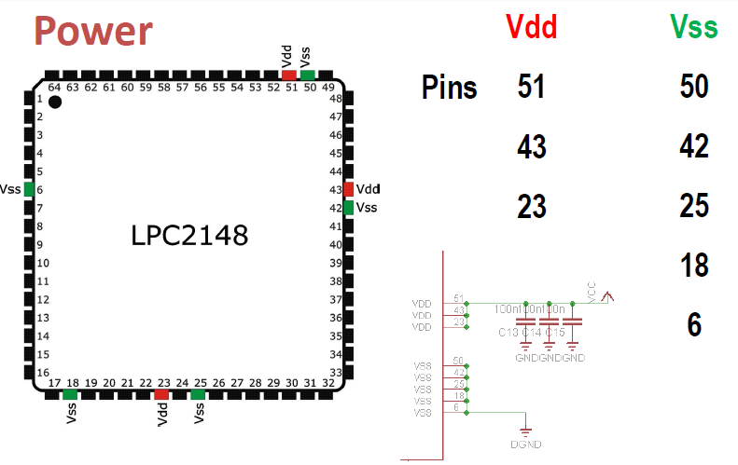

Slide 22
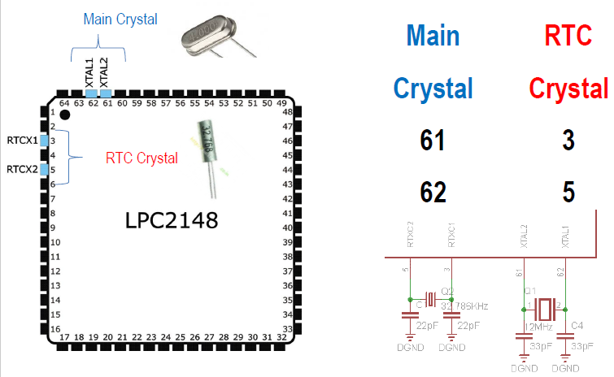

Slide 23
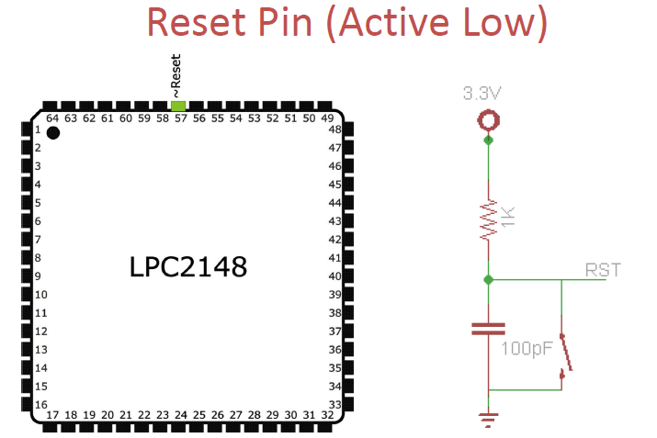

Slide 24
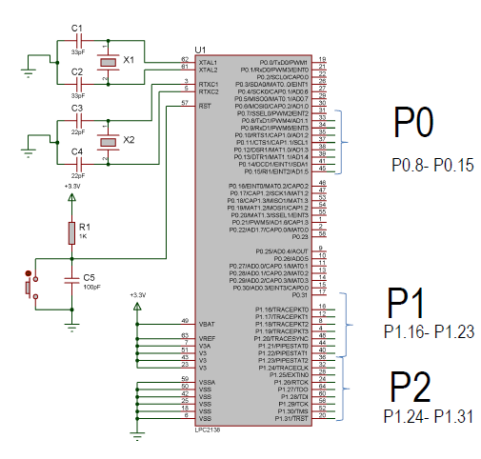

Slide 26
Parallel Port – Port 0:
• Port 0 = 32 Pins (P0.0 to P0.31)
• P0.24, P0.26 and P0.27 are not available
• So (32-3) = 29 Pins are Available
• Out of 29 Pins, 28 Pins → Bidirectional,
Pin 31 → O/P Only.

Slide 27
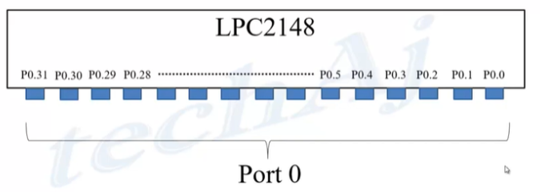
LPC2148 I/O Ports:

Slide 28
Parallel Port – Port 1:
• Port 1 = 16 Pins P1.16 to P1.31
• P1.0 to P1.15 of port 1 are not used
===========================================
• P0 = 29 (28 Bidirectional + 1 output only)
• P1 = 16 (16 Bidirectional)
• Total = 45 GPIOs

Slide 29
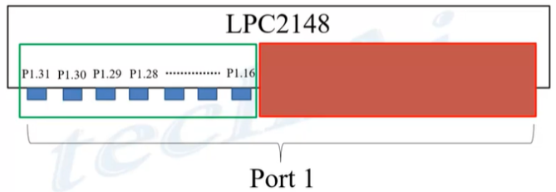
LPC2148 I/O Ports:

Slide 30
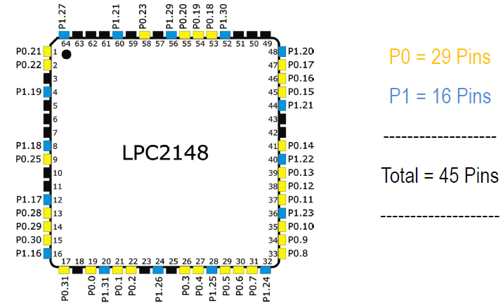
PARALLEL PORT:

Slide 31
SFR Programming in ARM:
• Each underlying SFR is controlled by three user registers.
• Set register which is used to set bits,
• Clear register which is used to clear bits by writing a logic 1 to the bits you wish to clear
• Status register which is used to read the current contents of the register.
• The most common mistake made when new to the LPC2100 is to write zero into the Clear register which has no effect.

Slide 32
SFRs Used:
P0
• IODIR0 → to set the direction
• IOSET0 → to set a Pin
• IOCLR0 → to clear a Pin
• IOPIN0 → to Read a Pin
P1
• IODIR1 → to set the direction
• IOSET1 → to set a Pin
• IOCLR1 → to clear a Pin
• IOPIN1 → to Read a Pin

Slide 33
IODIR:
1 → Output 0 → Input
• IODIR controls the 'direction' of the GPIO pin.
• You use this register to set a GPIO pin to either Input (0) or Output (1).
• To Configure GPIO 0.10 to 'Output' (1).
IODIR |= (1 << 10);
• To Configure GPIO 0.10 to ‘Input' (0).
IODIR &= ~(1 << 10);

Slide 34
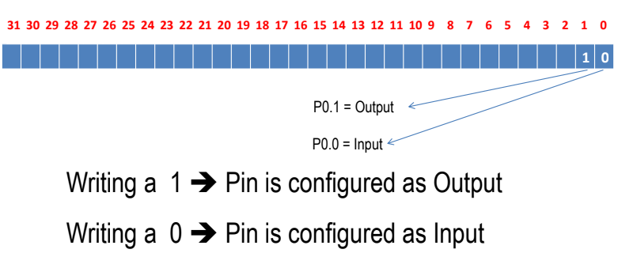
IODIR0:

Slide 35
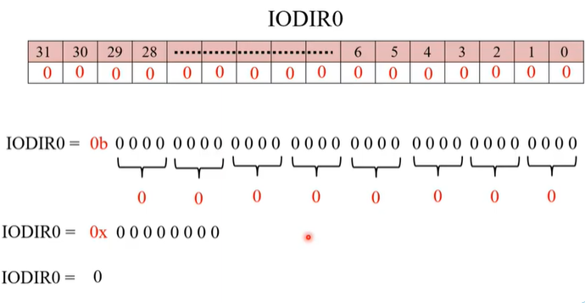

Slide 36
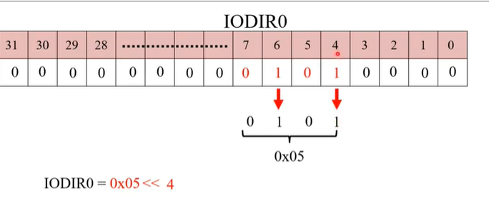

Slide 37
IOSET and IOCLR
• If GPIO pin is set as Output (using the IODIR register)
• IOSET is used to set GPIO pin to 'high' (providing a small 3.3V electrical output)
• IOCLR is used to clear it to 'low' (providing a connection to GND).

Slide 38
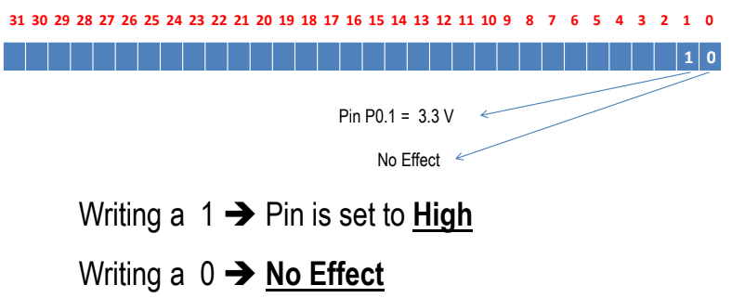
IOSET0

Slide 39
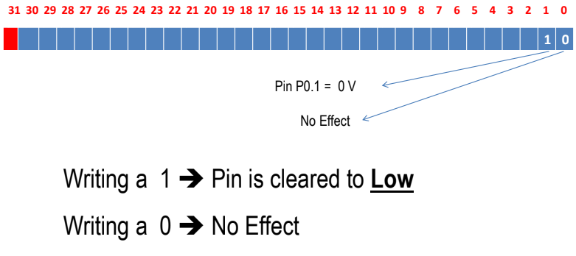
IOCLR0

Slide 40
A small Example
• Make sure GPIO 0.10 and 0.11 are set to output
• IODIR0 |= (1 << 10) | (1 << 11);
• Turn the LEDs off using IOCLR (which gives a GND connection)
• IOCLR0 |= (1 << 10) | (1 << 11);
• Turn the LEDs on using IOSET (which supplies 3.3V
• IOSET0 |= (1 << 10) | (1 << 11);

Slide 41
IOPIN:
• Regardless of whether GPIO pins direction is set to Input or Output.
• IOPIN register is used to read the current 'state' of every GPIO pin(all 32 pins in GPIO).
• A 1 value means that the pin is currently 'high', and a 0 value means the pin is currently 'low'.

Slide 42
A Small Example
int getPinState(int pinNumber)
{
// Read the current state of all pins in GPIO block 0
int pinBlockState = IO0_IOPIN;
// Read the value of 'pinNumber'
int pinState = (pinBlockState & (1 << pinNumber)) ? 1 : 0;
// Return the value of pinState
return pinState;
}

Slide 44
Applications of LPC2148:
• Industrial control
• Medical systems
• Access control
• Point-of-sale
• Communication gateway
• Embedded soft modem
• General purpose applications

Slide 45
ADC Calculations:
A/D Conv=PCLK / X+1
= 15MHz / X+1
= 15MHz / 3+1
= 3.75MHz
freq value must be < 4.5MHz
A/D Conv=pclk / x+1
= 10MHz / x+1
= 10MHz / 2+1
= 3.33MHz
freq value must be < 4.5MHz

Slide 47
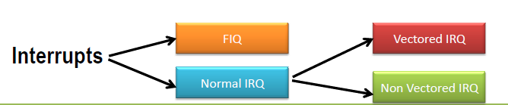
How We classify them ?
We Classify them as 2 types :
• Fast IRQs or FIQs
• Normal IRQs or IRQs which can be further classified as :
– Vectored IRQ
– Non-Vectored IRQ.

Slide 48
Types of Interrupts in LPC2148
Interrupts are Handled by Vectored Interrupt Controller(VIC)
Types of Interrupts in LPC2148
• Fast Interrupt Request i.e FIQ : which has highest priority
• Vectored Interrupt Request i.e Vectored IRQ : which has
‘middle’ or priority between FIQ and Non-Vectored IRQ.
• Non-Vectored IRQ : which has the lowest priority.

Slide 49
What does Vectored mean ?
• ‘Vectored‘ means that the CPU is aware of the address of the ISR when the interrupt occurs
• Non-Vectored means that CPU doesn’t know the address of the ISR (nor) the source of the IRQ when the interrupt occurs.
• For Non – Vectored interrupts,CPU needs to be supplied by the ISR address.
• For the Vectored interrupts , the System internally maintains a table called IVT or Interrupt Vector Table which contains the information about Interrupts sources and their corresponding ISR address.

Slide 50
How Non-Vectored Interrupts are handled?
• Non-Vectored ISRs doesn’t point to a unique ISR
• The CPU needs to be supplied with the address of the ‘default’ or a ‘common’ ISR that needs to be executed when the interrupt occurs.
• In LPC2148 this is facilitated by a register called ‘VICDefVectAddr‘.
• The user must assign the address of the default ISR to this register for handling Non-Vectored IRQs.

Slide 51
How Many Possible Interrupt Sources are there ?
• There are 22 Interrupt Sources in LPC2148
• But there are only 16 Slots in in the Vectored Interrupt Controller (VIC) 0 to 15.
• These 22 possible sources have to be shared by using Slots 0 to 15 of VIC
• Slot 0 Highest Priority
• Slot 15 Lowest Priority

Slide 52
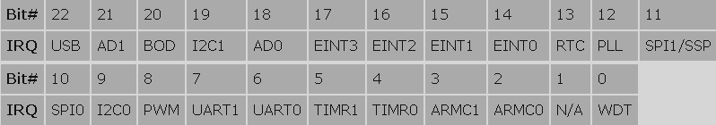

Slide 53
VICVectCntl0 to VICVectCntl15:
• These are the Vector Control registers.
• These are used to assign a particular interrupt source to a particular slot.
• As mentioned before slot 0 i.e VICVectCntl0 has highest priority and VICVectCntl15 has the lowest.
• Each of this registers can be divided into 3 parts : {Bit0 to bit4} , {Bit 5} , {and rest of the bits}.

Slide 54

• The first 5 bits i.e Bit 0 to Bit 4 contain the number of the interrupt request which is assigned to this slot. The interrupt source numbers are given in the table below :
• The 5th bit is used to enable the vectored IRQ slot by writing a 1

Slide 55
Important Note:
• Note that if the vectored IRQ slot is disabled it will not disable the interrupt but will change the corresponding interrupt to Non-Vectored IRQ.
• Enabling the slot here means that it can generate the address of the ‘dedicated Interrupt handling function (ISR)’
• Disabling it will generate the address of the ‘common/default Interrupt handling function (ISR)’ which is for Non-Vectored ISR.
• In simple words if the slot is enabled it points to ‘specific and dedicated interrupt handling function’ and if its disable it will point to the ‘default function’.

Slide 56
VICVectAddr0 to VICVectAddr15
(16 registers in all):
• For Vectored IRQs these register store the address of the function that must be called when an interrupt occurs.
• Note – If you assign slot 4 for TIMER0 IRQ then care must be taken that you assign the address of the interrupt function to corresponding address register .. i.e
VICVectAddr4 in this example.

Slide 57
VICVectAddr:
• This must not be confused with the above set of 16 VICVecAddrX registers.
• When an interrupt is Triggered this register holds the address of the associated ISR i.e the one which is currently active.
• Writing a value i.e dummy write to this register indicates to the VIC that current Interrupt has finished execution.
• The only place we’ll use this register .. is at the end of the ISR to signal end of ISR execution.

Slide 58
How to Write an ISR:
Method – 1
__irq void myISR (void)
{
...
}
For 8051
void myISR (void) interrupt 1
{
...
}
Method – 2
void myISR (void) __irq
{
...
}

Slide 59
Step Process to Enable a Vectored IRQ:
Step–1: Configure the Pin Function (PINSEL)
Step-2:Enable the IRQ by setting the appropriate bit of VICIntEnable to ’1′.
Step-3: Select the appropriate Ext Interrupt
Step-4: Assign the address of the related ISR to VICVectAddrX.
Step-5: Identify the interrupt source number/ priority and assign it to VICVectCntlX.
Step-6: Select the Sensitive Mode.
Step-7: Select the Polarity.

Slide 61
Introduction to RTC:
Real Time Clock (RTC) is a time counter that counts real time continuously.
We can get present time details using RTC. It gives us time as well as date information.
RTC is clocked by separate 32.768KHz oscillator to continuously keep track of current time.
RTC is powered either by main system power or separately by battery backup in absence of main system power.
Since RTC needs to be running continuously, it should be provided with battery backup in case of main system power failure. Otherwise, it can lose present time information.
We can easily program the RTC with the current date and time information in the case of loss time and date information due to power failure.

Slide 62
Formula of RTC:
PREINT=int(PCLK/Frtc)-1
PREFRAC=PCLK -([PREINT+1]*32768)

Slide 63
Frequency Calculation of RTC:
Fosc=10MHz
PCLK=CCLK/4
=60MHz /4
PCLK=15MHz
Frequency of RTC 32.768
Division Factor = PREINT
PREINT=int(PCLK/Frtc)-1
=int(15Mhz/32.768)-1
PREINT =456.
PREFRAC=PCLK -([PREINT+1]*32768)
= 15MHZ -([456+1]*32768)
PREFRAC =25026

Slide 64
UART:
In LPC2148 there are 2 UART:
Uart 0
Uart 1

Slide 65
Registers associated with LPC2148:
Line control register (U0LCR,U1LCR)
DIVISOR LATCH Register (U0DLL, U0DLM) → BR
Transmit Buffer Register (U0THR and U1THR)
Receive Buffer Register (U0RBR, U1RBR)
Line Status Register (U0LSR and U1LSR)→ read only register where the data TX & RX or not
Fractional Divisor Register.

Slide 66
FORMULA:
UART0 baudrate= PCLK MulVal
-------------------------X—------------------
16X(U0DLM + U0DLL) (MulVal + DivAddVal)
As per Datasheet we can skip the fractional no.
UART0 baud rate = PCLK
-----------------------
16X(U0DLM + U0DLL)

Slide 67
(U0DLL+U0DLM)= PCLK
-----------
BR*16
= 15*10^6
------------
9600*16
= 97
= 0x0061
DLL=61
DLM=00

Slide 69
Introduction of PWM:
Pulse Width Modulation (PWM) is a technique by which width of a pulse is varied while keeping the frequency constant.
A period of a pulse consists of an ON cycle (HIGH) and an OFF cycle (LOW). The fraction for which the signal is ON over a period is known as duty cycle.
Duty Cycle (In %) = Ton / Ton +Toff x 100

Slide 70
Why we need PWM?
we know that microcontrollers do everything with ones and zeros. That means microcontroller works with 3.3V and 0V as digital 1 & 0. It can’t produce for example 1V or 2.5V or any other value different than 0V and 3.3V.
Here PWM feature allows us to generate any voltage level between 0V and 3.3V. Now we will see how it’s been done using PWM so that we will control brightness of LED. This is probably the best way to see effect of PWM.

Slide 71
