Slide 1
Western Financial Data Analysis
Analyzing financial trends in Western countries
Presented by Sachin Jalakoti

Slide 2
Project Overview
This project analyzes financial data from Western countries using Power BI, SQL, and Excel. The aim is to identify trends and insights that can aid in financial decision-making.

Slide 3
Data Sources & Tools Used
- Power BI for data visualization
- SQL for data processing
- Excel for data storage
- Western Countries Financial Data dataset

Slide 4
Key Features of Analysis
- Financial performance trends
- Country-wise comparisons
- Revenue and expense patterns
- Interactive Power BI dashboards

Slide 5
Project Workflow
1.Data Collection & Preparation (Excel)
Raw financial data is collected and pre-processed.
2.Database Management & Querying (SQL)
Data is stored, cleaned, and queried for analysis.
3.Data Visualization & Insights (Power BI)
Reports and dashboards are built for insights.

Slide 6
Data Processing in Excel
Cleaning and formatting financial data.
Handling missing values and outliers.
Initial exploratory analysis using pivot tables.

Slide 7
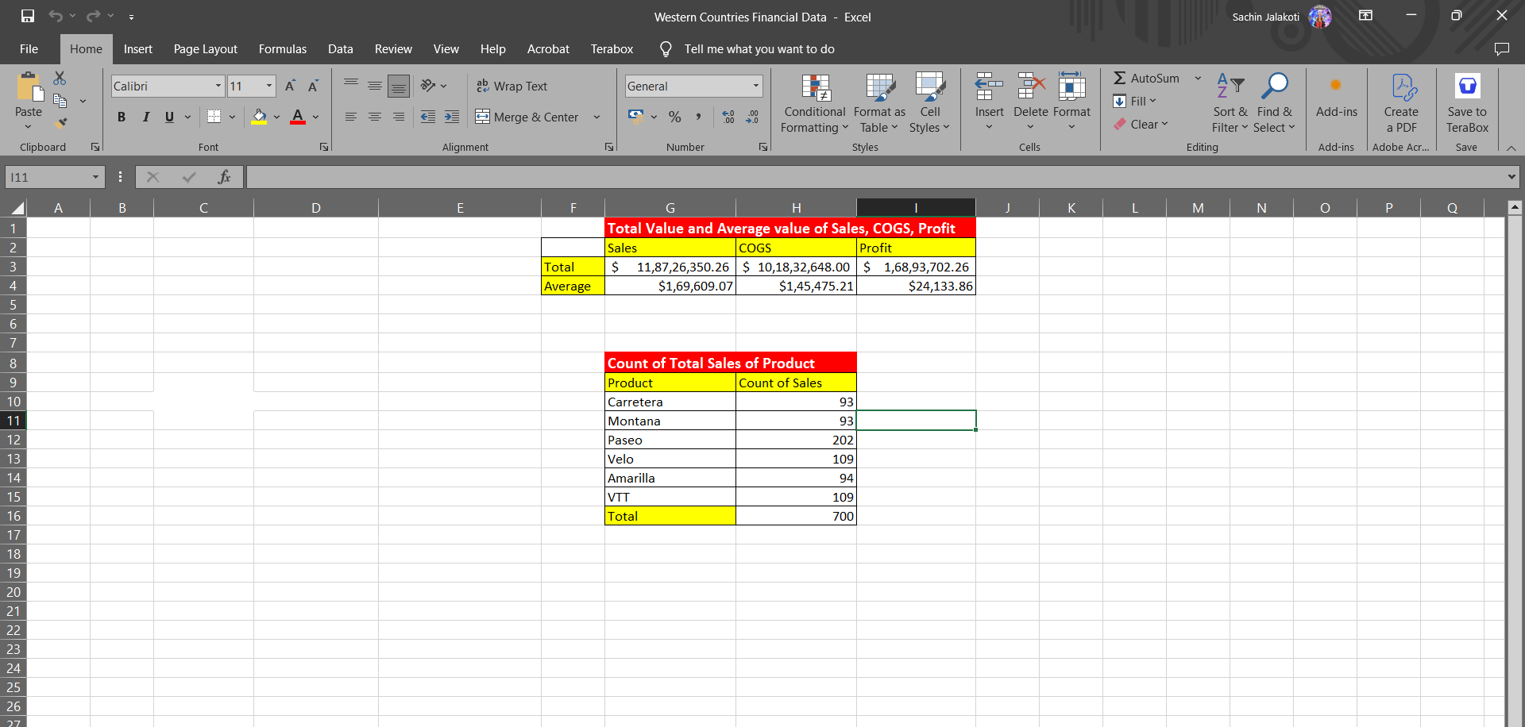

Slide 8
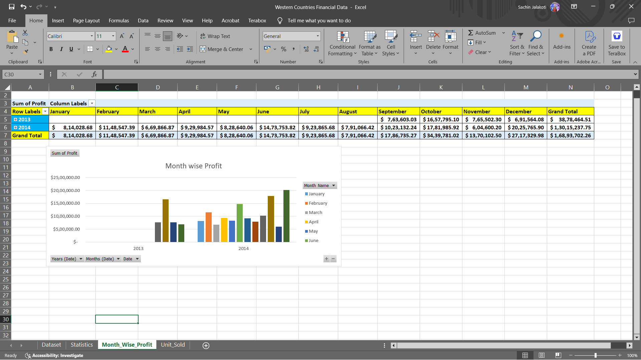

Slide 9
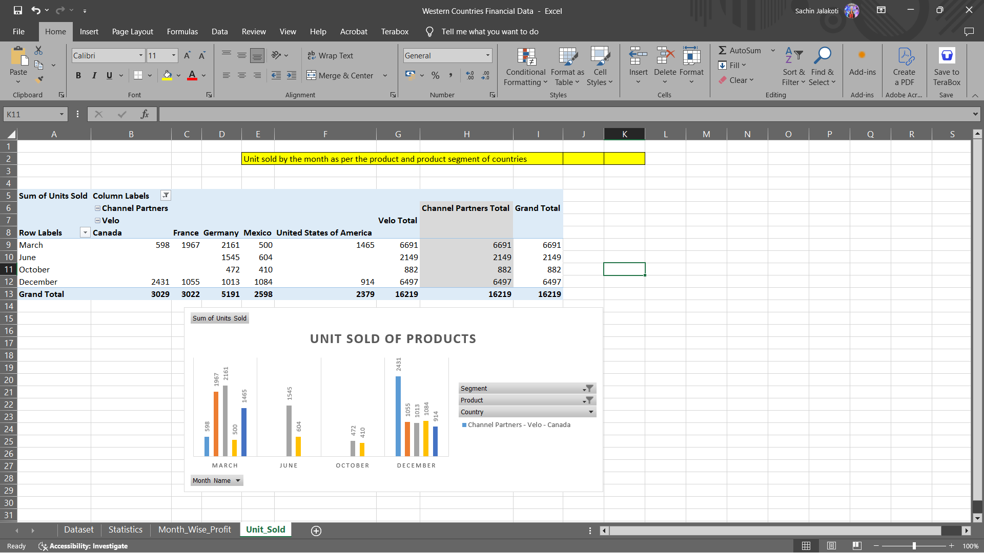

Slide 10
SQL for Data Processing
Importing data into SQL databases.
Running queries to filter and transform data.
Optimizing database performance.

Slide 11
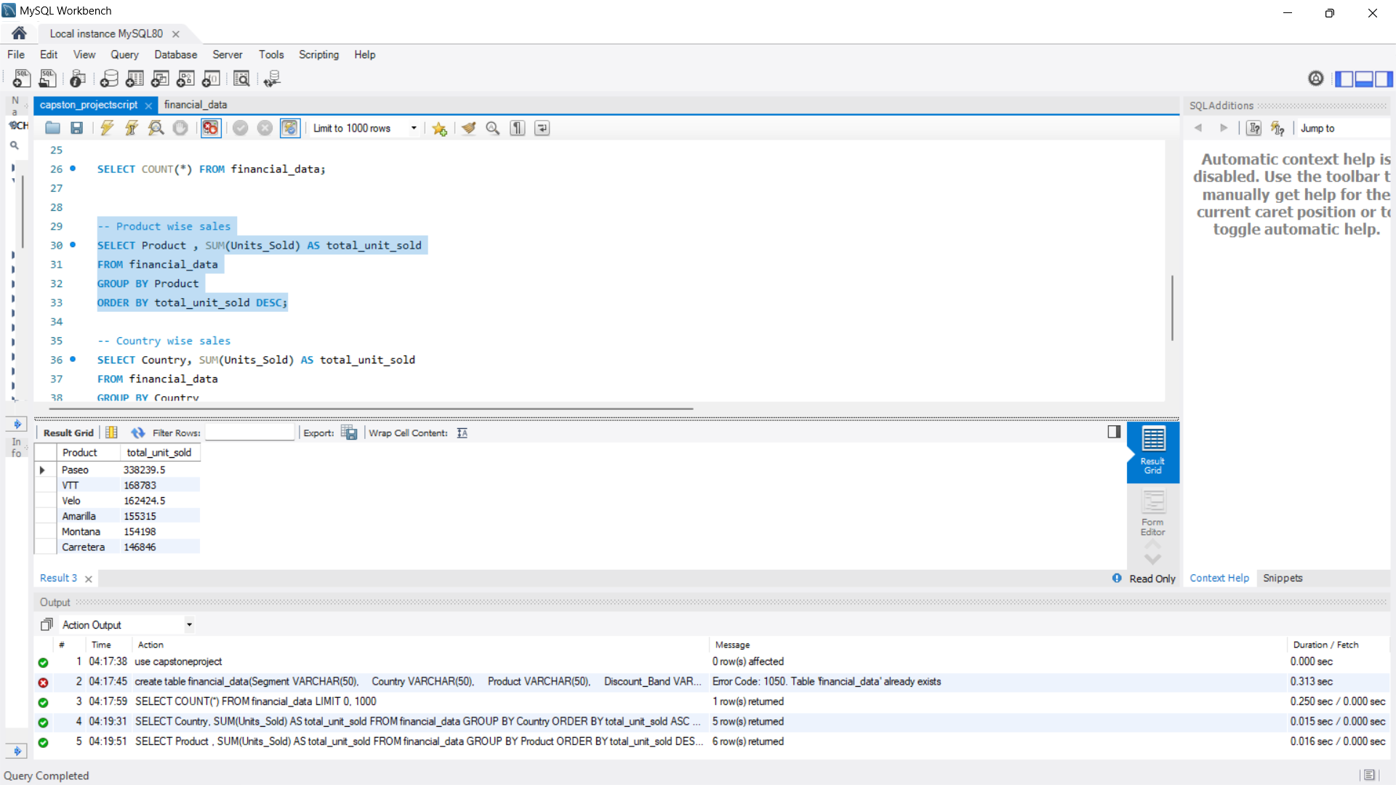

Slide 12
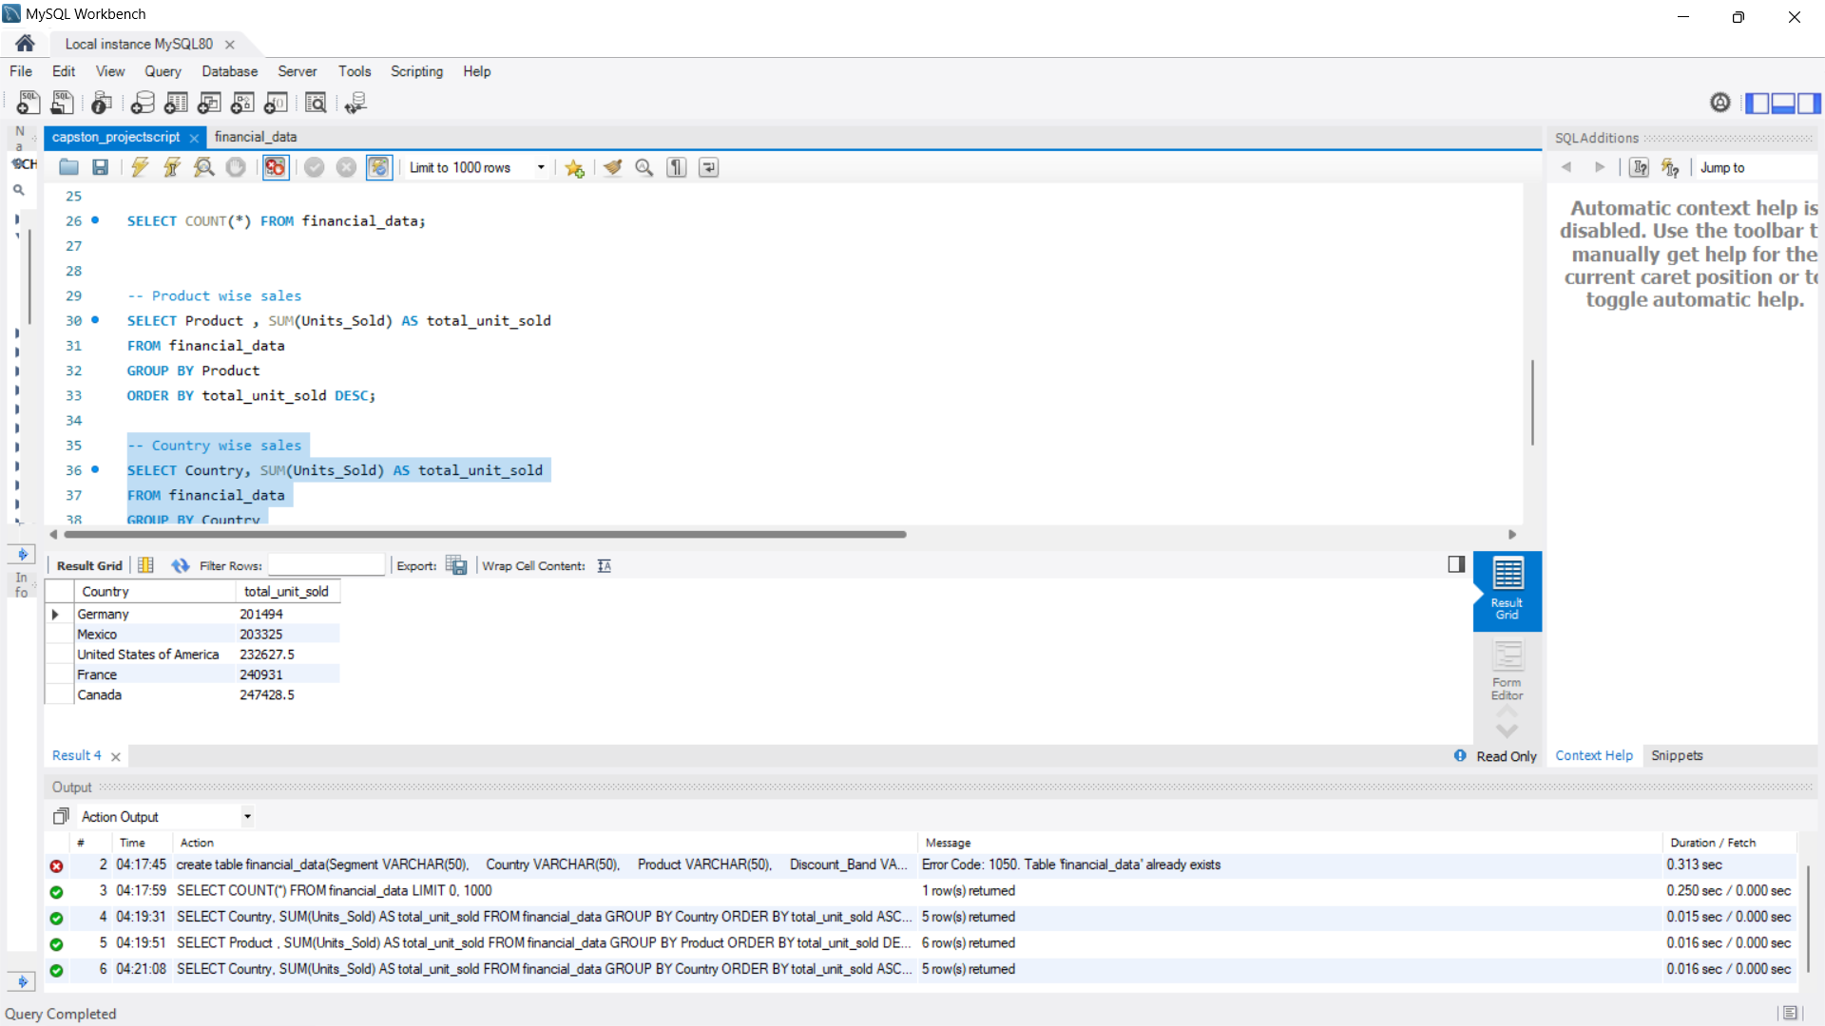

Slide 13
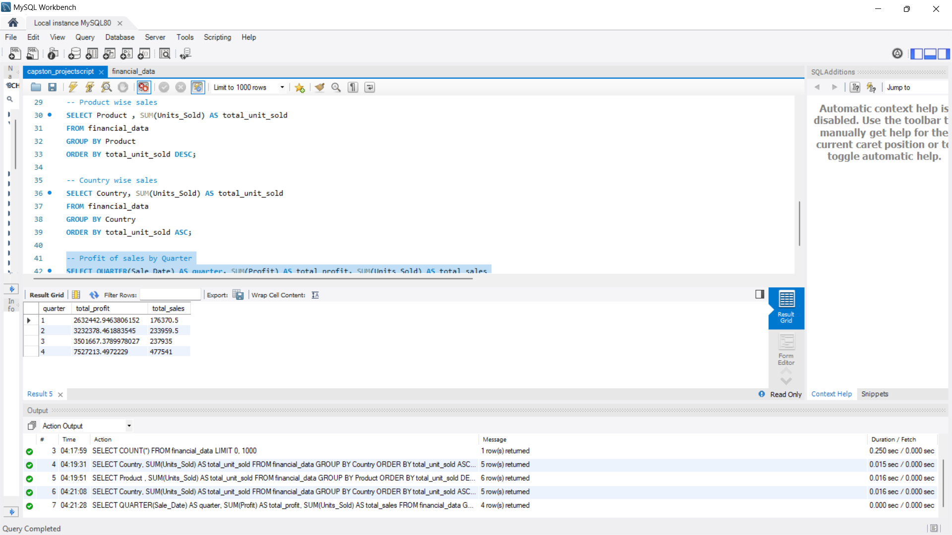

Slide 14
Power BI Dashboards
Creating visual reports for business insights.
Using charts, graphs, and KPIs to analyze trends.
Interactive dashboards for real-time tracking.

Slide 15
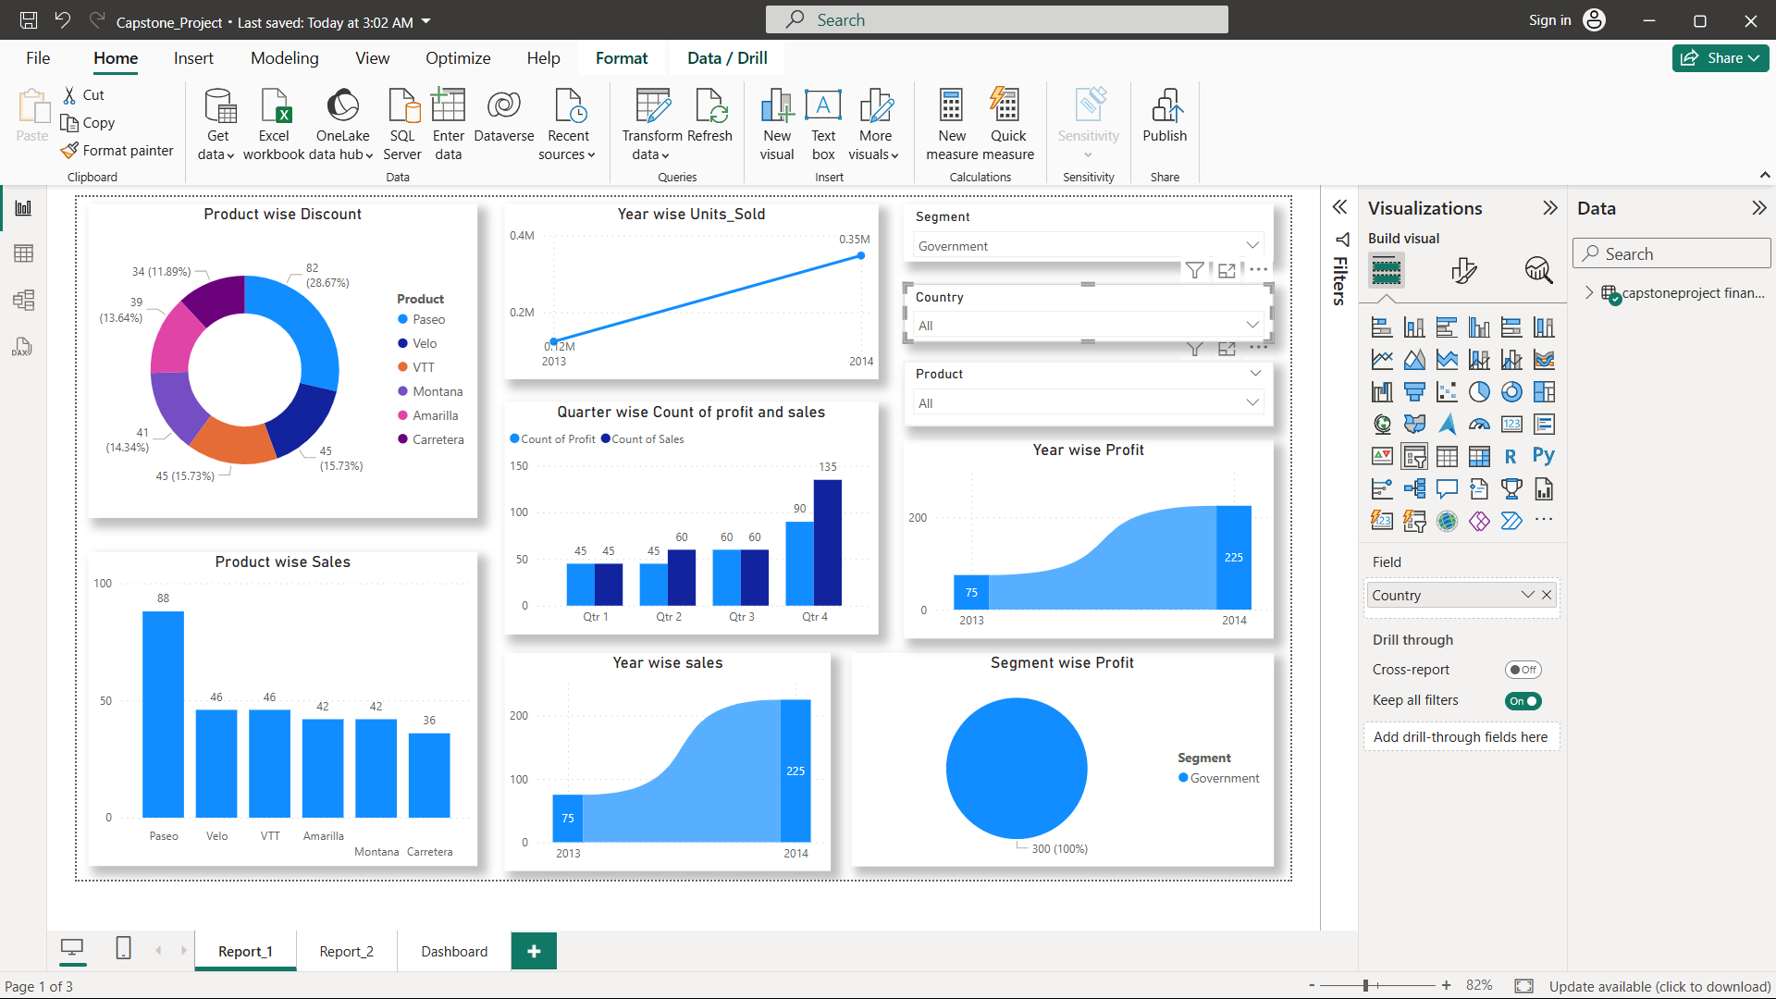

Slide 16
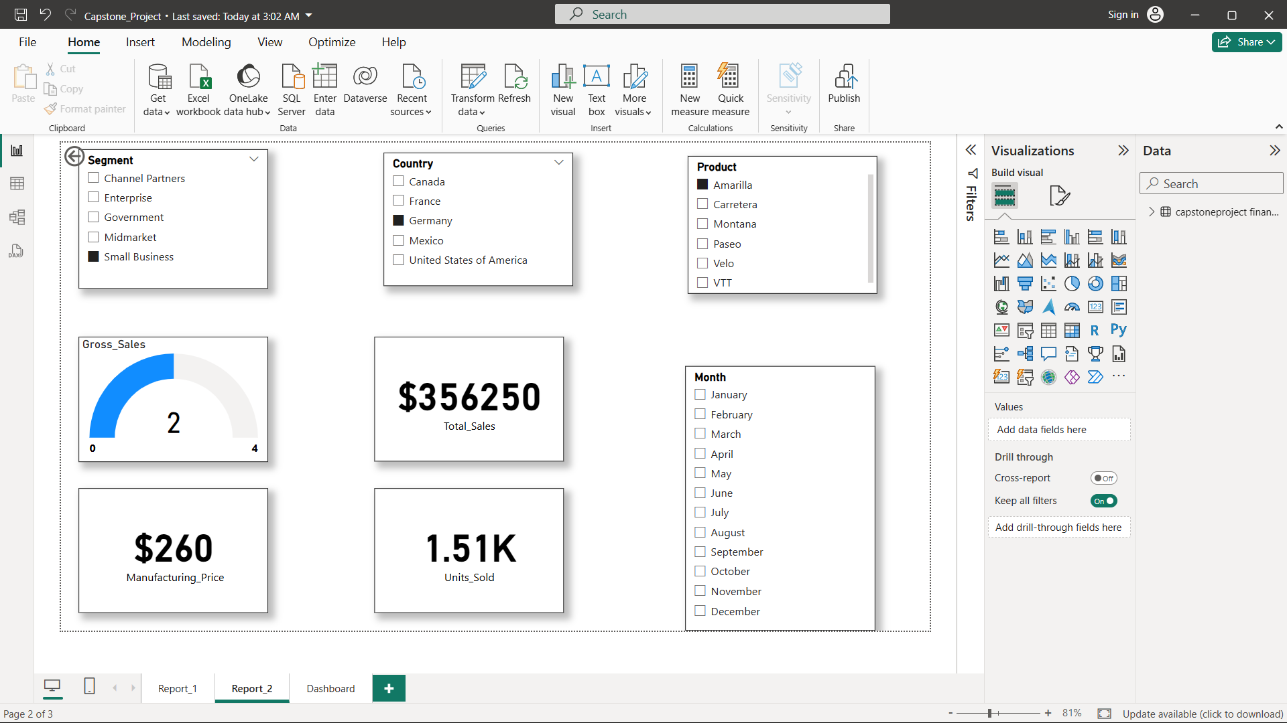

Slide 17
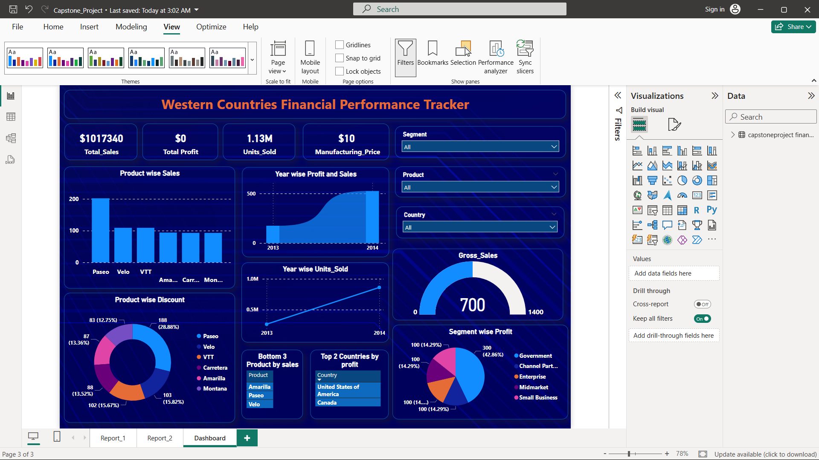

Slide 18
Findings & Insights
- Western countries show diverse financial performance.
- Certain economies show higher stability in revenue trends.
- Data visualization provides clear understanding of financial health.

Slide 19
Conclusion
The project successfully identifies financial trends in Western countries. Power BI dashboards make data interpretation easier, while SQL ensures efficient data processing. This analysis can aid policymakers and financial analysts in decision-making.

