Slide 1
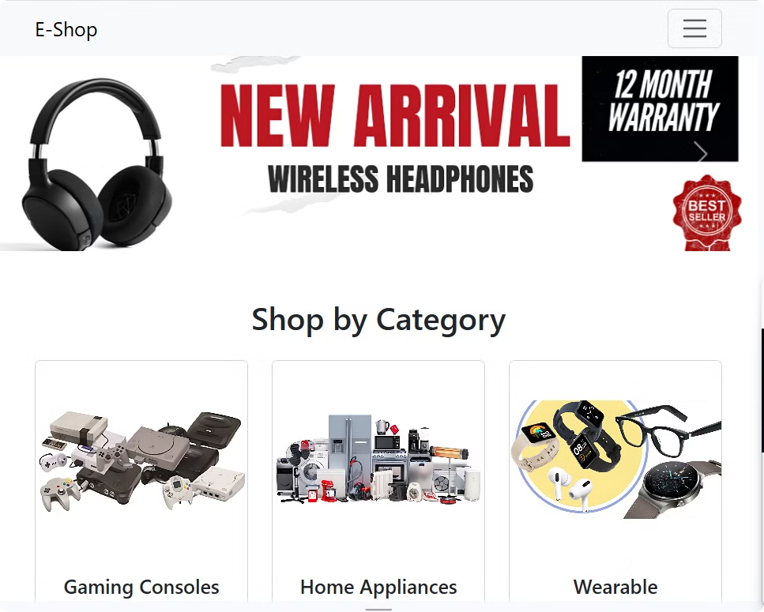
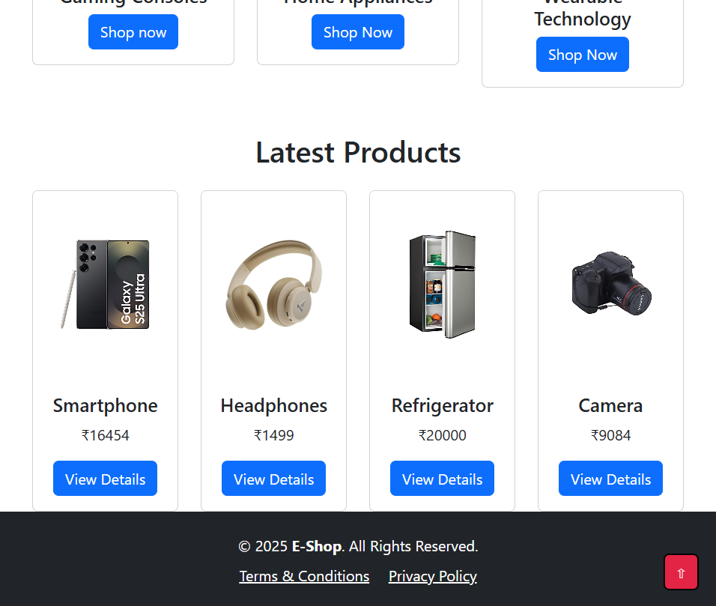
Introduction
Overview: The Electronic Store is an advanced e-commerce platform designed to provide an intuitive and seamless shopping experience.
Objective: Enable users to browse, search, and purchase electronic items effortlessly with a modern UI and secure transactions.

Slide 2




Technologies Used
HTML
CSS
Bootstrap 5
JavaScript
HTML is the standard language for building web pages..
CSS styles and formats web pages.
Bootstrap is a CSS framework for responsive web design.
JavaScript adds interactivity and functionality to web pages.

Slide 3
Key Features
Responsive Design using Bootstrap
Product Listing with Categories & Filters
Interactive UI with Modals and Carousels
Easy Navigation with Search Functionality
Custom Sorting Price
Optional Cart Functionality using JavaScript

Slide 4
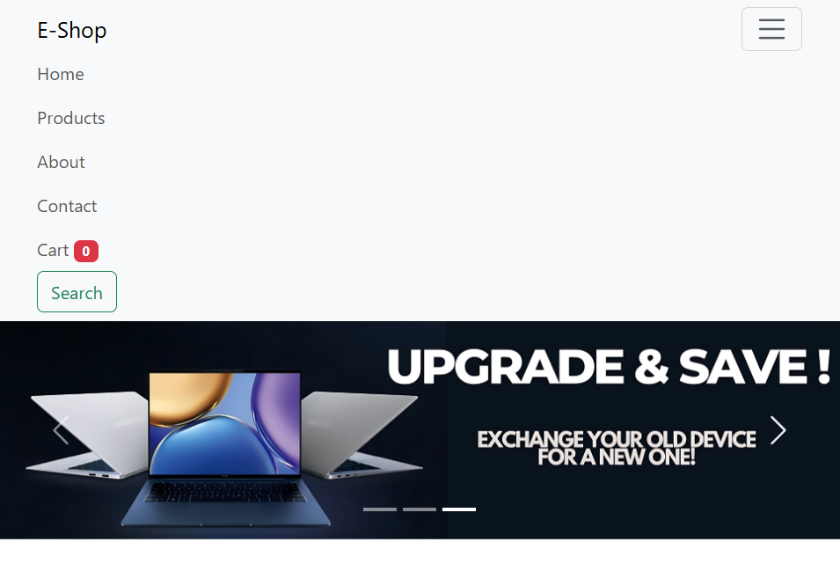
Homepage & Navigation
Engaging Dynamic Carousel
Navigation Bar
Seamless Navigation & Search
Easy access to Home, Products, Cart, About, and Contact
Highlights featured products and offers for better user engagement
Quickly find products using keywords with auto-suggestions and filters.

Slide 5
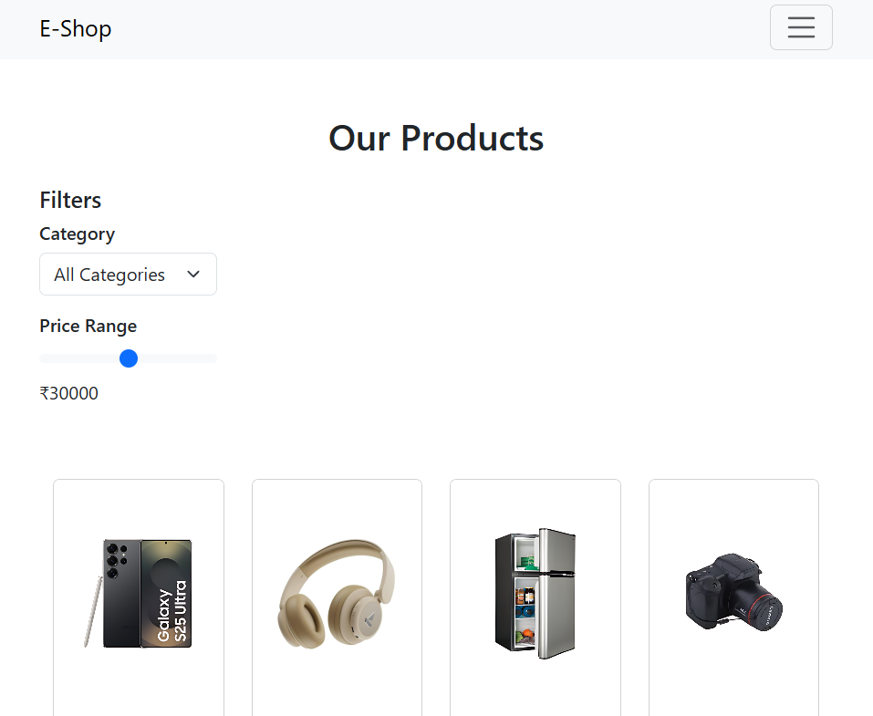
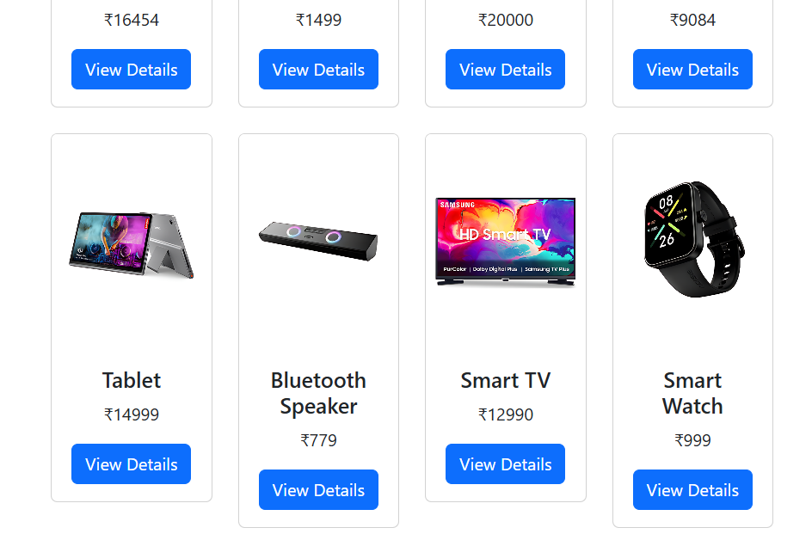
Product Listing Page
Organized Product Display
Advanced Filtering
Price range, category selection
Category-wise product listing
Sorting Options
Sort by price, popularity, or relevance

Slide 6
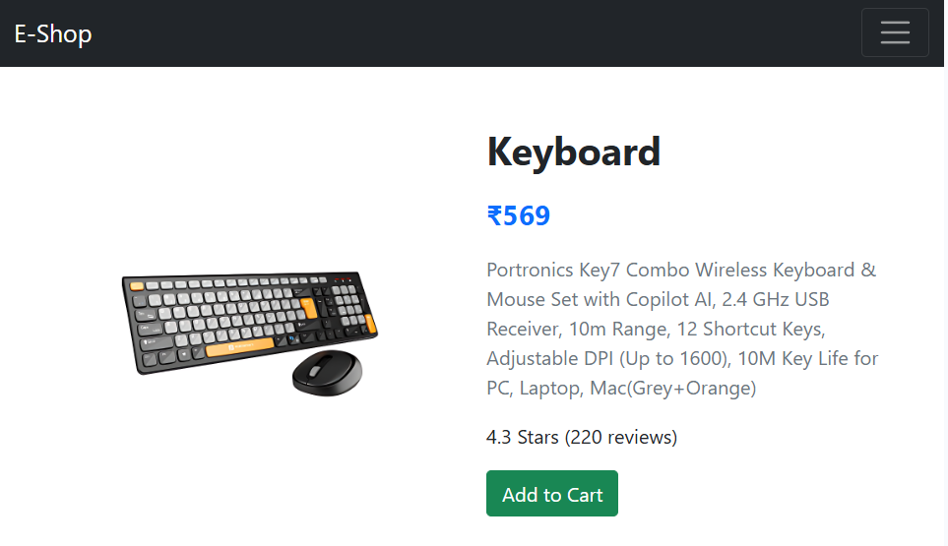
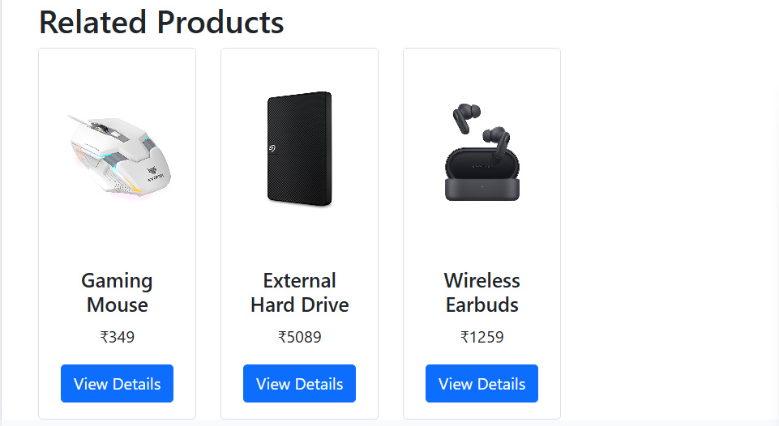
Product View Page
Comprehensive Product Details
Customer Feedback
Ratings and reviews section
Description, specifications, and pricing
Add to Cart Button
Seamless shopping experience

Slide 7
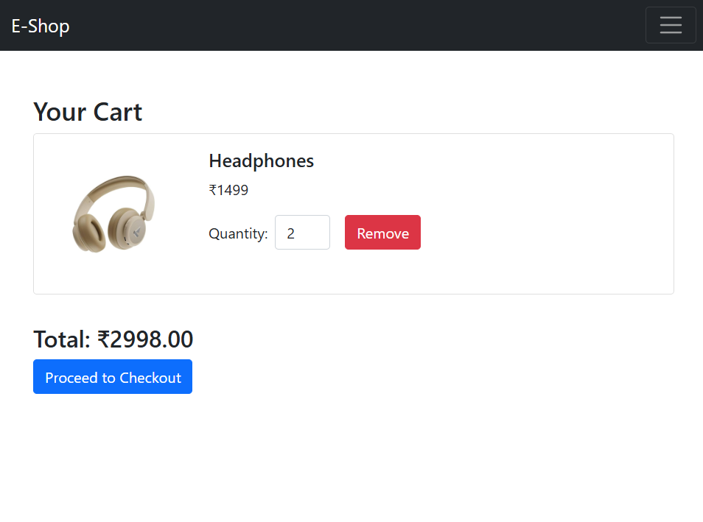
Shopping Cart & Checkout
Cart Management
Live Price Calculation
Add, remove, and update product quantity
Dynamic total pricing updates
Checkout Process
Secure order summary

Slide 8
Future Enhancements
Payment Gateway Integration
User Authentication
Order Tracking System
Personalized experience with login/signup
Real-time delivery updates
Secure online transactions

Slide 9
Thank-You
Presented By : Soni Divyesh [2204050200170]
Sachin Kharat [2204050200053]
Lalit Chandora [2204050200009]
Aditya Pathak [2204050200130]

