Slide 1

College of Computer Application
Screen Recorder Using Python
Presentated By:
Sachin Kharat : [ 2204050200053]
Dhaval Joshi : [ 2204050200037]
Divyesh Soni : [ 2204050200170]
Lalit Chandora : [ 2204050200009]
Industry : Integrated Master Of Science In Information Technology (IMSC-IT)

Slide 2

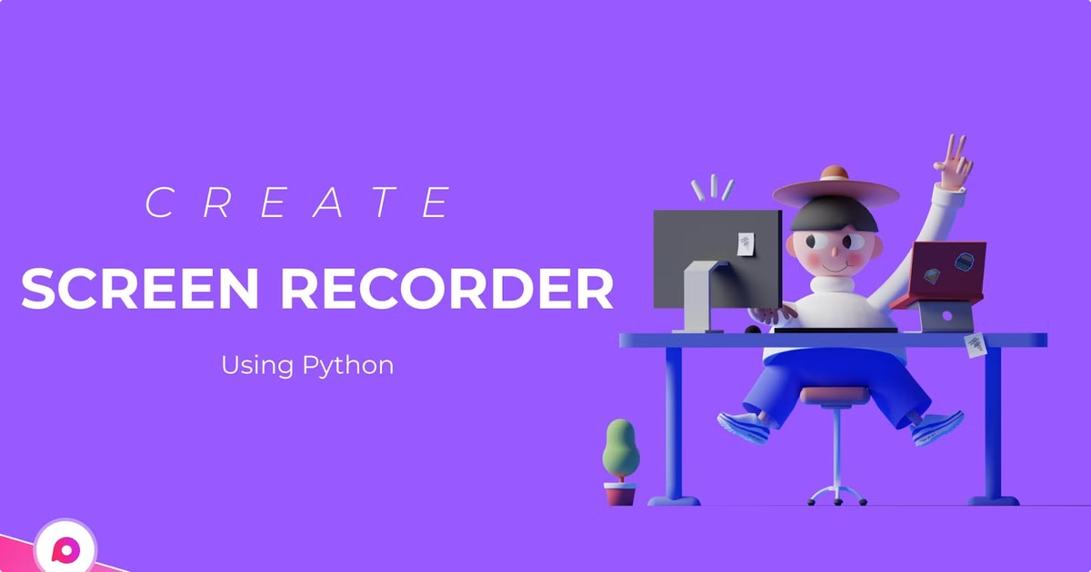
Python Screen Recorder Project
This project aims to develop a Python-based screen recording application. The software will capture user screen activity and save it as a video file, allowing users to record tutorials, presentations, gameplay, and more. The application will be designed with user-friendliness and efficiency in mind.

Slide 3
Problem Defination
The need for a simple, efficient screen recording tool for users.
Existing screen recorders can be complex or lack key functionalities like real-time processing and seamless integration.
The goal of this project is to develop a Python-based solution with a user-friendly interface and efficient performance.

Slide 4
Need of the Project
1
Simplified solution for screen recording
2
No dependency on proprietary software
3
Real-time functionality for educational and professional users
The project aims to provide a simplified solution for screen recording, without the need for proprietary software.
The screen recorder will be developed using open-source technologies, eliminating the need for costly proprietary software.
The screen recorder will offer real-time functionality, catering to the needs of educational and professional users who require immediate access to their recordings.

Slide 5
Time Duration
1
Time Efficient Development
2
Balanced Workflow
3
Presentation and Documentation
The project is completed within
4 weeks , with development (2 weeks ) taking up half of the total duration
The Planning ,Design and Testing are given 1 week each , ensuring proper attention to detail at every stage
Finalization ,preparing the PPT , and the report are streamlined into the final days (4 days total ) , ensuring efficient wrap-up and communication of results

Slide 6
Literature Review
Tkinter
PyAutoGUI
Pillow (PIL)
OpenCV
Provides GUI for the application, offering buttons to control the recording process.
Detects screen size and ensures compatibility across various display configurations.
Utilizes ImageGrab to capture screenshots of the display in real-time.
Handles frame processing, video encoding, and saving the video to an MP4 format.

Slide 7
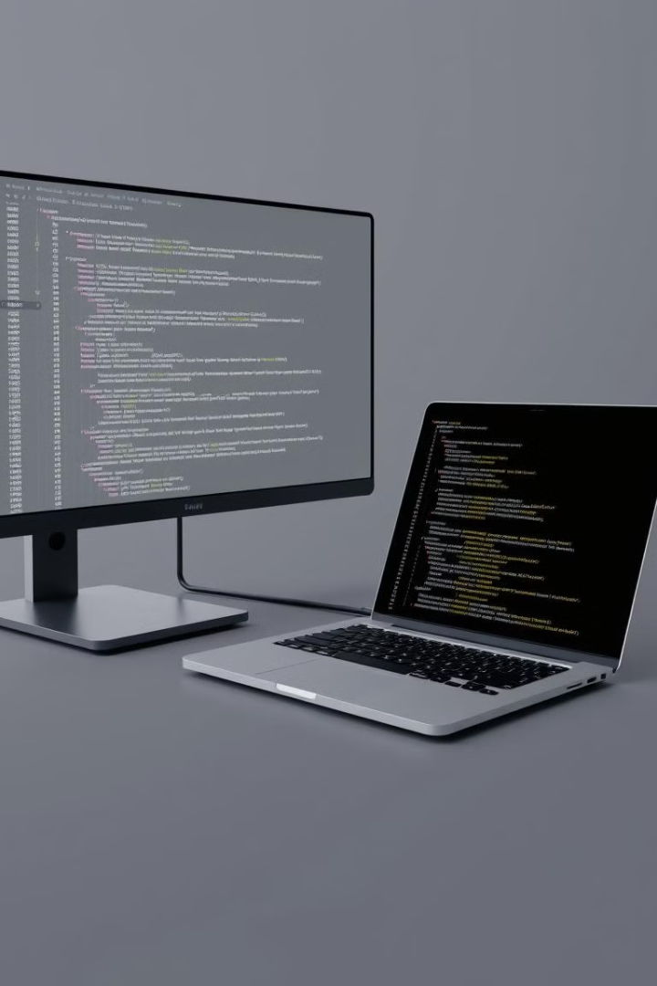
Hardware Requirements
System
Moderate CPU and RAM for smooth screen recording
Operating System
Windows, macOS, or Linux
Software Requirements
Python 3.x
Required for the project
Tkinter
For the GUI
PyAutoGUI
For screen size detection
Pillow (PIL)
For screen capture
OpenCV
For video processing

Slide 8
Technology Used
Python
OpenCV
The application's core functionality is written in Python, leveraging its powerful features for scripting and GUI development.
OpenCV, an open-source computer vision library, provides essential tools for capturing screen activity and processing images, facilitating seamless screen recording.
PyAutoGUI
Tkinter
PyAutoGUI is a Python library used to control the mouse and keyboard, enabling the application to interact with the user's desktop and capture specific areas of the screen.
Tkinter, Python's built-in GUI toolkit, is used to design the application's user interface, allowing users to control recording settings and manage recordings.

Slide 9
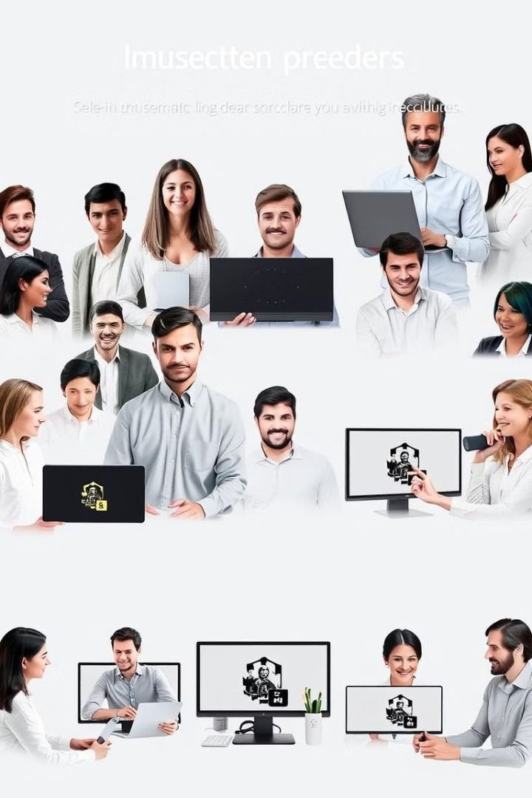




User Characteristics
Students
Teachers
Students use the screen recorder to create tutorials, record lectures, and capture educational content.
Teachers use the screen recorder to create engaging online lessons, demonstrate educational concepts, and share classroom activities.
Gamers
Professionals
Gamers utilize the screen recorder to capture their gameplay, share highlights, and engage with the gaming community.
Professionals leverage the screen recorder for creating software demos, documenting technical processes, and sharing presentations.

Slide 10
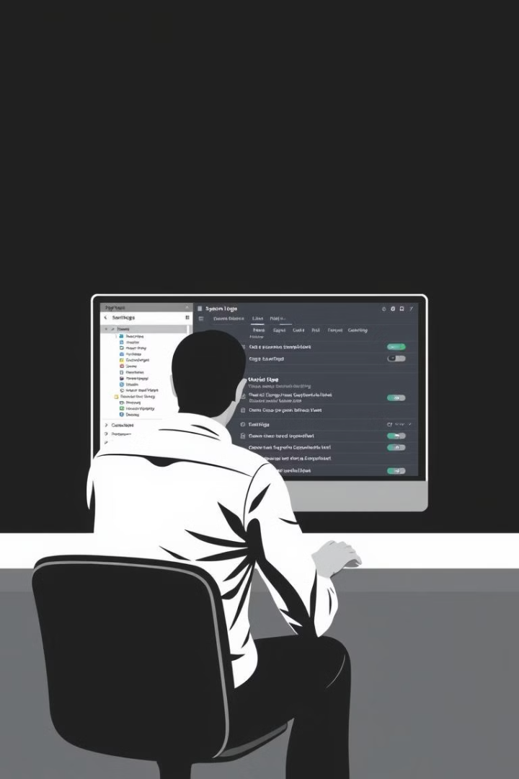



Admin Characteristics
System Monitoring
Administrators monitor the system's performance, track resource usage, and ensure smooth operation.
User Management
Administrators manage user accounts, control access permissions, and ensure security.
Configuration Updates
Administrators update system settings, apply security patches, and ensure the application's compatibility.

Slide 11
Functional and Non-Functional Dependencies
Functional Dependencies
Non-Functional Dependencies
Start recording
Performance
User Interface
Scalability
Stop recording
Security
Video Processing
Reliability
Save recordings
Maintainability

Slide 12
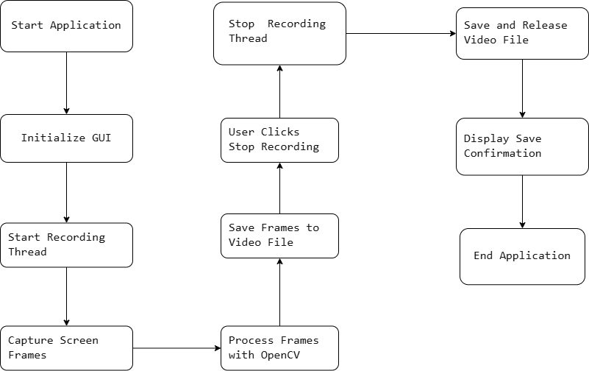
System Flow Diagram

Slide 13
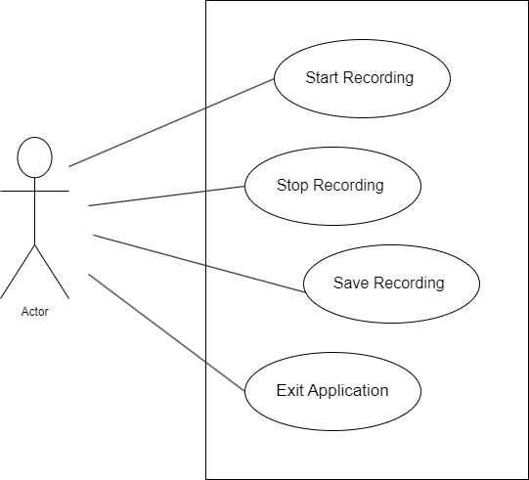
Use Case Diagram

Slide 14
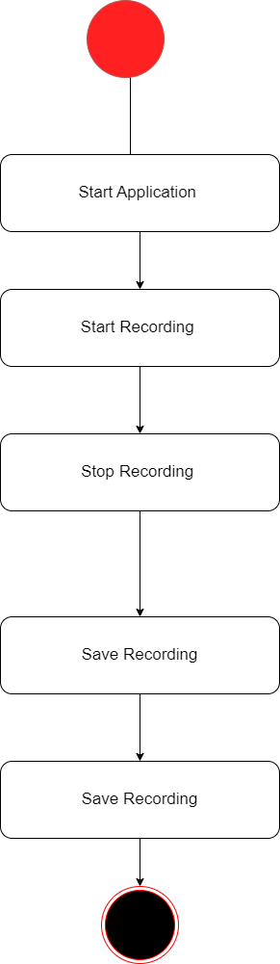
Activity Diagram

Slide 15
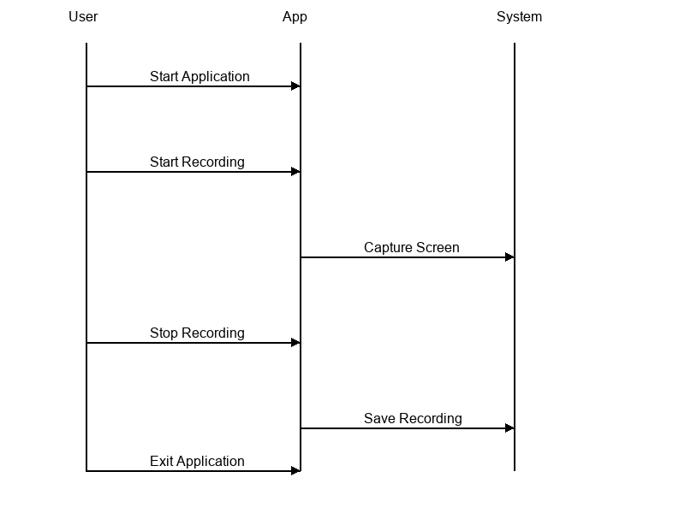
Sequence Diagram

Slide 16
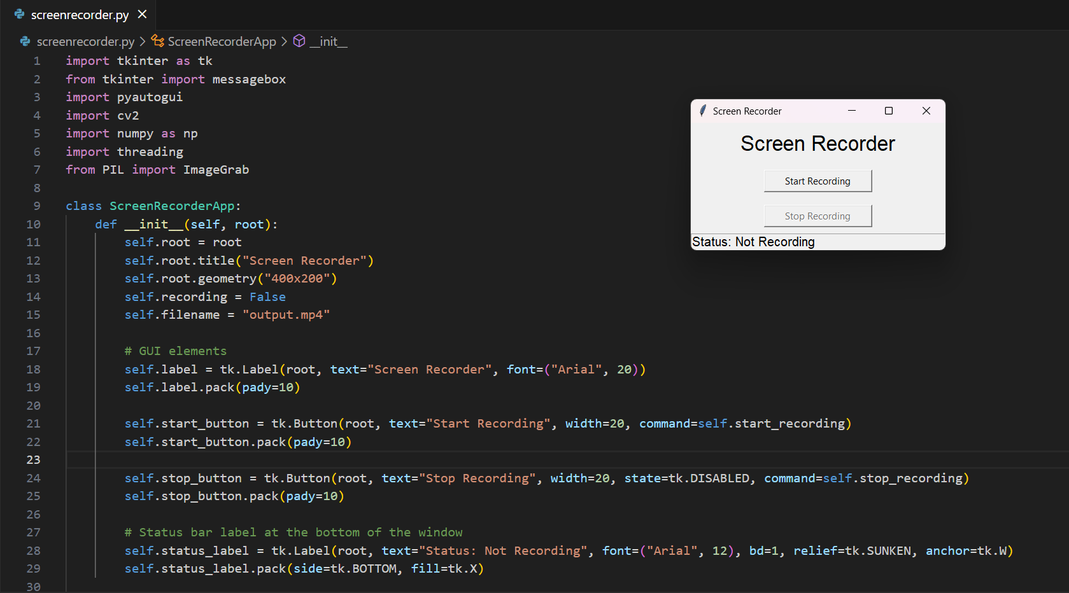
SCREENSHOTS OF MODULE

Slide 17
Application
Tutorial Creation
Record step-by-step guides and software tutorials.
Presentation Recording
Record and share slide presentations or demos.
Remote Assistance
Provide visual support and troubleshooting.
Gaming
Record gameplay for reviews or sharing.

Slide 18
Excepted Outcome
User-Friendly Interface
Simple controls for starting and stopping recording.
Real-Time Feedback
Status updates displayed on the GUI.
Customizable Output
Video saved as output.mp4 with adjustable settings.
Error Handling
Clear notifications for recording status and completion

Slide 19
Future Scope
Audio Recording
Integrate system and microphone audio capture with the video.
Region Selection
Allow users to select specific screen areas for recording.
File Format Options
Add support for various video formats (e.g., MKV, AV
Scheduled Recording
Implement functionality for automatic start and stop based on a schedule.

Slide 20
References
https://www.geeksforgeeks.org/

Slide 21
Thankyou

