Slide 1
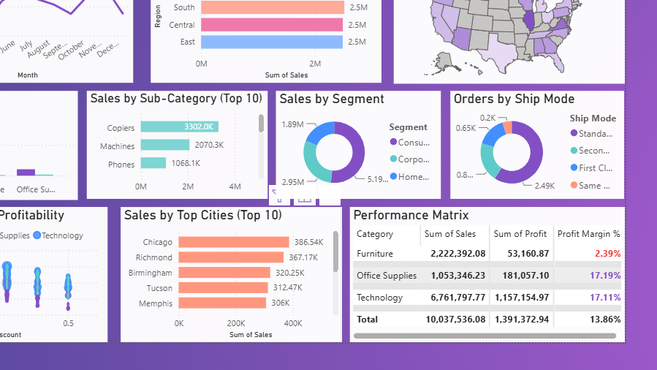
DATA ANALYTICS PROJECT
Retail Sales
Performance
Dashboard
A Power BI dashboard for evidence-based retail decisions
Presented by
Sachin Kumar · Mohd. Ismaeel Zaidi · Shubham Karki
Course PETV103 | Microsoft Power BI

Slide 2
The dashboard turns 4,200 orders into one clear decision story
02
Executive summary
$10.04M
1
Healthy overall performance
$1.39M profit at a 13.86% margin demonstrates a profitable business at scale.
sales across 2022–2025
2
Furniture hides the biggest risk
Furniture contributes $2.22M sales but only a 2.39% margin because heavy discounts erode profit.
3
Action is specific—not generic
Cap high discount tiers, protect Technology growth, and strengthen loyalty for the Consumer segment.
Retail Sales Performance Dashboard · Viva Presentation
2

Slide 3
The core challenge was fragmented visibility across sales and profit drivers
03
Problem statement and project objectives
PROJECT OBJECTIVES
THE PROBLEM
• Measure performance — sales, profit, orders, margin and discount.
• Find winners and risks — categories, sub-categories and customers.
• Compare geography — region, state and city performance.
• Explain margin erosion — discount versus profitability.
• Enable exploration — slicers, cross-filtering and reset controls.
• Recommend actions — convert findings into business decisions.
Managers could not quickly see which regions, products, customers, or discount levels were driving revenue—or destroying margin.
Need: one interactive page that supports fast, evidence-based decisions.
Retail Sales Performance Dashboard · Viva Presentation
3

Slide 4
A Superstore-style dataset provided enough breadth for multi-dimensional analysis
04
Dataset description and source
4,200
2022–25
3
0–50%
ORDER LINE ITEMS
REPORTING WINDOW
CUSTOMER SEGMENTS
DISCOUNT RANGE
Dimensions
Measures
Calculated fields
• Order and ship dates
• Customer, segment and ship mode
• Region, state and city
• Category and sub-category
• Sales revenue
• Quantity
• Discount
• Profit
• Ship Delay (Days)
• Profit Margin
• Order Year
• Order Month
Source: Kaggle — Superstore Sales Dataset
Retail Sales Performance Dashboard · Viva Presentation
4

Slide 5
The project followed a complete analytics workflow from raw data to decisions
05
Methodology and tools
01
Collect
02
Clean
03
Transform
04
Analyze
05
Visualize
06
Recommend
Kaggle retail orders
Excel validation and fixes
Calculated columns and measures
Trends, geography, products, discounts
One-page interactive Power BI dashboard
Business actions from evidence
TOOLS
Microsoft Excel for data cleaning → Microsoft Power BI for modeling, measures, visualization and interaction
Retail Sales Performance Dashboard · Viva Presentation
5

Slide 6
Data quality checks created a reliable foundation for every visual
06
Cleaning and preparation
01
Duplicates
02
Missing discount
03
Date integrity
Removed repeated order records during validation.
Imputed 0 where no discount value was present.
Converted Order Date and Ship Date to true date fields.
04
Standardization
05
Calculated fields
06
Model-ready output
Applied consistent date and numeric formats.
Added delay, margin, year and month.
Created Raw_Data and Cleaned_Data sheets.
Retail Sales Performance Dashboard · Viva Presentation
6

Slide 7
The one-page design balances monitoring, diagnosis and exploration
07
Dashboard architecture
1
2
3
4
MONITOR
COMPARE
EXPLAIN
EXPLORE
• 6 KPI cards
• Sales trend
• Performance matrix
• Region and state
• Category and sub-category
• Customers and cities
• Discount vs margin
• Segment share
• Shipping mix
• 5 slicers
• Cross-filtering
• Reset bookmark
What happened?
Where did it happen?
Why did it happen?
What if we filter?
Retail Sales Performance Dashboard · Viva Presentation
7

Slide 8
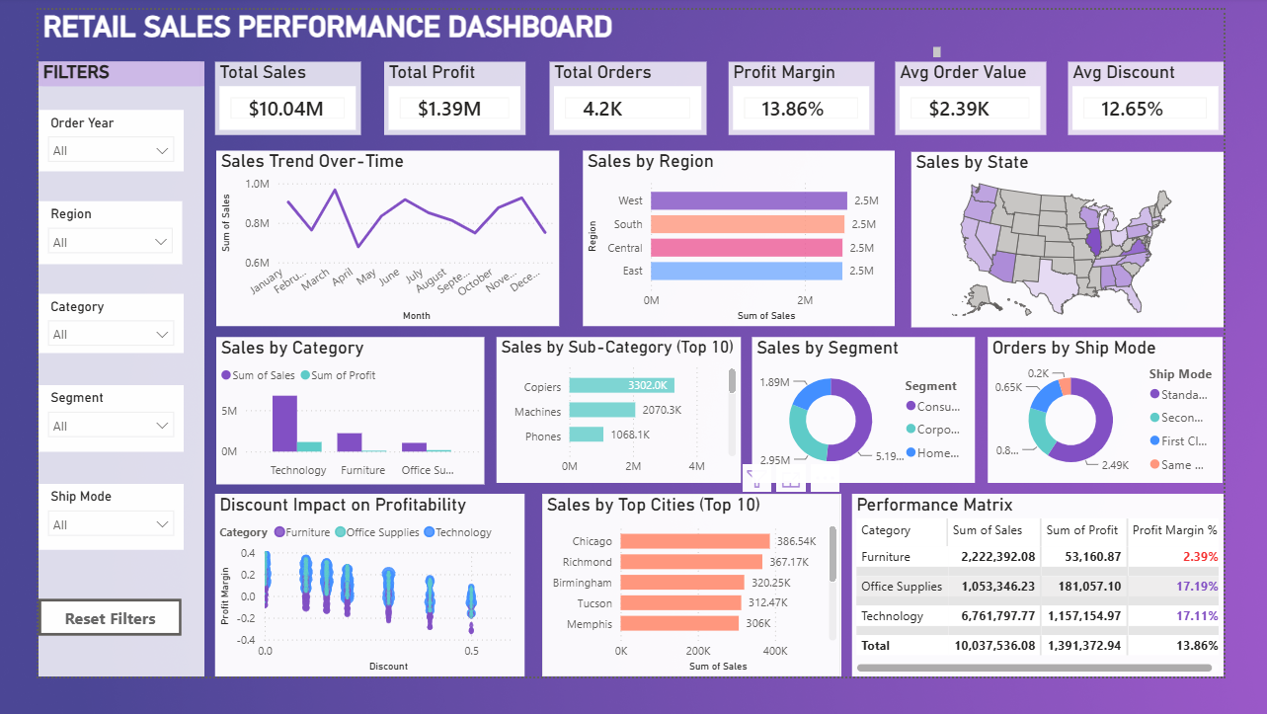
Retail Sales Performance Dashboard
08
Original project screenshot from the report
Figure 1 · Retail Sales Performance Dashboard (Power BI)
8

Slide 9
Overall performance is profitable, with a geographically balanced sales base
09
Key performance indicators and regional analysis
$10.04M
$1.39M
4.2K
13.86%
$2.39K
12.65%
TOTAL SALES
TOTAL PROFIT
TOTAL ORDERS
PROFIT MARGIN
AVG ORDER VALUE
AVG DISCOUNT
REGIONAL SALES
West
$2.55M
MANAGEMENT JUDGMENT
$2.51M
No single region dominates.
South
Central
$2.49M
Marketing investment can remain proportionate rather than being heavily skewed toward one geography.
East
$2.49M
Retail Sales Performance Dashboard · Viva Presentation
9

Slide 10
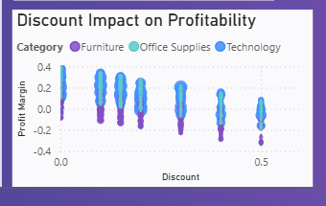
Furniture looks strong on revenue but weak on profit—the central business risk
10
Category and product findings
CATEGORY SALES
Technology
$6.76M
17.11% margin
Furniture
$2.22M
2.39% margin
Office Supplies
$1.05M
17.19% margin
DISCOUNT IMPACT
40–50% discounts cluster in negative-margin territory; Tables and Bookcases need the closest review.
Retail Sales Performance Dashboard · Viva Presentation
10

Slide 11
Consumer demand and Standard Class shipping define the operating mix
11
Customer segment and shipping insights
SALES BY SEGMENT
ORDERS BY SHIP MODE
Consumer
51.7%
Standard Class
59%
Second Class
20%
Corporate
29.4%
First Class
16%
Home Office
18.8%
Same Day
5%
Business implication
Use tiered loyalty and repeat-purchase incentives to protect the Consumer base while maintaining reliable Standard Class operations.
Retail Sales Performance Dashboard · Viva Presentation
11

Slide 12
Five actions convert the dashboard insights into measurable business decisions
12
Recommendations and implementation priorities
NOW
Cap Furniture discounts
Restrict approvals beyond ~30%, especially for Tables and Bookcases.
NOW
Audit high-value orders
Review margin leakage before large Furniture orders are approved.
NEXT
Scale Technology winners
Expand Copiers and Machines while protecting current margins.
NEXT
Strengthen Consumer loyalty
Use tiered rewards and repeat-purchase incentives.
ONGOING
Balance regional spend
Allocate proportionally because regional sales are closely matched.
Retail Sales Performance Dashboard · Viva Presentation
12

Slide 13
The current dashboard is descriptive; the next step is a connected, predictive system
13
Limitations, future scope and conclusion
CURRENT LIMITATIONS
FUTURE SCOPE
• Fixed 2022–2025 historical window
• Limited customer attributes
• No macro, competitor or marketing inputs
• No forward-looking forecast
• AI-based sales and profit forecasting
• Live database and automatic refresh
• Low-margin order risk alerts
• Mobile-optimized dashboard
• Scheduled KPI email notifications
VIVA TAKEAWAY
Clean data + focused visuals revealed that discounting—not weak demand—is the main cause of Furniture margin erosion.
References: Kaggle Superstore Sales Dataset · Microsoft Power BI · Microsoft Excel
13

