Slide 1


DIGITAL NOTICE BOARD SYSTEM
SUPERVISOR Mr.A.Malarmannan,M.E.,, AP/CSE.
PRESENTED BY
2303811710421132 – A SACHIN KUMAR

Slide 2

PRESENTATION OVERVIEW
Objective
Project Introduction
Problem Statement
Methodologies (Programming concepts relevant to problem statement)
Architecture of the proposed system
List of Modules
Merits
Results and Discussion
Queries

Slide 3
OBJECTIVE
The Digital Notice Board Management system aims to create a centralized platform for efficiently sharing notices and announcements. It features a user-friendly interface for administrators to dynamically add, update, or delete notices while organizing them into categories for easier access. The system supports real-time updates to ensure the latest information is instantly available, promoting accessibility and streamlined communication.

Slide 4
PROJECT INTRODUCTION
.Traditional notice boards require manual updates, leading to inefficiency and time consumption.
A digital solution offers a centralized and dynamic method for managing notices.
The system is designed to ensure user accessibility while maintaining secure updates by authorized personnel.
Java programming provides a robust platform to develop this scalable and interactive application.
The application can be used in institutions, offices, and public places for effective communication.
With its simple interface, the system encourages paperless and eco-friendly notice dissemination.

Slide 5
PROBLEM STATEMENT
Managing notices and announcements using traditional methods, such as physical boards or paper-based systems, is inefficient, time-consuming, and environmentally unfriendly. There is a need for a centralized, user-friendly, and real-time digital system to streamline the creation, update, and dissemination of notices while ensuring accessibility and reducing manual effort.

Slide 6
Methodologies (Programming concepts relevant to problem statement)
Classes:The project uses a DigitalNoticeBoardAWT class to encapsulate data and methods for managing the notice board.
Objects:Instances of the class are created to handle operations such as adding, updating, and displaying notices.
Inheritance:The project utilizes inheritance by extending the Frame class to build the graphical user interface.
Polymorphism:Method overriding is employed to define custom implementations for actions like button clicks and event handling.
Encapsulation:Data and methods related to notices and the system's functionality are encapsulated within the class.

Slide 7
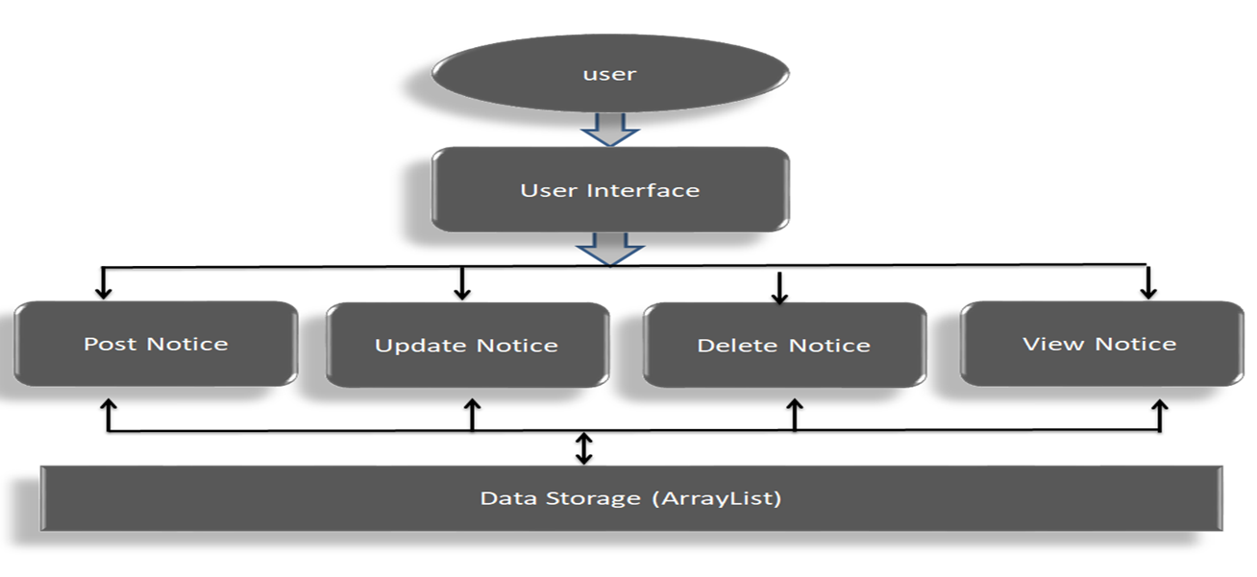
FLOW DIAGRAM

Slide 8
MODULE DESCRIPTION
1. Notice Management Module
Handles CRUD (Create, Read, Update, Delete)
operations for notices.
Ensures each notice is uniquely identified using an auto-
incremented ID.
2. User Interaction Module
Provides a menu-driven interface for users to post,
update, delete, or view notices.
Uses the Scanner class for input handling.

Slide 9
MODULE DESCRIPTION
3. Data Storage and Retrieval Module
Utilizes ArrayList to store notices dynamically in memory.
Facilitates efficient retrieval of notices by their unique IDs.
4. Display Module
Outputs all existing notices for public viewing.
Displays user-friendly messages for system operations (e.g., successful Updates or errors).

Slide 10
MERITS
Instant Updates - Notices can be updated in real-time for everyone to see immediately.
Paperless System - Saves paper, making it eco-friendly and cost-effective.
Easy to Use - A simple interface makes managing and viewing notices hassle free.
Accessible Anywhere - Notices can be viewed on different devices anytime.
Organized Display - Notices are sorted into categories for better readability.
Customizable and Scalable - Can be adjusted to suit the needs of any organization or grow with more users.

Slide 11
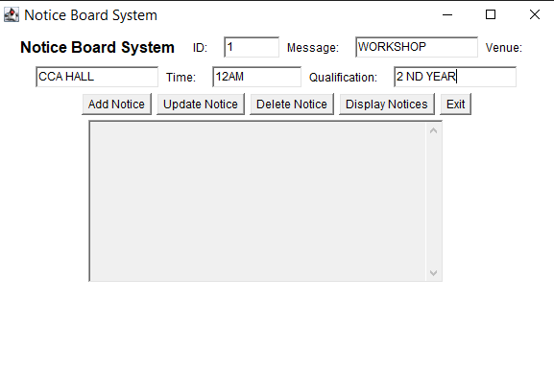
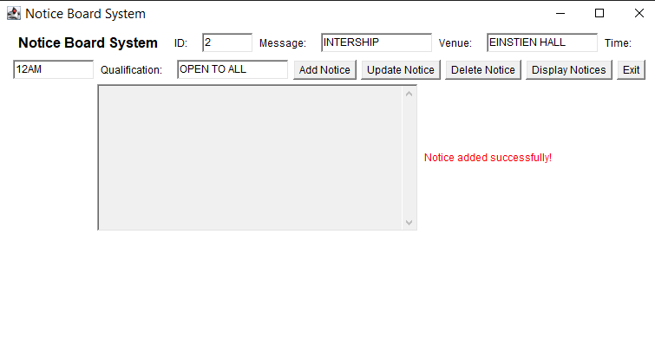
RESULT AND DISCUSSION

Slide 12
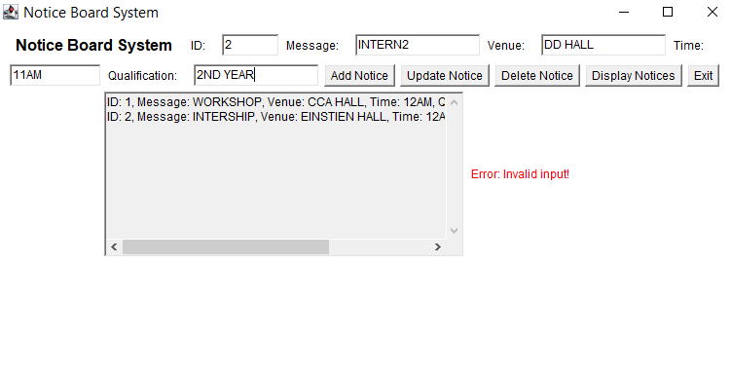
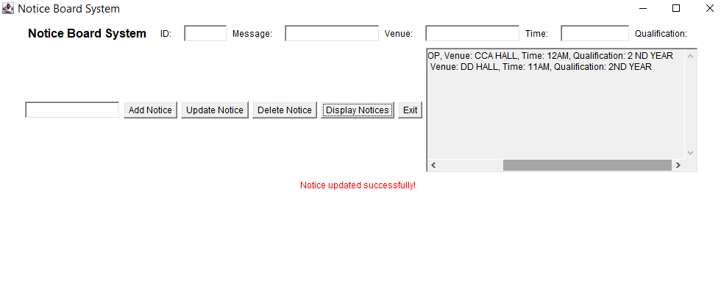
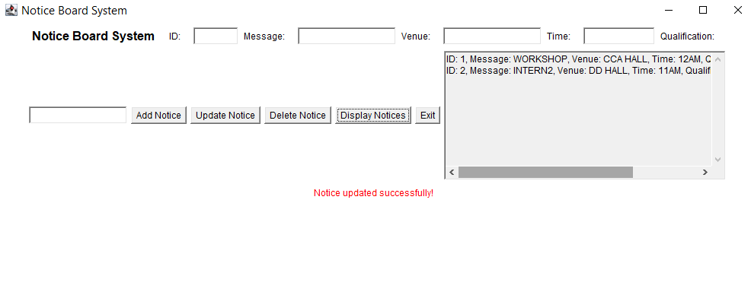
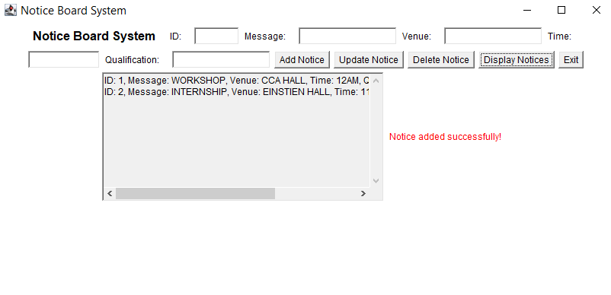
RESULT AND DISCUSSION

Slide 13
THANK YOU

