Slide 1
Data Science Project
Sachin Motwani (PhD21102)

Slide 2
Hypothesis
Null Hypothesis: Central government schemes are equally impactful in all parts of the country
Alternate Hypothesis: Central government schemes are unequally impactful in all parts of the country

Slide 3
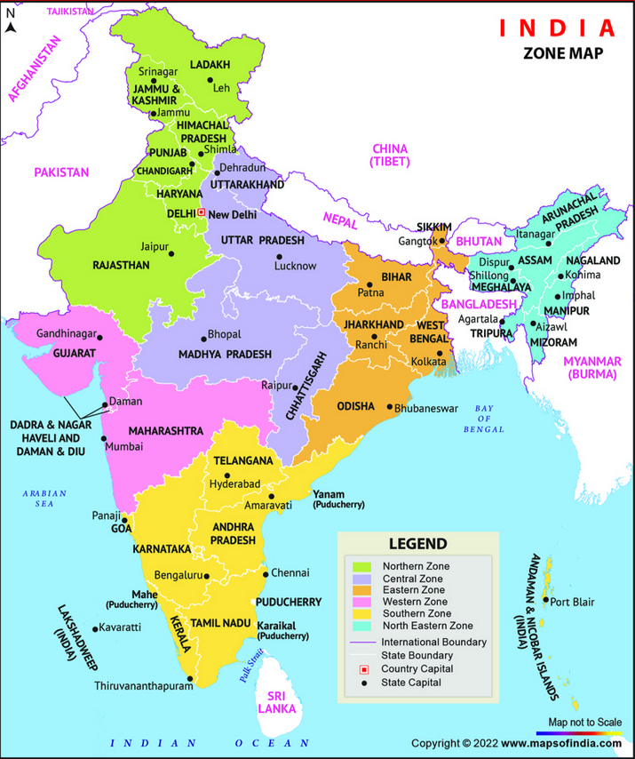
Zones
India is divided into zones for various reasons, primarily for administrative, geographical, and developmental purposes. These zones facilitate easier governance, more efficient resource management, and regional cooperation. The division also helps in organizing national activities such as elections, infrastructure projects, and development schemes. Additionally, some institutions (such as the Ministry of Home Affairs) use these zones to manage disaster response and coordinate regional planning.
Northern Zone
Central Zone
Eastern Zone
Western Zone
Southern Zone
North Eastern Zone
https://www.mapsofindia.com/maps/india/zonal-map.html

Slide 4
Physical & Financial Progress of Pradhan Mantri Gram Sadak Yojna (PMGSY)
https://www.data.gov.in/resource/physical-financial-progress-pradhan-mantri-gram-sadak-yojna-pmgsy-date
2241 * 14

Slide 5
MNREGA 2023-24
Link:
8880 * 36

