Slide 1
Data Science Project Variational development in different zones of India
Oct. 16, 2024
Sachin Motwani
sachinm@iiitd.ac.in

Slide 2
Hypothesis
Null Hypothesis: Central government schemes are equally impactful in all zones of India
Alternate Hypothesis: Central government schemes are NOT equally impactful in all zones of India

Slide 3
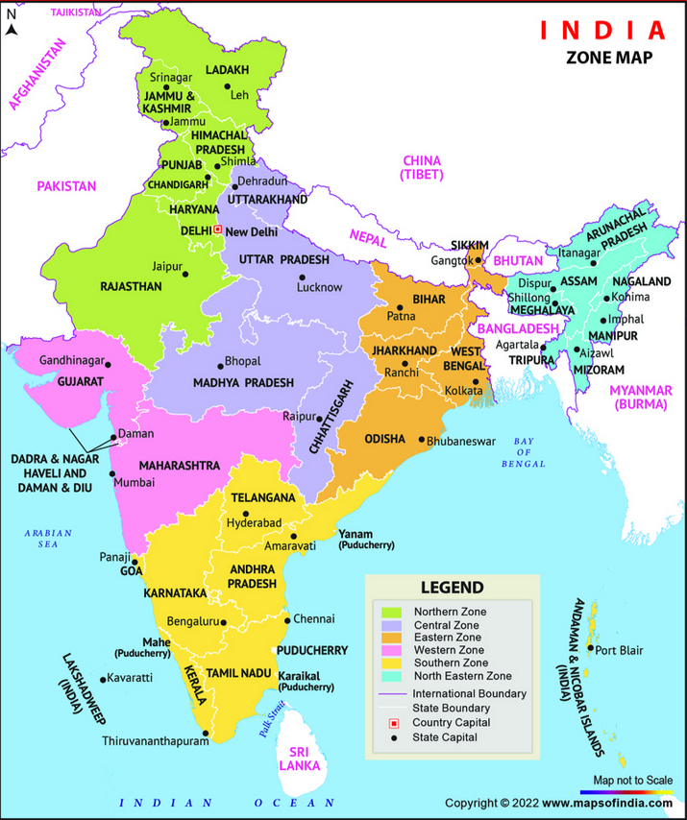
Zones of India
India is divided into zones for various administrative, geographical, and developmental purposes
Facilitate easier governance, efficient resource management, and regional cooperation
Also helps in organizing national activities such as elections, infrastructure projects, and development schemes.
Northern Zone
Central Zone
Eastern Zone
Western Zone
Southern Zone
North Eastern Zone

Slide 4


Dataset 1
Physical & Financial Progress of Pradhan Mantri Gram Sadak Yojna (PMGSY)
Link: https://www.data.gov.in/resource/physical-financial-progress-pradhan-mantri-gram-sadak-yojna-pmgsy-date
Shape: $2245 ×14$

Slide 5

Dataset 2
District-wise MGNREGA Data at a Glance
Mahatma Gandhi National Rural Employment Guarantee Act (MNREGA)
Link: https://www.data.gov.in/resource/district-wise-mgnrega-data-glance
Shape: $8880 ×36$

Slide 6

Dataset 6
Indira Gandhi Widow Pension Scheme (IGNWPS) Beneficiaries Abstract during FY 2023-24
Link: https://www.data.gov.in/resource/indira-gandhi-widow-pension-scheme-ignwps-beneficiaries-abstract-during-fy-2023-24
Shape: $11490×15$

Slide 7
Dataset 7
Indira Gandhi National Disability Pension Scheme (IGNDPS) Beneficiaries Abstract during FY 2023-24
Link: https://www.data.gov.in/resource/indira-gandhi-national-disability-pension-scheme-igndps-beneficiaries-abstract-during-fy
Shape: 11438 x 15

Slide 8
Dataset 8
Indira Gandhi National Old Aged Pension Scheme (IGNOAPS) Beneficiaries Abstract during FY 2023-24
Link: https://www.data.gov.in/resource/indira-gandhi-national-old-aged-pension-scheme-ignoaps-beneficiaries-abstract-during-fy
Shape: 11622 x 15

Slide 9
Dataset 9
BharatNet Service Ready Gram Panchayat as on 31-03-2024
Link: https://www.data.gov.in/resource/district-wise-service-ready-gram-panchayat-31-03-2024
Shape: 716 x 4

Slide 10
Dataset 10
TB Laboratory Infrastructure, 2022
Link: https://www.data.gov.in/resource/tb-laboratory-infrastructure-2022
Shape: 97 x 8

Slide 11

Dataset 4
State-wise Telecom pensioners’ details on SAMPANN (as of 29/04/2024)
SAMPANN is an online pension payment software, catering 4.30 lakhs telecom pensioners of Department of Telecommunication, Ministry of Communications. This catalog provides State wise Telecom pensioner data onboarded on SAMPANN.
Link: https://www.data.gov.in/resource/state-wise-telecom-pensioners-details-sampann-29042024
Shape: $28 ×10$

Slide 12

Dataset 5
Village-wise Self Help Group (SHG) and Members Count
2023-2024
Link: https://www.data.gov.in/resource/village-wise-self-help-group-shg-and-members-count
Shape: $209969×22$

