Slide 1

TITLE SLIDE
THE HUMAN IMMUNE SYSTEM
How Our Body Fights Diseases

Slide 2
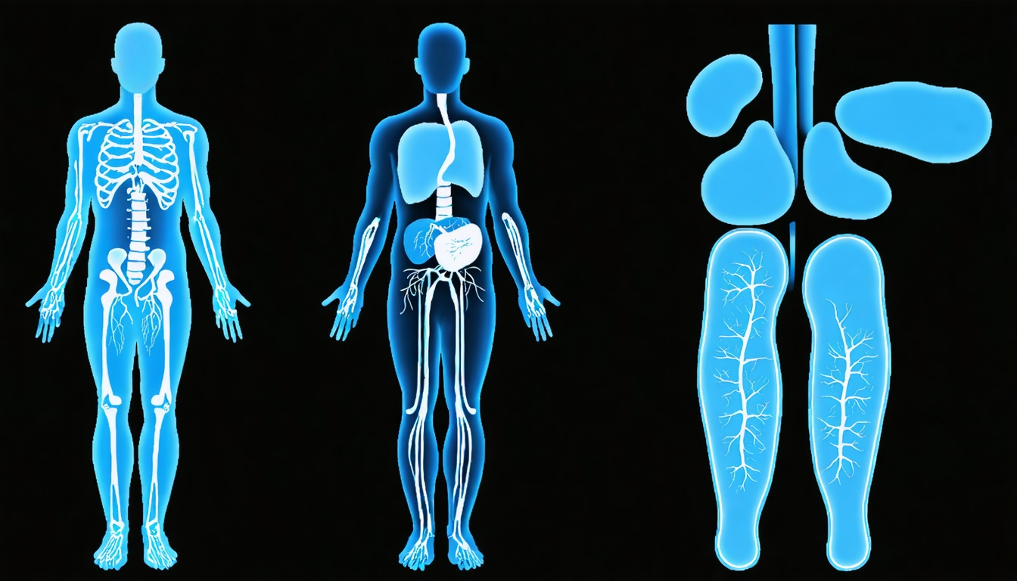
INTRODUCTION
What is the Immune System?
• A complex network of organs, cells, and proteins
• Defends against harmful invaders: bacteria, viruses, fungi, parasites
• Maintains internal balance and promotes tissue healing
• Distinguishes between self and non-self entities

Slide 3
SYSTEM OVERVIEW
Two-Tier Defense System
• Innate Immunity: Rapid, non-specific response
• Adaptive Immunity: Targeted, specific response
• Both systems work together for comprehensive protection
• Previous infections enhance adaptive responses
Key Insight:
This slide covers 'Two-Tier Defense System' in context of The Human Immune System: How Our Body Fights Diseases. Focus on discussing design boundaries and parameters during lecture.

Slide 4
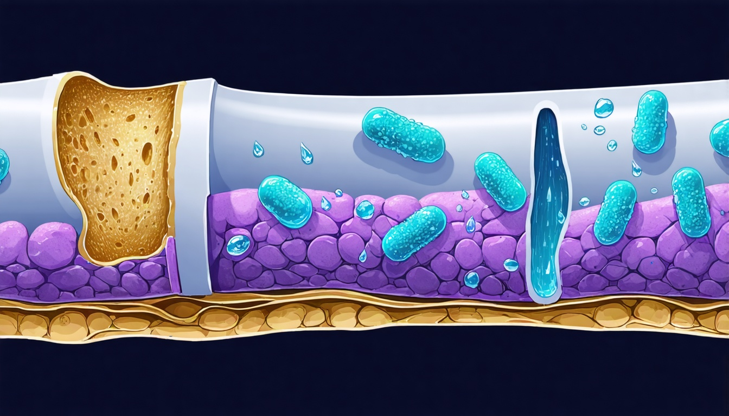
FIRST LINE OF DEFENSE
Physical & Chemical Barriers
• Skin: Protective barrier and microbiome
• Mucus membranes: Line respiratory and digestive tracts
• Stomach acid: Kills many ingested pathogens
• Tears & saliva: Contain antimicrobial proteins

Slide 5
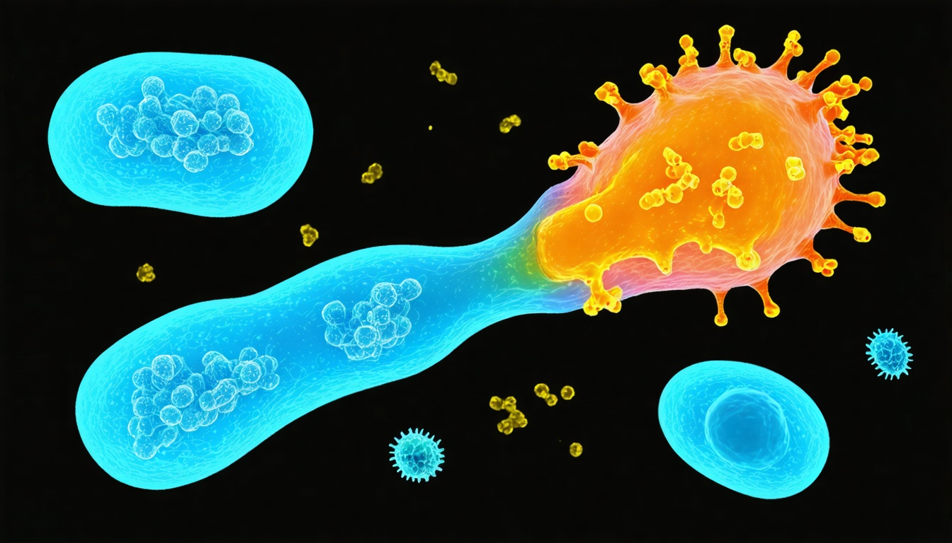
INNATE IMMUNITY
Non-Specific Defense Mechanisms
• Immediate response without prior exposure
• Phagocytes engulf and destroy pathogens
• Natural killer cells eliminate infected cells
• Complement system marks pathogens for destruction

Slide 6
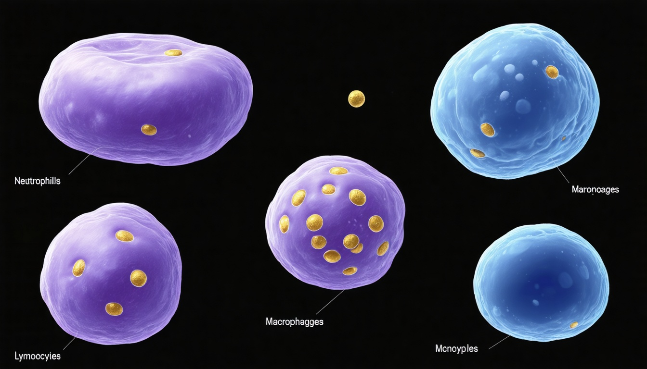
IMMUNE CELLS
Key Players: White Blood Cells
• Neutrophils: Most abundant, first responders
• Macrophages: "Eat" pathogens and present antigens
• Lymphocytes: B cells and T cells for adaptive response
• Dendritic cells: Bridge between innate and adaptive immunity

Slide 7
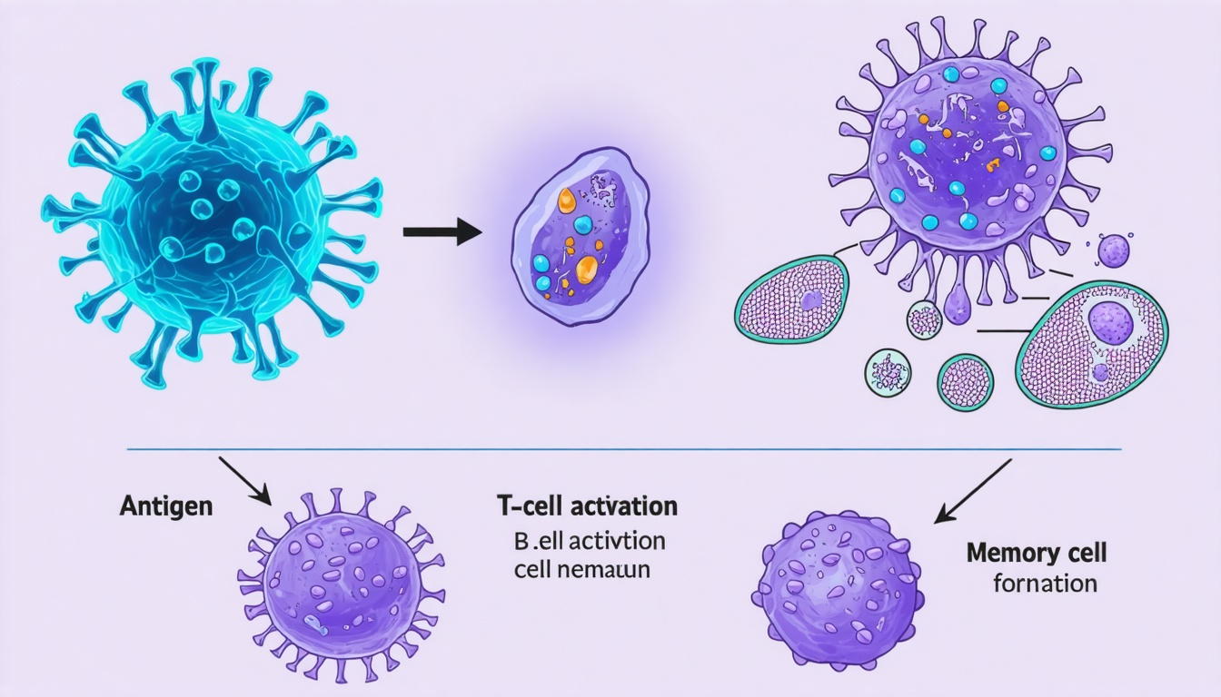
ADAPTIVE IMMUNITY
Specific & Targeted Defense
• Develops over time with exposure to pathogens
• Creates memory of specific antigens
• Faster and stronger response on re-exposure
• Foundation for vaccination effectiveness

Slide 8
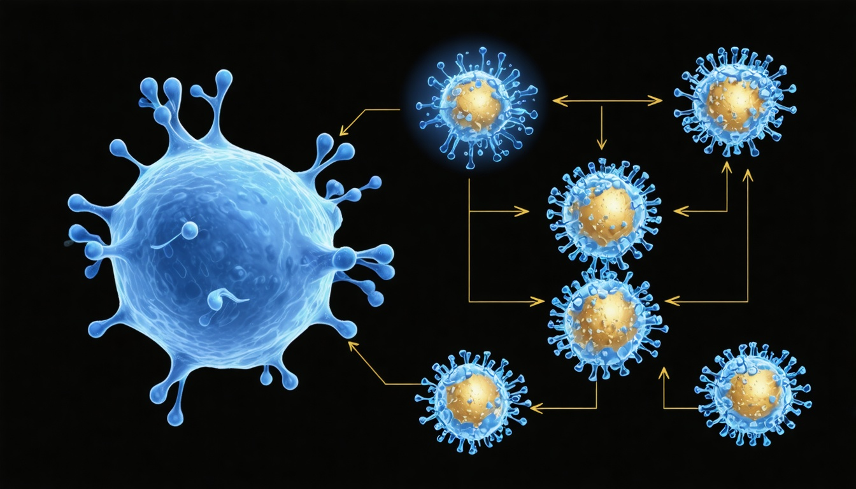
HUMORAL IMMUNITY
B Cells & Antibody Production
• B cells recognize specific antigens
• Differentiate into plasma cells producing antibodies
• Antibodies neutralize or mark pathogens
• Memory B cells provide long-term immunity

Slide 9
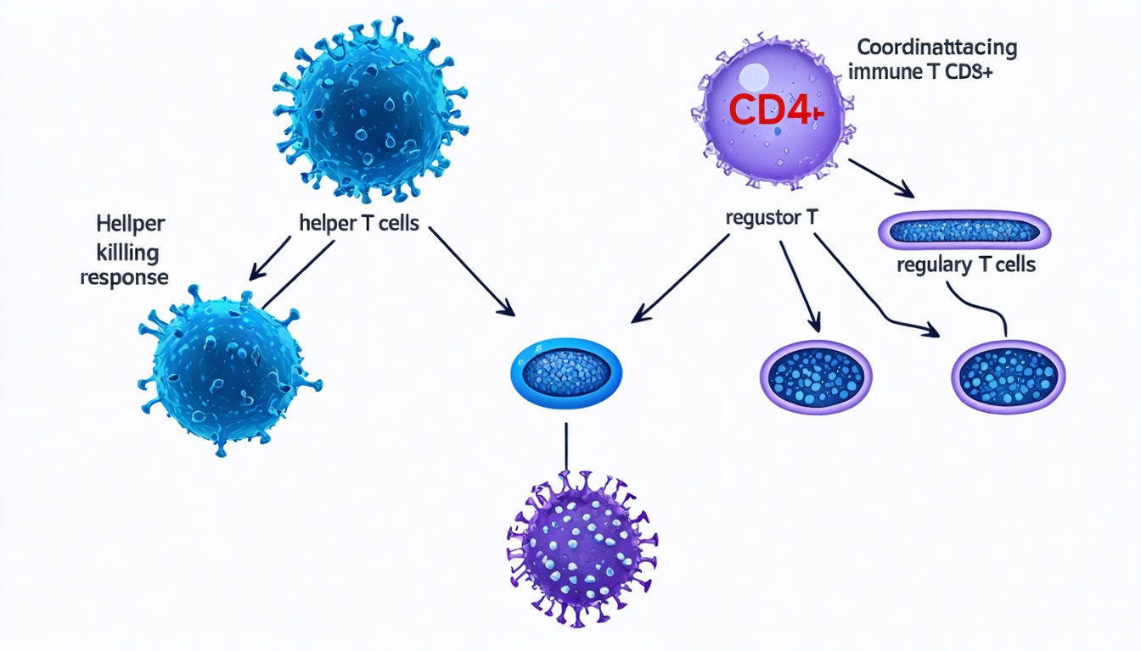
CELL-MEDIATED IMMUNITY
T Cell Functions & Responses
• Helper T cells (CD4+): Coordinate immune response
• Cytotoxic T cells (CD8+): Kill infected cells
• Regulatory T cells: Prevent overreaction
• T cell memory enables rapid re-response

Slide 10
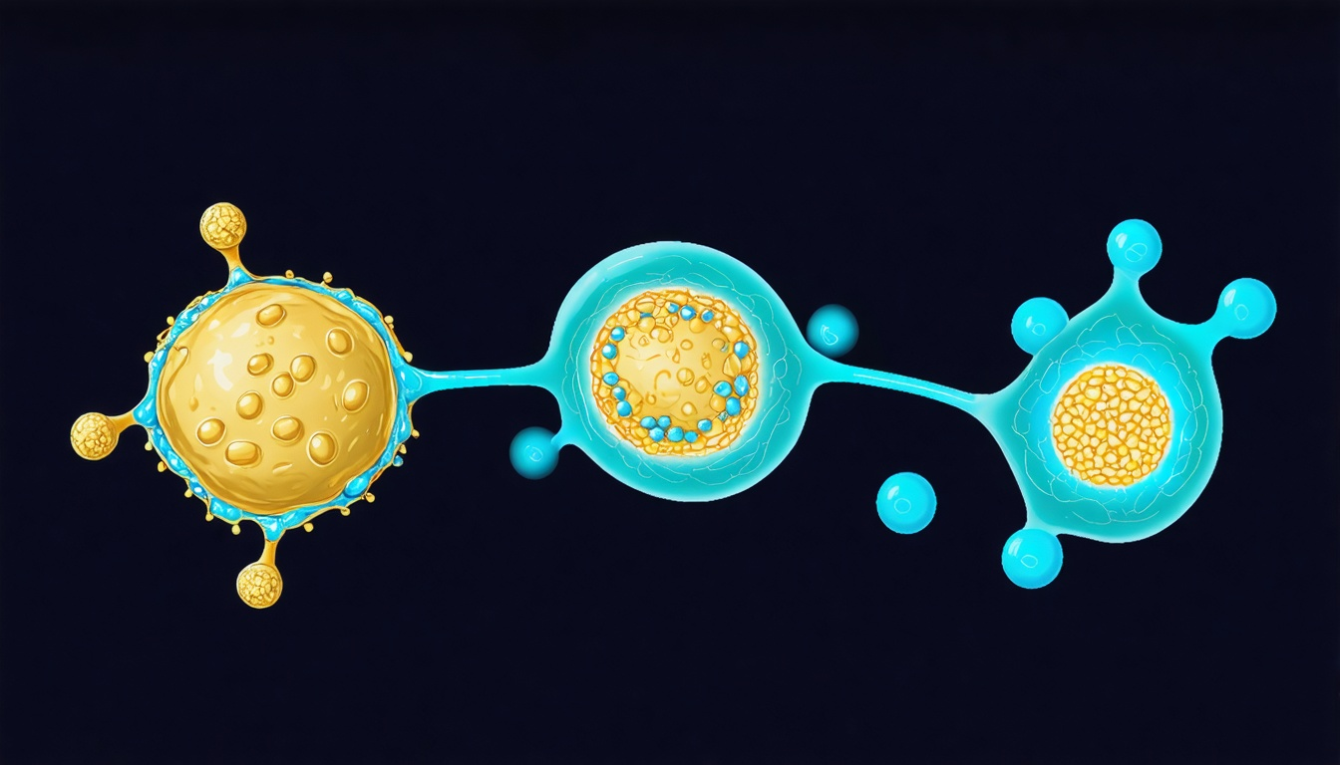
SECONDARY RESPONSE
Inflammation & Complement System
• Inflammatory response: Redness, heat, swelling, pain
• Complement proteins cascade to destroy pathogens
• Membrane attack complex creates pores in pathogens
• Promotes tissue repair and healing processes

Slide 11
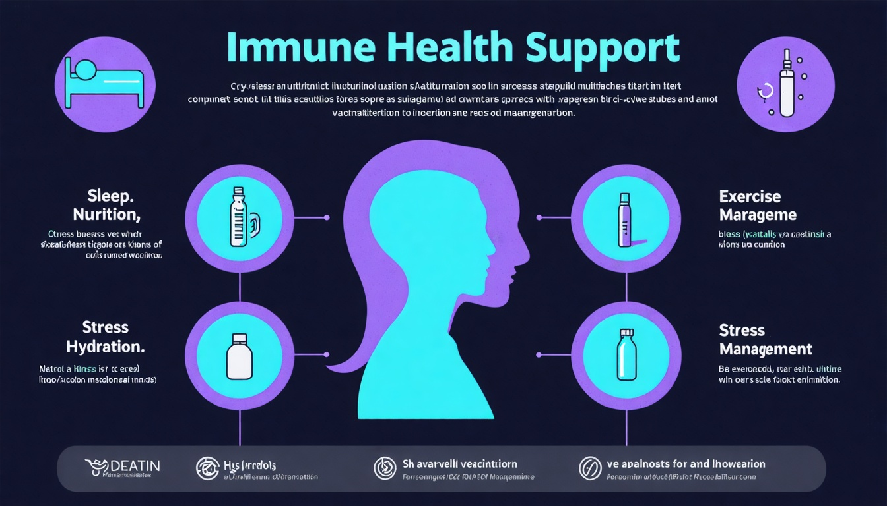
PREVENTION & SUPPORT
Supporting Your Immune Health
• Adequate sleep: Essential for immune cell production
• Balanced nutrition: Vitamins, minerals, proteins
• Regular exercise: Enhances circulation and immunity
• Vaccination: Trains immune system safely

Slide 12
SUMMARY & DISCUSSION
• The immune system is a sophisticated multi-layered defense network
• Innate and adaptive immunity work synergistically
• Understanding immunity helps us support our health
• Vaccination harnesses adaptive immunity for disease prevention
Ready for Labs
Review loaded notebooks in your workspace. Test code inference endpoints, verify cross-region configurations, and execute agent runs.

