Slide 1

INTRODUCTION
THE HUMAN IMMUNE SYSTEM
How Our Body Fights Diseases

Slide 2
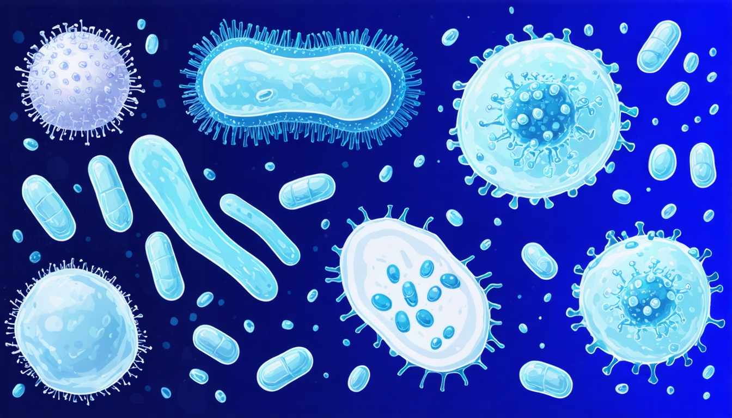
IMMUNE SYSTEM OVERVIEW
What is the Immune System?
• A complex network of cells, tissues, and organs working together
• Primary role: Protect the body from harmful pathogens and infections
• Includes bacteria, viruses, fungi, parasites, and abnormal cells
• Maintains homeostasis and prevents disease development

Slide 3
CORE FUNCTIONS
Key Functions & Goals
• Recognition: Identify pathogens and foreign substances
• Response: Activate defense mechanisms to neutralize threats
• Elimination: Remove pathogens and damaged cells
• Memory: Learn and remember past infections for faster future responses
Key Insight:
This slide covers 'Key Functions & Goals' in context of The Human Immune System: How Our Body Fights Diseases. Focus on discussing design boundaries and parameters during lecture.

Slide 4
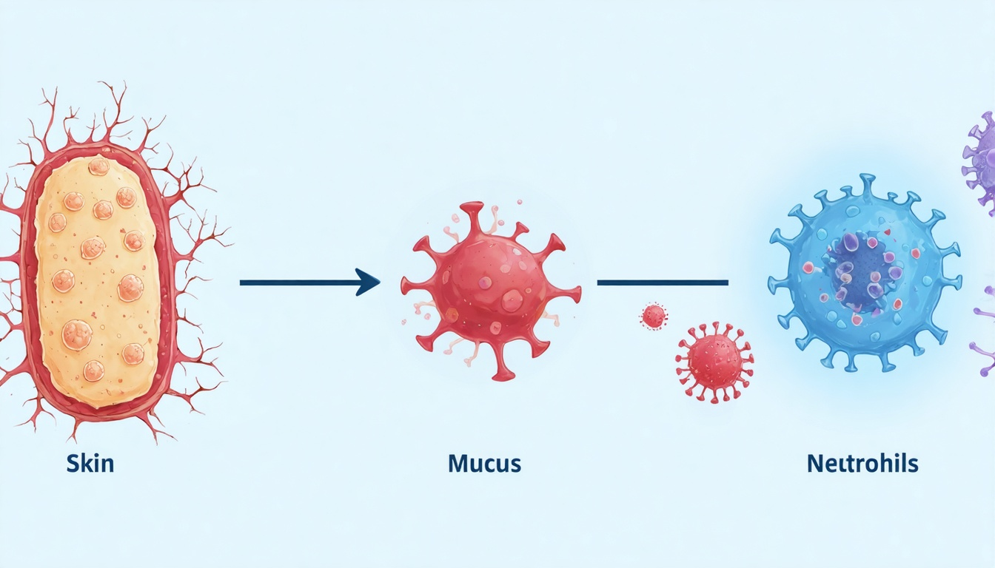
INNATE IMMUNITY
Innate Immunity: First Line of Defense
• Immediate, non-specific response to any pathogen
• Physical barriers: Skin, mucus membranes, stomach acid
• Cellular response: Neutrophils and macrophages engulf pathogens
• Inflammation: Increases blood flow and immune cell recruitment

Slide 5
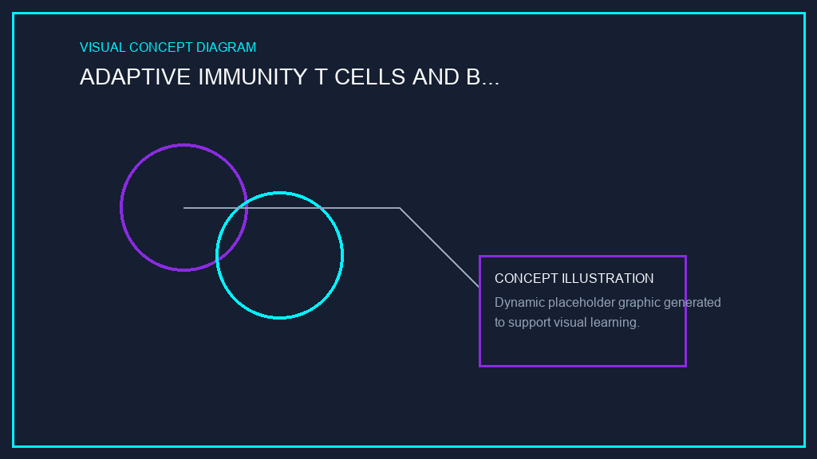
ADAPTIVE IMMUNITY
Adaptive Immunity: Specific Defense
• Targeted response tailored to specific pathogens
• Takes longer to activate but highly effective
• Creates memory cells for rapid future responses
• Forms basis for vaccination and long-term immunity

Slide 6
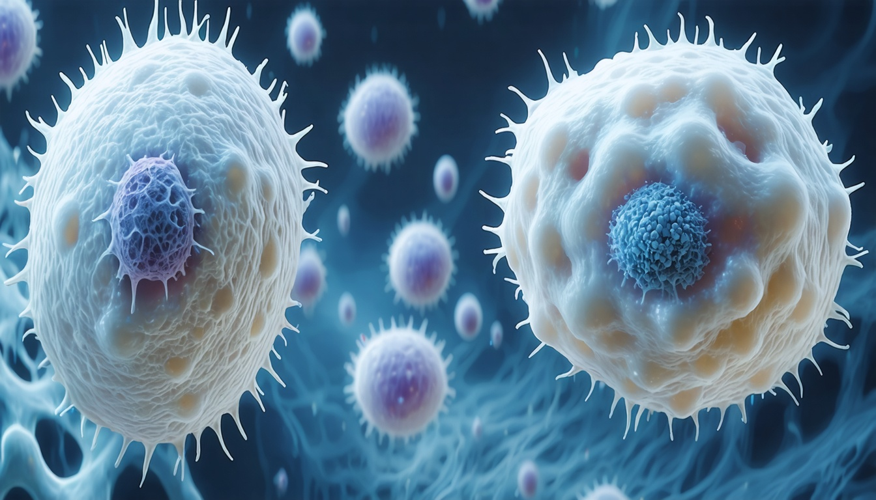
IMMUNE CELLS
Immune Cells: White Blood Cell Types
• Neutrophils: Most abundant, first responders to infection
• Macrophages: Large cells that engulf pathogens and dead cells
• Lymphocytes: T cells and B cells for adaptive immunity
• Dendritic cells: Present antigens to activate immune response

Slide 7
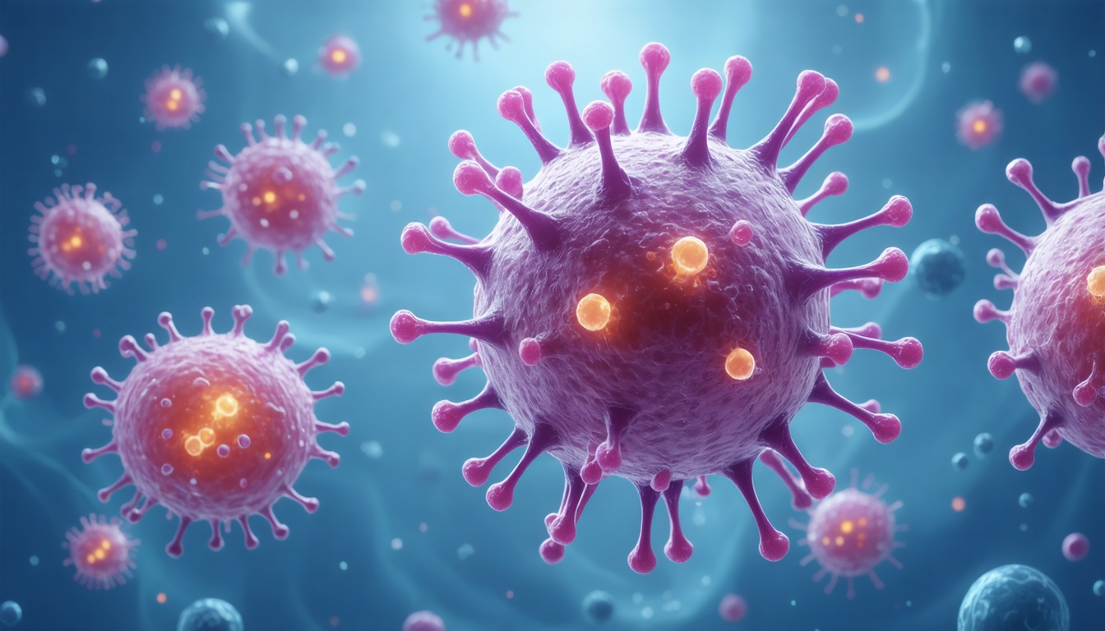
HUMORAL IMMUNITY
B Cells & Antibodies
• B cells produce antibodies (immunoglobulins) against specific antigens
• Antibodies neutralize pathogens and mark them for destruction
• Plasma cells: Antibody factories during active infection
• Memory B cells: Provide long-lasting immunity

Slide 8
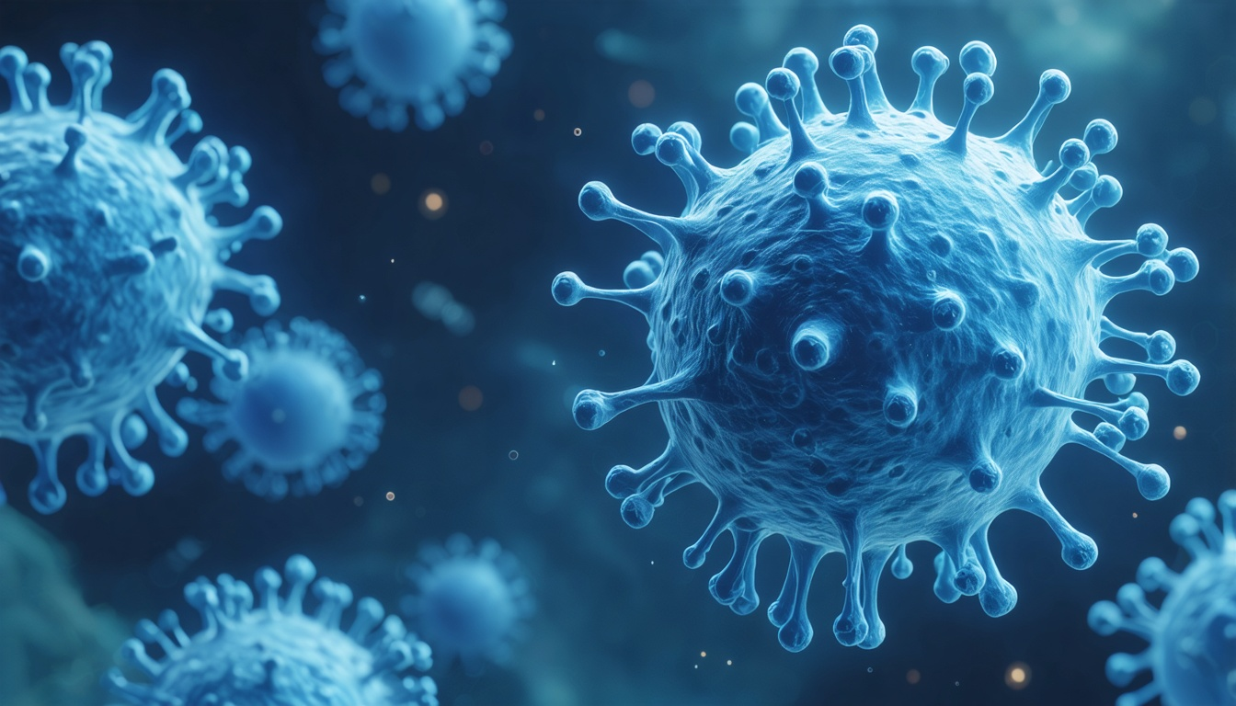
CELL-MEDIATED IMMUNITY
T Cells: Direct Cellular Defense
• Cytotoxic T cells: Kill virus-infected and cancerous cells
• Helper T cells: Coordinate immune response and activate other cells
• Regulatory T cells: Control immune response to prevent autoimmunity
• Direct attack mechanism using cytotoxic granules

Slide 9
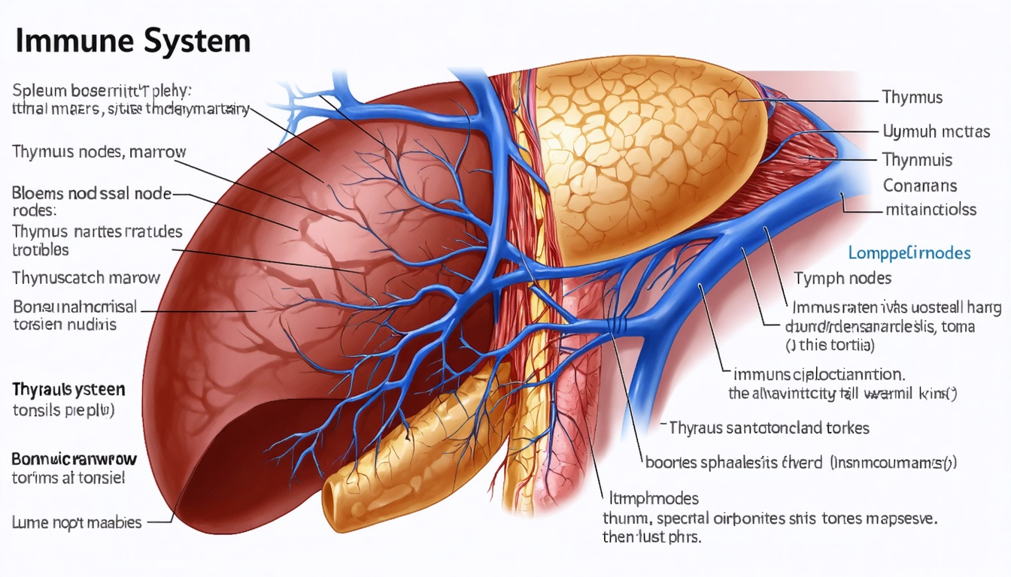
LYMPHOID ORGANS
Immune System Organs & Tissues
• Bone marrow: Produces all white blood cells
• Thymus: T cell development and maturation
• Lymph nodes: Filter lymph and activate immune response
• Spleen: Filters blood and stores immune cells

Slide 10
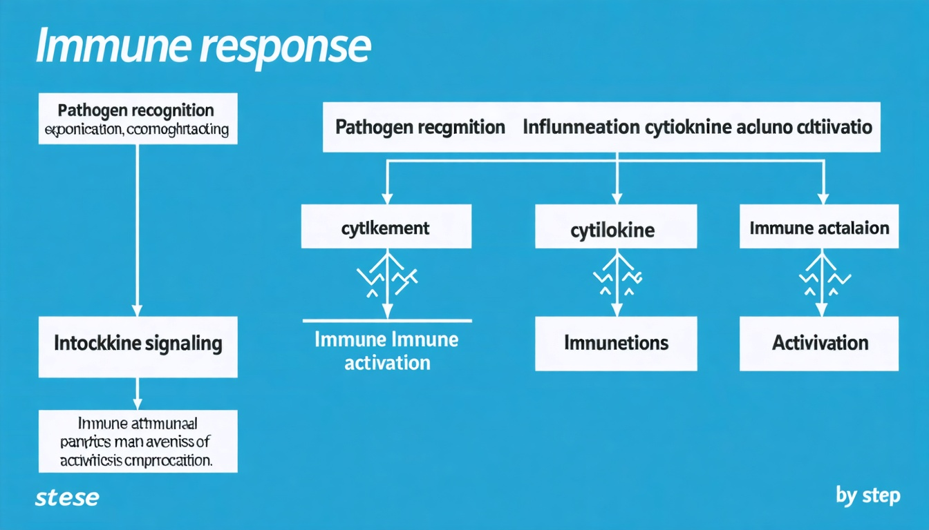
IMMUNE RESPONSE
The Immune Response Process
• Recognition: Antigen detection by immune cells
• Activation: Cytokine signaling and immune cell proliferation
• Attack: Pathogen elimination through multiple mechanisms
• Resolution: Inflammation reduction and tissue repair

Slide 11
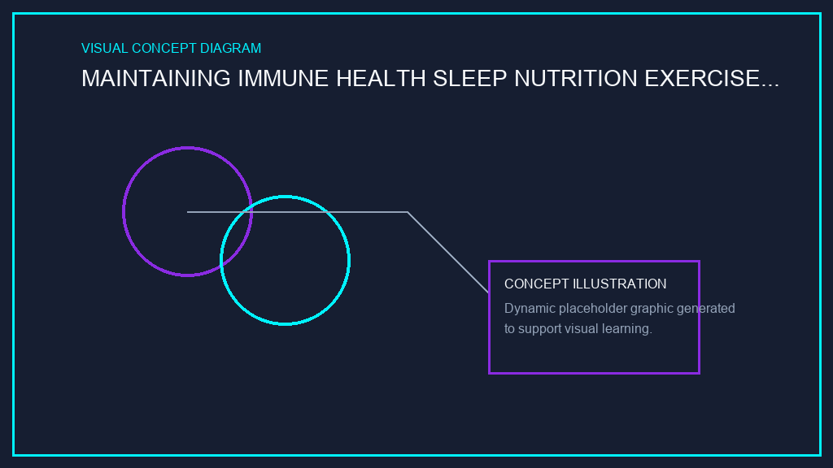
HEALTH MAINTENANCE
Maintaining Optimal Immune Health
• Sleep: 7-9 hours daily for immune cell production and repair
• Nutrition: Vitamins C, D, zinc, and antioxidant-rich foods
• Exercise: Regular physical activity enhances immune function
• Stress management: Chronic stress suppresses immune response

Slide 12
SUMMARY & DISCUSSION
• The immune system is a multi-layered defense protecting against pathogens
• Innate immunity provides immediate response; adaptive immunity provides specificity
• White blood cells, antibodies, and immune organs work in coordination
• Understanding immune function helps optimize health and disease prevention
Ready for Labs
Review loaded notebooks in your workspace. Test code inference endpoints, verify cross-region configurations, and execute agent runs.

