Slide 1

INTRODUCTION
PYTHON PROGRAMMING
Master the Essentials of Python Development

Slide 2
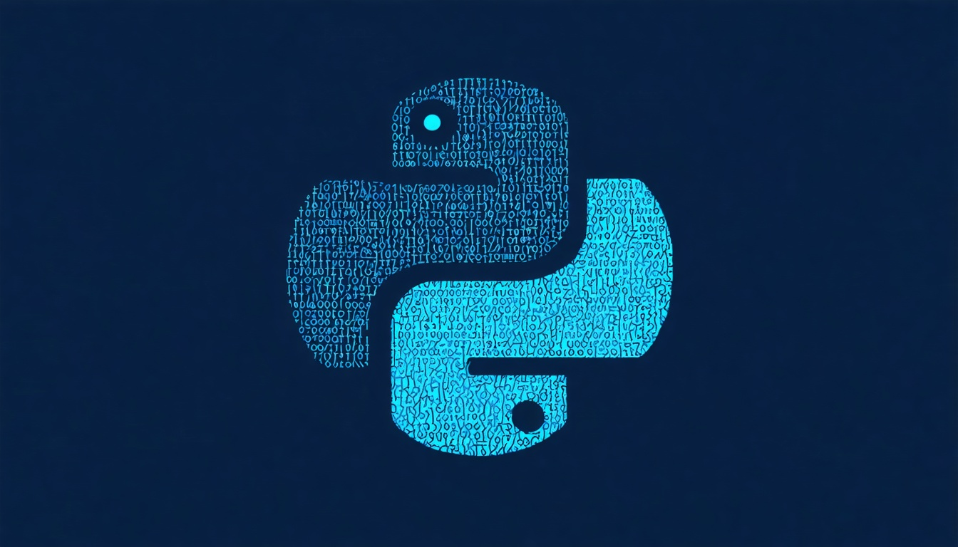
PYTHON OVERVIEW
Why Python?
• Simple, readable syntax similar to natural English
• Highly versatile: web, data science, AI, automation
• Large ecosystem of libraries and frameworks
• Strong community support and extensive documentation

Slide 3
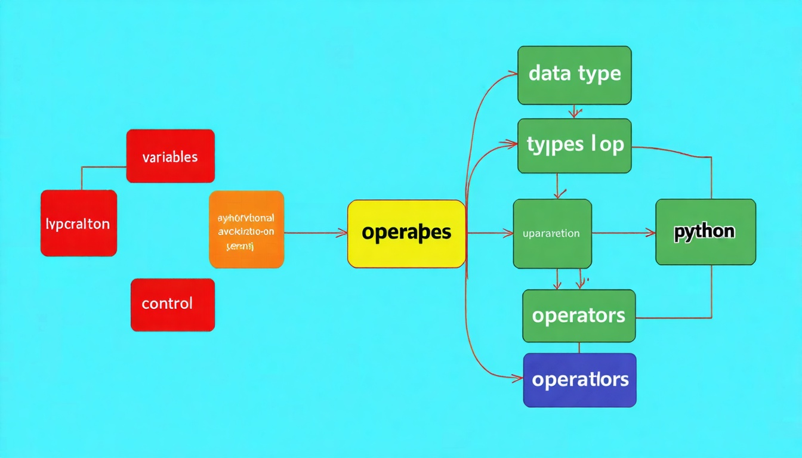
CORE CONCEPTS
Python Fundamentals
• Variables & Data Types: int, float, str, bool, complex
• Operators: arithmetic, comparison, logical, assignment
• Control Flow: if-elif-else, loops (for, while)
• Exception Handling: try-except-finally blocks

Slide 4
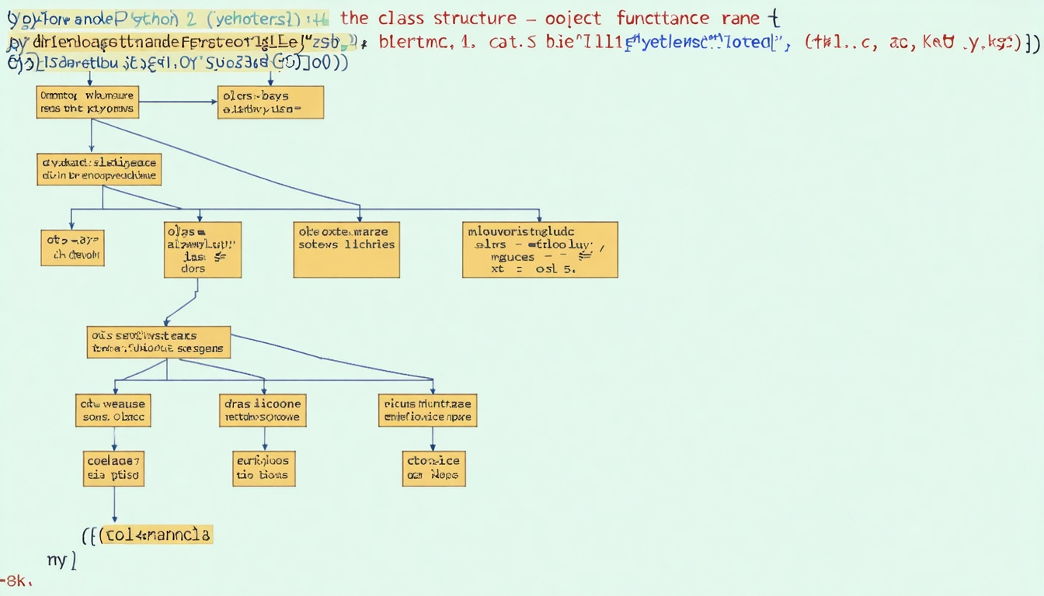
CORE CONCEPTS
Functions & Object-Oriented Programming
• Functions: def keyword, parameters, return values, scope
• Lambda Functions: anonymous functions for quick operations
• Classes & Objects: inheritance, encapsulation, polymorphism
• Modules & Packages: organize code into reusable components

Slide 5
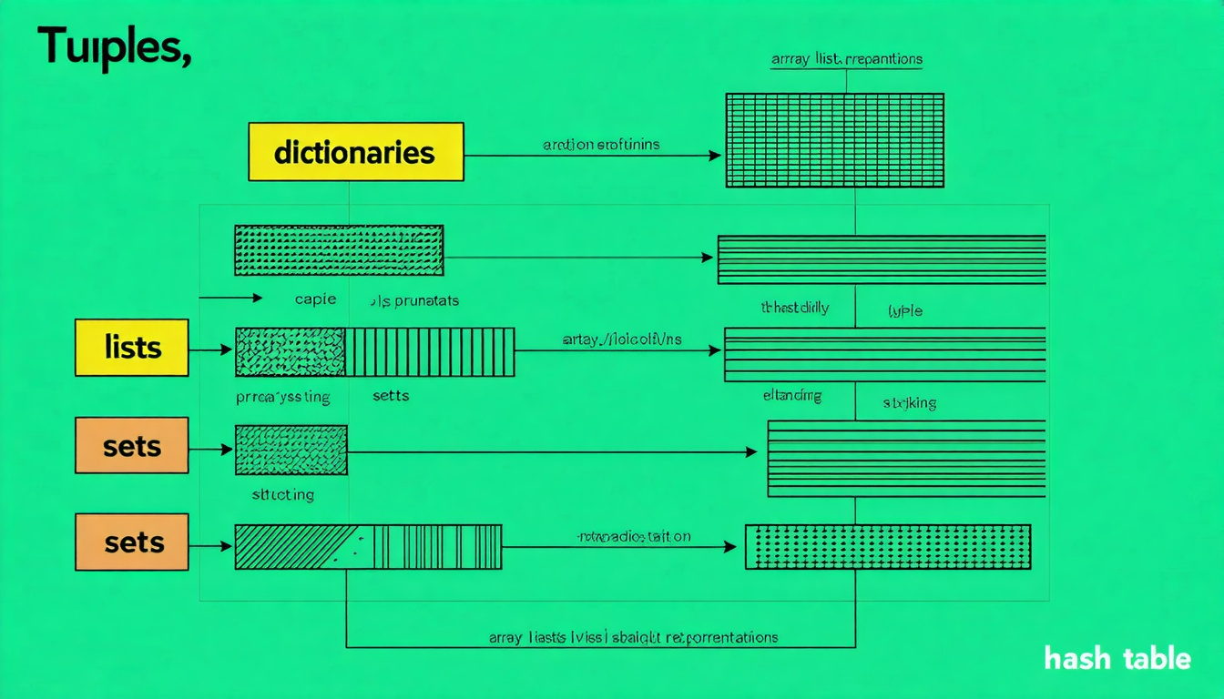
CORE CONCEPTS
Essential Data Structures
• Lists: ordered, mutable collections with indexing
• Tuples: immutable sequences for fixed data
• Dictionaries: key-value pairs for fast lookups
• Sets: unordered unique collections for membership testing

Slide 6
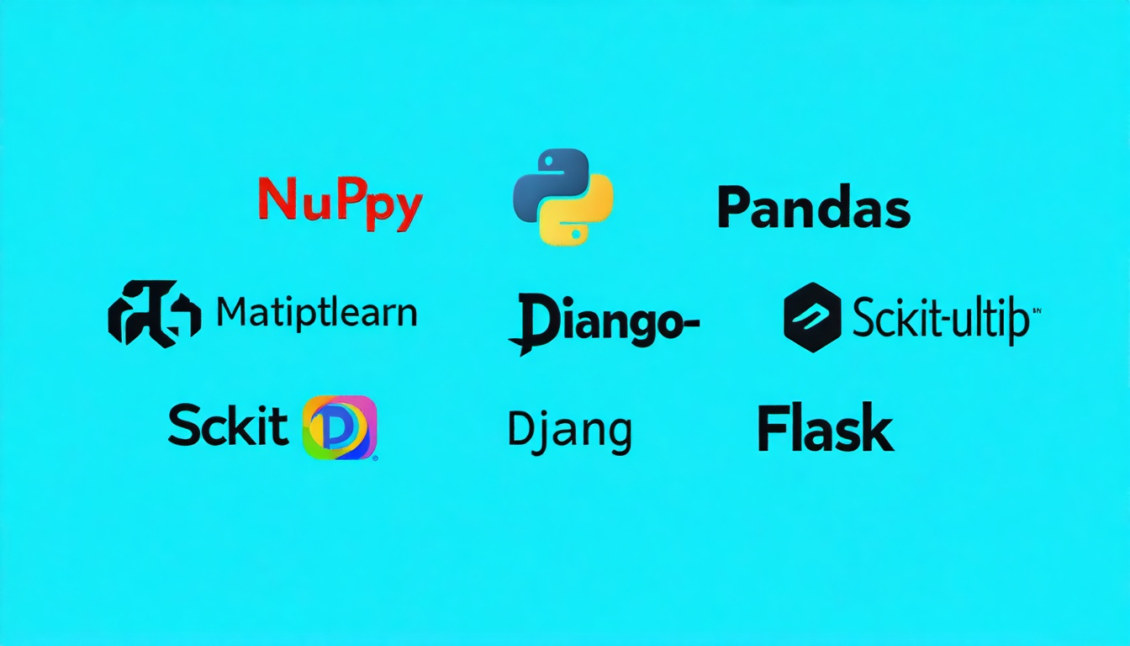
LIBRARIES & TOOLS
Popular Python Libraries
• NumPy & Pandas: numerical computing and data manipulation
• Matplotlib & Seaborn: data visualization and plotting
• Scikit-learn: machine learning and statistical modeling
• Requests & BeautifulSoup: web scraping and HTTP requests

Slide 7
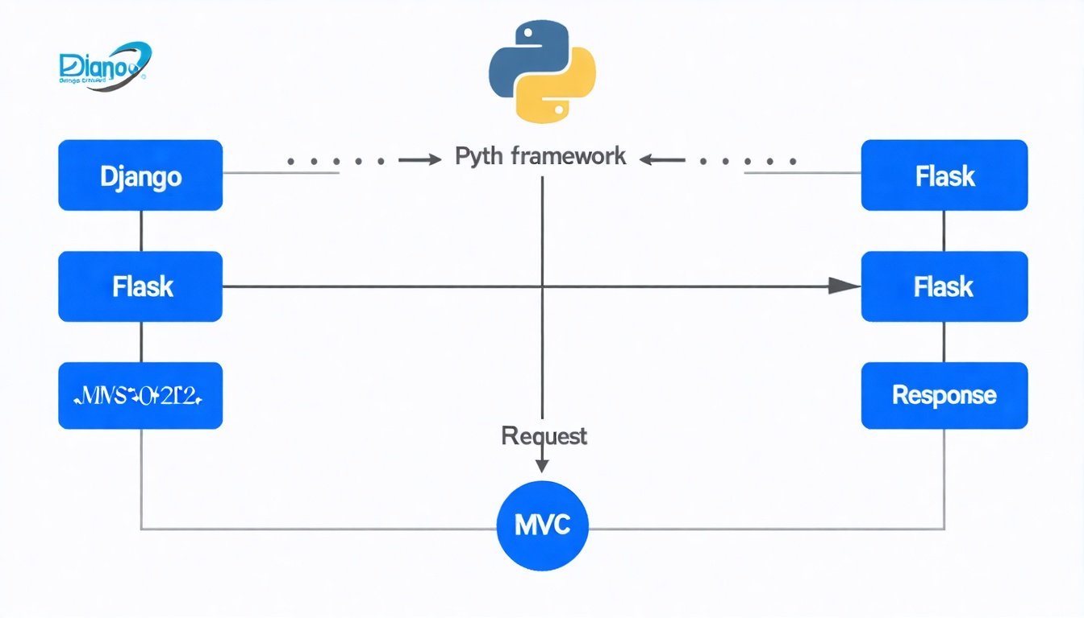
LIBRARIES & TOOLS
Web Frameworks
• Django: full-featured framework with ORM and admin panel
• Flask: lightweight microframework for flexibility
• FastAPI: modern async framework for high-performance APIs
• Streamlit: rapid development of data science web apps

Slide 8

BEST PRACTICES
Code Quality & Best Practices
• PEP 8 Style Guide: 4-space indentation, line length limits
• Testing: unit tests with pytest, test-driven development
• Documentation: docstrings, type hints, README files
• Code Review: peer review, linting with pylint and flake8

Slide 9
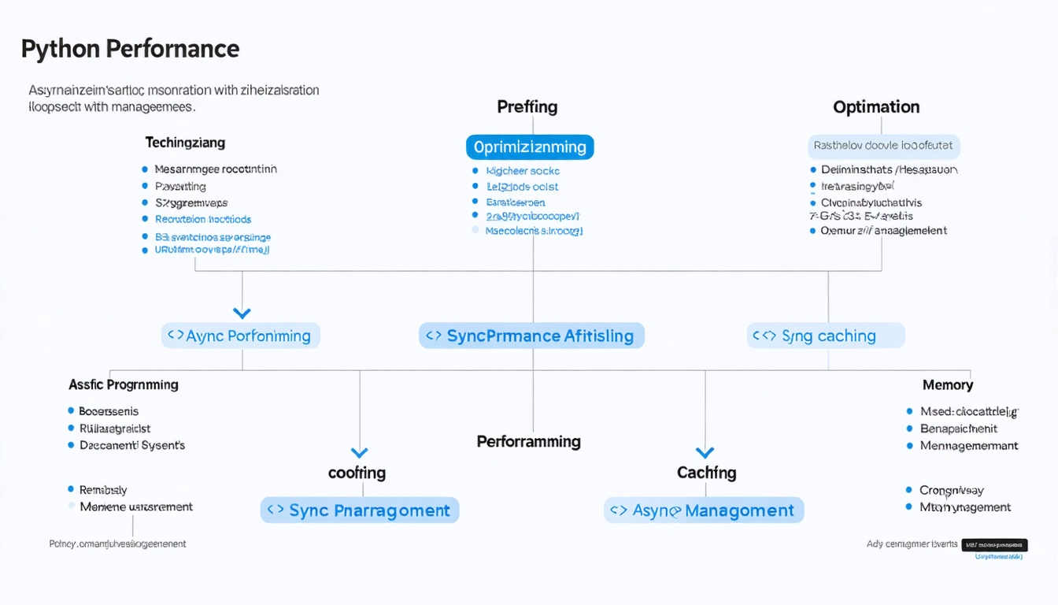
ADVANCED TOPICS
Performance & Optimization
• Profiling: identify bottlenecks with cProfile and timeit
• Caching: memoization and functools.lru_cache
• Async Programming: asyncio for concurrent operations
• Memory Management: generators, list comprehensions, garbage collection

Slide 10
SUMMARY & DISCUSSION
• Master fundamentals first: variables, functions, OOP
• Explore libraries relevant to your domain
• Follow PEP 8 and write testable, maintainable code
• Practice with real projects and contribute to open source
Ready for Labs
Review loaded notebooks in your workspace. Test code inference endpoints, verify cross-region configurations, and execute agent runs.

