Slide 1

01 // INTRODUCTION
Langchain Agents: Transforming the Future of AI Interaction
AUTONOMOUS AI PRESENTATION ARCHITECTURE • 8 SLIDES • GEMINI 2.5 FLASH VISUALS

Slide 2

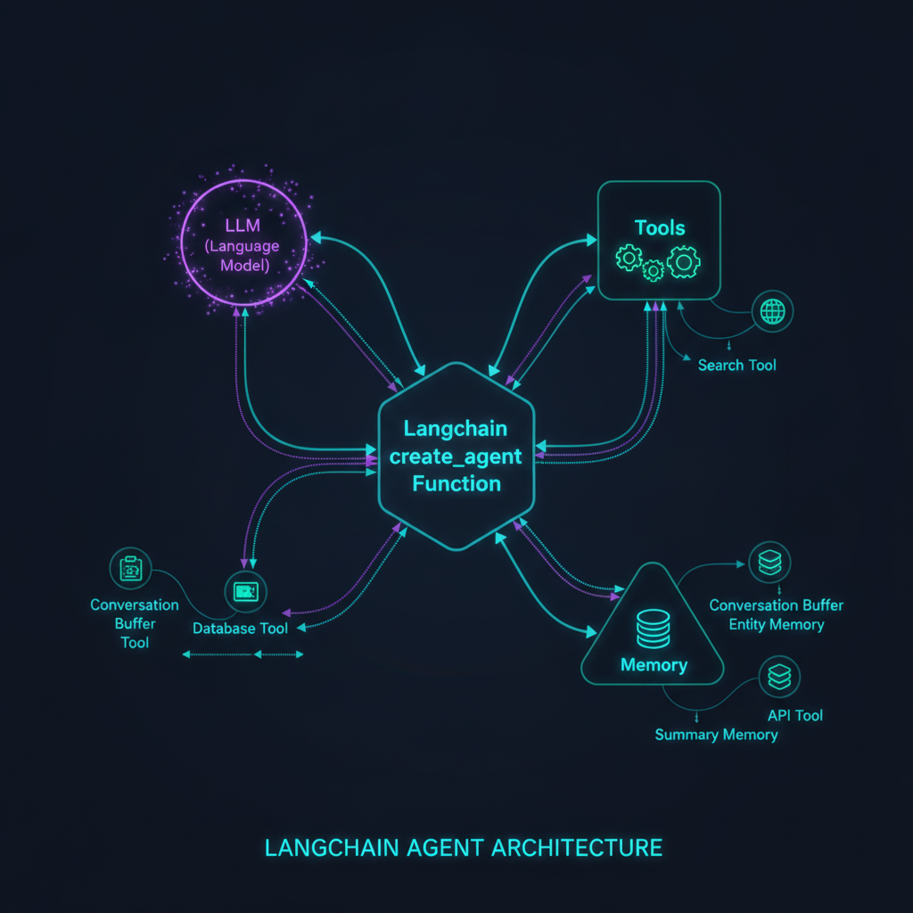
02 // ARCHITECTURE
SLIDE 02 / 08
The Power of create_agent Functionality
01
01. create_agent Architecture
Streamlined creation of intelligent agents using modular components.
◆ VISUAL ARCHITECTURE // RIGHT PANEL
02
02. Dynamic Tool Selection
Agents autonomously select the best tools for complex tasks.
03
03. Reasoning Loops
Iterative thought processes that improve accuracy and reliability.
The Power of create_agent Functionality
KEY INSIGHT
Langchain's create_agent function provides a robust foundation for building scalable, autonomous AI agents.

Slide 3
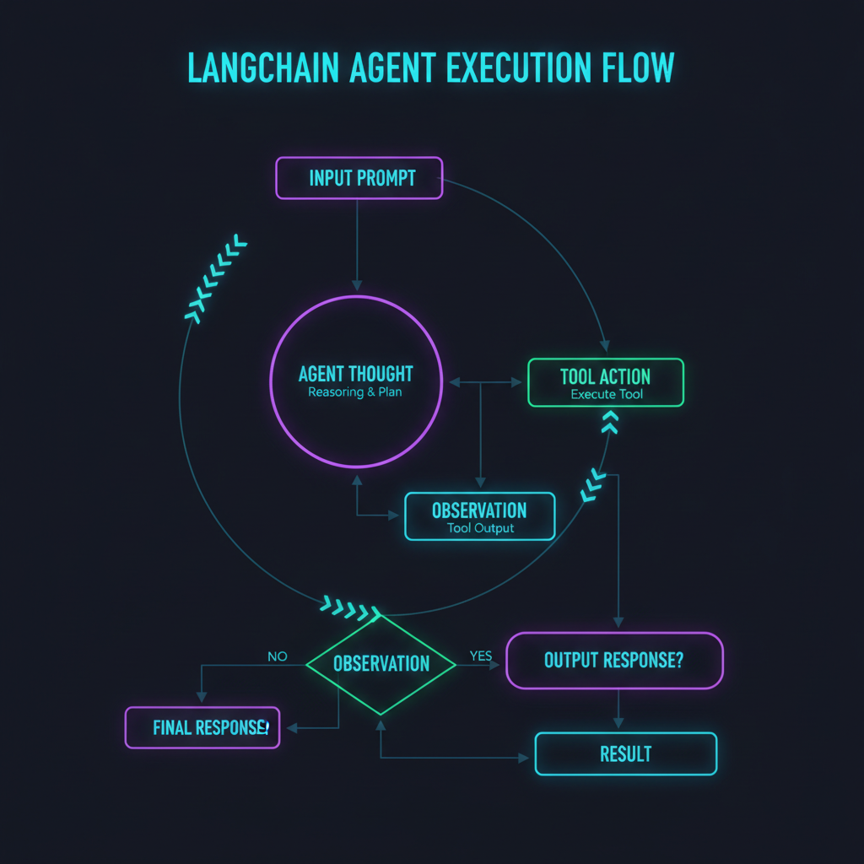
03 // EXECUTION FLOW
SLIDE 03 / 08
Langchain Agent Execution Flow
◆ VISUAL ARCHITECTURE // LEFT PANEL
01
01. Sequential Execution
Structured flow of thought, action, and observation cycles.
02
02. Error Handling
Built-in mechanisms to recover from tool execution failures.
03
03. Context-Awareness
Maintaining state across multiple turns for coherent interactions.
Langchain Agent Execution Flow
KEY INSIGHT
The agent execution flow ensures reliable, repeatable, and context-aware AI behavior.

Slide 4

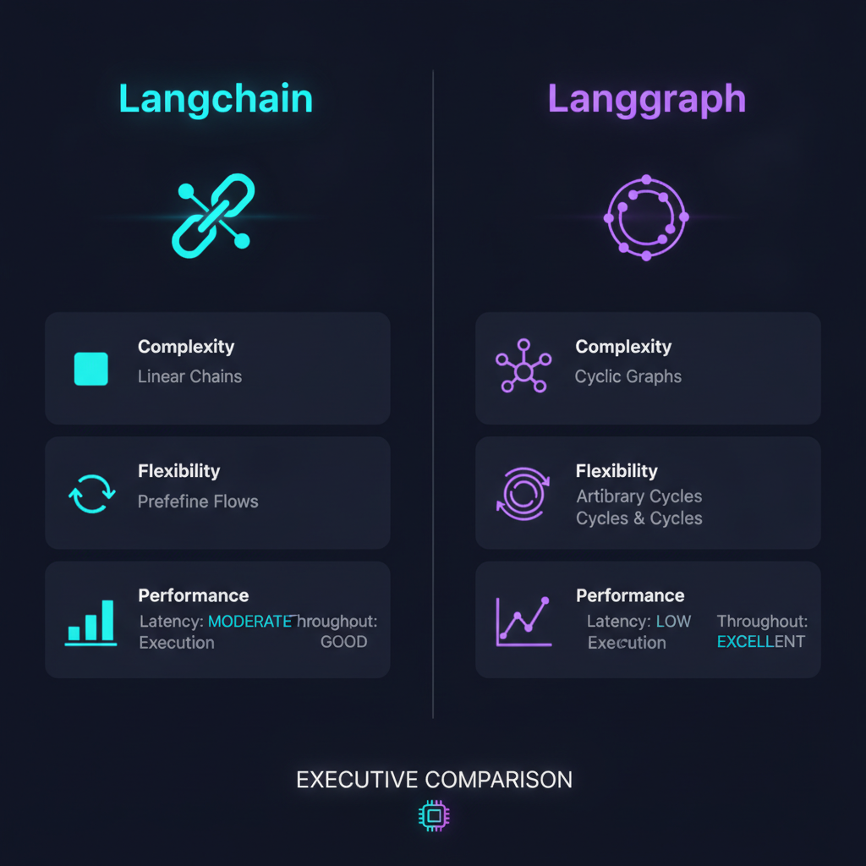
04 // COMPARISON
SLIDE 04 / 08
Langchain vs. Langgraph: Strategic Comparison
Feature | Langchain Agents | Langgraph
State Management | Basic/Stateless | Complex/Stateful Graphs
Complexity Handling | Low to Medium | High/Cyclic Graphs
Flexibility | High (Modular) | Maximum (Customizable)
◆ COMPARISON INFOGRAPHIC
Visual Comparison Matrix generated via Gemini 2.5 Flash Image
KEY INSIGHT
Choosing between Langchain and Langgraph depends on the complexity and state requirements of your agent.

Slide 5
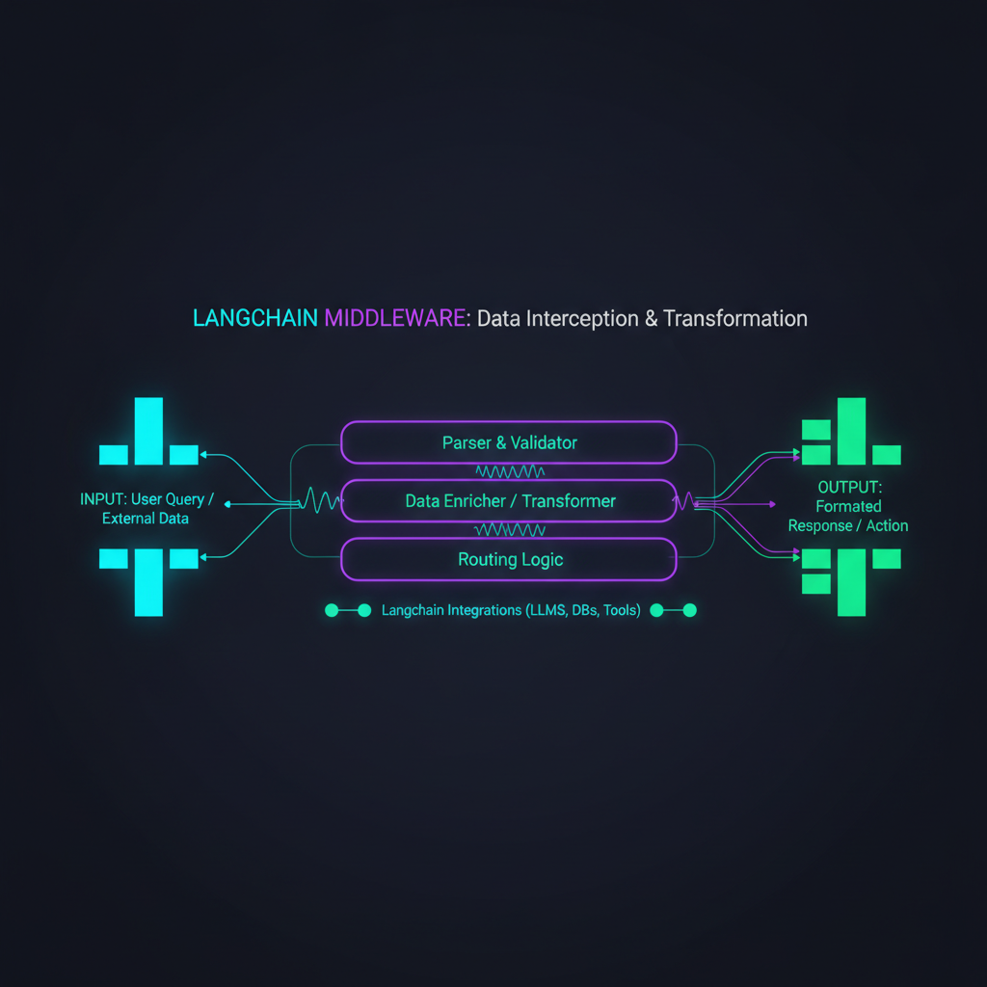
05 // MIDDLEWARE
SLIDE 05 / 08
Langchain Middleware Concept
◆ VISUAL ARCHITECTURE // LEFT PANEL
01
01. Middleware Architecture
Intercepting and transforming data streams within the agent pipeline.
02
02. Data Transformation
Standardizing inputs and outputs for consistent agent performance.
03
03. Enterprise Security
Implementing custom middleware for compliance and data protection.
Langchain Middleware Concept
KEY INSIGHT
Langchain middleware provides a powerful mechanism for customizing and securing agent data flows.

Slide 6
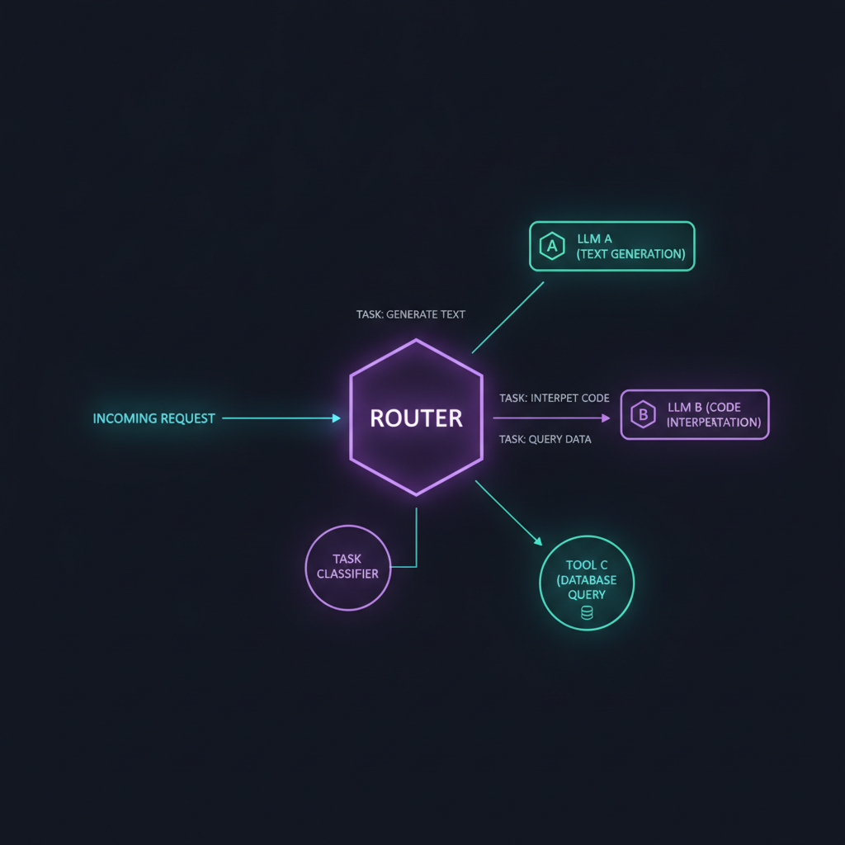
06 // ROUTING
SLIDE 06 / 08
Langchain Router Pattern
01
01. Router Pattern
Dynamically directing requests to the most suitable model or tool.
◆ VISUAL ARCHITECTURE // RIGHT PANEL
02
02. Task Optimization
Improving efficiency by matching tasks to specialized resources.
03
03. Scalability
Enabling complex agent systems to handle diverse workloads effectively.
Langchain Router Pattern
KEY INSIGHT
The router pattern is critical for building scalable and efficient multi-agent systems.

Slide 7
07 // CAPABILITIES
SLIDE 07 / 08
Advanced HITL Capabilities in Langchain Agents
01
01. Human-in-the-loop (HITL)
Enabling human oversight for critical agent decisions.
STRATEGIC SYNTHESIS
HITL capabilities are essential for deploying agents in high-stakes enterprise environments.
02
02. Approval Workflows
Implementing checkpoints for manual verification of actions.
03
03. Real-time Intervention
Allowing users to steer agent behavior during execution.

Slide 8

08 // CONCLUSION
SLIDE 08 / 08
Executive Summary & Future Directions
Executive Takeaways & Strategic Outlook
01
01. Summary
Langchain agents represent a paradigm shift in AI interaction.
EXECUTIVE SUMMARY & NEXT STEPS
Investing in Langchain agents today positions your organization at the forefront of AI-driven automation.
02
02. Future Directions
Moving towards multi-agent systems and autonomous orchestration.
03
03. Strategic Roadmap
Prioritize modular development and robust HITL integration.

