Slide 1

01 // INTRODUCTION
Solar System: Planetary Exploration
Strategic Overview of Planetary Exploration and Future Missions
AUTONOMOUS AI PRESENTATION ARCHITECTURE • 6 SLIDES • GEMINI 2.5 FLASH VISUALS

Slide 2

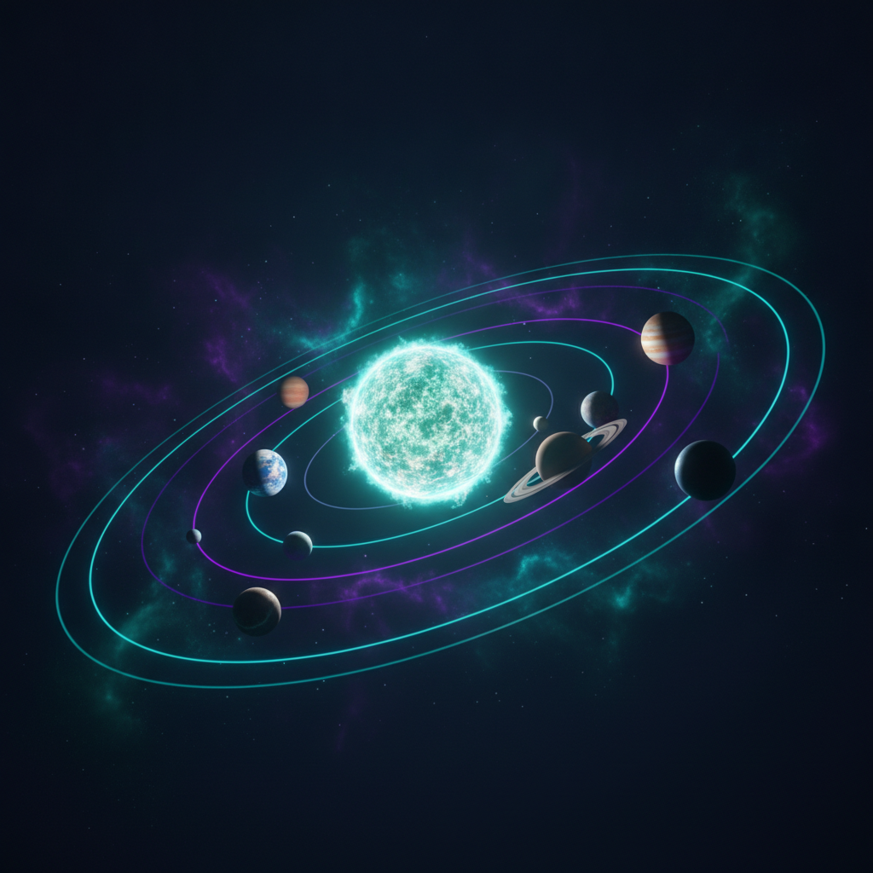
02 // MECHANICS
SLIDE 02 / 06
How the Solar System Works
01
Gravitational Dynamics
The Sun acts as the primary anchor, maintaining orbital stability for all celestial bodies.
◆ VISUAL ARCHITECTURE // RIGHT PANEL
02
Orbital Mechanics
Planets follow precise elliptical paths governed by the Sun's massive gravitational influence.
03
Energy Distribution
Solar radiation provides the essential energy flux that dictates planetary climate and potential habitability.
How the Solar System Works
KEY INSIGHT
The Sun's gravitational and radiative output is the fundamental driver of all solar system activity.

Slide 3
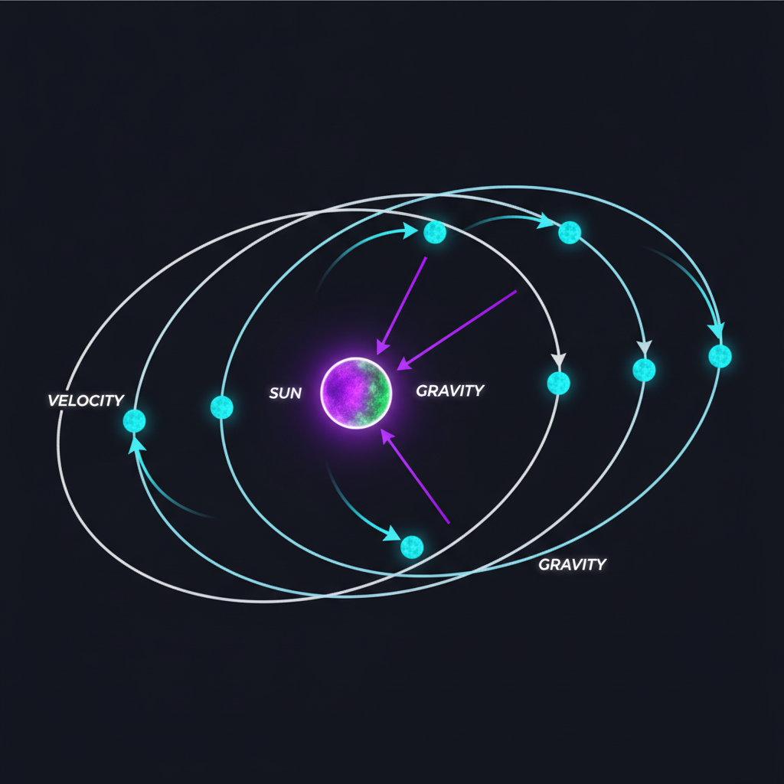
03 // ORBITS
SLIDE 03 / 06
Planetary Orbits & Dynamics
◆ VISUAL ARCHITECTURE // LEFT PANEL
01
Kepler's Laws
Planetary motion is defined by elliptical orbits, ensuring predictable and repeatable trajectories.
02
Orbital Resonance
Gravitational interactions between bodies create stable, long-term orbital configurations.
03
Velocity & Distance
Orbital speed inversely correlates with distance from the Sun, defining the duration of planetary years.
Planetary Orbits & Dynamics
KEY INSIGHT
Understanding orbital dynamics is critical for mission planning and trajectory optimization.

Slide 4

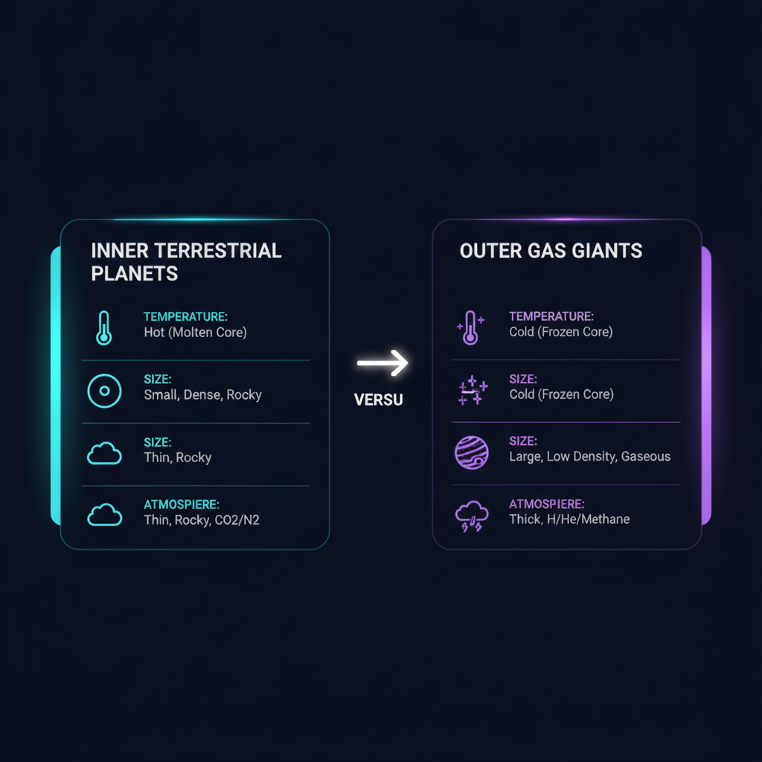
04 // COMPARISON
SLIDE 04 / 06
Comparative Planetary Analysis
Planet Type | Primary Composition | Atmospheric Density | Exploration Priority
Terrestrial | Rock/Metal | Low to Moderate | High (Habitability)
Gas Giant | Hydrogen/Helium | Extreme High | Medium (Atmospheric)
◆ COMPARISON INFOGRAPHIC
Visual Comparison Matrix generated via Gemini 2.5 Flash Image
KEY INSIGHT
Terrestrial planets offer high-density exploration targets, while gas giants provide insights into early solar system formation.

Slide 5
05 // CAPABILITIES
SLIDE 05 / 06
Earth & Jupiter: Exploration Capabilities
01
Earth's Habitable Zone
Earth resides in the optimal region for liquid water and complex biological development.
STRATEGIC SYNTHESIS
Strategic focus on Earth-like environments and Jupiter's moons remains the cornerstone of current exploration.
02
Jupiter's Gravitational Influence
Jupiter acts as a gravitational shield, protecting the inner system from frequent asteroid impacts.
03
Exploration Challenges
Long-distance transit and intense radiation environments require advanced shielding and autonomous navigation.

Slide 6

06 // CONCLUSION
SLIDE 06 / 06
Executive Summary & Future Directions
Executive Takeaways & Strategic Outlook
01
Summary of Findings
Our solar system is a complex, interconnected environment governed by gravitational and radiative forces.
EXECUTIVE SUMMARY & NEXT STEPS
The next decade of exploration will focus on identifying signs of life and expanding our reach into the outer solar system.
02
Upcoming Missions
Europa Clipper and Mars Sample Return represent the next frontier in planetary science.
03
Future Directions
Advancing propulsion and autonomous systems will enable deeper exploration of the outer solar system.

