Slide 1

Sepsis Early Warning System
GenAI-Powered 6-Hour Predictive Risk Assessment
Leadership Update | Apr 2026

Slide 2
Why This Matters
The Problem
Our Solution
Sepsis kills Thousands annually Every hour of delayed treatment increases mortality ~ 7-8% "Silent Sepsis" — normal vitals hide organ failure Current alerts are reactive, not predictive
AI predicts septic shock, hours* in advance Fuses numeric trends + clinician notes (narrative intelligence) Deterministic safety guardrails over AI output Real-time risk scoring at the bedside
Key Differentiator: Silent Sepsis Detection
Traditional systems: Alert only when vitals cross thresholds or identifies pattern in data (too late) Our system: AI detects discordance — stable vitals BUT concerning nurse notes (mottled skin, fluid non-response) Example: BP 115/70 (normal) + Nurse note 'required 2L bolus, skin mottled' → AI flags as compensated shock, risk 75% This is the gap that costs lives — and exactly what our system is built to catch
* "Our system is designed to detect early sepsis signals — trend deterioration, clinical note discordance, and sub-threshold organ stress — with the goal of providing a 6-hour early warning. The clinical framework is sound (Sepsis-3, qSOFA, SIRS, SOFA), and the AI is applying established medical reasoning. The next step is a clinical validation study with outcome tracking to measure our actual lead time and accuracy."

Slide 3
Our Journey — How the System Evolved
Step 1
Step 2
Step 3
Step 4
Hybrid ML
GenAI Narrative
Safety & Trust
Production
XGBoost + GPT-4o (Azure) Numeric-only prediction Basic risk scoring
GPT-4o narrative intelligence Nurse notes fusion Red Rover integration
Clinical guardrails qSOFA/SIRS/SOFA scores Confidence reasoning Audit logging
Claude Sonnet 4 (Bedrock) EKS deployment Doctor feedback loop (next) SJSA integration (next)
Key Pivot: Moved from ML to GenAI, "ML models see only numbers; GenAI reads the nurse's concern and notes, flexible and modern.
Moved from Azure OpenAI GPT-4o → AWS Bedrock Claude Sonnet 4 for better compliance, lower cost, and same-cloud deployment

Slide 4
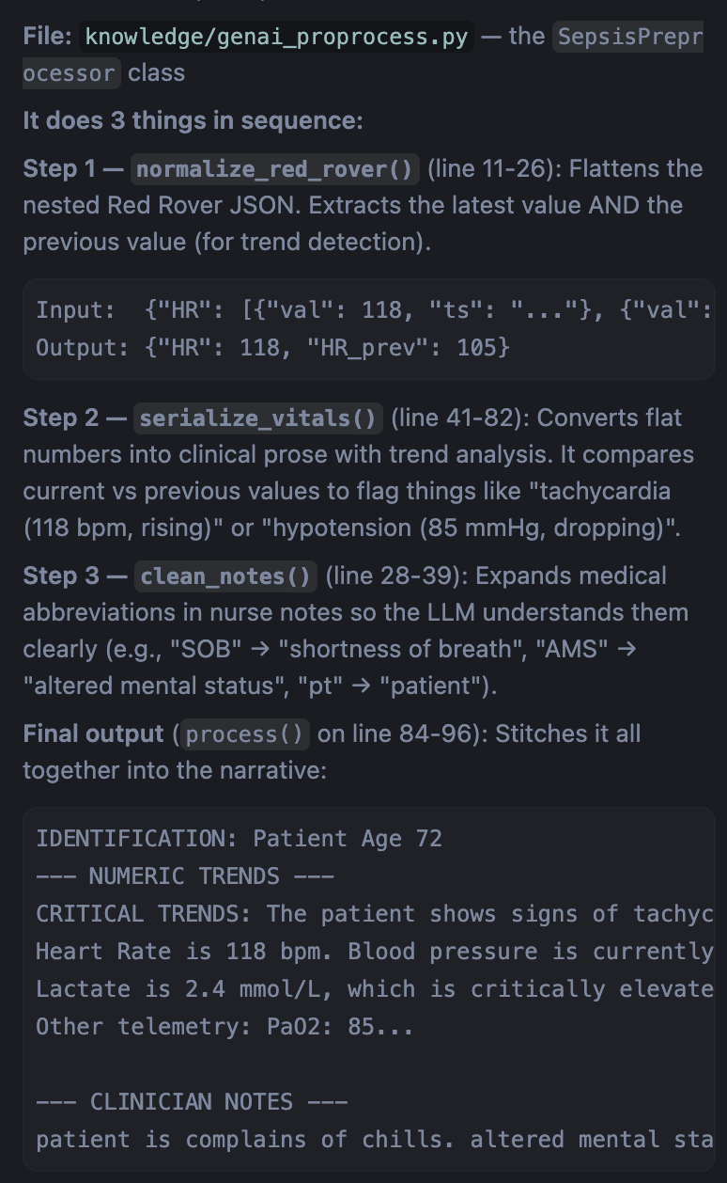
System Architecture — 3-Stage Pipeline
Stage 1
Stage 2
Stage 3
Preprocessor
LLM Inference
Safety Guardrail
Converts raw vitals, labs, and nurse notes into clinical narrative prose for LLM consumption
Claude Sonnet 4 analyzes narrative for sepsis risk with confidence reasoning and clinical rationale
Deterministic validation: qSOFA, SIRS, SOFA scores Threshold overrides Silent sepsis detection
→
→
API Output (~7.5s response time)
Risk Score (0-100) | Priority (Critical/High/Standard) | 6h Sepsis Probability Clinical Rationale (LLM-generated explanation for doctors) Confidence Level + Reasoning | Deterministic qSOFA, SIRS, SOFA scores Guardrail Override flags | Structured audit trail
Preprocessor in action

Slide 5
Model Comparison & Cost Analysis
Azure GPT-4o
Bedrock Sonnet 3.5 v2
Bedrock Sonnet 4 (Current)
Response Time
~3s
FAILED (throttled)
~7.5s
Cost / 1K patients
~$4.50
$3.00 (if working)
$4.50
HIPAA / Compliance
BAA required separately
AWS BAA included
AWS BAA included
PHI Risk
Data leaves AWS to Azure
Stays within AWS
Stays within AWS
Model Status
Active
LEGACY (deprecated)
ACTIVE
Sepsis Accuracy
Good*
N/A
Excellent*
Why We Moved to Claude Sonnet 4
Cost Breakdown (Usage-Based)
Same-cloud (AWS) — no data leaving to Azure AWS BAA covers HIPAA compliance out of the box Sonnet 3.5 deprecated by AWS (LEGACY, throttled) Sonnet 4 is active, faster, better clinical reasoning
Bedrock: ~$4.50 per 1,000 patients EKS Infra: Shared cluster, ~$0 marginal cost No idle charges — pay only when API is called No model hosting/GPU costs (fully managed)
*This is based on our qualitative testing experience, not measured benchmarks. Sonnet 4 brings Richer, more detailed reasoning always

Slide 6
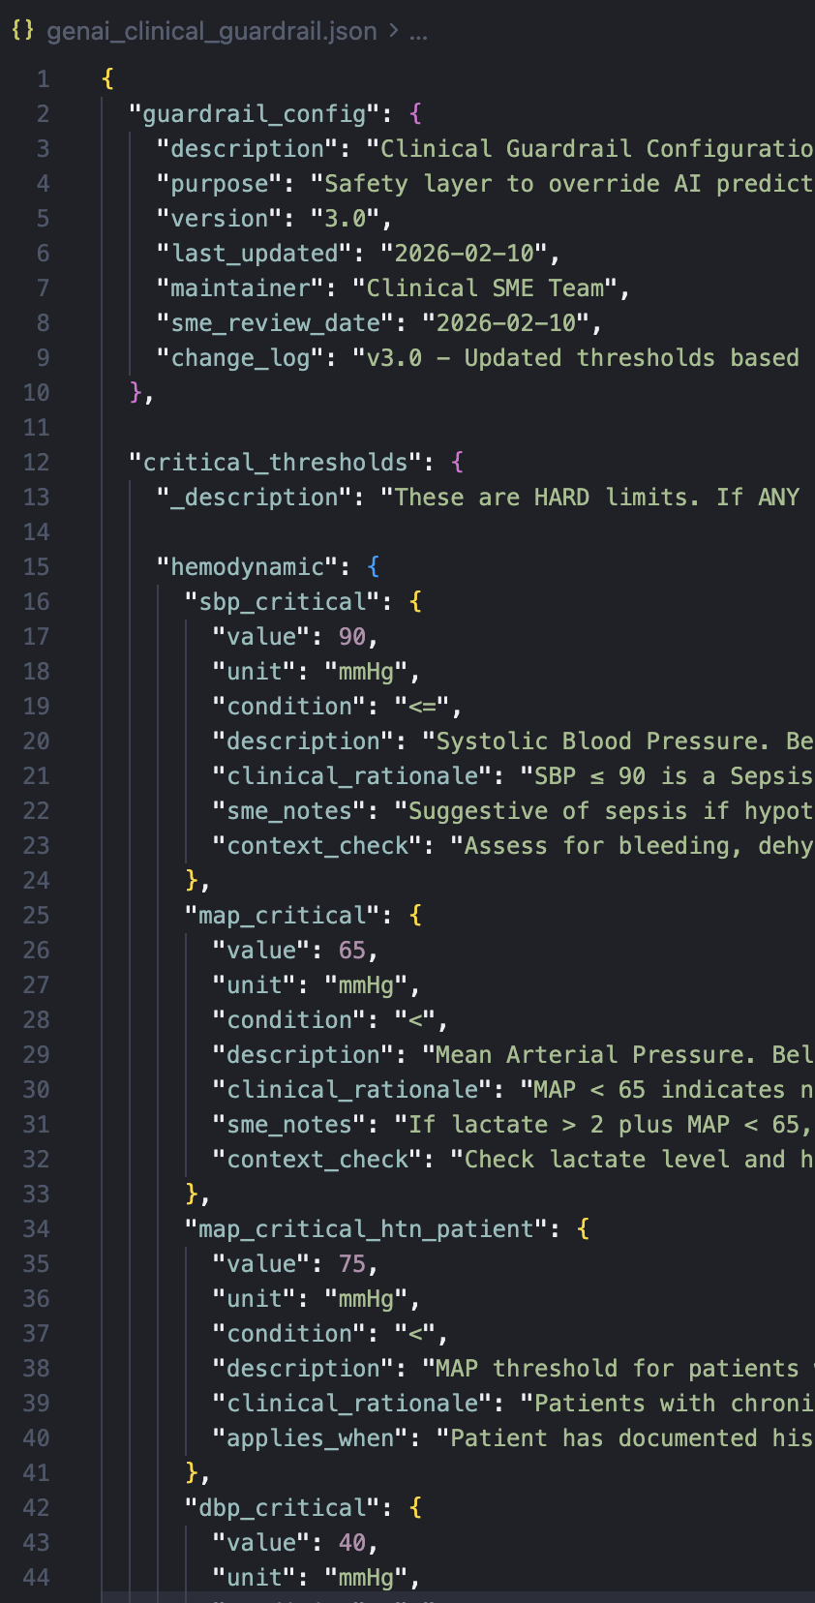
Safety, Trust & Clinical Guardrails
Deterministic Scores
AI Safety Layer
Compliance & Audit
qSOFA (0-3) — sepsis screening SIRS (0-4) — inflammatory response SOFA (0-24) — organ dysfunction Sepsis-3 criteria evaluation Calculated from raw data, not AI 100% reproducible, no hallucination
Confidence level (High/Med/Low) Confidence reasoning (why) Clinical rationale (explanation) Guardrail override when vitals contradict AI assessment Silent sepsis detection
Structured JSON audit logging No PHI in logs (names stripped) Model version tracking Every override documented CloudWatch ready Full decision audit trail
Doctor Feedback Loop (Next)
Guardrail Configuration (SME-Managed)
Capture: Doctor agrees/disagrees with AI score + actual outcome Store: MongoDB with structured feedback schema Analyze: Automated script detects calibration drift Improve: Insights embedded back into system prompt Result: System gets smarter with every doctor interaction
850+ line clinical guardrail config with rationale API endpoints for SMEs to view, update, export config Hot-reload without service restart In-memory updates for testing, persistent for production Every threshold has clinical rationale and SME notes
Guardrail in action

Slide 7
Deployment & Integration Readiness
Current Deployment (Live)
API Endpoints (Production Ready)
EKS (medbeacon-cluster) ALB with path-based routing, multi-AZ ECR image: v4.0-sonnet4-fix-throttle Swagger UI live at ALB endpoint /docs API key authenticated, CORS enabled Auto-scaling: 1-4 nodes (t3.medium)
POST /classify — Single patient risk assessment POST /classify-batch — Batch processing GET /health — Lightweight health check (ALB) GET /health/deep — Model connectivity test GET /guardrail/* — Config management for SMEs GET /audit/info — Audit system metadata
Red Rover Data for SJSA (In Progress)
Infrastructure Summary
Preprocessor handles Red Rover nested JSON format Supports time-series vitals with timestamps Clinician notes fusion from Red Rover documents API SJSA alert integration — awaiting Red Rover sandbox setup Working with Red Rover team on order/event codes
All AWS — Bedrock, EKS, ECR, CloudWatch No data leaves AWS boundary (HIPAA alignment) Docker containerized, AMD64 cross-compiled CI/CD managed via EKS Git repo: sepsis-genai (GitHub)

Slide 8
Roadmap — What's Next
Near Term
Medium Term
Long Term
SJSA alert integration via Red Rover orders API Doctor feedback capture (front-end + MongoDB) HTTPS/TLS on ALB EKS logging enablement
Prompt tuning from doctor feedback analysis
Outcome tracking (actual sepsis vs. predicted)
Model benchmarking with clinical validation study
Expand Scope as needed
Key Steps
1. Red Rover sandbox setup for SJSA data — email sent (Meeting arranged) 2. validation study on larger patients data set through RedRover

Slide 9
Thank You
Questions & Discussion
Live Demo: k8s-medbeaconalb-cf9abd09e4-682506655.us-east-1.elb.amazonaws.com/docs Contact: Prabha and Sachin

