Slide 1
Address Book Application

Slide 2
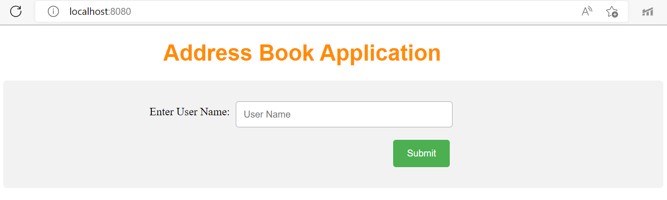
Step 1 - Enter User Name

Slide 3
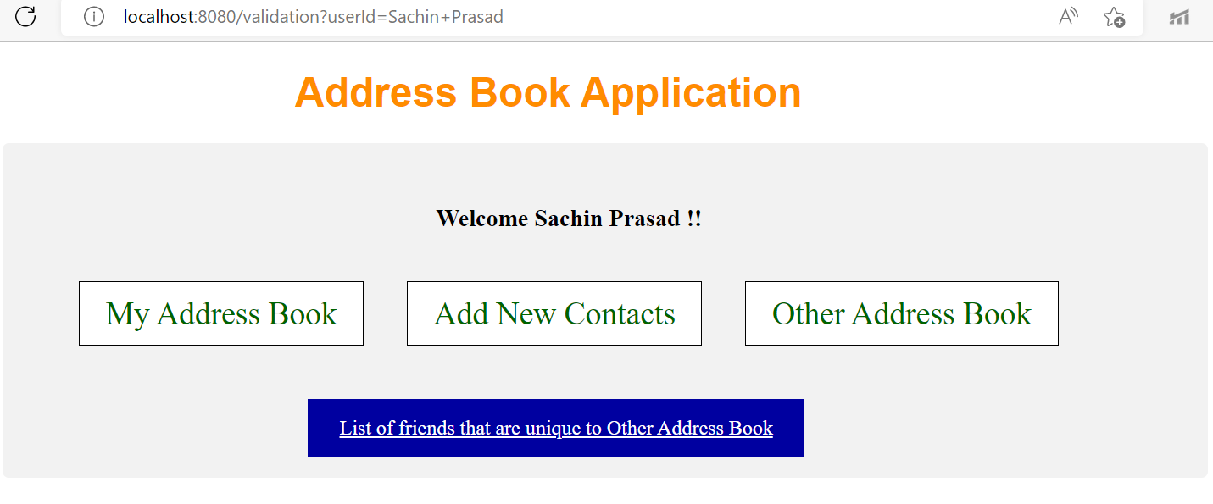
Step 2 - Welcome Page will open. Step 3 - Now Click on Add New Contacts to add new contacts to your My Address Book. OR You can also check Other Address Books contacts by clicking Other Address Books Button. OR You can also Check your Contact List By clicking My Address Book Button. OR You can check the List of Friends that are Unique to Other Address Book

Slide 4
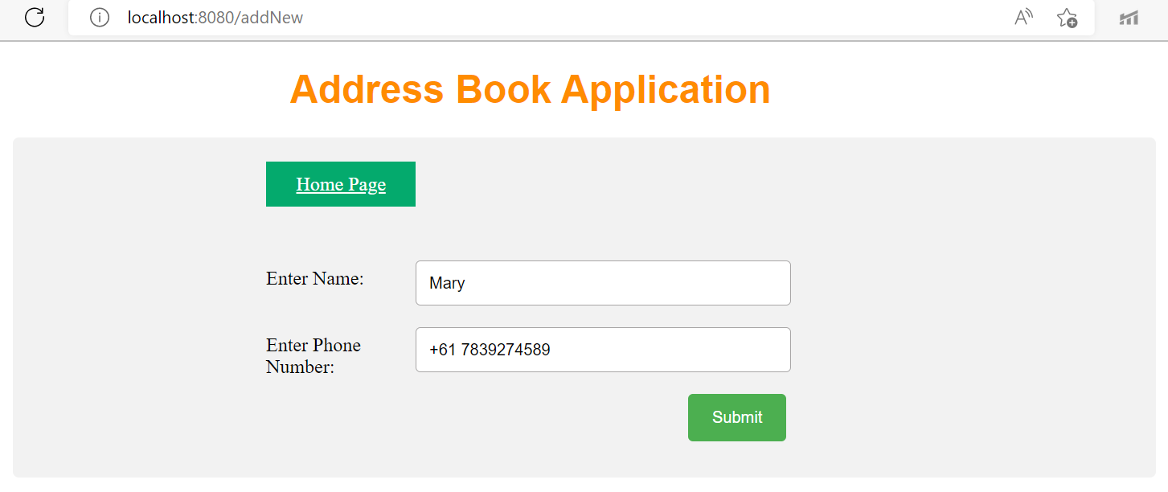
Step 4 – Enter your Contacts. You can also return to the Welcome page by clicking Home Page Button

Slide 5
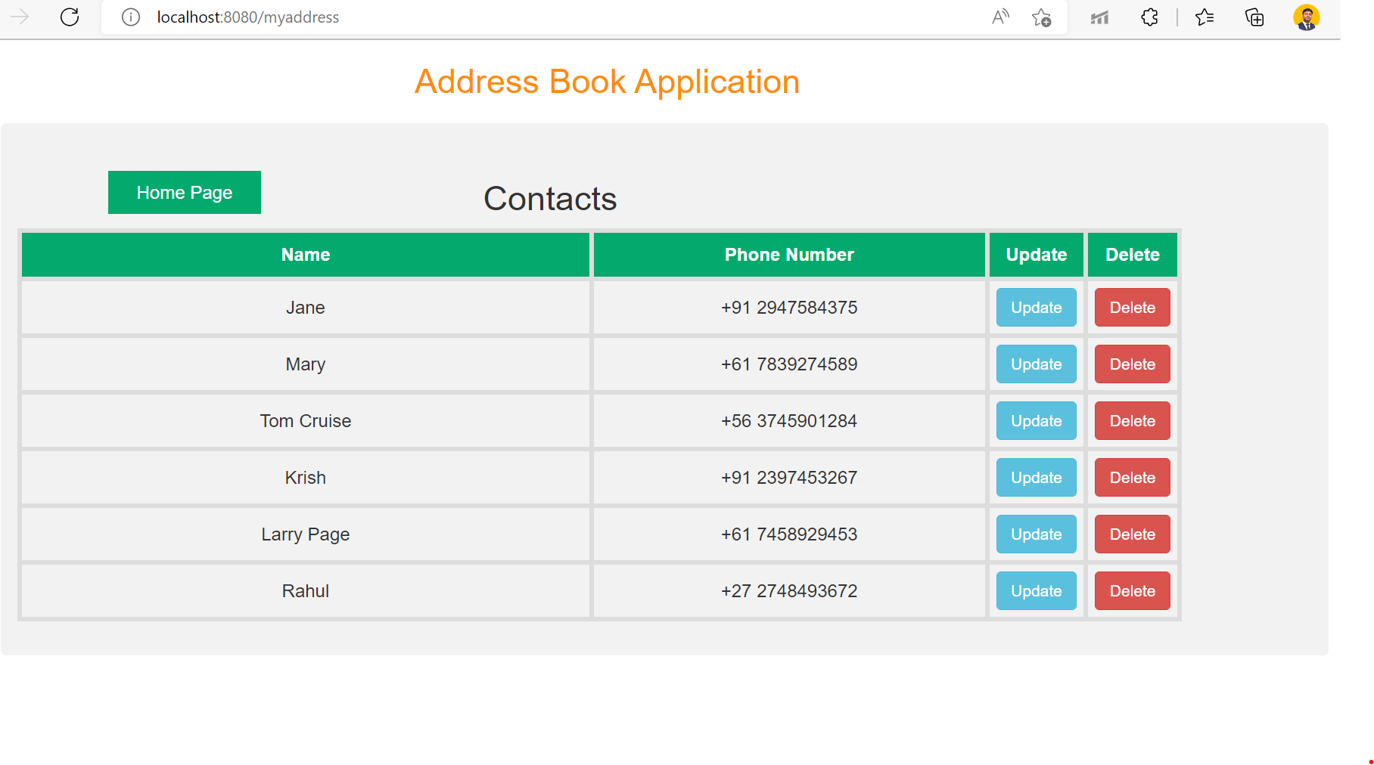
Step 5 – You can Delete or Update Your Contacts

Slide 6
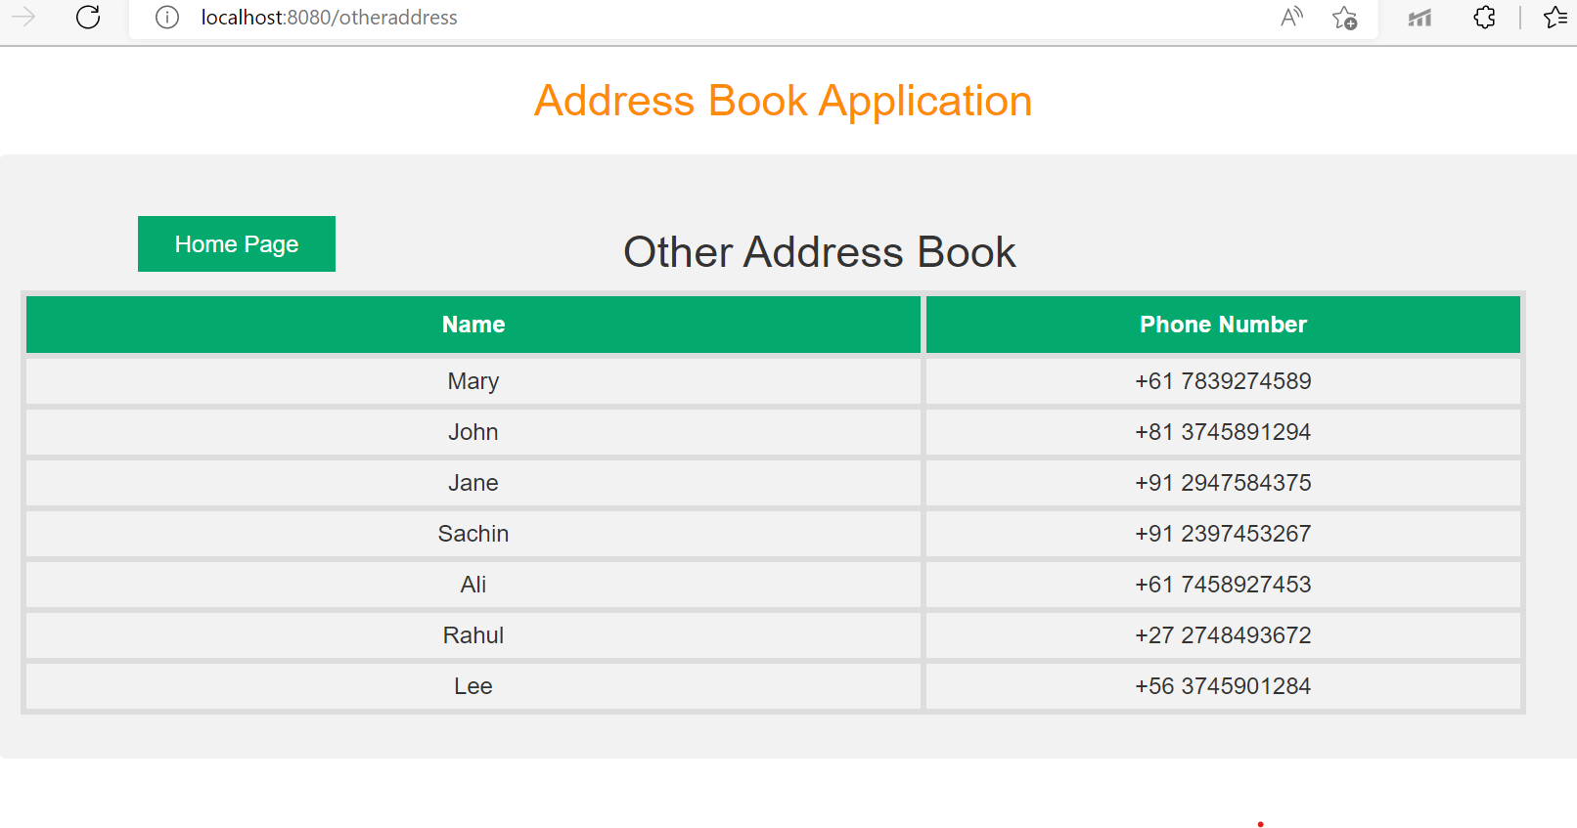
Check Contacts in Other Address Book

Slide 7
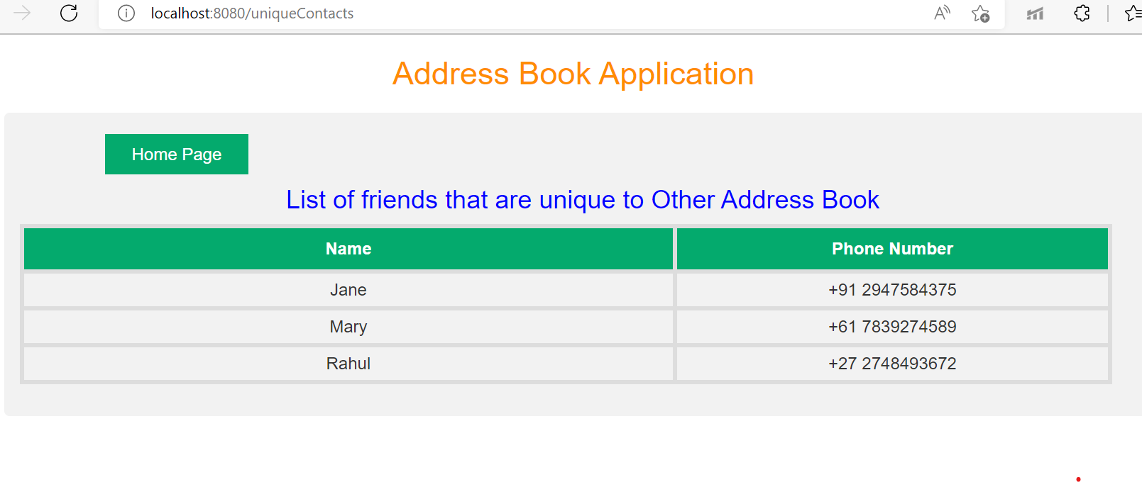
List of friends that are Unique to Other Address Book. Click on Home Page Button to return to the Welcome page.

Slide 8
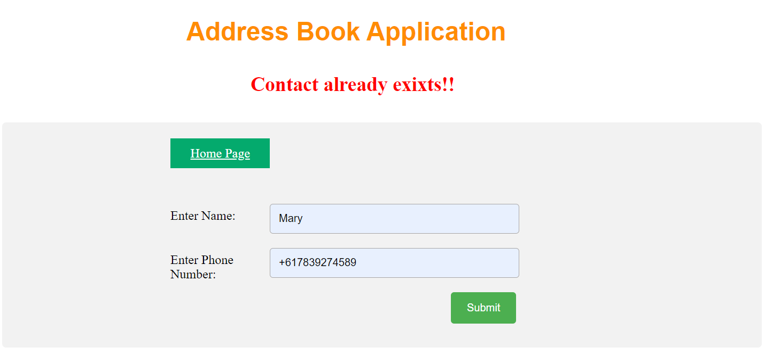
Added Exception Handler

Slide 9
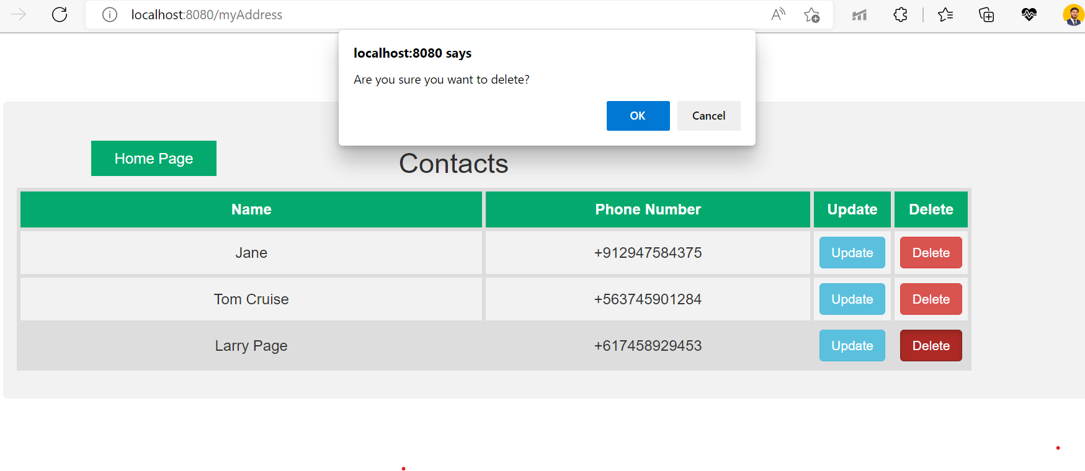
Confirmation before deleting any saved Contact

Slide 10
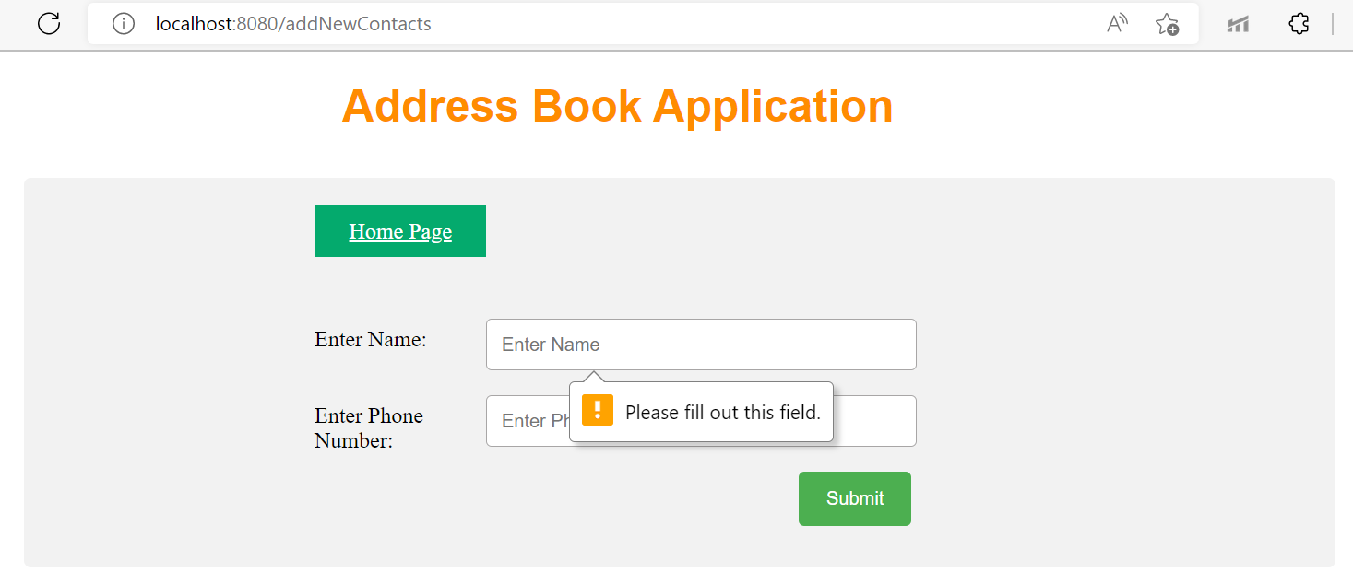
Input Validation

Slide 11
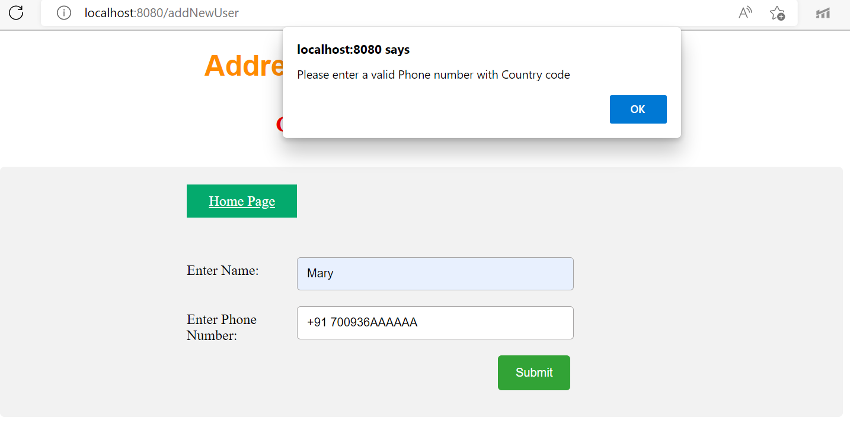
Proper Form Validation

Slide 12
Technologies & Tools used
Java 1.8, JavaScript, Spring Framework
HTML, CSS
Build tool – Maven
In memory H2 database.
Out of Scope
Application does not cover the below
User Authentication
Future scope
1.Adding database for persistent storage
2.Angular or ReactJS to create Single page Reactive Application
3.Proper Authentication

