Slide 1
curry
Sachin Reddy Y

Slide 2
Problem statement
Currently in India the food delivery platforms have been one of the successful customer service platforms and I see one problems i.e., many of the people who stays in pg’s or rented rooms prefer to cook rice and get curry from nearby curry point.
So, with this application I am trying to fill that gap by providing them in which customers can check nearby curry point outlets and their menu list.

Slide 3
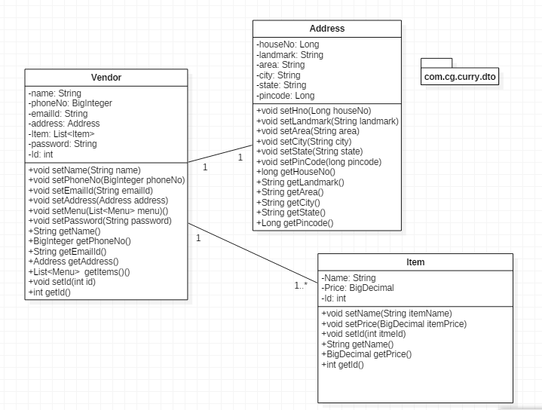
POJO Class diagram

Slide 4
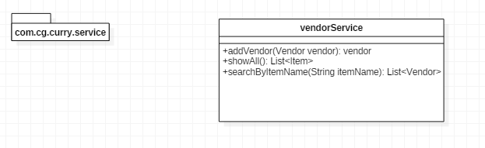
Service

Slide 5
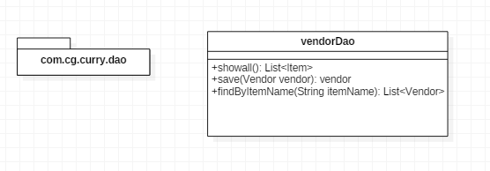
Dao interfaces

Slide 6
Thank you

