Slide 1
Sachin Saravana (2021503043)
Department of Computer Technology
Madras Institute of Technology
Anna University, Zone - IV
Final Project
3/21/2024 Annual Review

Slide 2
PROJECT TITLE
Next Word Predictor Using LSTM and Tokenization
3/21/2024 Annual Review

Slide 3


AGENDA
The project agenda encompasses several key phases aimed at developing and deploying a Next Word Prediction System powered by LSTM models and tokenization techniques. Initially, we'll embark on project initiation, defining clear objectives, scope, and deliverables, while also formulating a comprehensive project plan with milestones and timelines. Communication channels and collaboration tools will be established to facilitate seamless coordination among team members.
Following this, the project will progress to data collection and preprocessing, involving the acquisition and cleaning of large text datasets. Next, we'll design and implement the LSTM model architecture, incorporating tokenization and sequential processing to enable accurate next-word predictions. Subsequent phases will focus on model training, validation, and testing, ensuring robust performance across diverse datasets and language contexts. Finally, integration and deployment will involve optimizing the model for real-time predictions and seamless integration into user-facing applications, marking the culmination of the project agenda.
3/21/2024 Annual Review

Slide 4

PROBLEM STATEMENT
Design and implement a next word prediction system leveraging LSTM (Long Short-Term Memory) architecture and tokenization methodologies. The objective of this project is to develop a sophisticated model capable of accurately forecasting the subsequent word in a given sequence of text. This endeavor addresses the complexities of natural language processing and seeks to enrich user interactions across diverse applications, including but not limited to predictive text input, auto-complete functionalities, and language generation tasks.
The system must exhibit versatility in handling input sequences of varying lengths and be adept at providing reliable predictions grounded in learned linguistic patterns and contextual cues derived from the training data. Through meticulous training and fine-tuning, the model should acquire an understanding of language structure and semantics, enabling it to generate coherent and contextually appropriate predictions.
3/21/2024 Annual Review

Slide 5
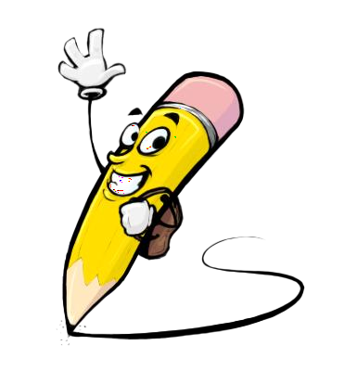
PROJECT OVERVIEW
The Next Word Prediction System is a cutting-edge natural language processing (NLP) solution designed to enhance text-based interactions through the utilization of LSTM (Long Short-Term Memory) models. Unlike conventional predictive text systems, our approach leverages deep learning techniques to accurately forecast the next word in a sequence. Users input text as a sequence of words, granting flexibility in integrating with various applications such as messaging platforms and document editors. One distinguishing feature is the option to specify the number of words the model should predict, catering to individual preferences and writing styles. By continuously learning from user feedback, the system personalizes predictions, improving accuracy and relevance over time. This not only accelerates typing but also reduces cognitive load, leading to increased productivity in tasks like writing emails or composing documents. Moreover, the system enhances user experience by providing intuitive and contextually relevant word suggestions, thereby elevating the quality of text-based interactions across digital platforms. Through scalability and adaptability, the system remains at the forefront of language processing technology, seamlessly integrating into evolving linguistic trends and user behaviors. Overall, the Next Word Prediction System represents a groundbreaking advancement in predictive text technology, empowering users to communicate more effectively and efficiently in today's digital landscape.
3/21/2024 Annual Review

Slide 6

WHO ARE THE END USERS?
General Users: Everyday individuals who engage in text-based communication through messaging apps, social media platforms, and email clients would benefit from the predictive capabilities of the system, enhancing their typing speed and accuracy.
Content Creators: Writers, bloggers, journalists, and content creators who frequently compose articles, blog posts, or other written content can streamline their writing process and improve the quality of their work by receiving contextually relevant word suggestions.
Students and Academics: Students writing essays, research papers, or taking notes can use the system to expedite the writing process and reduce errors, thereby enhancing their academic productivity and efficiency.
Professionals: Professionals across various industries, including business, law, medicine, and academia, who rely on written communication for reports, presentations, and correspondence, can benefit from the system's predictive text capabilities to improve the accuracy and clarity of their documents.
Language Learners: Individuals learning a new language can use the system to receive real-time feedback and suggestions as they practice writing in the target language, aiding in vocabulary acquisition and grammatical accuracy.
Accessibility Users: Individuals with disabilities or conditions that affect typing speed or accuracy, such as motor impairments or dyslexia, can leverage the predictive text system to improve their ability to communicate effectively through written text.
Developers and Integrators: Software developers and application integrators can incorporate the next word prediction system into their products, enhancing the user experience and functionality of their text-based applications, such as virtual keyboards, writing assistants, or chatbots.
3/21/2024 Annual Review

Slide 7

YOUR SOLUTION AND ITS VALUE PROPOSITION
Solution:
The Next Word Prediction System offers unparalleled value by revolutionizing text-based interactions through advanced natural language processing capabilities. By leveraging LSTM models and sequence-based input, the system accurately anticipates the next word in a given text sequence, enhancing typing speed, accuracy, and overall productivity for users. Whether composing emails, writing documents, or engaging in real-time conversations, users can rely on the system's contextually relevant word suggestions to streamline their writing process and elevate the quality of their communication. Furthermore, the system's adaptability and scalability ensure continuous improvement over time, catering to evolving linguistic trends and user preferences. With its ability to seamlessly integrate into existing applications and workflows, the Next Word Prediction System empowers users to communicate more effectively and efficiently in today's digital landscape.
3/21/2024 Annual Review

Slide 8
YOUR SOLUTION AND ITS VALUE PROPOSITION
Value Proposition:
The Next Word Prediction System presents a compelling proposition for individuals, businesses, and developers alike seeking to enhance text-based interactions and workflows. By offering a customizable and intuitive solution powered by state-of-the-art LSTM models, the system provides a competitive edge in improving typing speed, accuracy, and user experience across various applications and platforms. Whether deployed as a standalone application or integrated into existing software, the system offers a versatile solution for a wide range of end users, including general consumers, content creators, professionals, and individuals with accessibility needs. With its emphasis on continuous learning and adaptation, the Next Word Prediction System represents not just a tool for efficiency but a cornerstone of innovation in natural language processing technology.
3/21/2024 Annual Review

Slide 9

THE WOW IN YOUR SOLUTION
The "WOW" factor in the solution lies in its ability to seamlessly predict the next word in a text sequence with remarkable accuracy and contextuality. By harnessing the power of LSTM models and sequence-based input, the system goes beyond traditional predictive text solutions, offering users an intuitive and personalized writing experience. The system's adaptability to individual writing styles and preferences, coupled with its continuous learning capabilities, ensures that predictions are not only fast but also highly relevant, elevating the overall user experience to new heights.
3/21/2024 Annual Review

Slide 10
MODELLING
Keras and TensorFlow Integration: The project utilizes Keras, a high-level neural networks API, which is seamlessly integrated with TensorFlow, an open-source deep learning framework. This combination provides a powerful and flexible platform for building and training deep learning models.
LSTM Architecture: The core of the model architecture is built using LSTM (Long Short-Term Memory) units. LSTM networks are well-suited for sequential data modeling due to their ability to capture long-term dependencies and remember information over extended time intervals, making them ideal for next word prediction tasks.
Sequential Model: The model is structured as a sequential neural network, allowing for a straightforward layer-by-layer construction. This sequential design facilitates the flow of data through the network, making it intuitive to define and train complex architectures.
Tokenizer: Text data is preprocessed using a Tokenizer, a utility provided by Keras, which converts input text into sequences of numerical tokens. Each token represents a unique word in the vocabulary, enabling the model to process textual data efficiently.
3/21/2024 Annual Review

Slide 11
MODELLING
Embedding Layer: The Tokenizer output sequences are passed through an Embedding layer, which converts the tokenized input into dense vector representations. These embeddings capture semantic relationships between words in the input text and serve as the input to the LSTM layers.
LSTM Layers: Multiple LSTM layers are stacked on top of the embedding layer to form the core of the model. These LSTM layers learn to extract and capture meaningful patterns and dependencies from the input sequences, enabling the model to make accurate predictions about the next word in the sequence.
Output Layer: The final output layer of the model consists of a dense layer with softmax activation, which generates a probability distribution over the vocabulary of possible next words. The word with the highest probability is selected as the predicted next word.
Training and Optimization: The model is trained using backpropagation and gradient descent optimization algorithms, such as Adam optimizer. During training, the model adjusts its parameters to minimize the difference between predicted and actual next words, optimizing its performance over time.

Slide 12
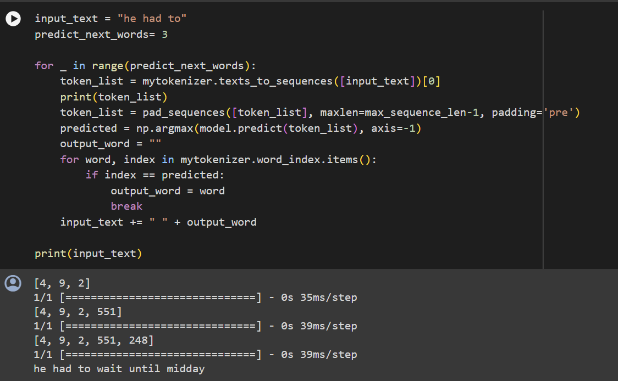
RESULTS
3/21/2024 Annual Review

Slide 13
Thank you!

