Slide 1
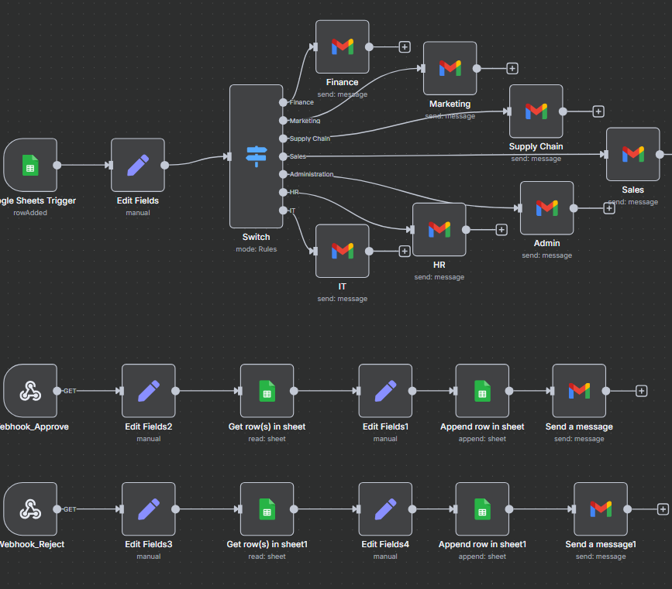


AI-Enabled Leave Request & Approval Automation
SACHIN SAVKARE

Slide 2




Introduction
Manual leave requests were slow and error-prone. This project automates the process end-to-end using Google Forms, Sheets, and n8n, making it fast, accurate, and hands-free.
Leave approvals became faster, error-free, and fully trackable. No manual follow-ups—everything updates and notifies automatically.
Benefits After Automation
Department managers save time with one-click approvals. HR and employees get real-time updates with zero manual coordination.
Who Benefits from the Automation?

Slide 3
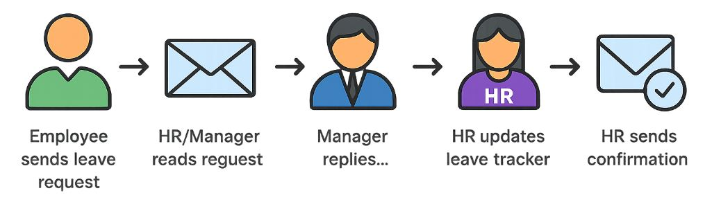
Manual Leave Approval Process
Employee manually sends leave details via email or message (Name, Dates, Reason).
HR/Manager reads the email and notes the request.
Manager replies with approval/rejection manually.
HR updates a leave tracker (e.g., Excel or Google Sheet) by copying the data manually.
HR sends final confirmation email to the employee.
Status tracking is inconsistent and error-prone, with no automatic logs.

Slide 4
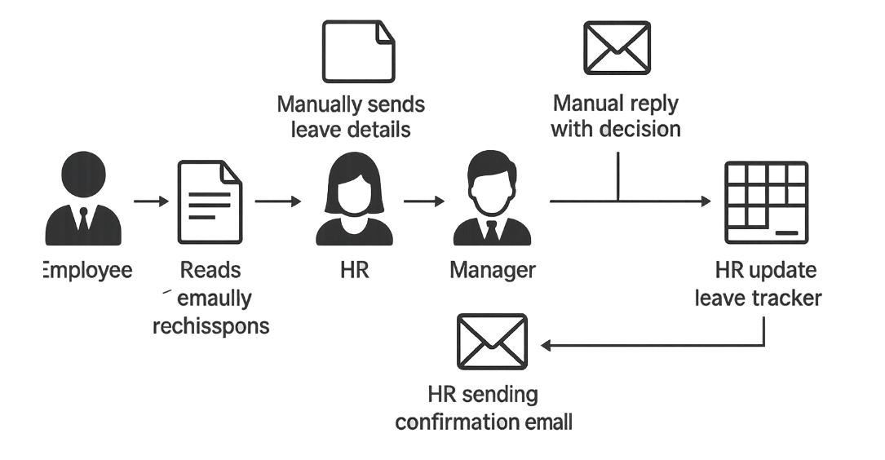
Problems in Manual Leave Process
Delayed approvals due to manual follow-ups
No standardized request method (email/chat)
HR had to update sheets manually
Repeated back-and-forth between employee, manager, and HR
No centralized dashboard for real-time tracking

Slide 5
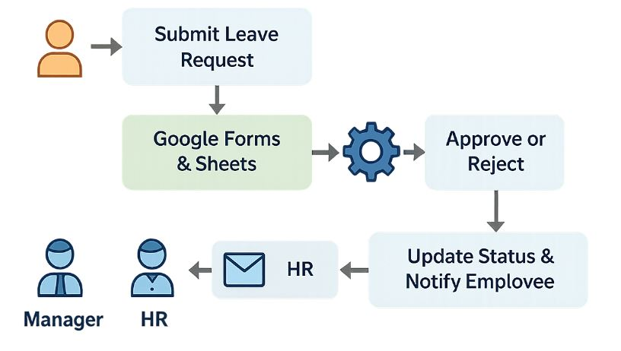
Automation Workflow
Employee submits a Google Form
Google Sheet auto-captures form response
n8n detects a new row added (via Trigger or Polling)
Set Node formats data
Data is appended to the Leave Tracker Sheet
n8n sends an email to the respective Department Manager
Manager clicks on a decision link (via Webhook URL)
n8n updates the request status in Leave Tracker
Final email is sent to Employee

Slide 6

Thank you
Sachin savkare
sachinsavkare08@gmail.com

