Slide 1
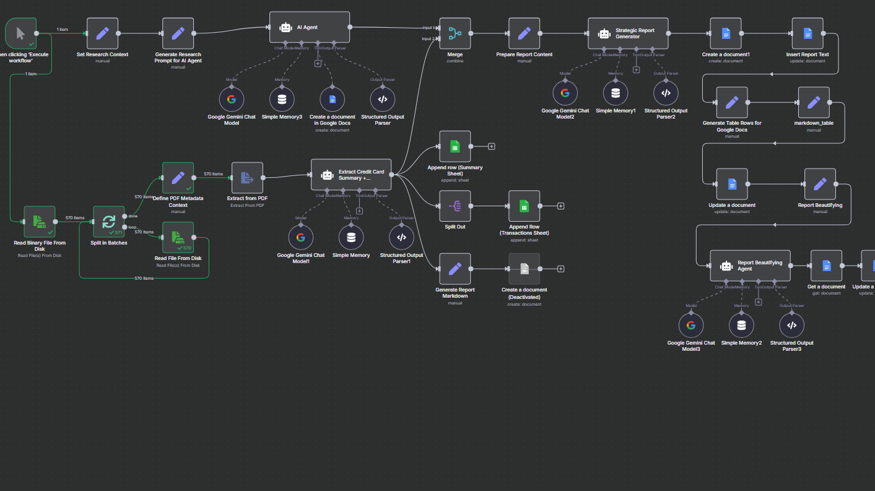

Optimizing Corporate Credit Card Usage with AI & Automation | n8n
SaCHIN SAVKARE

Slide 2

Project Introduction
In today’s fast-paced business world, companies face growing complexity in managing corporate credit card expenses.
BizPro Solutions — a business consulting firm — faced rising costs due to:
Inefficient card usage
Missed rewards
Unnecessary late fees
To solve this, we built an end-to-end AI-powered automation system using n8n and Google Gemini that:
Extracts & analyzes credit card statements
Identifies spending patterns
Recommends better card usage
Provides real-time insights to the finance team
This project bridges the gap between manual finance workflows and smart automation, unlocking new ways to save money and improve employee behavior.

Slide 3
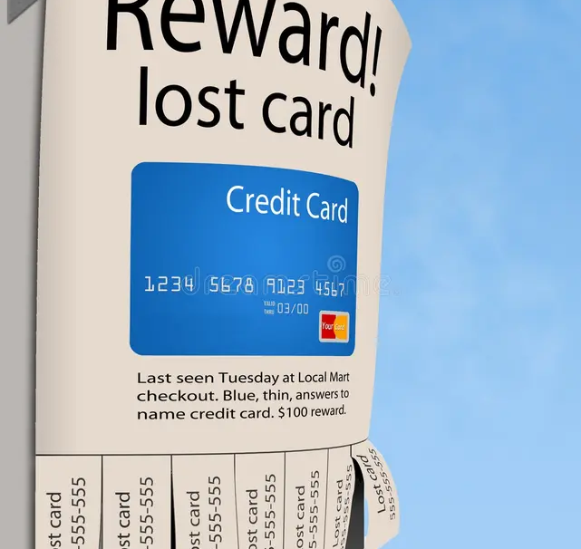
The Business Challenge
.
The Cost of Unoptimized Credit Card Usage
BizPro Solutions issued multiple credit cards to employees for travel, dining, office expenses, and more. However, they faced growing challenges:
Employees used the wrong cards for the wrong categories
Late payments led to recurring penalties
Rewards were underutilized — money left on the table
Annual fees stacked up unnecessarily
No visibility into individual or team-level spending patterns
These inefficiencies led to:
Unnecessary financial losses
Manual statement reviews every month
No real-time insight or accountability
That’s when the CFO stepped in and assigned Peter Pandey, a business automation specialist, to automate the credit card analysis and uncover optimization opportunities

Slide 4

What Were We Trying to Achieve?
The CFO’s goal was simple: “Optimize corporate credit card usage and eliminate financial leakage.”
To achieve this, the automation project had the following requirements:
Input:
Credit card statements in PDF format
Multiple cards from different banks (Axis, HDFC, ICICI, etc.)
Tasks to Automate:
Extract structured data from PDFs
Categorize transactions by spending type (Travel, Dining, etc.)
Identify annual fees, late charges, and reward points
Analyse card usage and recommend better alternatives
Build a system that works every month automatically
Output all findings to Google Sheets and Docs for reporting
Goals:
Maximize reward utilization
Minimize late and annual fees
Recommend card usage strategies
Improve employee spending behaviour
Save finance team hours of manual work every month

Slide 5

Manual vs Automated Workflow
Before Automation (Manual Process):
Finance team manually opened each PDF
Extracted transaction data into Excel
Categorized expenses by guessing merchant names
Missed important details like late fees or unused rewards
Took 6–8 hours per employee per month
High chance of errors and missed optimization
After Automation (n8n + AI):
PDFs processed automatically via n8n workflow
Extracted and structured into clean JSON/CSV
Categorization done using AI & NLP
Reward tracking, fee identification, and recommendations included
Data auto-pushed to Google Sheets & Docs
Takes less than 1 minute per statement
Consistent, scalable, and error-free

Slide 6


Comparing Contoso to the competition
Contoso empowers businesses to communicate efficiently with technology that’s simple and easy to use.
The competition also offers similar technology, but their tools aren't user friendly.

Slide 7
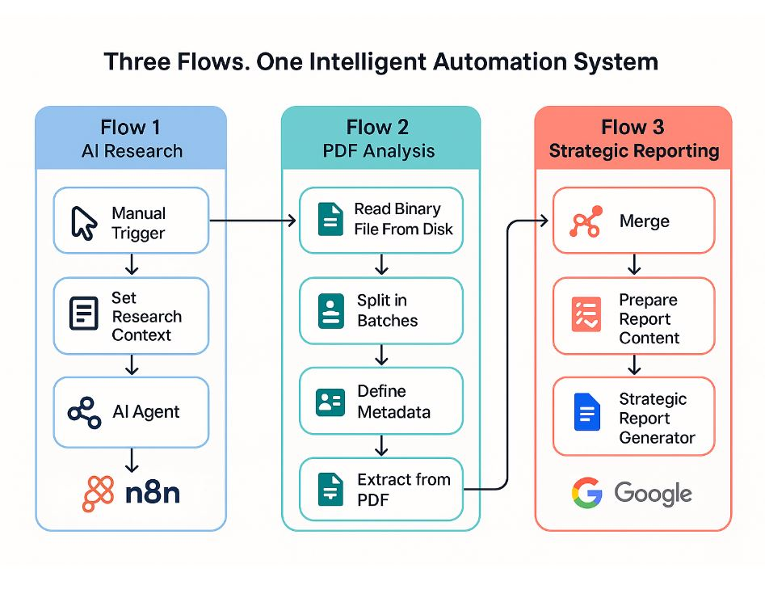
Flow 1: AI Research (External Credit Card Strategy)
Manual Trigger
Set Research Context
Prompt
AI Agent (Gemini)
Flow 2: PDF Analysis (Internal Card Usage)
Read Binary File From
Split in Batches
Read File From Disk
Define Metadata
Extract from PDF
AI Agent
Flow 3: Strategic Reporting (Final Output)
Merge
Prepare Report Content
Strategic Report Generator
Create Document

Slide 8

What Did Automation Change for BizPro?
Time Saved
Reduced processing time from 8 hours to <1 minute per statement
No more manual copying, categorizing, or formatting
Employee Behaviour Insights
Flagged risky spend patterns
Showed which employees missed due dates or used wrong cards
Smart Reporting
Auto-generated Google Docs reports per employee
Company-wide summary for CFO with actionable insights
Scalability
Easily handles 25+ PDFs at once
Can run monthly without additional setup
A one-time setup created a long-term finance optimization engine.

Slide 9

Thank you
SACHIN SAVKARE​
sachinsavkare08@gmail.com

