Slide 1
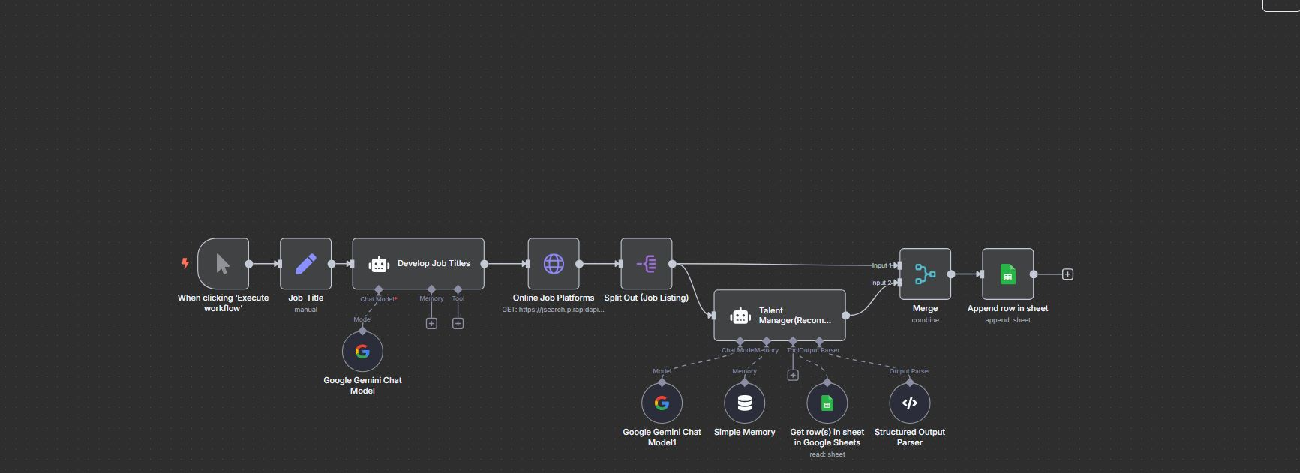
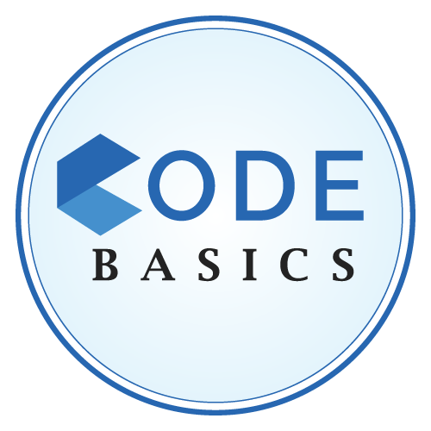
Smart Job Scraping Automation using AI & n8n
Sachin Savkare

Slide 2
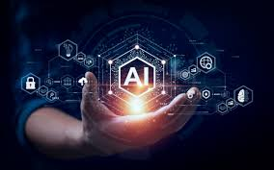

Project Importance
Frequent job postings are missed due to inconsistent checks.
Manual job hunting is time-consuming and inefficient.
AI can intelligently extract relevant skills and match with personal project experience.
Automation ensures:
Consistency (runs daily/weekly)
Smart Matching (AI insights on job fit)
Tracking (organized Google Sheets record)

Slide 3
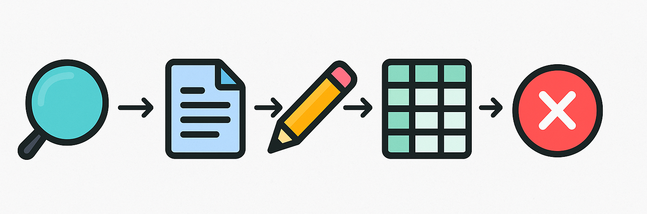
Manual Job Search Process
Job Hunting on Multiple Platforms
Visiting sites like LinkedIn, Indeed, Naukri manually.
Searching with Limited Keywords
Often missing out on related roles like BI Analyst, Product Analyst, etc.
Reading Each Job Description
Time-consuming to analyze relevance and skills.
Copy-Pasting into Spreadsheets
Manual tracking of job links, titles, and company names.
No AI Insights
No personalized recommendations or ATS optimization.

Slide 4


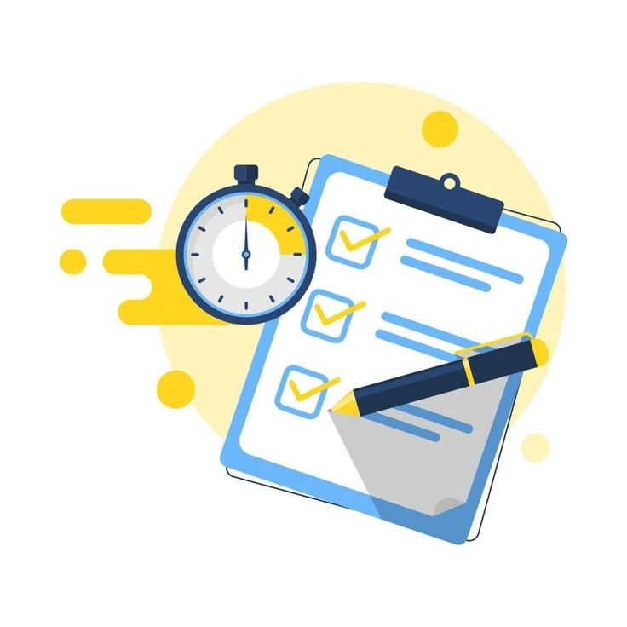
Why Automate the Job Search?
🔁 Consistency Automates job search daily/weekly without missing opportunities.
🤖 AI-Driven Search Terms Generates broader, more intelligent job titles beyond basic keywords.
🧠 Smart JD Analysis Extracts relevant skills & ATS keywords automatically.
🗂️ Organized Tracking Saves structured job data directly to Google Sheets.
🎯 Personalized Recommendations Suggests job fit based on your project portfolio.
🕒 Saves Time & Effort No more manual hunting, reading, or copying.

Slide 5
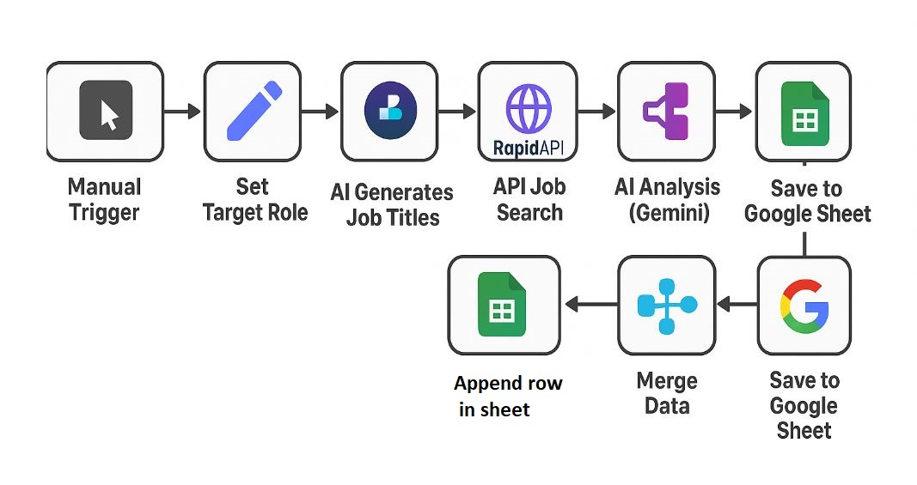
Step-by-Step Automation Flow
.

Slide 6
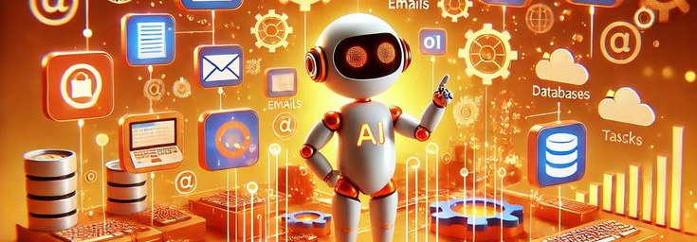
Thank You
Sachin Savkare
sachinsavkare08@gmail.com

