Slide 1


AI BASED CANDIDATES RECOMMENDING SYSTEM FOR A COMPANY VACANCY
InsightHire
Group ID : R25-040

Slide 2
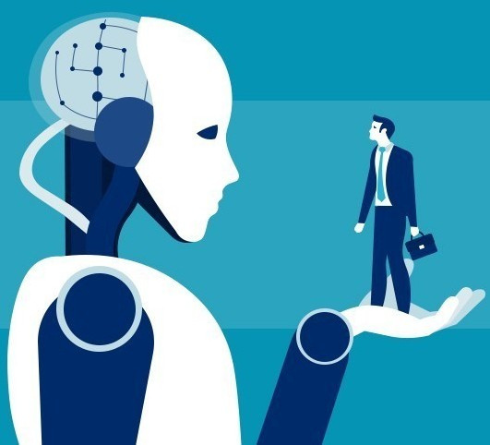
INTRODUCTION
Finding the right candidate today goes beyond resumes. Traditional hiring methods often miss crucial soft skills like confidence, stress management, decision-making, engagement, presentation skills and hand behaviors—key factors for job success. To ensure a more efficient, unbiased, and effective hiring process, innovative solutions are essential in identifying candidates who truly fit organizational needs and culture.
02

Slide 3






OUR TEAM
Prof. Samantha Thelijjagoda
Supervisor
Ms. Poorna Panduwawala
Co-supervisor
Prof. Nishantha Giguruwa
External-supervisor
Teamwork is the Key
De Silva R.S.K
Team Member
K.T.A.D.K Kasthurirathna
Team Member
S.U.D.A Gunasekara
Team Member
B.D.A.M Kumara
Team Member
03

Slide 4

RESEARCH PROBLEM
How can we go beyond the traditional method of candidate selection for a company vacancy, which often fail to assess critical soft skills?
The limitation results in mismatches between job roles and candidates, leading to increased turnover rates and inefficiencies in the hiring process.
04

Slide 5

To implement intelligent algorithms that provide personalized job-candidate matching based on a comprehensive skill assessment.
Detection of confident level by voice tone
Detection of stress by facial expressions
Detection of decision making skill by text analysis and eye engagement
Detection of presentation skills by gestures with hands
RESEARCH OBJECTIVES
05

Slide 6
system overview diagram
06

Slide 7
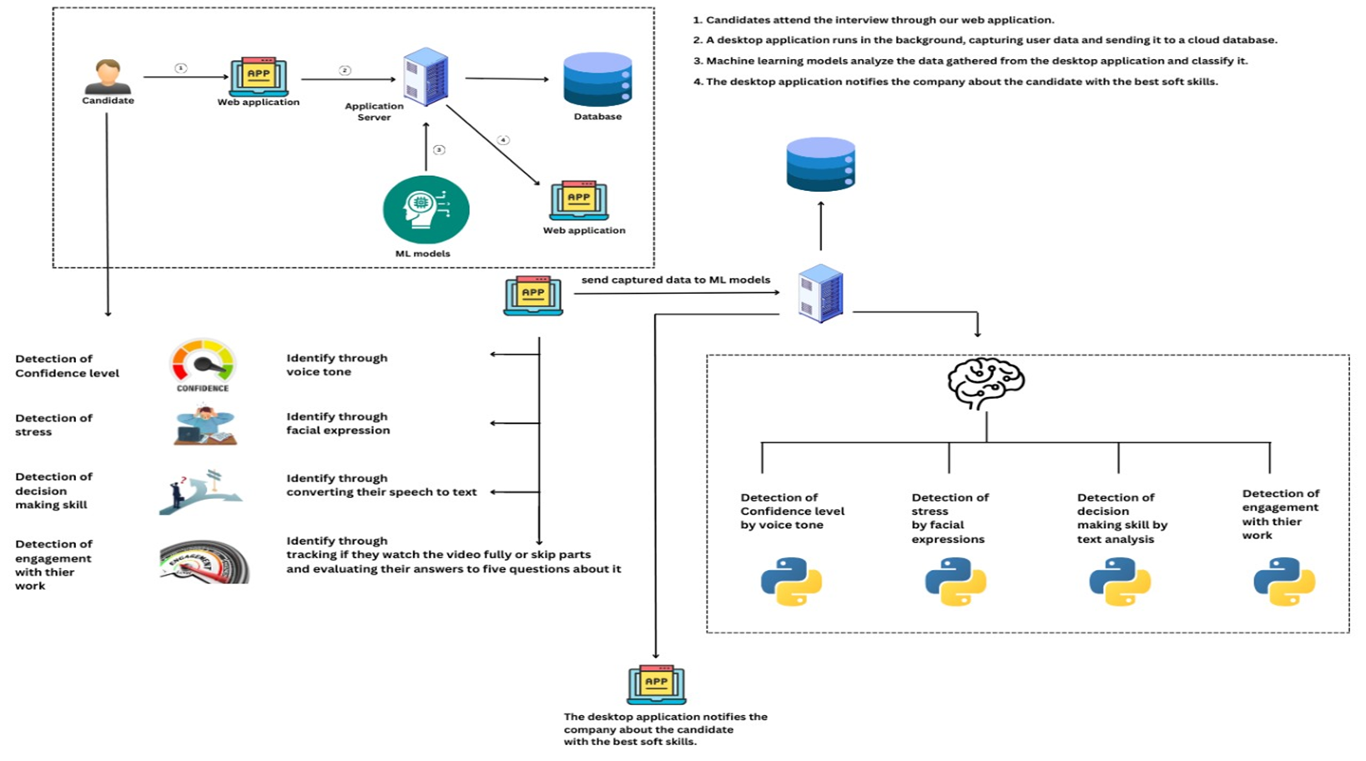
DETECTION OF CANDIDATE CONFIDANCE LEVEL USING VOICE TONE
DETECTION OF CANDIDATE STRESS LEVEL USING FAIAL EXPRESSIONS
PREDICT THE DECISION MAKING SKILL BY TEXT ANALYSIS AND ENGAGEMENT USING EYE ENGAGEMENT
PREDICT HAND GESTURES IN REAL TIME, MEASURING THEIR IMPACT ON PRESENTATION QUALITY AND ENGAGEMENT LEVELS
07

Slide 8
IT21834424 | DE SILVA R.S.K
COMPONENT 01: Predict the Confident
level through speech & tone analysis
BACHELOR OF SCIENCE (HONS) IN INFORMATION TECHNOLOGY
SPECIALIZING IN INFORMATION TECHNOLOGY
IT21834424 | DE SILVA R.S.K | R25-040
08

Slide 9
Why is it important to objectively assess a candidate’s confident level during the hiring process?
How can speech and tone analysis improve the accuracy and fairness of candidate evaluations compared to traditional interview methods?
BACKGROUND
IT21834424 | DE SILVA R.S.K | R25-040
09

Slide 10

How can speech and tone analysis be effectively utilized to predict a candidate's confidence level during an interview?
RESEARCH QUESTION
IT21834424 | DE SILVA R.S.K | R25-040
10

Slide 11


RESEARCH GAP
= ADDRESSED BY THE RESEARCH PAPER
= NOT ADDRESSED BY THE RESEARCH PAPER
ASPECT | RESEARCH [01] | RESEARCH [02] | RESEARCH [03] | RESEARCH [04] | PROPOSED
Confident level prediction
Real-time speech analysis
Acoustic feature extraction
Integration with recruitment systems
Speech emotion recognition
IT21834424 | DE SILVA R.S.K | R25-040
11

Slide 12
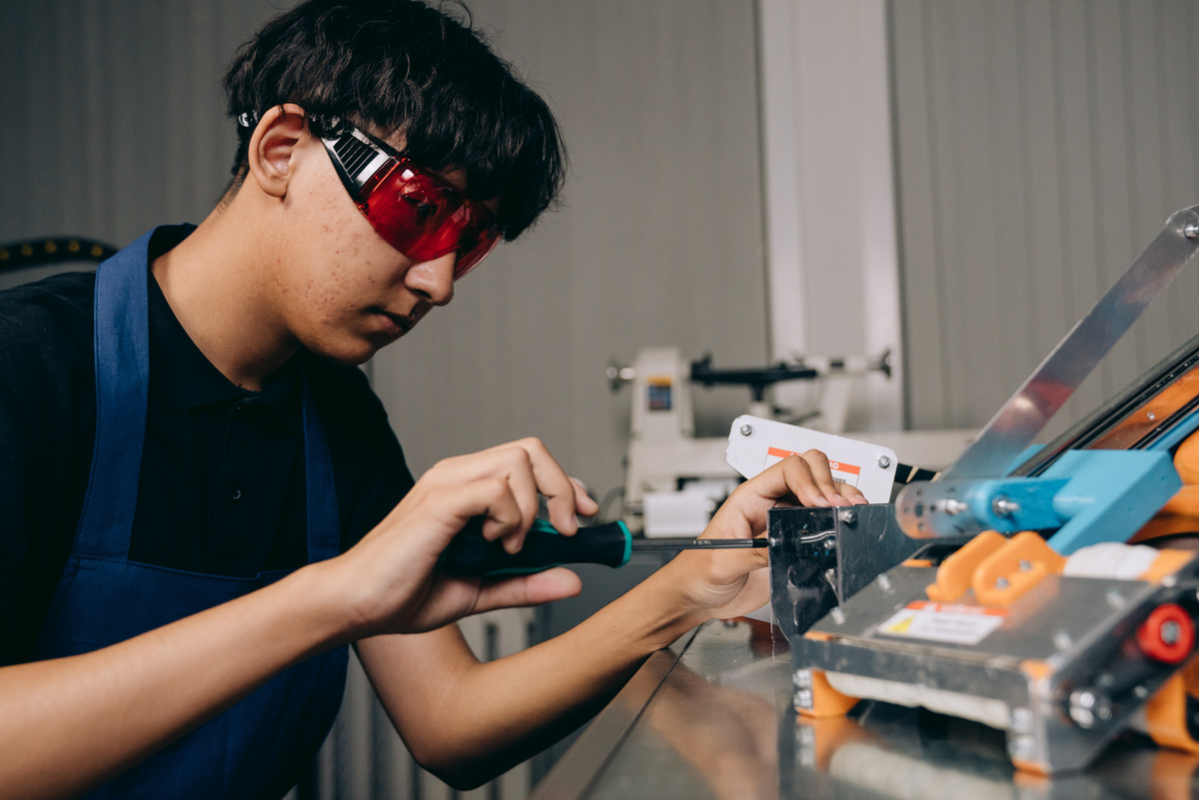
SPECIFIC OBJECTIVE
DEVELOP AN AI-DRIVEN SYSTEM THAT PREDICTS A CANDIDATE'S CONFIDENCE LEVEL THROUGH SPEECH AND TONE ANALYSIS DURING INTERVIEWS.
OBJECTIVES
Sub Objectives
Identify key acoustic features that indicate confidence.
Develop machine learning models to analyze speech data and classify confidence levels.
IT21834424 | DE SILVA R.S.K | R25-040
12

Slide 13
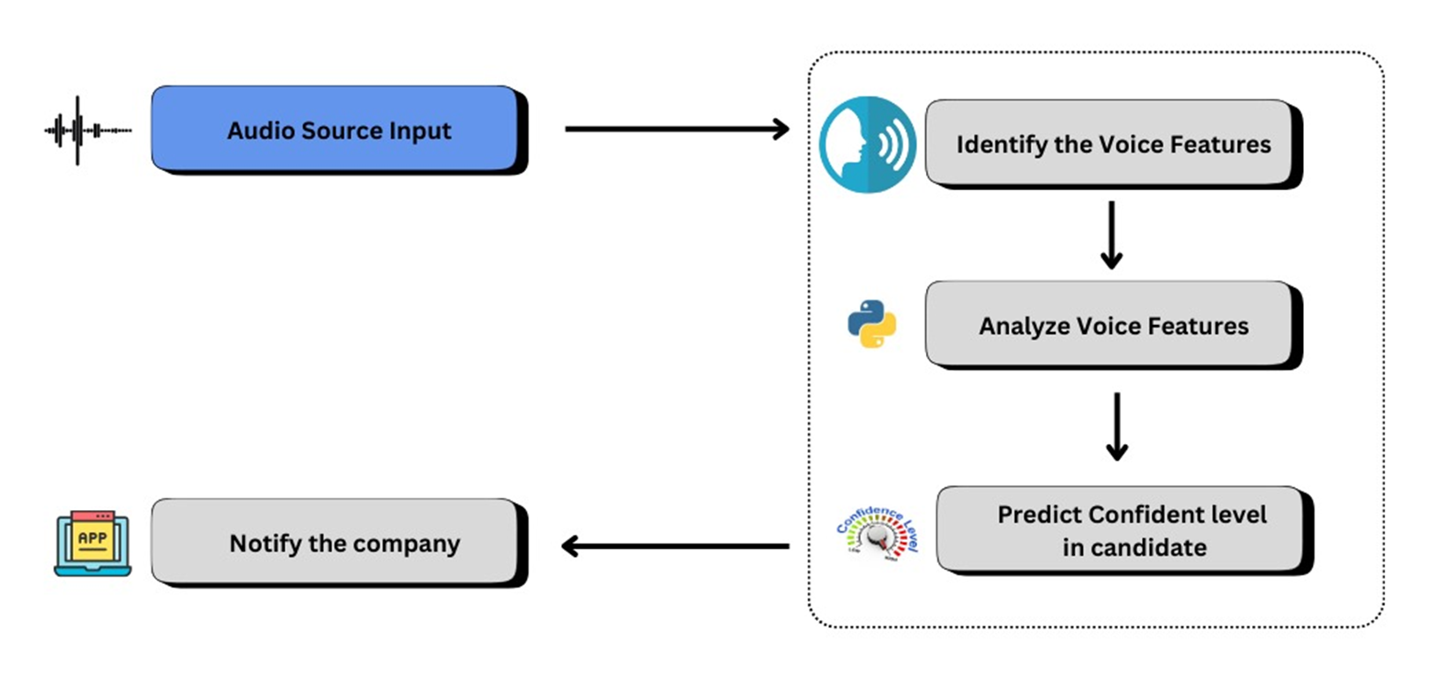
SYSTEM DIAGRAM
IT21834424 | DE SILVA R.S.K | R25-040
13

Slide 14
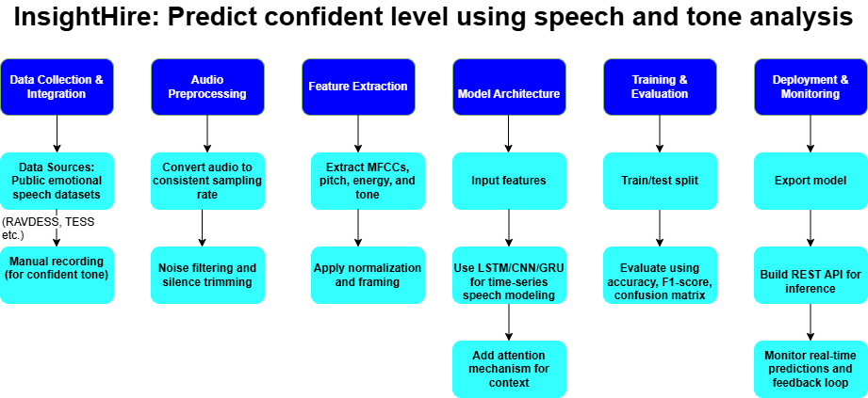
METHODOLOGY
IT21834424 | DE SILVA R.S.K | R25-040
14

Slide 15
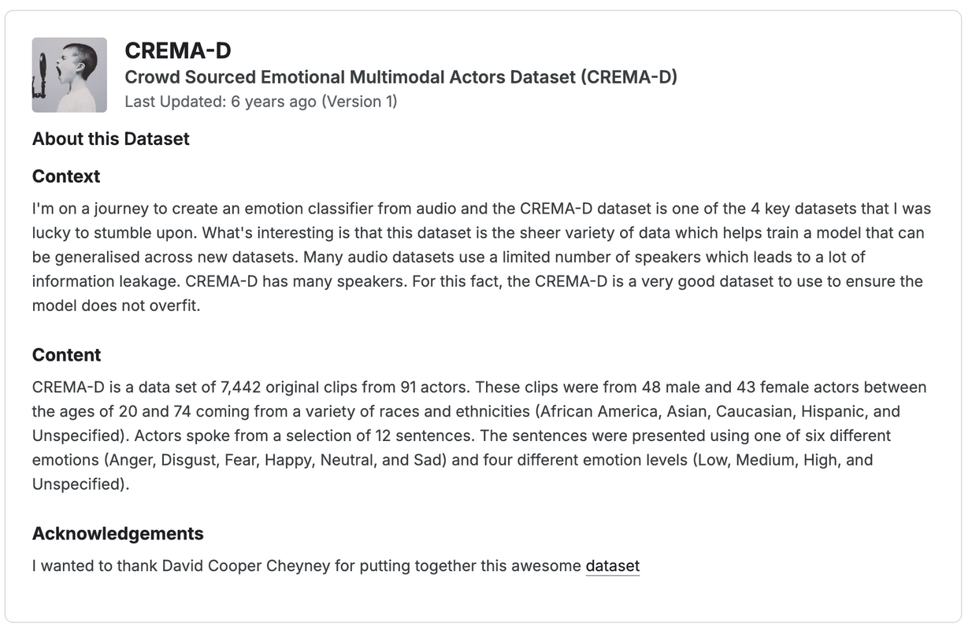
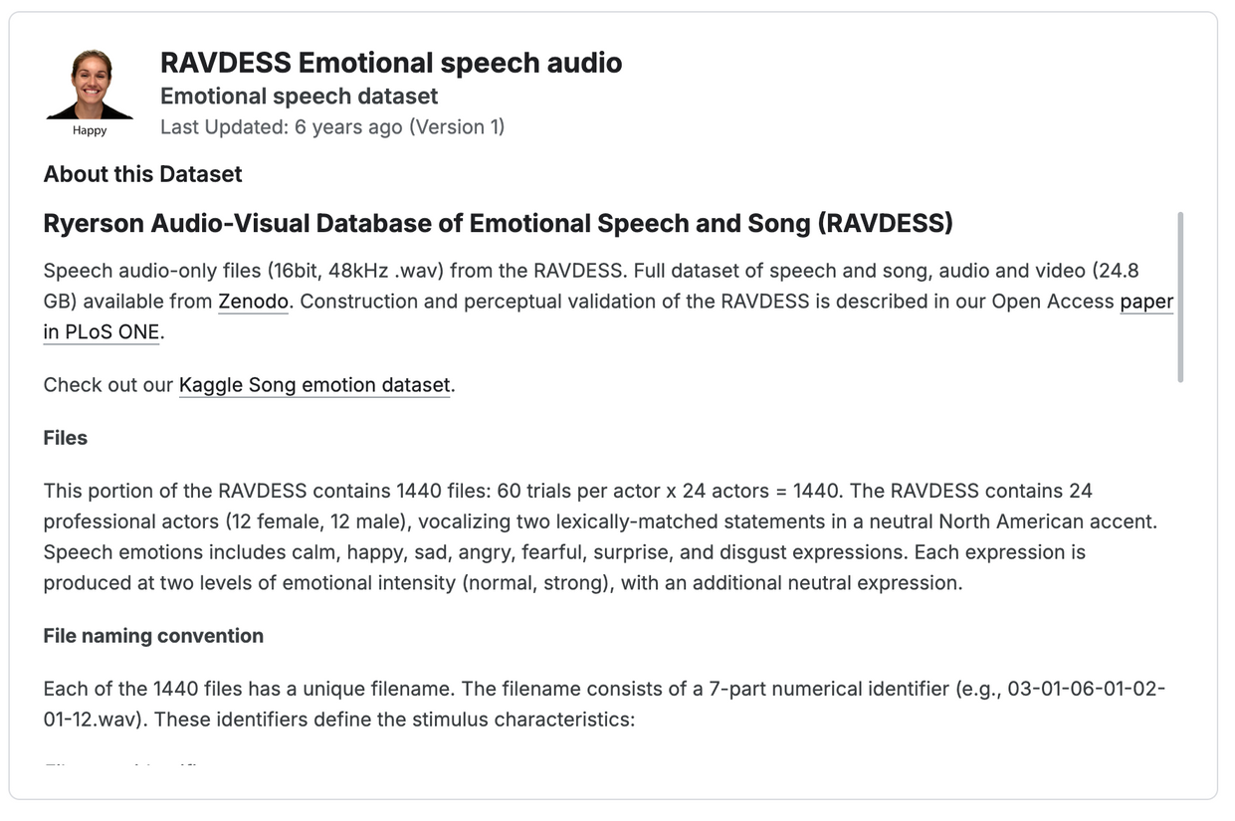
Dataset
IT21834424 | DE SILVA R.S.K | R25-040
15

Slide 16
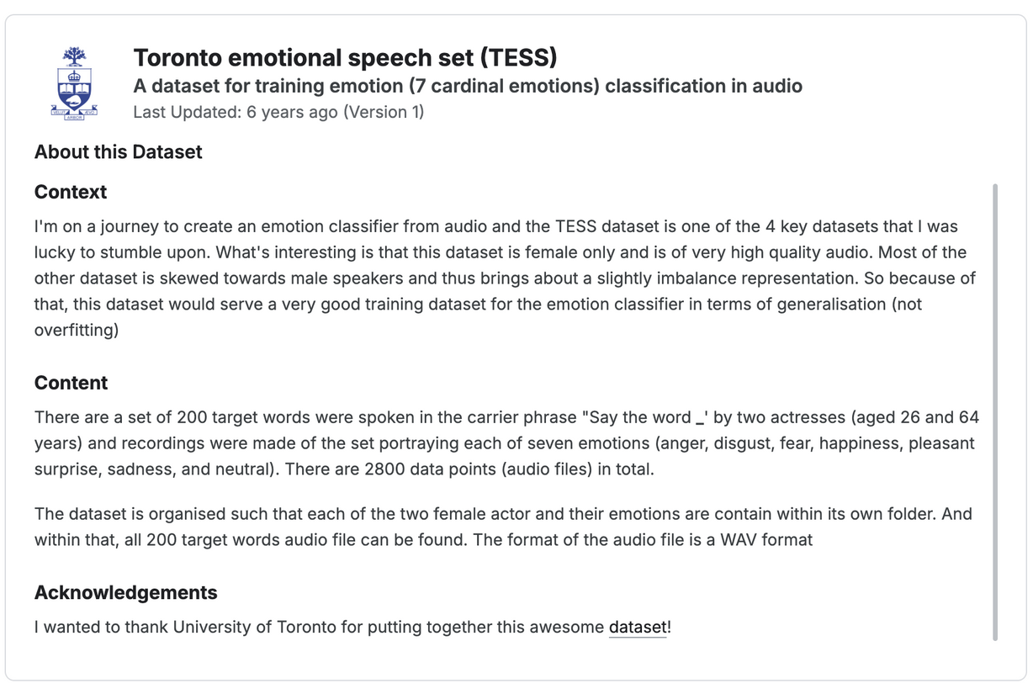
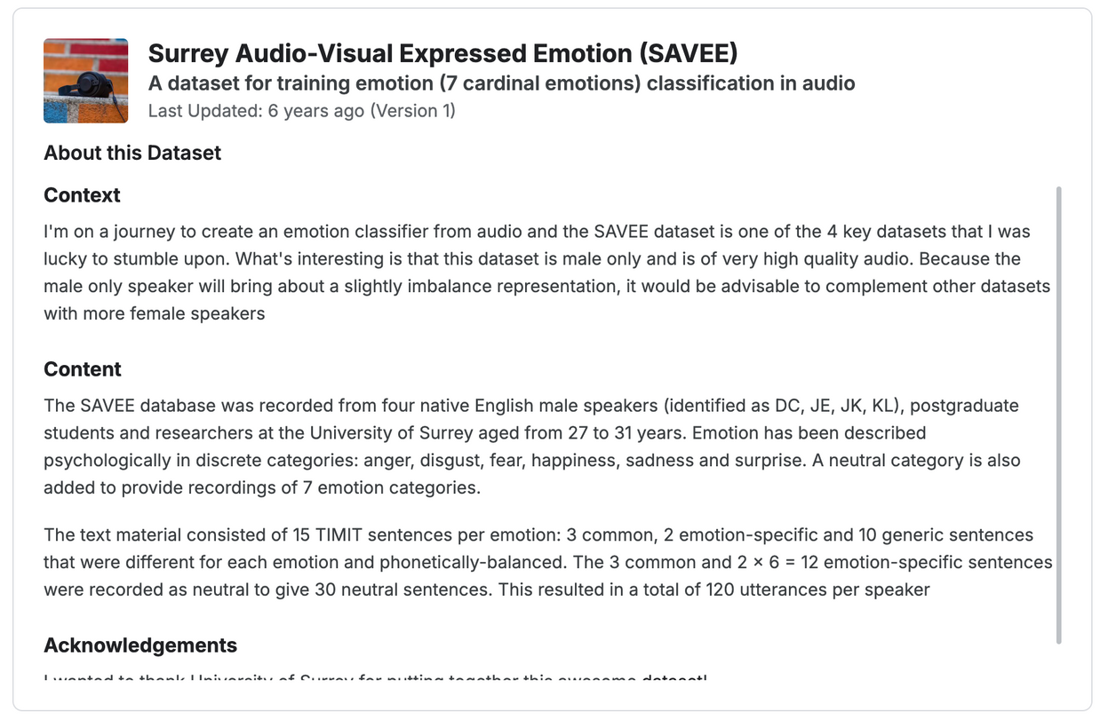
Dataset
IT21834424 | DE SILVA R.S.K | R25-040
16

Slide 17
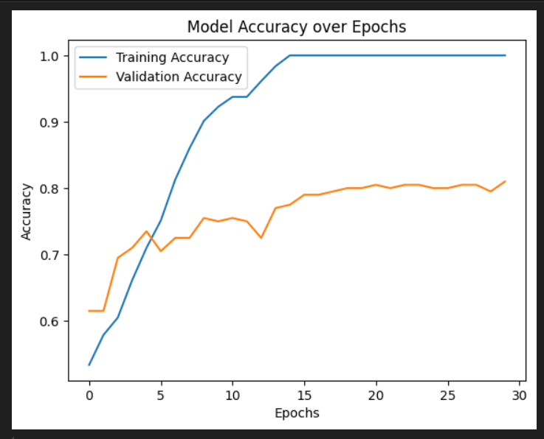

Accuracy rates
CNN Method 01
IT21834424 | DE SILVA R.S.K | R25-040
17

Slide 18
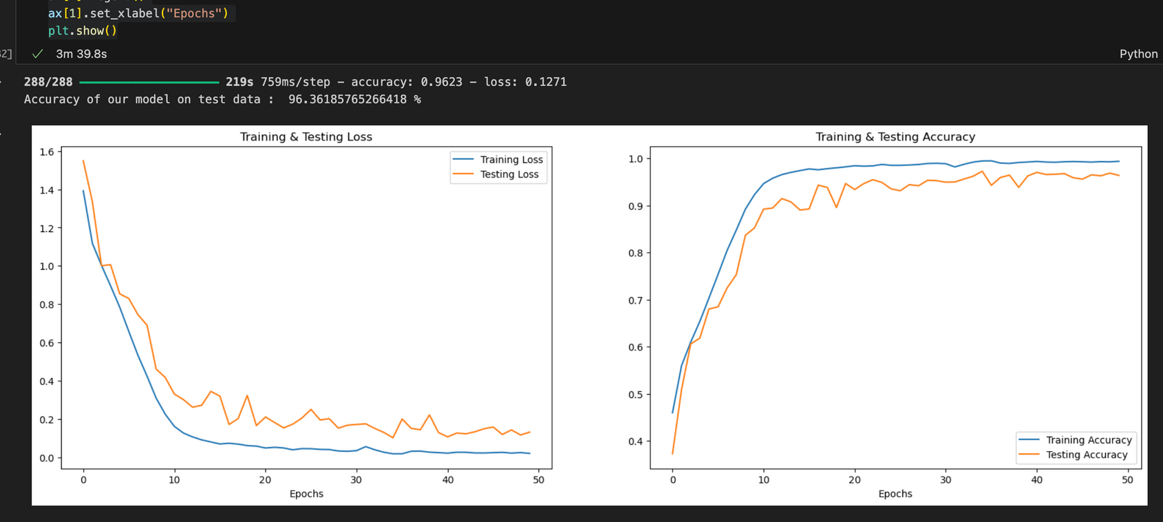

Accuracy rates
CNN METHOD 02
IT21834424 | DE SILVA R.S.K | R25-040
18

Slide 19
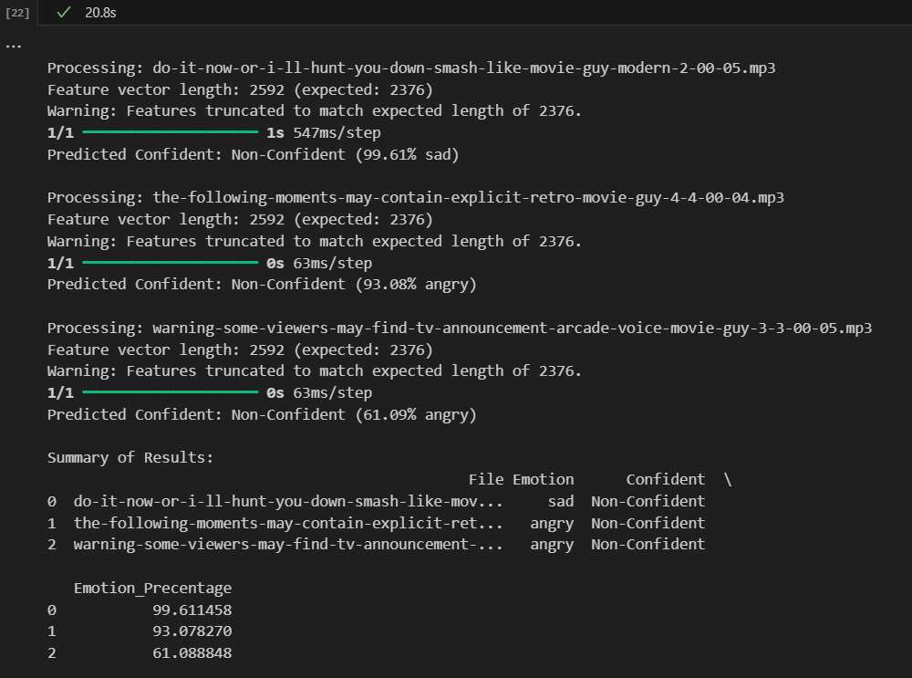
PREDICTIONS
IT21834424 | DE SILVA R.S.K | R25-040
19

Slide 20
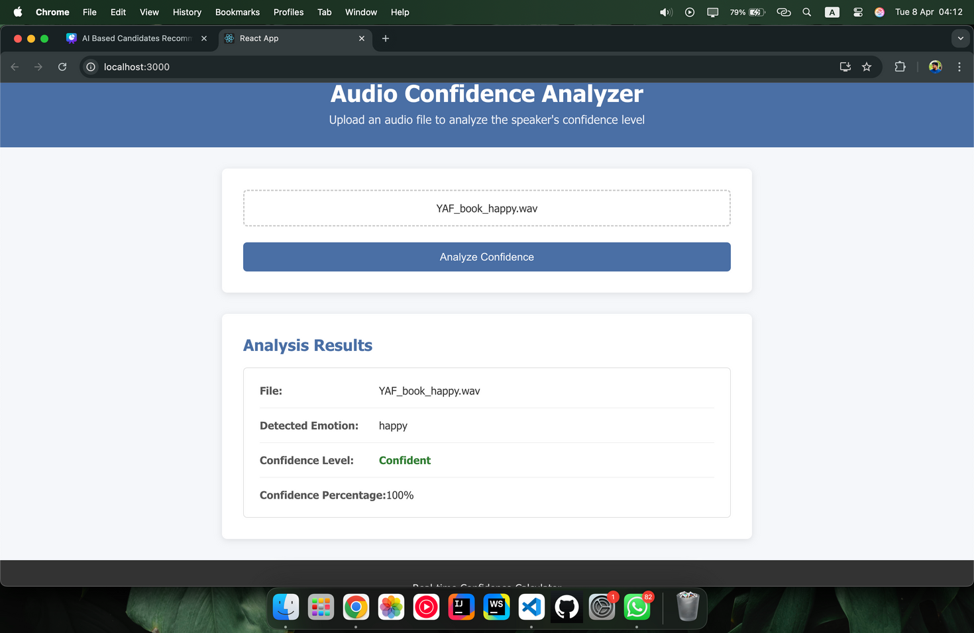
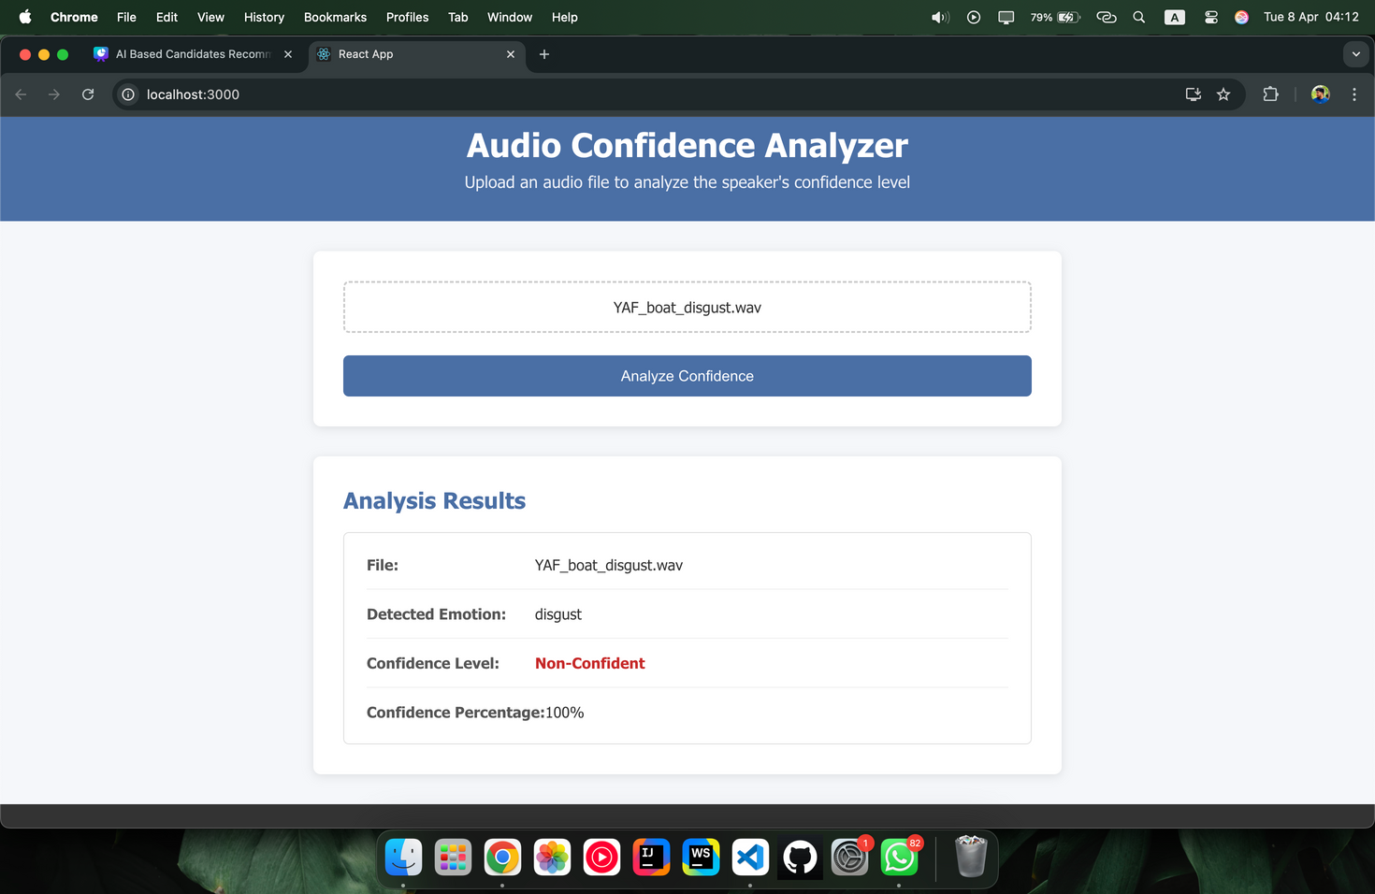
DEMO
IT21834424 | DE SILVA R.S.K | R25-040
20

Slide 21
REQUIREMENTS
FUNCTIONAL REQUIREMENTS | NON FUNCTIONAL REQUIREMENTS
The system must capture audio input during interviews | The system should process data in real-time with minimal latency
The model should analyze speech characteristics and provide a confidence score | Ensure data security and privacy for recorded speech samples.
The results should be displayed in a dashboard for recruiters | The solution should be scalable to handle multiple concurrent interviews.
IT21834424 | DE SILVA R.S.K | R25-040
21

Slide 22
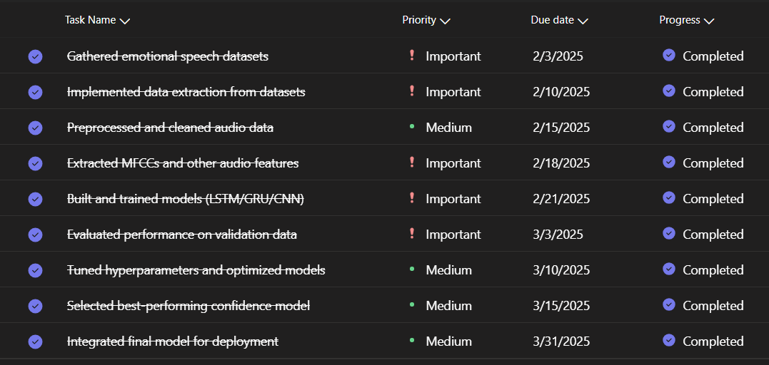
CURRENT PROGRESS- COMPLETED
IT21834424 | DE SILVA R.S.K | R25-040
22

Slide 23
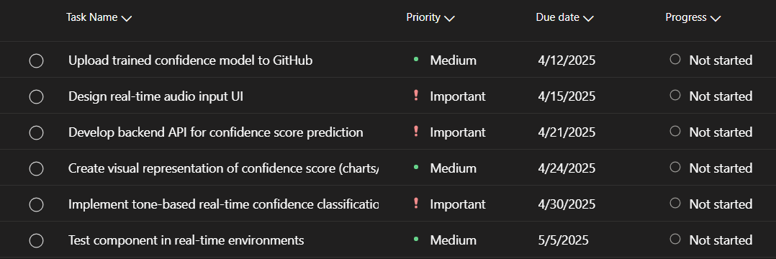
CURRENT PROGRESS- TO BE COMPLETED
IT21834424 | DE SILVA R.S.K | R25-040
23

Slide 24
PREDICTED & UNPREDICTED ASPECTS
Predicted aspects | Non Predicted aspects
Real-Time Confidence Classification | Accent or Language Variation Impact
Speaker Emotion and Tone-Based Feedback | User Mic/Device Quality Issues
Visualization of Confidence Scores | Environmental Noise Affecting Predictions
Seamless Integration with Other UI Modules | Potential Misuse of Audio Data (Privacy Issues)
IT21834424 | DE SILVA R.S.K | R25-040
24

Slide 25










TOOLS & TECHNOLOGIES
IT21834424 | DE SILVA R.S.K | R25-040
25

Slide 26
REFERENCES
[1] F. EYBEN, M. WÖLLMER, AND B. SCHULLER, "OPENSMILE – THE MUNICH VERSATILE AND FAST OPEN-SOURCE AUDIO FEATURE EXTRACTOR," IN PROCEEDINGS OF THE 18TH ACM INTERNATIONAL CONFERENCE ON MULTIMEDIA, 2010, PP. 1459–1462. HTTPS://DOI.ORG/10.1145/1873951.1874246
[2] J. D. ROJAS AND J. A. BILMES, "PREDICTING CONFIDENCE AND DOUBT IN ACCENTED SPEAKERS: HUMAN PERCEPTION AND MACHINE LEARNING EXPERIMENTS," IN PROCEEDINGS OF INTERSPEECH 2016, 2016, PP. 2150–2154.
HTTPS://DOI.ORG/10.21437/INTERSPEECH.2016-1426
[3] P. BOERSMA AND D. WEENINK, "PRAAT: DOING PHONETICS BY COMPUTER," HTTP://WWW.PRAAT.ORG/
[4] B. SCHULLER ET AL., "SPEECH EMOTION RECOGNITION: STATE OF THE ART AND REMAINING CHALLENGES," COGNITIVE COMPUTATION, VOL. 10, NO. 4, PP. 1–19, 2018. HTTPS://DOI.ORG/10.1007/S12559-018-9522-2
IT21834424 | DE SILVA R.S.K | R25-040
26

Slide 27
IT21815614 | KASTHURIRATHNE K.T.A.D.K
COMPONENT 02: Predict the STRESS level
through facial expressions
BACHELOR OF SCIENCE (HONS) IN INFORMATION TECHNOLOGY
SPECIALIZING IN INFORMATION TECHNOLOGY
IT21815614 | KASTHURIRATHNE K.T.A.D.K | R25-040
27

Slide 28
HOW DOES STRESS AFFECT TO THEIR WORK DURING THE WORKING TIME?
HOW CAN WE PREDICT CANDIDATES' STRESS LEVELS WHEN FACING SERIOUS JOB-RELATED PROBLEMS DURING AN INTERVIEW?
BACKGROUND
IT21815614 | KASTHURIRATHNE K.T.A.D.K | R25-040
28

Slide 29

"HOW CAN A MACHINE LEARNING MODEL BE DESIGNED TO ANALYZE FACIAL EXPRESSIONS"
RESEARCH QUESTION
"WHAT ARE THE KEY FACIAL EXPRESSION FEATURES THAT CAN BE USED TO ACCURATELY PREDICT STRESS LEVELS"
"HOW CAN REAL-TIME STRESS DETECTION BE INTEGRATED INTO AN AI-BASED INTERVIEW SYSTEM?"
IT21815614 | KASTHURIRATHNE K.T.A.D.K | R25-040
29

Slide 30
ASPECT | RESEARCH [01] | RESEARCH [02] | RESEARCH [03] | RESEARCH [04] | PROPOSED
Real-time stress detection using facial analysis
Integration with webcam (non-wearable devices)
Stress level classification during interviews
Behavioral analysis under high-pressure scenarios
Prediction of stress levels using ML models
= ADDRESSED BY THE RESEARCH PAPER
= NOT ADDRESSED BY THE RESEARCH PAPER
RESEARCH GAP
IT21815614 | KASTHURIRATHNE K.T.A.D.K | R25-040
30

Slide 31
OBJECTIVES
SPECIFIC OBJECTIVE
TO DEVELOP AND IMPLEMENT A REAL TIME SYSTEM FOR PREDICTING STRESS LEVELS IN CANDIDATES THROUGH FACIAL EXPRESSION ANALYSIS.
TO DESIGN AND TRAIN A MACHINE
LEARNING MODEL FOR ANALYZING FACIAL
EXPRESSION FEATURES TO PREDICT STRESS
LEVELS ACCURATELY.
TO VALIDATE THE PERFORMANCE
OF THE STRESS PREDICTION MODEL USING
REAL-TIME DATA CAPTURED THROUGH A
WEBCAM.
SUB OBJECTIVE
TO IDENTIFY SPECIFIC FACIAL EXPRESSION FEATURES THAT ARE INDICATIVE OF STRESS DURING INTERVIEWS.
IT21815614 | KASTHURIRATHNE K.T.A.D.K | R25-040
31

Slide 32
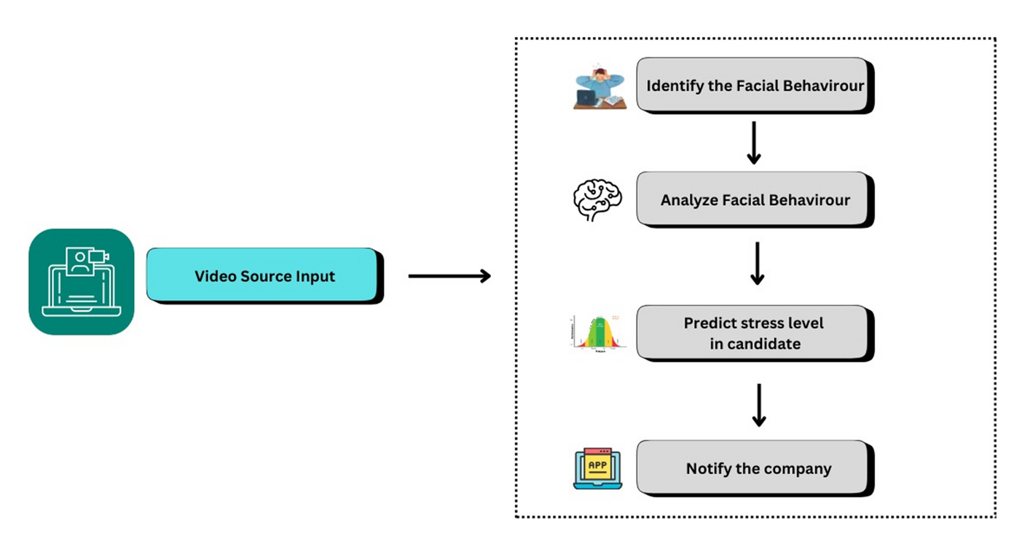
SYSTEM DIAGRAM & METHODOLOGY
IT21815614 | KASTHURIRATHNE K.T.A.D.K | R25-040
32

Slide 33
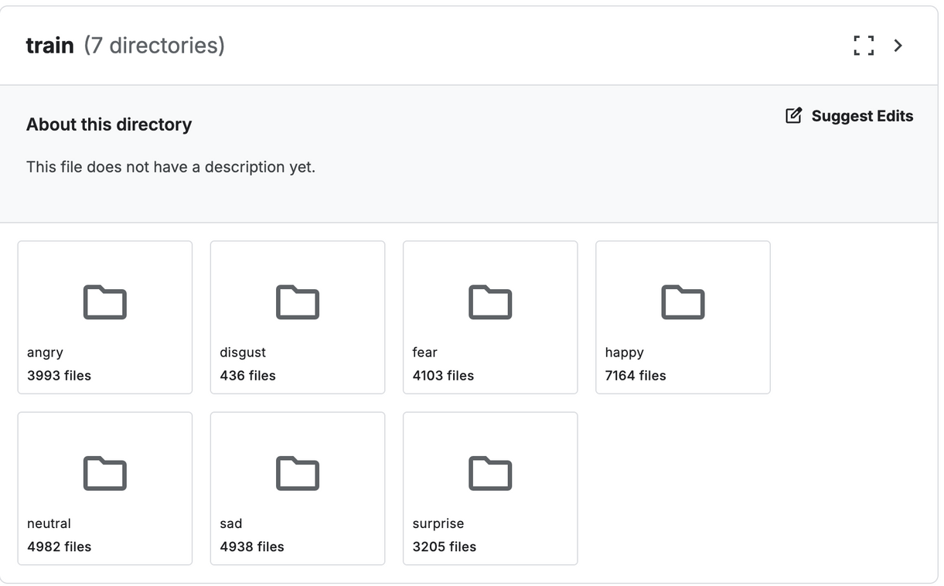
datasets
07 LABELS EMOTIONS
DATASET SIMPLIFIES TRAINING BY FOCUSING ON KEY FACIAL PATTERNS
IT21815614 | KASTHURIRATHNE K.T.A.D.K | R25-040
33

Slide 34
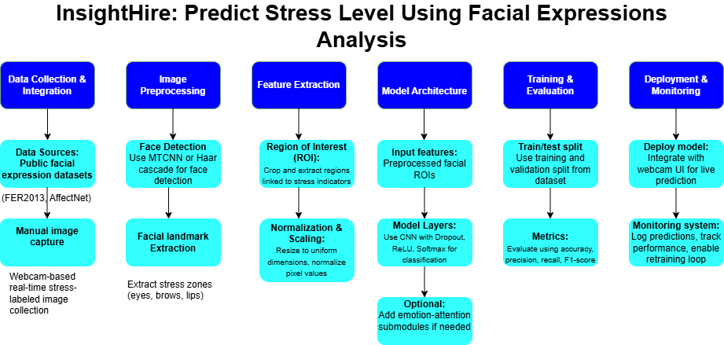
METHODOLOGY
IT21815614 | KASTHURIRATHNE K.T.A.D.K | R25-040
34

Slide 35
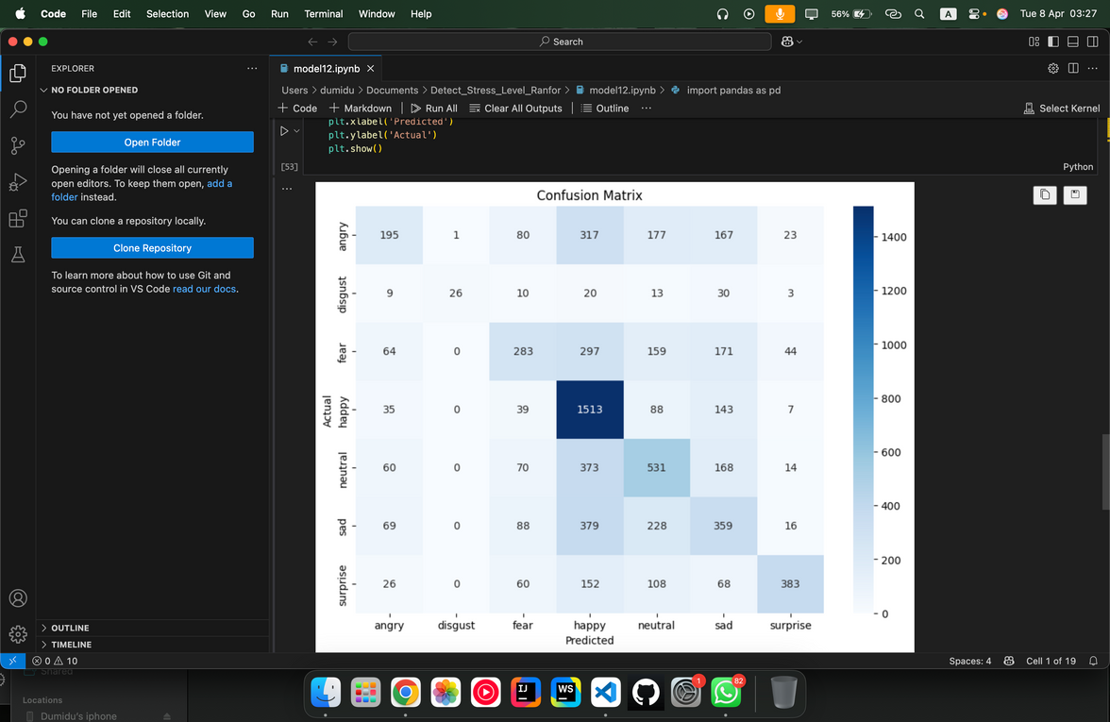

Accuracy rates
RANDOM FOREST CLASSIFIER
IT21815614 | KASTHURIRATHNE K.T.A.D.K | R25-040
35

Slide 36
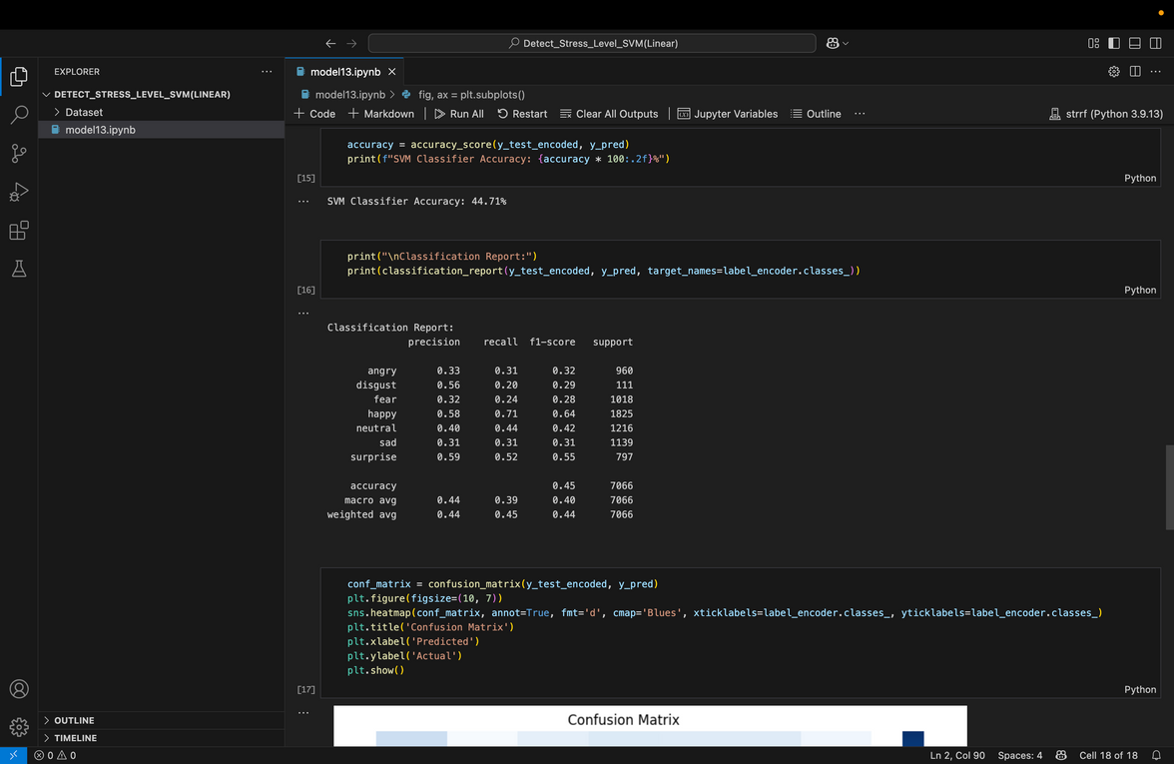
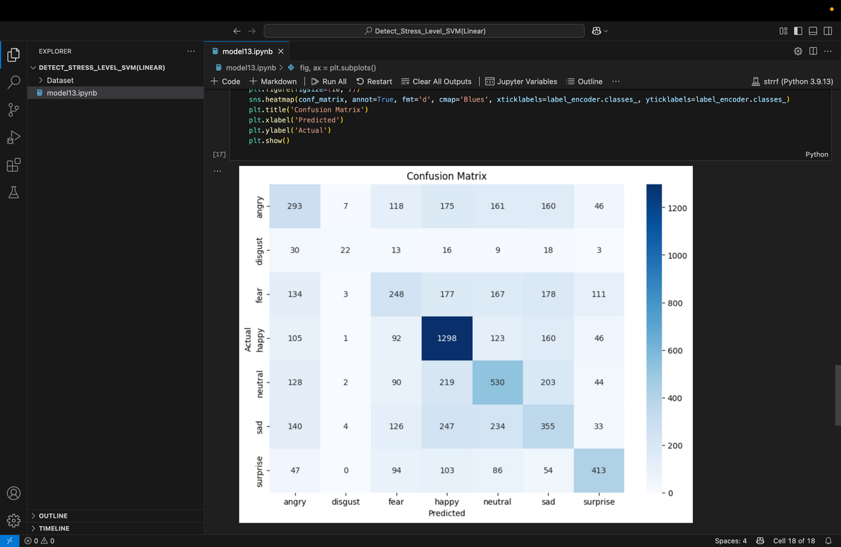
Accuracy rates
SVM CLASSIFIER
IT21815614 | KASTHURIRATHNE K.T.A.D.K | R25-040
36

Slide 37
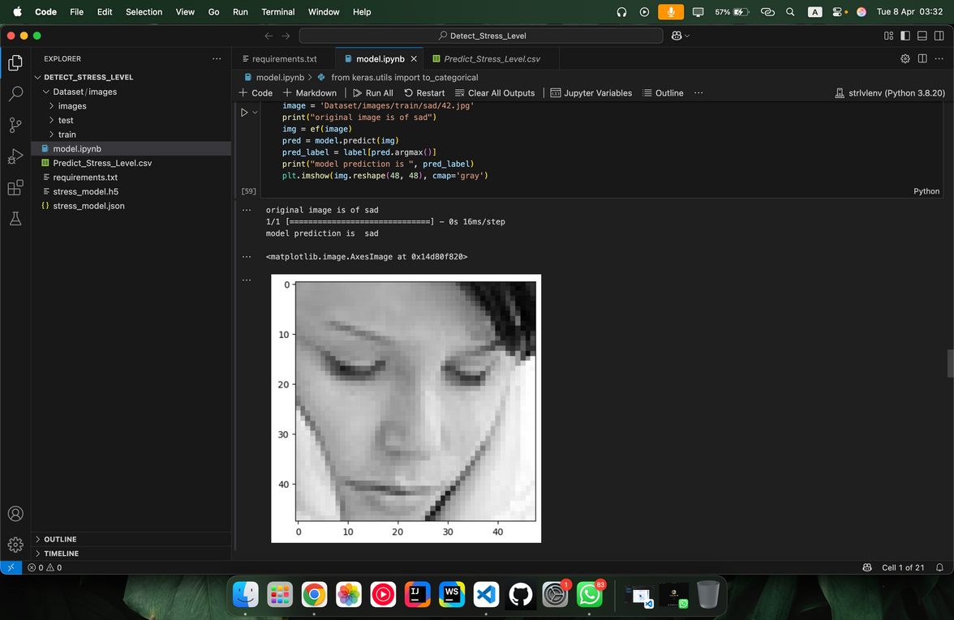
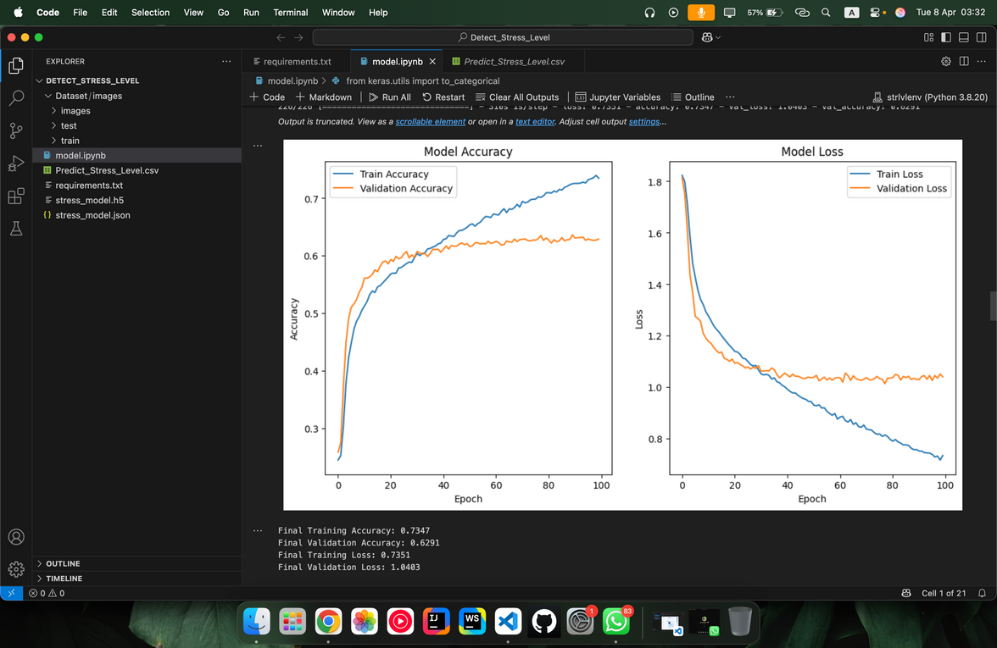

Accuracy rates
CNN MODEL
IT21815614 | KASTHURIRATHNE K.T.A.D.K | R25-040
37

Slide 38
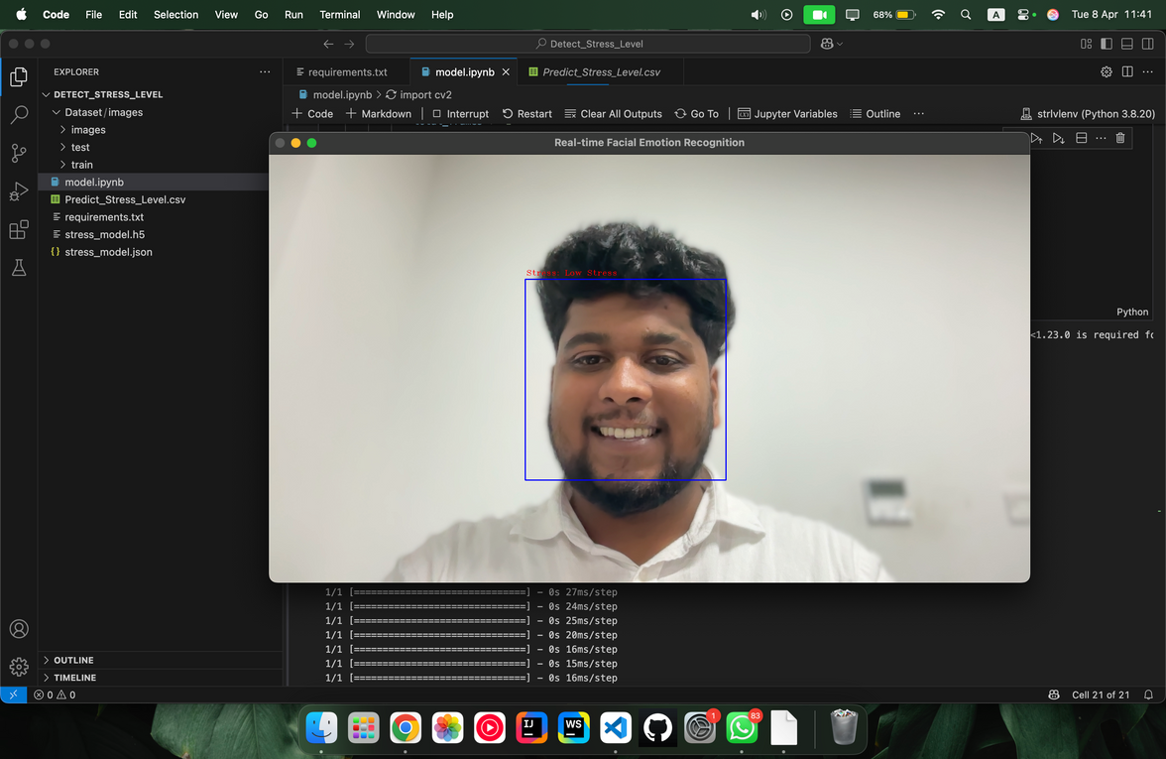
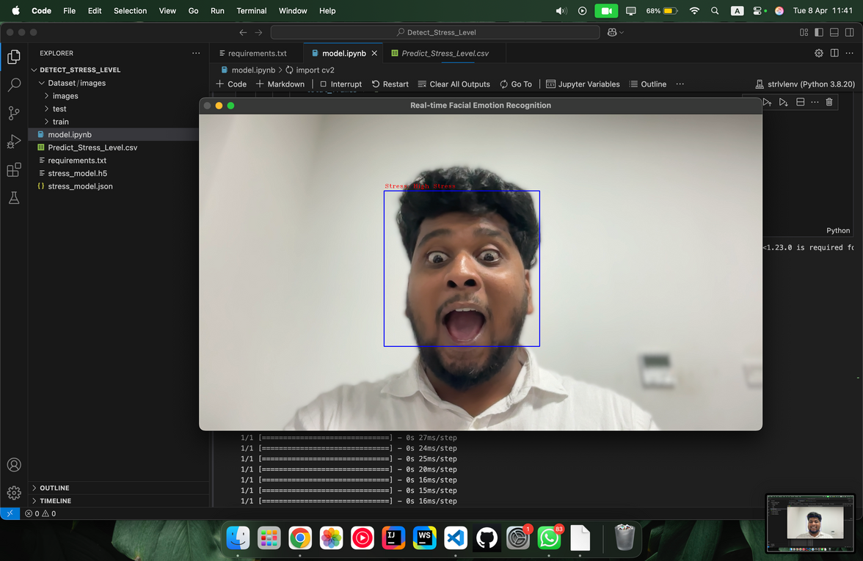
PREDICTIONS
IT21815614 | KASTHURIRATHNE K.T.A.D.K | R25-040
38

Slide 39
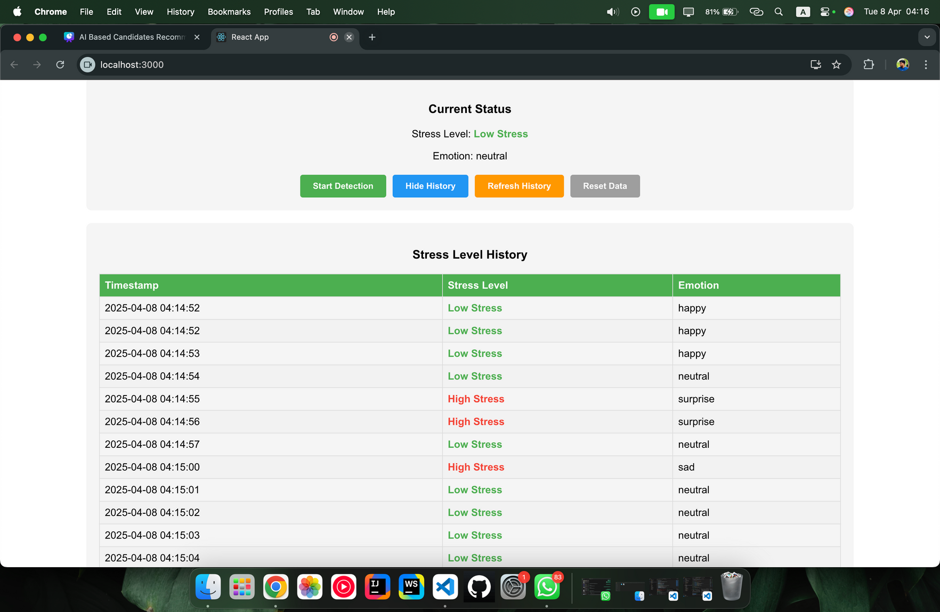
DEMO
IT21815614 | KASTHURIRATHNE K.T.A.D.K | R25-040
39

Slide 40
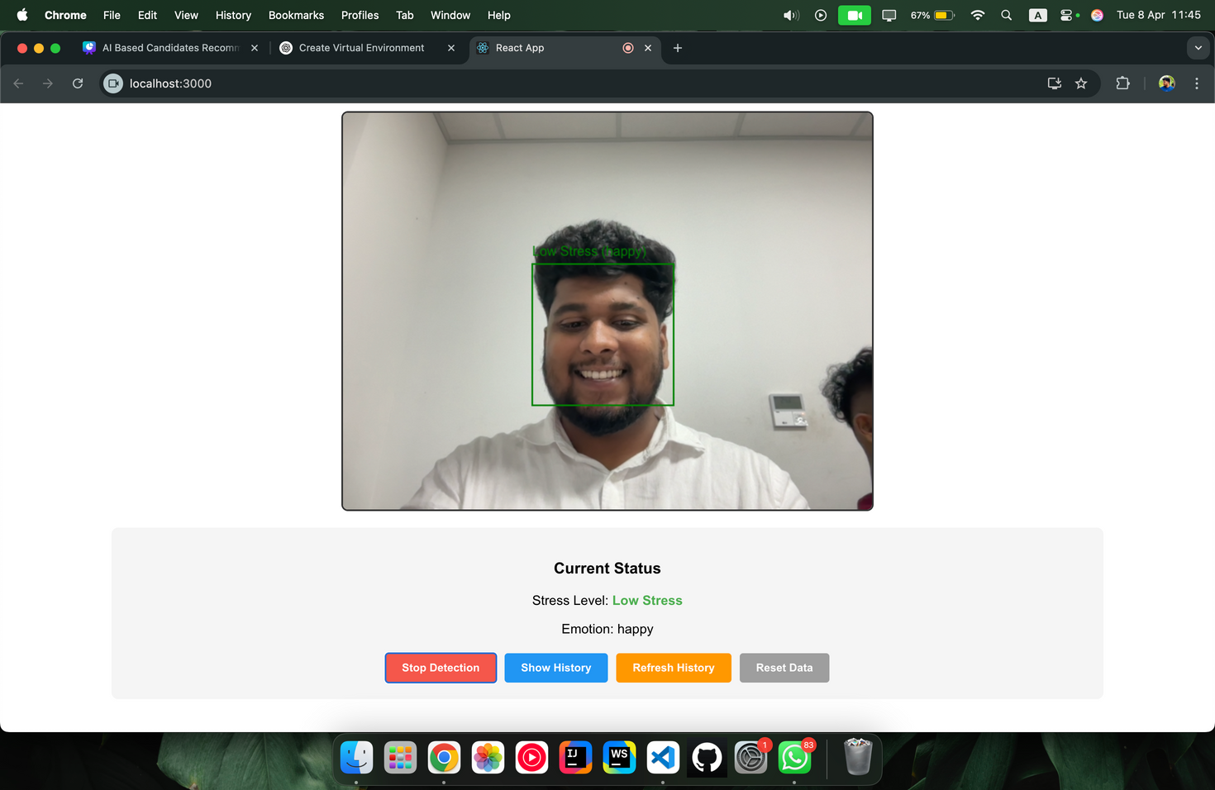
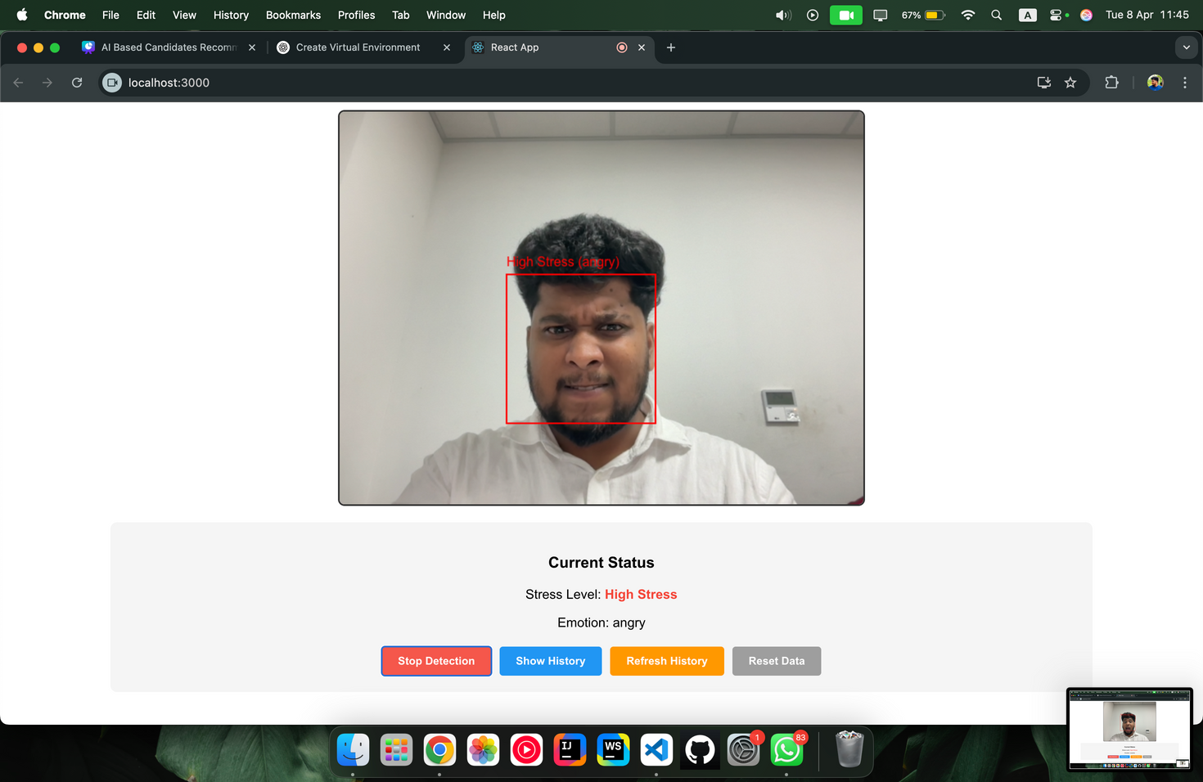
IT21815614 | KASTHURIRATHNE K.T.A.D.K | R25-040
40

Slide 41

REQUIREMENTS
FUNCTIONAL REQUIREMENTS | NON FUNCTIONAL REQUIREMENTS
Real-Time Facial Expression Analysis | Performance
Stress Level Prediction | Accuracy
Machine Learning Integration | Scalability
.Facial Feature Detection | Usability
IT21815614 | KASTHURIRATHNE K.T.A.D.K | R25-040
41

Slide 42
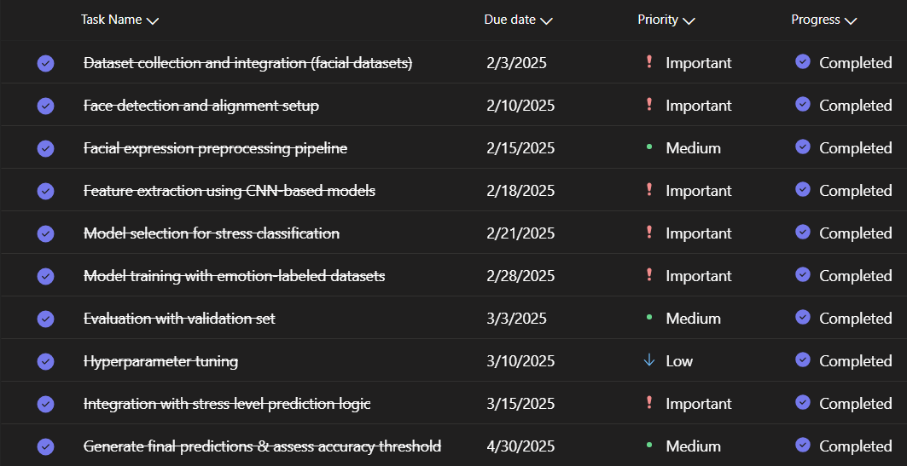
CURRENT PROGRESS- COMPLETED
IT21815614 | KASTHURIRATHNE K.T.A.D.K | R25-040
42

Slide 43
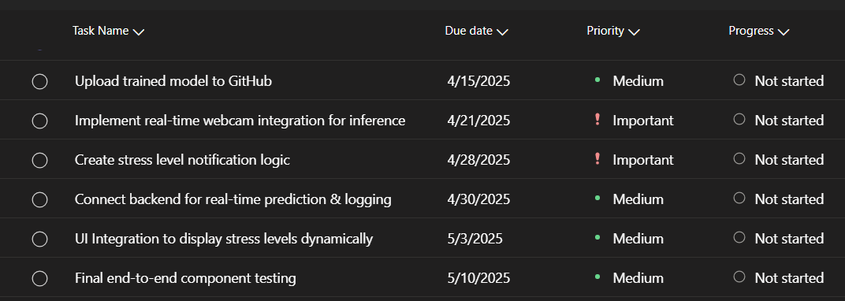
CURRENT PROGRESS- TO BE COMPLETED
IT21815614 | KASTHURIRATHNE K.T.A.D.K | R25-040
43

Slide 44
PREDICTED & UNPREDICTED ASPECTS
Predicted aspects | Non Predicted aspects
Real-Time Stress Detection | Individual Variation in Stress Response
Emotion Classification | Environment-Dependent Performance
Timely Notifications | User Compliance
Increased Accuracy Over Time | Data Privacy Concerns
IT21815614 | KASTHURIRATHNE K.T.A.D.K | R25-040
44

Slide 45







TOOLS & TECHNOLOGIES
IT21815614 | KASTHURIRATHNE K.T.A.D.K | R25-040
45

Slide 46
REFERENCES
[1] A. S. Rathore, S. Mehta, and P. Gupta, "Real-Time Stress Detection and Analysis using Facial Emotion Recognition," International Journal of Advanced Research in Computer and Communication Engineering, vol. 10, no. 5, pp. 45-50, May 2021. Add a little bit of body text.
[2] J. Zhang, Y. Shen, and H. Wang, "Real-Time Mental Stress Detection Using Multimodality Expressions," Frontiers in Neuroscience, vol. 16, no. 947168, pp. 1-10, Nov. 2022. Add a little bit of body text.
[3] D. Thomas, R. Lee, and A. Park, "Real-Time Emotion Detection by Quantitative Facial Motion Analysis," Journal of Emotion and Computing, vol. 8, no. 2, pp. 45-52, Mar. 2023.
Add a little bit of body text.
[4] L. C. Smith and D. N. Patel, "Stress Detection of Autistic Adults during Simulated Job Interviews," Proceedings of the ACM Digital Library, vol. 22, no. 7, pp. 120-129, Oct. 2023.
Add a little bit of body text.
IT21815614 | KASTHURIRATHNE K.T.A.D.K | R25-040
46

Slide 47

IT21838620 ~ S.U.D.A GUNASEKARA
COMPONENT 03: Predict the decision making skill by text analysis AND ENGAGEMENT USING EYE ENGAGEMENT
BACHELOR OF SCIENCE (HONS) IN INFORMATION TECHNOLOGY
SPECIALIZING IN INFORMATION TECHNOLOGY
IT21838620 | S.U.D.A GUNASEKARA | R25-040
47

Slide 48

HOW CAN A CANDIDATE’S DECISION-MAKING SKILLS BE DETECTED BY COMBINING TEXT ANALYSIS (SPEECH-TO-TEXT) AND EYE ENGAGEMENT DATA?
WHAT ARE THE POTENTIAL ADVANTAGES OF USING AUTOMATED TEXT AND EYE ENGAGEMENT ANALYSIS OVER TRADITIONAL FACE-TO-FACE INTERVIEW METHODS?
WHAT TYPES OF DECISION-MAKING SKILLS ARE MOST CRITICAL TO ASSESS FOR THE JOB ROLES TARGETED BY THIS SYSTEM?
BACKGROUND
IT21838620 | S.U.D.A GUNASEKARA | R25-040
48

Slide 49
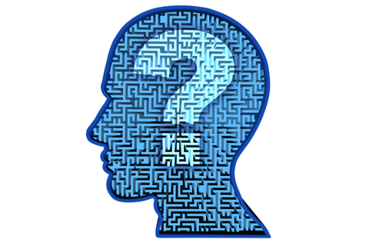
“HOW CAN EYE ENGAGEMENT PATTERNS BE LEVERAGED TO ASSESS DECISION-MAKING BEHAVIORS DURING REAL-TIME JOB INTERVIEWS?”
“HOW RELIABLE ARE EYE ENGAGEMENT DETECTION SYSTEMS IN VARYING LIGHTING, ENVIRONMENTAL, AND CANDIDATE-SPECIFIC CONDITIONS (E.G., GLASSES, EYE SHAPE)?”
“CAN EYE ENGAGEMENT ANALYSIS BE INTEGRATED INTO AI-BASED CANDIDATE RECOMMENDATION SYSTEMS TO ENHANCE BEHAVIORAL EVALUATION?”
RESEARCH QUESTION
IT21838620 | S.U.D.A GUNASEKARA | R25-040
49

Slide 50
RESEARCH GAP
= ADDRESSED BY THE RESEARCH PAPER
= NOT ADDRESSED BY THE RESEARCH PAPER
ASPECT | RESEARCH [01] | RESEARCH [02] | RESEARCH [03] | RESEARCH [04] | PROPOSED
Eye movement tracking accuracy
Analysis of decision-making from eye patterns
Use of ML for eye engagement insight
Application in job interview scenarios
IT21838620 | S.U.D.A GUNASEKARA | R25-040
50

Slide 51

OBJECTIVES
Specific Objective | Sub Objective
Develop a robust framework for detecting and evaluating candidates' decision-making skills during interviews by analysing speech-to-text data using advanced natural language processing (NLP) techniques and used machine learning models for eye engagement , ensuring real-time, and reliable assessment method | To process speech-to-text data. To analyse decision-making patterns in text To predict decision-making proficiency using AI To design a scoring mechanism for eye engagement during the process. To validate the proposed decision-making and eye engagement model
IT21838620 | S.U.D.A GUNASEKARA | R25-040
51

Slide 52
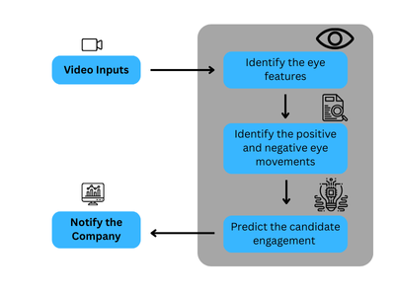
SYSTEM DIAGRAM & METHODOLOGY
IT21838620 | S.U.D.A GUNASEKARA | R25-040
52

Slide 53
Accuracy rates
IT21838620 | S.U.D.A GUNASEKARA | R25-040
53

Slide 54
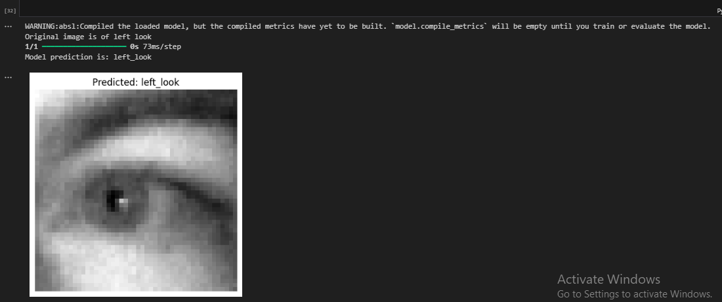
PREDICTIONS
IT21838620 | S.U.D.A GUNASEKARA | R25-040
54

Slide 55
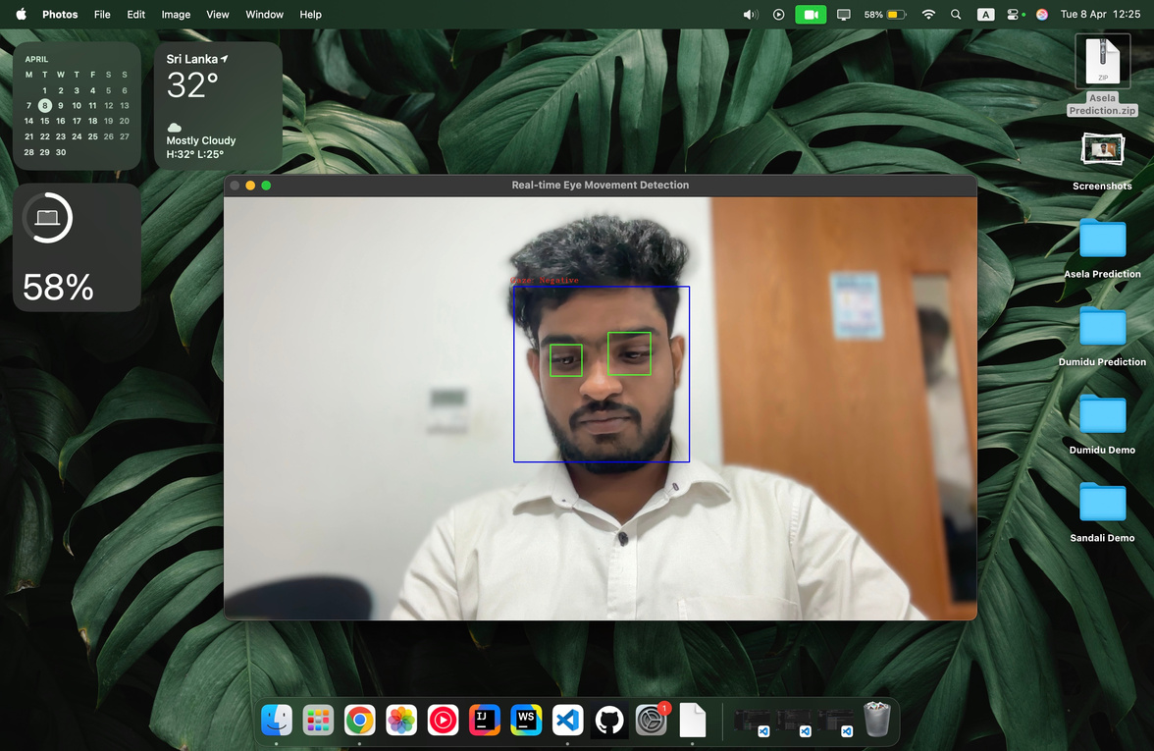
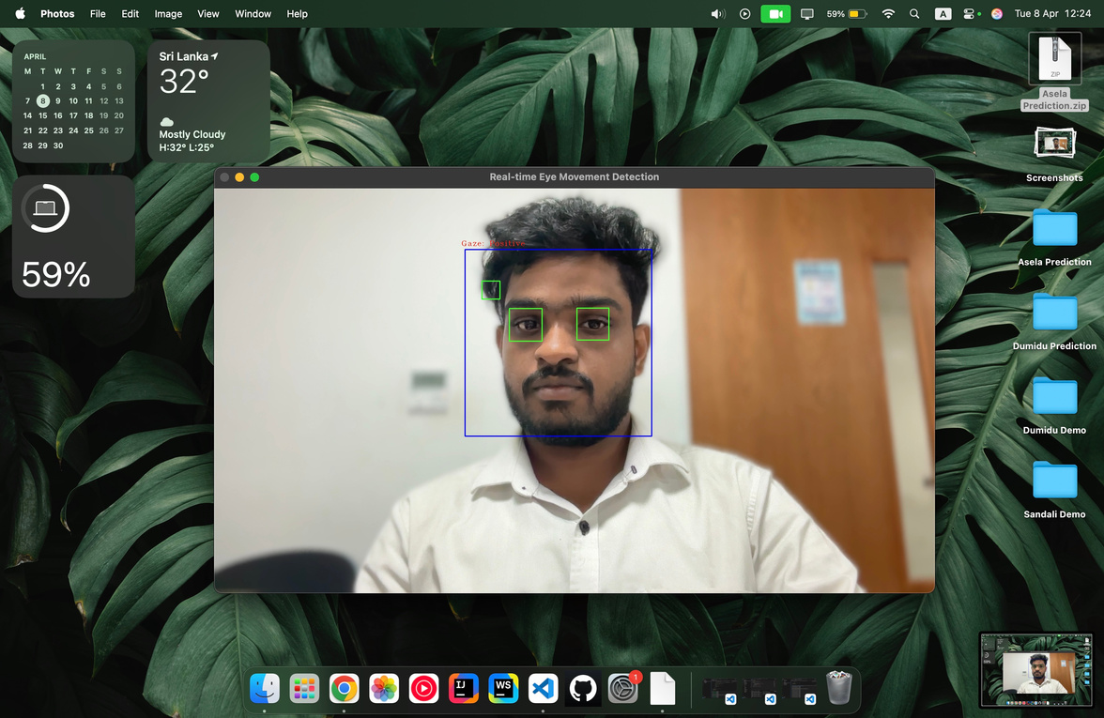
PREDICTIONS
IT21838620 | S.U.D.A GUNASEKARA | R25-040
55

Slide 56
REQUIREMENTS
Functional Requirements | Non Functional Requirements
Speech-to-Text Conversion Decision-Making Detection Contextual Analysis Machine Learning Integration Real-time Analysis | Performance Scalability Security Usability Reliability Compatibility
IT21838620 | S.U.D.A GUNASEKARA | R25-040
56

Slide 57
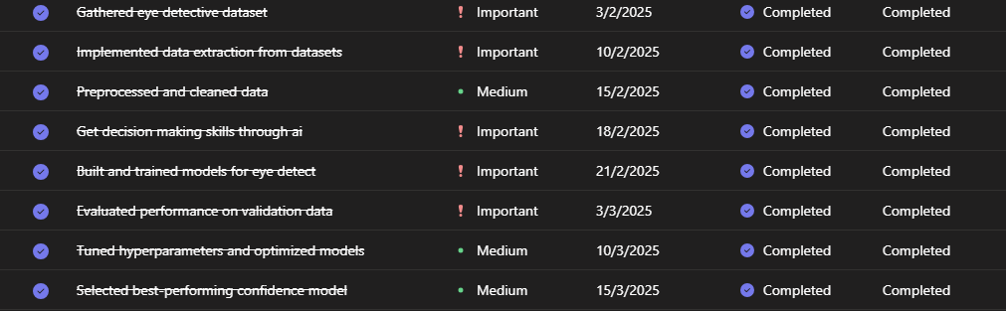
CURRENT PROGRESS- COMPLETED
IT21838620 | S.U.D.A GUNASEKARA | R25-040
57

Slide 58
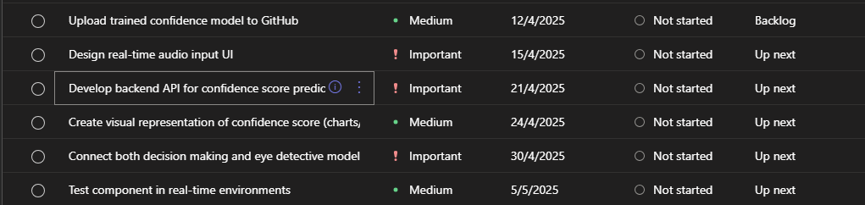
CURRENT PROGRESS- TO BE COMPLETED
IT21838620 | S.U.D.A GUNASEKARA | R25-040
58

Slide 59
PREDICTED & UNPREDICTED ASPECTS
Predicted aspects | Non Predicted aspects
Real-Time Focus and Attention Tracking | Variations in Eye Movement due to Fatigue or Health Conditions
Detection of Cognitive Load during Decision Points | Distraction from External Environmental Factors (e.g., lighting)
Identification of Hesitation and Uncertainty | Varying Results in Different Cultural Eye Behaviours
Non-Intrusive Behavioural Monitoring | Data Privacy and Ethical Concerns
IT21838620 | S.U.D.A GUNASEKARA | R25-040
59

Slide 60







TOOLS & TECHNOLOGIES
IT21838620 | S.U.D.A GUNASEKARA | R25-040
60

Slide 61
[1] A. AGRAWAL, S. CHAKRABORTY, AND K. GHOSH, "ANALYZING BEHAVIORAL CUES IN VIDEO INTERVIEWS FOR CANDIDATE ASSESSMENT," ARXIV PREPRINT ARXIV:2006.07909, 2020. HTTPS://ARXIV.ORG/ABS/2006.07909.
[2] B. NIEMITZ AND A. WIHLER, "THE (NULL) EFFECTS OF VIDEO QUESTIONS ON APPLICANT REACTIONS IN ASYNCHRONOUS VIDEO INTERVIEWS: EVIDENCE FROM AN ACTUAL HIRING CONTEXT," INTERNATIONAL JOURNAL OF SELECTION AND ASSESSMENT, VOL. 32, NO. 1, PP. 1–15, 2024.
HTTPS://ONLINELIBRARY.WILEY.COM.
[3] M. ABDULLAH, K. ALISSA, AND O. ALZOUBI, "NEW USER ENGAGEMENT PREDICTION USING MACHINE LEARNING ALGORITHMS," 2023 14TH INTERNATIONAL CONFERENCE ON INFORMATION AND COMMUNICATION SYSTEMS (ICICS), IRBID, JORDAN, NOV. 21–23, 2023, PP. 1–6. HTTPS://DOI.ORG/10.1109/ICICS60529.2023.10330488.
[4] R. T. KHAN, M. S. RIZVI, AND S. A. SINGH, "PREDICTIVE ANALYTICS FOR JOB CANDIDATE ASSESSMENT: DEVELOPING A HOLISTIC SCORING MODEL," INTERNATIONAL JOURNAL OF HUMAN-COMPUTER INTERACTION, VOL. 38, NO. 5, PP. 112–125, 2022.
HTTPS://DOI.ORG/10.1080/10447318.2021.1980763
REFERENCES
IT21838620 | S.U.D.A GUNASEKARA | R25-040
61

Slide 62

IT21819810 | B.D.A.M KUMARA
COMPONENT 04: Predict hand gestures in real time, measuring their impact on presentation quality and engagement levels
BACHELOR OF SCIENCE (HONS) IN INFORMATION TECHNOLOGY
SPECIALIZING IN INFORMATION TECHNOLOGY
IT21819810 |B.D.A.M KUMARA | R25-040
62

Slide 63
WHY ARE SOFT SKILLS, ESPECIALLY NON-VERBAL COMMUNICATION, CRITICAL DURING INTERVIEWS?
HOW DO HAND GESTURES INFLUENCE A CANDIDATE’S PERCEIVED CONFIDENCE AND ENGAGEMENT?
WHAT ARE THE LIMITATIONS OF CURRENT INTERVIEW ASSESSMENT METHODS?
HOW CAN AI BE USED TO BRING OBJECTIVITY AND STRUCTURE INTO SOFT SKILL EVALUATIONS?
BACKGROUND
IT21819810 |B.D.A.M KUMARA | R25-040
63

Slide 64

RESEARCH QUESTION
HOW DO HAND GESTURES INFLUENCE A CANDIDATE’S PRESENTATION QUALITY, CONFIDENCE AND ENGAGEMENT DURING AN INTERVIEW?
HOW CAN AI TOOLS BE LEVERAGED FOR REAL-TIME HAND GESTURE CLASSIFICATION IN INTERVIEW ANALYSIS?
IT21819810 |B.D.A.M KUMARA | R25-040
64

Slide 65
ASPECT | RESEARCH [01] | RESEARCH [02] | RESEARCH [03] | RESEARCH [04] | PROPOSED
Real-time Hand Gesture Prediction
Measurement of Gesture Impact on Presentation Quality
Engagement Level Estimation Based on Gestures
Multimodal Data Integration (Video, Audio, Gestures)
Integration with Presentation Feedback Systems
= ADDRESSED BY THE RESEARCH PAPER
= NOT ADDRESSED BY THE RESEARCH PAPER
RESEARCH GAP
IT21819810 |B.D.A.M KUMARA | R25-040
65

Slide 66
OBJECTIVES
Main objective | Specific objectives
Develop an AI-based hand gesture analysis framework to evaluate soft skills during interviews. By utilizing computer vision and machine learning, the system aims to provide an objective, real-time and automated evaluation of candidates’ non-verbal communication skills, reducing human bias in hiring decisions. | Hand Gesture Analysis for Soft Skill Assessment Predicting Engagement and Communication Skills with AI Real-Time AI-Based Presentation Skill Evaluation Design a Gesture-Based Scoring System for Candidate Evaluation
IT21819810 |B.D.A.M KUMARA | R25-040
66

Slide 67
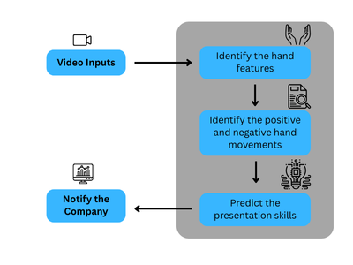
SYSTEM DIAGRAM & METHODOLOGY
IT21819810 |B.D.A.M KUMARA | R25-040
67

Slide 68

REQUIREMENTS
FUNCTIONAL REQUIREMENTS:
HAND GESTURE TRACKING
GESTURE CLASSIFICATION
REAL-TIME GESTURE ANALYSIS
SCORING SYSTEM
MACHINE LEARNING INTEGRATION
REAL-TIME FEEDBACK
NON-FUNCTIONAL REQUIREMENTS
PERFORMANCE
SCALABILITY
SECURITY
USABILITY
RELIABILITY
COMPATIBILITY
IT21819810 |B.D.A.M KUMARA | R25-040
68

Slide 69




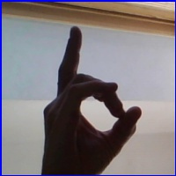
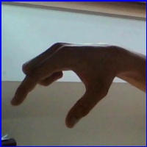


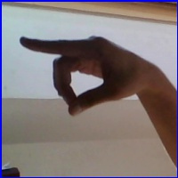
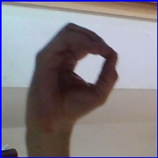

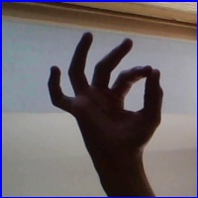
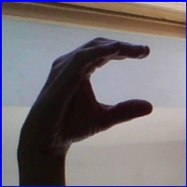
DATA SETS
POSITIVE HAND MOMENTS
IT21819810 |B.D.A.M KUMARA | R25-040
69

Slide 70

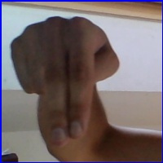
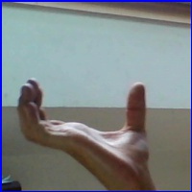
DATA SETS
NEGATIVE HAND MOMENTS
IT21819810 |B.D.A.M KUMARA | R25-040
70

Slide 71
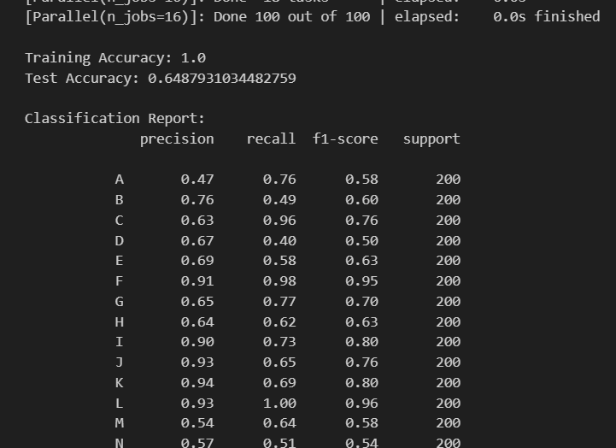
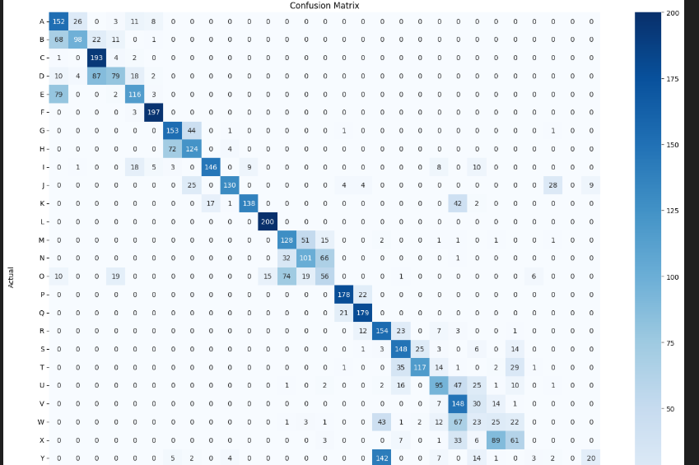
ACCURACY RATES
Random Forest Classifier
IT21819810 |B.D.A.M KUMARA | R25-040
71

Slide 72
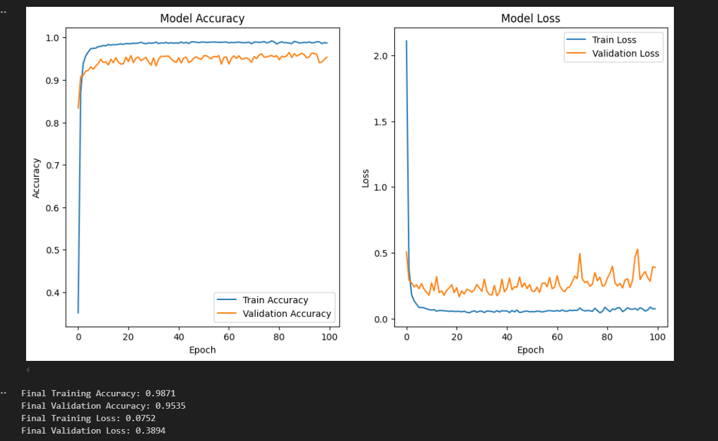
ACCURACY RATES
CNN Model
IT21819810 |B.D.A.M KUMARA | R25-040
72

Slide 73



PREDICTION
Negative Hand Gesture
Positive Hand Gesture
IT21819810 |B.D.A.M KUMARA | R25-040
73

Slide 74

CURRENT PROGRESS- TO BE COMPLETED
IT21819810 |B.D.A.M KUMARA | R25-040
74

Slide 75

CURRENT PROGRESS- TO BE PENDING
IT21819810 |B.D.A.M KUMARA | R25-040
75

Slide 76

TOOLS & TECHNOLOGIES
IT21819810 |B.D.A.M KUMARA | R25-040
76

Slide 77
[1] M. M. ROBLES, "EXECUTIVE PERCEPTIONS OF THE TOP 10 SOFT SKILLS NEEDED IN TODAY'S WORKPLACE," BUSINESS COMMUNICATION QUARTERLY, VOL. 75, NO. 4, PP. 453–465, DEC. 2012.
[2] D. MCNEILL, HAND AND MIND: WHAT GESTURES REVEAL ABOUT THOUGHT. CHICAGO, IL, USA: UNIVERSITY OF CHICAGO PRESS, 1992
[3] B. CHEN, L. YU, X. MENG, AND Y. HUA, "VISUAL GESTURE RECOGNITION BASED ON HAND KEY POINTS," IN JOURNAL OF PHYSICS: CONFERENCE SERIES, VOL. 2024, NO. 1, P. 012037, 2021.
[4] I. SOMMERVILLE, SOFTWARE ENGINEERING, 10TH ED. BOSTON, MA, USA: PEARSON, 2015.
[5] A. AGRAWAL, R. A. GEORGE, S. S. RAVI, S. K. S, AND A. K. M, "LEVERAGING MULTIMODAL BEHAVIORAL ANALYTICS FOR AUTOMATED JOB INTERVIEW PERFORMANCE ASSESSMENT AND FEEDBACK," ARXIV PREPRINT ARXIV:2006.07909, 2020.
[6] OPENCV, “INTRODUCTION TO OPENCV,” [ONLINE]. AVAILABLE: HTTPS://OPENCV.ORG. [ACCESSED: JAN. 25, 2025].
[7] SCIKIT-LEARN, “DOCUMENTATION,” [ONLINE]. AVAILABLE: HTTPS://SCIKIT-LEARN.ORG. [ACCESSED: JAN. 25, 2025].
[8] A. AGRAWAL, S. CHAKRABORTY, AND K. GHOSH, "ANALYZING BEHAVIORAL CUES IN VIDEO INTERVIEWS FOR CANDIDATE ASSESSMENT," ARXIV PREPRINT ARXIV:2006.07909, 2020.
HTTPS://ARXIV.ORG/ABS/2006.07909.
REFERENCES
IT21819810 |B.D.A.M KUMARA | R25-040
77

Slide 78
Q & A
THANK YOU
https://www.canva.com/design/DAGjUAfEFv0/xpGNaqc0_JIBG4ydwF9T8Q/edit?utm_content=DAGjUAfEFv0&utm_campaign=designshare&utm_medium=link2&utm_source=sharebutton
79

