Slide 1


INSIGHTHIRE
AI Based Candidates Recommending Application For a Company Vacancy
Group ID : R25-040 | PP2

Slide 2
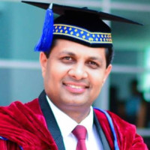

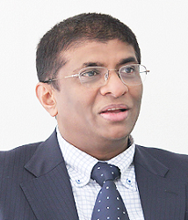




OUR TEAM
Prof. Samantha Thelijjagoda
Supervisor
Ms. Poorna Panduwawala
Co-supervisor
Prof. Nishantha Giguruwa
External-supervisor
De Silva R.S.K
Team Member
K.T.A.D.K Kasthurirathna
Team Member
S.U.D.A Gunasekara
Team Member
B.D.A.M Kumara
Team Member
02

Slide 3

INTRODUCTION
Finding the right candidate today goes beyond resumes. Traditional hiring methods often miss crucial soft skills like confidence and stress management key factors for job success. To ensure a more efficient, unbiased and effective hiring process, innovative solutions are essential in identifying candidates who truly fit organizational needs and culture.
03

Slide 4

RESEARCH OBJECTIVES
Design and implement an intelligent system that evaluates candidates’ soft skills including confidence (via voice tone, eye engagement, and hand gestures) and stress levels (via facial expressions) to provide personalized job-candidate matching and help organizations select the most suitable candidate for a vacancy.
04

Slide 5
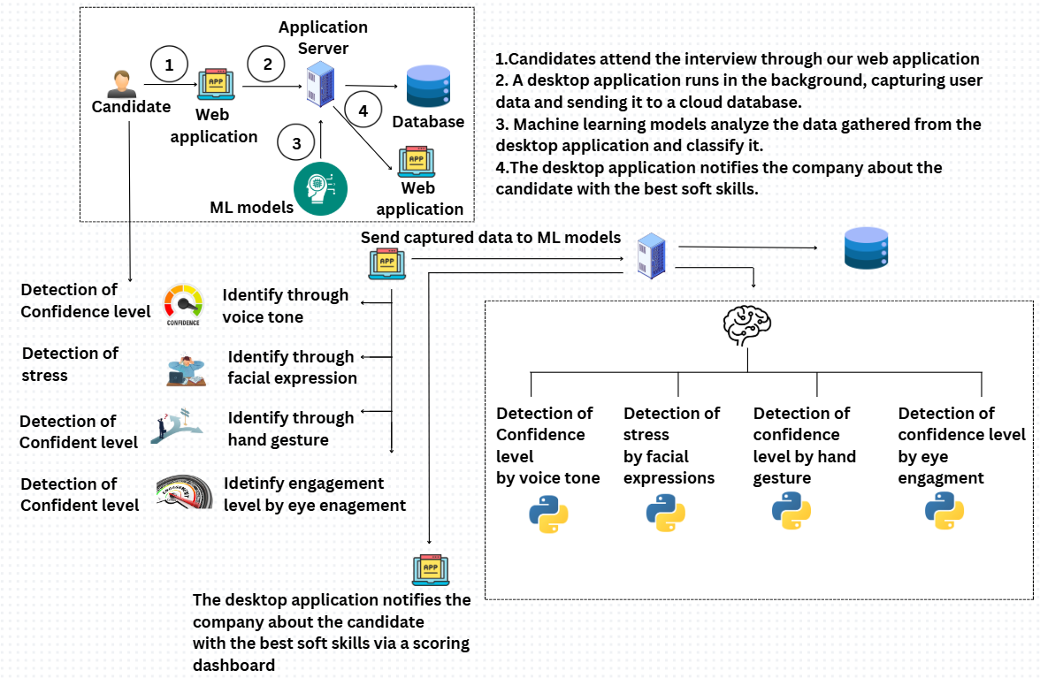
systEM OVERVIEW DIAGRAM
05

Slide 6


IT21834424 | DE SILVA R.S.K
COMPONENT 01: Predict the Confident
level through speech & tone analysis
BACHELOR OF SCIENCE (HONS) IN INFORMATION TECHNOLOGY
SPECIALIZING IN INFORMATION TECHNOLOGY
IT21834424 | DE SILVA R.S.K | R25-040
06

Slide 7

SUMMARY OF THE COMPONENT
RESEARCH GAP
BACKGROUND
RESEARCH QUESTION
OBJECTIVES
IT21834424 | DE SILVA R.S.K | R25-040
07

Slide 8
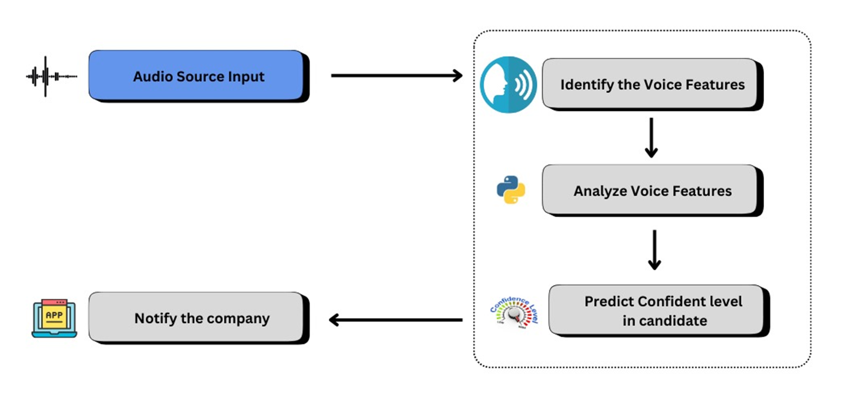
SYSTEM DIAGRAM
IT21834424 | DE SILVA R.S.K | R25-040
08

Slide 9



CURRENT PROGRESS
Data gathering & Analyzing
preprocessing &
model training
testing Model accuracy
100%
100%
85%
IT21834424 | DE SILVA R.S.K | R25-040
09

Slide 10
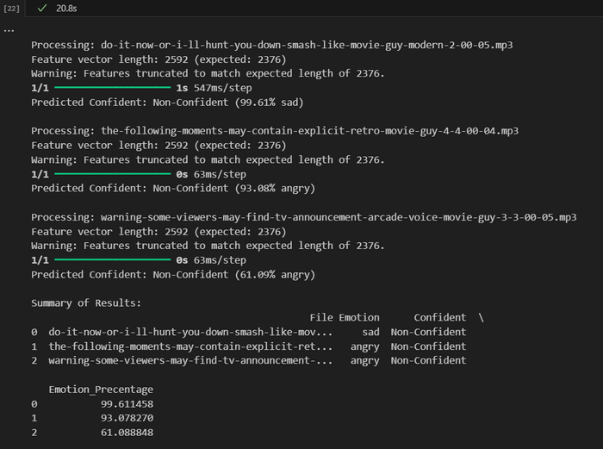
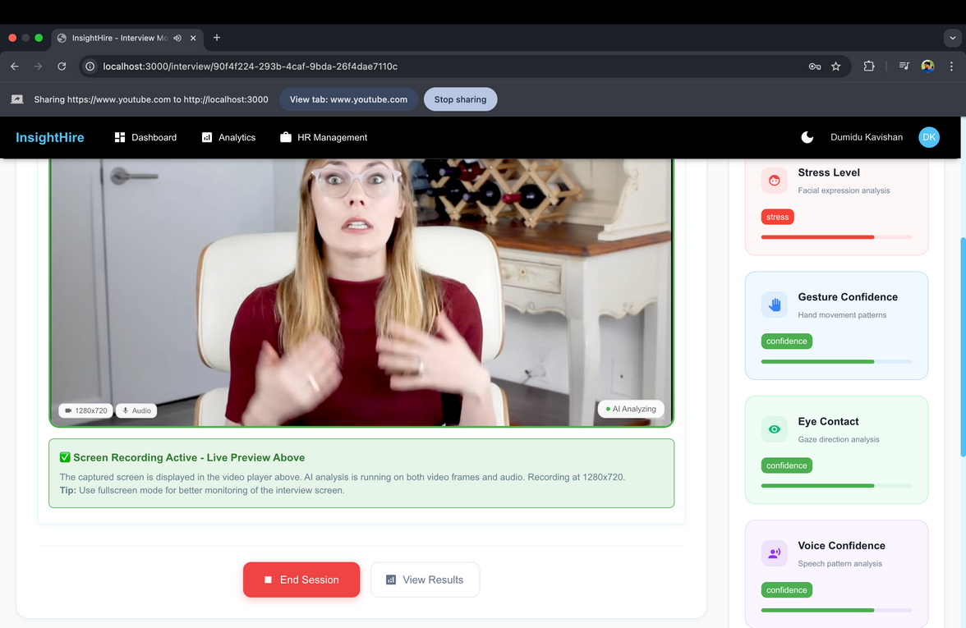
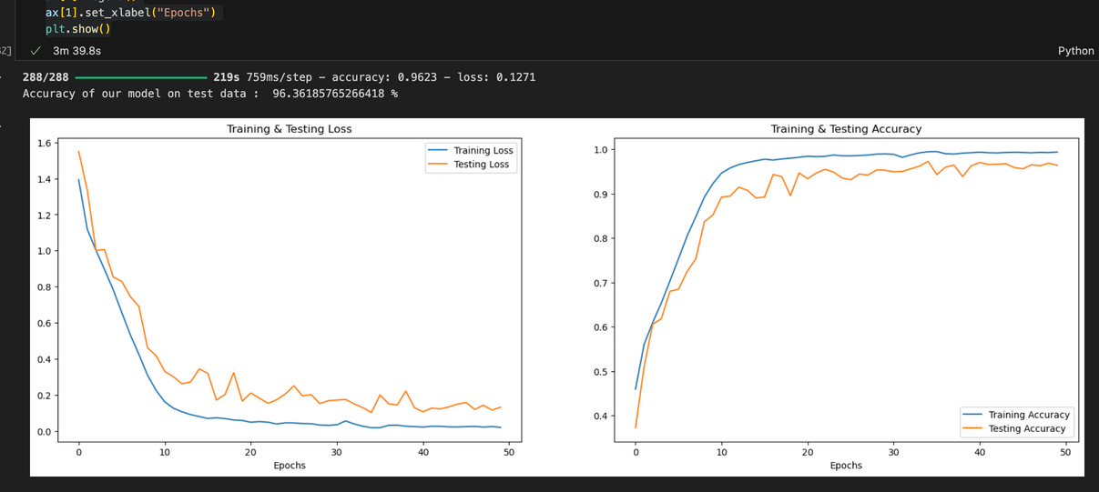
MODEL TRAINING
EVIDENCES FOR COMPLETION
ARCHITECTURE OF IMPLEMENTATION
IT21834424 | DE SILVA R.S.K | R25-040
10

Slide 11
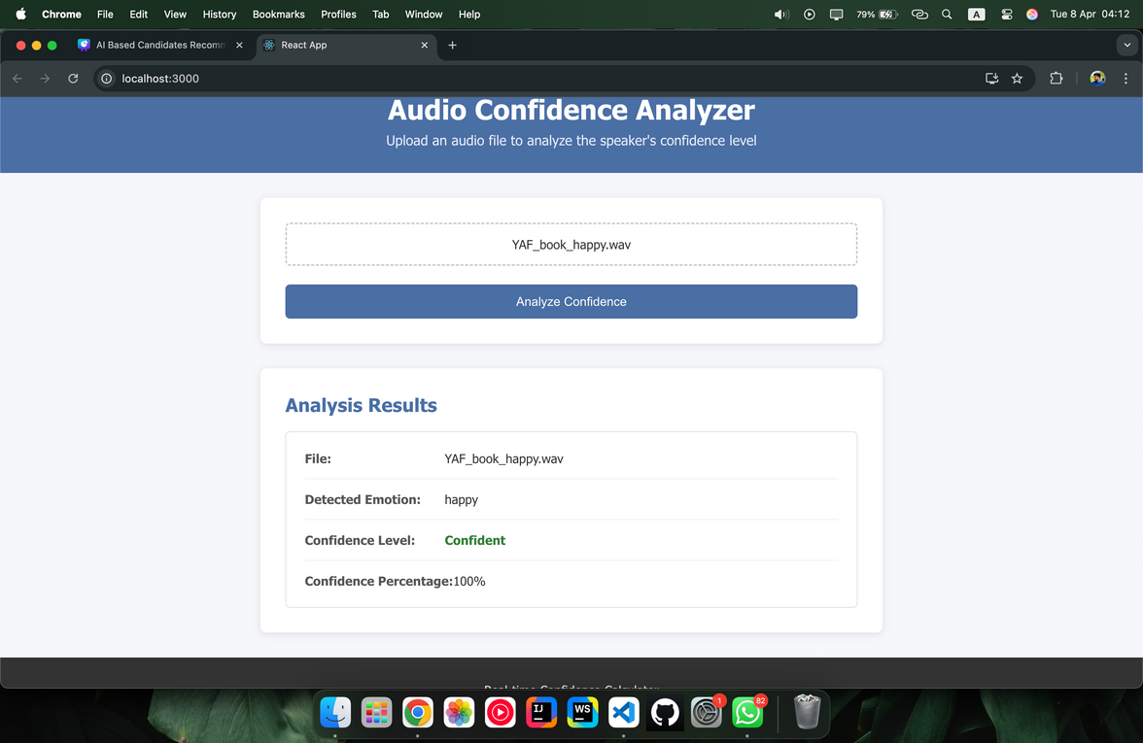
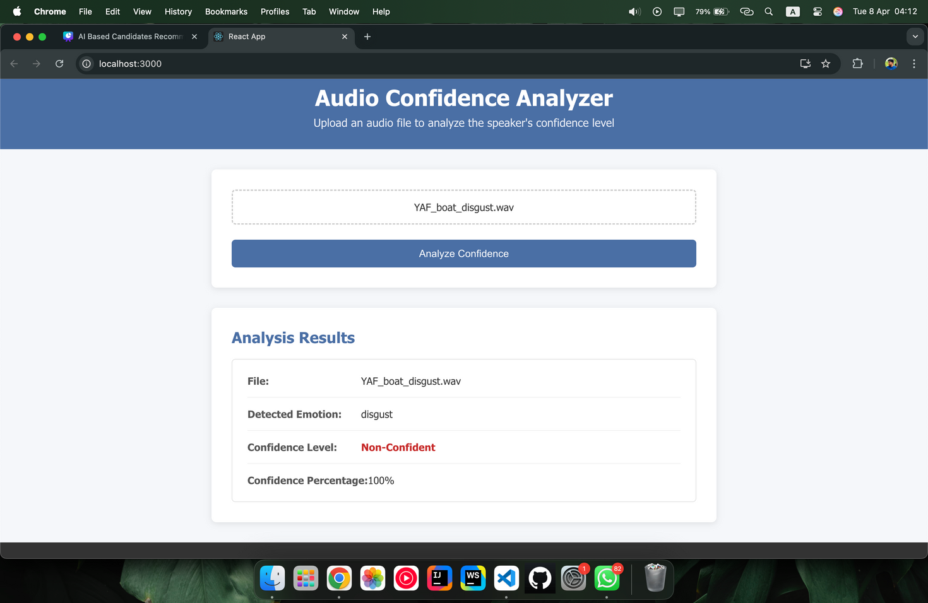
EVIDENCES FOR COMPLETION
IT21834424 | DE SILVA R.S.K | R25-040
11

Slide 12

IT21815614 | KASTHURIRATHNE K.T.A.D.K
COMPONENT 02: Predict the STRESS level
through facial expressions
BACHELOR OF SCIENCE (HONS) IN INFORMATION TECHNOLOGY
SPECIALIZING IN INFORMATION TECHNOLOGY
IT21815614 | KASTHURIRATHNE K.T.A.D.K | R25-040
12

Slide 13
SUMMARY OF THE COMPONENT
RESEARCH GAP
BACKGROUND
RESEARCH QUESTION
OBJECTIVES
IT21815614 | KASTHURIRATHNE K.T.A.D.K | R25-040
13

Slide 14
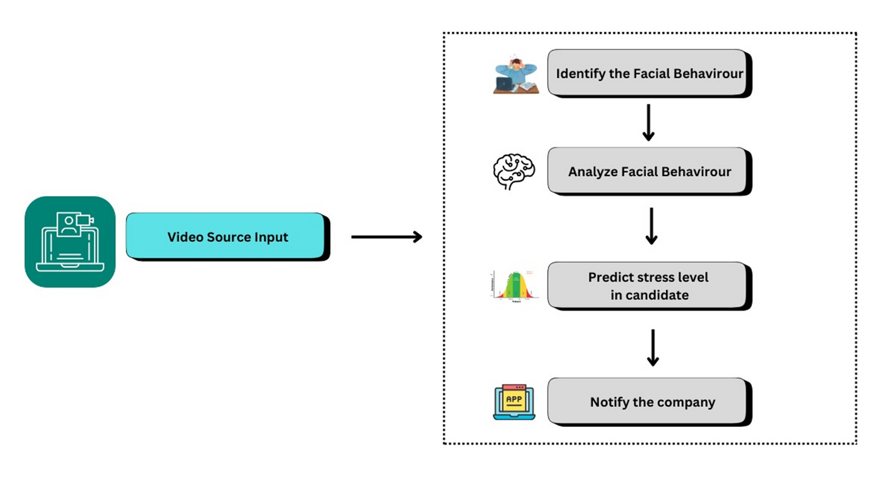
SYSTEM DIAGRAM & METHODOLOGY
IT21815614 | KASTHURIRATHNE K.T.A.D.K | R25-040
14

Slide 15



CURRENT PROGRESS
Data gathering & Analyzing
preprocessing &
model training
testing Model accuracy
100%
100%
88%
IT21815614 | KASTHURIRATHNE K.T.A.D.K | R25-040
15

Slide 16
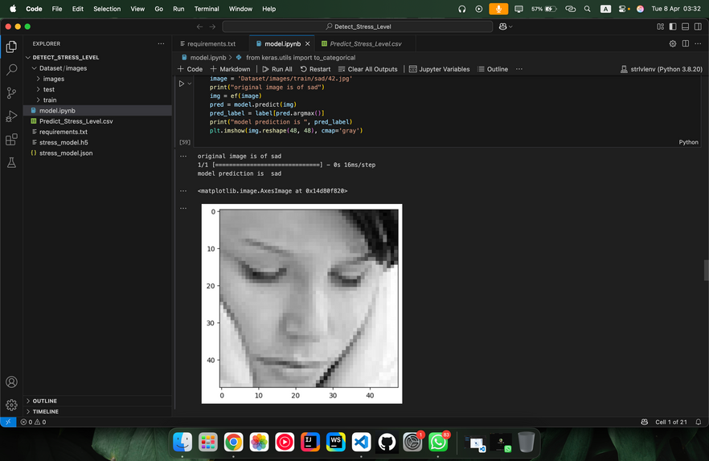

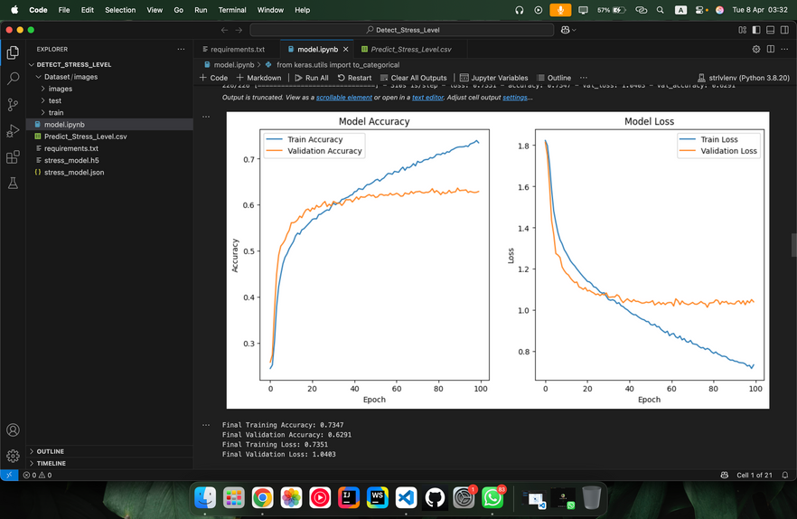
EVIDENCES FOR COMPLETION
MODEL TRAINING
ARCHITECTURE OF IMPLEMENTATION
IT21815614 | KASTHURIRATHNE K.T.A.D.K | R25-040
16

Slide 17
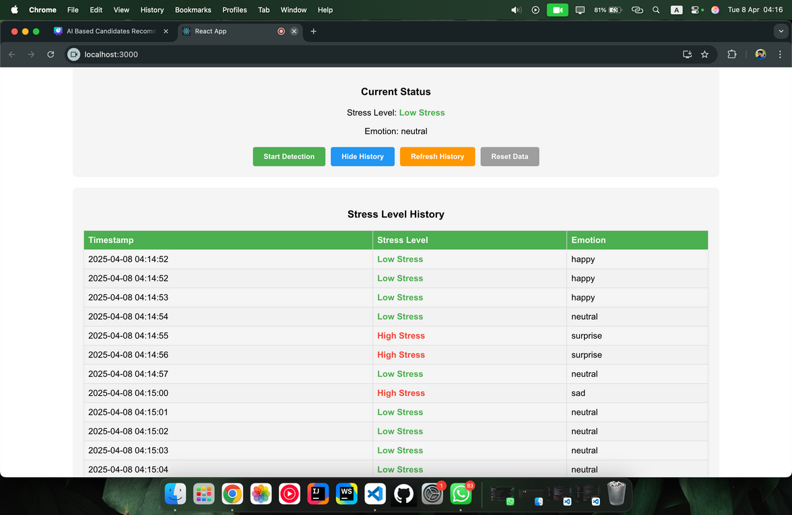
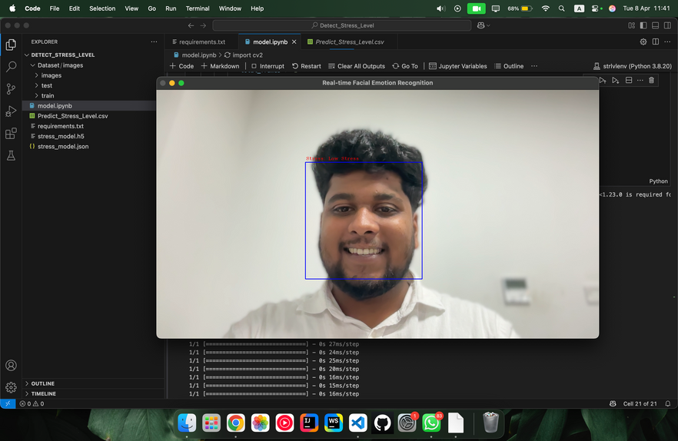
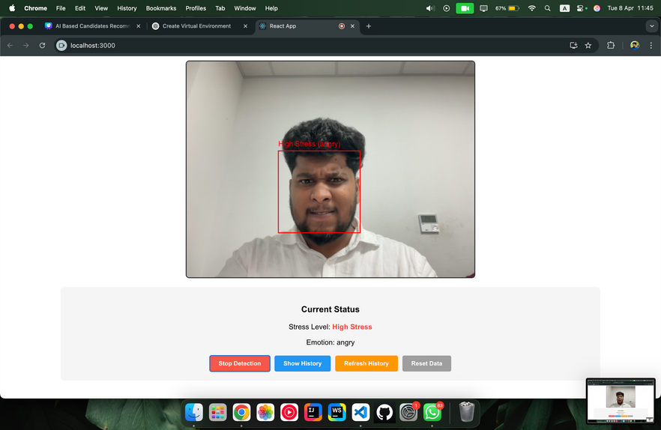
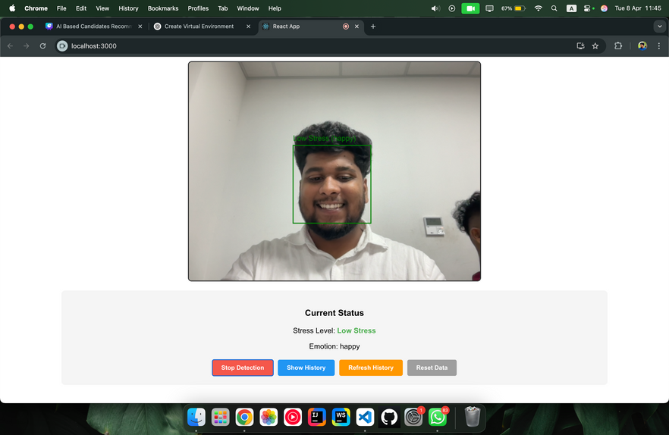
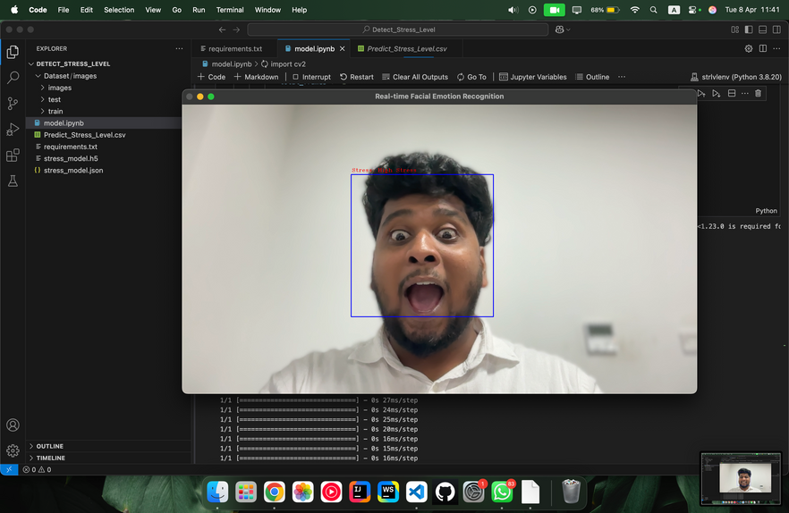
EVIDENCES FOR COMPLETION
PREDICTIONS
IT21815614 | KASTHURIRATHNE K.T.A.D.K | R25-040
17

Slide 18
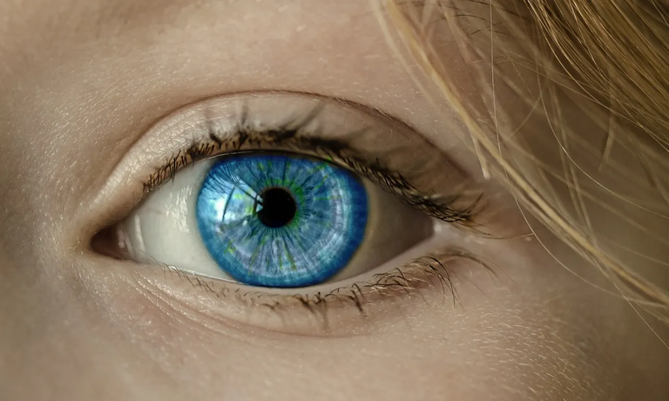
IT21838620 | S.U.D.A GUNASEKARA
COMPONENT 03: Predict the Confident through eye contact
BACHELOR OF SCIENCE (HONS) IN INFORMATION TECHNOLOGY
SPECIALIZING IN INFORMATION TECHNOLOGY
IT21838620 | S.U.D.A GUNASEKARA | R25-040
18

Slide 19
SUMMARY OF THE COMPONENT
RESEARCH GAP
BACKGROUND
RESEARCH QUESTION
OBJECTIVES
IT21838620 | S.U.D.A GUNASEKARA | R25-040
19

Slide 20
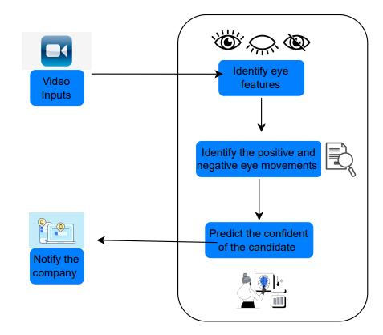
SYSTEM DIAGRAM & METHODOLOGY
IT21838620 | S.U.D.A GUNASEKARA | R25-040
20

Slide 21



CURRENT PROGRESS
Data gathering & Analyzing
preprocessing &
model training
testing Model accuracy
100%
100%
85%
IT21838620 | S.U.D.A GUNASEKARA | R25-040
21

Slide 22
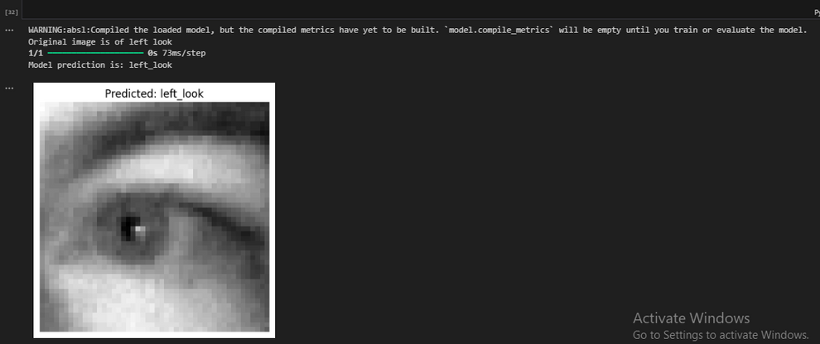
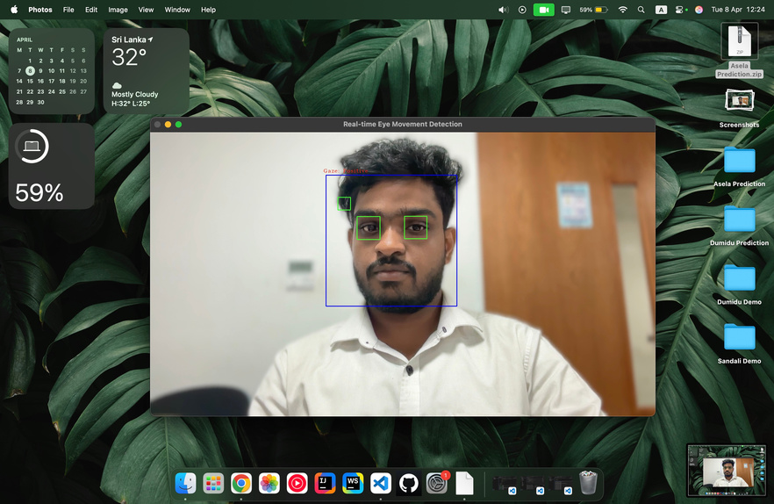
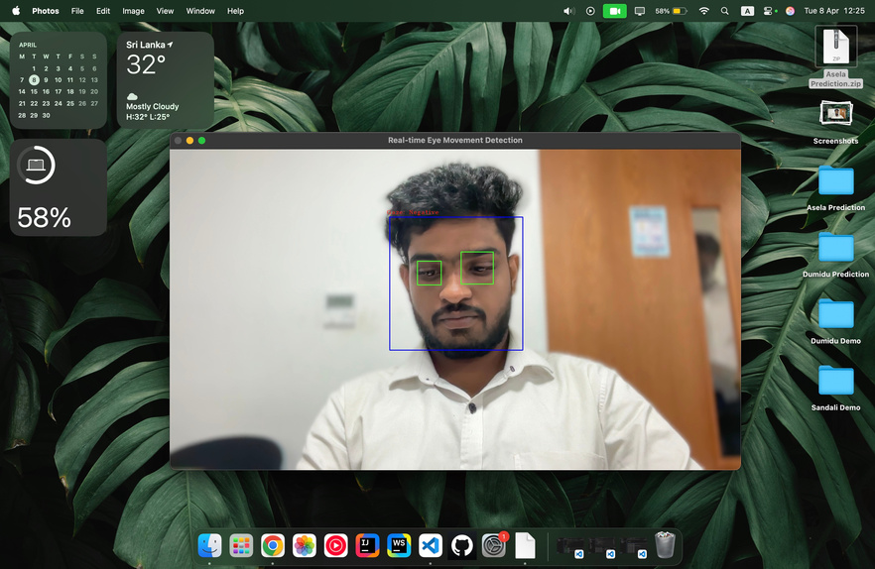
MODEL TRAINING
EVIDENCES FOR COMPLETION
PREDICTION
IT21838620 | S.U.D.A GUNASEKARA | R25-040
22

Slide 23
EVIDENCES FOR COMPLETION
ARCHITECTURE OF IMPLEMENTATION
IT21838620 | S.U.D.A GUNASEKARA | R25-040
23

Slide 24

IT21819810 | B.D.A.M KUMARA
COMPONENT 04: Predict confident through hand gestures in real time
BACHELOR OF SCIENCE (HONS) IN INFORMATION TECHNOLOGY
SPECIALIZING IN INFORMATION TECHNOLOGY
IT21819810 |B.D.A.M KUMARA | R25-040
24

Slide 25
SUMMARY OF THE COMPONENT
RESEARCH GAP
BACKGROUND
RESEARCH QUESTION
OBJECTIVES
IT21819810 |B.D.A.M KUMARA | R25-040
25

Slide 26
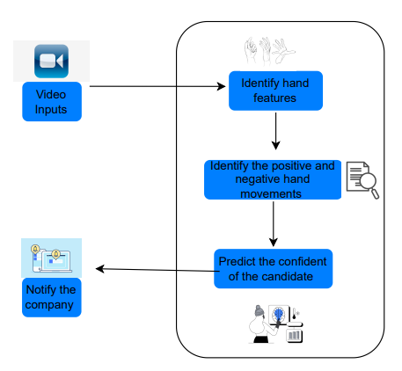
SYSTEM DIAGRAM & METHODOLOGY
IT21819810 |B.D.A.M KUMARA | R25-040
26

Slide 27



CURRENT PROGRESS
Data gathering & Analyzing
preprocessing &
model training
testing Model accuracy
100%
100%
87%
IT21819810 |B.D.A.M KUMARA | R25-040
27

Slide 28
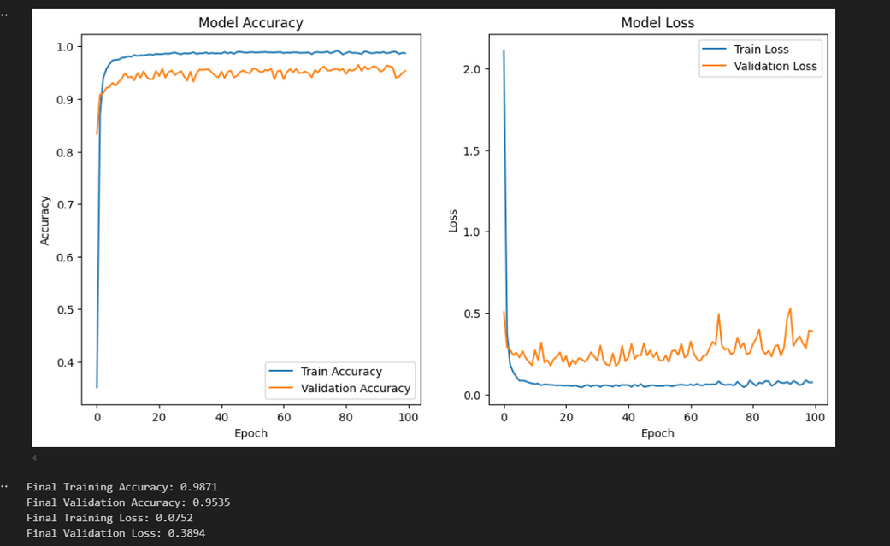
EVIDENCES FOR COMPLETION
MODEL TRAINING
ARCHITECTURE OF IMPLEMENTATION
IT21819810 |B.D.A.M KUMARA | R25-040
28

Slide 29
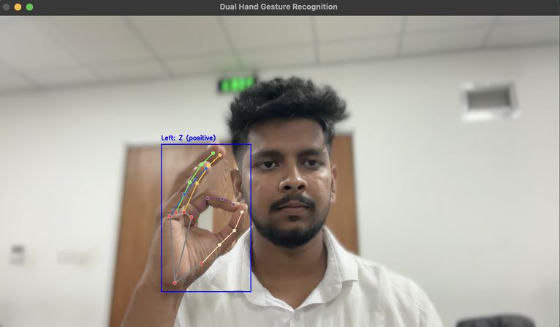
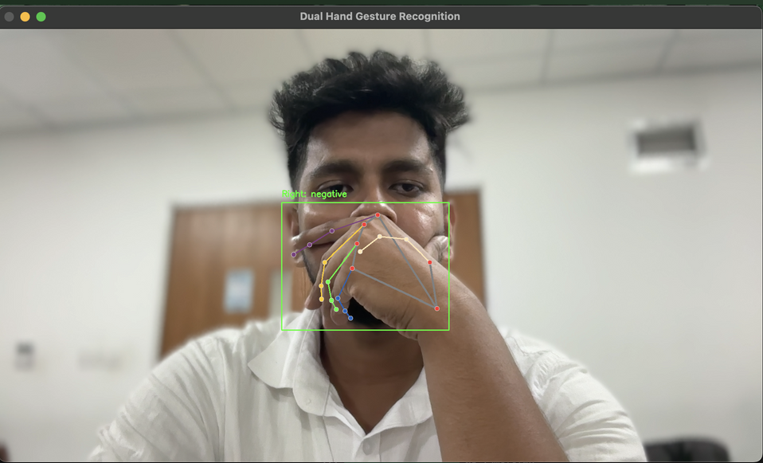
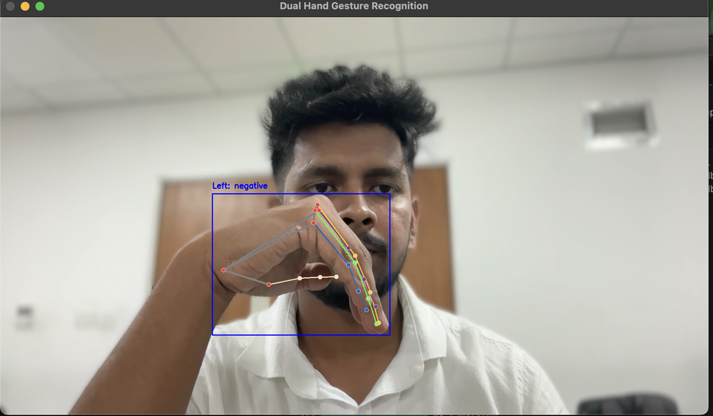
PREDICTION
Positive Hand Gesture
Negative Hand Gesture
IT21819810 |B.D.A.M KUMARA | R25-040
29

Slide 30
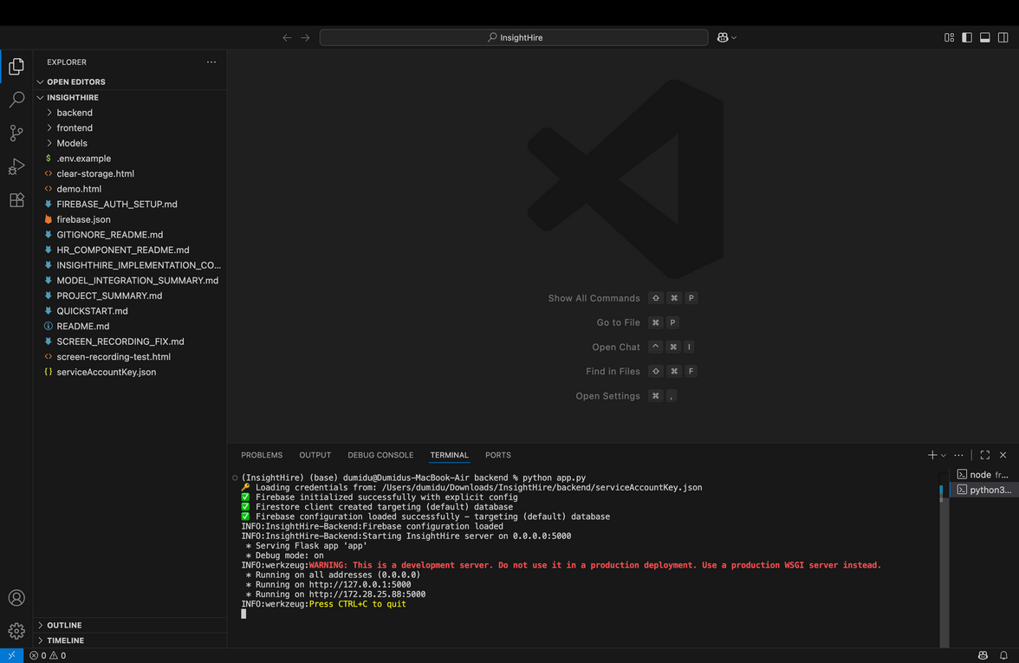
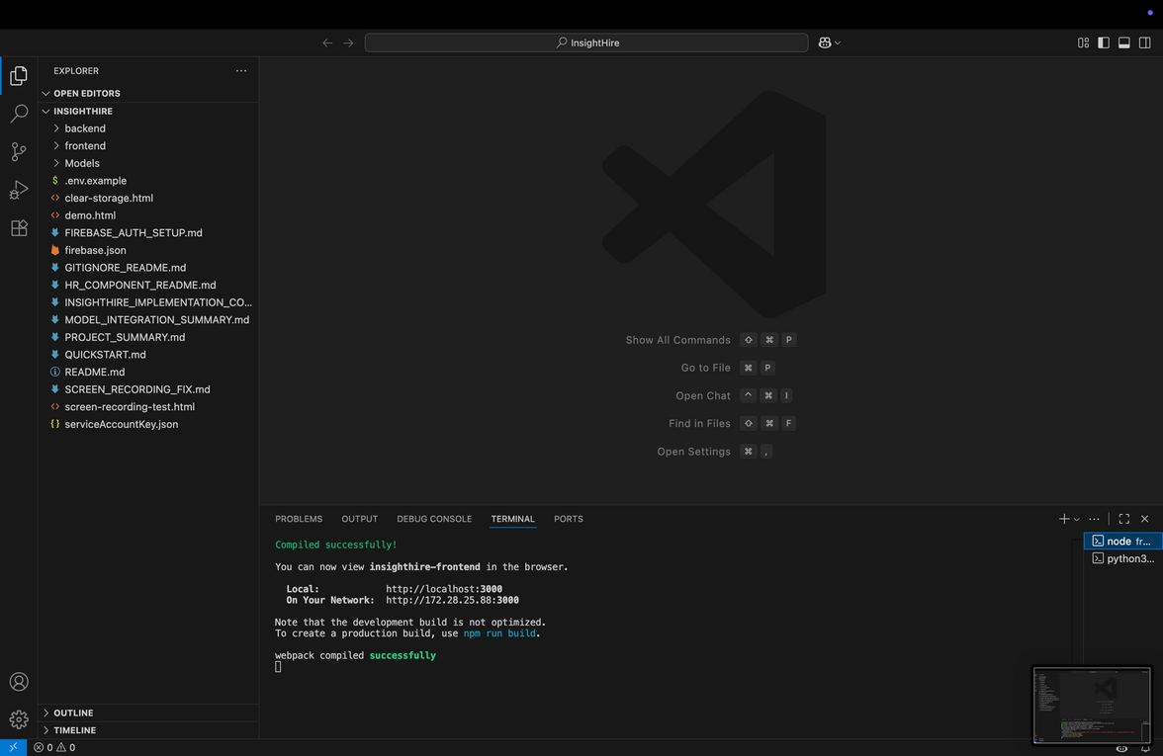
EVIDENCES OF IMPLEMENTATIONS OF THE APPLICATION
Backend Implementation
FRONTEND IMPLEMENTATION
30

Slide 31
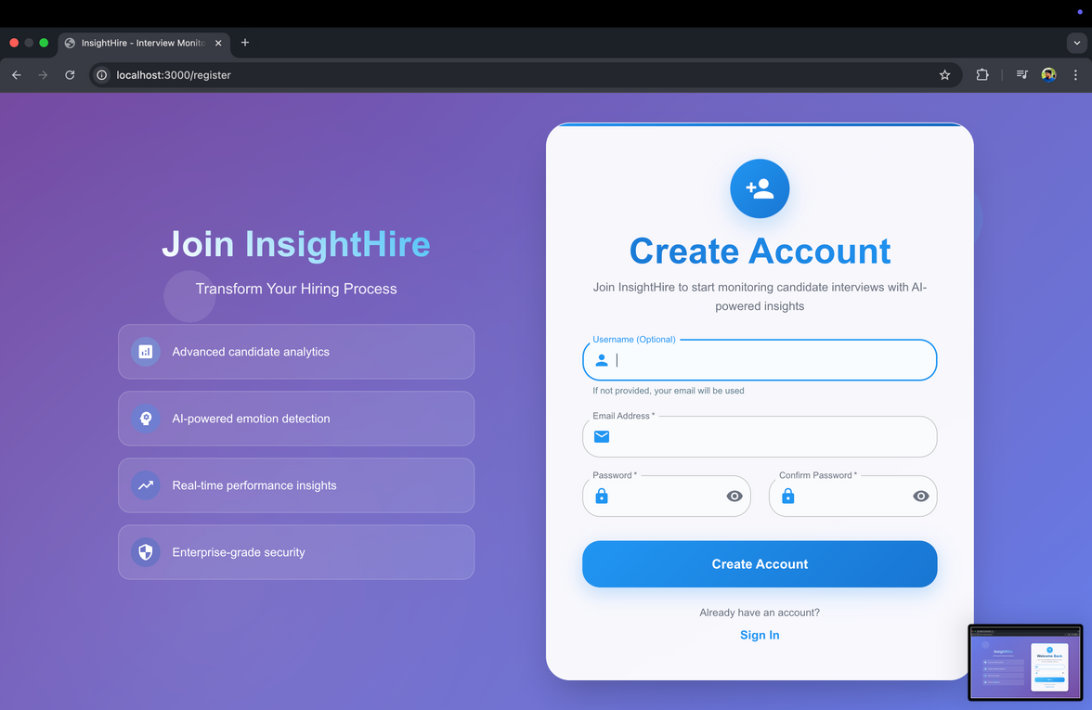
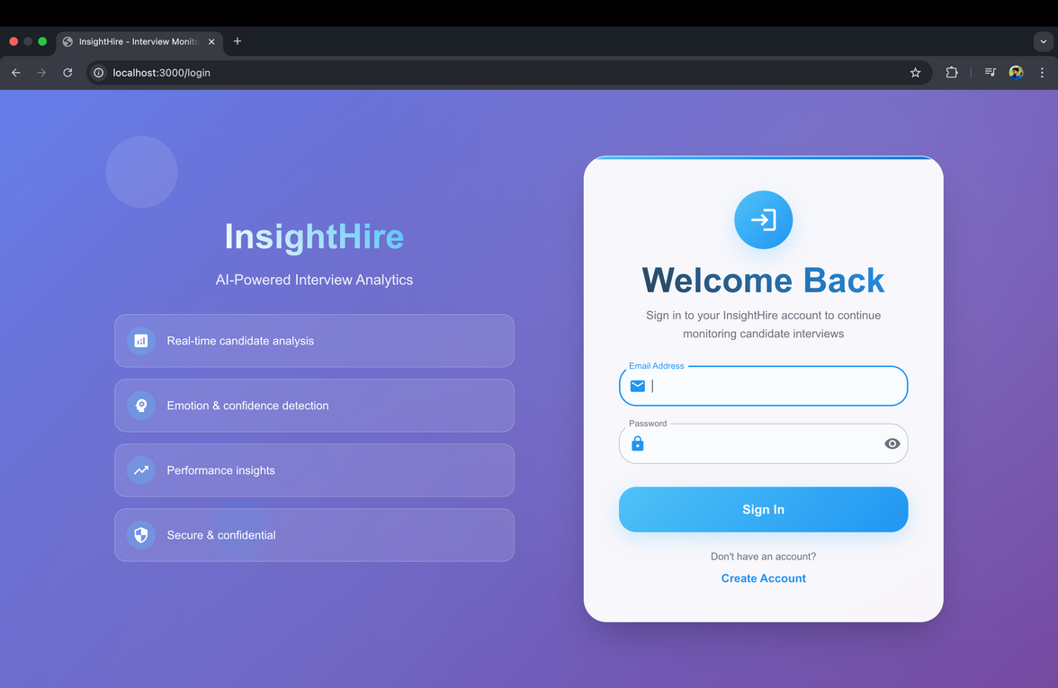
LOGIN TO APPLICATION
LOGIN TO APPLICATION
31

Slide 32
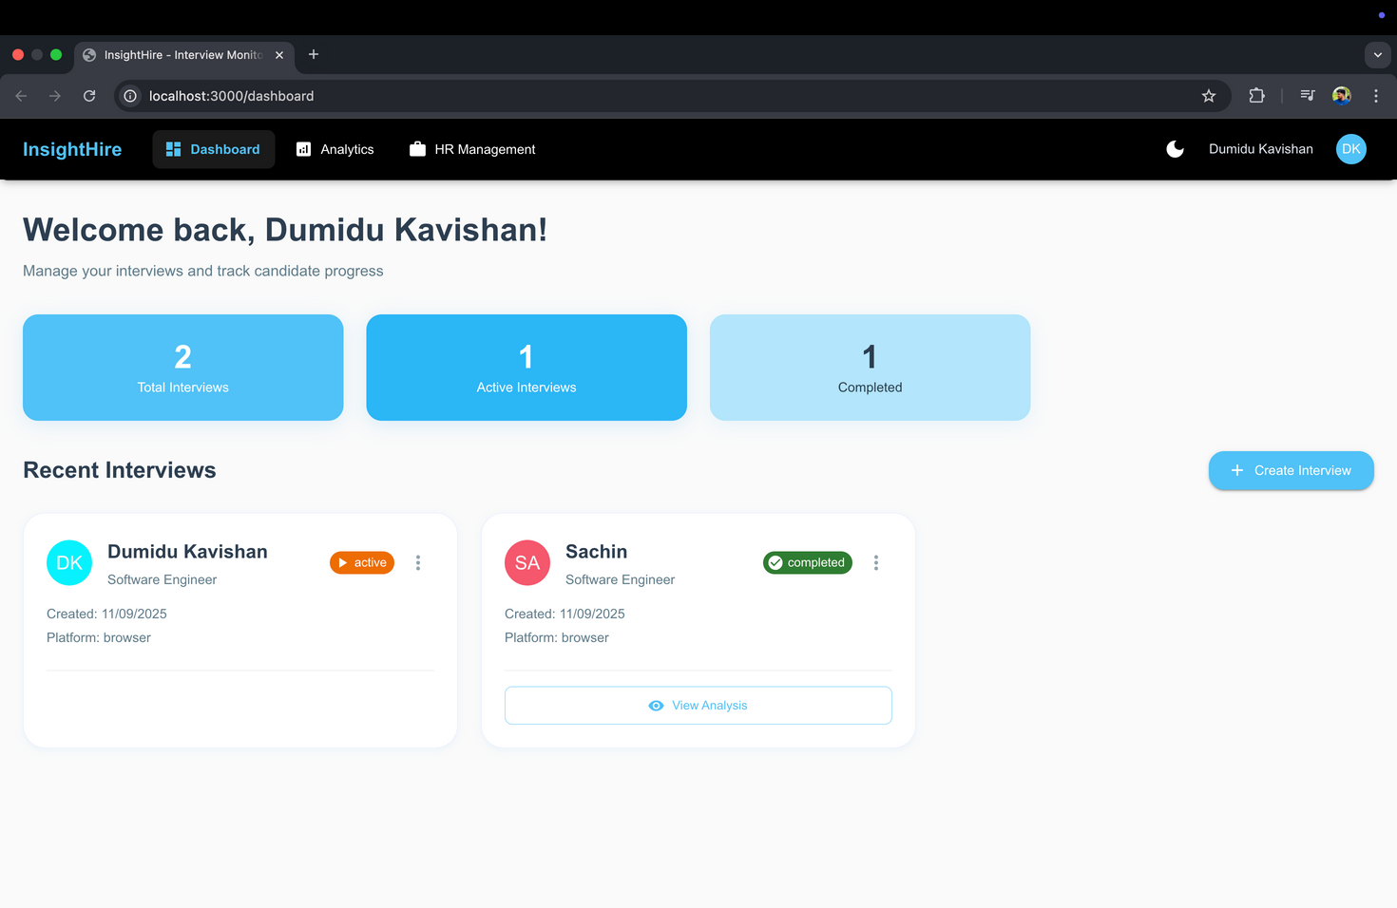
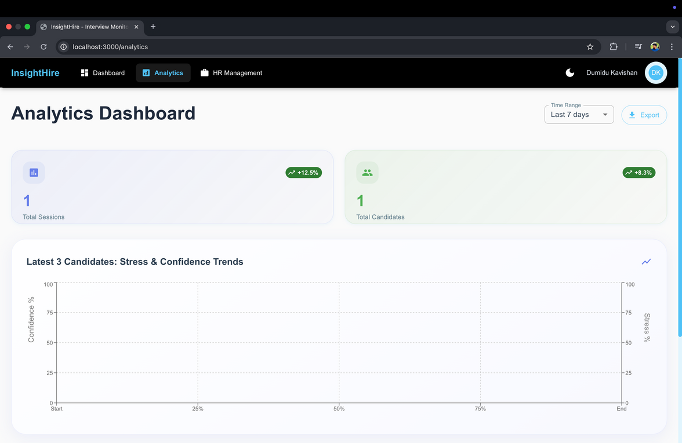
32

Slide 33
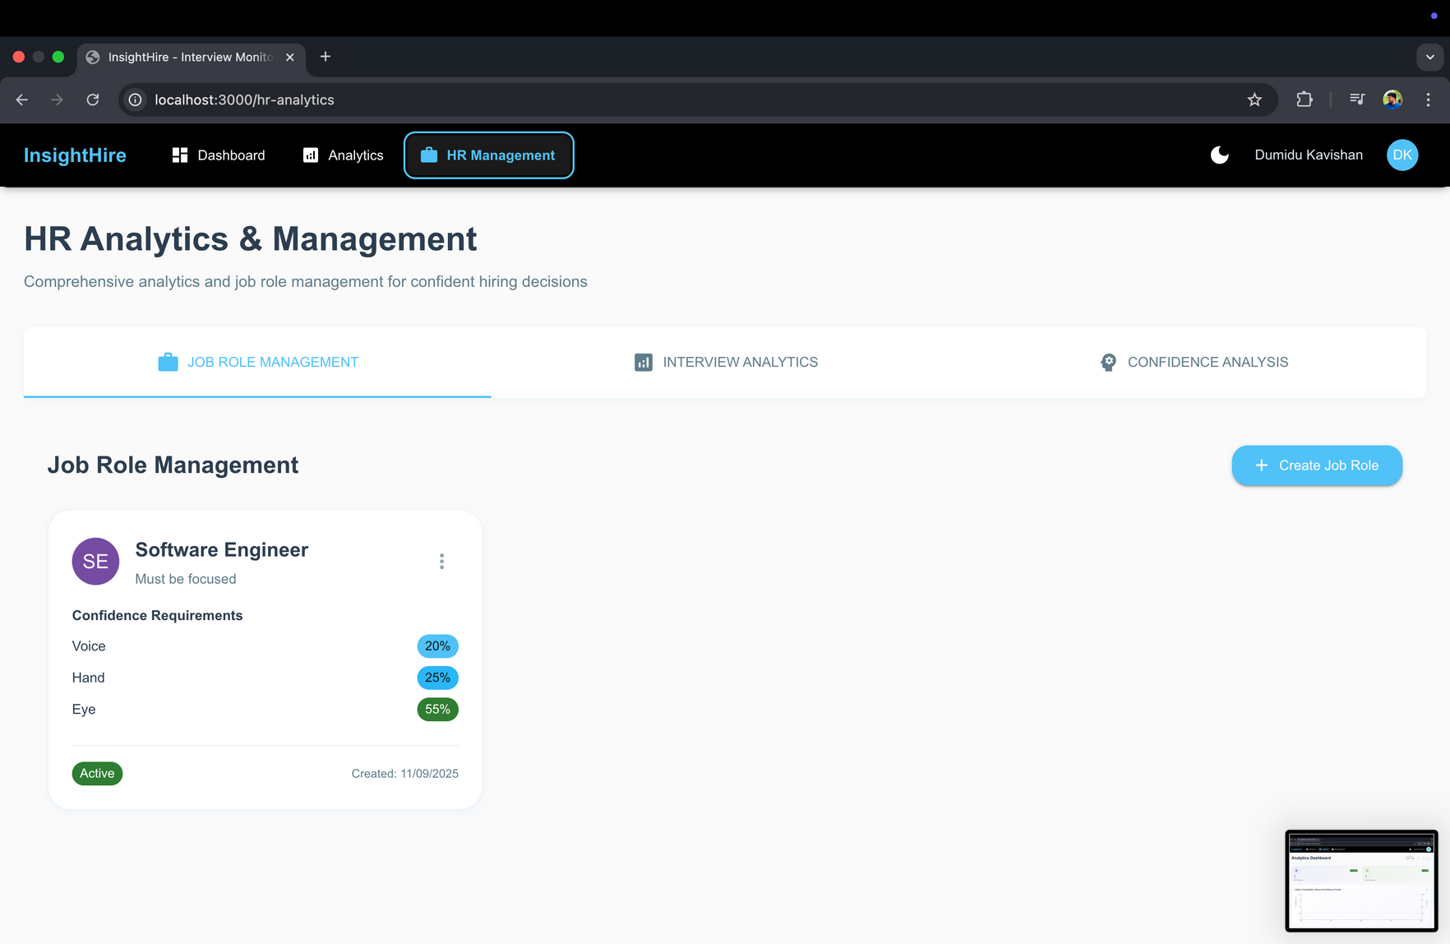
33

Slide 34
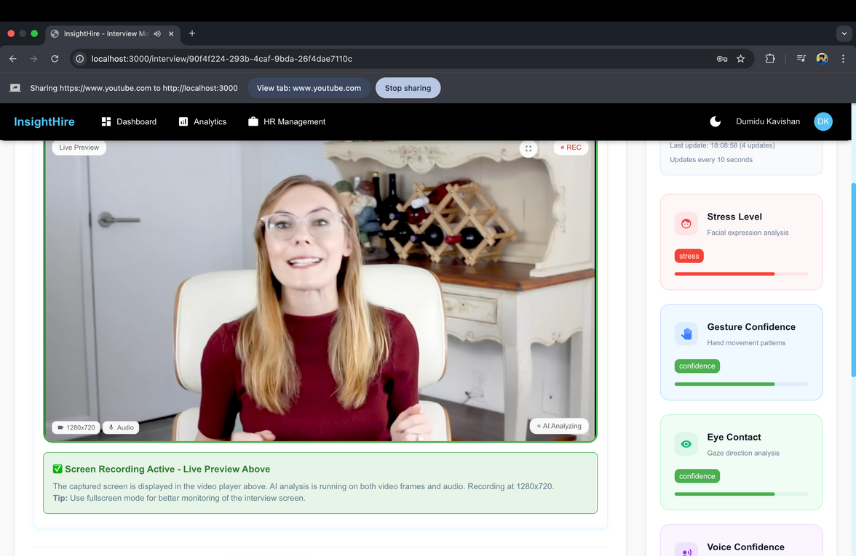
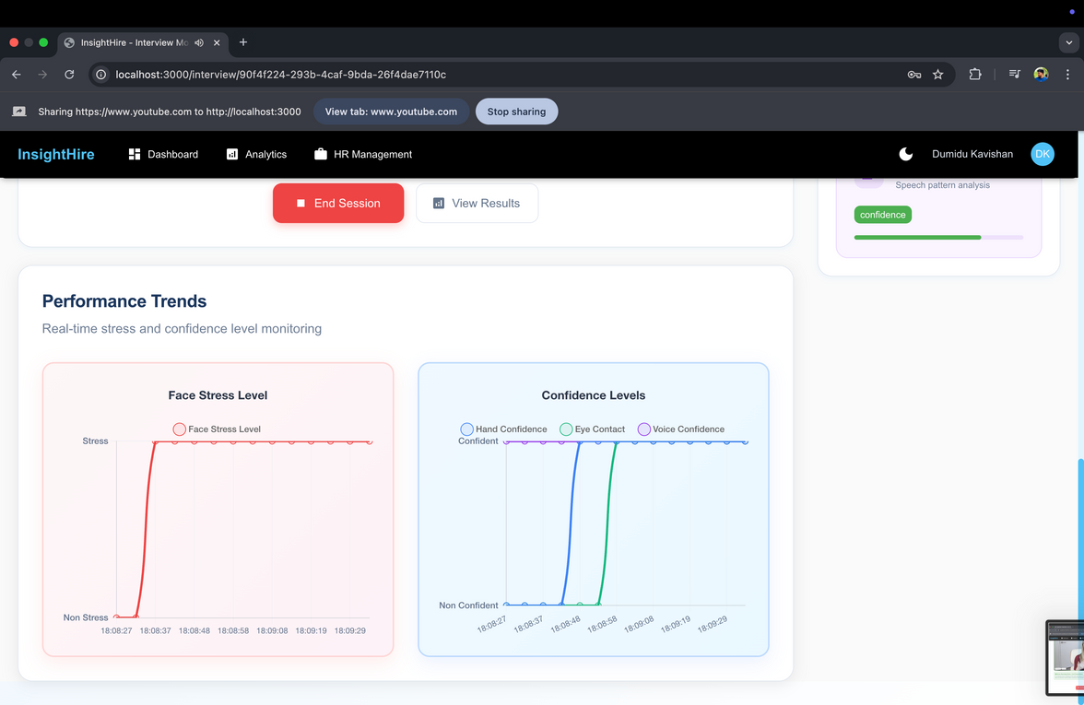
34

Slide 35











TOOLS & TECHNOLOGIES
35

Slide 36






CURRENT APPLICATION PROGRESS
completion of each component
web application
integration
enhancing the application
95%
98%
90%
testing
analytics
Report generation
95%
100%
60%
36

Slide 37



COMMERCIALIZATION
•Offer a Free Trial or Basic Plan
•Leverage Direct-to-Consumer Marketing
•Incentives and Loyalty Programs
37

Slide 38

Q & A
Thank You!
INSIGHTHIRE

