Slide 1



Noida Institute of Engineering and Technology, Greater Noida
DISTRIBUTED RELATIONAL DATABASE
Unit: 2
Advance database management system
Shruti Dadhich
AIML dept
B Tech 6th Sem

Slide 2
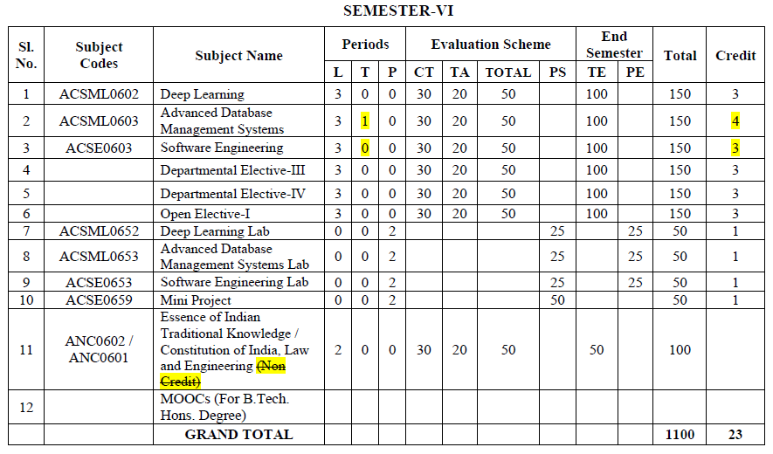
Evaluation Scheme

Slide 3
Syllabus
Introduction to relational database: Describe the relational model: Conformity and integrity, Use of constraints, Mapping design approaches to relational systems, Processing database data: Describe advanced SQL programming,
Query optimization: Query transformations, Optimization approaches, Use of constraints, Creation and use of a variety of index types.
Concurrency control and transaction management: The ACID principle, Two-phase locking and Deadlocks, Recovery and transaction design.

Slide 4
Branch wise Application
There are various application of Advance DBMS in different fields like:
Railway Reservation System,
Library Management System,
Banking,
Universities and colleges,
Credit card transactions etc.

Slide 5
Course Objective
This course provides an introduction to the advanced database management system.
The course introduces both theoretical (knowledge-based) and practical approaches, illustrate the use of advanced database and tools in a variety of application areas, as well as provide insight into many open research problems.

Slide 6
Content
Introduction to relational database
Describe the relational model Conformity and integrity
Use of constraints
Mapping design approaches to relational systems
Processing database data
Describe advanced SQL programming
Query optimization
Query transformations
Optimization approaches
Use of constraints
Creation and use of a variety of index types
Concurrency control and transaction management
The ACID principle
Two-phase locking and Deadlocks
Recovery and transaction design

Slide 7
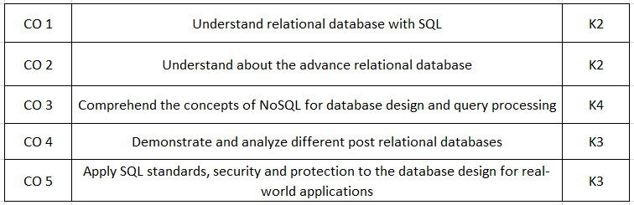
Course Outcomes(COs)

Slide 8
Program Outcomes (POs)
Engineering Graduates will be able to:
1. Engineering knowledge: Apply the knowledge of mathematics, science, engineering fundamentals, and an engineering specialization to the solution of complex engineering problems.
2. Problem analysis: Identify, formulate, review research literature, and analyze complex engineering problems reaching substantiated conclusions using first principles of mathematics, natural sciences, and engineering sciences.
3. Design/development of solutions: Design solutions for complex engineering problems and design system components or processes that meet the specified needs with appropriate consideration for the public health and safety, and the cultural, societal, and environmental considerations.
4. Conduct investigations of complex problems: Use research-based knowledge and research methods including design of experiments, analysis and interpretation of data, and synthesis of the information to provide valid conclusions.

Slide 9
Program Outcomes (POs)
5. Modern tool usage: Create, select, and apply appropriate techniques, resources, and modern engineering and IT tools including prediction and modeling to complex engineering activities with an understanding of the limitations.
6. The engineer and society: Apply reasoning informed by the contextual knowledge to assess societal, health, safety, legal and cultural issues and the consequent responsibilities relevant to the professional engineering practice.
7. Environment and sustainability: Understand the impact of the professional engineering solutions in societal and environmental contexts, and demonstrate the knowledge of, and need for sustainable development.
8. Ethics: Apply ethical principles and commit to professional ethics and responsibilities and norms of the engineering practice.

Slide 10
Program Outcomes (POs)
9. Individual and team work: Function effectively as an individual, and as a member or leader in diverse teams, and in multidisciplinary settings.
10. Communication: Communicate effectively on complex engineering activities with the engineering community and with society at large, such as, being able to comprehend and write effective reports and design documentation, make effective presentations, and give and receive clear instructions.
11. Project management and finance: Demonstrate knowledge and understanding of the engineering and management principles and apply these to one’s own work, as a member and leader in a team, to manage projects and in multidisciplinary environments.
12. Life-long learning: Recognize the need for, and have the preparation and ability to engage in independent and life-long learning in the broadest context of technological change.

Slide 11
Program Educational Objectives (PEOs)
PEO1:
Able to apply sound knowledge in the field of information technology to fulfill the needs of IT industry.
PEO2:
Able to design innovative and interdisciplinary systems through latest digital technologies.
PEO3:
Able to inculcate professional ethics, team work and leadership for serving the society.
PEO4:
Able to inculcate lifelong learning in the field of computing for successful career in organizations and R&D sectors.

Slide 12
COs and POs Mapping
 | PO1 | PO2 | PO3 | PO4 | PO5 | PO6 | PO7 | PO8 | PO9 | PO10 | PO11 | PO12
 | 2 | 2 | 3 | 3 | 3 | 2 | 3 | 2 | 2 | 2 | 2 | 3
KCS501.2 | 3 | 3 | 3 | 2 | 2 | 2 | 2 | 2 | 2 | 2 | 2 | 3
KCS501.3 | 2 | 3 | 3 | 3 | 3 | 2 | 2 | 2 | 2 | 2 | 2 | 2
KCS501.4 | 2 | 3 | 2 | 2 | 2 | 2 | 2 | 2 | 2 | 3 | 2 | 2
KCS501.5 | 2 | 3 | 2 | 2 | 2 | 3 | 2 | 2 | 3 | 2 | 2 | 2
AVG | 2.20 | 2.80 | 2.60 | 2.40 | 2.40 | 2.20 | 2.20 | 2.00 | 2.20 | 2.20 | 2.00 | 2.40

Slide 13
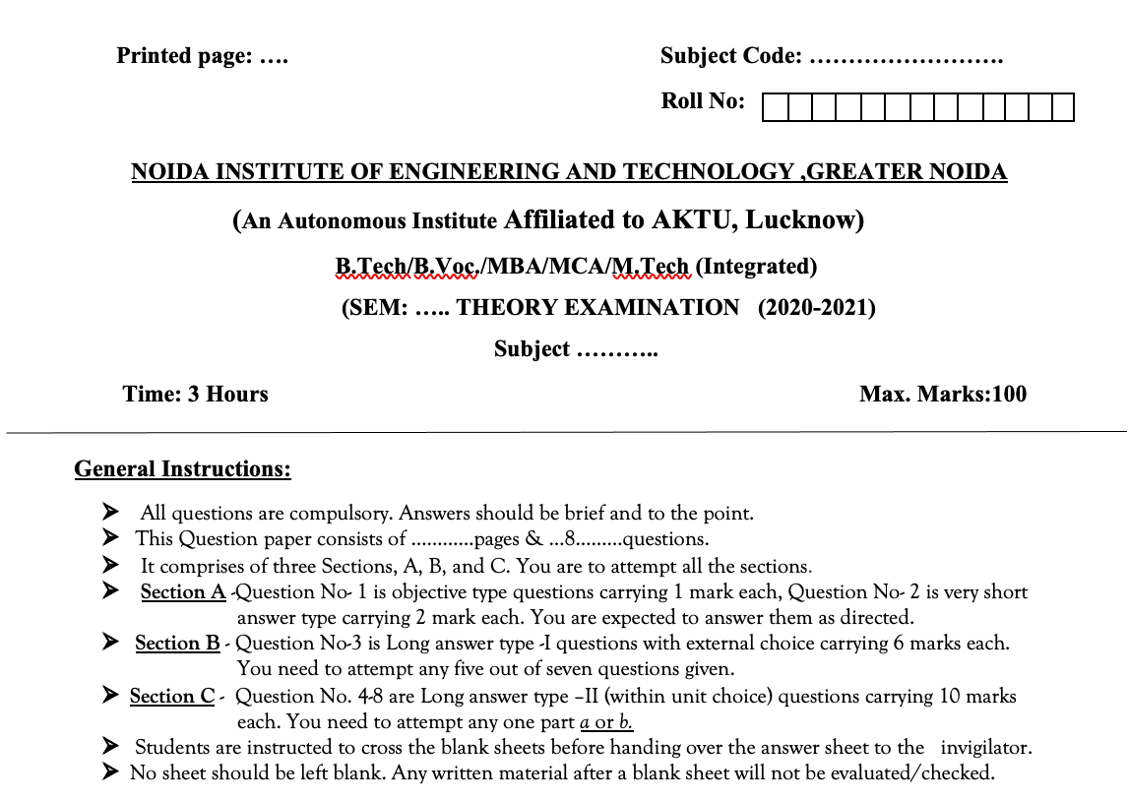
Question Paper Template

Slide 14
Question Paper Template
 |  | SECTION – A |  | CO
 | Attempt all parts- |  | [10×1=10]
 | 1-a. | Question- | (1)
 | 1-b. | Question- | (1)
 | 1-c. | Question- | (1)
 | 1-d. | Question- | (1)
 | 1-e. | Question- | (1)
 | 1-f. | Question- | (1)
 | 1-g. | Question- | (1)
 | 1-h. | Question- | (1)
 | 1-i. | Question- | (1)
 | 1-j. | Question- | (1)
2. | Attempt all parts- |  | [5×2=10] | CO
 | 2-a. | Question- | (2)
 | 2-b. | Question- | (2)
 | 2-c. | Question- | (2)
 | 2-d. | Question- | (2)
 | 2-e. | Question- | (2)
SECTION – B |  |  |  | CO
3. | Answer any five of the following- |  | [5×6=30]
 | 3-a. | Question- | (6)
 | 3-b. | Question- | (6)
 | 3-c. | Question- | (6)
 | 3-d. | Question- | (6)
 | 3-e. | Question- | (6)
 | 3-f. | Question- | (6)
 | 3-g. | Question- | (6)
SECTION – C |  |  |  | CO
4 | Answer any one of the following- |  | [5×10=50]
 | 4-a. | Question- | (10)
 | 4-b. | Question- | (10)
5. | Answer any one of the following-
 | 5-a. | Question- | (10)
 | 5-b. | Question- | (10)
6. | Answer any one of the following-
 | 6-a. | Question- | (10)
 | 6-b. | Question- | (10)
7. | Answer any one of the following-
 | 7-a. | Question- | (10)
 | 7-b. | Question- | (10)
8. | Answer any one of the following-
 | 8-a. | Question- | (10)
 | 8-b. | Question- | (10)

Slide 15
Prerequisite and Recap
The student should have knowledge of relational database management system (RDBMS) and SQL.
Having knowledge of basic mathematics like - SUM, DIFFERENCE, AVERAGE, MEAN, MEDIAN, MODE, etc will definitely be a plus point.
Having knowledge on Set Theory will help.
The proper understanding of data structures (B and B+ trees) will help you to understand the DBMS quickly.

Slide 16
Unit Objective
Students will be able to learn various Distributed Relational Database Model Concepts, constraints.
Introduction on Homogeneous and heterogeneous databases, overview of distributed transactions, Database System Catalogs, learning about Data replication. Differentiate between Synchronous and Asynchronous replication.
Introduction of Two-Phase Commit protocol and its weaknesses and concurrency control in distributed databases Implications for cloud storage.

Slide 17
Introduction to distributed Database
A distributed database is a collection of multiple interconnected databases, which are spread physically across various locations that communicate via a computer network.
A distributed database system is located on various sites that don’t share physical components. This may be required when a particular database needs to be accessed by various users globally. It needs to be managed such that for the users it looks like one single database.

Slide 18
Conti…
A distributed database management system (DDBMS) is a centralized software system that manages a distributed database in a manner as if it were all stored in a single location.

Slide 19
Features
Features:
It is used to create, retrieve, update and delete distributed databases.
It synchronizes the database periodically and provides access mechanisms by the virtue of which the distribution becomes transparent to the users.
It ensures that the data modified at any site is universally updated.
It is used in application areas where large volumes of data are processed and accessed by numerous users simultaneously.
It is designed for heterogeneous database platforms.
It maintains confidentiality and data integrity of the databases.

Slide 20
Advantage of Distributed Database
Advantages of Distributed Databases:
Following are the advantages of distributed databases over centralized databases.
Modular Development − If the system needs to be expanded to new locations or new units, in centralized database systems, the action requires substantial efforts and disruption in the existing functioning.
However, in distributed databases, the work simply requires adding new computers and local data to the new site and finally connecting them to the distributed system, with no interruption in current functions.

Slide 21
Conti...
More Reliable − In case of database failures, the total system of centralized databases comes to a halt. However, in distributed systems, when a component fails, the functioning of the system continues may be at a reduced performance. Hence DDBMS is more reliable.
Better Response − If data is distributed in an efficient manner, then user requests can be met from local data itself, thus providing faster response.
On the other hand, in centralized systems, all queries have to pass through the central computer for processing, which increases the response time.

Slide 22
Conti...
Lower Communication Cost − In distributed database systems, if data is located locally where it is mostly used, then the communication costs for data manipulation can be minimized. This is not feasible in centralized systems.

Slide 23
Types of Distributed Database
1. Homogeneous Distributed Databases:
In a homogeneous distributed database, all the sites use identical DBMS and operating systems. Its properties are −
The sites use very similar software.
The sites use identical DBMS or DBMS from the same vendor.
Each site is aware of all other sites and cooperates with other sites to process user requests.
The database is accessed through a single interface as if it is a single database.

Slide 24
Conti…
Types of Homogeneous Distributed Database:
In a homogeneous database, all different sites store database identically. The operating system, database management system, and the data structures used – all are the same at all sites. Hence, they’re easy to manage.

Slide 25
Conti…
There are two types of homogeneous distributed database −
Autonomous − Each database is independent that functions on its own. They are integrated by a controlling application and use message passing to share data updates.
Non-autonomous − Data is distributed across the homogeneous nodes and a central or master DBMS co-ordinates data updates across the sites.

Slide 26
Conti…
2. Heterogeneous Distributed Databases:
In a heterogeneous distributed database, different sites can use different schema and software that can lead to problems in query processing and transactions. Also, a particular site might be completely unaware of the other sites.
In a heterogeneous distributed database, different sites have different operating systems, DBMS products and data models.

Slide 27
Conti…
Types of Heterogeneous Distributed Databases:
Federated − The heterogeneous database systems are independent in nature and integrated together so that they function as a single database system.
Un-federated − The database systems employ a central coordinating module through which the databases are accessed.

Slide 28
Conti…
Properties:
Different sites use dissimilar schemas and software.
The system may be composed of a variety of DBMSs like relational, network, hierarchical or object oriented.
Query processing is complex due to dissimilar schemas.
Transaction processing is complex due to dissimilar software.
A site may not be aware of other sites and so there is limited co-operation in processing user requests.

Slide 29
Distributed Transaction
A distributed transaction is a set of operations on data that is performed across two or more data repositories (especially databases). It is typically coordinated across separate nodes connected by a network, but may also span multiple databases on a single server.
Databases are common transactional resources and, often, transactions span a couple of such databases.

Slide 30
Conti…
In this case, a distributed transaction can be seen as a database transaction that must be synchronized (or provide ACID properties) among multiple participating databases which are distributed among different physical locations.
Flat & Nested Distributed Transactions : If a client transaction calls actions on multiple servers, it is said to be distributed. Distributed transactions can be structured in two different ways:
Flat transactions
Nested transactions

Slide 31
Conti…
FLAT TRANSACTIONS : A flat transaction has a single initiating point(Begin) and a single end point(Commit or abort). They are usually very simple and are generally used for short activities rather than larger ones. A client makes requests to multiple servers in a flat transaction. Transaction T, for example, is a flat transaction that performs operations on objects in servers X, Y, and Z. Before moving on to the next request, a flat client transaction completes the previous one. As a result, each transaction visits the server object in order.

Slide 32
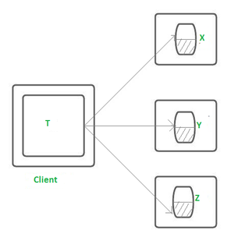
Conti…
A transaction can only wait for one object at a time when servers utilize locking.
Limitations of a flat Transaction :
All work is lost in the event of a crash.
Only one DBMS may be used at a time.
No partial rollback is possible.

Slide 33
Conti…
NESTED TRANSACTIONS : A transaction that includes other transactions within its initiating point and a end point are known as nested transactions. So the nesting of the transactions is done in a transaction. The nested transactions here are called sub-transactions. The top-level transaction in a nested transaction can open sub-transactions, and each sub-transaction can open more sub-transactions down to any depth of nesting.

Slide 34
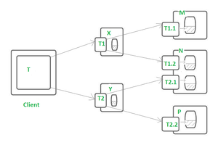
Conti…
A client’s transaction T opens up two sub-transactions, T1 and T2, which access objects on servers X and Y, as shown in the diagram below.
T1.1, T1.2, T2.1, and T2.2, which access the objects on the servers M,N, and P, are opened by the sub-transactions T1 and T2.

Slide 35
Conti…
Concurrent Execution of the Sub-transactions is done which are at the same level – in the nested transaction strategy.
Here, in the above diagram, T1 and T2 invoke objects on different servers and hence they can run in parallel and are therefore concurrent.
T1.1, T1.2, T2.1, and T2.2 are four sub-transactions. These sub-transactions can also run in parallel.

Slide 36
Database System Catalog
A system catalog is a group of tables and views that incorporate vital details regarding a database. Every database comprised of a system catalog and the information in the system catalog specifies the framework of the database.
The system catalog is a vital part of a database. Inside the database, there are objects, which include tables, views and indexes. Basically, the system catalog is a set of objects, which includes information that defines.

Slide 37
Conti…
Other objects included in the database:
The database structure itself
Other objects included in the database
Several other vital pieces of information

Slide 38
Query Processing
Query Processing includes translations on high level Queries into low level expressions that can be used at physical level of file system, query optimization and actual execution of query to get the actual result.
Query Processing is the activity performed in extracting data from the database. In query processing, it takes various steps for fetching the data from the database.
The steps involved are:
Parsing and translation
Optimization
Evaluation

Slide 39
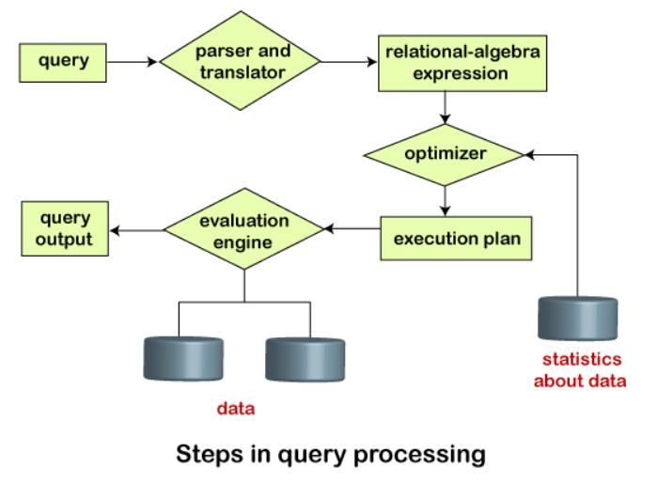
Conti…
The query processing works in the following way:

Slide 40
Conti…
Parsing and Translation:
As query processing includes certain activities for data retrieval. Initially, the given user queries get translated in high-level database languages such as SQL.
It gets translated into expressions that can be further used at the physical level of the file system.
After this, the actual evaluation of the queries and a variety of query -optimizing transformations and takes place.
The translation process in query processing is similar to the parser of a query.

Slide 41
Conti…
When a user executes any query, for generating the internal form of the query, the parser in the system checks the syntax of the query, verifies the name of the relation in the database, the tuples, and finally the required attribute value.
The parser creates a tree of the query, known as 'parse-tree.' Further, translate it into the form of relational algebra.
With this, it evenly replaces all the use of the views when used in the query.

Slide 42
Evaluation
For this, with addition to the relational algebra translation, it is required to annotate the translated relational algebra expression with the instructions used for specifying and evaluating each operation. Thus, after translating the user query, the system executes a query evaluation plan.
Query Evaluation Plan:
In order to fully evaluate a query, the system needs to construct a query evaluation plan.
The annotations in the evaluation plan may refer to the algorithms to be used for the particular index or the specific operations.

Slide 43
Conti…
Such relational algebra with annotations is referred to as Evaluation Primitives. The evaluation primitives carry the instructions needed for the evaluation of the operation.
Thus, a query evaluation plan defines a sequence of primitive operations used for evaluating a query. The query evaluation plan is also referred to as the query execution plan.
A query execution engine is responsible for generating the output of the given query. It takes the query execution plan, executes it, and finally makes the output for the user query.

Slide 44
Optimization
The cost of the query evaluation can vary for different types of queries. Although the system is responsible for constructing the evaluation plan, the user does need not to write their query efficiently.
Usually, a database system generates an efficient query evaluation plan, which minimizes its cost. This type of task performed by the database system and is known as Query Optimization.

Slide 45
Conti…
For optimizing a query, the query optimizer should have an estimated cost analysis of each operation.
It is because the overall operation cost depends on the memory allocations to several operations, execution costs, and so on.
Finally, after selecting an evaluation plan, the system evaluates the query and produces the output of the query.

Slide 46
Data Replication
Data Replication is the process of storing data in more than one site or node. It is useful in improving the availability of data.
It is simply copying data from a database from one server to another server so that all the users can share the same data without any inconsistency.
The result is a distributed database in which users can access data relevant to their tasks without interfering with the work of others.

Slide 47
Conti…
Data replication encompasses duplication of transactions on an ongoing basis, so that the replicate is in a consistently updated state and synchronized with the source.
However in data replication data is available at different locations, but a particular relation has to reside at only one location.

Slide 48
Synchronous and Asynchronous replication
Synchronous replication:
Synchronous replication is typically used to provide high availability of critical applications. In this scenario, failover from the primary to secondary array is nearly instantaneous, to ensure little to no application downtime. As noted above, it is also expensive.
Asynchronous replication:
Asynchronous replication is a store and forward approach to data backup or data protection.
Asynchronous replication writes data to the primary storage array first and then, depending on the implementation approach, commits data to be replicated to memory or a disk-based journal. It then copies the data in real-time or at scheduled intervals to replication targets.

Slide 49
Synchronous vs. asynchronous replication
Synchronous vs. asynchronous replication:
The primary difference between synchronous replication and asynchronous replication is the way in which data is written to the replica. Most synchronous replication products write data to primary storage and the replica simultaneously. As such, the primary copy and the replica should always remain synchronized.
In contrast, asynchronous replication products write data to the primary storage first and then copy the data to the replica. Although the Replication process may occur in near-real-time, it is more common for replication to occur on a scheduled basis. For instance, write operations may be transmitted to the replica in batches on a periodic basis (for example, every five minutes).

Slide 50
Conti…
The benefits of asynchronous replication:
There are two main benefits to asynchronous replication:
It tends to cost significantly less than synchronous replication:
Synchronous replication requires more bandwidth than asynchronous replication and may also require specialized hardware (depending on the implementation).
It is designed to work over long distances:
Since the Replication process does not have to occur in real time, asynchronous replication can tolerate some degradation in connectivity.

Slide 51
Distributed Two Phase Commit Protocol
Distributed two-phase commit reduces the vulnerability of one-phase commit protocols.
The steps performed in the two phases are as follows −
Phase 1: Prepare Phase
After each slave has locally completed its transaction, it sends a “DONE” message to the controlling site. When the controlling site has received “DONE” message from all slaves, it sends a “Prepare” message to the slaves.
The slaves vote on whether they still want to commit or not. If a slave wants to commit, it sends a “Ready” message.

Slide 52
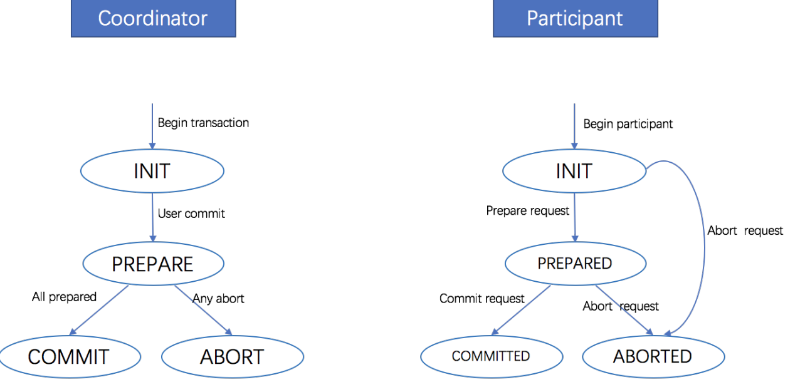
Conti…
A slave that does not want to commit sends a “Not Ready” message. This may happen when the slave has conflicting concurrent transactions or there is a timeout.

Slide 53
Conti…
Phase 2: Commit/Abort Phase:
After the controlling site has received “Ready” message from all the slaves −
The controlling site sends a “Global Commit” message to the slaves.
The slaves apply the transaction and send a “Commit ACK” message to the controlling site.
When the controlling site receives “Commit ACK” message from all the slaves, it considers the transaction as committed.

Slide 54
Disadvantage
The greatest disadvantage of the two-phase commit protocol is that it is a blocking protocol.
If the coordinator fails permanently, some participants will never resolve their transactions: After a participant has sent an agreement message to the coordinator, it will block until a commit or rollback is received.

Slide 55
Recap of Unit
Knowledge of Distributed Database .
Knowledge of distributed transactions, Database System Catalogs and Query Processing and Evaluation
Knowledge of Data replication .
Knowledge of concurrency control in distributed databases Implications for cloud storage.
Video Link
https://www.youtube.com/watch?v=yCokw7VSbZw&ab_channel=Lastmomenttuitions

Slide 56

Previous year question paper

Slide 57
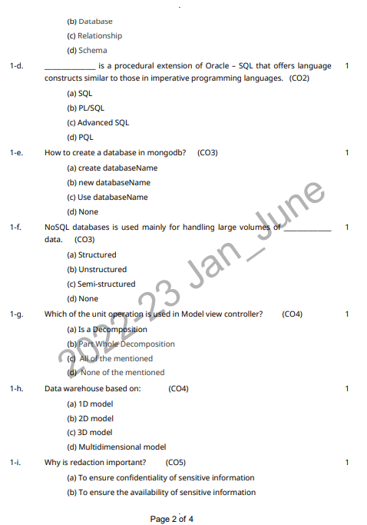
Previous year question paper

Slide 58

Previous year question paper

Slide 59

Previous year question paper

Slide 60
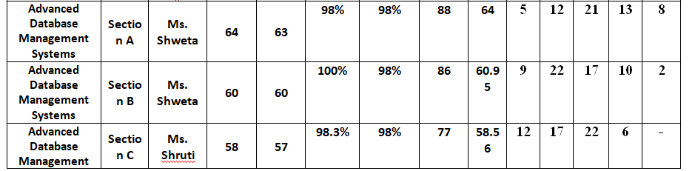
Result Analysis

Slide 61
MCQ
1. A distributed database has which of the following advantages over a centralized database?
Software cost
B. Software complexity
C. Slow Response
D. Modular growth
Answer: Option D
2. An autonomous homogenous environment is which of the following?
A. The same DBMS is at each node and each DBMS works independently.
B. The same DBMS is at each node and a central DBMS coordinates database access.
C. A different DBMS is at each node and each DBMS works independently.
D. A different DBMS is at each node and a central DBMS coordinates database access.
Answer: Option A
3. A transaction manager is which of the following?
A. Maintains a log of transactions
B. Maintains before and after database images
. Maintains appropriate concurrency control
D. All of the above.
Answer: Option D

Slide 62
MCQ
4. Location transparency allows for which of the following?
A. Users to treat the data as if it is at one location
B. Programmers to treat the data as if it is at one location
C. Managers to treat the data as if it is at one location
D. All of the above.
Answer: Option D
5. A heterogeneous distributed database is which of the following?
A. The same DBMS is used at each location and data are not distributed across all nodes.
B. The same DBMS is used at each location and data are distributed across all nodes.
C. A different DBMS is used at each location and data are not distributed across all nodes.
D. A different DBMS is used at each location and data are distributed across all nodes.
Answer: Option D

Slide 63
Thank You

